Slide 1
Wired Equivalent Privacy (WEP)
B.R.SREEPADARAJA

Slide 2
INTRODUCTION
WEP (Wired Equivalent Privacy) is the oldest and most common Wi-Fi security protocol. It was the privacy component established in the IEEE 802.11, a set of technical standards that aimed to provide a wireless local area network (WLAN) with a comparable level of security to a wired local area network (LAN).
The Wi-Fi Alliance ratified WEP as a security standard in 1999. Once touted to offer the same security benefits as a wired connection, WEP has been plagued over the years by many security flaws. And as computing power has increased, these vulnerabilities have worsened. Despite efforts to improve WEP, it’s still vulnerable to security breaches. The Wi-Fi Alliance officially retired WEP in 2004.

Slide 3
COMPONENTS OF WEP
It uses the RC4 stream cipher, using a 64-bit key consisting of:
1. 40-bit master key
2. 24-bit initialization vector (IV)
For 128-bit key
1. 104-bit master key
2. 24-bit intialization vector
It also employs a CRC integrity checksum
B

Slide 4
WEP Cryptographic Operations
Three major objectives of communication security
Confidentiality
Integrity
Authentication
WEP provides operations that attempt to meet these criteria
Frame body encryption supports confidentiality.
An integrity check sequence protects data in transit and allows receivers to validate that the received data was not altered in transit.

Slide 5
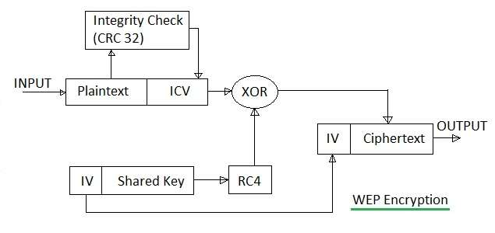
WEP flow of encryption

Slide 6
What is rc4
RC4 stands for Rivest Cipher 4. Ron Rivest invented RC4 in 1987, and it is a stream cipher. Because RC4 is a stream cipher, it encrypts data bytes by bits. Because of its speed and simplicity, RC4 is the most extensively used stream cipher of all the stream ciphers.
While RC4 is known for its ease of use and speed in software, it has been found to have several weaknesses, making it insecure. When the beginning of the output keystream isn't destroyed, or when non-random or linked keys are utilized, it's highly vulnerable. The usage of RC4, in particular, has resulted in relatively insecure protocols such as WEP.
Three things performed :-
Key generation
Key scheduling
Encryption/decryption

Slide 7
Key scheduling algorithum
Lets try to understand the working of this algorithm with an simple example:
Assume an S-array of length is S=[0 1 2 3 4 5 6 7]
Assume given Key an Plain Text as:
K=[1 2 3 6]
PT=[1 2 2 2]
Intialize the state vector ‘S’ and temporary vector T. S is intialized and S[i]=i and T is intialized and key is repeated until the length of S-array is met.
T=[1 2 3 6 1 2 3 6]
i=0 to 7 do
j=(j+S[i]+T[i]) mod 8
swap( S[i] ,S[j])
If i=0
j=(0+0+1) mod8=1
swap(S[0],S[1])
S=[1 0 2 3 4 5 6 7]

Slide 8
for i=1
j=(1+0+2) mod8=3
swap(S[1],S[3])
S=[1 3 2 0 4 5 6 7]
For i=2
j=(3+2+3) mod8=0
swap(S[2],S[0])
S=[2 3 1 0 4 5 6 7]
For i=3
j=(0+0+6) mod8=6
swap(S[3],S[6])
S=[2 3 1 6 4 5 0 7]

Slide 9
For i=4
j=(6+4+1) mod8=3
swap(S[4],S[3])
S=[2 3 1 4 6 5 0 7]
For i=5
j=(3+5+2) mod8=2
swap(S[5],S[2])
S=[2 3 5 4 6 1 0 7]
For i=6
j=(2+0+3) mod8=5
swap(S[6],S[5])
S=[2 3 5 4 6 0 1 7]
For i=7
j=(5+7+6) mod8=2
swap(S[7],S[2])
S=[2 3 7 4 6 0 1 5]
Now finally the S is obtained
S=[2 3 7 4 6 0 1 5]

Slide 10
Key generation
i,j=0
while(true)
i=(i+1) mod 8
j=(j+S[i])mod 8
swap( S[i] ,S[j])
t=(S[i]+S[j]) mod 8;
k=S(t)
First iteration
i=(0+1) mod 8=1
j=(0+3)mod 8=3
swap( S[1] ,S[3])
t=(4+3) mod 8=7
k=S(7)=5
Second iteration
S=[2 4 7 3 6 0 1 5]
i=(1+1) mod 8=2
j=(3+7)mod 8=2
swap( S[2] ,S[2])
t=(7+7) mod 8=6
k=S(6)=1
Third iteration
S=[2 4 7 3 6 0 1 5]
i=(2+1) mod 8=3
j=(2+3)mod 8=5
swap( S[3] ,S[2])
S=[2 4 7 0 6 3 1 5]
t=(0+3) mod 8=3
k=S(3)=0

Slide 11
Fourth iteration
S=[2 4 7 3 6 0 1 5]
i=(3+1) mod 8=4
j=(5+6)mod 8=3
swap( S[4] ,S[3])
S=[2 4 7 6 0 3 1 5]
t=(0+6) mod 8=6
k=S(6)=1
The Key Stream obtained is =[5 1 0 1]

Slide 12
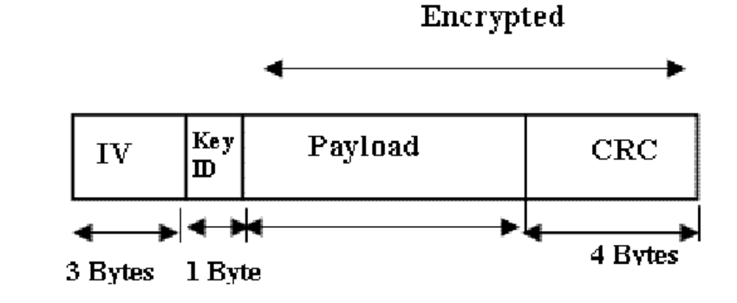
Data encapsualtion
when WEP is in use, the frame body expands by 8 bytes.
4 bytes for IV Header
Remaining 4 for ICV Trailer

Slide 13
Design flaw in wep
Key management
Manual key management is a minefield of problems
Static WEP offers a shared secret of only 40 bits.
Key Reuse
Stream ciphers are vulnerable to analysis when the key stream is reused. 
IV reuse:
WEP's IV size is 24 bits.
WEP uses the same IV for different data packets.
An attacker can decrypt packets that were encrypted with the same IV.
Inappropriate Integrity check:
MD5 or SHA-1 algorithms are more suitable for cryptographic hash than CRC-32.

Slide 14
Attacks on WEP
FMS Attack
Fluhrer, Martin and Shamir published the first key recovery attack onWEP.
If the first 2 bytes of enough key stream are known -> The RC4 key is discovered .
The first 8 bytes of WEP packet is a known SNAP-SAP header .
AirSnort implements this attack . Recovers key after 20,000 packets = 11 seconds .
IP redirection: ○
Change the destination of an encrypted packet to a machine controlled by the attacker on the wired network.
Send modified frame to AP that will decrypt it and send to attacker machine.
Derive keystream from this ciphertext, plaintext pair.
Attacker can reuse keysteam to send/receive WLAN traffic.

Slide 15
ARP Request replay attacks
Both FMS and PTW attacks need to collect quite a large number of frames to succeed and can be conducted passively, sniffing the wireless traffic on the same channel of the target AP and capturing frames. The problem is that, in normal conditions, we will have to spend quite a long time to passively collect all the necessary packets for the attacks, especially with the FMS attack.
To accelerate the process, the idea is to reinject frames in the network to generate traffic in response so that we can collect the necessary IVs more quickly. A type of frame that is suitable for this purpose is the ARP request because the AP broadcasts it, each time with a new IV. As we are not associated with the AP, if we send frames to it directly, they are discarded and a de-authentication frame is sent. Instead, we can capture ARP requests from associated clients and retransmit them to the AP.
This technique is called the ARP Request Replay attack and is also adopted by Aircrack-ng for the implementation of the PTW attack.

Slide 16
solutions to improve security of WEP
Multiple Security measures along with WEP.
Using VPN.
Using Efficient key management techniques as an additional measure.
Using alternative encryption techniques like IPsec instead of WEP.

Slide 17
Conclusions
WEP does little to secure the WLAN’s from attackers.
Better to use WEP rather than not using any encryption.
New standards and specifications which will replace WEP can be expected to provide sufficient security for wireless LAN’s.

Slide 18

GET THE FUTURE YOU WANT
capgemini.com

