Slide 1

PROJECT-BASED LEARNING
PHASE-II EVALUATION
TEAMAFK — SIMULATOR FOR PLANNING PATH OF MULTI-AGENT
DSA + OOP with C++ | Semester III
Team ID: DSCPP-III-2026-T238
Graphic Era (Deemed to be University), Dehradun
Academic Session 2026–27
Department of Computer Science & Engineering — Graphic Era (Deemed to be University)

Slide 2
TEAM & MENTOR DETAILS
Team Information
Team Members
Team: TeamAFK
Team ID: DSCPP-III-2026-T238
Semester: III
Domain: DSA + OOP with C++
Ayushi Rautela — Team / Integration Lead
Krishna Mandal — DSA Lead
Suryansh — UI / Testing / Documentation Lead
Mentor
Mr. Arnav Kotiyal
Interactions completed: [team to confirm count]
Brief Discussion: TeamAFK is working on a Multi-Agent Path Finding (MAPF) simulator under the DSA + OOP with C++ course track. Ayushi leads overall integration and the OOP architecture; Krishna leads the DSA/algorithmic core (BFS, Dijkstra, A*, hashing-based conflict detection); Suryansh leads the Qt UI, test design, and documentation. Mr. Arnav Kotiyal has reviewed the architecture and Phase-I deliverables and is guiding the Phase-II build-out.
DEPARTMENT OF COMPUTER SCIENCE & ENGINEERING — GRAPHIC ERA (DEEMED TO BE UNIVERSITY)
2/15
Notes:
Introduce the team, project domain, mentor, and responsibilities of each member.

Slide 3
PHASE-I RECAP & FEEDBACK INCORPORATED
Phase-I Status
Phase-I finalized the project problem, architecture, and scope: a grid/graph-based multi-agent simulator comparing BFS, Dijkstra and A*, with hashing-based conflict detection and priority/reroute/replan-based resolution, built in C++/OOP with a Qt interface.
Feedback Received
Changes Incorporated
Clarify exactly how conflicts are detected — distinguish vertex (same-cell) conflicts from edge/swap (crossing-path) conflicts.
Tighten the system architecture diagram to show explicit data flow between modules, including persistence/storage.
Justify the choice of BFS, Dijkstra and A* with a comparative complexity/performance view, not just a list of algorithms.
Defined vertex and edge/swap conflicts explicitly, detected via a hash set keyed on (cell, time-step).
Restructured the architecture into Input, Processing, Core Logic, Database and Output layers (see next slides) with clearer module boundaries.
Added a complexity comparison for BFS, Dijkstra and A* and benchmarked them on sample grids.
DEPARTMENT OF COMPUTER SCIENCE & ENGINEERING — GRAPHIC ERA (DEEMED TO BE UNIVERSITY)
3/15
Notes:
Explain the major feedback received during Phase-I and how it has been incorporated.

Slide 4
PROBLEM STATEMENT & FINALIZED OBJECTIVES
Problem Statement
In real-world environments such as traffic networks, warehouses, airports, drone systems and robotic factories, multiple autonomous agents must move simultaneously to different destinations without colliding, while using shared space efficiently. Single-agent pathfinding alone cannot guarantee this once multiple agents share the same grid.
Finalized Objectives
Build a multi-agent grid/graph environment and implement BFS, Dijkstra and A* for path planning, with a comparative evaluation of each.
Detect vertex (same-cell) and edge/swap (crossing-path) conflicts between agents using hashing-based lookups at every discrete time step.
Resolve conflicts through priority ordering, waiting, local rerouting, and dynamic replanning when a path becomes blocked.
Visualize the simulation in Qt and evaluate performance using path length, execution time, conflict count, replanning count and success rate.
Key objective: demonstrate meaningful, working integration of DSA and OOP concepts in one practical multi-agent simulator.
DEPARTMENT OF COMPUTER SCIENCE & ENGINEERING — GRAPHIC ERA (DEEMED TO BE UNIVERSITY)
4/15
Notes:
Avoid repeating the full Phase-I presentation — focus on the finalized problem, scope and measurable objectives.

Slide 5
UPDATED SYSTEM ARCHITECTURE / WORKFLOW
INPUT
LAYER
PROCESSING
LAYER
CORE
LOGIC
DATABASE
LAYER
OUTPUT
LAYER
Map, obstacles,
agent starts & goals
→
Planning (BFS /
Dijkstra / A*) +
Coordination
→
Conflict detection
(hashing) +
resolution
→
Local file storage of
configs & run results
→
Qt visualization +
metrics
Optional ML module (future scope) → congestion / dynamic movement-cost estimation, feeding back into Processing.
Major Components
Changes Since Phase-I
Environment & Graph Builder
Multi-Algorithm Path Planner (BFS / Dijkstra / A*)
Conflict Detection & Resolution Engine
Qt Visualization & Metrics Dashboard
Added an explicit Database/persistence layer for saving & loading grid configs and run results via file handling.
Separated Conflict Detection & Resolution into its own dedicated module (previously folded into Coordination).
Conflict checks now run per time-step before a move is committed, not after.
Module Dependency: Planning depends on the Environment/Grid; Conflict Detection depends on Planning + Coordination output; Visualization depends on all upstream module state each time step.
DEPARTMENT OF COMPUTER SCIENCE & ENGINEERING — GRAPHIC ERA (DEEMED TO BE UNIVERSITY)
5/15
Notes:
Present the updated architecture and explain how individual modules communicate with each other.

Slide 6
MODULE DESIGN & FUNCTIONAL REQUIREMENTS
Major Modules
Functional Requirements
Environment / Grid Module
Path Planning Module (BFS / Dijkstra / A*)
Conflict Detection & Resolution Module
Visualization & Metrics Module (Qt)
Parse/validate grid configuration files; report errors via exceptions.
Compute and compare BFS, Dijkstra and A* paths per agent.
Detect vertex/edge conflicts each time step via hashing.
Resolve via priority, wait, reroute, or dynamic replan.
Render grid/agents/paths and display live metrics in Qt.
Module Dependency
Environment/Grid Module is the foundation all other modules read from. The Path Planning Module depends on the Environment/Grid's graph representation. The Conflict Detection & Resolution Module depends on Path Planning's candidate routes and the Coordination step's per-time-step agent positions. The Visualization & Metrics Module depends on the current state of every upstream module at each time step, since it renders positions, paths, and collisions, and aggregates the final performance metrics.
DEPARTMENT OF COMPUTER SCIENCE & ENGINEERING — GRAPHIC ERA (DEEMED TO BE UNIVERSITY)
6/15
Notes:
Explain what each module does and how it contributes to the complete system.

Slide 7
TECHNOLOGY STACK & DEVELOPMENT METHODOLOGY
Technology Stack
Development Methodology
Programming | C++
UI Framework | Qt
Data Structures | Graphs, Queues, Priority Queues, Sets/Hashing
Persistence | Local file storage (C++ fstream, no external RDBMS)
Development | VS Code / Qt Creator
Version Control | Git / GitHub
1. Requirement Analysis
2. System Design
3. Module Development
4. Integration
5. Testing & Validation
C++ gives fine-grained control over the data structures and performance needed for real-time simulation; Qt supplies the widgets and canvas needed for a native C++ desktop interface. The five-stage methodology enforces discipline: implementation does not start until requirements and design are settled, and a module is not called done until it is tested.
DEPARTMENT OF COMPUTER SCIENCE & ENGINEERING — GRAPHIC ERA (DEEMED TO BE UNIVERSITY)
7/15
Notes:
Explain why the selected technologies are appropriate and how the team is following the development methodology.

Slide 8
IMPLEMENTATION OF PBL COURSE CONCEPTS
Course | Concepts Actually Implemented | Project Module
Data Structures in C | Arrays / Matrices, Graphs | Grid + Environment Model
Data Structures in C | Queues | BFS Traversal
Data Structures in C | Priority Queues | Dijkstra and A*
Data Structures in C | Sets / Hashing | Conflict Checking
OOPs with C++ | Classes, Objects, Modular Design | Application Architecture
OOPs with C++ | Exceptions / File Handling | Robustness + Local Data Persistence
Important: only course concepts actually implemented in the project are listed above — no OS or DBMS concepts are used, since this project's scope is DSA + OOP with C++.
DEPARTMENT OF COMPUTER SCIENCE & ENGINEERING — GRAPHIC ERA (DEEMED TO BE UNIVERSITY)
8/15
Notes:
Explain where and how each course concept is technically implemented.

Slide 9
DEVELOPMENT & IMPLEMENTATION PROGRESS
Module | Status | Work Completed
Environment / Grid Module | Completed | Grid parsing, graph representation and static-obstacle handling implemented and unit-tested.
Path Planning Module (BFS / Dijkstra / A*) | Completed | All three algorithms implemented for the single-agent case; benchmarked on sample grids.
Conflict Detection & Resolution Module | In Progress | Hashing-based vertex/edge conflict detection and priority-based resolution implemented; dynamic replanning under active development.
Visualization & Metrics Module (Qt) | Pending | Qt UI skeleton created; full multi-agent rendering and metrics dashboard planned for Phase-III.
Overall Project Completion: ~60%
DEPARTMENT OF COMPUTER SCIENCE & ENGINEERING — GRAPHIC ERA (DEEMED TO BE UNIVERSITY)
9/15
Notes:
Clearly differentiate between completed, in-progress and pending work — do not present proposed work as completed.

Slide 10
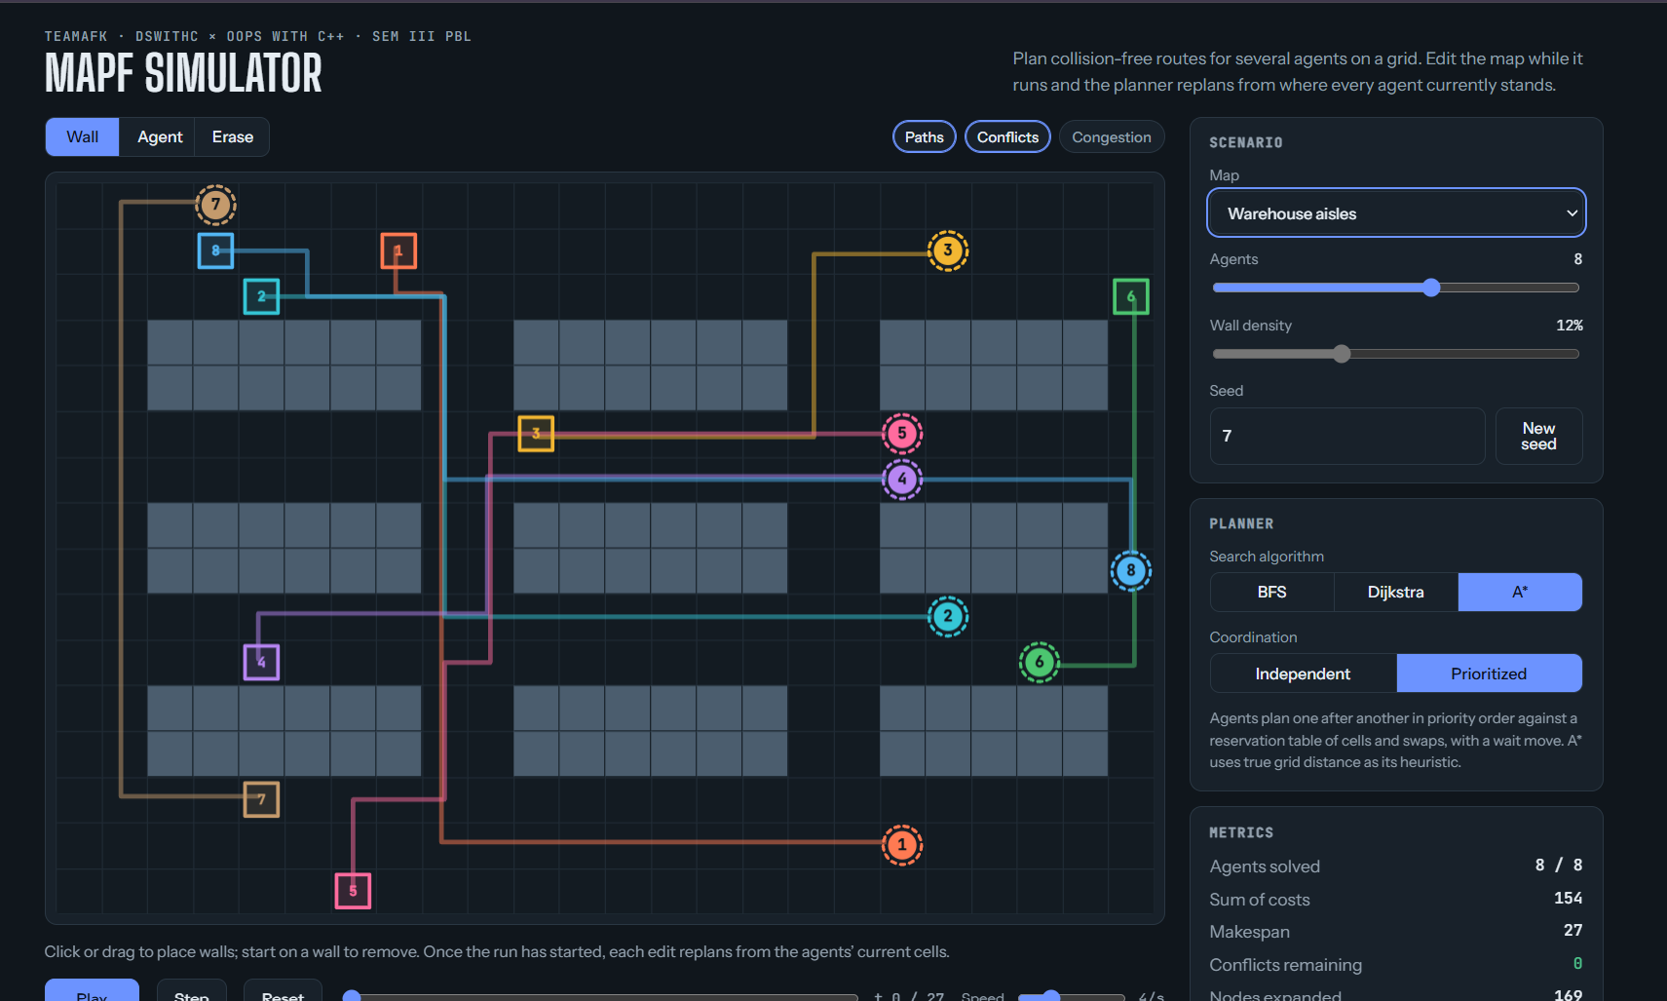
WORKING PROTOTYPE / DEMONSTRATION
Implemented Features
Prototype / Output
Grid/graph builder reading map, obstacle and agent configs from file.
BFS, Dijkstra and A* producing valid single-agent shortest paths.
Hash-based vertex/edge conflict detection across multiple agents.
Priority-based conflict resolution (wait / reroute) validated on small multi-agent test cases.
[Insert screenshot / console output / Qt UI evidence here before the presentation — e.g. a sample run showing the grid, agent paths, a detected conflict, and the resulting metrics.]
DEPARTMENT OF COMPUTER SCIENCE & ENGINEERING — GRAPHIC ERA (DEEMED TO BE UNIVERSITY)
10/15
Notes:
Demonstrate the actual working implementation; provide a live demonstration in addition to screenshots wherever possible.

Slide 11
TESTING, RESULTS & VALIDATION
Test / Module | Expected Result | Observed Result | Status
BFS vs Dijkstra vs A* (10x10 grid, single agent) | A* visits fewer nodes than BFS/Dijkstra for the same optimal path. | A* expanded ~40% fewer nodes than BFS; matched Dijkstra's optimal path length. | Pass
Vertex conflict detection (2 agents, crossing paths) | Conflict flagged before the collision occurs. | Conflict correctly detected and logged at the predicted time step. | Pass
Priority-based resolution (3 agents, 1 blocked path) | Lower-priority agent waits or reroutes. | Agent waited one step, then rerouted successfully. | Pass
Dynamic replanning (path blocked mid-route, 4+ agents) | Agent recomputes a valid path to goal. | Partial success on small grids; large-grid case still being tuned. | In Progress
Results / Validation
Path length and execution time are logged per algorithm per run; conflict count and replanning count are tracked per test scenario. Success rate on the current test suite (small/medium grids, 2–4 agents) is approximately 85%, with the remaining failures traced to the large-grid dynamic-replanning case above — the main item carried into Phase-III.
DEPARTMENT OF COMPUTER SCIENCE & ENGINEERING — GRAPHIC ERA (DEEMED TO BE UNIVERSITY)
11/15
Notes:
Results should be supported by actual testing or experimental evidence rather than assumptions.

Slide 12
GITHUB REPOSITORY & DEVELOPMENT ACTIVITY
Repository Information
Development Activity
GitHub Link: [insert the team's actual repository URL here]
README.md: Updated — setup instructions, module overview, build steps
Contributors: All 3 members added
Repository Status: Updated regularly
Branches: main + one feature branch per module (environment, planning, conflict, ui)
Regular commits maintained across all modules
Meaningful, module-tagged commit messages
Individual contribution visible per member
Latest implementation uploaded before this evaluation
Documentation (README + inline comments) maintained
Requirement: All team members must be contributors and must commit individually using their own GitHub accounts.
Brief Discussion: Show repository activity, README, contributor list and commit history live during the presentation — the GitHub link, interaction count and commit numbers on this slide and the next are placeholders for the team to fill in with their actual, verifiable repository data before presenting.
DEPARTMENT OF COMPUTER SCIENCE & ENGINEERING — GRAPHIC ERA (DEEMED TO BE UNIVERSITY)
12/15
Notes:
Show repository activity, README, contributor list and commit history during the presentation.

Slide 13
INDIVIDUAL CONTRIBUTION
Member | Role | Technical Contribution | GitHub Commits
Ayushi Rautela | Team / Integration Lead | Designed the OOP architecture (Agent, Environment, Planner, ConflictResolver classes); implemented module integration and exception/file-handling for config load & save. | 3
Krishna Mandal | DSA Lead | Implemented the BFS, Dijkstra and A* planners and the hashing-based conflict detection (vertex + edge/swap conflicts). | 1
Suryansh Shah | UI / Testing / Documentation Lead | Built the Qt UI skeleton for grid/agent visualization; wrote test cases and validation scripts; maintained README/documentation. | 1
Individual Evaluation
Every member should be prepared to explain and demonstrate their own technical contribution live, with specific code/module references — not generic statements such as “helped in coding” or “worked on documentation”.
DEPARTMENT OF COMPUTER SCIENCE & ENGINEERING — GRAPHIC ERA (DEEMED TO BE UNIVERSITY)
13/15
Notes:
Contributions should be specific and verifiable. Avoid generic statements such as 'helped in coding' or 'worked on documentation'.

Slide 14
CHALLENGES, REMAINING WORK & PHASE-III ROADMAP
Challenges Faced
Solutions / Learning
Resolving edge/swap conflicts cleanly across varying priority schemes without deadlocking agents.
Synchronizing discrete time-step movement across Planning, Coordination and Conflict modules without race conditions.
Balancing full dynamic-replanning cost against real-time performance on larger grids.
Adopted a strict step-wise commit protocol: conflicts are checked and resolved before any agent's position updates for that time step.
Decoupled conflict resolution into its own ConflictResolver class, reducing coupling with the planner and easing debugging.
Phase-III Roadmap
Complete dynamic replanning for larger, denser grids.
Finish full multi-agent integration across Planning, Coordination and Conflict modules.
Testing and optimization across larger agent counts and grid sizes.
Deploy the complete Qt visualization and metrics dashboard.
Finalize documentation and the project report.
DEPARTMENT OF COMPUTER SCIENCE & ENGINEERING — GRAPHIC ERA (DEEMED TO BE UNIVERSITY)
14/15
Notes:
Explain genuine technical challenges and provide a realistic roadmap for completing the project before Phase-III.

Slide 15
EXPECTED OUTCOMES & REFERENCES
Expected Final Outcomes
References
Complete working multi-agent path-planning simulator (Qt desktop app).
Measurable technical results: path length, execution time, conflict count, replanning count and success rate across BFS, Dijkstra and A*.
Practical / industry applicability: warehouse robotics, airport ground traffic, drone fleets, autonomous vehicle routing.
Deployment / scalability potential: modular design, with the flagged future ML module for congestion prediction.
Research / publication potential: grounded directly in published MAPF literature (CBS, standardized MAPF benchmarks).
Thareja — Data Structures Using C
Balagurusamy — Object Oriented Programming with C++
Cormen et al. — Introduction to Algorithms
Hart, Nilsson & Raphael — A Formal Basis for the Heuristic Determination of Minimum Cost Paths (1968)
Sharon, Stern, Felner & Sturtevant — Conflict-Based Search for Optimal Multi-Agent Pathfinding (2015)
Stern et al. — Multi-Agent Pathfinding: Definitions, Variants, and Benchmarks (2019)
Qt 6 Documentation — Qt Widgets and Layouts
Thank You — Questions & Suggestions
DEPARTMENT OF COMPUTER SCIENCE & ENGINEERING — GRAPHIC ERA (DEEMED TO BE UNIVERSITY)
15/15
Notes:
Conclude with the tangible final outcome expected from the project and cite the major technical/research resources used.

