Slide 1
REVIEW 2 • DATABASE SYSTEMS LABORATORY
AI-Enhanced Food Supply Chain Traceability
and Contamination Risk Prediction
Using a Relational Database Management System
Schema, ER Model & 50% Implementation
Fall Semester 2026–2027 | Faculty: Dr. K. Sudhakar | Slot: A1+TA1, A2+TA2
School of Computer Science and Engineering

Slide 2
ABSTRACT
Project Abstract
The modern food supply chain spans farmers, processing plants, warehouses, transporters, and retailers, each generating records in isolation. This fragmentation makes it slow and difficult to trace a contaminated food batch back to its exact point of origin.
This project implements an AI-enhanced relational database system that assigns every batch a unique identifier and links its data across all supply chain stages — harvesting, processing, storage, transportation, and retail — inside a single normalized RDBMS.
On top of this traceability backbone, a machine learning module analyzes historical quality, storage, and logistics data to flag batches at elevated risk of contamination before they reach the consumer, enabling faster, narrower, and more targeted recalls.
Review 2 delivers the finalized ER model, the normalized schema, and a working 50% implementation: core traceability tables populated and queryable, with the AI risk-scoring approach defined and prototyped.
Review 2 | AI-Enhanced Food Supply Chain Traceability & Contamination Risk Prediction
2

Slide 3
INTRODUCTION
Why This Project, and What's Built So Far
!
#
%
Motivation
Scope
Review 2 focus
Contamination outbreaks cost lives and money mainly because it takes days to find the affected batch — most recalls pull entire product lines instead of the few at-risk units.
A single normalized RDBMS spans six actor types (farmer → retail) and keys every record to one Batch ID, paired with an ML module that scores contamination risk per batch.
Finalized ER diagram and schema, a populated database with working traceability queries, and the risk-scoring algorithm selected and prototyped end-to-end.
The core relational backbone is complete; the AI Risk Engine is defined and partially prototyped, on track for full training and validation by Review 3.
Review 2 | AI-Enhanced Food Supply Chain Traceability & Contamination Risk Prediction
3

Slide 4
LITERATURE SURVEY
What Prior Work Covers (1/2)
Yr
Source
Key Contribution
Angle
2023
Tang, J.
Combines a relational database with blockchain for food-chain traceability, keeping records tamper-evident while querying cross-organization.
Traceability / DB
2017
Zhong et al.
Reviews 192 data-driven food supply chain management systems (1993–2017) and organizes them into a hierarchical framework by function.
Traceability / DB
2022
Zhou & Xu
Systematic review of 278 food-traceability studies (1994–2019); finds focus shifting to post-adoption evaluation, not predictive risk.
Traceability / DB
Review 2 | AI-Enhanced Food Supply Chain Traceability & Contamination Risk Prediction
4

Slide 5
LITERATURE SURVEY
What Prior Work Covers (2/2)
Yr
Source
Key Contribution
Angle
2010
Thakur, M.
Builds a relational schema for internal batch traceability at a grain elevator — a node-level model this project extends chain-wide.
Traceability / DB
2026
Wu & Wang
Trains an XGBoost model on 180,000+ agricultural inspection records for safety risk prediction, reaching ~75.4% recall, ~71.9% precision.
AI / Contamination
2025
Deshmukh et al.
Surveys ML/DL methods (regression, classifiers, CNNs) for aflatoxin detection, applied at the lab/sample level, not the supply-chain level.
AI / Contamination
Review 2 | AI-Enhanced Food Supply Chain Traceability & Contamination Risk Prediction
5

Slide 6
RESEARCH GAP
The Gap Between Traceability and Prediction
Traceability-focused work
ML-focused work
• Strong on recording and linking batch data (relational or blockchain-based).
• Strong at predicting contamination risk from sample/sensor-level data.
• Good at answering “where did this batch go” after the fact.
• Usually evaluated on a single lab dataset, not live chain-wide records.
• Little to no forward-looking risk analysis — purely reactive.
• Not wired into a batch-traceability system administrators can act on.
Gap: no system unifies full chain-wide relational traceability with an integrated, batch-level contamination risk score — Review 2 delivers the schema and a working 50% build toward exactly that intersection.
Review 2 | AI-Enhanced Food Supply Chain Traceability & Contamination Risk Prediction
6

Slide 7
PROPOSED SYSTEM
System Architecture
Data Capture Layer
Farmer, processor, warehouse, transporter & retailer entry points
Relational Database (RDBMS)
Normalized schema — Batch, Stage, Inspection, Transport, Inventory tables
AI Risk Engine
ML model scores each batch using historical quality & logistics features
Reporting & Admin Dashboard
Traceability lookup, risk alerts, analytical reports
Every layer keys off a single unique Batch ID, so a query at the dashboard layer can trace back through the AI score, the DB records, and the original capture event.
Review 2 | AI-Enhanced Food Supply Chain Traceability & Contamination Risk Prediction
7

Slide 8
SYSTEM DESIGN
List of Modules
1
Farmer & Batch Registration
2
Processing & Storage Tracking
3
Warehouse Management
Implemented
Implemented
Implemented
4
Transportation Tracking
5
Retail Inventory
6
Quality Inspection Records
Implemented
Implemented
Implemented
7
Batch Traceability Query
8
AI Contamination Risk Prediction
9
Analytical Reports & Dashboard
Implemented
In progress
In progress
Review 2 | AI-Enhanced Food Supply Chain Traceability & Contamination Risk Prediction
8

Slide 9
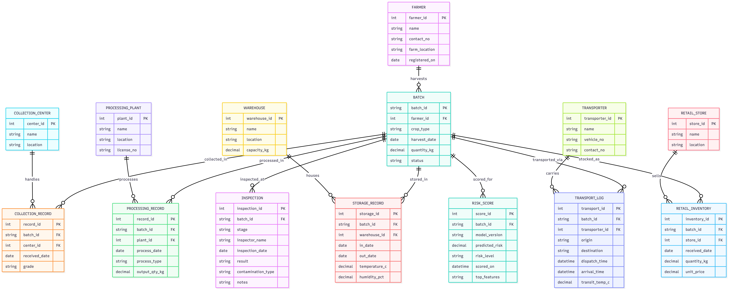
DATABASE DESIGN
Entity-Relationship Diagram
Review 2 | AI-Enhanced Food Supply Chain Traceability & Contamination Risk Prediction
9

Slide 10
DATABASE DESIGN
Schema Structures — Core Tables
Table
Primary Key
Key Columns
Batch
batch_id (PK)
farmer_id (FK), crop_type, harvest_date, quantity_kg, status
Farmer
farmer_id (PK)
name, contact_no, farm_location, registered_on
Collection_Record
record_id (PK)
batch_id (FK), center_id (FK), received_date, grade
Processing_Record
record_id (PK)
batch_id (FK), plant_id (FK), process_date, process_type, output_qty_kg
Storage_Record
storage_id (PK)
batch_id (FK), warehouse_id (FK), in_date, out_date, temperature_c, humidity_pct
Transport_Log
transport_id (PK)
batch_id (FK), transporter_id (FK), origin, destination, dispatch_time, arrival_time
Retail_Inventory
inventory_id (PK)
batch_id (FK), store_id (FK), received_date, quantity_kg, unit_price
Inspection
inspection_id (PK)
batch_id (FK), stage, inspector_name, result, contamination_type
Risk_Score
score_id (PK)
batch_id (FK), model_version, predicted_risk, risk_level, top_features
Review 2 | AI-Enhanced Food Supply Chain Traceability & Contamination Risk Prediction
10

Slide 11
SYSTEM DESIGN
Module Description — Core Traceability Modules
Farmer & Batch Registration
Warehouse & Transport Tracking
Technique: surrogate PK generation (batch_id) at INSERT time.
Technique: 1:M foreign-key chaining across Storage_Record / Transport_Log.
Generates a unique Batch ID at harvest and writes the root Batch row; every downstream table references it by foreign key.
Logs storage conditions and transit checkpoints per batch, linked via foreign keys to build a continuous movement history.
Quality Inspection Records
Batch Traceability Query
Technique: normalized fact table keyed by (batch_id, stage).
Technique: multi-table LEFT JOIN on batch_id (6-way join).
Stores inspection outcomes at each stage; this table is the historical training data for the AI module.
SQL views and joins reconstruct a batch's complete journey — farm to retail — in a single lookup (see Slide 13).
Review 2 | AI-Enhanced Food Supply Chain Traceability & Contamination Risk Prediction
11

Slide 12
SYSTEM DESIGN
Module Description — AI Contamination Risk Engine
Algorithm & Approach
Why It's Wired to the DB, Not Standalone
• Model: Random Forest classifier (baseline), benchmarked against XGBoost — matches the approach validated in Wu & Wang (2026).
Unlike Wu & Wang (2026) and Deshmukh et al. (2025), which score risk on static, offline datasets, this module reads features live from Storage_Record and Transport_Log and writes its output back into Risk_Score — the same table the Batch Traceability Query joins against.
• Features: storage_temperature, storage_duration, transit_time, transit_temperature, inspection_history, supply-chain stage, product category.
• Training source: Inspection table (labeled Pass/Fail/Flagged outcomes) joined with Storage_Record and Transport_Log via batch_id.
• Output: predicted_risk (0–1 probability) and risk_level (Low/Medium/High), written to Risk_Score, keyed to batch_id.
That means a risk score is never orphaned from a batch's supplier, storage, or transport history — closing the exact gap identified in Review 1.
• Status: feature pipeline and schema wired end-to-end; a scored example is live in Risk_Score (see Slide 13). Full training/tuning targeted for Review 3.
Review 2 | AI-Enhanced Food Supply Chain Traceability & Contamination Risk Prediction
12

Slide 13
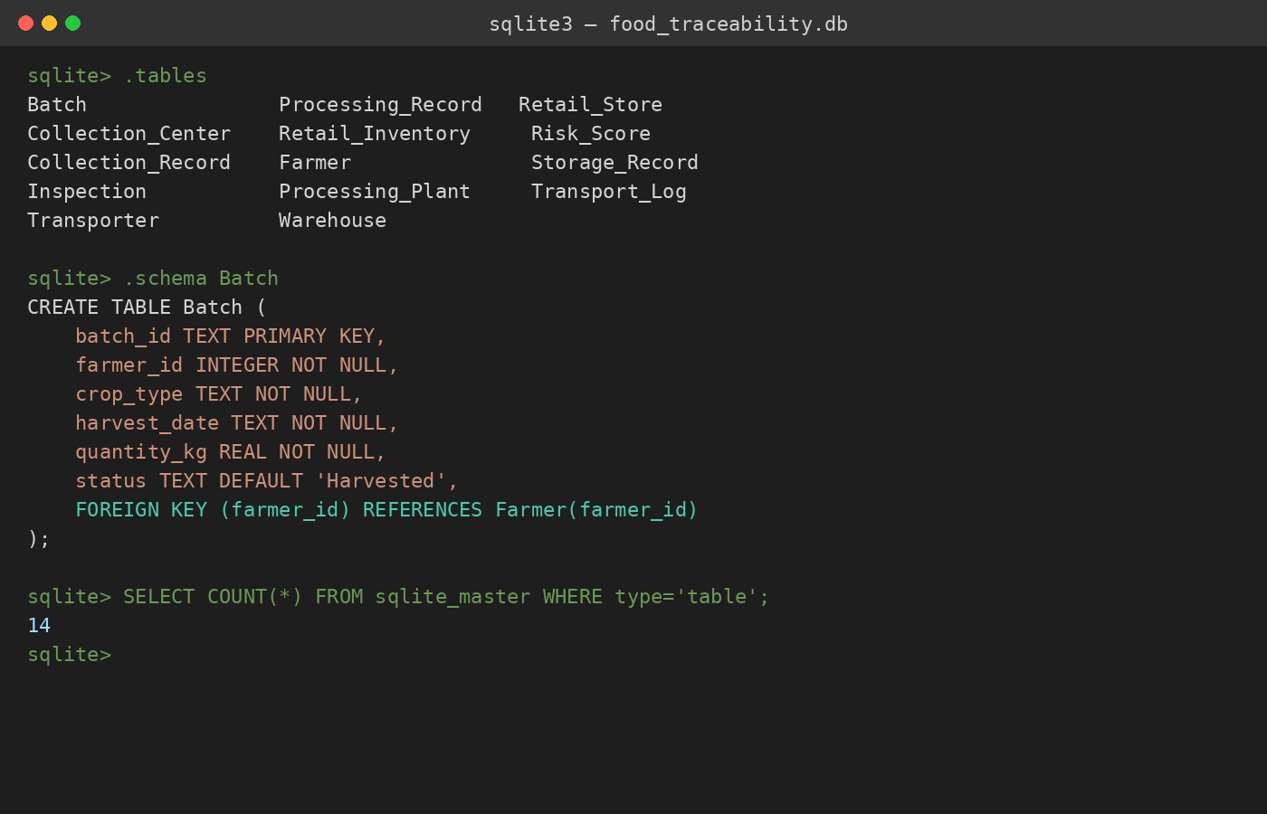
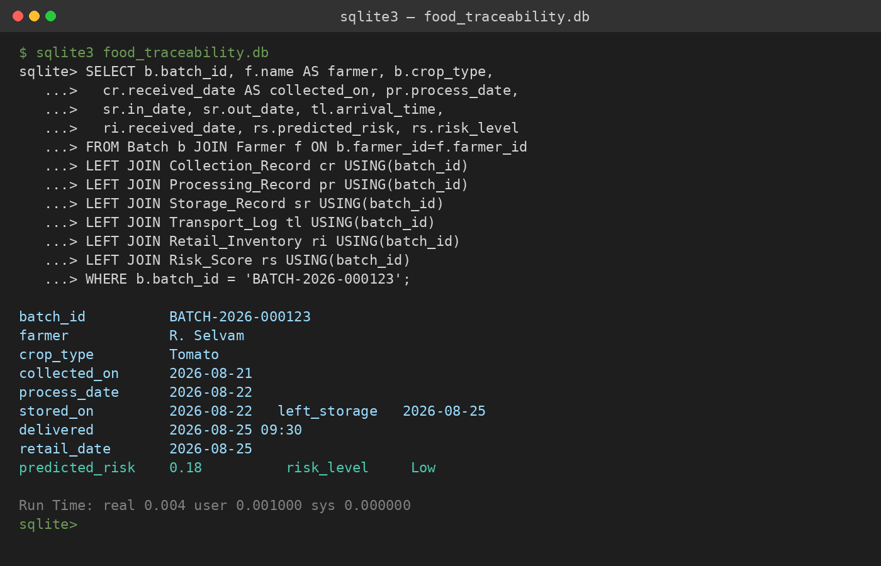
EXECUTION
50% Implementation — Output Screenshots
Schema created (14 tables) — SQLite prototype
Full batch traceability query — live join across 6 tables
Both queries run against a populated instance of the schema on Slide 10, with one full batch (farmer → retail) inserted end-to-end.
Review 2 | AI-Enhanced Food Supply Chain Traceability & Contamination Risk Prediction
13

Slide 14
ROADMAP
Future Work & Next Steps (Review 3)
1
Cloud Database Migration & API Integration
2
Full ML Risk Model Training & Optimization
Migrate the local SQLite prototype to Supabase (Cloud PostgreSQL) so the schema exposes live REST APIs for the dashboard and QR endpoints.
Retrain the Random Forest / XGBoost risk model on 10,000+ synthetic batch records, with hyperparameter tuning and validation metrics.
3
Interactive Web Dashboard Development
4
QR-Code Traceability for Consumers
Build a React / Streamlit dashboard for farmers, warehouse managers, and inspectors — live risk alerts and batch movement tracking.
Generate a QR code per batch so retailers/buyers can scan and see the full farm-to-fork history and risk status instantly; a blockchain layer remains a stretch goal beyond Review 3, consistent with the scope decision from Review 1.
Review 2 | AI-Enhanced Food Supply Chain Traceability & Contamination Risk Prediction
14

Slide 15
REFERENCES
References
[1] Tang, J. (2023). Food Supply Chain Traceability System Based on Blockchain Technology. Applied and Computational Engineering, 8, 311–317.
[2] Zhong, R., Xu, X., & Wang, L. (2017). Food Supply Chain Management: Systems, Implementations, and Future Research. Industrial Management & Data Systems, 117(9), 2085–2114.
[3] Zhou, X., & Xu, Z. (2022). Traceability in Food Supply Chains: A Systematic Literature Review and Future Research Directions. Int'l Food and Agribusiness Mgmt Review, 25(2).
[4] Thakur, M. (2010). Operational Techniques for Implementing Traceability in Bulk Product Supply Chains. PhD Dissertation, Iowa State University.
[5] Wu, D., & Wang, Y. (2026). Food Safety Risk Prediction and Regulatory Strategies Based on Machine Learning. Frontiers in Sustainable Food Systems, 10:1838879.
[6] Deshmukh, M. T., et al. (2025). Towards Intelligent Food Safety: Machine Learning Approaches for Aflatoxin Detection and Risk Prediction. Trends in Food Science & Technology, 161, 105055.
Review 2 | AI-Enhanced Food Supply Chain Traceability & Contamination Risk Prediction
15

