Slide 1
DATABASE SYSTEMS PROJECT • FINAL REVIEW
AI-Enhanced Food
Supply Chain Traceability
Batch-level traceability, QR-based access, and AI-assisted contamination-risk estimation
Fall Semester 2026–2027 | School of Computer Science & Engineering
Team members: SHORYA SHEKHAR, AYUSHI KUMARI
Faculty: K SUDHAKAR • Slot: A2+TA2
WORKING DEMONSTRATION • SYNTHETIC AI TRAINING DATA

Slide 2
EXECUTIVE SUMMARY
Project at a glance
01 Trace
02 Access
03 Estimate
A unique batch ID links recorded journey details from farm origin through retail.
A QR code provides a quick entry point to a selected batch’s traceability page.
A Random Forest model estimates risk from selected supply-chain conditions.
What is demonstrated
A working Streamlit interface, SQLite-backed traceability records, QR generation, a trained model, saved risk scores, and evaluation on held-out synthetic data. This is an academic prototype—not a certified food-safety system.
AI-ENHANCED FOOD SUPPLY CHAIN TRACEABILITY • FINAL REVIEW
02

Slide 3
WHY THIS PROJECT MATTERS
Problem statement
Fragmented records
Slow trace-back
Limited early warning
• Different supply-chain stages may maintain separate records.
• A shared batch identity is needed to connect events.
• Manually joining records makes it harder to see a batch’s full journey quickly.
• Missing entries can create gaps in the evidence.
• Traceability explains where a batch went.
• Risk estimation can add a decision-support signal, if appropriately validated.
Core question: Can one application connect batch records and demonstrate a risk estimate in the same workflow?
AI-ENHANCED FOOD SUPPLY CHAIN TRACEABILITY • FINAL REVIEW
03

Slide 4
WHAT THE PROTOTYPE AIMS TO DO
Objectives and project scope
Objectives
Scope boundaries
• Connect stage records through a batch identifier.
• Display farm-to-retail details in one traceability view.
• Generate a batch-specific QR code and downloadable image.
• Estimate contamination risk from model input conditions.
• Persist existing-batch predictions in Risk_Score and show history.
• Prototype built with Python, Streamlit, SQLite and scikit-learn.
• Demonstration batch: BATCH-2026-000123 (Tomato, 1,000 kg).
• AI training/evaluation data are synthetic.
• QR access depends on a reachable URL and running app.
• Not intended to approve, reject, or certify real food for sale.
AI-ENHANCED FOOD SUPPLY CHAIN TRACEABILITY • FINAL REVIEW
04

Slide 5
LITERATURE CONTEXT
Background and related work
Traceability systems
Data-driven supply chains
Predictive risk work
• Prior work studies how to identify and trace products across supply-chain nodes.
• Relational databases provide structured records and joins; blockchain has also been explored for tamper-evident records.
• Reviews describe how data systems support visibility and management across food supply chains.
• A traceability record answers “where did this batch go?”
• Machine-learning research explores risk prediction from inspection, product and environmental data.
• Performance depends on data quality, labels, and validation.
Positioning: this project combines a relational traceability workflow with a demonstrative batch-level risk estimate in one application.
AI-ENHANCED FOOD SUPPLY CHAIN TRACEABILITY • FINAL REVIEW
05

Slide 6
FROM RECORDS TO DECISION SUPPORT
Research gap and project contribution
Traceability alone
Integrated prototype
• Stores and retrieves historical events.
• Supports trace-back when a problem is reported.
• Does not by itself estimate future risk.
• Uses a batch ID as the traceability anchor.
• Shows recorded conditions alongside an AI estimate.
• Saves existing-batch scores for later display.
Contribution: an end-to-end academic demonstration—not a claim of a novel or validated food-safety algorithm.
AI-ENHANCED FOOD SUPPLY CHAIN TRACEABILITY • FINAL REVIEW
06

Slide 7
APPLICATION DESIGN
Proposed system architecture
User interface
Application logic
Data layer
AI model
Streamlit pages
Python / app.py
SQLite database
Random Forest
Outputs
Batch journey • QR entry point • Risk probability/class • Saved risk history • Evaluation metrics
Data flow: recorded batch conditions → feature preparation → trained model → estimated probability → optional save to Risk_Score.
AI-ENHANCED FOOD SUPPLY CHAIN TRACEABILITY • FINAL REVIEW
07

Slide 8
IMPLEMENTATION
Technology stack and project files
Python
Application and model-training language
Streamlit
Interactive multi-page web interface
SQLite
Local relational database: food_traceability.db
pandas
Tabular data handling
scikit-learn
Random Forest classifier and evaluation
joblib + JSON
Persist trained model and metric results
qrcode
Generate a QR image for a batch-specific URL
AI-ENHANCED FOOD SUPPLY CHAIN TRACEABILITY • FINAL REVIEW
08

Slide 9
RELATIONAL MODEL
Database design: conceptual ER view
FARMER / ORIGIN
STORAGE
farmer, location, harvest
dates, temperature, humidity
BATCH
batch_id (PK)
COLLECTION
TRANSPORT / RETAIL
date, grade, centre
route, transit, store
PROCESSING
RISK_SCORE
INSPECTION
plant, process, output
probability, level, time
result, inspector, notes
Conceptual view: stage records reference the batch; Risk_Score stores multiple time-stamped predictions for a batch.
AI-ENHANCED FOOD SUPPLY CHAIN TRACEABILITY • FINAL REVIEW
09

Slide 10
DATABASE DESIGN
Core database tables and key fields
TABLE / ENTITY
KEY
EXAMPLE FIELDS
Batch
batch_id (PK)
crop_type, harvest_date, quantity_kg, status
Farmer / origin
farmer_id or batch-linked details
name, farm_location
Collection_Record
record_id (PK), batch_id (FK)
received_date, grade, centre
Processing_Record
record_id (PK), batch_id (FK)
process_type, plant, output_qty_kg
Storage_Record
storage_id (PK), batch_id (FK)
in/out dates, temperature_c, humidity_pct
Transport_Log
transport_id (PK), batch_id (FK)
origin, destination, dispatch/arrival, transit conditions
Retail_Inventory
inventory_id (PK), batch_id (FK)
received_date, quantity_kg, unit_price
Inspection
inspection_id (PK), batch_id (FK)
stage, inspector, result, contamination_type
Risk_Score
score_id (PK), batch_id (FK)
model_version, predicted_risk, risk_level, scored_on, top_features
PK = Primary Key (uniquely identifies a row) • FK = Foreign Key (connects a row to another table)
AI-ENHANCED FOOD SUPPLY CHAIN TRACEABILITY • FINAL REVIEW
10

Slide 11
DBS CONCEPTS
Relational design: keys, normalization and joins
Primary key (PK)
Foreign key (FK)
Normalization / JOIN
• Identifies a row uniquely.
• Example: batch_id identifies the batch.
• score_id distinguishes separate risk-history entries.
• Connects a stage record to its batch.
• Allows related data to be retrieved together.
• Supports referential consistency when constraints are enforced.
• Keep each fact in a suitable table to reduce repeated data.
• Use joins or lookups to reconstruct a batch journey.
• LEFT JOINs can preserve a batch even if some stage records are absent.
Missing data means “not recorded here”; it does not prove the event never occurred.
AI-ENHANCED FOOD SUPPLY CHAIN TRACEABILITY • FINAL REVIEW
11

Slide 12
USER JOURNEY
End-to-end batch traceability workflow
1
2
3
4
5
6
7
Farm origin
Collection
Processing
Storage
Transport
Retail
Inspection
Farmer, crop, harvest
Date, grade, centre
Process, plant, output
Temperature, humidity, dates
Route, transit conditions
Store, received quantity
Result and notes
QR CODE → batch-specific traceability URL
RISK SCORE → saved estimate and history
The traceability view assembles recorded events for one selected batch; records are only as complete as the data entered.
AI-ENHANCED FOOD SUPPLY CHAIN TRACEABILITY • FINAL REVIEW
12

Slide 13
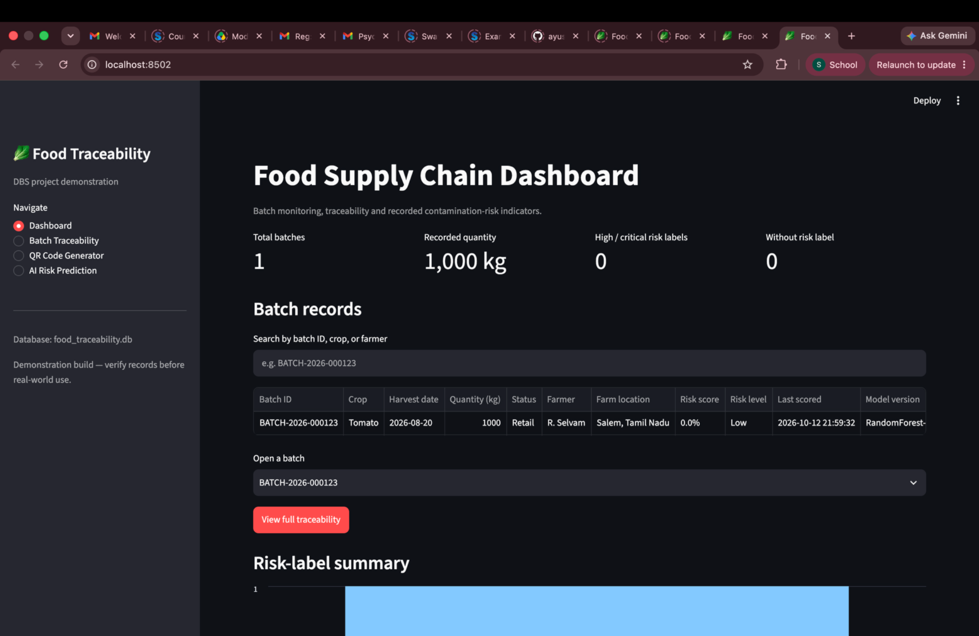
IMPLEMENTATION EVIDENCE
Working application: dashboard and navigation
What the UI provides
• Dashboard landing page
• Batch traceability
• QR Code Generator
• AI Risk Prediction
• Local SQLite-backed records
AI-ENHANCED FOOD SUPPLY CHAIN TRACEABILITY • FINAL REVIEW
13

Slide 14
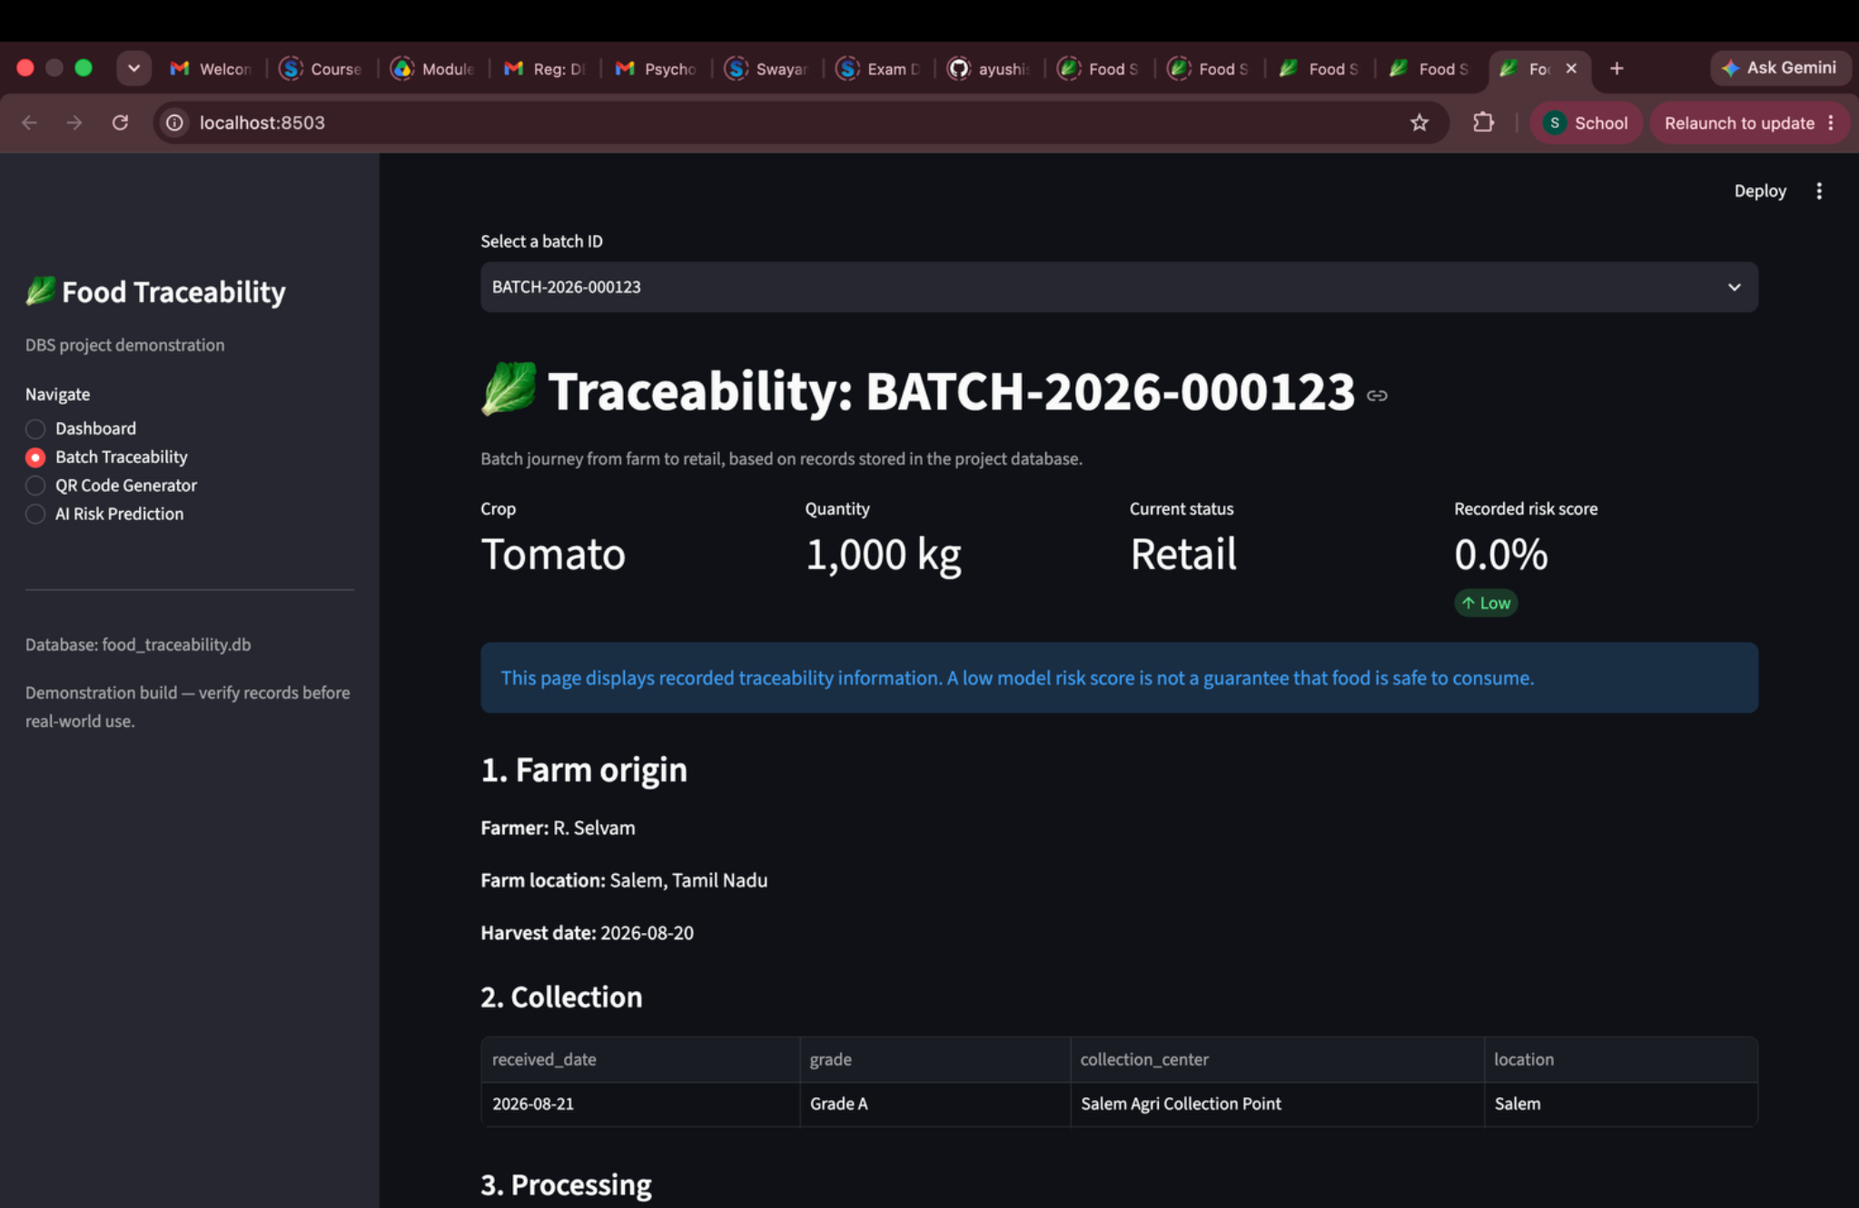
IMPLEMENTATION EVIDENCE
Working application: batch traceability
Demo batch
BATCH-2026-000123
Crop: Tomato
Quantity: 1,000 kg
Traceability sections
• Farm origin
• Collection / processing
• Storage / transport
• Retail / inspection
• Risk history
AI-ENHANCED FOOD SUPPLY CHAIN TRACEABILITY • FINAL REVIEW
14

Slide 15
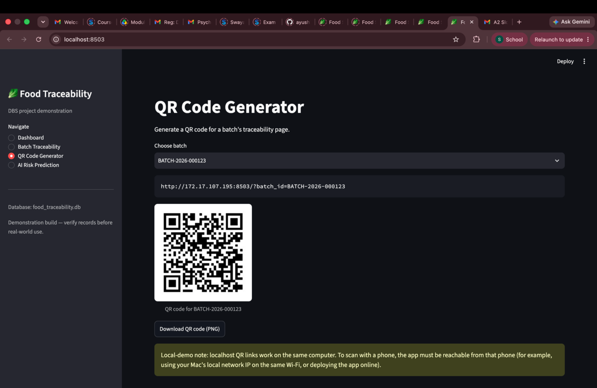
IMPLEMENTATION EVIDENCE
QR-code generation and access
QR flow
1. Select batch
Choose a batch ID in the QR page.
2. Generate
Render the QR and download a PNG.
3. Scan
Phone opens the batch-specific URL.
4. View
Traceability page loads if host is reachable.
Network note: localhost only refers to the device running the browser; phone access requires a reachable LAN or deployed URL.
AI-ENHANCED FOOD SUPPLY CHAIN TRACEABILITY • FINAL REVIEW
15

Slide 16
MACHINE-LEARNING WORKFLOW
AI risk prediction pipeline
Input data
Crop, stage, storage, transit, humidity, inspection history
Feature preparation
Convert recorded conditions into model-ready fields
Random Forest
Trained classifier loaded from food_risk_model.joblib
Probability
Estimated class-1 probability (0–1)
Display / save
Show result; save existing-batch score to Risk_Score
Important: estimated probability is model output, not a measured contamination level or safety certification.
AI-ENHANCED FOOD SUPPLY CHAIN TRACEABILITY • FINAL REVIEW
16

Slide 17
AI FEATURE ENGINEERING
Model inputs and how they are assembled
Product / stage
Cold-chain conditions
Crop type and recorded supply-chain stage
Storage temperature, storage duration, humidity
Transport conditions
Quality history
Transit time and transit temperature
Count of previous failed/rejected inspections
Time since harvest
Harvest date compared with latest recorded event
For the existing-batch mode, values are assembled from stored records where possible; fallback values may be used when records are missing. New-condition scenarios are not automatically saved as batches.
AI-ENHANCED FOOD SUPPLY CHAIN TRACEABILITY • FINAL REVIEW
17

Slide 18
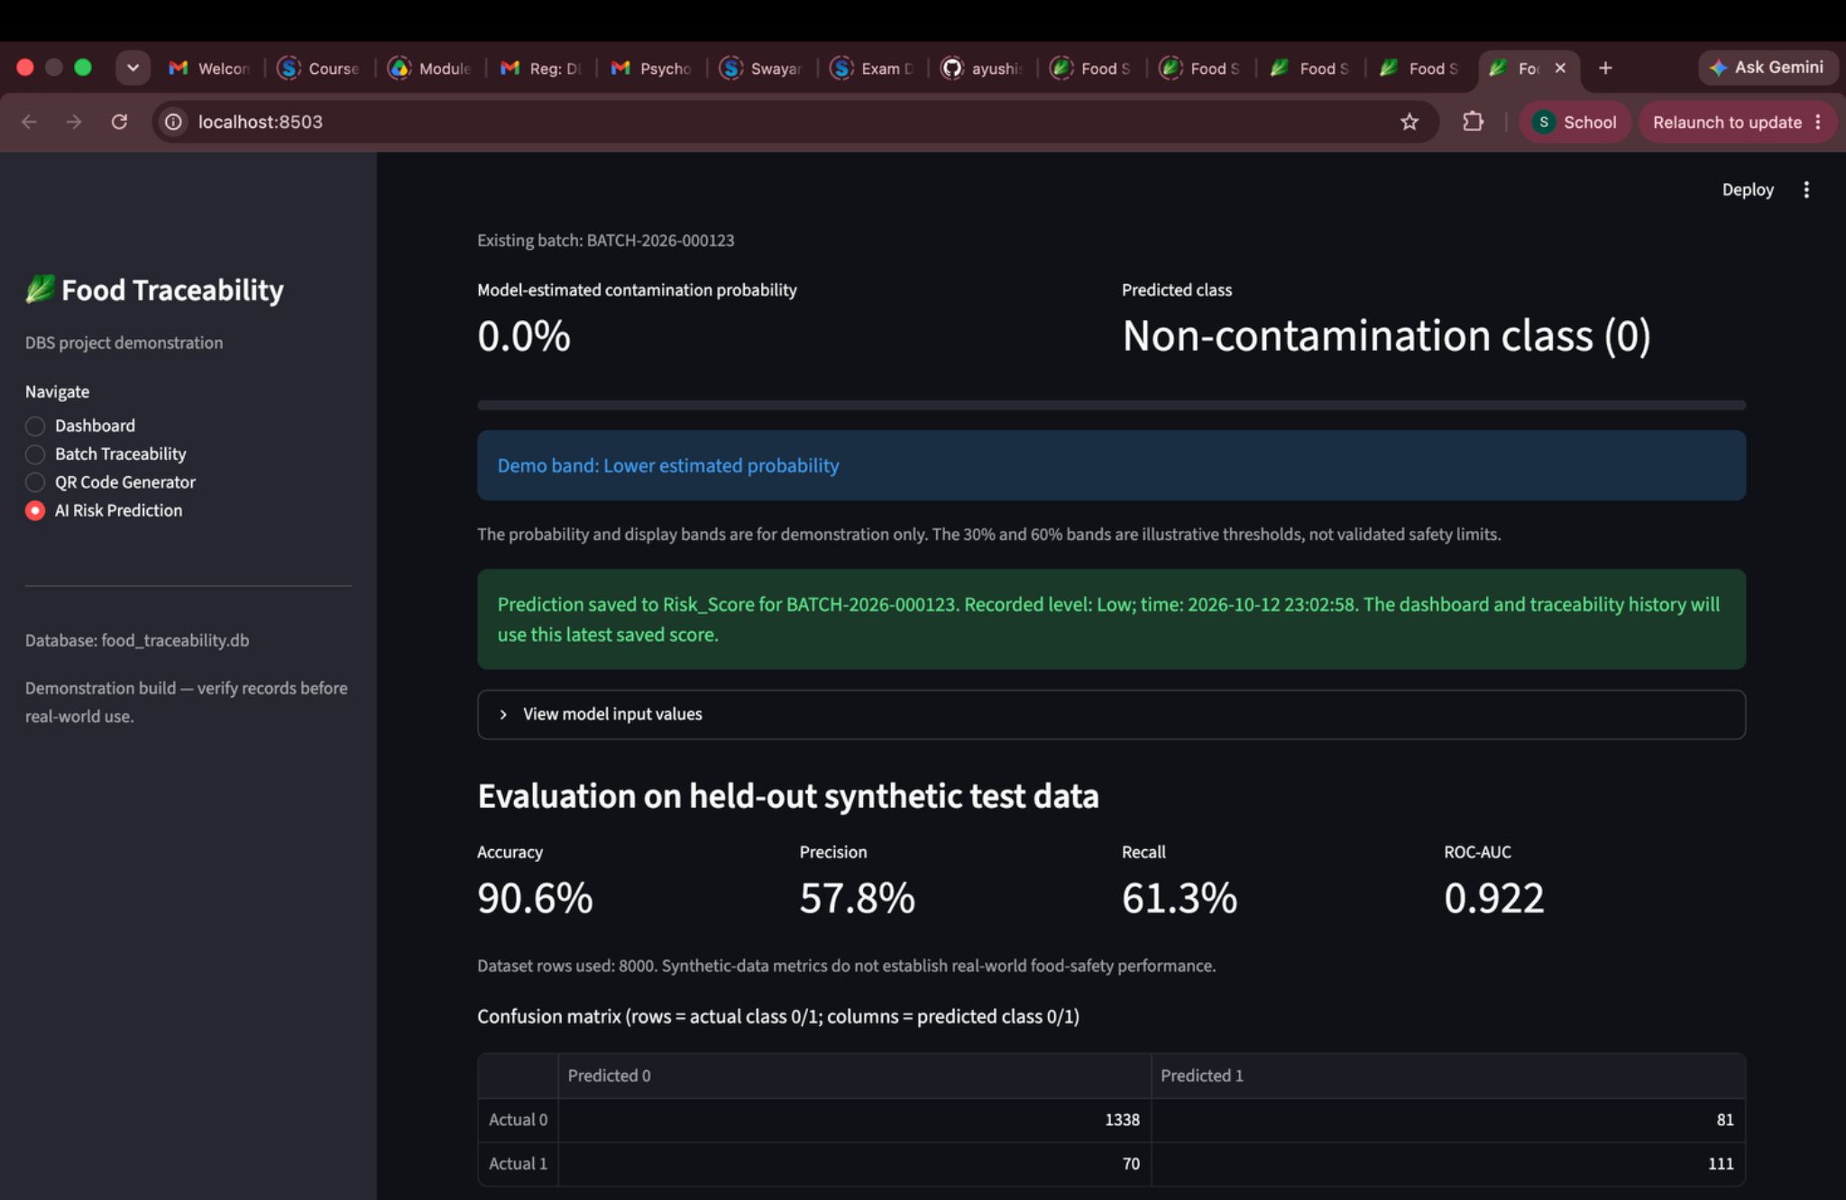
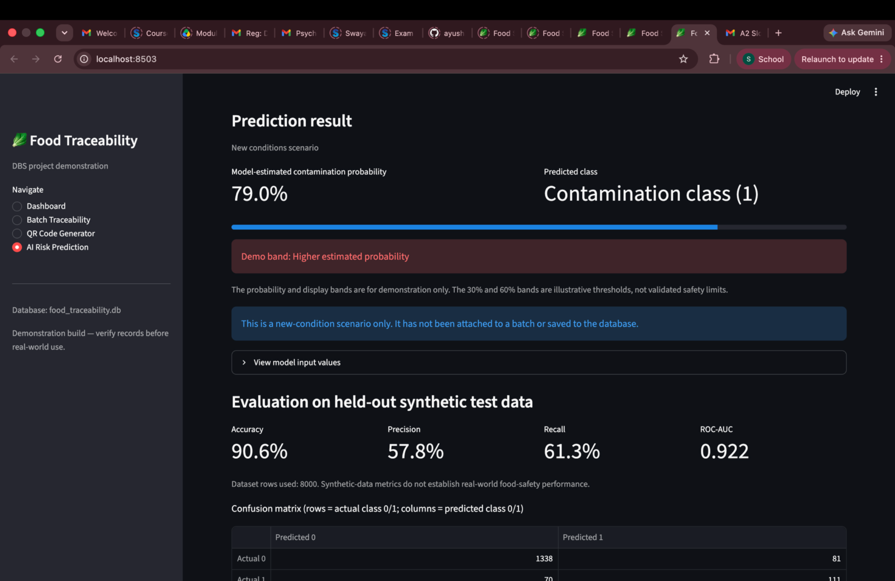
OBSERVED APPLICATION OUTPUTS
AI demo: existing batch vs new conditions
Existing batch: saved result shown as 0.0% (class 0)
New conditions: 79.0% in the displayed scenario (class 1)
These outputs are specific to the displayed inputs and model; neither result should be interpreted as proof of real-world food safety.
AI-ENHANCED FOOD SUPPLY CHAIN TRACEABILITY • FINAL REVIEW
18

Slide 19
RESULTS
Model evaluation on held-out synthetic data
Accuracy
Precision
Recall
F1-score
ROC-AUC
90.6%
57.8%
61.3%
59.5%
0.922
Correct predictions overall
Predicted positives that were correct
Actual positives detected
Balance of precision and recall
Ranking / separation measure
8,000 synthetic rows • 6,400 training rows • 1,600 held-out test rows
Interpretation: accuracy is high on this generated dataset, but precision and recall are more moderate. In the test set, some actual positive cases were missed. These results do not establish performance on real food-safety data.
AI-ENHANCED FOOD SUPPLY CHAIN TRACEABILITY • FINAL REVIEW
19

Slide 20
MODEL EVALUATION
Confusion matrix and error interpretation
Rows = actual class • Columns = predicted class
Predicted 0
Predicted 1
Actual 0
1,338
81
Actual 1
70
111
True positives: 111
False negatives: 70
Positive examples correctly predicted as positive.
Positive examples predicted as negative—important to monitor.
AI-ENHANCED FOOD SUPPLY CHAIN TRACEABILITY • FINAL REVIEW
20

Slide 21
VERIFICATION SUMMARY
Functional testing and results
Traceability
Selected batch displays recorded farm-to-retail sections
Demonstrated
QR generation
QR code is rendered and downloadable as PNG
Demonstrated
QR access
Phone scan opened traceability page in the tested setup
Demonstrated in local setup
Existing-batch prediction
Model predicts and shows probability/class
Demonstrated
Persistence
Prediction saved to Risk_Score with timestamp
Demonstrated
History refresh
Traceability history shows saved risk records
Demonstrated
Model evaluation
Metrics and confusion matrix loaded from saved results
Demonstrated
AI-ENHANCED FOOD SUPPLY CHAIN TRACEABILITY • FINAL REVIEW
21

Slide 22
CRITICAL DISCUSSION
Limitations and responsible interpretation
Synthetic training data
Model errors
Operational limits
• The model was trained and tested on generated examples.
• Patterns may not match real contamination events.
• Precision: 57.8%; recall: 61.3%.
• 70 positive cases were missed in the held-out test matrix.
• Incomplete data can affect feature quality.
• Local QR access needs network reachability.
• Security, user authentication and audit controls need strengthening.
A low score does not prove a batch is safe; a high score does not confirm contamination.
AI-ENHANCED FOOD SUPPLY CHAIN TRACEABILITY • FINAL REVIEW
22

Slide 23
NEXT DEVELOPMENT STEPS
Future enhancements
1. Real labelled data
2. Improve recall
Train and validate with expert-labelled inspection and contamination records.
Tune thresholds, address class imbalance, calibrate probabilities and inspect false negatives.
3. Data quality
4. Security
Add input validation, completeness indicators and controlled data-entry workflows.
Add authentication, role-based access, audit trails and secure deployment.
5. Live sensing
6. Evaluation
Explore IoT temperature/humidity capture and alerts for excursions.
Use cross-validation, temporal or external test sets, and document model versions.
AI-ENHANCED FOOD SUPPLY CHAIN TRACEABILITY • FINAL REVIEW
23

Slide 24
PROJECT OUTCOME
Conclusion
A single batch ID connects traceability records, QR access and a saved AI risk estimate.
Traceability
QR access
AI demonstration
One view assembles recorded supply-chain stages.
A quick route to the selected batch page.
A trained Random Forest produces a probability estimate.
Outcome: a functioning academic prototype with transparent limitations and a clear path toward real-data validation.
AI-ENHANCED FOOD SUPPLY CHAIN TRACEABILITY • FINAL REVIEW
24

Slide 25
SELECTED REFERENCES
References and supporting literature
• [1] Zhong, R., Xu, X., & Wang, L. (2017). Food supply chain management: systems, implementations, and future research. Industrial Management & Data Systems, 117(9), 2085–2114.
• [2] Thakur, M. (2010). A framework for implementing traceability system in the bulk grain supply chain. Journal of Food Engineering.
• [3] Tang, J. (2023). Food supply chain traceability system based on blockchain technology. Applied and Computational Engineering, 8, 311–317. https://ace.ewapub.com/article/view/2519
• [4] Zhou & Xu (2022). Systematic review of food traceability research (review of studies published 1994–2019).
• [5] Deshmukh et al. (2025). Review of machine-learning and deep-learning methods for aflatoxin detection in food matrices.
• [6] Project implementation artifacts: app.py, train_model.py, synthetic_batched.csv, food_risk_model.joblib, trained_model_metrics.json, food_traceability.db.
Before submission, verify complete bibliographic details and format these entries to your department’s required citation style.
AI-ENHANCED FOOD SUPPLY CHAIN TRACEABILITY • FINAL REVIEW
25

Slide 26
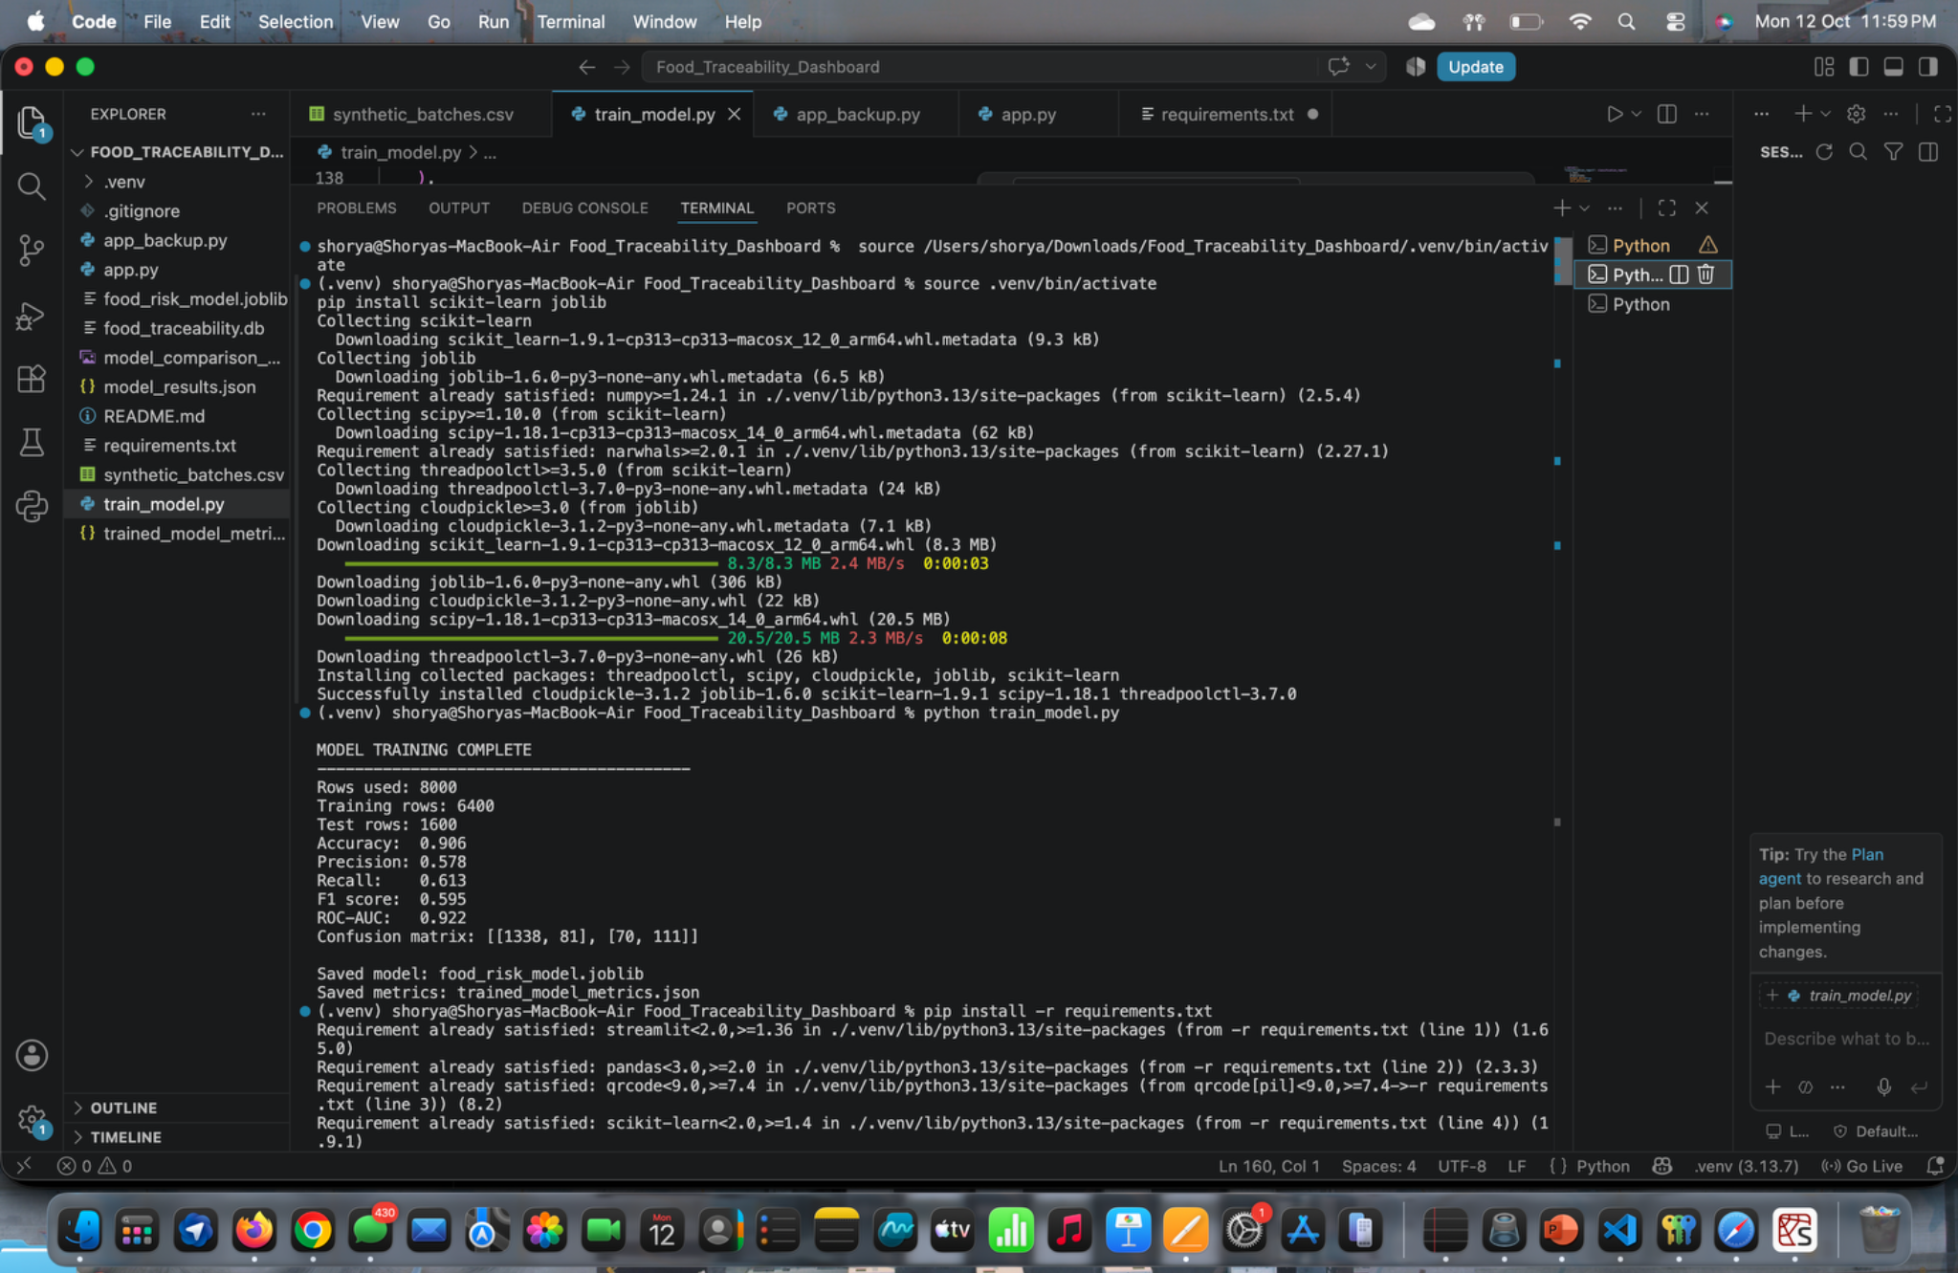
IMPLEMENTATION EVIDENCE
Model training run and saved artifacts
Rows used
8,000 synthetic rows
Split
6,400 train • 1,600 test
Artifacts
food_risk_model.joblib
trained_model_metrics.json
AI-ENHANCED FOOD SUPPLY CHAIN TRACEABILITY • FINAL REVIEW
27

