Slide 1
DATABASE SYSTEMS PROJECT • FINAL REVIEW
AI-Enhanced Food
Supply Chain Traceability
Batch-level traceability, QR-based access, and AI-assisted contamination-risk estimation
Fall Semester 2026–2027
Team members: SHORYA SHEKHAR , AYUSHI KUMARI
Faculty : K SUDHAKAR

Slide 2
OVERVIEW
Presentation roadmap
01 Project overview
02 System design
03 AI and validation
• Problem and objectives
• Scope and contribution
• Architecture and workflow
• Database design
• Model pipeline and metrics
• Testing and limitations
04 Full screenshot appendix
Every supplied image is included on its own evidence slide for readability, including app pages, QR screens, model outputs, code/terminal views, and supporting documentation.
AI-ENHANCED FOOD SUPPLY CHAIN TRACEABILITY • FINAL REVIEW
02

Slide 3
PROJECT FOUNDATION
Problem statement and motivation
Fragmented records
Slow trace-back
Risk awareness
• Different supply-chain stages can store separate information.
• A batch identifier can link the journey end-to-end.
• Manual searching across records takes time.
• Missing stage entries make the journey harder to reconstruct.
• Historical traceability explains what was recorded.
• A model can add a risk estimate as decision support when validated.
Project question: Can one application connect batch records, provide QR entry, and demonstrate an AI-generated risk estimate?
AI-ENHANCED FOOD SUPPLY CHAIN TRACEABILITY • FINAL REVIEW
03

Slide 4
PROJECT FOUNDATION
Objectives and scope
Objectives
Scope boundaries
• Connect supply-chain stage records using a batch identifier.
• Show recorded origin-to-retail information in one view.
• Generate a batch-specific QR code and downloadable image.
• Estimate risk from selected supply-chain conditions.
• Save existing-batch predictions and show their history.
• Python, Streamlit, SQLite and scikit-learn prototype.
• Demo batch: BATCH-2026-000123; Tomato; 1,000 kg.
• Model trained/evaluated using synthetic data.
• QR access depends on the URL being reachable.
• Not a certified food-safety or contamination-detection system.
AI-ENHANCED FOOD SUPPLY CHAIN TRACEABILITY • FINAL REVIEW
04

Slide 5
SYSTEM DESIGN
Proposed system architecture
User interface
Application logic
Relational data
ML inference
Streamlit pages
Python
SQLite
Random Forest
Application outputs
Traceability view • QR image • Risk probability/class • Saved score history • Model metrics
Data flow: batch/stage data → feature preparation → trained model → estimated probability → optional persistence.
AI-ENHANCED FOOD SUPPLY CHAIN TRACEABILITY • FINAL REVIEW
05

Slide 6
SYSTEM DESIGN
Supply-chain traceability workflow
1
2
3
4
5
6
7
Farm origin
Collection
Processing
Storage
Transport
Retail
Inspection
QR entry point
AI risk history
QR encodes a URL linked to the selected batch.
Saved estimates can appear with timestamps.
Important: the system shows recorded events; absent data should be treated as unrecorded, not proof that an event never occurred.
AI-ENHANCED FOOD SUPPLY CHAIN TRACEABILITY • FINAL REVIEW
06

Slide 7
DATABASE SYSTEMS
Database design: conceptual ER view
FARM / ORIGIN
STORAGE
farmer, location
temperature, humidity
BATCH
batch_id (PK)
COLLECTION
TRANSPORT / RETAIL
date, grade, centre
route, store
PROCESSING
RISK_SCORE
INSPECTION
plant, process
probability, level, time
result, notes
Conceptual model: a batch connects the stage records; Risk_Score can hold multiple predictions for the same batch.
AI-ENHANCED FOOD SUPPLY CHAIN TRACEABILITY • FINAL REVIEW
07

Slide 8
DATABASE SYSTEMS
Relational design: keys and normalization
Primary keys
Foreign keys
Normalization and joins
• A primary key uniquely identifies a row.
• batch_id identifies the batch.
• score_id distinguishes prediction-history rows.
• Stage records link to the batch they describe.
• Relationships make cross-stage queries possible.
• Constraints should be enabled and validated.
• Keep each kind of fact in an appropriate table.
• Join stage data when reconstructing a journey.
• Missing rows should remain visible as data gaps.
PK = Primary Key • FK = Foreign Key • Database shown is a prototype schema
AI-ENHANCED FOOD SUPPLY CHAIN TRACEABILITY • FINAL REVIEW
08

Slide 9
DATABASE SYSTEMS
Core database tables and fields
TABLE
KEY
EXAMPLE FIELDS
Batch
batch_id (PK)
crop type, harvest date, quantity, status
Origin / Farmer
farmer identifier
farmer name, farm location
Collection
record_id, batch_id (FK)
date, grade, collection centre
Processing
record_id, batch_id (FK)
process type, plant, output quantity
Storage
storage_id, batch_id (FK)
temperature, humidity, dates
Transport
transport_id, batch_id (FK)
route, transit time, conditions
Retail
inventory_id, batch_id (FK)
store, received date, quantity
Inspection
inspection_id, batch_id (FK)
stage, result, notes
Risk_Score
score_id, batch_id (FK)
model version, probability, level, timestamp, features
Exact implementation details should be cross-checked against the submitted database schema.
AI-ENHANCED FOOD SUPPLY CHAIN TRACEABILITY • FINAL REVIEW
09

Slide 10
APPLICATION FEATURE
QR-code generation and user access
1. Select
2. Generate
3. Open
Choose the batch identifier that the QR code should represent.
Create a QR image encoding the batch-specific traceability URL; download as PNG.
A phone scans the QR and opens the URL if the host is reachable.
Network note: localhost points to the current device; phone access requires a LAN IP or deployed public URL.
AI-ENHANCED FOOD SUPPLY CHAIN TRACEABILITY • FINAL REVIEW
10

Slide 11
MACHINE LEARNING
AI prediction pipeline
Input conditions
Product, storage, transit, inspection history
Feature preparation
Map records and form values to model inputs
Random Forest
Load trained food_risk_model.joblib
Risk probability
Model estimates the positive-class probability
Result and persistence
Display prediction; save existing-batch score to Risk_Score
Model probability is not a measured contamination level or food-safety certification.
AI-ENHANCED FOOD SUPPLY CHAIN TRACEABILITY • FINAL REVIEW
11

Slide 12
MACHINE LEARNING
Model evaluation results
Accuracy
Precision
Recall
F1-score
ROC-AUC
90.6%
57.8%
61.3%
59.5%
0.922
8,000 synthetic rows • 6,400 training rows • 1,600 held-out test rows
Interpretation: results describe performance on generated data only. Precision and recall are moderate; the model misses some positive examples. Real-world validation is still required.
Confusion matrix: [[1,338, 81], [70, 111]] • 70 false negatives in the held-out test set.
AI-ENHANCED FOOD SUPPLY CHAIN TRACEABILITY • FINAL REVIEW
12

Slide 13
EVALUATION
Testing, limitations and next steps
Functional tests
Limitations
Future work
• Traceability sections displayed.
• QR code generated and downloadable.
• Predictions displayed and saved.
• Risk history refreshed from SQLite.
• Synthetic training data only.
• Incomplete records affect feature quality.
• False negatives remain possible.
• Local QR URLs need network reachability.
• Validate on real labelled records.
• Improve recall and calibrate thresholds.
• Add authentication and audit logging.
• Explore IoT sensing and alerts.
Low risk does not prove a batch is safe; high risk does not prove contamination.
AI-ENHANCED FOOD SUPPLY CHAIN TRACEABILITY • FINAL REVIEW
13

Slide 14
WRAP-UP
Conclusion and live demo sequence
The prototype connects traceability records, QR access and AI-assisted risk estimation in one workflow.
1. Dashboard
Introduce the application and batch list.
2. Trace a batch
Show BATCH-2026-000123 and recorded stages.
3. QR generator
Show QR creation and explain network reachability.
4. AI prediction
Run existing-batch and new-condition modes.
5. Evaluation
Explain metrics and synthetic-data limitations.
AI-ENHANCED FOOD SUPPLY CHAIN TRACEABILITY • FINAL REVIEW
14

Slide 15
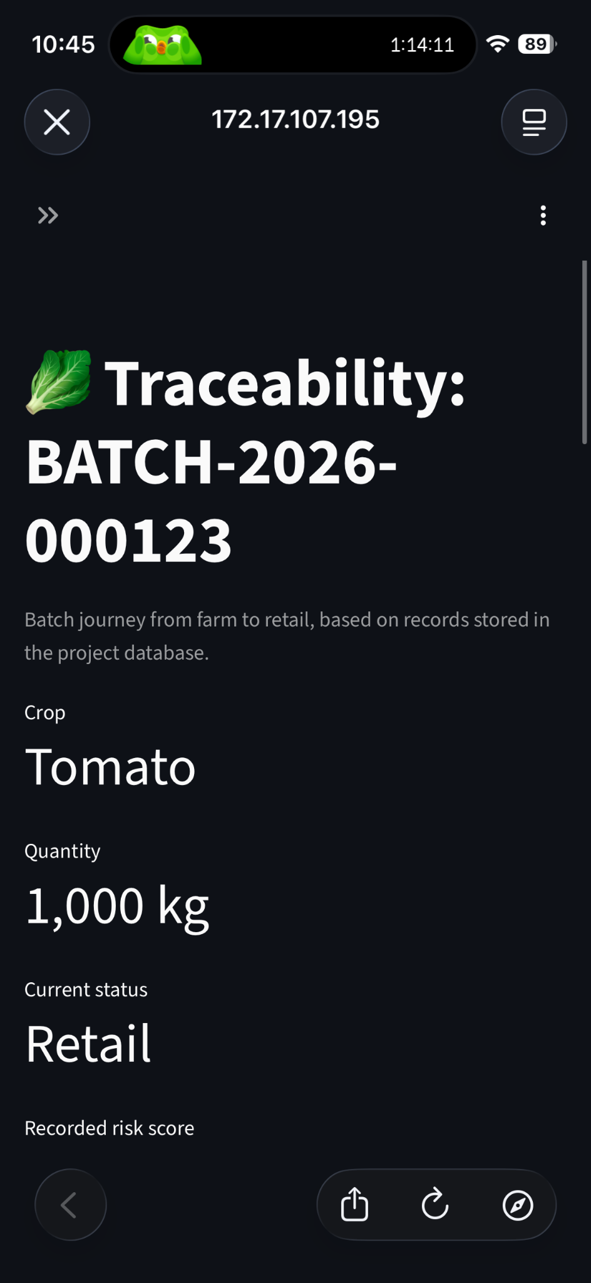
SCREENSHOT APPENDIX • MOBILE BATCH TRACEABILITY
Mobile traceability — batch overview
Source file: IMG_1721.PNG
AI-ENHANCED FOOD SUPPLY CHAIN TRACEABILITY • FINAL REVIEW
15

Slide 16
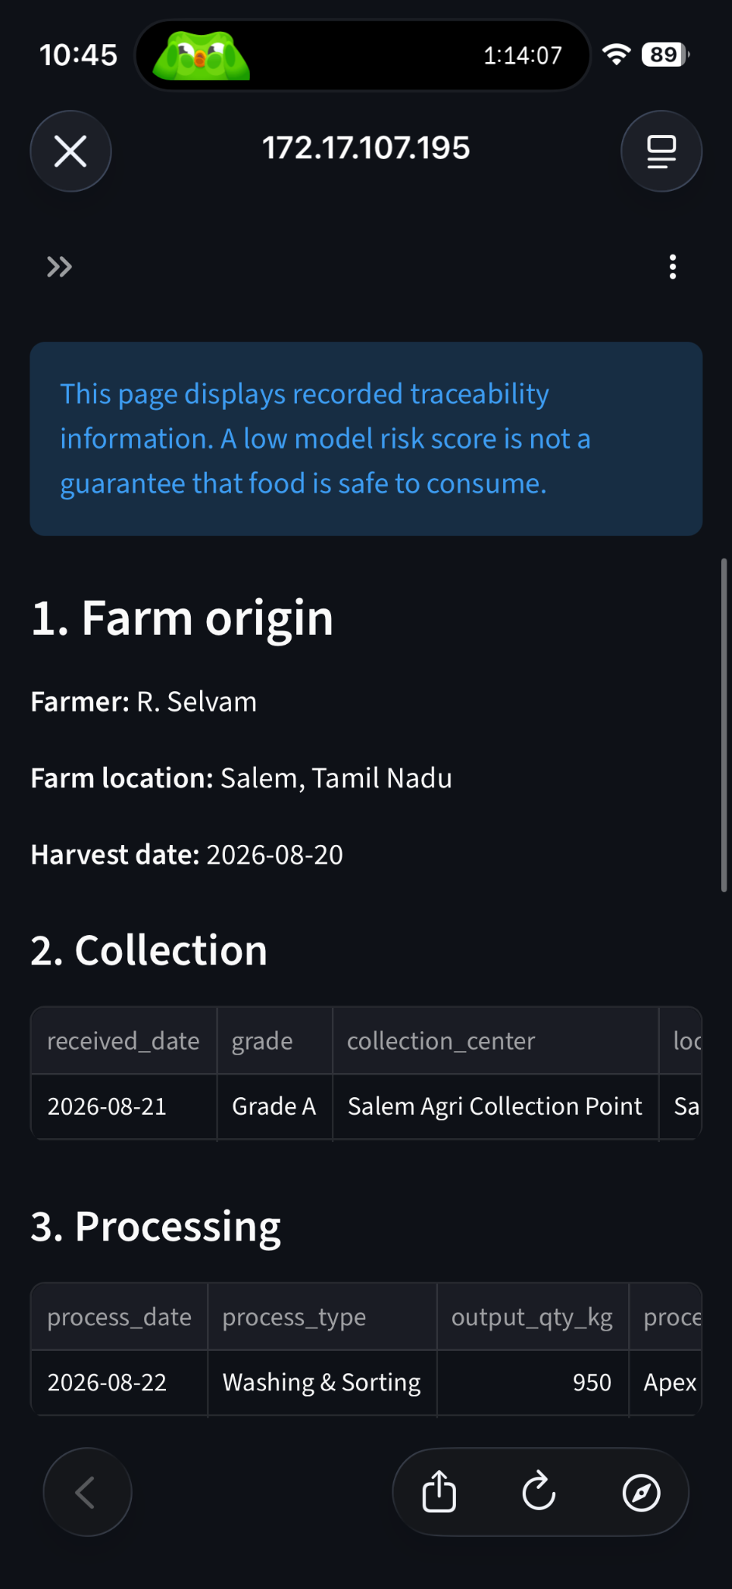
SCREENSHOT APPENDIX • MOBILE BATCH TRACEABILITY
Mobile traceability — supply-chain stages
Source file: IMG_1722.PNG
AI-ENHANCED FOOD SUPPLY CHAIN TRACEABILITY • FINAL REVIEW
16

Slide 17
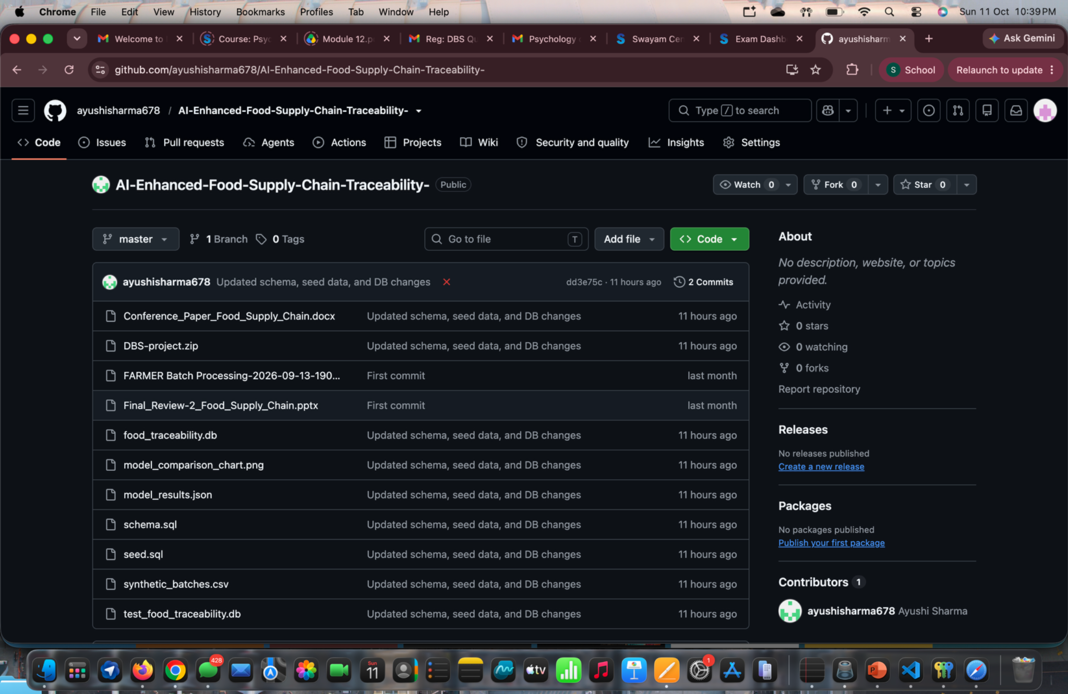
SCREENSHOT APPENDIX • CODE, TERMINAL OR DATABASE EVIDENCE
Database view — existing records
Source file: Screenshot 2026-10-11 at 10.39.57 PM.png
AI-ENHANCED FOOD SUPPLY CHAIN TRACEABILITY • FINAL REVIEW
17

Slide 18

SCREENSHOT APPENDIX • CODE, TERMINAL OR DATABASE EVIDENCE
Terminal evidence — schema and database updates
Source file: Screenshot 2026-10-11 at 10.46.56 PM.png
AI-ENHANCED FOOD SUPPLY CHAIN TRACEABILITY • FINAL REVIEW
18

Slide 19
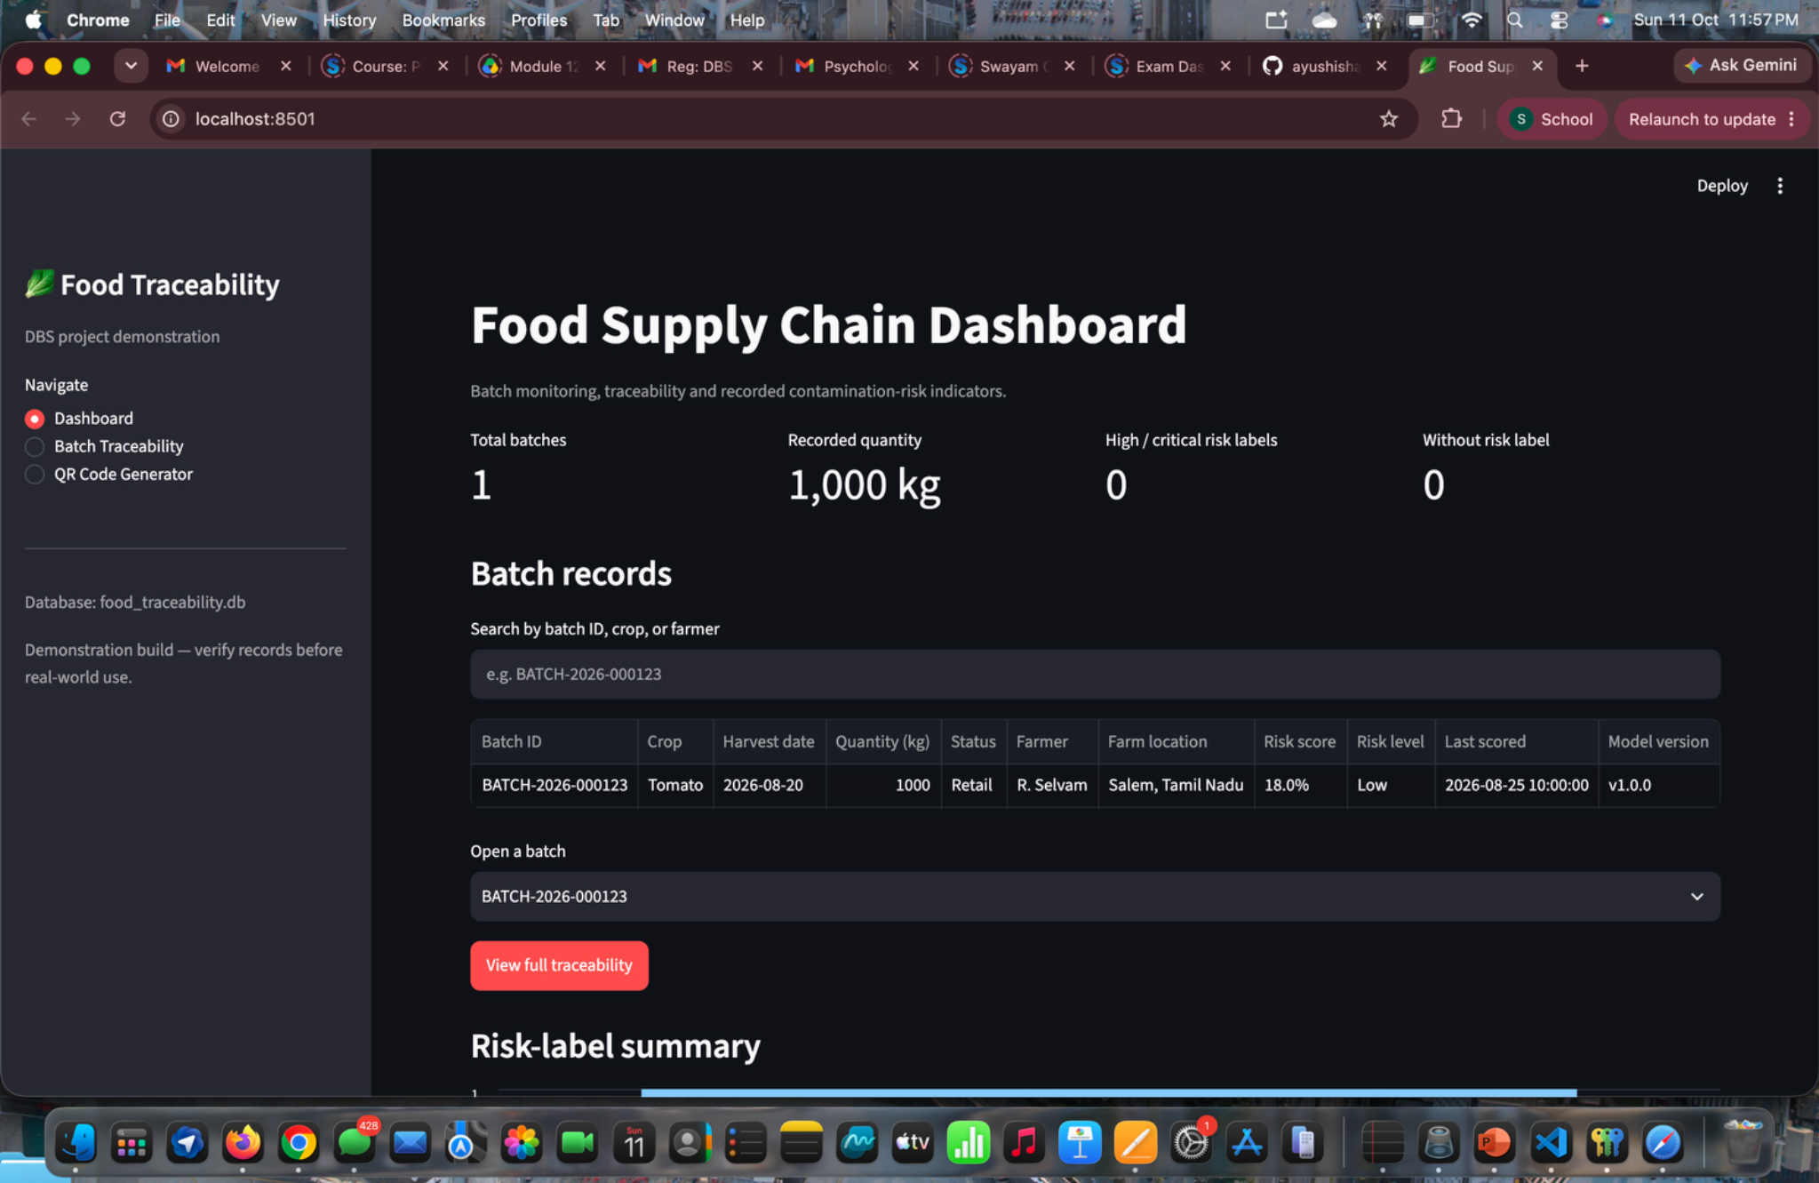
SCREENSHOT APPENDIX • DASHBOARD VIEW
Dashboard — initial working view
Source file: Screenshot 2026-10-11 at 11.57.58 PM.png
AI-ENHANCED FOOD SUPPLY CHAIN TRACEABILITY • FINAL REVIEW
19

Slide 20
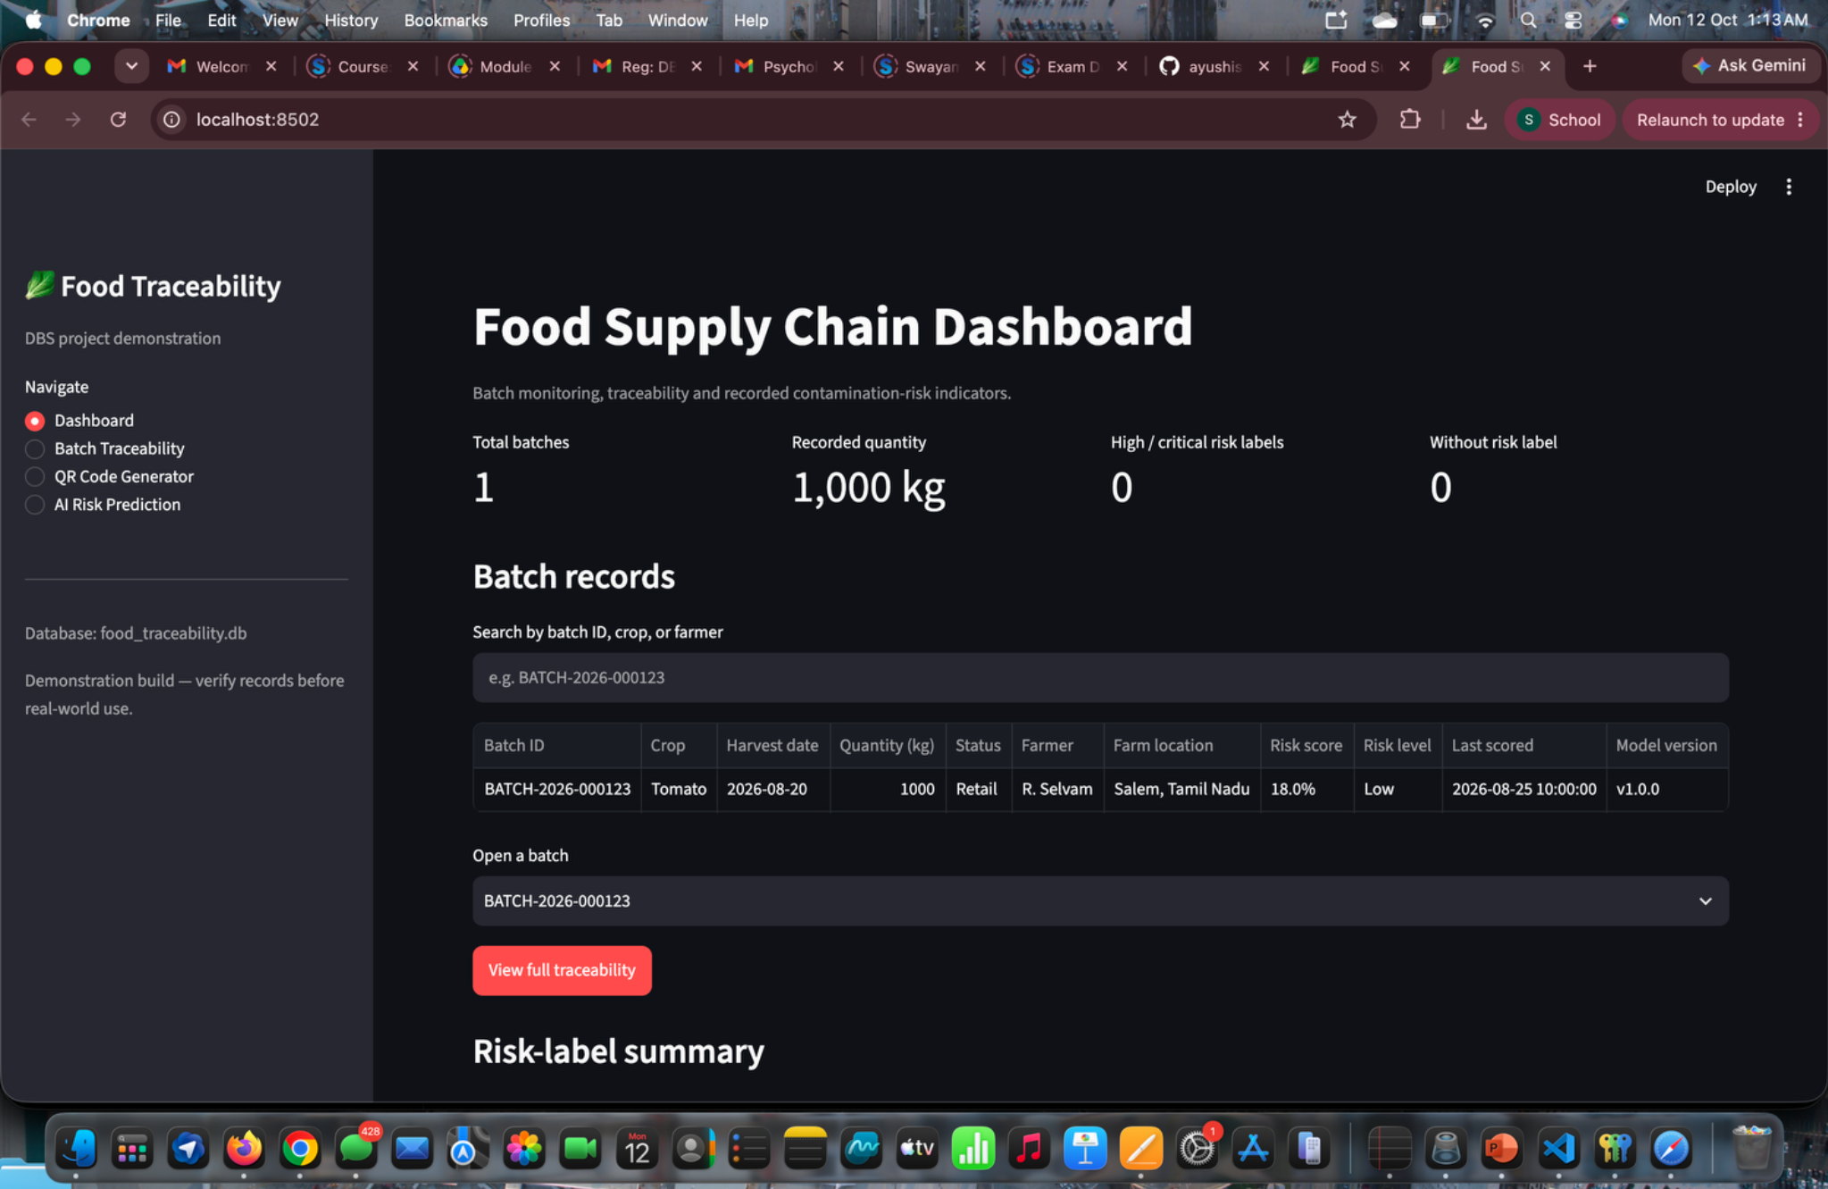
SCREENSHOT APPENDIX • DASHBOARD VIEW
Dashboard — batch summary
Source file: Screenshot 2026-10-12 at 1.13.47 AM.png
AI-ENHANCED FOOD SUPPLY CHAIN TRACEABILITY • FINAL REVIEW
20

Slide 21
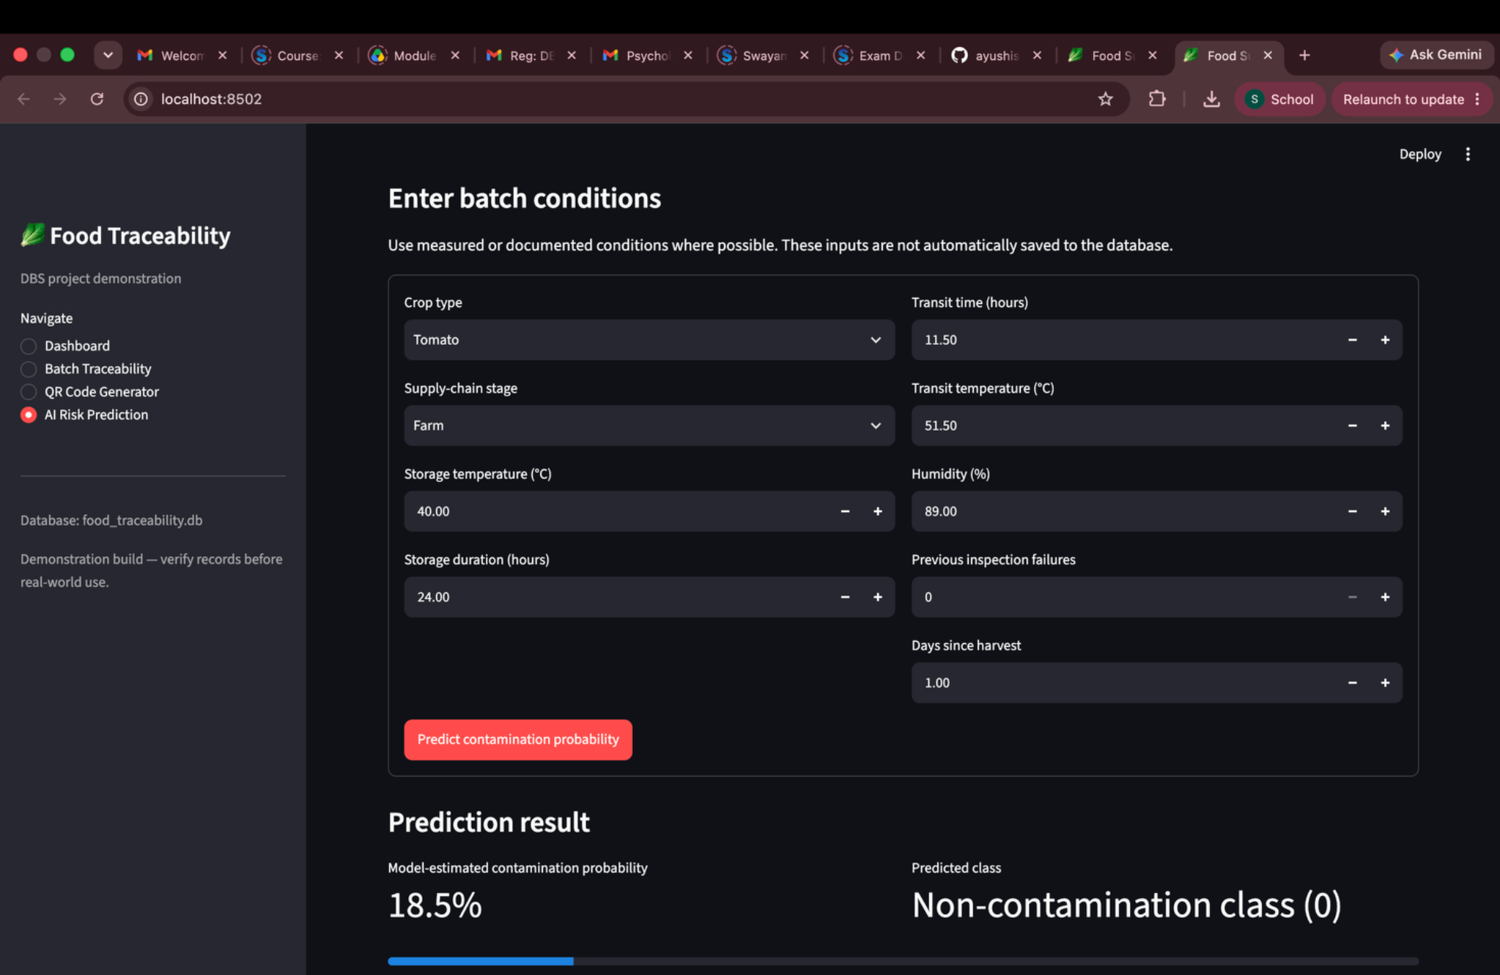
SCREENSHOT APPENDIX • AI RISK PREDICTION INPUTS
AI prediction — condition input form
Source file: Screenshot 2026-10-12 at 1.18.01 AM.png
AI-ENHANCED FOOD SUPPLY CHAIN TRACEABILITY • FINAL REVIEW
21

Slide 22
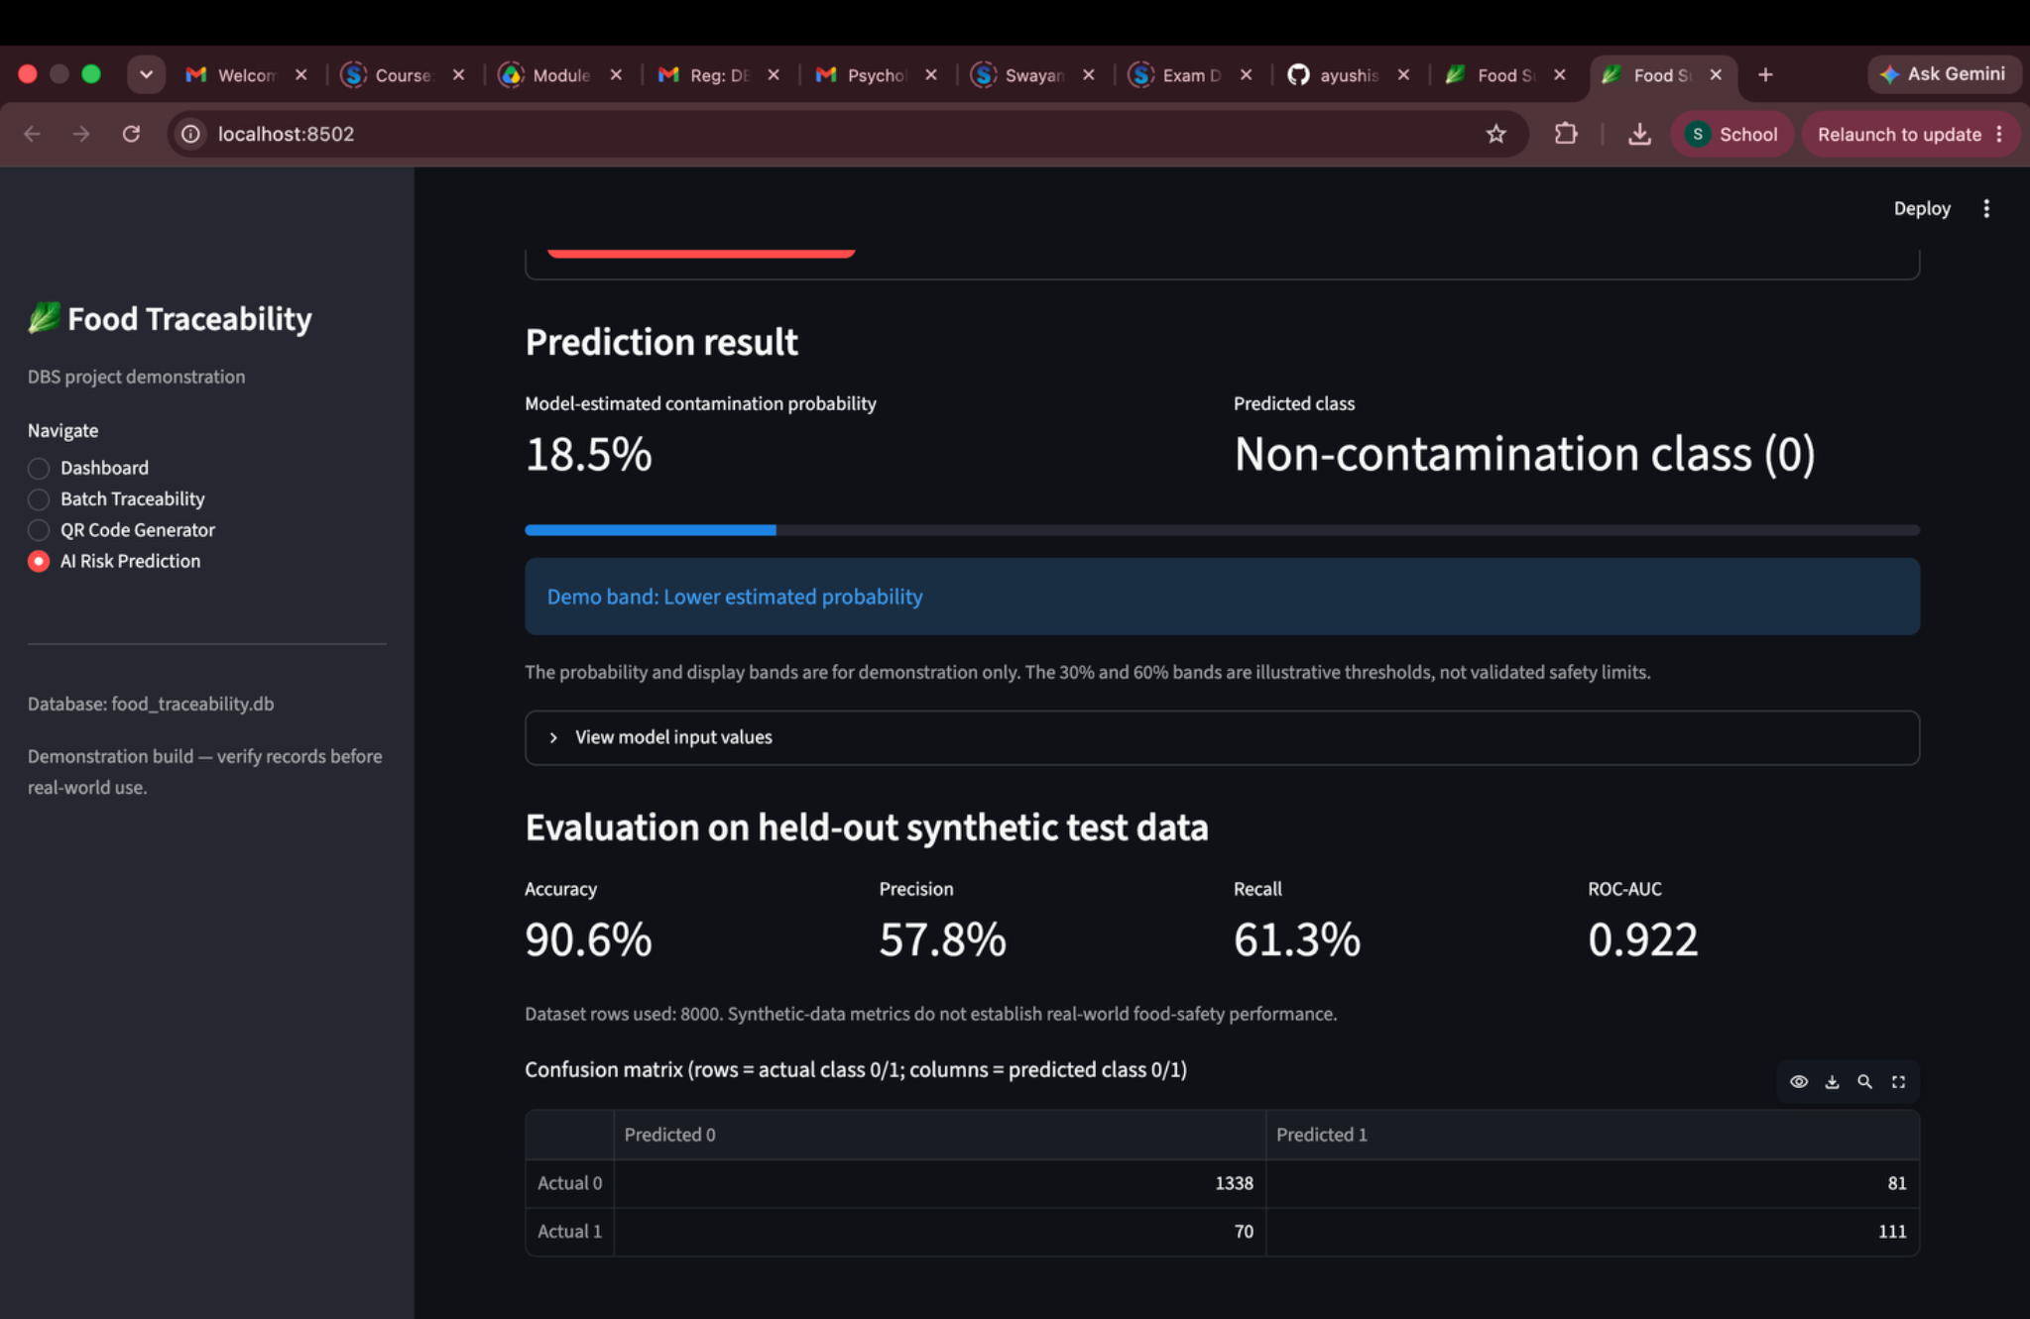
SCREENSHOT APPENDIX • AI PREDICTION OUTPUT AND METRICS
AI prediction — result and model metrics
Source file: Screenshot 2026-10-12 at 1.18.09 AM.png
AI-ENHANCED FOOD SUPPLY CHAIN TRACEABILITY • FINAL REVIEW
22

Slide 23
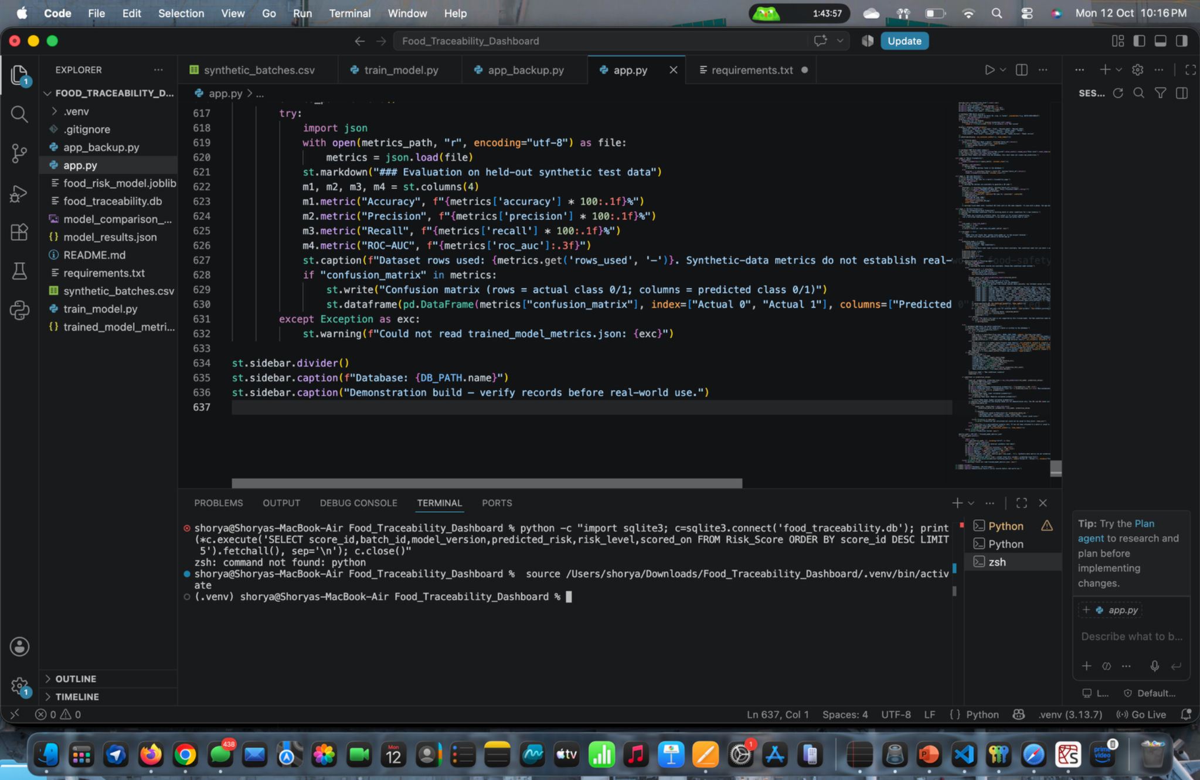
SCREENSHOT APPENDIX • CODE, TERMINAL OR DATABASE EVIDENCE
Development evidence — editor and terminal
Source file: Screenshot 2026-10-12 at 10.16.03 PM.png
AI-ENHANCED FOOD SUPPLY CHAIN TRACEABILITY • FINAL REVIEW
23

Slide 24
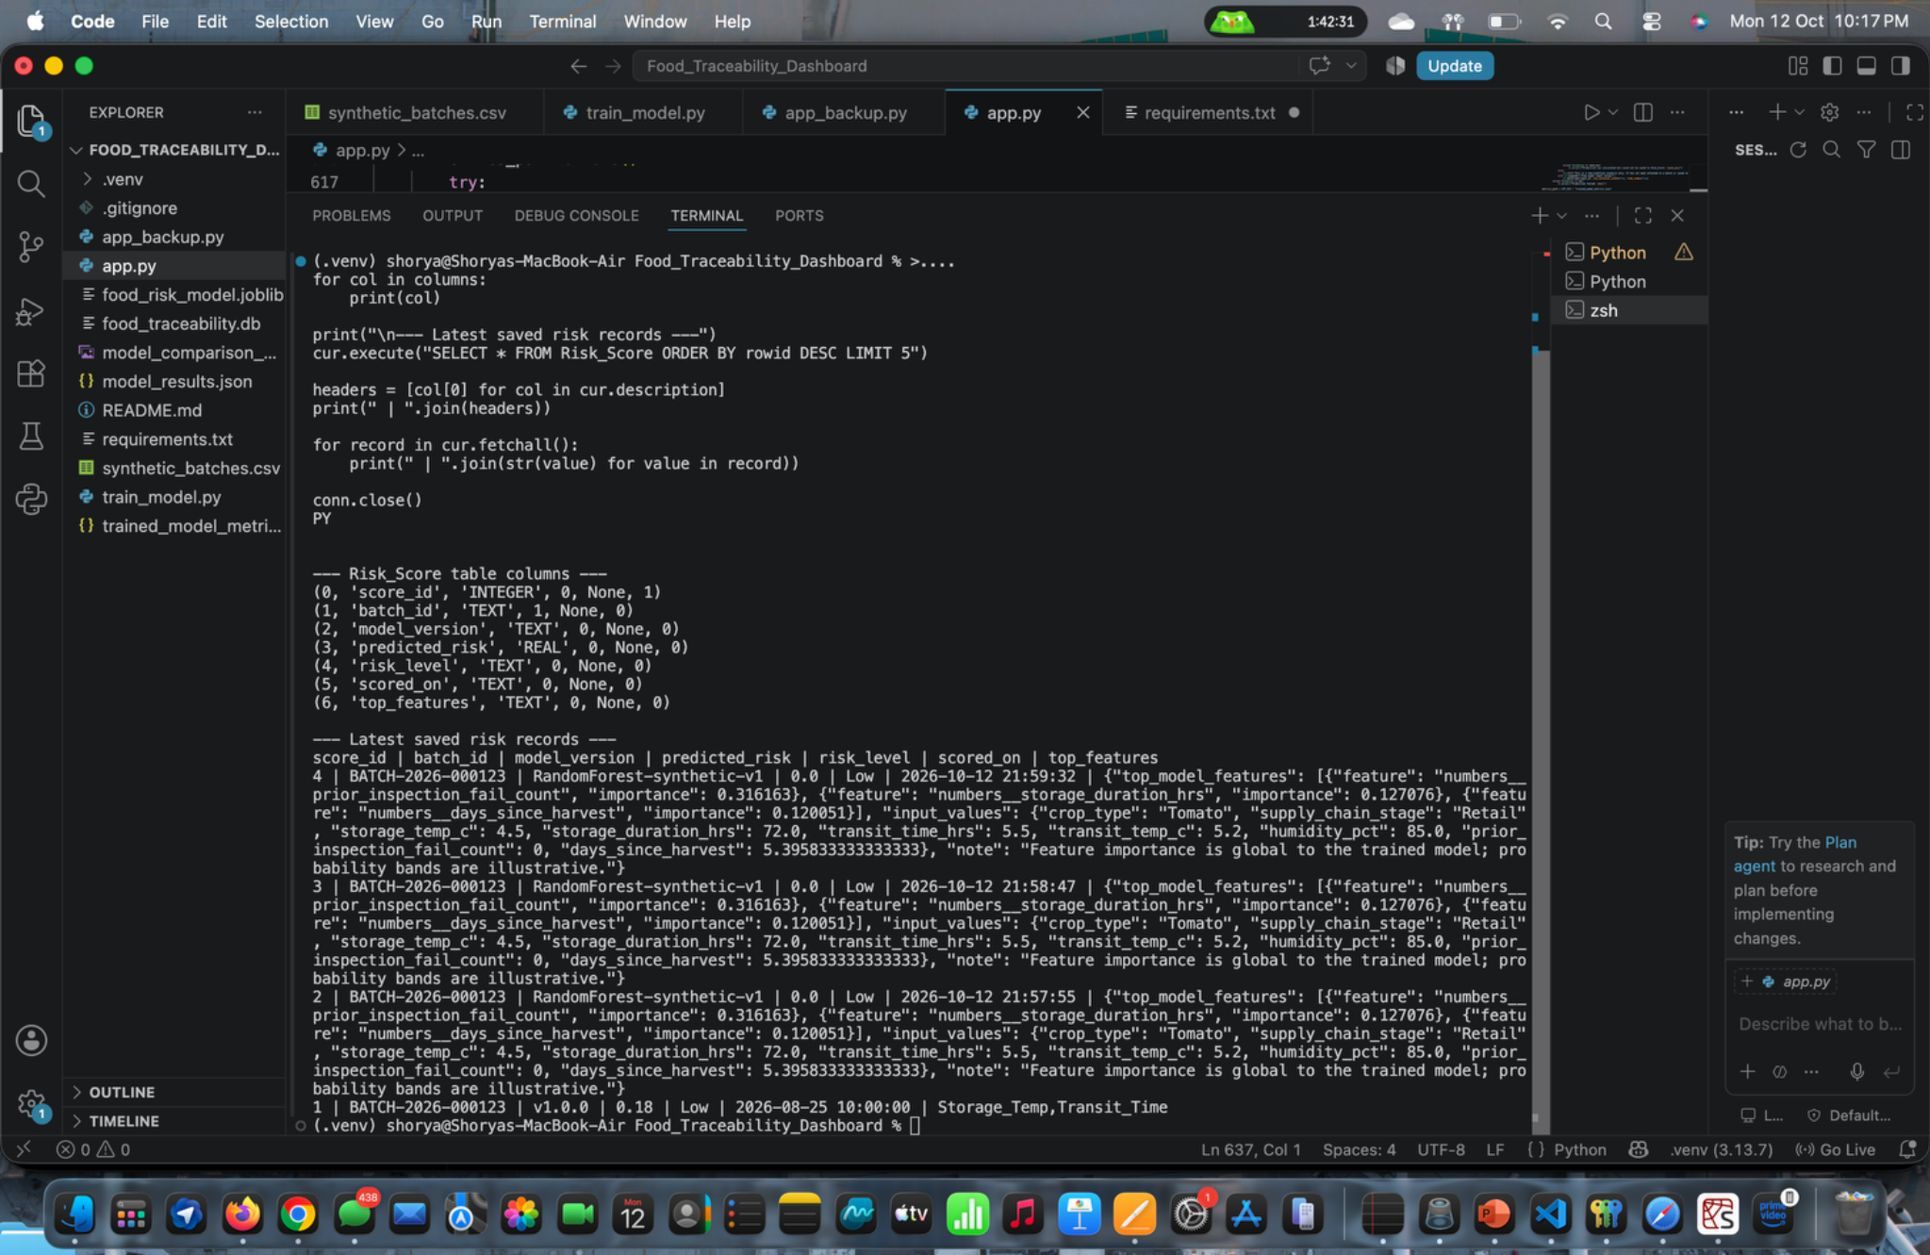
SCREENSHOT APPENDIX • CODE, TERMINAL OR DATABASE EVIDENCE
Development evidence — training output
Source file: Screenshot 2026-10-12 at 10.17.29 PM.png
AI-ENHANCED FOOD SUPPLY CHAIN TRACEABILITY • FINAL REVIEW
24

Slide 25
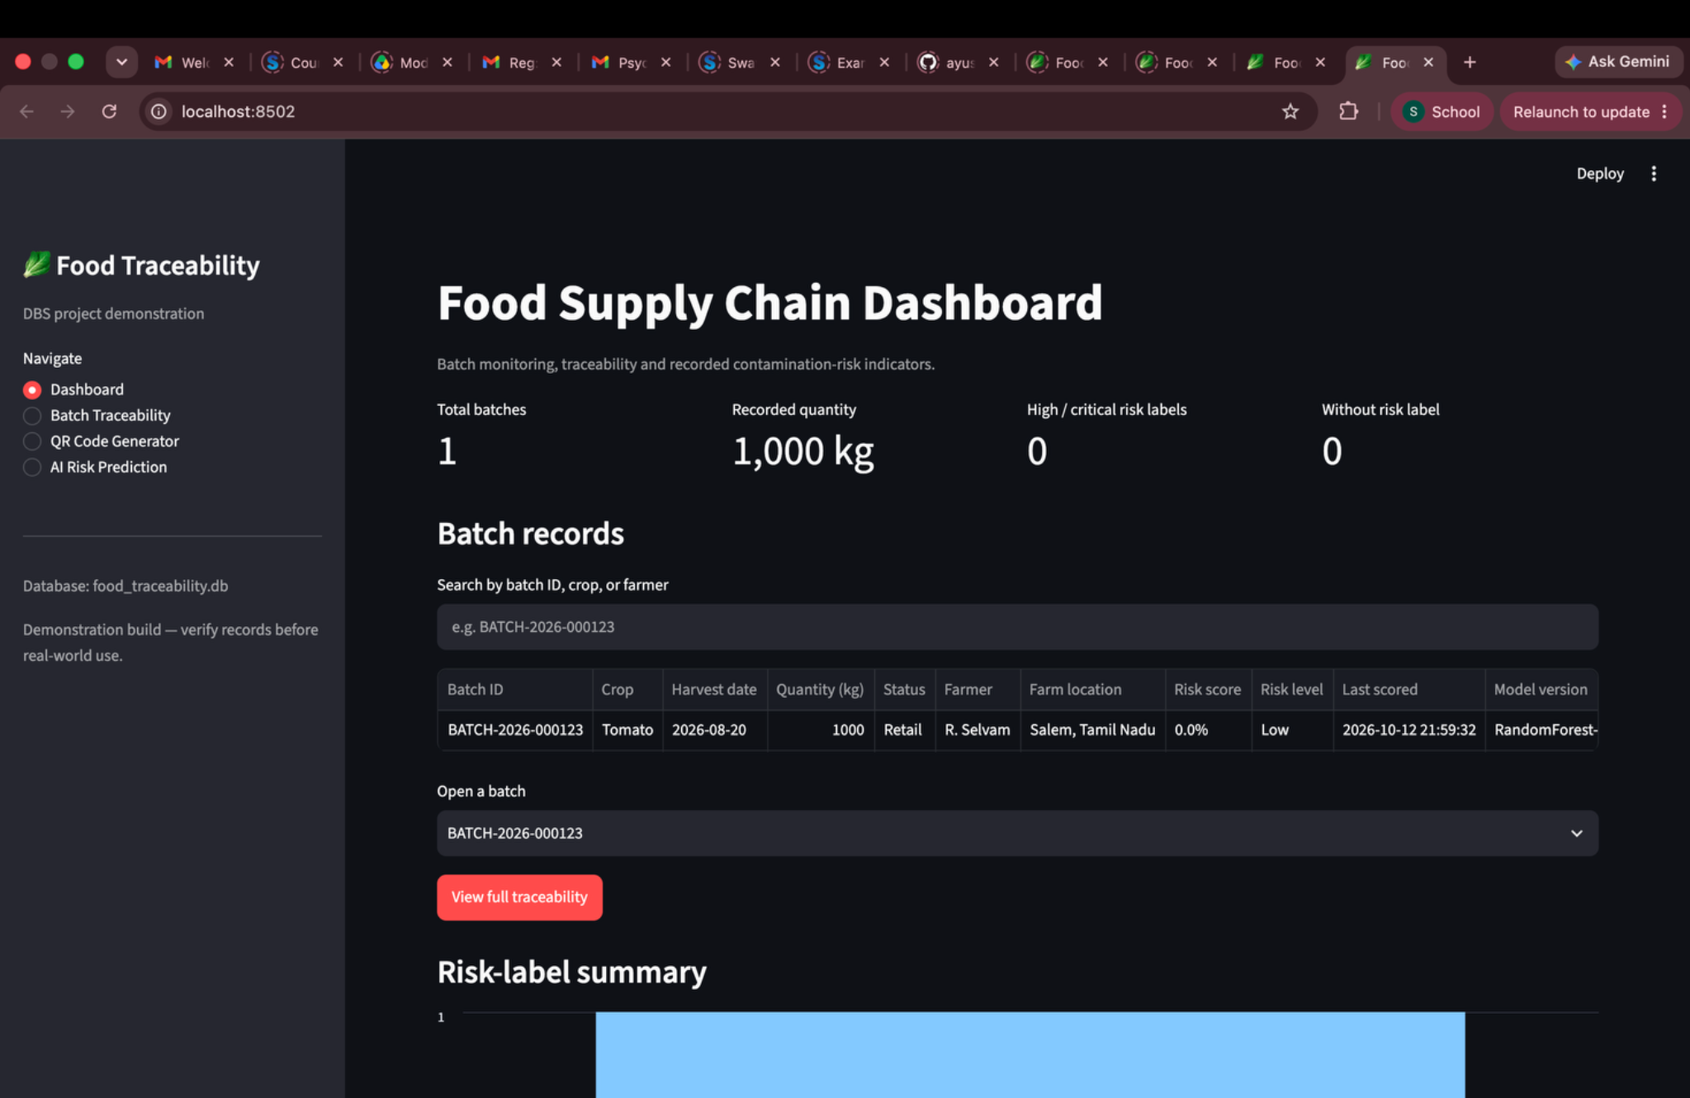
SCREENSHOT APPENDIX • DASHBOARD VIEW
Dashboard — current batch summary
Source file: Screenshot 2026-10-12 at 10.20.48 PM.png
AI-ENHANCED FOOD SUPPLY CHAIN TRACEABILITY • FINAL REVIEW
25

Slide 26
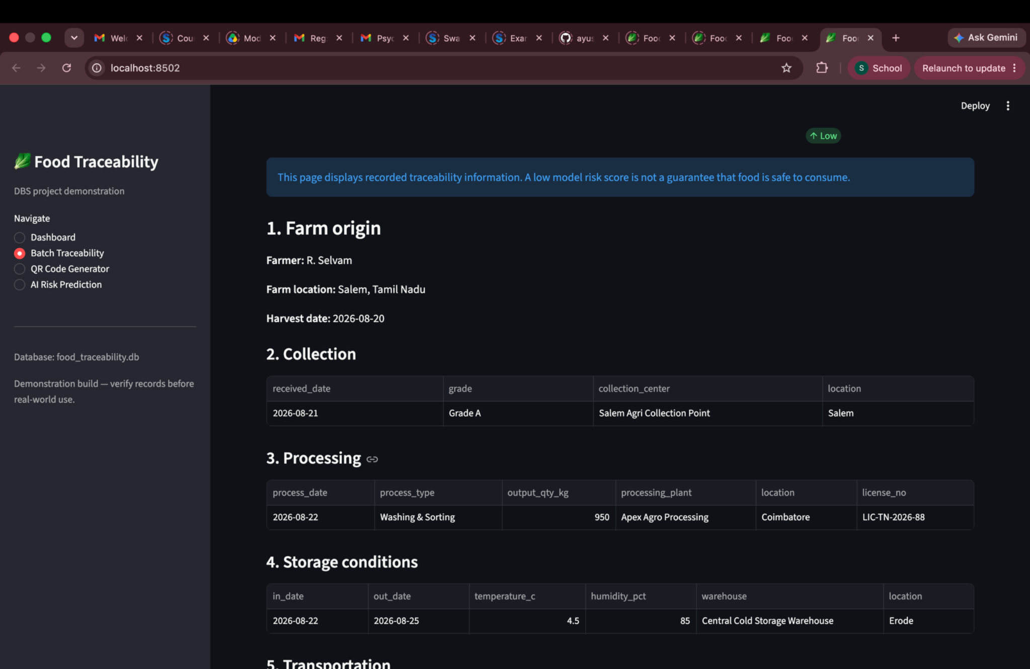
SCREENSHOT APPENDIX • BATCH TRACEABILITY AND STAGE RECORDS
Traceability — batch overview
Source file: Screenshot 2026-10-12 at 10.21.00 PM.png
AI-ENHANCED FOOD SUPPLY CHAIN TRACEABILITY • FINAL REVIEW
26

Slide 27
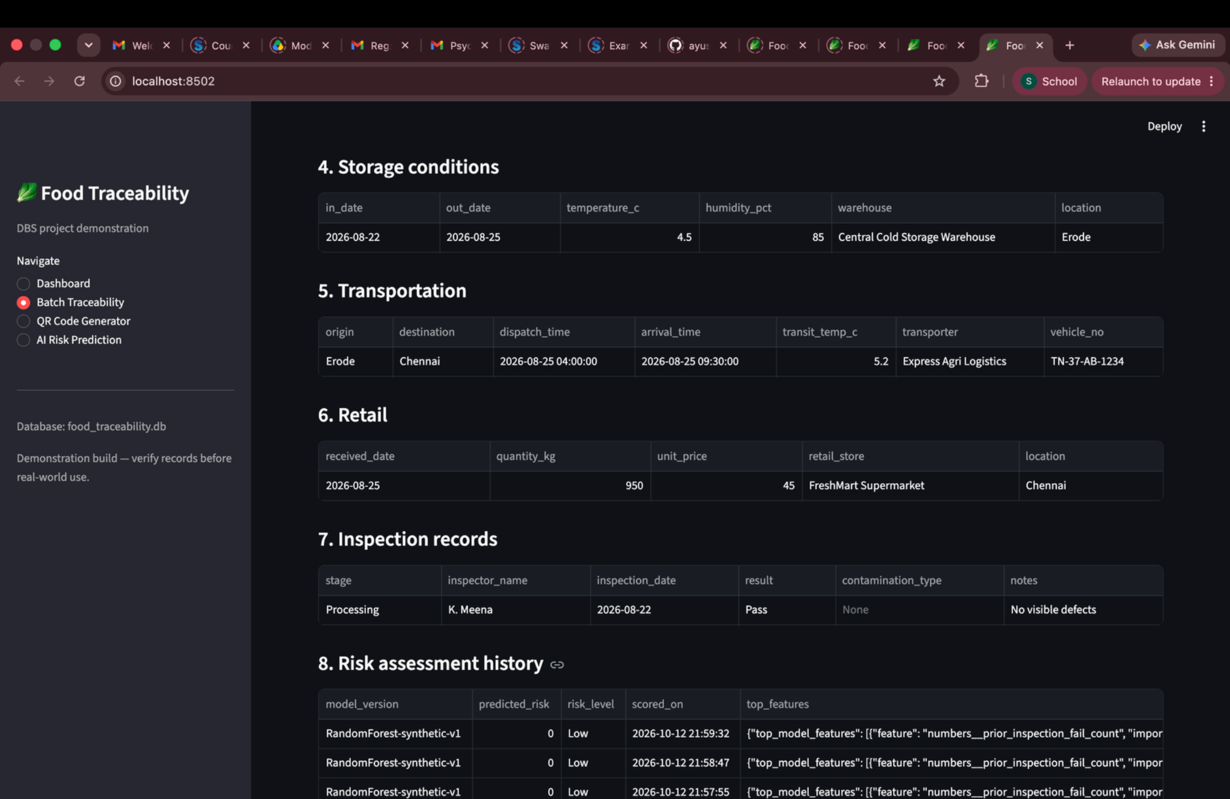
SCREENSHOT APPENDIX • BATCH TRACEABILITY AND STAGE RECORDS
Traceability — stage details
Source file: Screenshot 2026-10-12 at 10.21.09 PM.png
AI-ENHANCED FOOD SUPPLY CHAIN TRACEABILITY • FINAL REVIEW
27

Slide 28
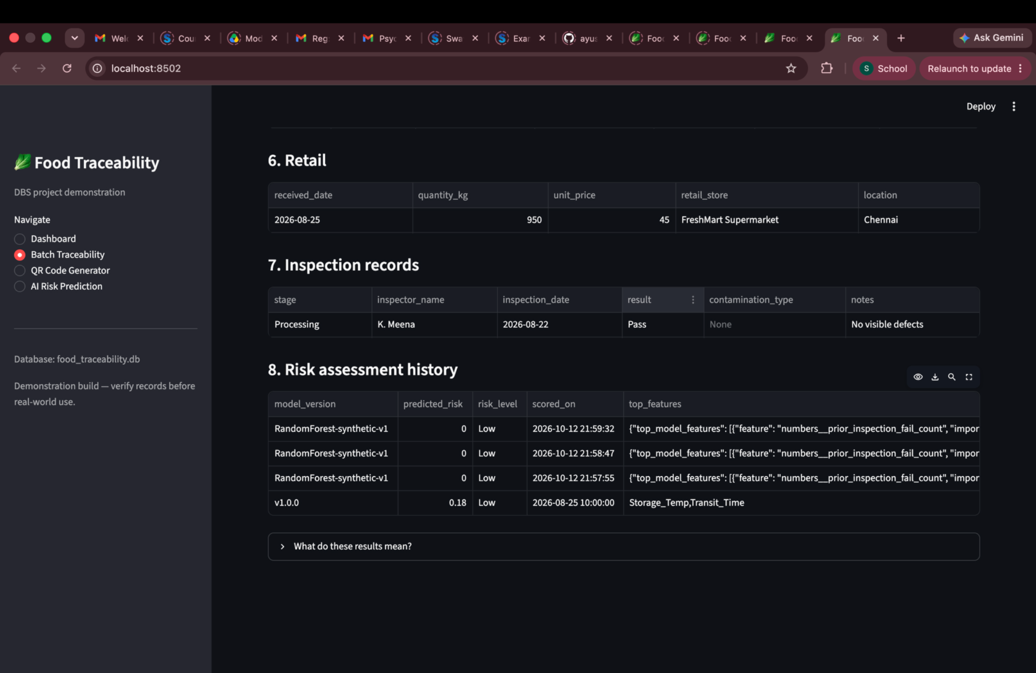
SCREENSHOT APPENDIX • BATCH TRACEABILITY AND STAGE RECORDS
Traceability — record/history view
Source file: Screenshot 2026-10-12 at 10.21.16 PM.png
AI-ENHANCED FOOD SUPPLY CHAIN TRACEABILITY • FINAL REVIEW
28

Slide 29
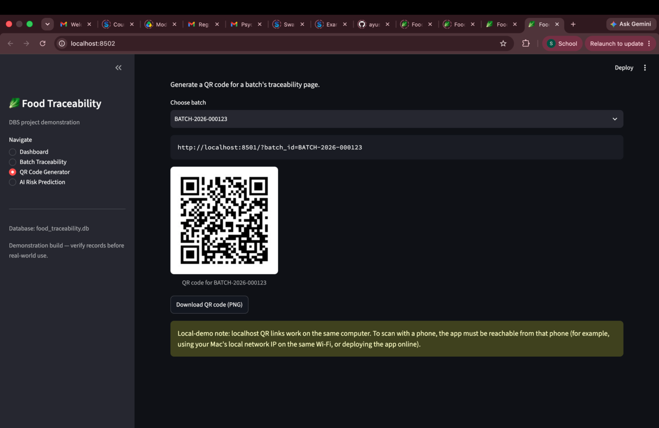
SCREENSHOT APPENDIX • QR CODE GENERATOR
QR code generator — generated QR
Source file: Screenshot 2026-10-12 at 10.21.35 PM.png
AI-ENHANCED FOOD SUPPLY CHAIN TRACEABILITY • FINAL REVIEW
29

Slide 30
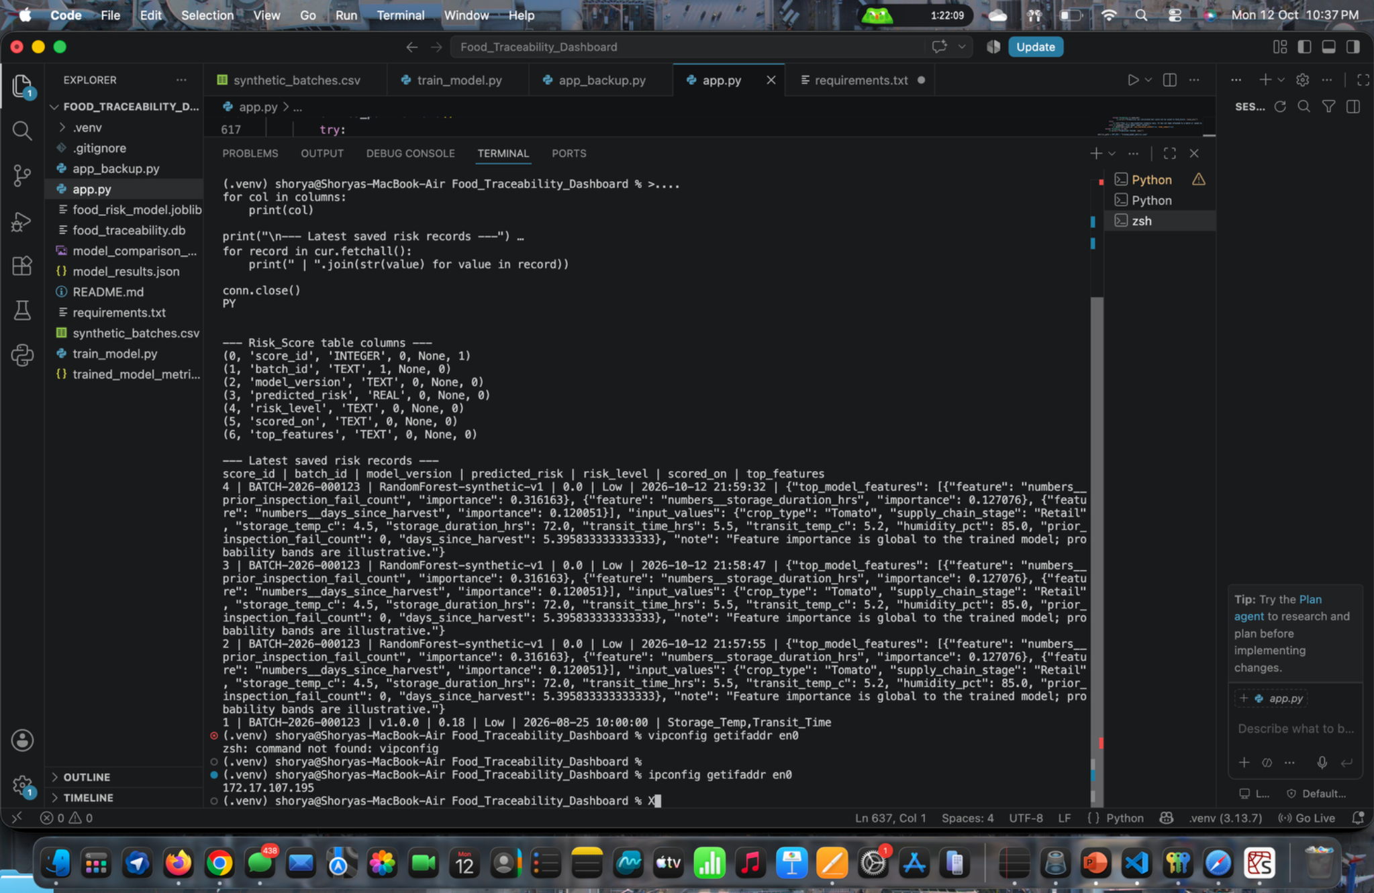
SCREENSHOT APPENDIX • CODE, TERMINAL OR DATABASE EVIDENCE
Code and terminal — application updates
Source file: Screenshot 2026-10-12 at 10.37.51 PM.png
AI-ENHANCED FOOD SUPPLY CHAIN TRACEABILITY • FINAL REVIEW
30

Slide 31
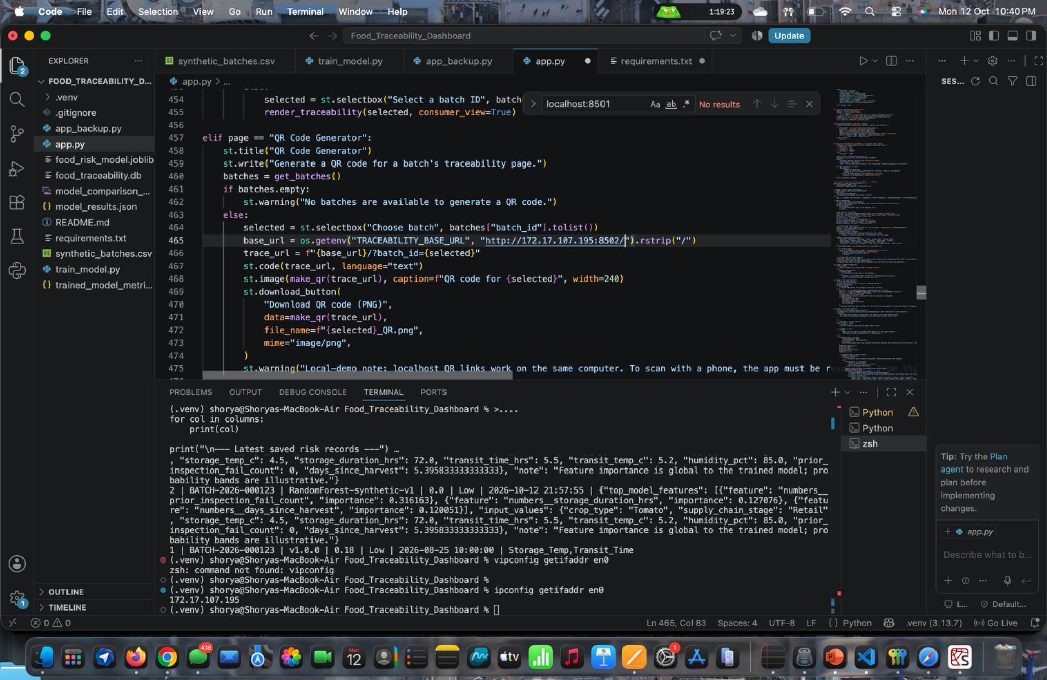
SCREENSHOT APPENDIX • CODE, TERMINAL OR DATABASE EVIDENCE
Code and terminal — development evidence
Source file: Screenshot 2026-10-12 at 10.40.37 PM.png
AI-ENHANCED FOOD SUPPLY CHAIN TRACEABILITY • FINAL REVIEW
31

Slide 32
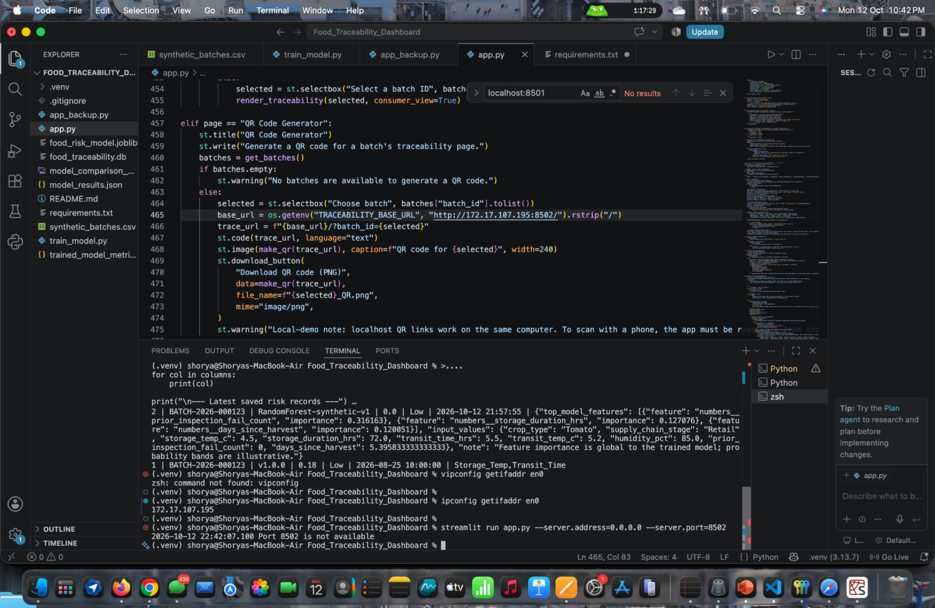
SCREENSHOT APPENDIX • CODE, TERMINAL OR DATABASE EVIDENCE
Code and terminal — development evidence
Source file: Screenshot 2026-10-12 at 10.42.31 PM.png
AI-ENHANCED FOOD SUPPLY CHAIN TRACEABILITY • FINAL REVIEW
32

Slide 33
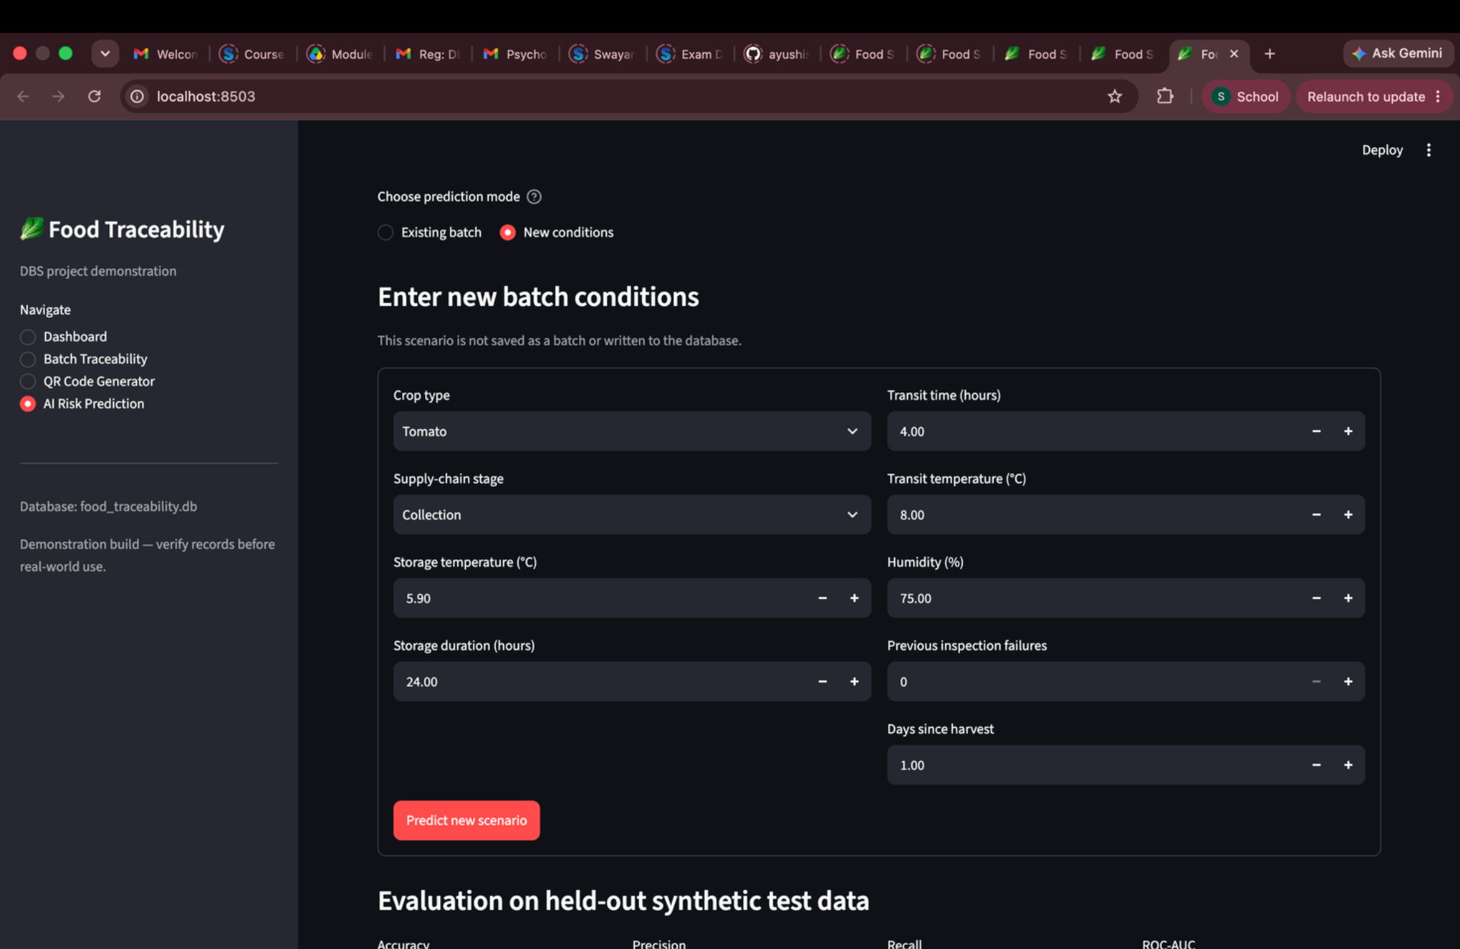
SCREENSHOT APPENDIX • AI RISK PREDICTION INPUTS
AI prediction — new-condition inputs
Source file: Screenshot 2026-10-12 at 10.55.32 PM.png
AI-ENHANCED FOOD SUPPLY CHAIN TRACEABILITY • FINAL REVIEW
33

Slide 34
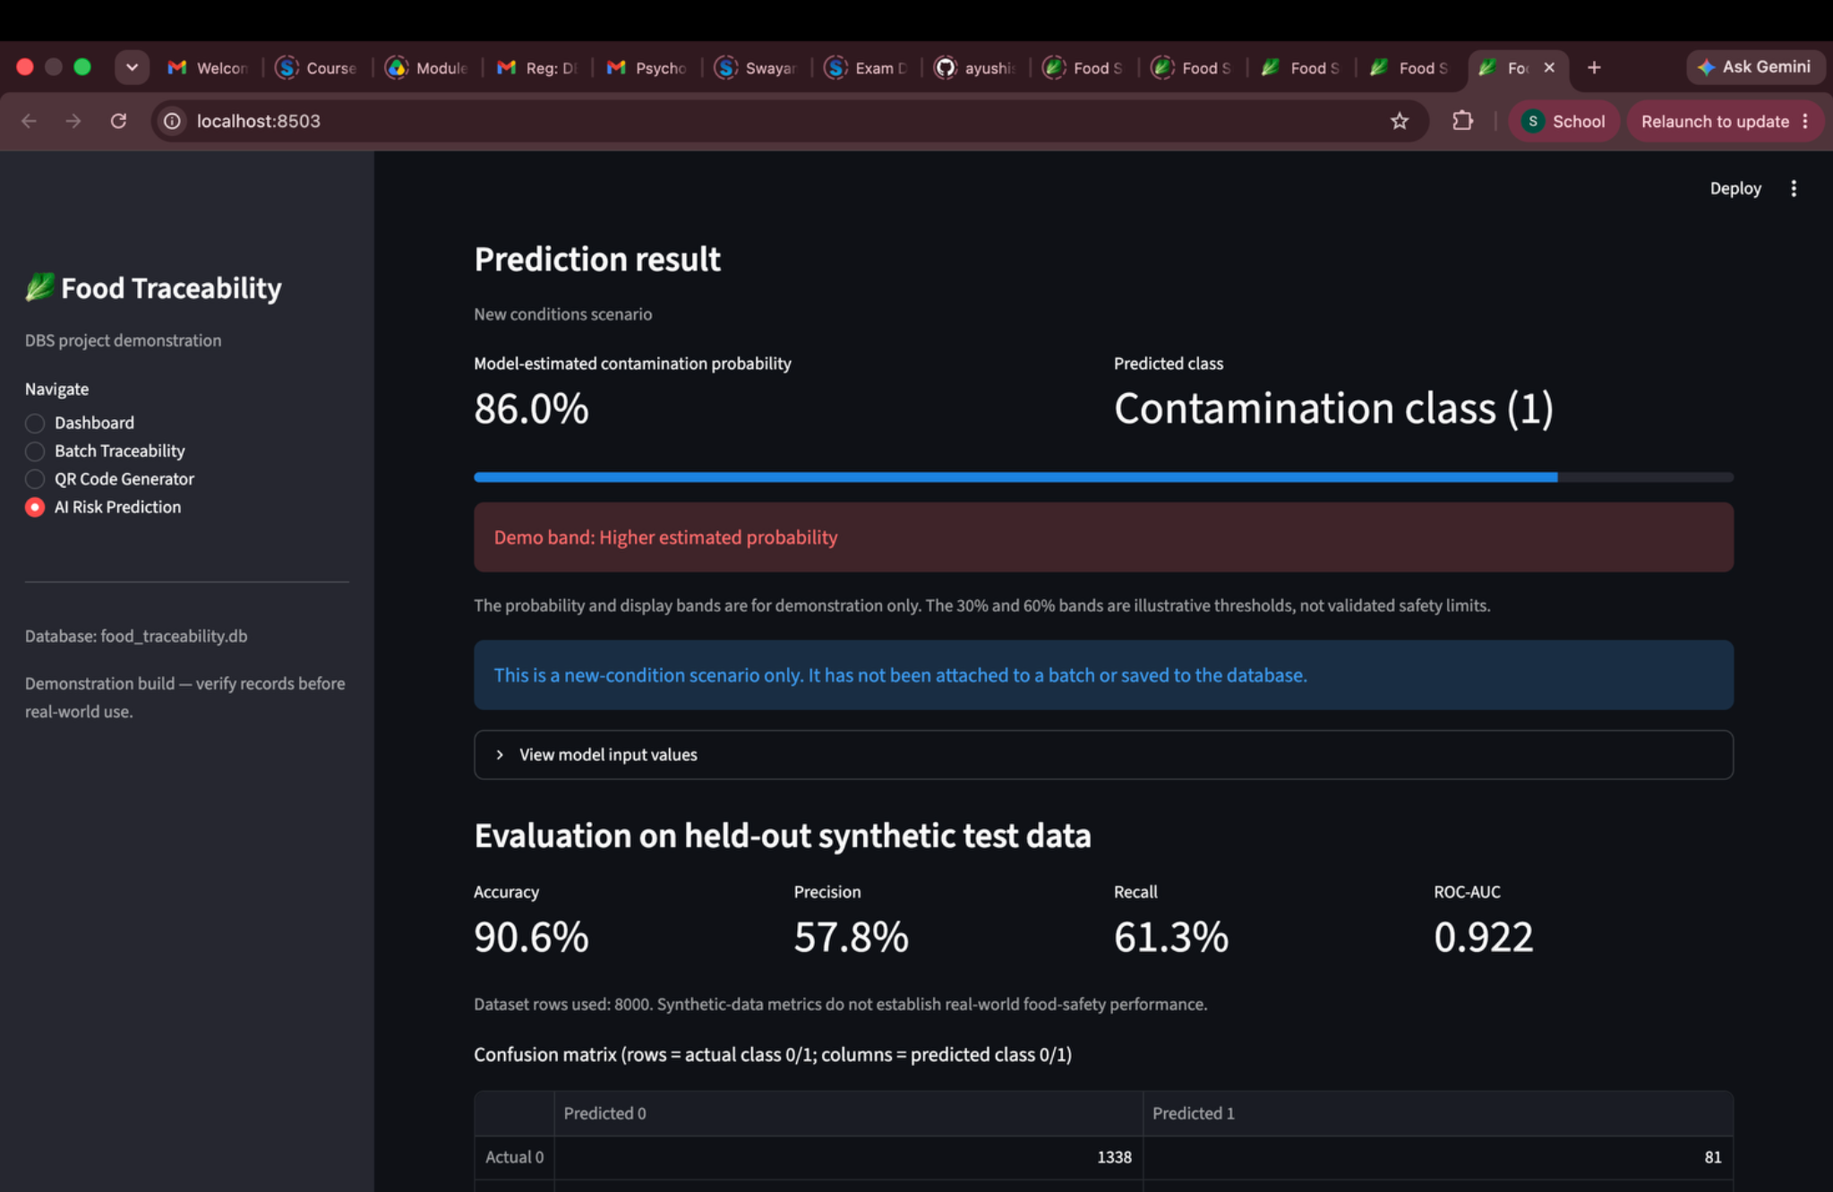
SCREENSHOT APPENDIX • AI PREDICTION OUTPUT AND METRICS
AI prediction — positive-class example
Source file: Screenshot 2026-10-12 at 10.58.06 PM.png
AI-ENHANCED FOOD SUPPLY CHAIN TRACEABILITY • FINAL REVIEW
34

Slide 35
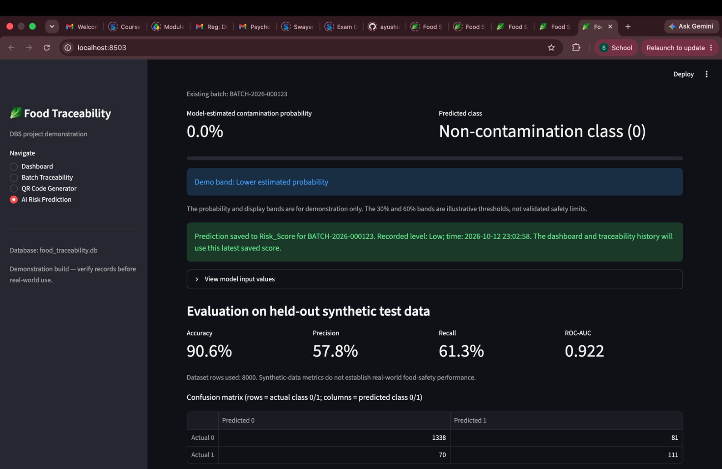
SCREENSHOT APPENDIX • AI PREDICTION OUTPUT AND METRICS
AI prediction — negative-class example
Source file: Screenshot 2026-10-12 at 11.03.12 PM.png
AI-ENHANCED FOOD SUPPLY CHAIN TRACEABILITY • FINAL REVIEW
35

Slide 36
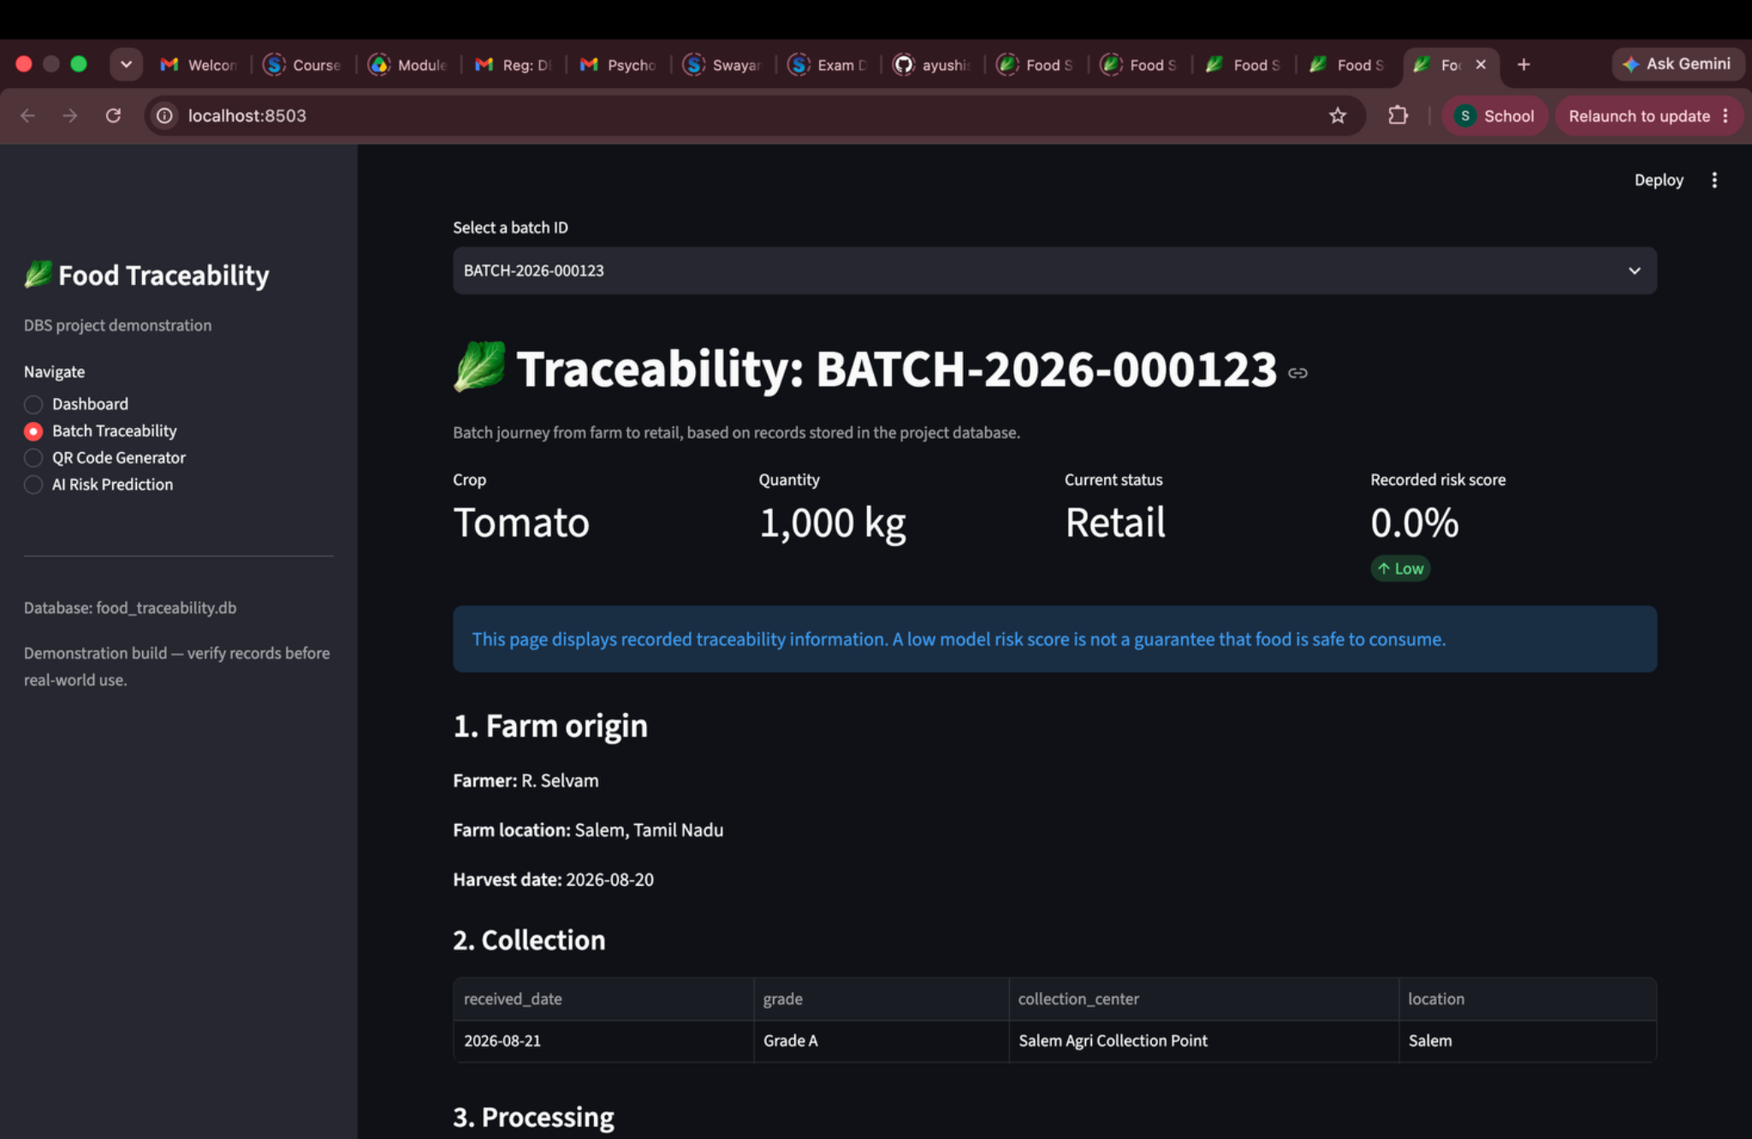
SCREENSHOT APPENDIX • BATCH TRACEABILITY AND STAGE RECORDS
Traceability — risk history included
Source file: Screenshot 2026-10-12 at 11.03.26 PM.png
AI-ENHANCED FOOD SUPPLY CHAIN TRACEABILITY • FINAL REVIEW
36

Slide 37
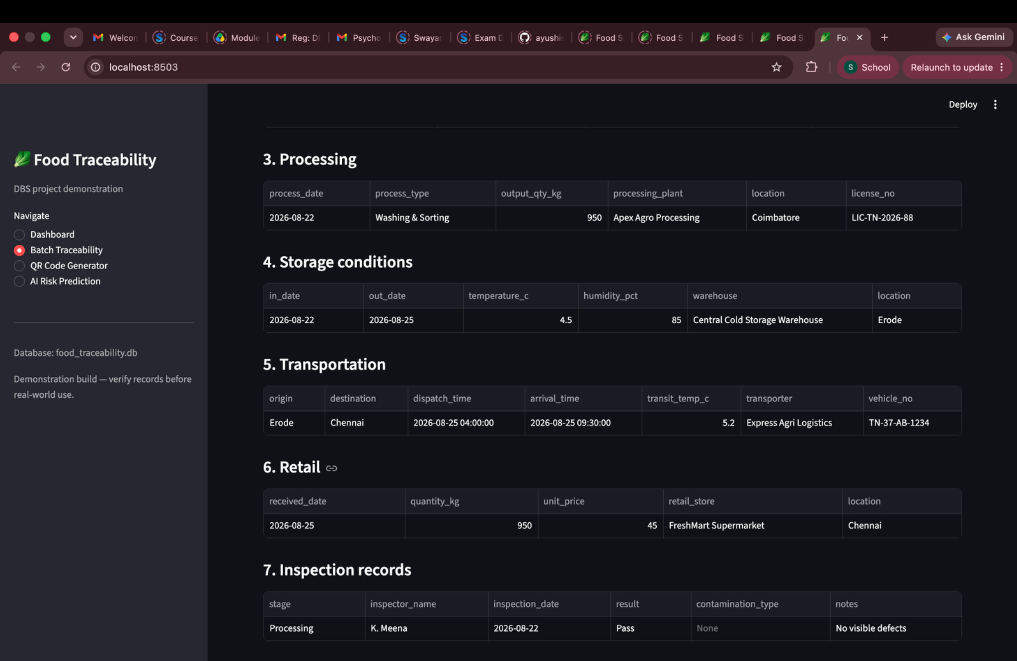
SCREENSHOT APPENDIX • BATCH TRACEABILITY AND STAGE RECORDS
Traceability — processing/stage records
Source file: Screenshot 2026-10-12 at 11.03.34 PM.png
AI-ENHANCED FOOD SUPPLY CHAIN TRACEABILITY • FINAL REVIEW
37

Slide 38
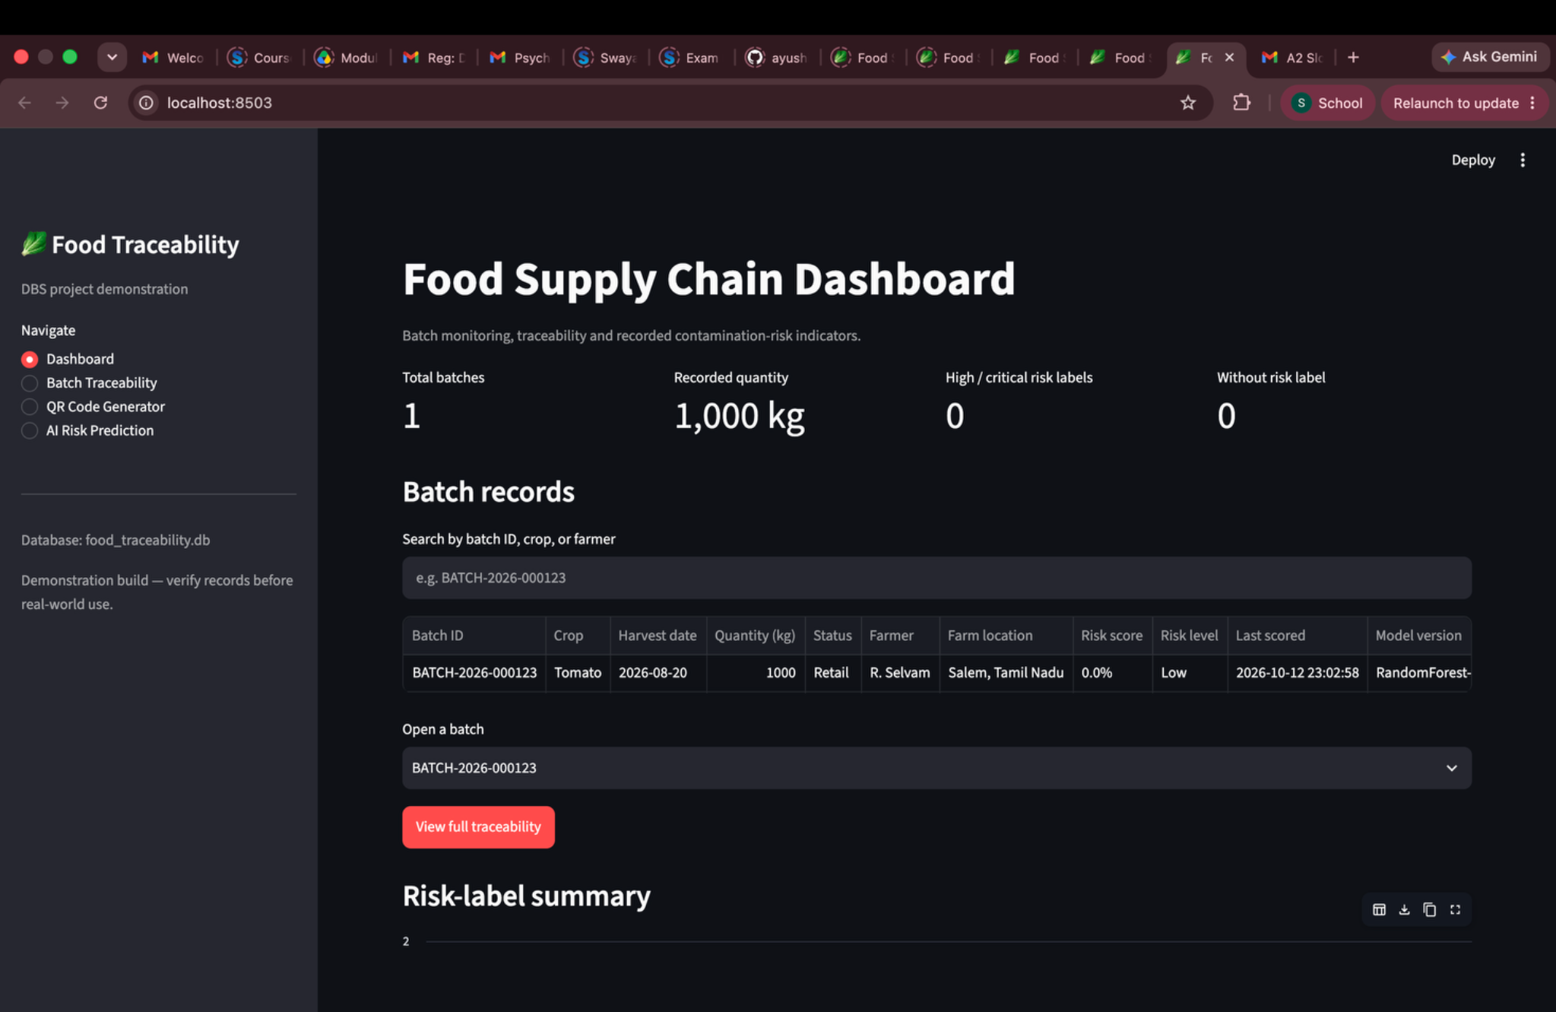
SCREENSHOT APPENDIX • DASHBOARD VIEW
Dashboard — later development view
Source file: Screenshot 2026-10-12 at 11.26.38 PM.png
AI-ENHANCED FOOD SUPPLY CHAIN TRACEABILITY • FINAL REVIEW
41

Slide 39
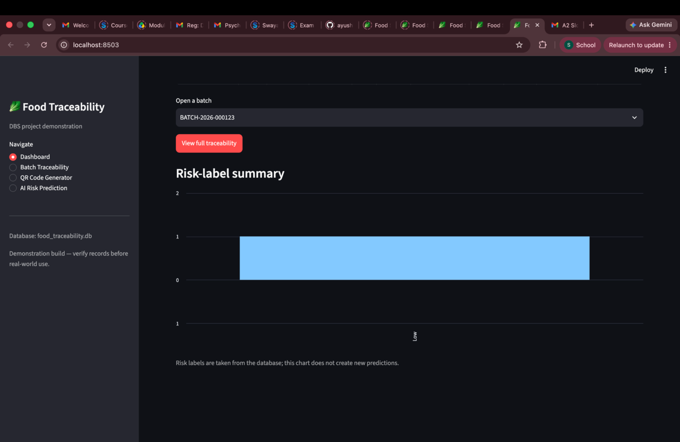
SCREENSHOT APPENDIX • QR CODE GENERATOR
QR page — generation and download controls
Source file: Screenshot 2026-10-12 at 11.26.48 PM.png
AI-ENHANCED FOOD SUPPLY CHAIN TRACEABILITY • FINAL REVIEW
42

Slide 40
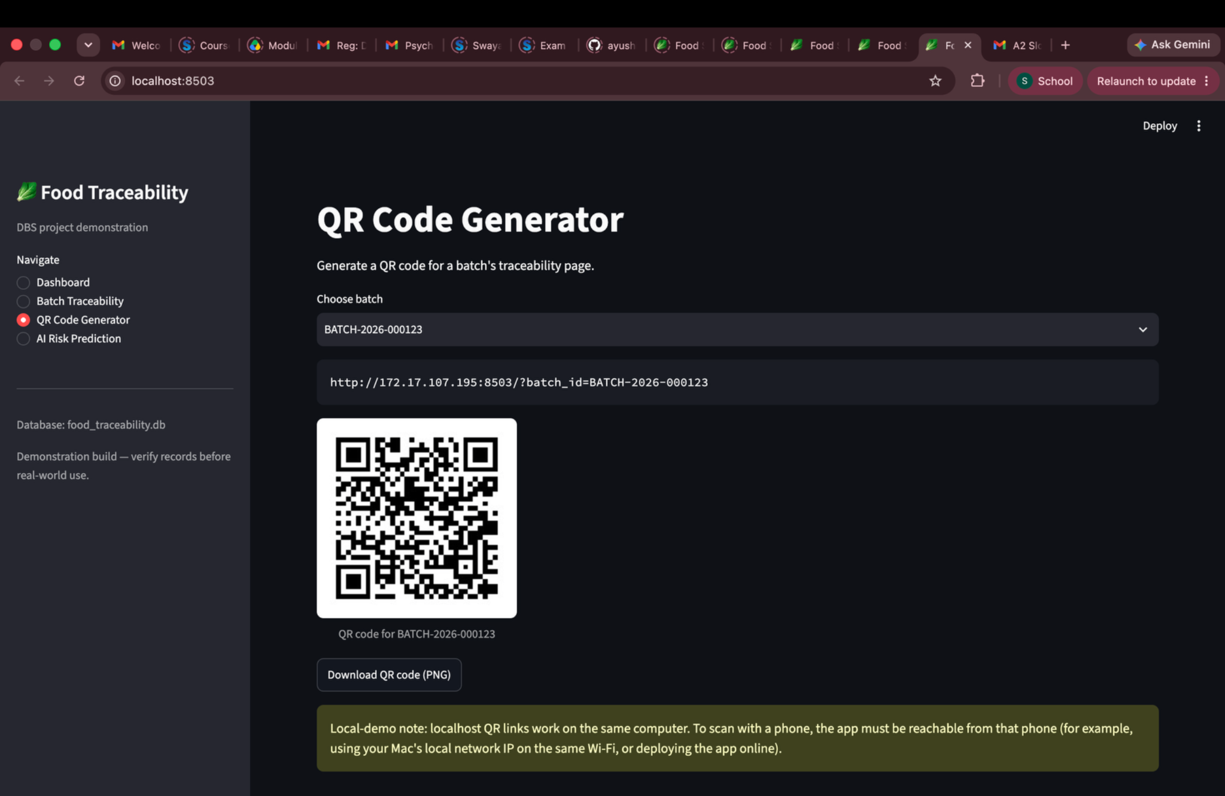
SCREENSHOT APPENDIX • QR CODE GENERATOR
QR code generator — QR preview
Source file: Screenshot 2026-10-12 at 11.28.06 PM.png
AI-ENHANCED FOOD SUPPLY CHAIN TRACEABILITY • FINAL REVIEW
43

Slide 41
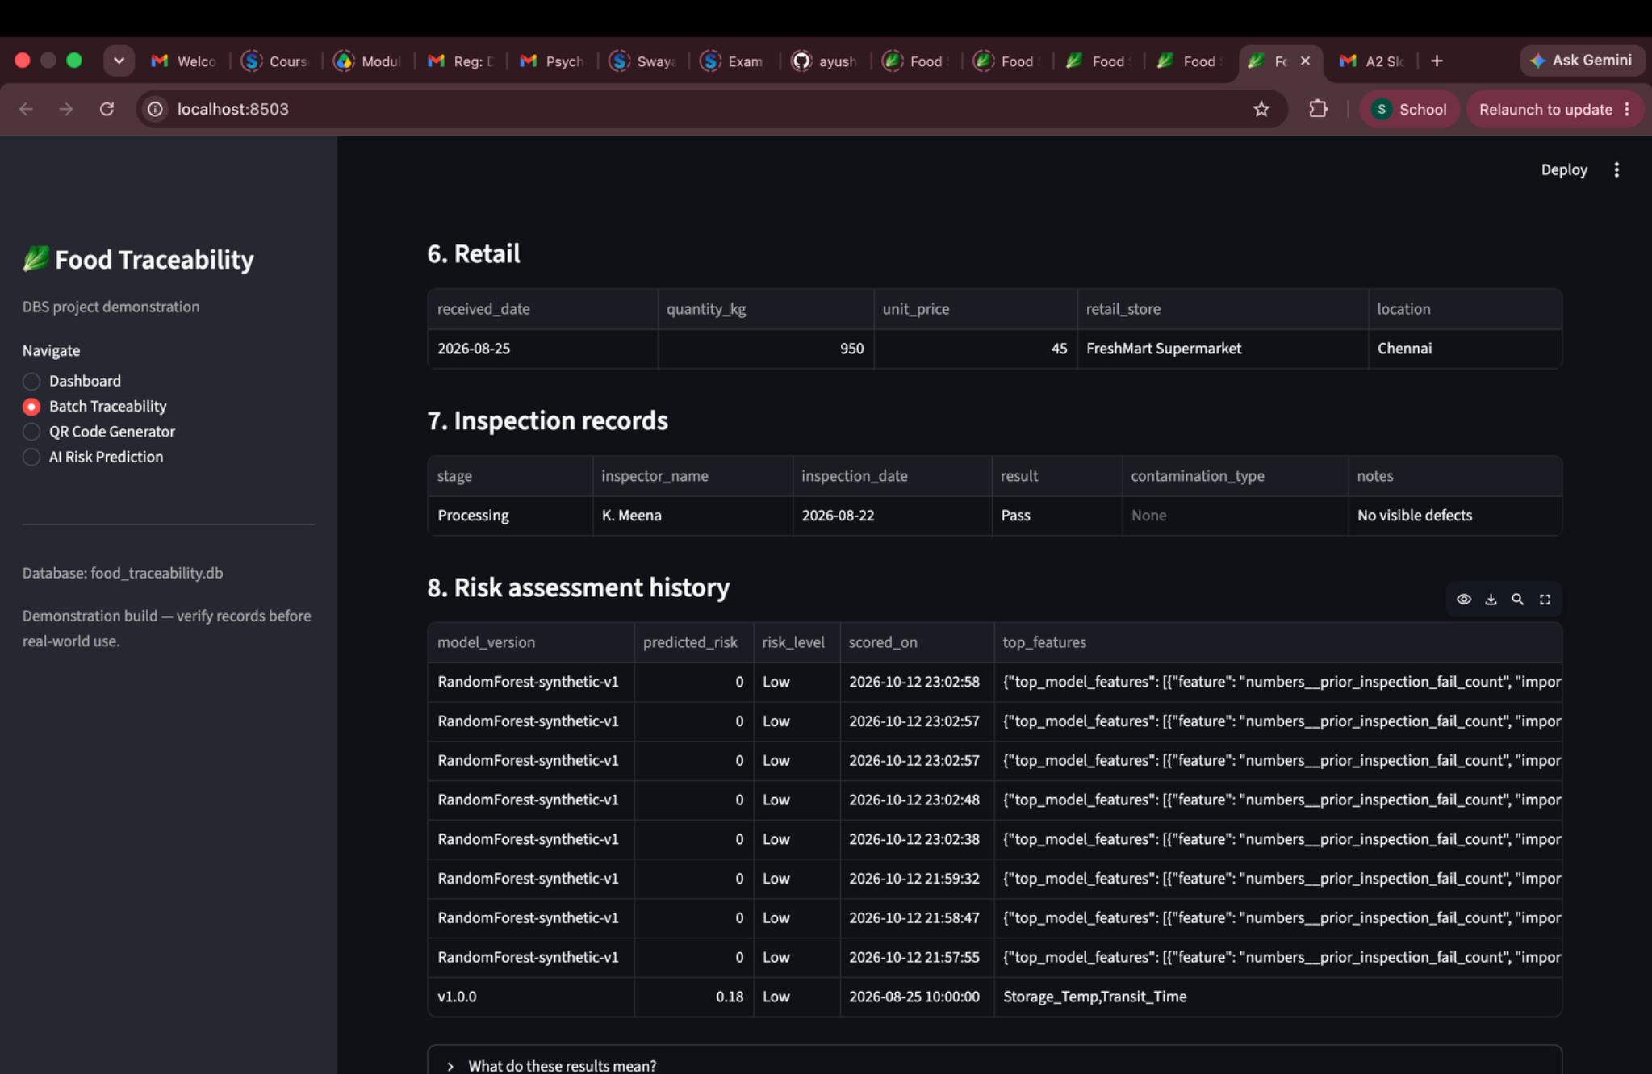
SCREENSHOT APPENDIX • BATCH TRACEABILITY AND STAGE RECORDS
Traceability — record table
Source file: Screenshot 2026-10-12 at 11.43.58 PM.png
AI-ENHANCED FOOD SUPPLY CHAIN TRACEABILITY • FINAL REVIEW
44

Slide 42
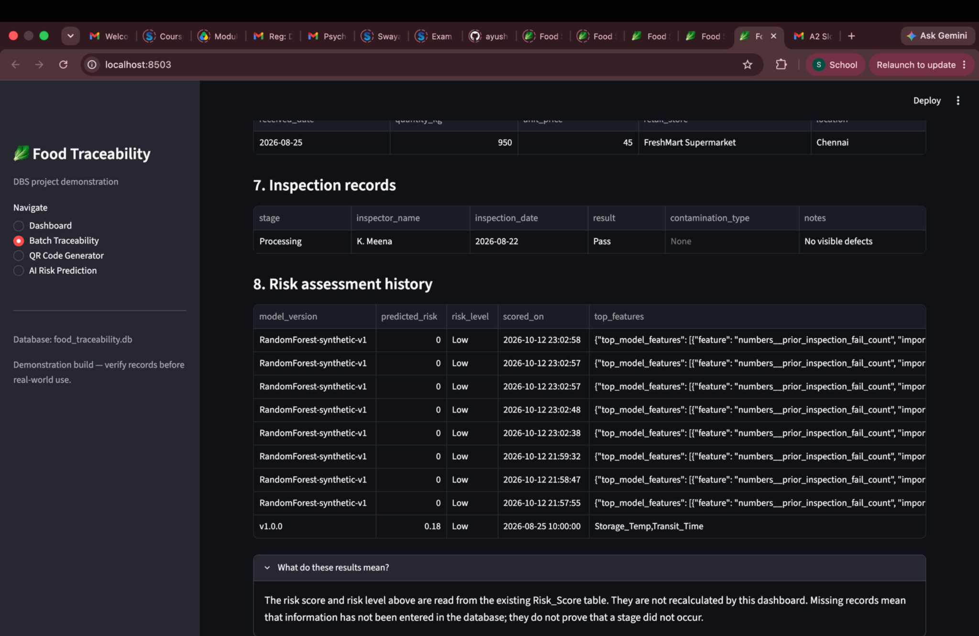
SCREENSHOT APPENDIX • BATCH TRACEABILITY AND STAGE RECORDS
Traceability — additional stage records
Source file: Screenshot 2026-10-12 at 11.44.32 PM.png
AI-ENHANCED FOOD SUPPLY CHAIN TRACEABILITY • FINAL REVIEW
45

Slide 43
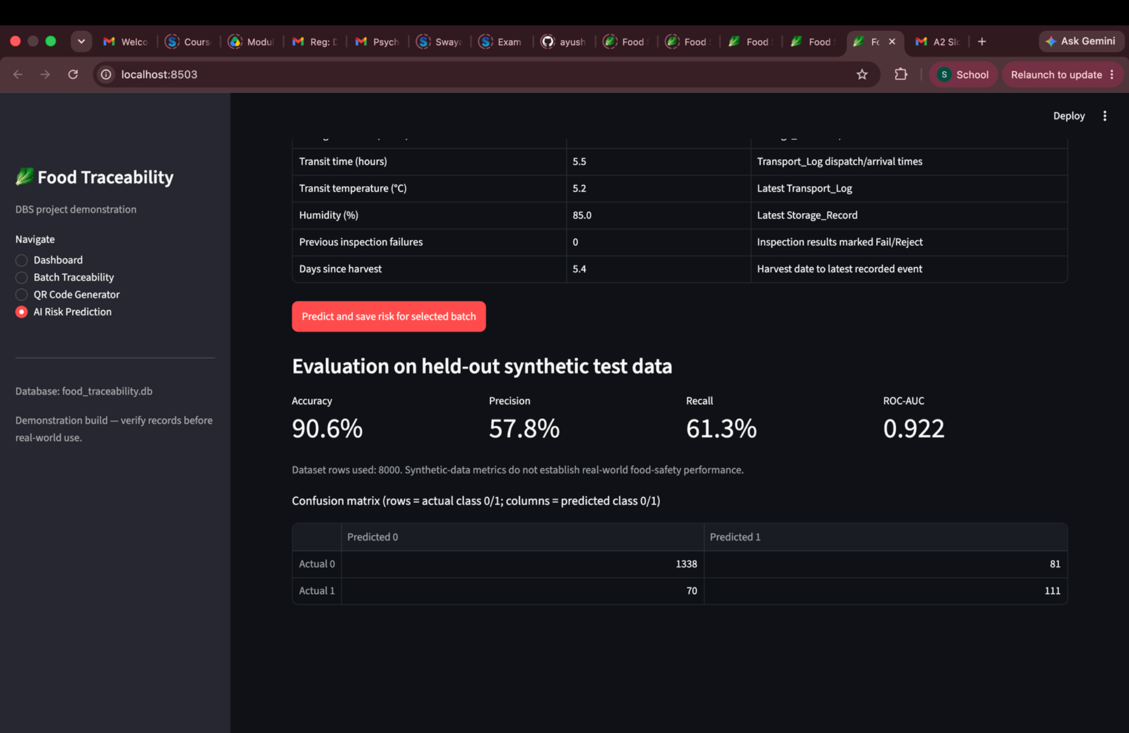
SCREENSHOT APPENDIX • AI PREDICTION OUTPUT AND METRICS
AI evaluation — displayed metrics
Source file: Screenshot 2026-10-12 at 11.44.56 PM.png
AI-ENHANCED FOOD SUPPLY CHAIN TRACEABILITY • FINAL REVIEW
46

Slide 44
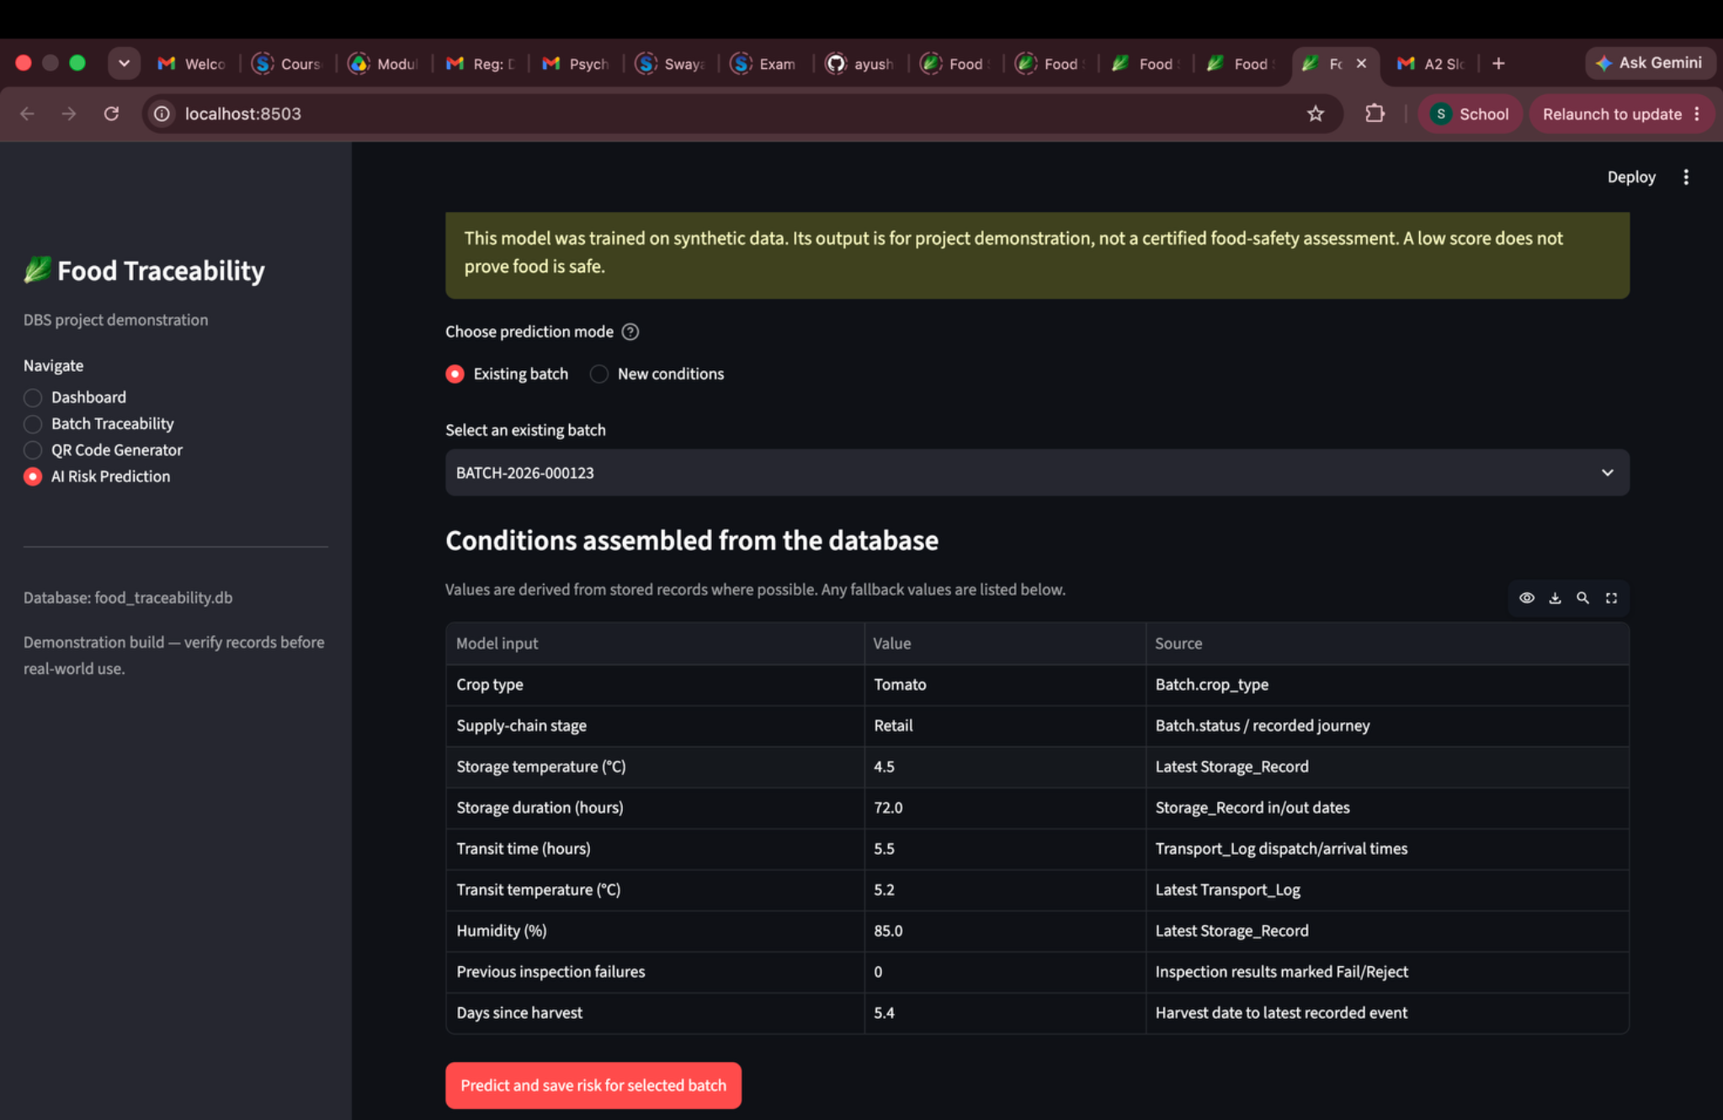
SCREENSHOT APPENDIX • BATCH TRACEABILITY AND STAGE RECORDS
Traceability — inspection and risk information
Source file: Screenshot 2026-10-12 at 11.55.20 PM.png
AI-ENHANCED FOOD SUPPLY CHAIN TRACEABILITY • FINAL REVIEW
47

Slide 45
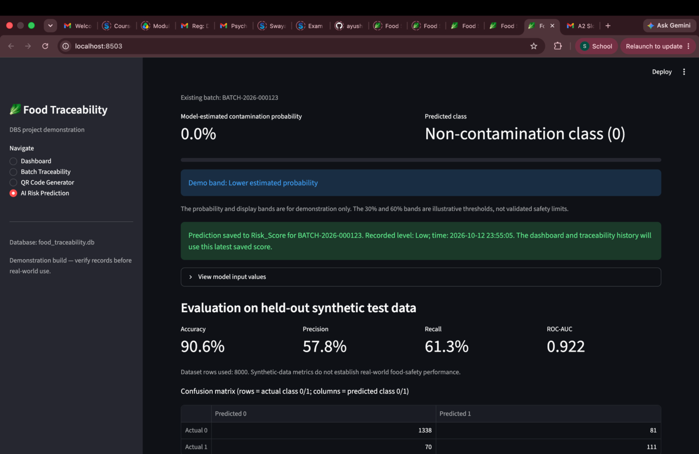
SCREENSHOT APPENDIX • AI PREDICTION OUTPUT AND METRICS
AI evaluation — metrics and prediction result
Source file: Screenshot 2026-10-12 at 11.55.39 PM.png
AI-ENHANCED FOOD SUPPLY CHAIN TRACEABILITY • FINAL REVIEW
48

Slide 46
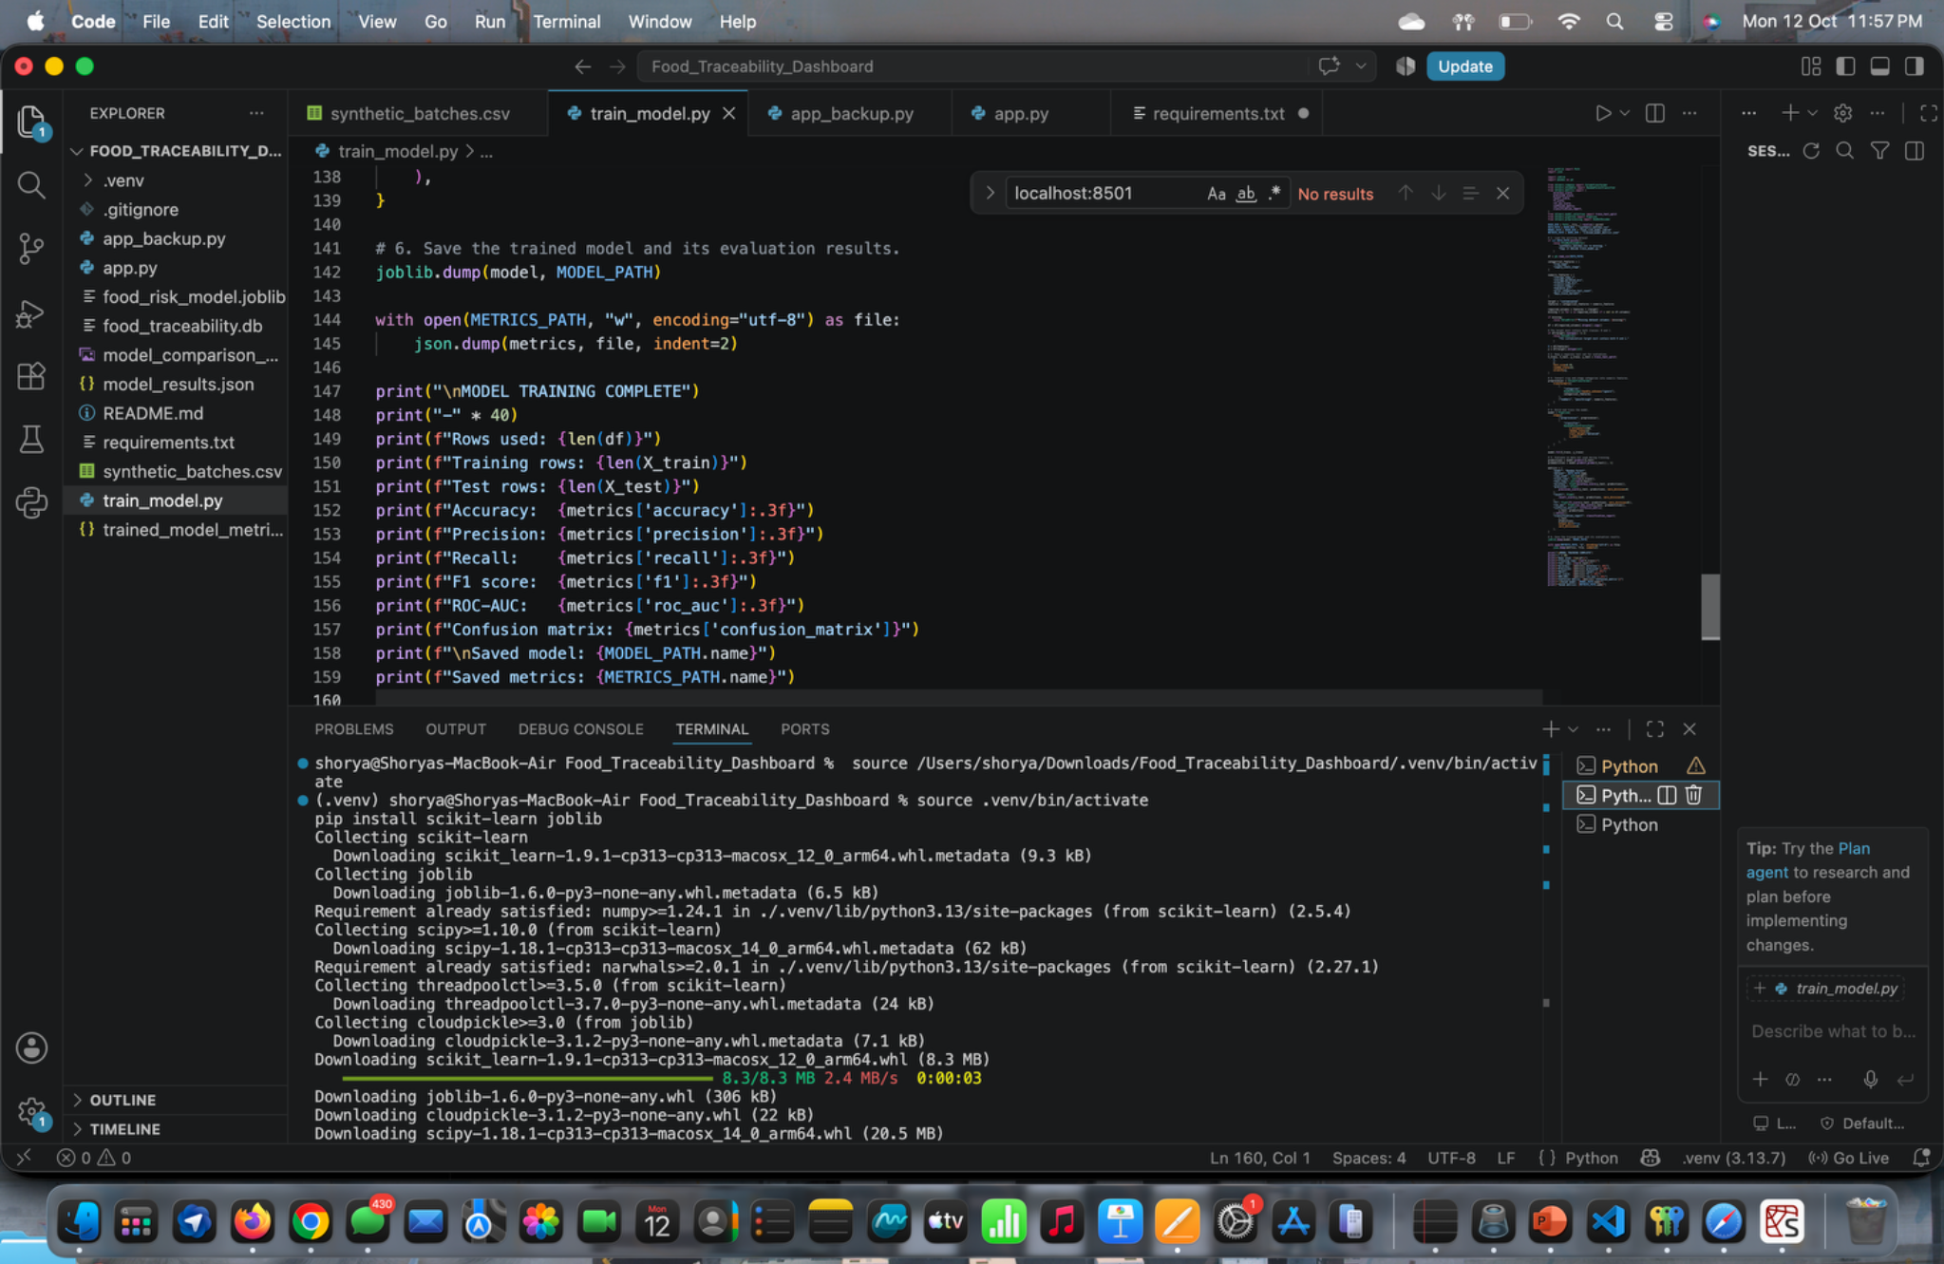
SCREENSHOT APPENDIX • CODE, TERMINAL OR DATABASE EVIDENCE
Development evidence — application code
Source file: Screenshot 2026-10-12 at 11.57.17 PM.png
AI-ENHANCED FOOD SUPPLY CHAIN TRACEABILITY • FINAL REVIEW
49

Slide 47
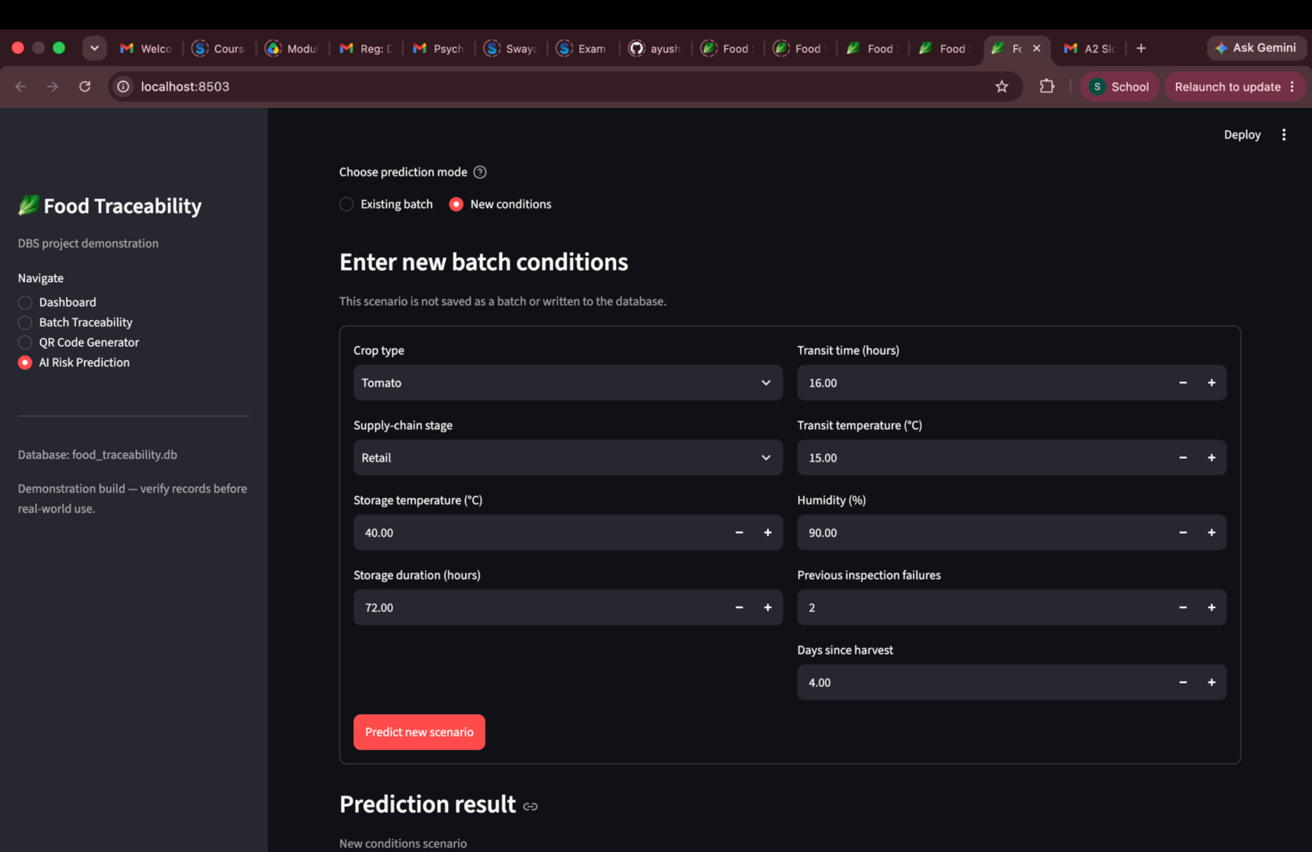
SCREENSHOT APPENDIX • AI RISK PREDICTION INPUTS
AI prediction — input scenario
Source file: Screenshot 2026-10-12 at 11.58.37 PM.png
AI-ENHANCED FOOD SUPPLY CHAIN TRACEABILITY • FINAL REVIEW
50

Slide 48
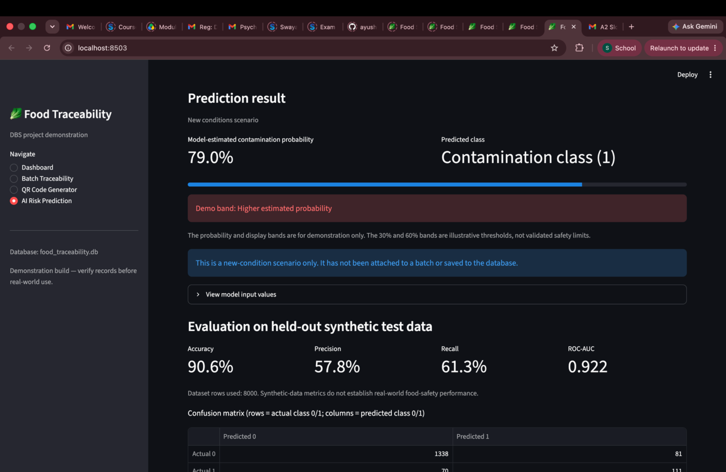
SCREENSHOT APPENDIX • AI PREDICTION OUTPUT AND METRICS
AI prediction — higher-risk scenario
Source file: Screenshot 2026-10-12 at 11.58.52 PM.png
AI-ENHANCED FOOD SUPPLY CHAIN TRACEABILITY • FINAL REVIEW
51

Slide 49
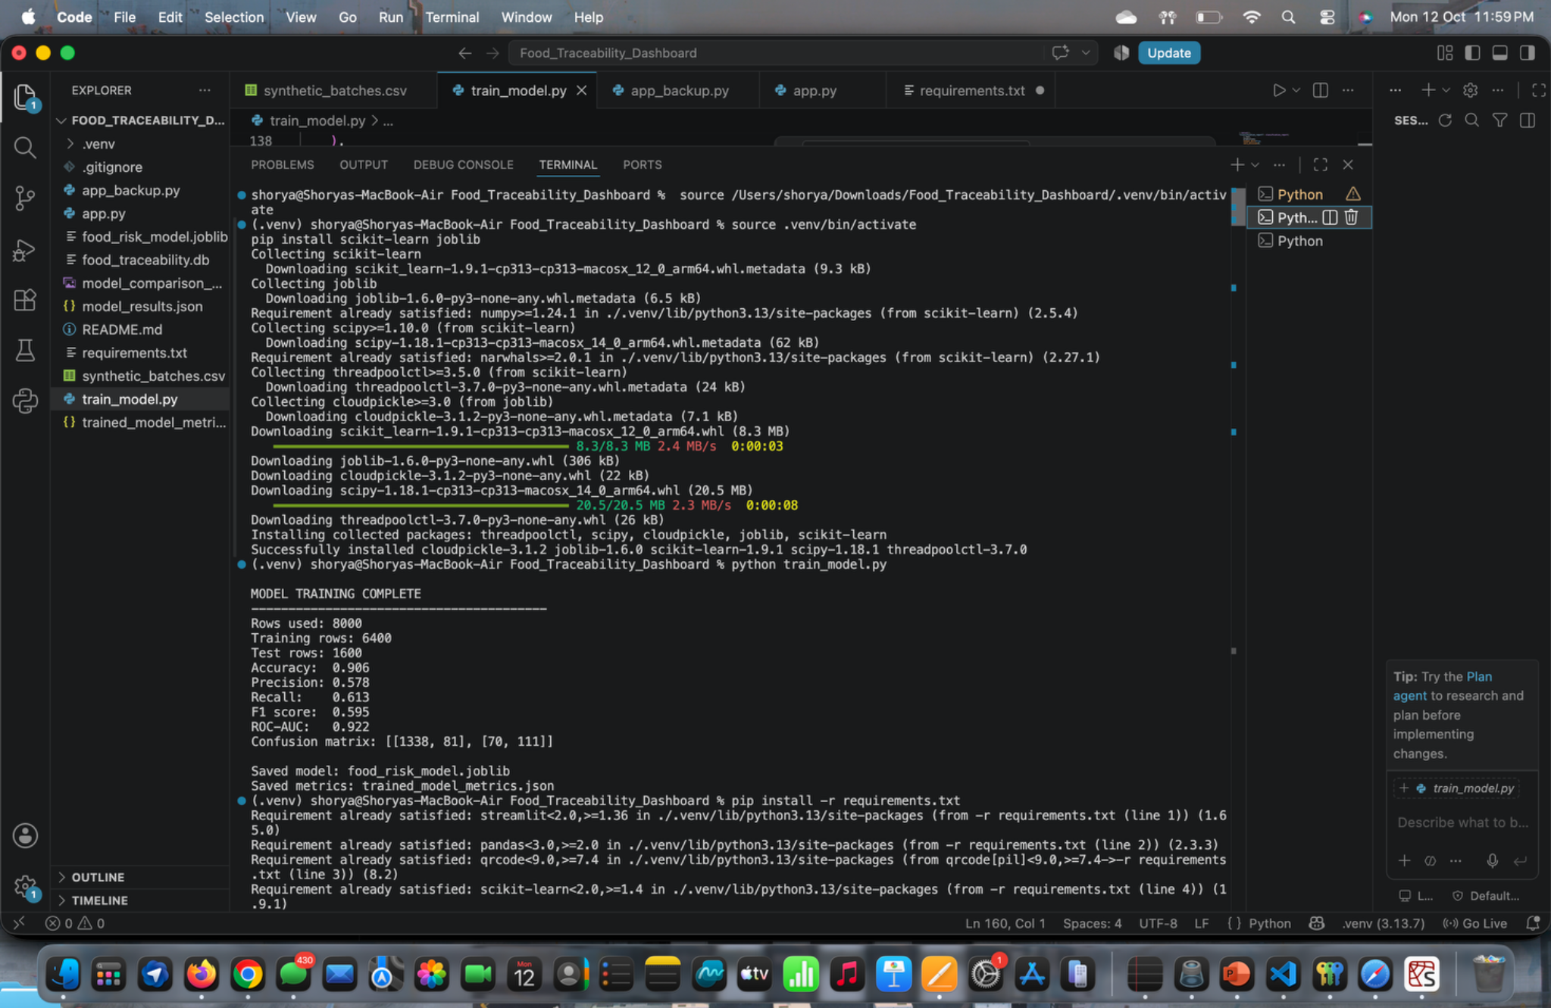
SCREENSHOT APPENDIX • CODE, TERMINAL OR DATABASE EVIDENCE
Model training — terminal and saved metrics
Source file: Screenshot 2026-10-12 at 11.59.27 PM.png
AI-ENHANCED FOOD SUPPLY CHAIN TRACEABILITY • FINAL REVIEW
52

Slide 50
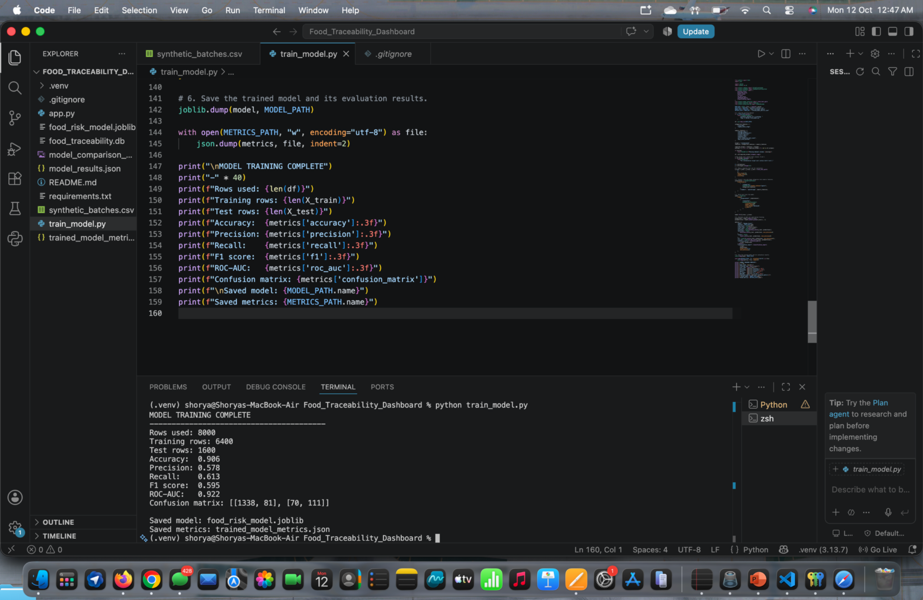
SCREENSHOT APPENDIX • CODE, TERMINAL OR DATABASE EVIDENCE
Development evidence — final code updates
Source file: Screenshot 2026-10-12 at 12.47.20 AM.png
AI-ENHANCED FOOD SUPPLY CHAIN TRACEABILITY • FINAL REVIEW
53

Slide 51
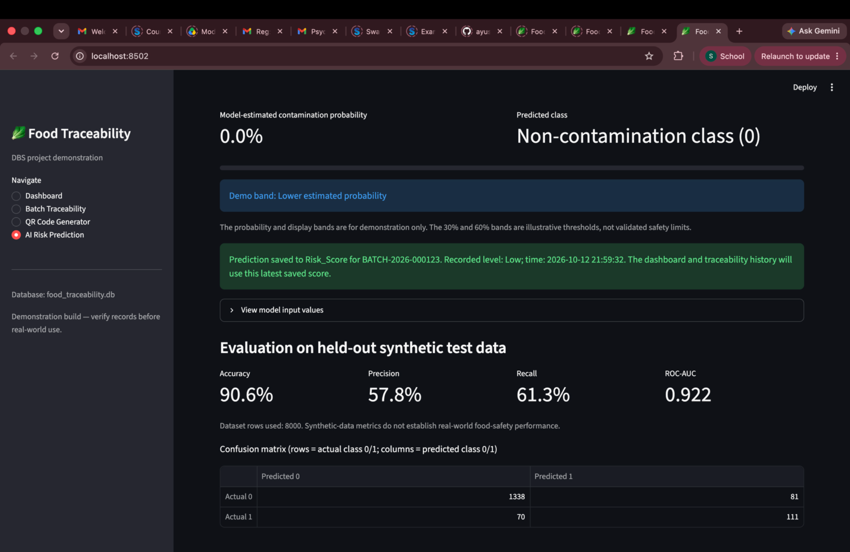
SCREENSHOT APPENDIX • AI PREDICTION OUTPUT AND METRICS
AI prediction — low-risk example
Source file: Screenshot 2026-10-12 at 9.59.39 PM.png
AI-ENHANCED FOOD SUPPLY CHAIN TRACEABILITY • FINAL REVIEW
54

