Slide 1
X Education - Lead Scoring Case Study
Identification of Hot Leads to focus more on them and thus enhancing the conversion ratio for X Education
Group Members:
Ahinram
Ayushi
Sonali

Slide 2
Background
X Education , An education company named sells online courses to industry professionals
Many interested professionals land on their website
The company markets its courses on several websites like Google. Once these people land on the website, they might browse the courses or fill up a form for the course or watch some videos
X Education Company

Slide 3
Background
When these people fill up a form providing their email address or phone number, they are classified to be a lead
Once these leads are acquired, employees from the sales team start making calls, writing emails, etc. Through this process, some of the leads get converted while most do not
The typical lead conversion rate at X education is around 30%
X Education Company

Slide 4
Problem Statement
X Education gets a lot of leads but its lead conversion rate is very poor
To make this process more efficient, the company wishes to identify the most potential leads, also known as ‘Hot Leads’
If they successfully identify this set of leads, the lead conversion rate should go up as the sales team will now be focusing more on communicating with the potential leads rather than making calls to everyone
X Education Company’s Problem

Slide 5
Problem Statement
We will help them to select the most promising leads, i.e. the leads that are most likely to convert into paying customers.
We are required to build a model wherein we need to assign a lead score to each of the leads such that the customers with higher lead score have a higher conversion chance
The CEO, in particular, has given a ballpark of the target lead conversion rate to be 80%.
X Education Company’s Problem

Slide 6
Lead – Conversion Process
Lead Generation:
1. Ads on websites like Google
2. Referrals
Visit to X Education website by these potential customers (professionals)
Visitors either provide Email id & Contact Details
Or
View videos etc
Tele calling and Emailing activity to all the leads
~30% leads get converted
Lead to Conversion process
Proposed Solution:
A model to filter leads so that leads to conversion ratio is 80%+

Slide 7
Proposed Solution
Selection of Hot Leads
Communicating with Hot Leads
Conversion of Hot Leads
Leads Clustering
We cluster the leads into certain categories based on their tendency or probability to convert, thus, getting a smaller section of hot leads to focus more on.
Focus Communication
Since we would have a smaller set of leads to have communication with, we might make more impact with effective communication.
Increase conversion
Since we focused on hot leads, which were more probable to convert, we would have a better conversion rate, and hence we can achieve the 80% target.

Slide 8
Solution
For our Problem Solution, the crucial part is to accurately identify hot leads.
The more accurate we obtain the hot lead, the more chance we get of higher conversion ratio.
Since we have a target of 80% conversion rate, we would want to obtain a high accuracy in obtaining hot leads.
Selection of Hot Leads

Slide 9
Implementation

Slide 10
Loading & Observing the past data provided by the Company
Univariate, Bivariate, and Heatmap for numerical and categorical columns
Performing pre-requisites for RFE and Logistic Regression
Data Gathering
Data Cleaning
Performing EDA
Data Preparation
Model Building
Duplicate removal, null value treatment, unnecessary column elimination, etc.
Outlier Treatment, Feature-Standardization

Slide 11
Selection of top 25 features using RFE
Reduction of columns and Model re-building
Feature Selection
Model Building
Model Improvement
Final Model
Verifying with PCA
Model building using RFE for selected columns
Final Model Analysis and performance on Test Data

Slide 12
Plots (Visualization)

Slide 13
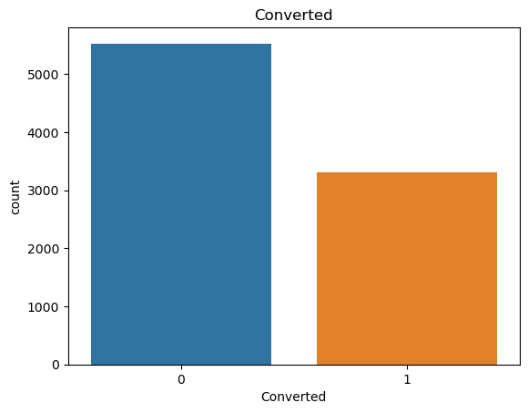
EDA plots showing Univariant Analysis for Converted and those who didn't.

Slide 14
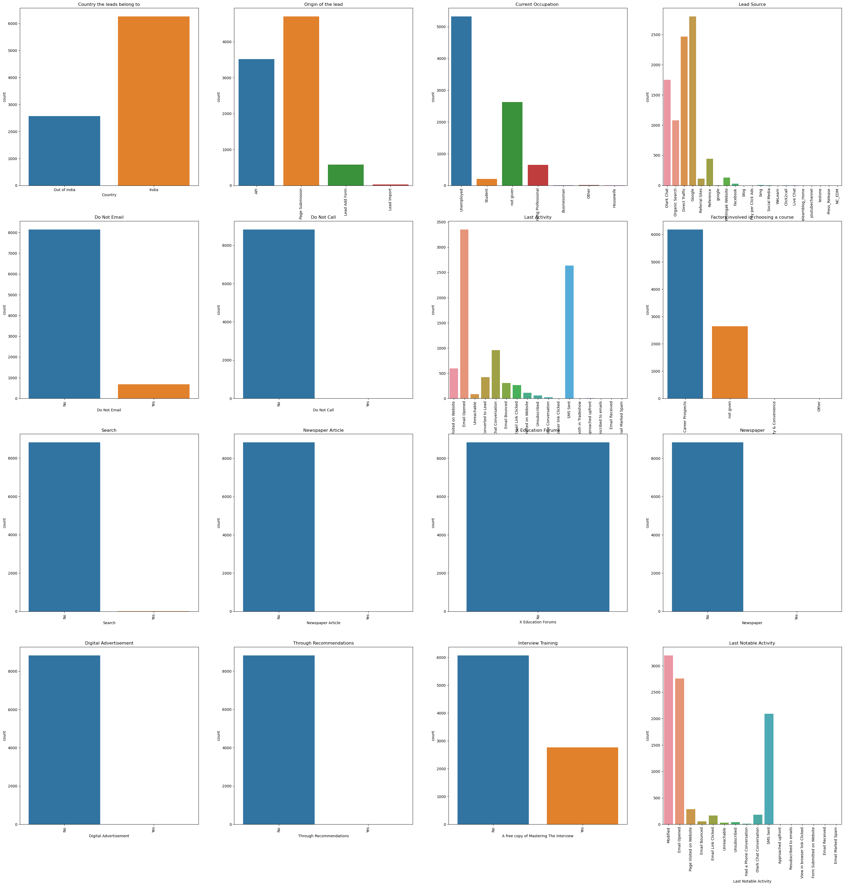
EDA plots showing categorical variables to understand the variance of the data.

Slide 15
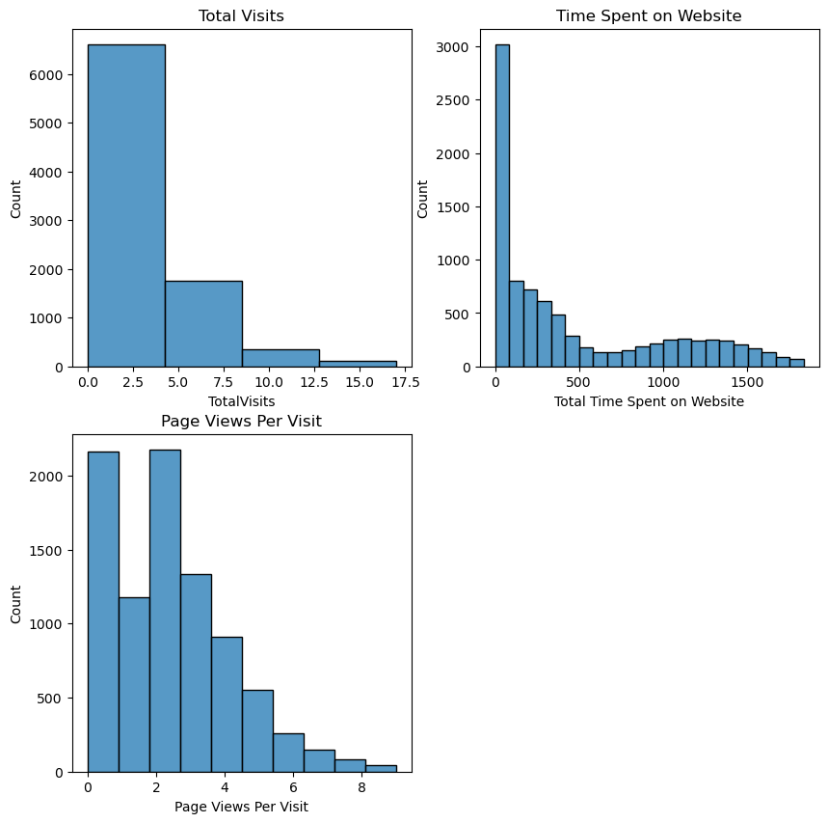
EDA plots showing Numerical variables to understand the variance of the data.

Slide 16
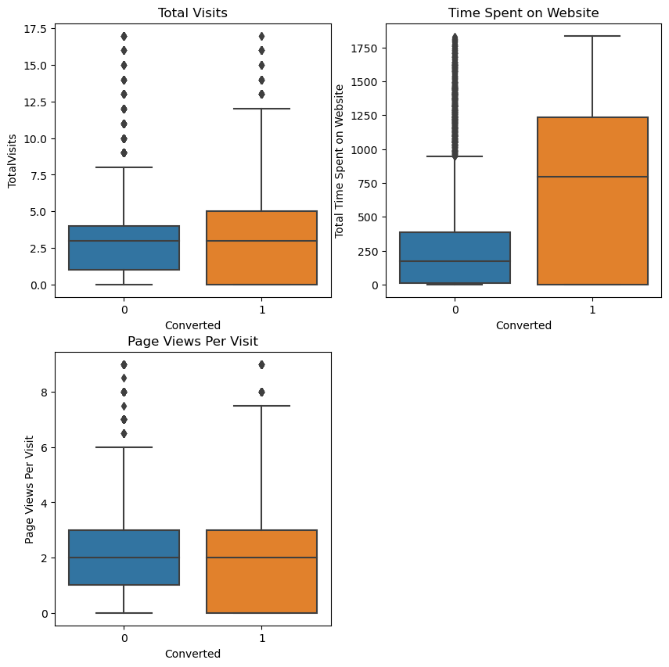
EDA plots depicting variation in numerical columns for those who Converted and those who didn't.

Slide 17
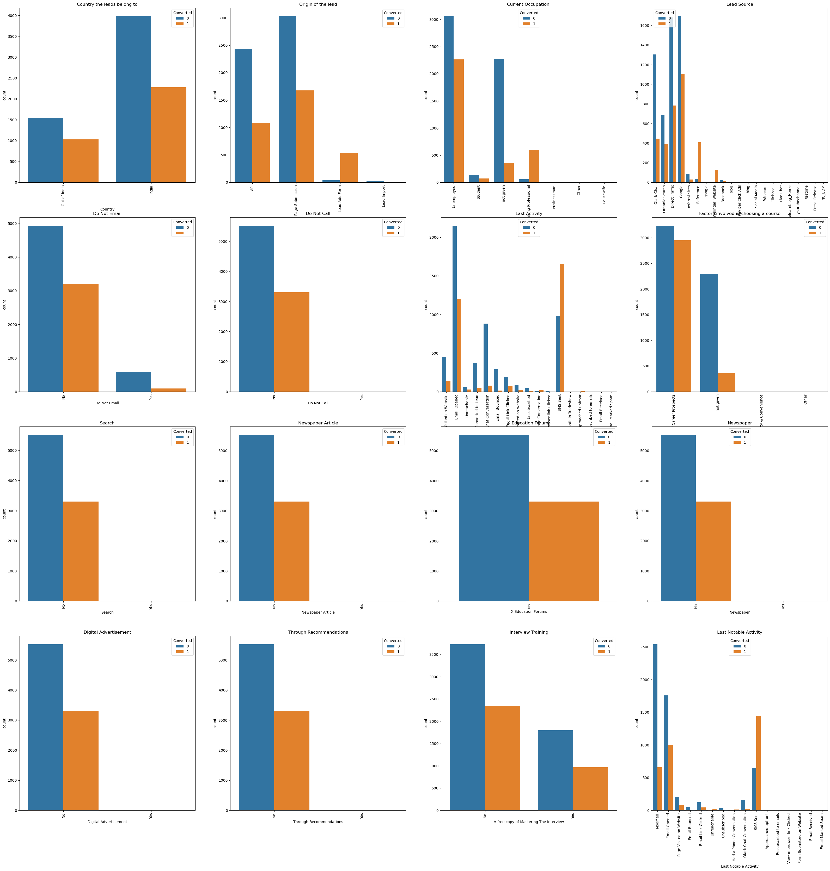
EDA plots with Bivariate analysis with all the variables Vs. Target variable.

Slide 18
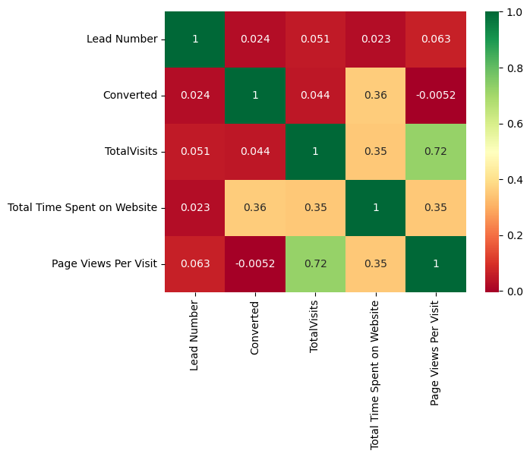
EDA plots depicting correlation (Heat Map) of all selected numerical columns.

Slide 19
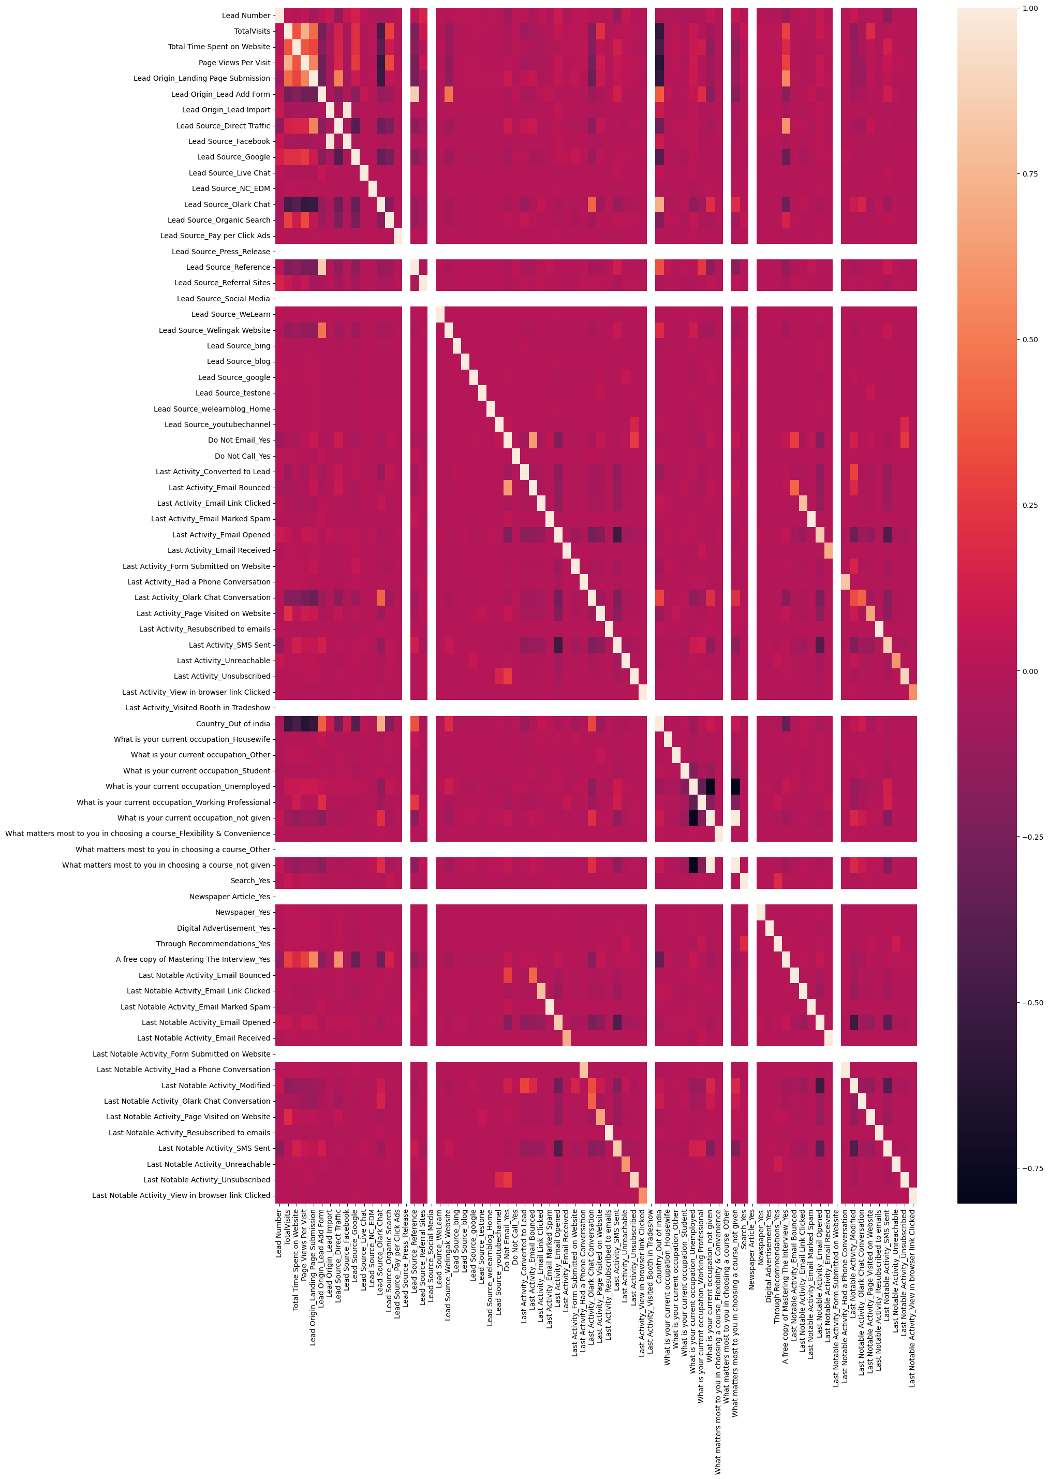
EDA plots depicting correlation (Heat Map) of all selected columns (numerical columns and dummy columns).

Slide 20
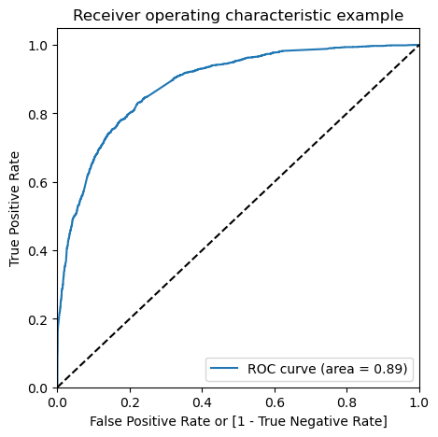
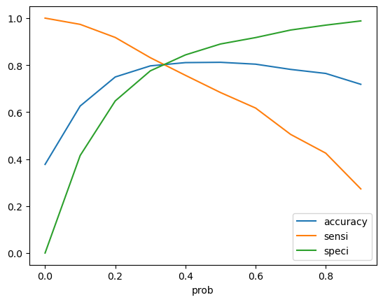
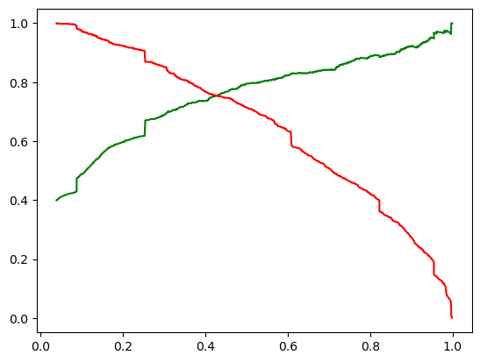
ROC Curve
Curve 1 – Area Under ROC = 0.84
Curve 2 – We can observer that 0.35 is the point where all metrics meet. 0.35 is the optimal probability(Intermediate cut-off = 0.35).
Curve 3 – It is clearly seen that the trade off is happening @ 0.4(Final cut-off = 0.42)

Slide 21
Inference / Conclusion

Slide 22
Model Analysis
We concluded that the model 5 with 0.35 as a cut-off is delivering the Recall value of 78.7% on training dataset & 80% on the test dataset.
With the obtained cut-off we got an accuracy of 80%, Specificity of 81% & Sensitivity of 79%
For the test data we got the result of Accuracy – 80%, Specificity – 82% & Sensitivity – 80%
Performance of our Models

Slide 23
Inferences from Model
Top 3 variables in model, that contribute towards lead conversion are:
Total Time Spent on Website
Total number of visits
When the lead source was: Olark chat coversation
Business Insights Derived from our Model

Slide 24
Inferences from Model
Top 3 variables in my model, that should be focused are:
Lead Source with elements Organic search.
Lead Source with elements direct traffic.
Lead Source with elements Olark chat conversation.
Business Insights Derived from our Model

Slide 25
Conclusion 1
For this particular problem - Recall is the important metric to evaluate the model performance. From the above we can confirm that with the probability cut off of 0.35 gives the best performance.

Slide 26
Conclusion 2 (Recommendation)
X Education Company needs to focus on following key aspects to improve the overall conversion rate:
Increase user engagement on their website since this helps in higher conversion
Increase on sending SMS notifications since this helps in higher conversion
Get Total visits increased by advertising etc. since this helps in higher conversion
Improve the Olark Chat service since this is affecting the conversion negatively

