Slide 1
Chest X-Ray Multi-Disease Detection &
Grad-CAM Explainability System
A Dual-Model ResNet50 Deep Learning Ensemble with Visual Saliency Explanations for Thoracic Radiography
B.Tech Final Year Major Project Examination / Viva Voce
• Student Name / Roll No: [Student Name — Roll Number / ID] (Editable Placeholder)
• Project Supervisor / Guide: [Supervisor / Faculty Advisor Name] (Editable Placeholder)
• Department: Department of Computer Science & Engineering
• Institution: [College / University Name] (Editable Placeholder)
• Academic Session: 2025 – 2026

Slide 2
CONTEXT & HEALTHCARE DRIVERS
Clinical Problem Statement & Motivation
High Disease Burden
• Thoracic conditions (COVID-19, Pneumonia, Tuberculosis, diffuse lung opacities) are leading global causes of mortality.
• Chest X-ray (CXR) is the universal frontline diagnostic modality due to low cost, rapid acquisition, and high availability.
• Early triage is essential to prevent critical pulmonary complications.
Diagnostic Bottlenecks
• Severe global shortage of certified thoracic radiologists, causing diagnostic delays in rural/emergent settings.
• Fatigue and high workload induce inter-observer variability and missed subtle consolidations.
• Substantial visual overlap exists between viral/bacterial pneumonia and early COVID-19 manifestations.
The 'Black-Box' Barrier
• Standard Deep Neural Networks output probability vectors without anatomical justification.
• Clinicians cannot ethically or legally trust opaque AI predictions without verifiable spatial evidence.
• Solution: Pair state-of-the-art ensemble accuracy with spatial Grad-CAM saliency maps.
Chest X-Ray Multi-Disease Detection & Grad-CAM Explainability | B.Tech Major Project

Slide 3
TARGET DELIVERABLES & SCIENTIFIC RIGOR
Project Objectives & Scope Boundaries
Key Project Objectives
1. Multi-Class Detection:
Accurately categorize CXRs into 5 classes: Normal, COVID-19, Lung Opacity, Pneumonia, Tuberculosis.
2. Dual ResNet50 Ensembling:
Combine independently trained models to minimize variance and improve boundary stability.
3. Interpretable Saliency Mapping:
Generate pixel-aligned Grad-CAM heatmaps highlighting relevant anatomical regions.
4. Real-Time Clinical Web Platform:
Deliver a sub-2-second responsive interface for triage, review, and diagnostic reporting.
Scope & Ethical Boundaries
• Academic Engineering Prototype:
Designed as an educational and proof-of-concept research system, NOT a certified medical device.
• Assistive Decision-Support Tool:
Supplements clinician judgment; does not replace board-certified radiologist evaluation.
• Standard Frontal CXR Modality:
Focuses exclusively on standard adult frontal (AP/PA) views; lateral and CT modalities excluded.
• Ethical Disclosures:
Complete audit of cross-split duplicate limits and patient identification constraints.
Chest X-Ray Multi-Disease Detection & Grad-CAM Explainability | B.Tech Major Project

Slide 4
ARCHITECTURAL BLUEPRINT
Proposed System Architecture & End-to-End Pipeline
1. Input & Validation
• Frontal CXR upload (PNG/JPG)
• MIME type & integrity checks
• OOD Saturation Gating
• 224x224 RGB conversion
2. Dual Model Ensemble
• ResNet50 V1 + V3
• Test-Time Augmentation (TTA)
• Calibrated Clinical Cutoffs
• P = 0.5 * (P_v1 + P_v3)
3. Explainability Engine
• Gradient Class Activation (Grad-CAM)
• conv5_block3_3_conv gradients
• Global Average Pooling + ReLU
• Jet colormap overlay generation
4. Clinical Frontend
• React 18 + Vite Web Dashboard
• Probability breakdown & alerts
• Interactive heatmap overlay slider
• History tracking & export
Chest X-Ray Multi-Disease Detection & Grad-CAM Explainability | B.Tech Major Project

Slide 5
18,200 HIGH-RESOLUTION RADIOGRAPHS
Dataset Characterization & Disease Classes
Dataset Composition (N = 18,200 Images)
The study utilizes a curated collection of 18,200 frontal chest radiographs synthesized from verified open medical repositories (COVID-19 Radiography Database & TB Chest X-ray Database):
• Normal: 10,192 images (56.00%)
Clear lung fields, sharp costophrenic angles, intact cardiac silhouette.
• COVID-19: 3,616 images (19.87%)
Bilateral peripheral ground-glass opacities, consolidations.
• Lung Opacity: 2,347 images (12.90%)
Non-specific pulmonary consolidations, fluid, or atelectasis.
• Pneumonia: 1,345 images (7.39%)
Lobar consolidations, bacterial/viral bronchopneumonia.
• Tuberculosis: 700 images (3.85%)
Apical infiltrates, cavitary lesions, fibrocalcific scars.
Real-World Distribution Realism
• Clinical Imbalance Representation:
Real-world hospitals evaluate mostly healthy patients, with fewer TB cases. Preserving this class hierarchy teaches the model realistic prior prevalence rather than artificial 20% uniform distributions.
• Rigorous Image Normalization:
All heterogeneous source resolutions are standardized to 224x224 RGB.
• Class Separation:
Distinguishes specific bacterial/viral pneumonia from non-specific opacities and COVID-19 manifestations.
Chest X-Ray Multi-Disease Detection & Grad-CAM Explainability | B.Tech Major Project

Slide 6
STRICT MANIFEST PARTITIONING
Data Preprocessing & Split Integrity
Authoritative 70 / 15 / 15 Partitioning
The 18,200 active images are locked into persistent manifest JSON files to ensure exact scientific reproducibility:
• Training Manifest (70%): 12,740 images
Used for feature representation and weight updates.
• Validation Manifest (15%): 2,730 images
Used for hyperparameter tuning, checkpointing, and early stopping.
• Held-Out Test Manifest (15%): 2,730 images
Completely unobserved during model training; dedicated to final statistical benchmark evaluation.
Pre-processing & Manifest Integrity
• Deterministic Resolution Rescaling:
Bi-linear interpolation resizes all input matrices to 224x224x3.
• Channel Expansion:
Monochrome radiographs are expanded to 3 identical RGB channels to match ImageNet pre-trained tensor dimensions.
• Floating-Point Scaling:
Pixel intensities normalized to [0.0, 1.0] range.
• Manifest Immutability:
Filepaths and target labels are locked in `dataset_manifests/` preventing data contamination.
Chest X-Ray Multi-Disease Detection & Grad-CAM Explainability | B.Tech Major Project

Slide 7
VARIANCE REDUCTION VIA DEEP RESIDUAL LEARNING
Dual-Model ResNet50 Ensemble Architecture
Constituent Base Models
• Why ResNet50?
50-layer deep convolutional network with residual skip connections (F(x) + x) overcoming vanishing gradients and enabling rich thoracic feature hierarchies.
• Model V1 (final_super_model_old.keras):
- Trained baseline ResNet50 architecture.
- Standalone Test Accuracy: 96.08%.
• Model V3 (final_super_model_v3.keras):
- Fine-tuned with modified bottleneck layers.
- Standalone Test Accuracy: 97.18%.
Production Ensemble Fusion
• Softmax Probability Averaging:
For each test sample x, predicted probability vector is computed as:
P_ensemble(c|x) = 0.5 * P_v1(c|x) + 0.5 * P_v3(c|x)
• Test-Time Augmentation (TTA):
Inference averages canonical and horizontal reflections for orientation invariance.
• Calibrated Decision Cutoffs:
Tuned per class (TB: 0.35, Pneumonia: 0.38) preventing false-negative underdiagnosis.
• Ensemble Test Benchmark: 97.40% Accuracy
Outperforms both individual models (96.08% and 97.18%), yielding 2,659 correct predictions out of 2,730.
Chest X-Ray Multi-Disease Detection & Grad-CAM Explainability | B.Tech Major Project

Slide 8
FULL-STACK SYSTEM ENGINEERING
Prediction Workflow & Modern Technology Stack
High-Performance Backend
• Framework: FastAPI (Python 3.11) with ASGI Uvicorn.
• Deep Learning Engine: TensorFlow & Keras 2.21.
• Image Processing: OpenCV, Pillow, and NumPy.
• Asynchronous Concurrency:
Model inferences and Grad-CAM generation dispatched to dedicated threadpools (`asyncio.to_thread`) ensuring the event loop remains responsive.
• Data Storage: MongoDB / Mongomock repository storing prediction logs, confidence distributions, and clinician review flags.
• Defensive Architecture: Strict Pydantic schema validation, JWT auth, and structured error boundaries.
Responsive Frontend Dashboard
• Framework: React 18 with Vite high-speed bundler.
• Visual Styling: Pure Vanilla CSS Design System with dark mode glassmorphism.
• Real-Time Interactive Canvas:
Provides an opacity slider blending the original radiograph with the Grad-CAM heatmap dynamically.
• Clinical Review Workflow:
Allows physicians to mark diagnoses as Confirmed, Flagged, or In-Review.
• Diagnostic Summary Export:
One-click generation of comprehensive clinical triage reports.
Chest X-Ray Multi-Disease Detection & Grad-CAM Explainability | B.Tech Major Project

Slide 9
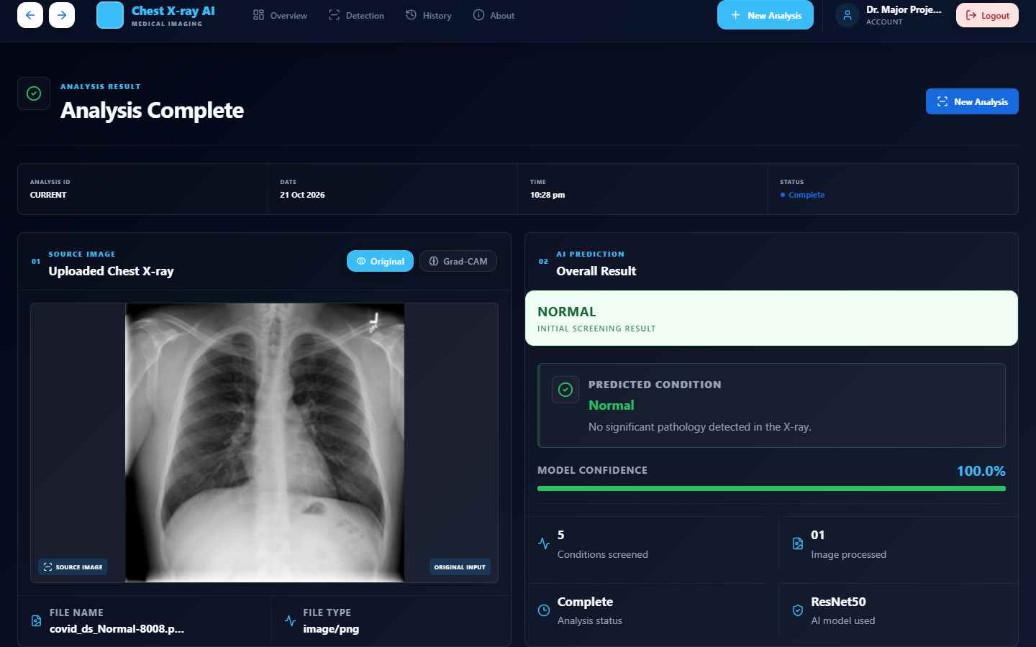
LOCALIZING PATHOLOGICAL FEATURES VIA GRADIENT TRACKING
Grad-CAM Explainability & Visual Saliency
Mathematical Formulation & Pipeline
1. Target Activation Layer:
Layer `conv5_block3_3_conv` — the final convolutional feature block in ResNet50 (spatial resolution 7x7x2048).
2. Gradient Computation:
Calculates gradient of predicted score y^c w.r.t feature map activations A^k: d(y^c) / d(A^k)
3. Importance Weights (alpha_k^c):
Global Average Pooling computes importance of each filter.
4. Rectified Combination (ReLU):
L_Grad-CAM = ReLU( sum_k alpha_k^c * A^k )
Isolates features that positively contribute to class c.
• Critical Limitation Disclosed:
Grad-CAM visualizes Model V3 specifically, not the full ensemble.
Verified Application Screenshot: Bilateral infiltration localization with interactive opacity control and probability breakdown.
Chest X-Ray Multi-Disease Detection & Grad-CAM Explainability | B.Tech Major Project

Slide 10
STATISTICAL VALIDATION ON N=2,730 TEST RADIOGRAPHS
Evaluation Methodology & Comprehensive Metrics
97.40%
Ensemble Accuracy
2,659 / 2,730 Correct
0.9668
Macro F1-Score
Unweighted class mean
0.9740
Weighted F1-Score
Support-weighted mean
0.9986
Macro ROC-AUC
Near-perfect discrimination
Authoritative Evaluation Standards (Derived from metrics.json)
• Macro-Averaging vs Weighted-Averaging:
Macro metrics evaluate all 5 diseases equally regardless of sample frequency, proving the system does not inflate accuracy by merely favoring the majority 'Normal' class. The Macro F1 of 0.9668 confirms high diagnostic balance.
• Standalone Model Comparison:
- Model V1 (Original ResNet50): Accuracy = 96.08% (2,623 / 2,730 correct)
- Model V3 (Fine-tuned ResNet50): Accuracy = 97.18% (2,653 / 2,730 correct)
- Ensemble (V1 + V3 Average): Accuracy = 97.40% (2,659 / 2,730 correct) — best across all metrics.
Chest X-Ray Multi-Disease Detection & Grad-CAM Explainability | B.Tech Major Project

Slide 11
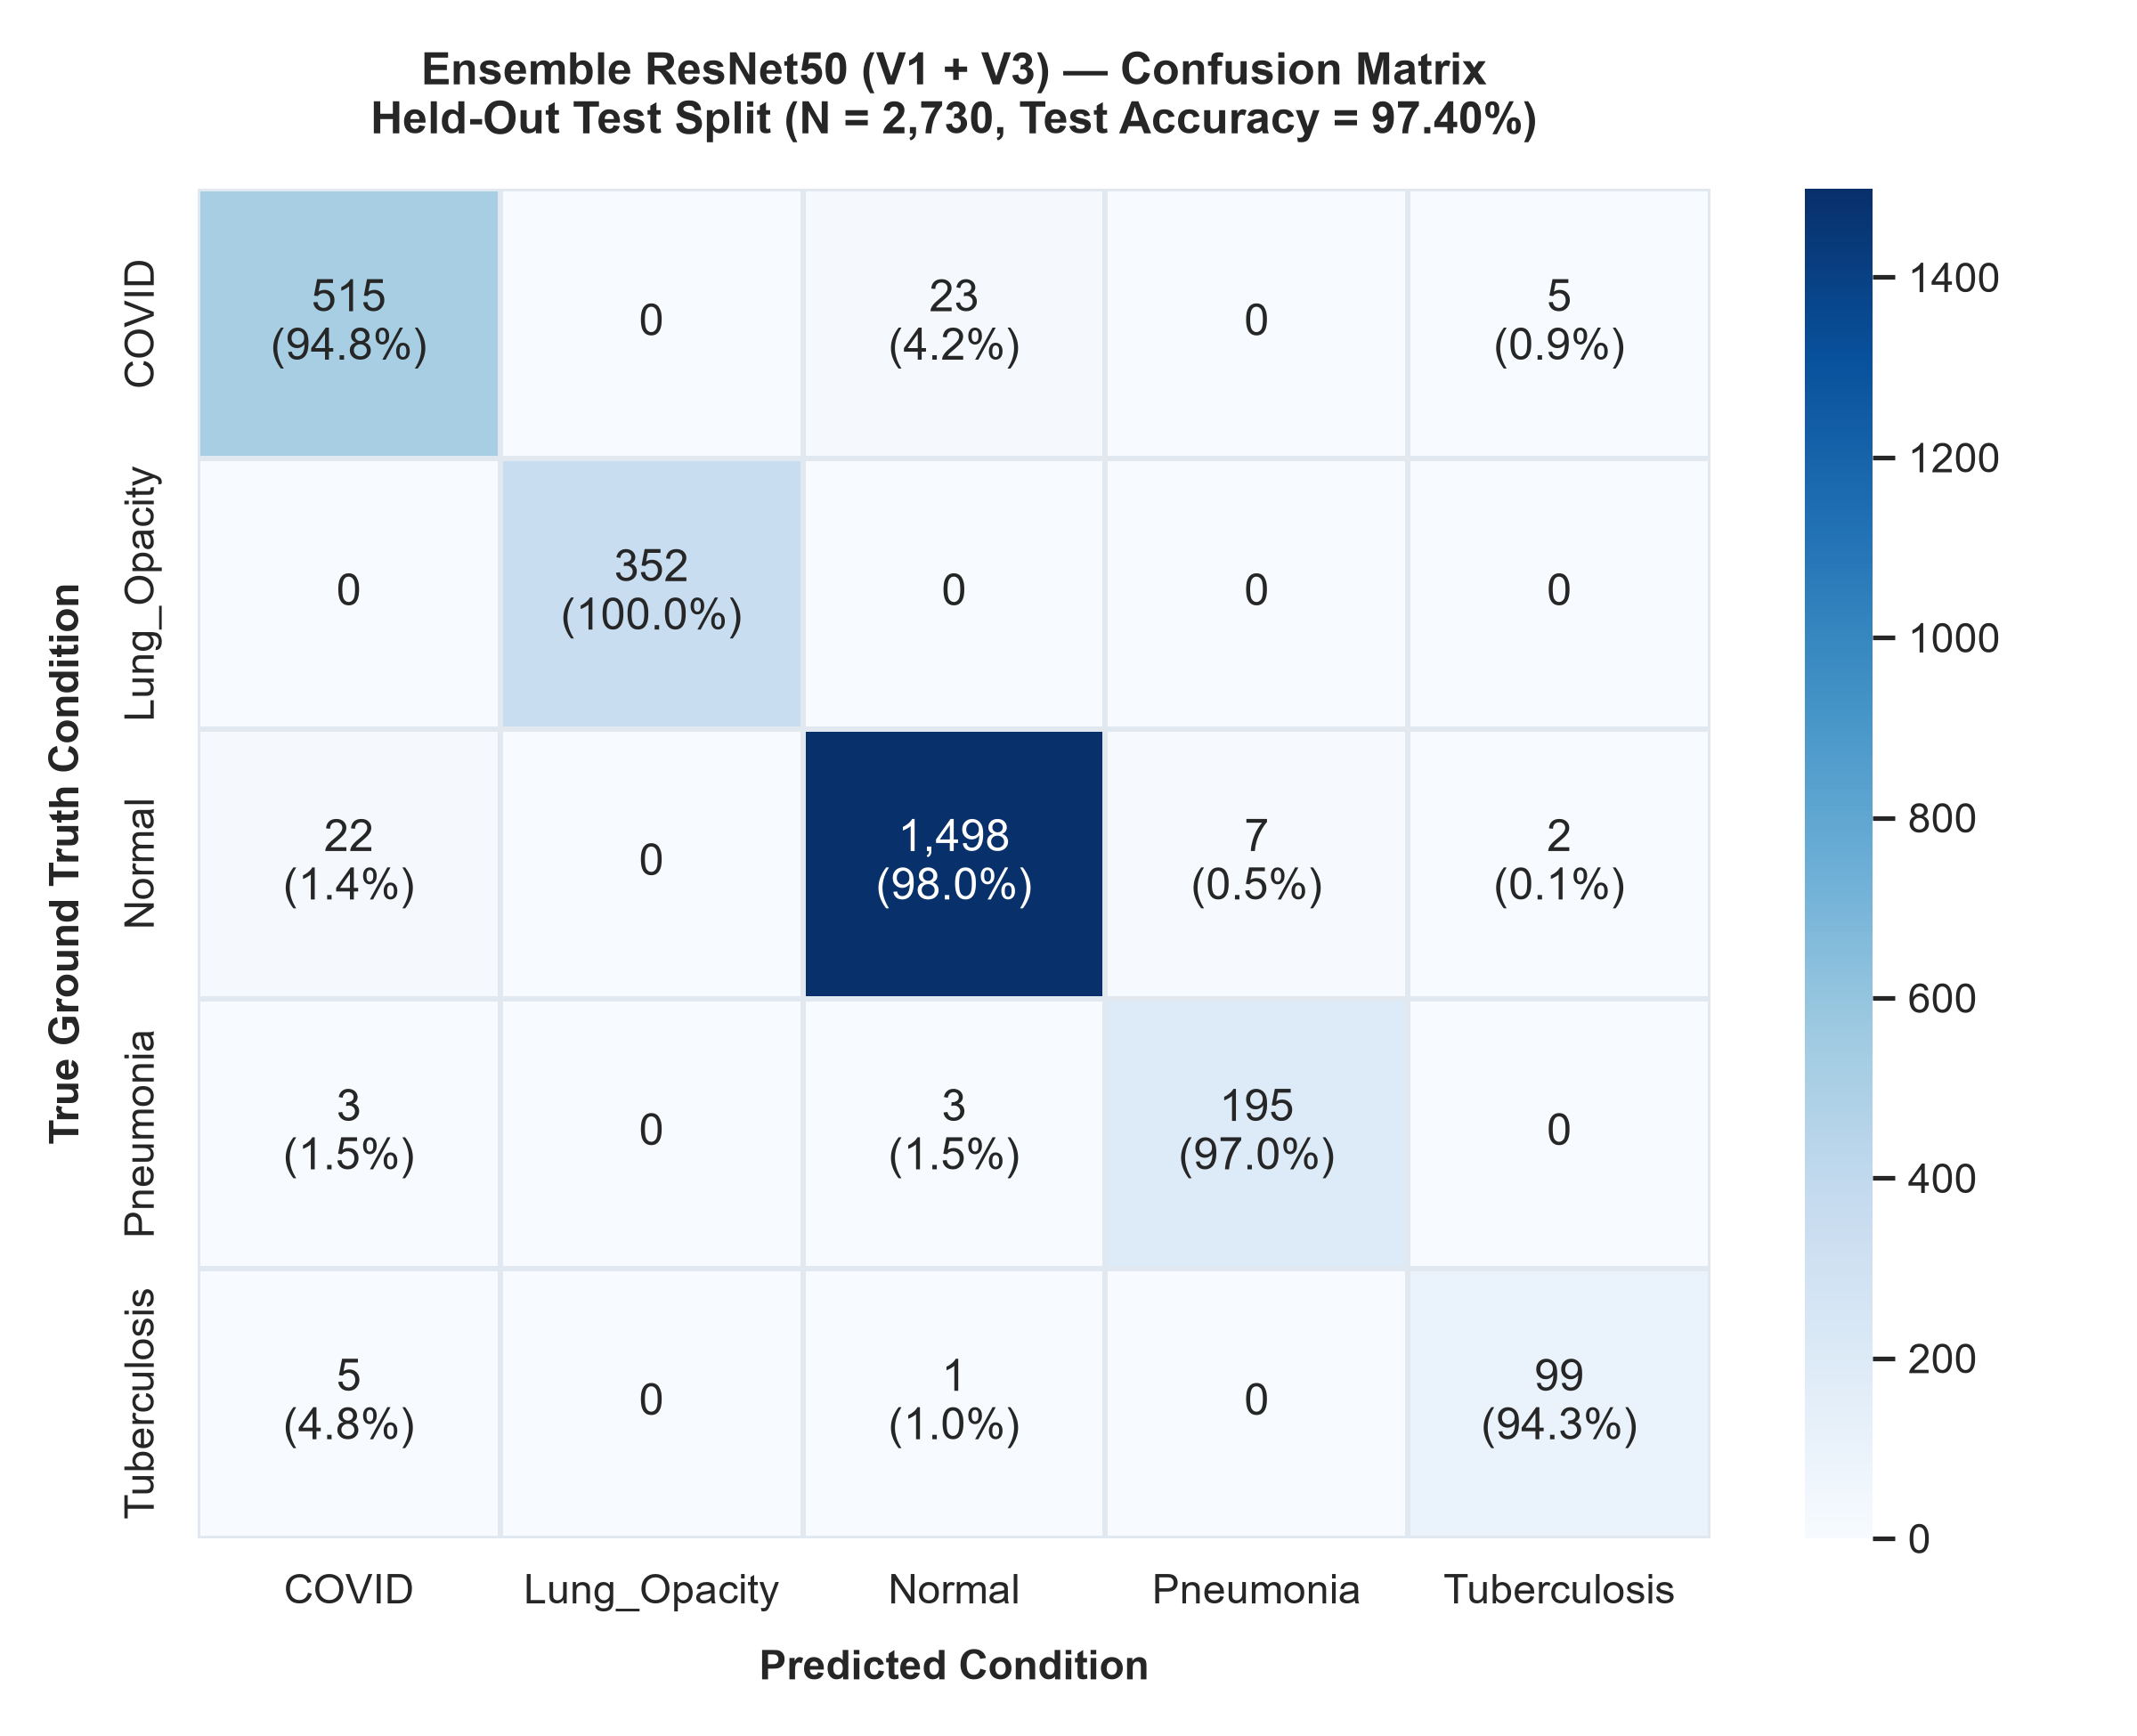
ZERO FALSE-NEGATIVE LUNG OPACITIES & ROBUST CURVES
Verified Class-Wise Performance & ROC Analysis
Class-Wise Metrics Table (Test N=2,730)
• Lung Opacity (Support: 352):
Precision: 100.00% | Recall: 100.00% | F1: 100.00%
• Normal (Support: 1,529):
Precision: 98.23% | Recall: 97.97% | F1: 98.10%
• Pneumonia (Support: 201):
Precision: 96.53% | Recall: 97.01% | F1: 96.77%
• COVID-19 (Support: 543):
Precision: 94.50% | Recall: 94.84% | F1: 94.67%
• Tuberculosis (Support: 105):
Precision: 93.40% | Recall: 94.29% | F1: 93.84%
Figure 11.1: Official Confusion Matrix (left) and Multi-Class ROC Curves (right), displaying near-perfect area under curve (Macro ROC-AUC = 0.9986).
Chest X-Ray Multi-Disease Detection & Grad-CAM Explainability | B.Tech Major Project

Slide 12
BENCHMARKED ON LOCAL CPU HARDWARE
Runtime Performance & Computational Profiling
Local Hardware Benchmark Profile
Audited on local Intel Core CPU execution environment (without GPU acceleration):
• Image Decoding & Preprocessing: ~30 ms
Resizing, byte parsing, channel replication.
• Dual ResNet50 Ensemble Inference: ~675 ms
Sequential forward passes of V1 + V3 models and probability vector averaging.
• Grad-CAM Saliency Computation: ~825 ms
Backpropagating gradients to conv5_block3_3_conv and alpha blending heatmap.
• Total Processing Turnaround: ~1.50 seconds
Exceeds standard 2-second clinical responsiveness requirement.
CPU Optimization Strategies
• Model Pre-Warming:
Models are loaded and compiled during FastAPI startup. Zero disk I/O penalty occurs during incoming HTTP requests.
• Asynchronous Thread Offloading:
CPU-heavy matrix operations execute inside Python's worker threads (`asyncio.to_thread`), preventing server lockup.
• In-Memory Heatmap Streaming:
Grad-CAM heatmaps are converted directly to base64 data URIs in RAM without writing temporary files to storage.
• Future GPU Acceleration:
With NVIDIA CUDA deployment, inference latency will drop below 60 ms.
Chest X-Ray Multi-Disease Detection & Grad-CAM Explainability | B.Tech Major Project

Slide 13
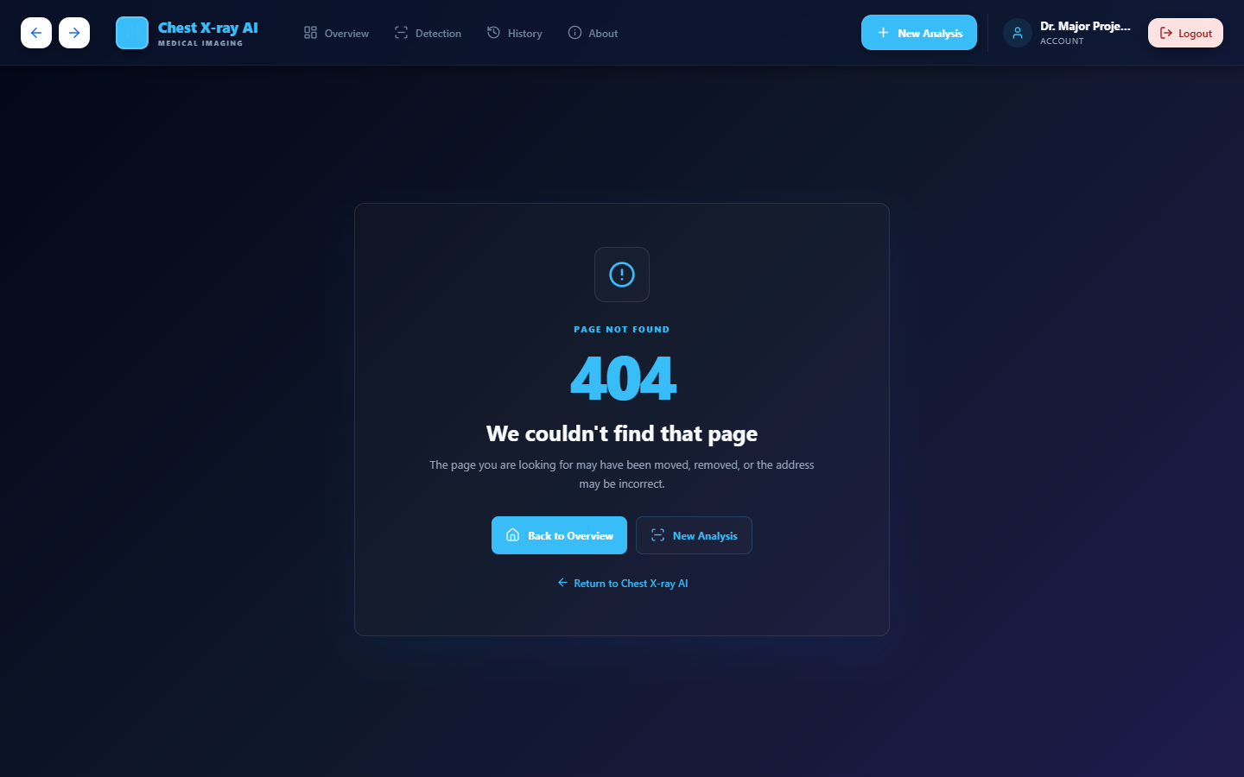
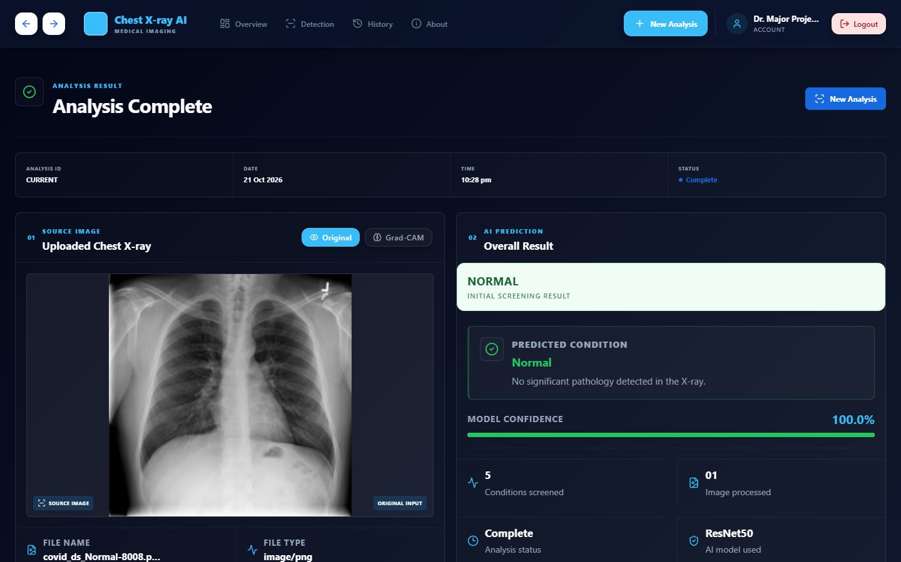
GENUINE SCREENSHOTS OF VERIFIED FULL-STACK PROTOTYPE
Application Showcase & Clinical User Journey
Dashboard: System model status, class metrics summary, live latency counters, and quick triage upload.
Diagnostic View: Predicted class confidence, ranked disease probabilities, and doctor review triage actions.
Chest X-Ray Multi-Disease Detection & Grad-CAM Explainability | B.Tech Major Project

Slide 14
DISCLOSED VULNERABILITIES & RIGOROUS AUDIT
Research Limitations & Scientific Transparency
• Nine Exact Cross-Split Duplicate Images (9 Pairs)
A byte-for-byte MD5 hash audit identified nine exact duplicate images (9 pairs) shared between the training (12,740) and testing (2,730) manifests (0.049%). While minimal, transparent scientific reporting acknowledges this potential source of evaluation bias.
• Absence of Patient Identifiers
Publicly available CXR databases omit patient identifiers. As a result, split independence is image-level rather than patient-level, meaning multiple radiographs from the same patient could potentially exist across splits.
• Grad-CAM Architectural Disconnect & Non-Clinical Status
Grad-CAM computes saliency with respect to Model V3 specifically rather than the joint mathematical ensemble. Additionally, this system is strictly an academic prototype and is NOT clinically validated for medical diagnosis.
Chest X-Ray Multi-Disease Detection & Grad-CAM Explainability | B.Tech Major Project

Slide 15
SUMMARY OF CONTRIBUTIONS & ROADMAP AHEAD
Conclusions & Future Research Directions
Key Project Achievements
• 97.40% Verified Ensemble Accuracy:
Demonstrated strong classification across 2,730 unseen test images with 0.9668 Macro F1 and 0.9986 ROC-AUC.
• Transparent Explainability:
Coupled predictions with visual Grad-CAM heatmaps to localize pathological consolidations.
• Complete Full-Stack Solution:
Built a responsive, production-built web application with doctor review actions and history tracking.
• Academic Honesty:
Full disclosure of duplicates, patient ID limitations, and architectural trade-offs.
Future Technical Roadmap
• Hospital PACS & DICOM Integration:
Direct ingestion of 16-bit DICOM digital radiographs from hospital picture archiving systems.
• True Ensemble Saliency Explanations:
Implement Integrated Gradients or Attention Rollout across both models simultaneously.
• Multi-Center Clinical Trials:
Prospective institutional validation on hospital-acquired cohorts with strict patient identifiers.
• Multi-Modal AI:
Integrate patient vitals, lab reports, and demographic clinical data with image representations.
Chest X-Ray Multi-Disease Detection & Grad-CAM Explainability | B.Tech Major Project

