Slide 1
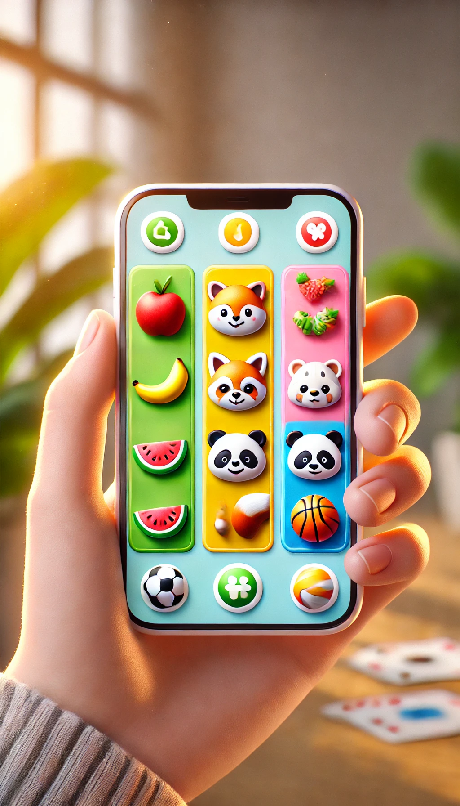
Memory Card Matching Game
Final Project Presentation
Swift-based Game Development
Welcome to an in-depth look at our innovative memory card matching game, built using SwiftUI and leveraging advanced frameworks like SpriteKit, Combine, CoreMotion, and Charts. This project showcases the power of modern iOS development techniques to create an engaging, interactive, and visually appealing game experience.
-Ayush Jaiswal
-Aqsa Noor Siddiqui -Dharaneedhar Reddy Nimma

Slide 2
Why This App Matters
Engaging Experience
Universal Appeal
Cognitive Benefits
This app provides an engaging experience with customizable themes for personalization, performance tracking to measure progress, and real-time responsiveness with animations and motion controls.
Suitable for all ages, from kids to adults.
Memory games improve cognitive abilities like focus and recall.

Slide 3






Frameworks Used
SwiftUI
SpriteKit
Used For building a responsive and visually appealing UI, including EmojiMemoryGameView.swift, ThemeSelectionView.swift, ThemeEditorView.swift, and GameHistoryView.swift.
Adds visual effects and animations to cards, particularly for moving cards off-screen when removed. Implemented in SpriteCard.swift.
CoreMotion
Uses accelerometer data to reset the game via motion gestures, implemented in EmojiMemoryGameView.swift.
Charts
Visualizes performance metrics (iOS 16+).
Combine
Manages asynchronous data streams (e.g., timer). and state updates, specifically for tracking elapsed game time in EmojiMemoryGameViewModel.swift.

Slide 4





Project Architecture
MemoryGame.swift
EmojiMemoryGameView.swift
ThemeSelectionView.swift
GameHistoryView.swift
Core game logic.
Main game interface.
Theme management screen.
Displays performance trends.
SpriteCard.swift
Animations for card removal.

Slide 5

Challenges We Solved
1
State Synchronization
2
Smooth Animations
Ensured real-time updates using SwiftUI's binding system.
Developed a custom \`Cardify\` modifier for 3D card flip.
3
Motion-Triggered Reset
4
Result
Seamless and professional user experience.
Leveraged CoreMotion's accelerometer with optimized sensitivity.

Slide 6




Core Game Logic
1
MemoryGame.swift
Defines generic structure for game logic
2
Card Tracking
Manages cards, matches, score, incorrect guesses
3
Game Functions
choose(card:), resetIncorrectGuesses()
4
Card Structure
Properties: isFaceUp, isMatched, content, id

Slide 7
User Interface Components
EmojiMemoryGameView.swift
ThemeSelectionView.swift
ThemeEditorView.swift
- Main Game View - Displays grid of cards, timer, and incorrect guesses - Implements card tap actions - Uses CoreMotion for game reset via device shake - Includes CardView for individual card display - Integrates SpriteKitView for animated elements
- Displays available themes in a list - Allows editing or adding themes - Provides option to reset themes to default - Serves as the app's entry point
- Modal editor for customizing themes - Input fields for theme name, emojis, and accent color - Used within ThemeSelectionView.swift

Slide 8
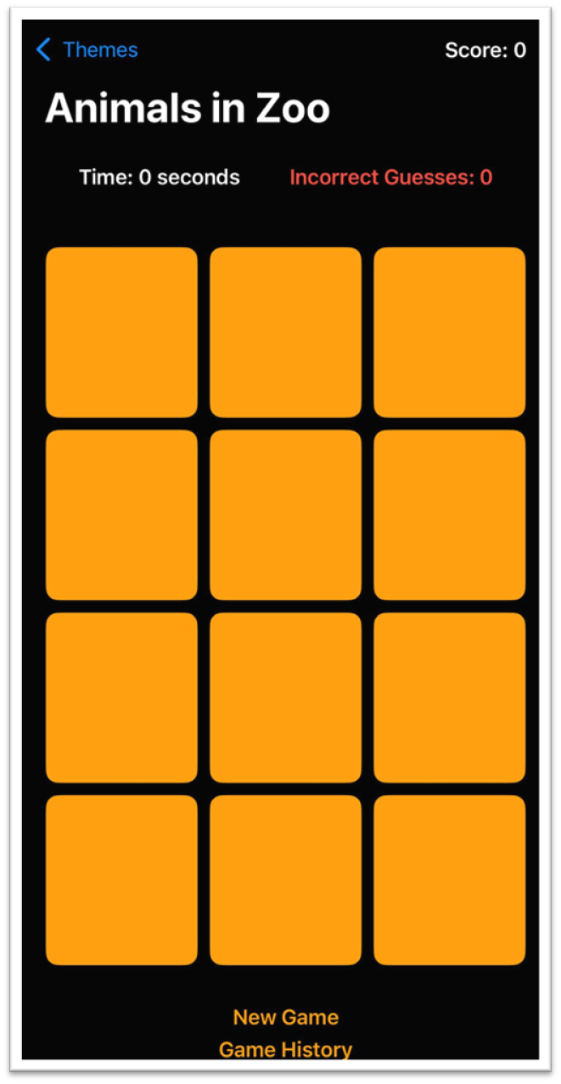




Animations and Visual Effects
Cardify.swift
Custom SwiftUI modifier for 3D card flip animations
SpriteCard.swift
Implements animateCardRemoval() for moving cards off-screen
SpriteKitView
Integrates SpriteKit animations into SwiftUI view
CardView
Animates matched cards with scaling and spinning effects

Slide 9
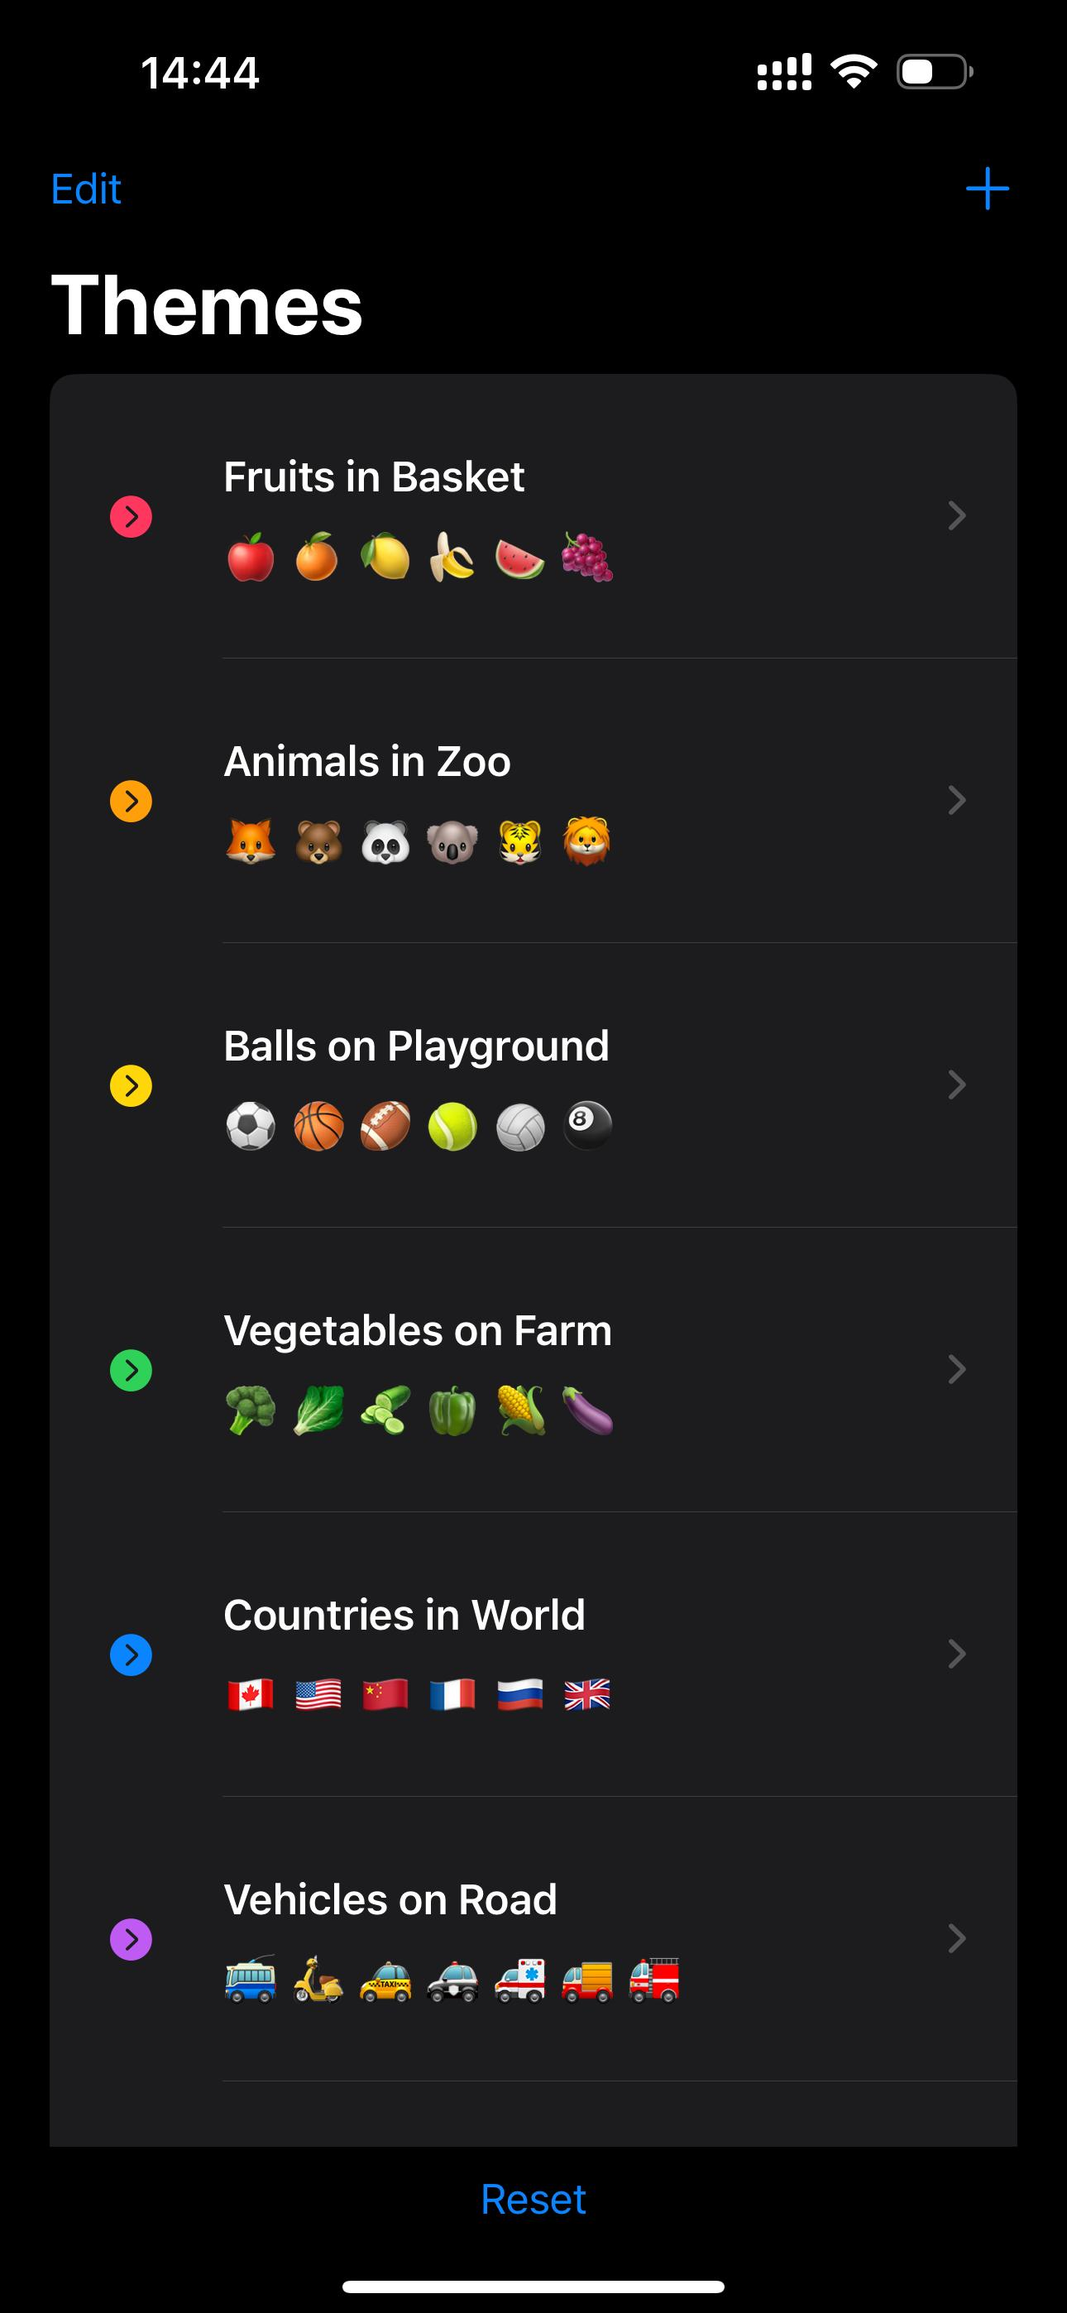
Theme Management
ThemeCollection.swift
DefaultThemes.swift
- Manages a collection of Theme objects - Supports Codable for saving/loading themes - Functions: addTheme(), editTheme(), resetThemes() - Used in ThemeSelectionView.swift and ThemeEditorView.swift
- Predefines six themes for the game - Each theme includes a name, accent color, and set of emojis
UIColor+RGBA.swift
- Utility extension for color encoding and decoding - Ensures proper persistence of theme colors

Slide 10
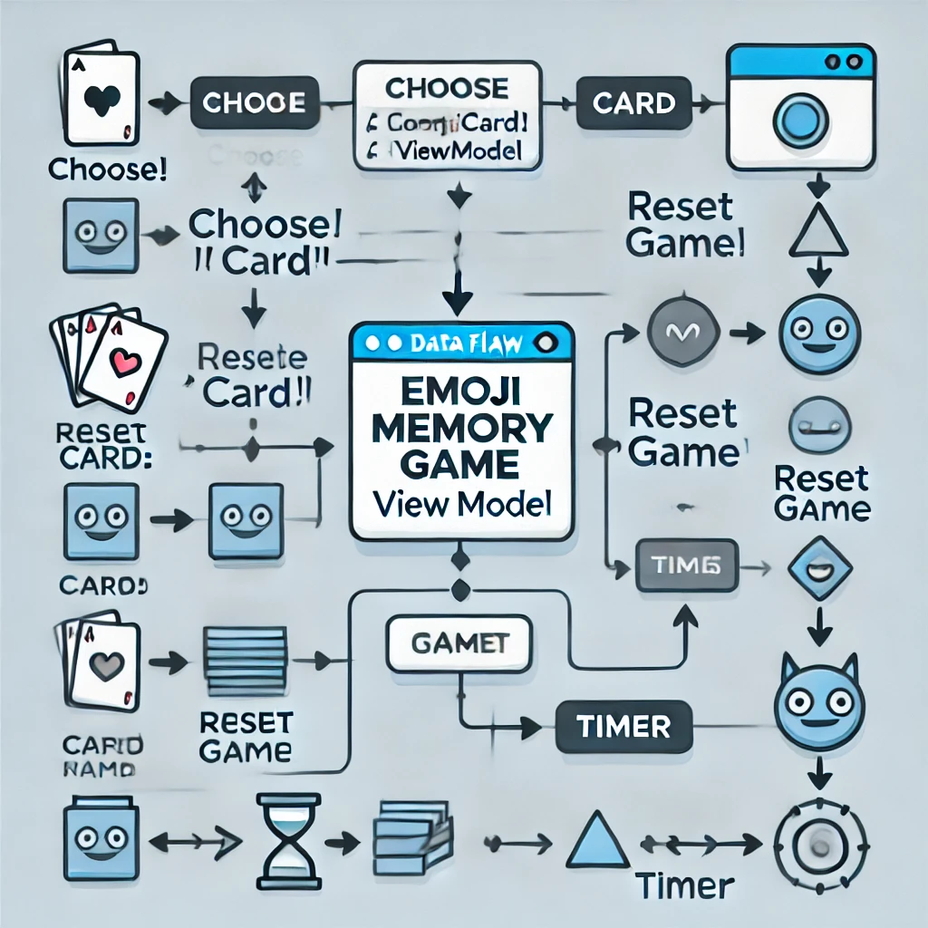
ViewModel and Data Flow
1
EmojiMemoryGameViewModel.swift
Connects the MemoryGame model to the UI, tracks game state, time, and score
2
choose(card:)
Calls the model's logic and tracks elapsed time
3
resetGame()
Resets the game and timer
4
Timer
Uses Combine's Timer.publish for updating elapsed time

Slide 11
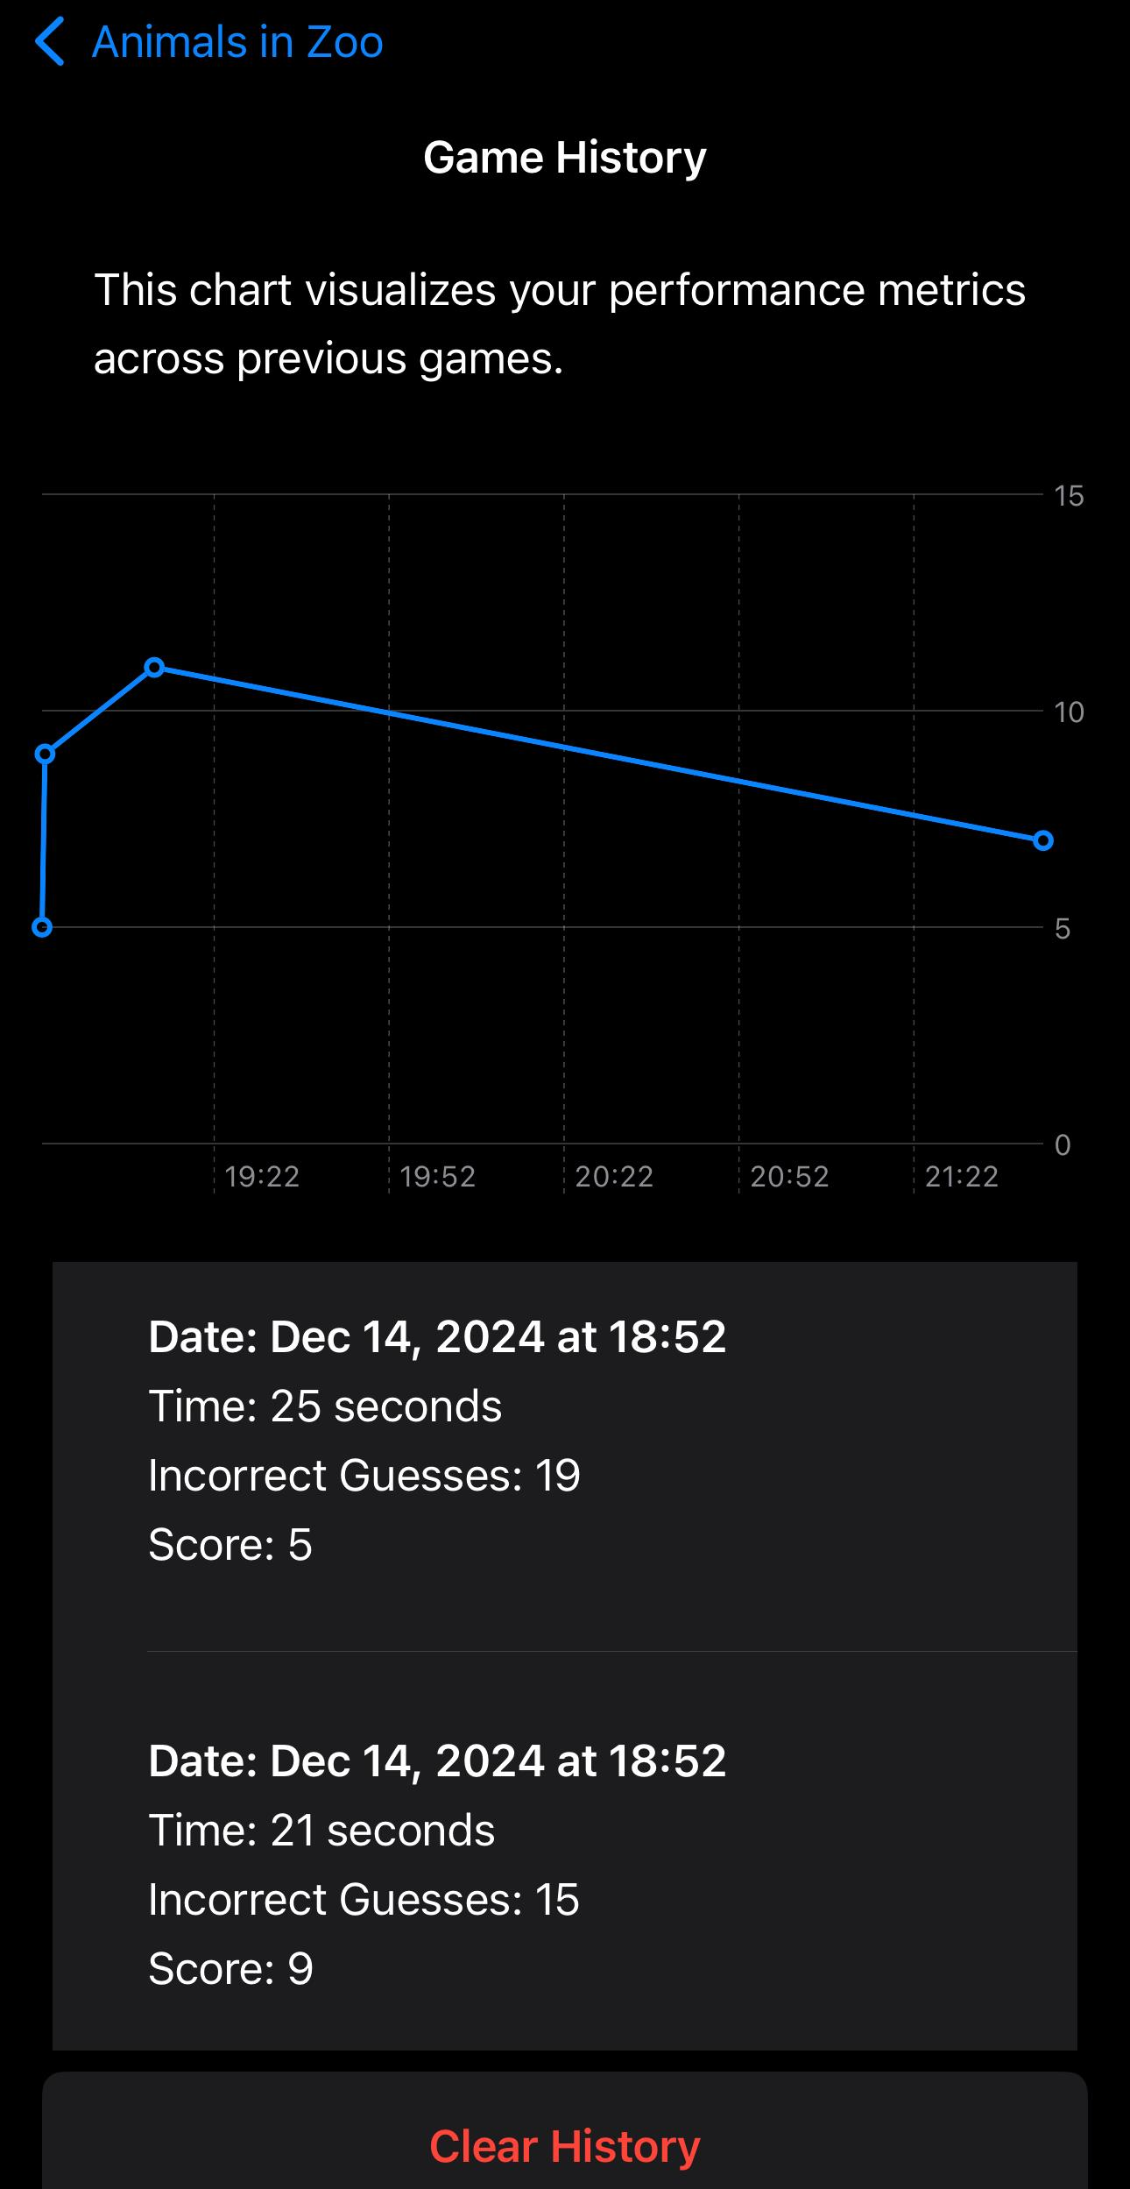

Game History and Performance Tracking
GameHistory.swift
GameHistoryView.swift
- Maintains the history of played games - GameRecord: Tracks each game's date, score, incorrect guesses, and elapsed time - GameHistory: Stores game records and persists them using UserDefaults
- Visualization and management of game history - Uses Charts framework to display scores over time (iOS 16+) - Provides a record list showing detailed game metrics - Allows deleting or clearing history records
• Tracks game records: Elapsed time, incorrect guesses, and scores.
• Persists data using UserDefaults for continuity.
• Uses Charts to visualize score trends over time.
• Users can delete or clear history as needed.

Slide 12
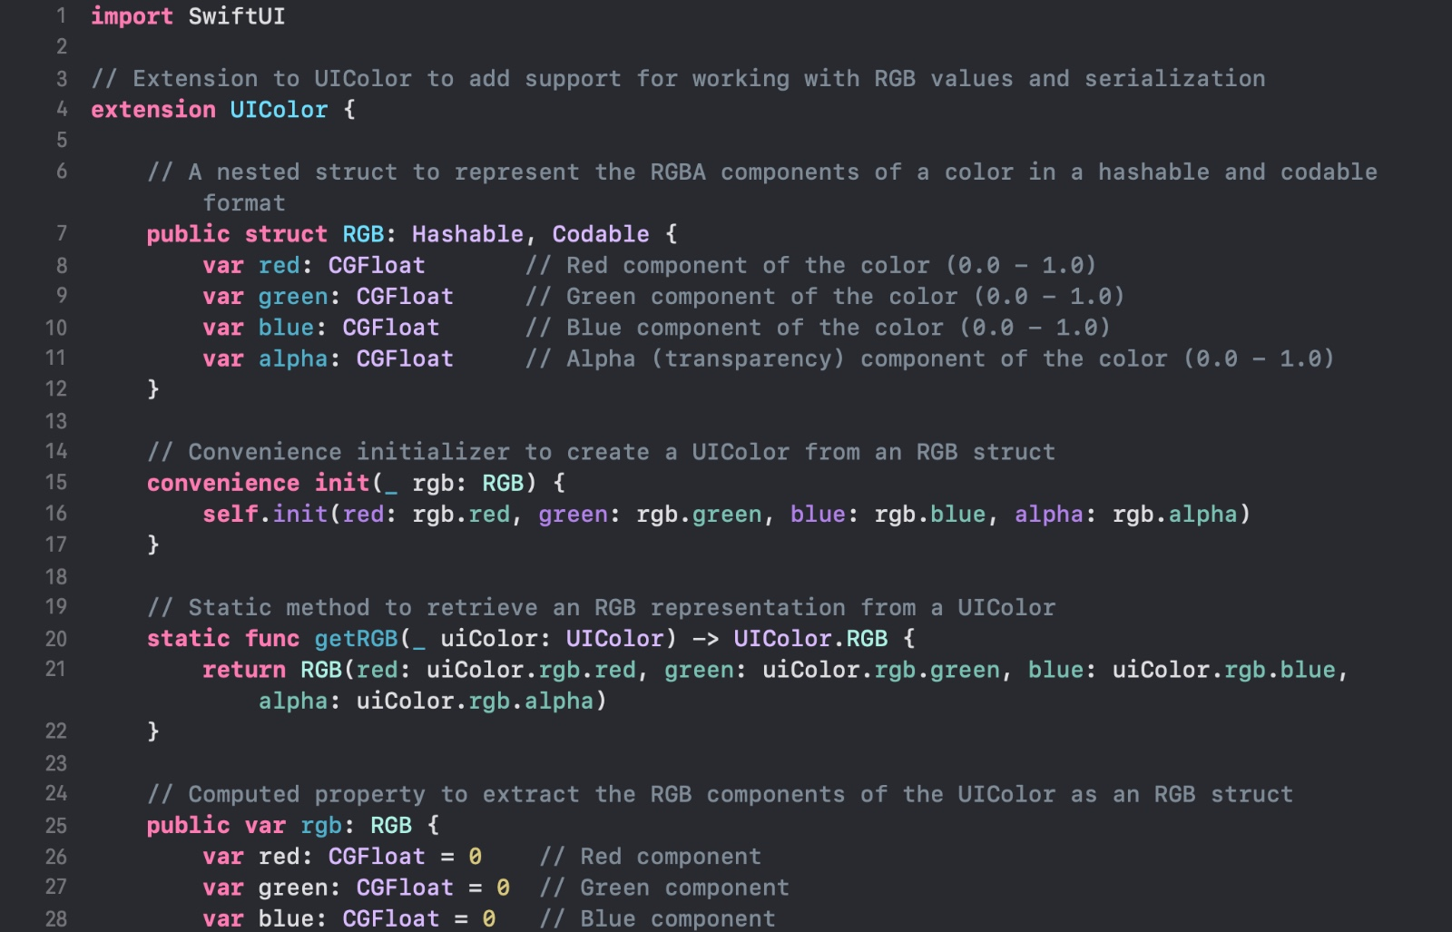
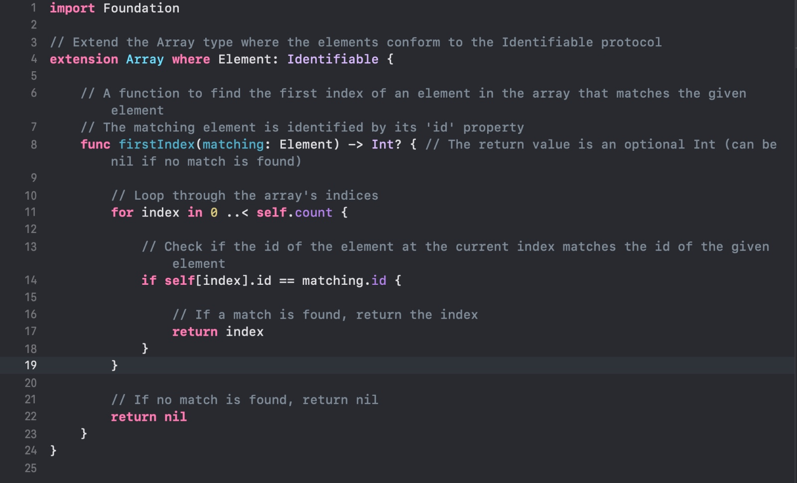
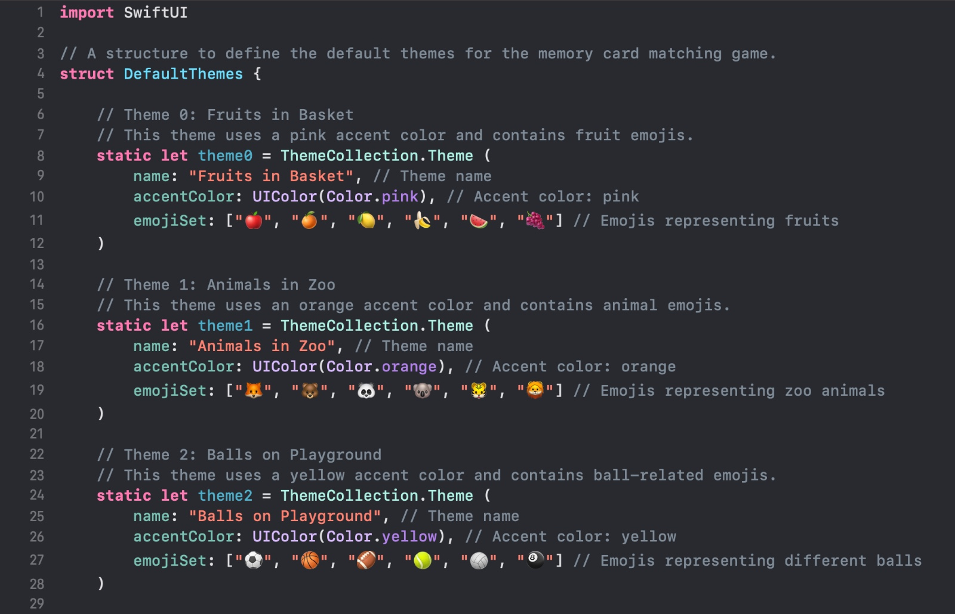
Supporting Utilities
Several supporting files enhance the functionality of our game:
Grid.swift & GridLayout.swiftProvides a generic grid layout to arrange cards dynamically based on screen size.
String+ToArray.swift Splits and merges strings into arrays of characters
Array+Identifiable.swift Finds elements by ID in arrays
DefaultThemes.swiftPredefines six themes with unique names, colors, and emoji sets.

Slide 13
Technical Highlights
Modular Design
1
Modular structure ensures scalability and maintainability
Framework Integration
2
Integrates frameworks like SwiftUI, SpriteKit, Combine, and CoreMotion.
Interactive Features
3
Responsive gameplay with motion controls and real-time animations
Performance Tracking
4
Performance tracking with detailed data visualization
This SwiftUI Memory Card Matching Game project demonstrates a well-structured, feature-rich application that leverages multiple iOS frameworks to create an engaging user experience. The modular design allows for easy maintenance and future expansions, while the interactive features and performance tracking add depth to the gameplay.

Slide 14


Conclusion and Vision
Combines logic, UI, animations, and performance tracking for an engaging experience.
• Provides a scalable, customizable, and user-friendly game.
• Future Enhancements:
Multiplayer mode.
Accessibility improvements.
Integration with Game Center for leaderboards.

