Slide 1

HERE is What we have for you READY4EMPLOYMENT
SMS Capabilities.
Voice Capabilities.
CV Templating.
Graphical Analysis of the placements so far.
Interactive Voice Response (IVR).
User Friendly Portal.
User friendly Forum for discussion.

Slide 2
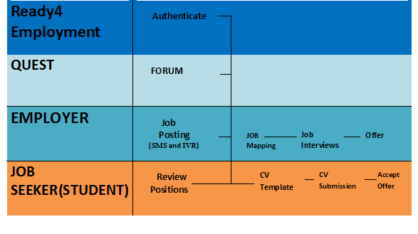
FLOW CHART

Slide 3

TECHNOLOGY USED
PHP
HTML
Java Script
MySQL
Bootstrap
Exotel (SMS API)
Google Charts API
JSON

Slide 4

ROAD MAP
Online Filtering- Selecting a candidate over others based on his qualities carefully observed.
Interactive Voice Response
Mobile Application- Taking a step forward to develop a Mobile application for this amazing web based application.
More SMS Capabilities

