Slide 1
Project Evaluation System
Made By :
Ayush Jain- 18012011026
Deepak Shah-18012011101

Slide 2
Introduction
The aim is to automate its existing manual system by computer software, fulfilling their requirements, so their valuable data/information can be stored for a longer period with easy accessing and manipulation of the same. Basically the project describes how to manage for good performance and better services for the students.
The 'Project Evaluation System' has been developed to override the problems prevailing in the practicing manual system. The application is reduced as much as possible to avoid errors while entering data. it also provides error messages while entering invalid data. No formal knowledge is needed for the user to use this system. It can assist the user to concentrate on their activities rather than to concentrate on record keeping. Thus it will help organizations in better utilization of resources.

Slide 3
Problem Statement
Every faculty has challenges to manage the information of the Assignment project and timesheet. This is designed to assist in strategic planning, and will help you to access information and details for your future goals. Our System comes with remote access features, which will allow you to manage your work anytime and anywhere. These systems will ultimately allow you to better manage resources.

Slide 4
Objective
The objective is to achieve systematic and objective assessment of ongoing projects of students and development effectiveness. This helps the faculty to store a student’s project statement and remarks. This also confirms that all project statements are different from one another. Also display that the team is regular or not. It helps in the development of student’s projects.

Slide 5
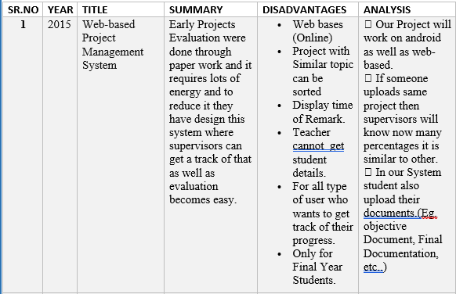
Literature Review Table

Slide 6
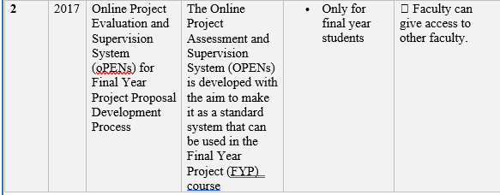
Literature Review Table (Cont.)

Slide 7
Hardware and Software Requirements
Hardware Requirements:
Device: Mobile phone or PC
Ram: 2GB
Software Requirements:
Browser: Safari/Firefox/Chrome
Internet connectivity speed: 256Kbps

Slide 8
Software Used
Front End :
Visual Studio for HTML,CSS,JS and Bootstrap
Back End :
Pycham for Python(Django)
Server – MySql WorkBench
Database – MySql

Slide 9
Safety Requirements
If there is extensive damage to a wide portion of the database due to catastrophic failure, such as a disk crash, there would be backup available of database.
User order status will be noted on database so that if server crash occurs in between then on system restart, it can cross-check with payment system provider for payment status decreasing payment failure chances.

Slide 10
Security Requirements
Data transfer
The system shall use secure sockets in all transactions that include any confidential users information.
Data Storage
The user’s web browser shall never display a user’s password. It shall always be echoed with special characters representing typed characters.
The system’s back-end servers shall never display a user’s password. The user’s password may be reset but never shown.

Slide 11
Software Quality Attributes
Availability
Correctness
Maintainability
Usability

Slide 12
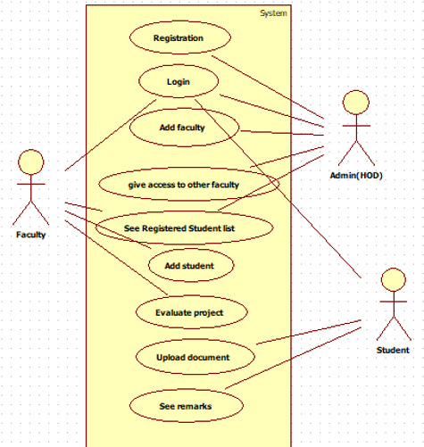
Use Case Diagram

Slide 13
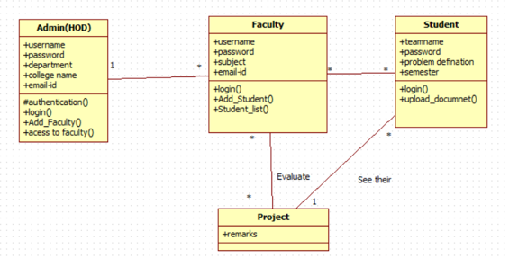
Class
Diagram

Slide 14
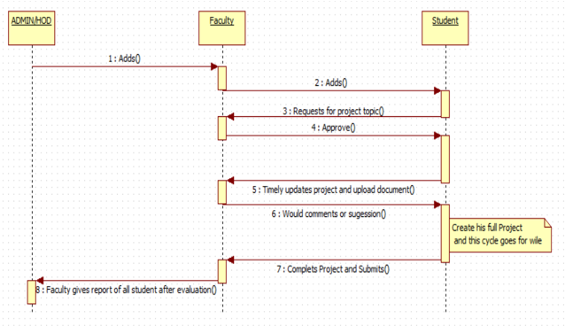
Sequence Diagram

Slide 15
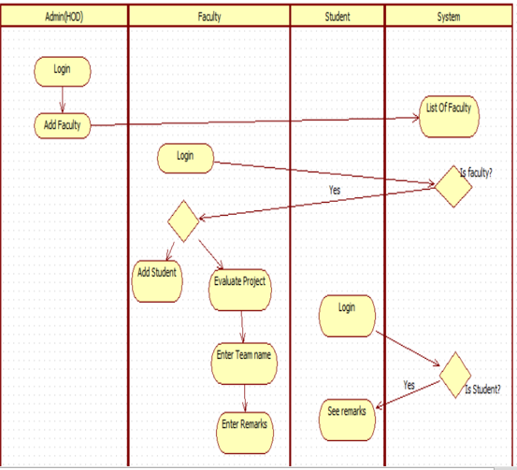
Activity Diagram

Slide 16
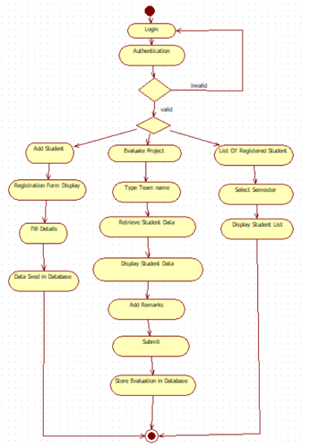
State Diagram

Slide 17
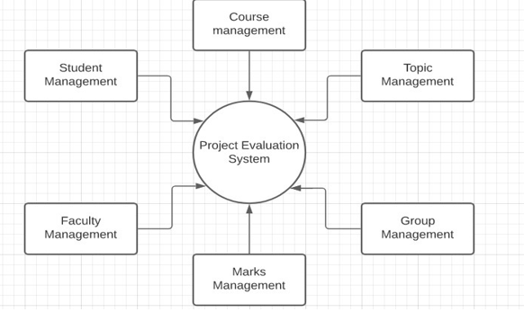
DATA FLOW DIAGRAM

Slide 18
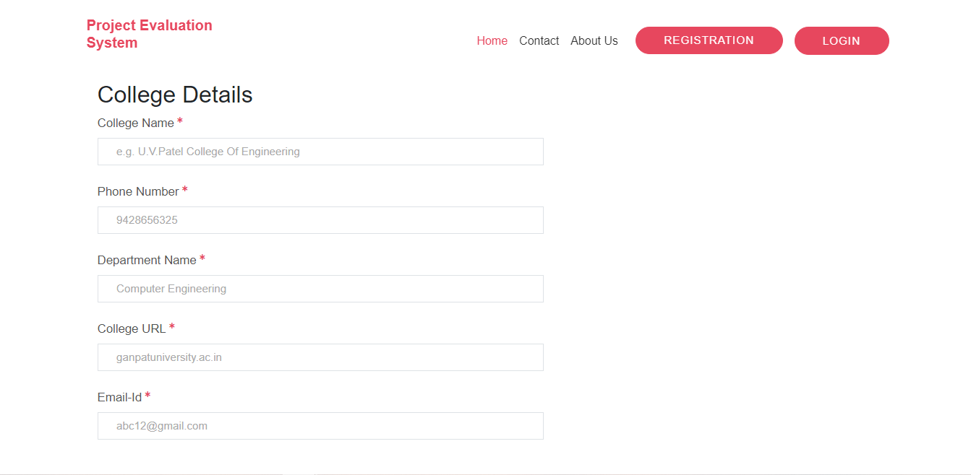
Implementation
Registration Page

Slide 19
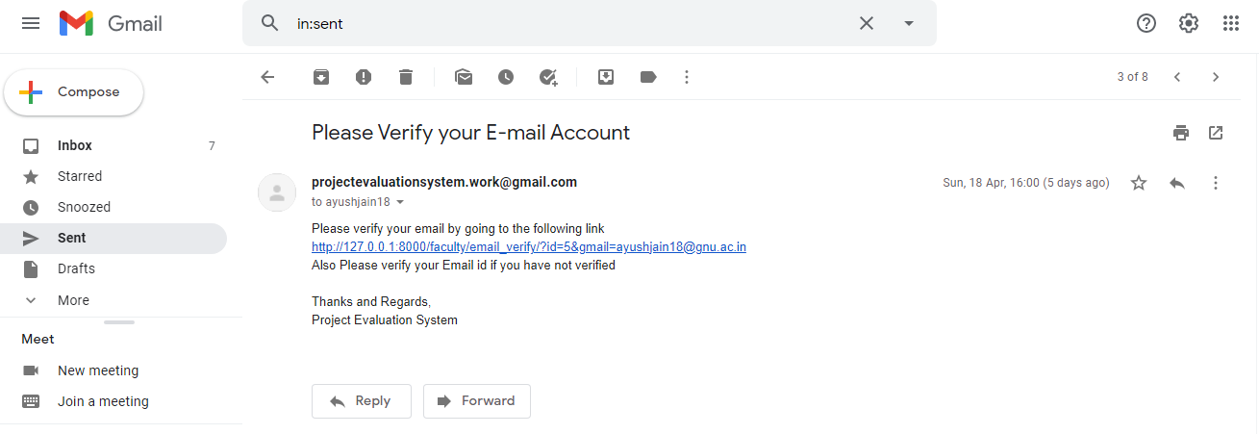
Implementation(Cont.)
Mail after
Registration

Slide 20
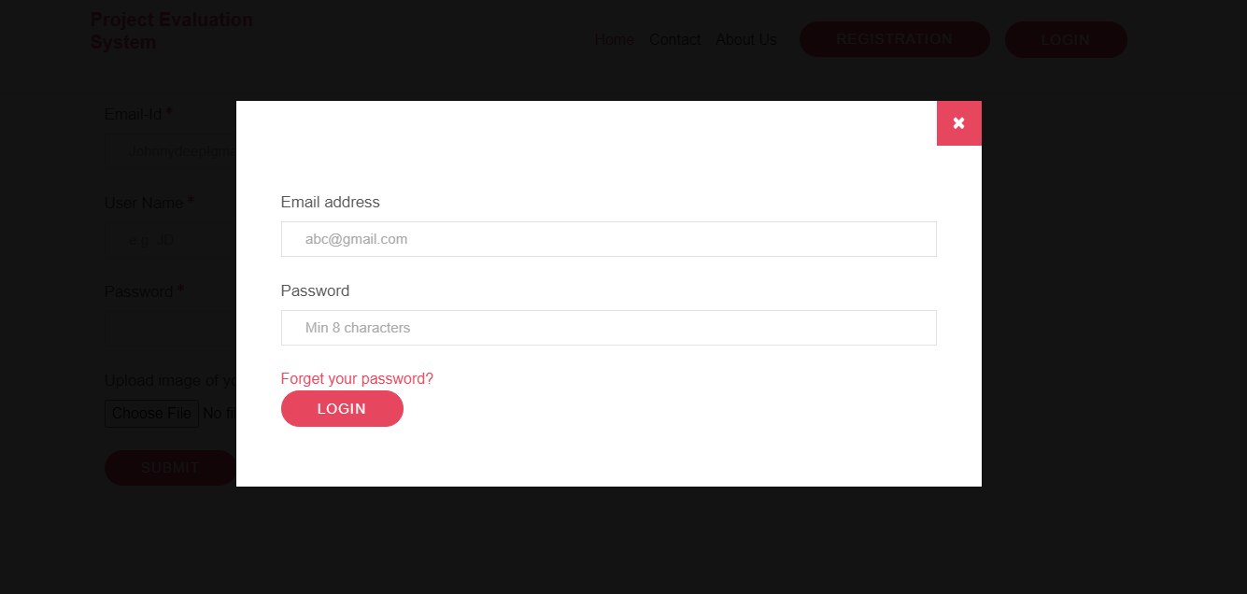
Implementation(Cont.)
Login Page

Slide 21
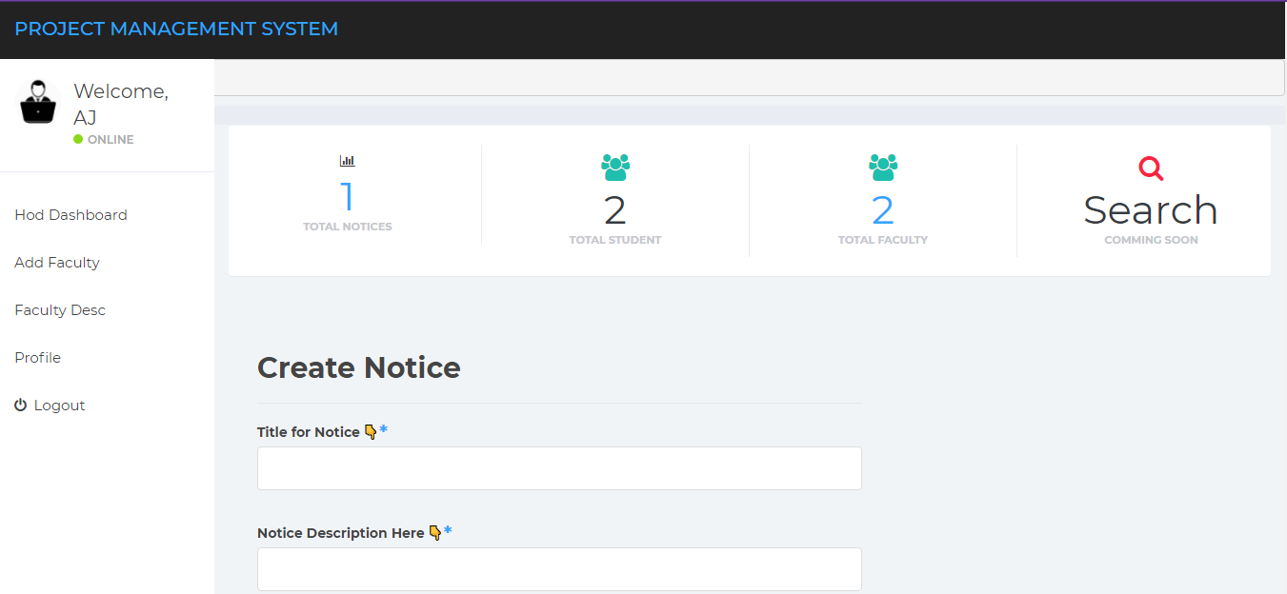
Implementation(Cont.)
HOD Dashboard

Slide 22
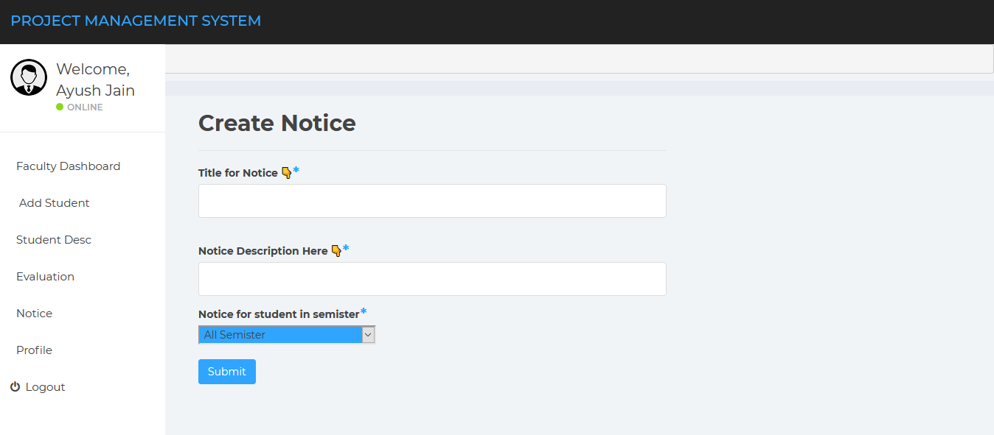
Implementation(Cont.)
Faculty
Dashboard

Slide 23
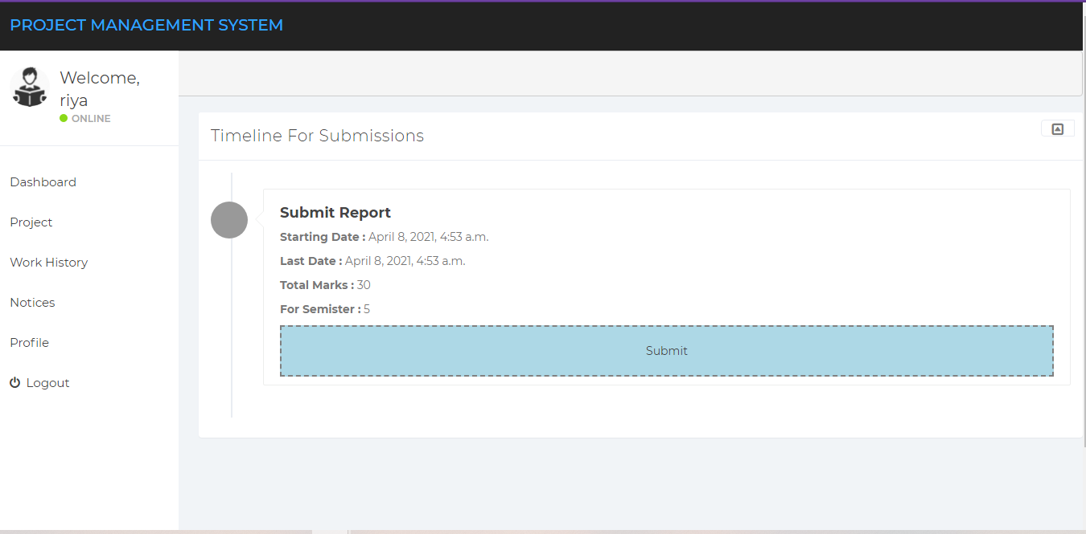
Implementation(Cont.)
Student Dashboard

Slide 24
Conclusion
A web-based project evaluation system was developed for faculty and students in order to enhance the projects evaluation process performance and increase their productivity. In addition, this web-based evaluation system convenience by offering them a web option for performing their evaluation tasks which can be available anywhere anytime.
In addition, the students can access the system and view their projects evaluation details like corrections and recommendations and grading.

Slide 25
REFERENCE
[1]https://www.researchgate.net/publication/26622086_Web-based_Projects_Evaluation_Management_System
[2] https://ieeexplore.ieee.org/document/8305392
[3] https://www.sciencedirect.com/science/article/pii/S221138191100138X
[4] https://www.researchgate.net/profile/Mohammad_Al_Zoubi/publication/26 62208 6 _Web-based_Projects_Evaluation_Management_System/links/5b93bff0 299bf147392 83a08/Web-based-Projects-Evaluation-Management-System.pdf

Slide 26
THANK YOU !!!
Submitted By:-
Ayush Jain-18012011026
Deepak Shah-18012011101

