Slide 1

VARDHAMAN COLLEGE OF ENGINEERING, HYDERABAD
Autonomous institute affiliated to JNTUH
DEPARTMENT OF COMPUTER SCIENCE & ENGINEERING(DATA SCIENCE)
Title: MediMesh AI — Explainable Multi-Hospital Care
BATCH ID : 24MPCSD-B20
S. No | Roll. No | Student Name
1 | 24881A6788 | K Safeeuddin Ahmed
2 | 24881A6789 | Kaila Varshitha
3 | 24881A67A8 | Pasam Lakshmi Rasagna
4
Guide Details
Faculty Name
Designation
Department of CSD

Slide 2
Mini Project Review-1 Outlines
Main idea of the Project
Existing System Vs Proposed
Proposed Project Objectives
Proposed Project Outcomes
Software and Hardware Requirements
Process Model
Architectural Diagram [Modified]
UML Diagrams — Use Case, Class, Sequence, Activity, State Chart
Proposed Methods and Algorithms [with working demo example]

Slide 3
Main idea of the Project
The problem
  Smaller hospitals still run booking, waiting, prescriptions and stock on disconnected registers.
  Patients cannot see the wait maths; reports are jargon; night staff is not who the app suggests.
The solution: MediMesh AI
  One affordable app for patient, doctor, nurse, pharmacist, receptionist and administrator.
  Three isolated hospitals (Sunrise, Lotus, Arogya). Stock never leaks. Only anonymised demand is pooled.
What is unique (not a generic HMS clone)
  Live OPD token on Confirm Appointment + dual wait: your turn vs hospital-wide HospitalFlow formula.
  Care Copilot routes by who is on this shift (day OPD / night nurse). It is not a diagnosis.
  Care Explainer in English / Hindi / Telugu + read-aloud, only after the doctor approves.

Slide 4
Existing System Vs Proposed
Aspect | Existing system | MediMesh (proposed)
Booking | Phone / walk-in registers, no slot visibility | Calendar booking; Confirm mints a live OPD token
Waiting | Unknown, blind wait | Dual wait: your turn maths vs hospital-wide HospitalFlow
Routing | Patient guesses the clinic | Care Copilot: right queue for this shift; emergency is not booked
Medical info | Jargon-heavy reports | Doctor-approved explainer EN / HI / TE + read-aloud
Handover | Verbal / paper, lossy | Signed day / night handover on the nurse dashboard
Pharmacy | Manual re-entry; stock guessed | Digital Rx; in / low / out; mesh demand without sharing stock
Access | Shared logins, no hospital wall | Role + hospital_id isolation (staff and stock stay inside one hospital)
Cost / scale | Built for large hospital chains | Affordable 3-hospital mesh for smaller facilities
DEPARTMENT OF CSD MINI PROJECT REVIEW-1

Slide 5
Proposed Project Objectives
Unify booking and live doctor availability across three hospitals, with hospital-level isolation.
Mint a live OPD token on confirm and show dual wait: people ahead × consult ÷ doctors vs HospitalFlow total.
Explain waits with a visible formula (queue, pharmacy, stock-outs, staffing, handover, crowd) — not a black box.
Route symptoms with Care Copilot to the staff on this shift; refuse diagnosis; divert chest tightness to casualty.
Simplify treatment in EN / HI / TE with read-aloud after the doctor approves the explainer.
Digitize prescription-to-pharmacy (in / low / out) and pool anonymised SKU demand for cheaper mesh buying.
Support day / night nurse handover that is written, signed and visible to the next shift.
Give administrators staffing sliders that recalculate HospitalFlow live, on a low-cost stack.

Slide 6
Proposed Project Outcomes
Patient sees a token and a wait they can argue with (your turn vs hospital-wide), like a Rapido ETA.
Same symptoms give different next steps by shift — night nurse now, GP when clinic opens.
Patients understand Metformin / recovery in their language; doctors stay accountable via approval.
Pharmacy knows in / low / out; mesh demand flags what three hospitals should buy together.
Handover is not lost between Kavitha (day) and Imran (night).
Queues, stock and files do not leak across Sunrise, Lotus and Arogya.
Admin can change doctors-on-duty and watch the formula move in the viva demo.
A reusable, affordable coordination template — not another Practo / HMS clone.

Slide 7
Software and Hardware Requirements
Category | Component | Choice
Software | Frontend | React + TypeScript + Vite + Tailwind (phone-shell UI)
Software | State / roles | MeshContext reducer; session picks hospital then role (demo login)
Software | Analytics AI | Python FastAPI HospitalFlow; same formula also runs on-device in TS
Software | Database | In-memory seed for demo; supabase/schema.sql with RLS by hospital_id
Software | Care Copilot | Rule-based, shift-aware routing (not an LLM diagnosis)
Software | Explainer | Doctor-approved cards + SpeechSynthesis (EN / HI / TE)
Hardware | Dev machine | i5 / Ryzen 5, 8GB+ RAM, Node 20, Python 3.11
Hardware | Server (pilot) | Local Vite :5173 + uvicorn :8000; cloud VM later
Hardware | Client devices | Smartphone or desktop browser
Hardware | Pharmacy | Optional barcode scanner later; demo uses tap to dispense

Slide 8
Process Model
Recommended model: Incremental / Agile
  Each review shows a working demo. Requirements stay allowed to change. Fits a small team.
Increment 1 — Multi-hospital login, role dashboards, calendar booking
Increment 2 — Care Explainer (EN/HI/TE + voice) and Care Copilot (shift-aware routing)
Increment 3 — Live token on confirm + dual wait + HospitalFlow FastAPI
Increment 4 — Pharmacy in/low/out, mesh buying power, admin staffing sliders

Slide 9
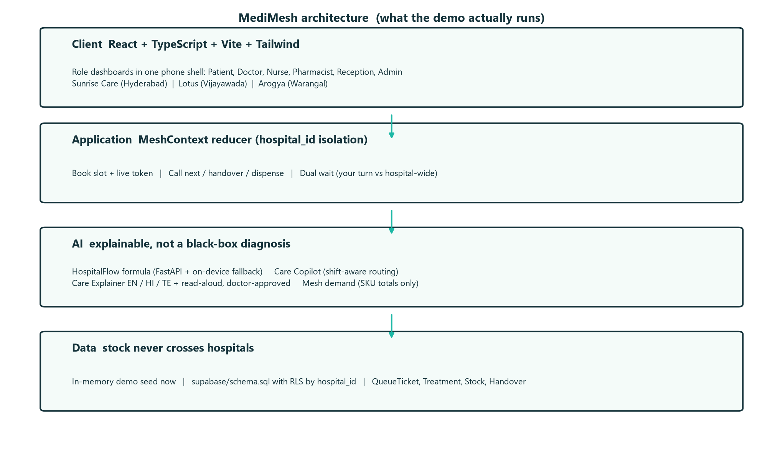
Architectural Diagram

Slide 10
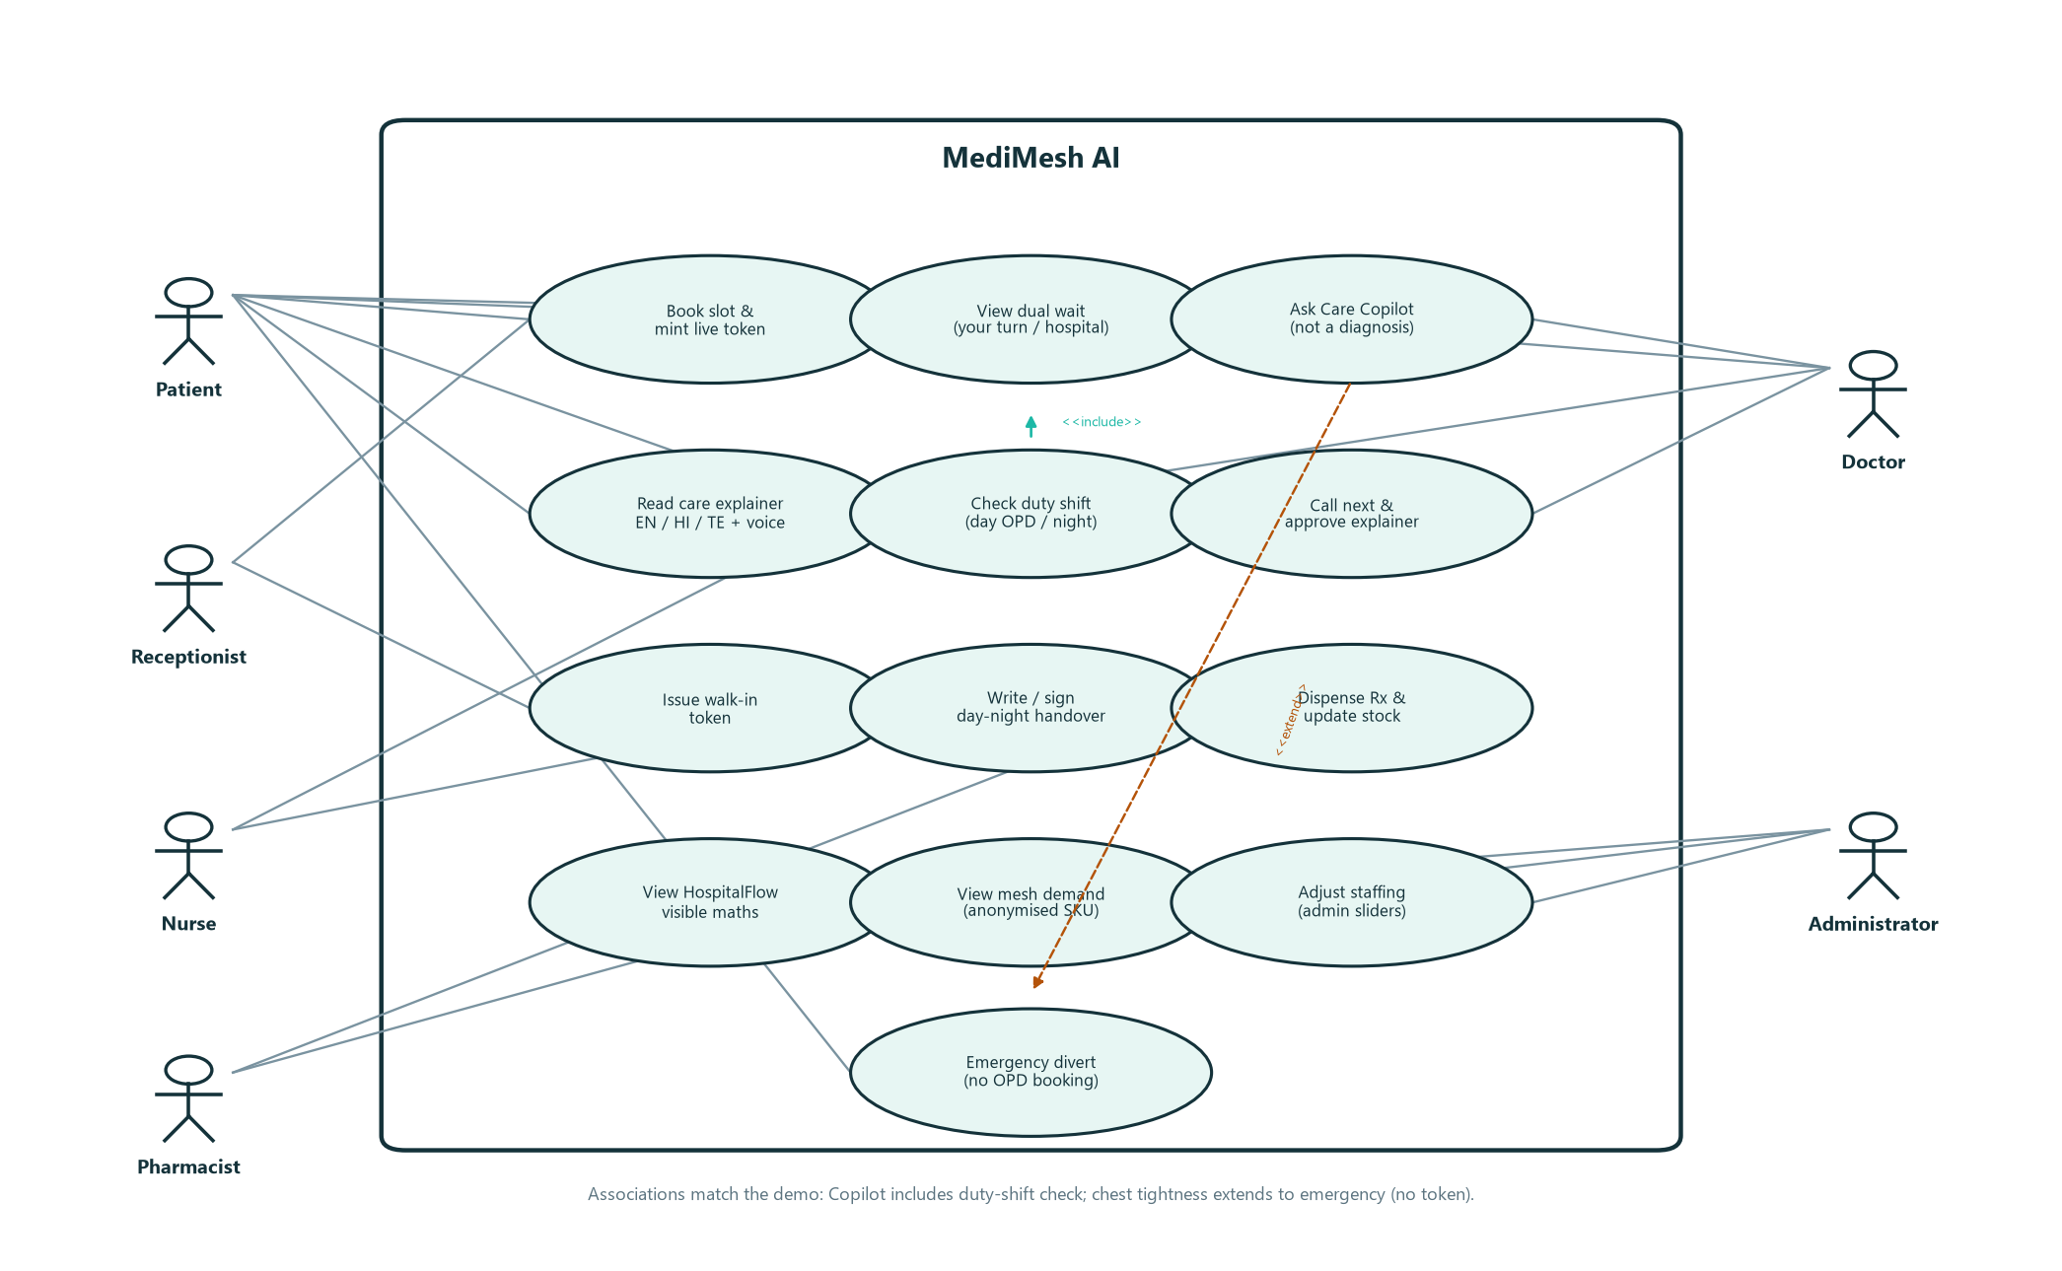
USE CASE DIAGRAM

Slide 11
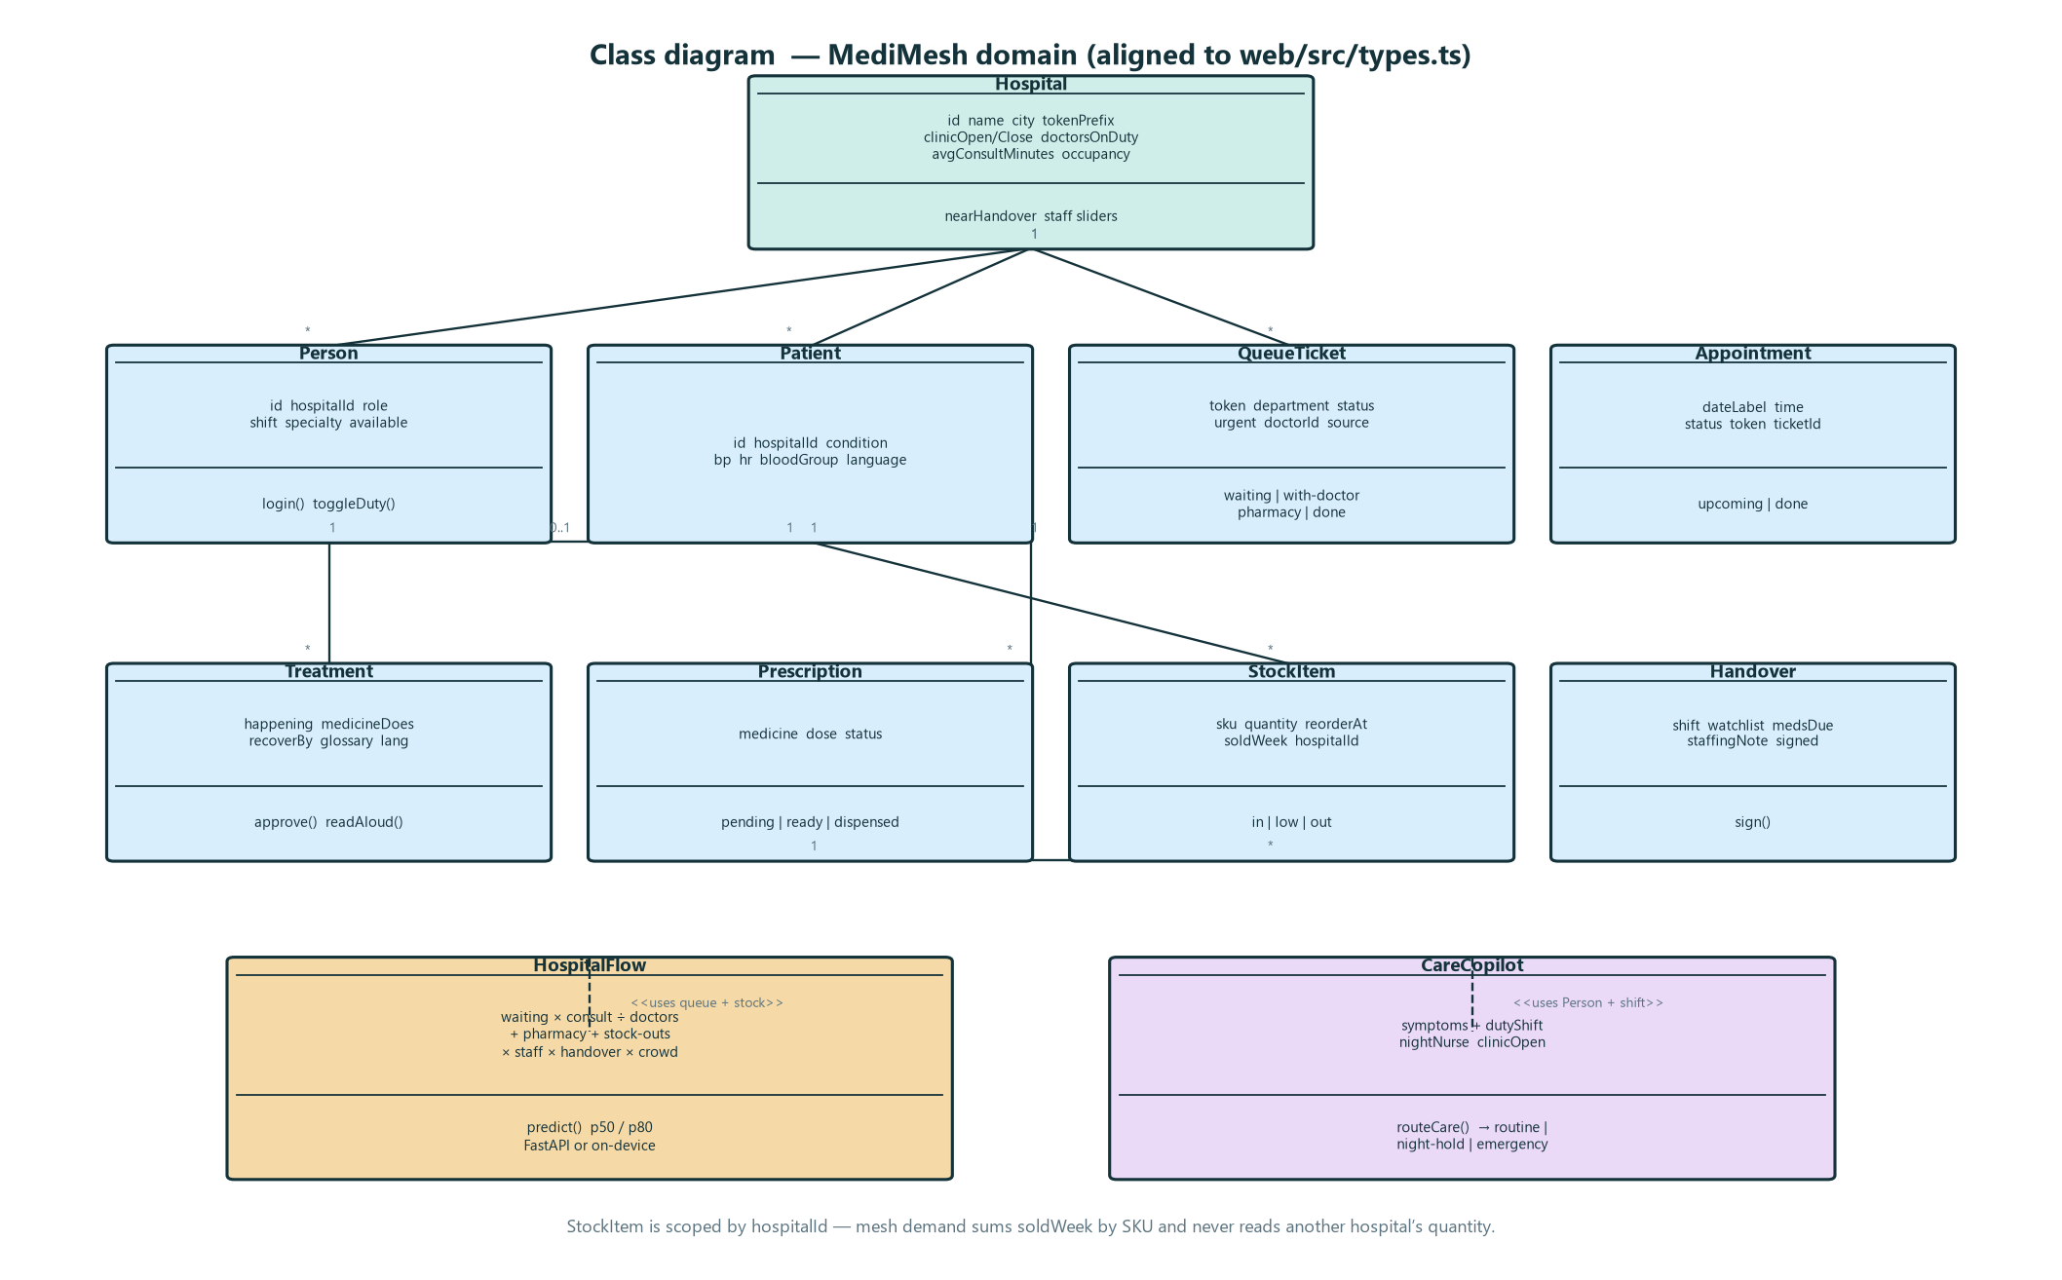
CLASS DIAGRAM

Slide 12
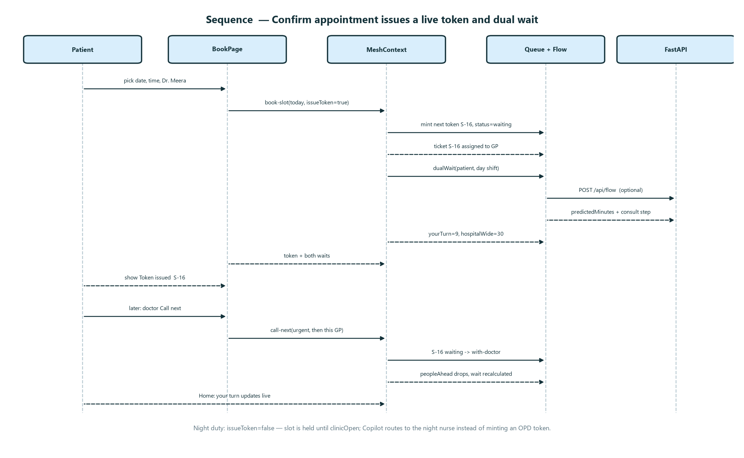
SEQUENCE DIAGRAM

Slide 13
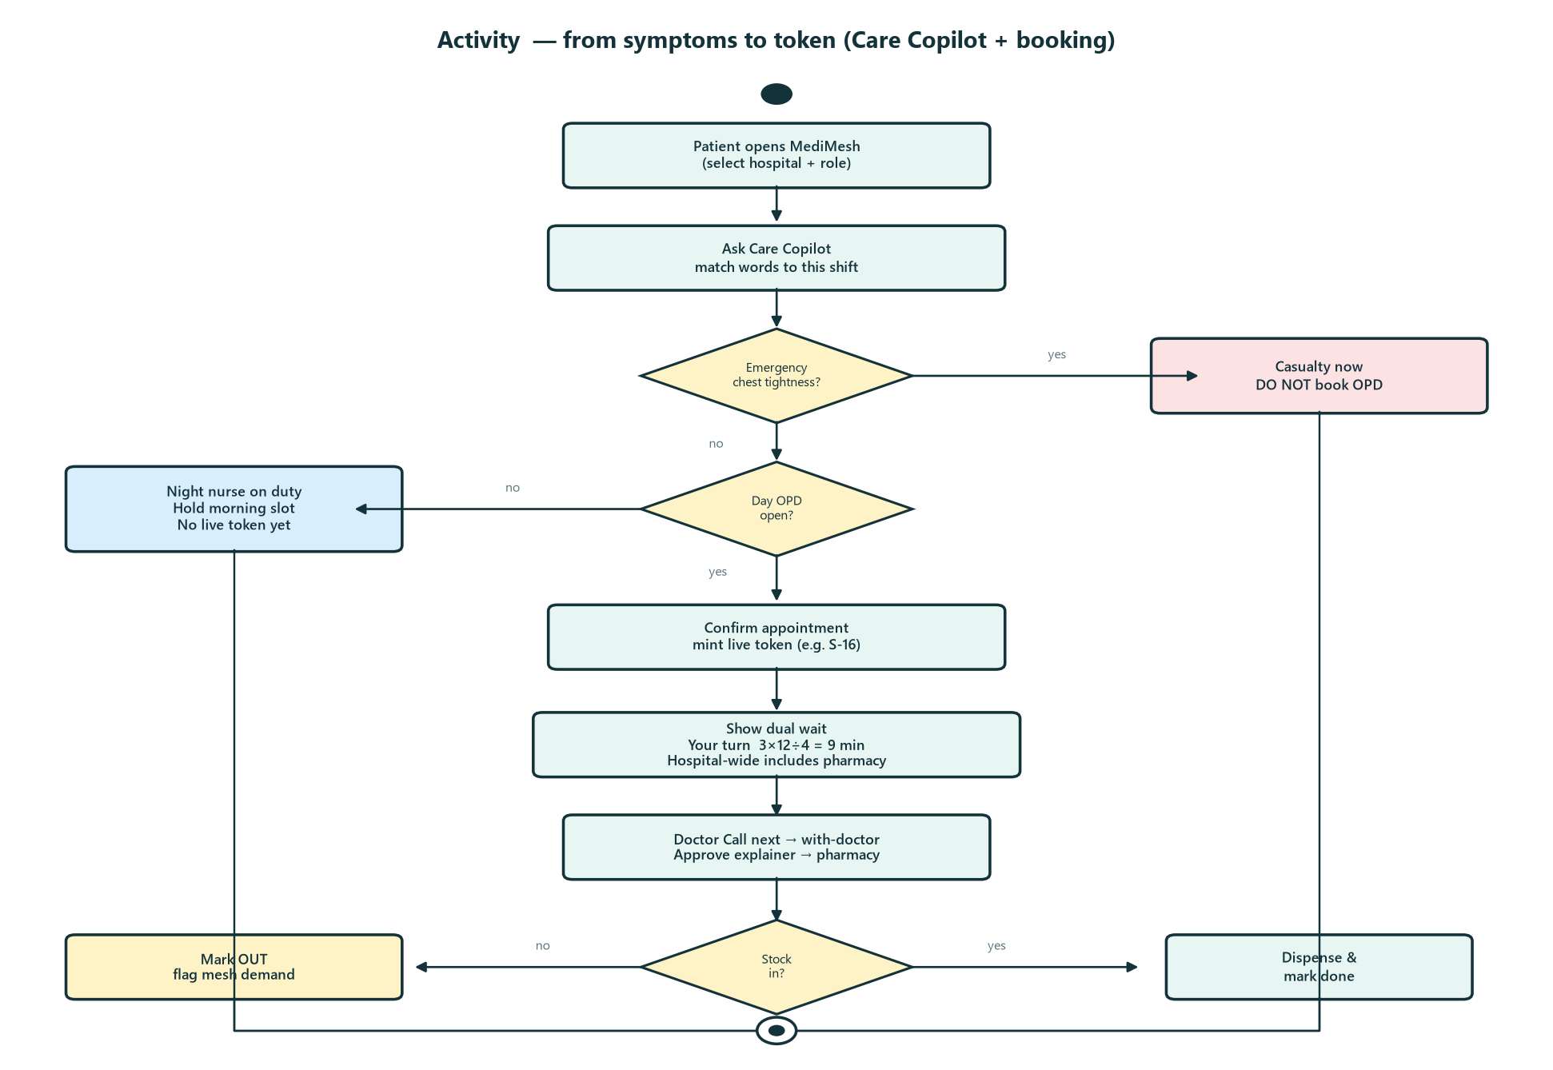
ACTIVITY DIAGRAM

Slide 14
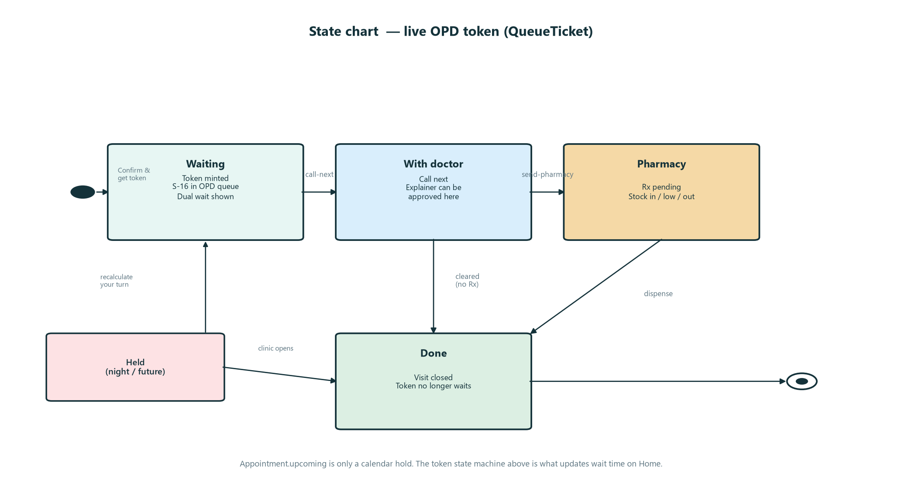
STATE CHART DIAGRAM

Slide 15
PROPOSED METHOD AND ALGORITHMS
HospitalFlow (visible wait formula)
  consult = waiting × avgConsult ÷ max(doctors,1); then + pharmacy + stock-outs×6; × staff × handover × crowd.
  Demo: 3 people × 12 min ÷ 4 doctors = 9 min YOUR TURN. Hospital-wide ~30 min includes pharmacy and crowd.
Care Copilot (shift-aware routing, not diagnosis)
  Match words to a specialty, then to who is on duty. Night → night nurse + hold morning slot. Chest tightness → casualty.
  Example: “thirsty and tired” + Day → Dr. Meera Iyer (GP) + Metformin. Same words + Night → Imran Shaik, clinic 08:00.
Mesh pharmacy intelligence (no stock sharing)
  Each hospital keeps its own quantity. Mesh only sums soldWeek by SKU and lists which hospitals are OUT.
  Example: Arogya Amlodipine quantity=0; Sunrise still has stock — Arogya cannot see Sunrise shelves.

Slide 16
Thank You

