Slide 1

APACHE SPARK & CUSTOMER CHURN ANALYSIS
Submitted by: Submitted to:
Ayush Bijawat Mr Deepa Modi

Slide 2
CONTENTS
1.HADOOP and MAPREDUCE
2.APACHE SPARK
3.RESILIENT DISTRIBUTED DATASETS
4.SPARK STACK
5.MLLIB : MACHINE LEARNING LIBRARY
6.EXAMPLES
7.CONCLUSION.

Slide 3
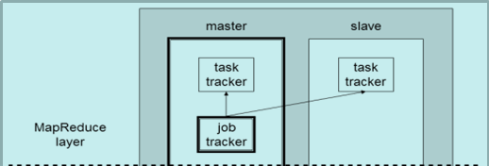
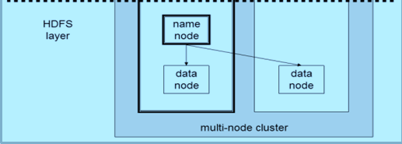
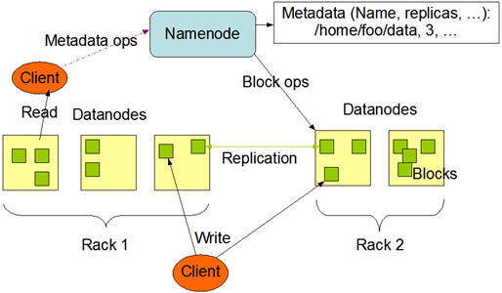
HADOOP
It’s an open-sourced software for distributed storage of large datasets on commodity class hardware in a highly fault-tolerant, scalable and a flexible way.
HDFS
It also provide a programming model/framework for processing these large datasets in a massively-parallel, fault-tolerant and data-location aware fashion.
MR
Map
Reduce
Input
Map
Output
Map
Reduce
Notes:
Hadoop brings the ability to cheaply process large amounts of data, regardless of its structure.
Large is basically 10-100 GBs and above only.
It is the driving force behind the big data industry growth.
Provides 2 basic components:
HDFS: Large Scale Storage System
Map Reduce: Distributed Cluster computing framework
Typical Hadoop setup comprises of :
Cluster of a particular Hadoop Distribution
Tools like Hive, Pig and Mahout running on top of Hadoop (internally processing HDFS data using Map Reduce jobs)
Set of tools for importing/exporting data into HDFS from/to external systems like RDBMS or Server Logs.

Slide 4
Limitations of MapReduce
HDFS read
HDFS write
HDFS read
HDFS write
Input
iter. 1
iter. 2
. . .
Map
Reduce
Input
Map
Output
Map
Reduce
Slow due to replication, serialization, and disk IO
Inefficient for:
Iterative algorithms (Machine Learning, Graphs & Network Analysis)
Interactive Data Mining (R, Excel, Adhoc Reporting, Searching)
Notes:
- One of the reason why Map Reduced is criticized is – Restricted programming framework
- MapReduce tasks must be written as acyclic dataflow programs
- Stateless mapper followed by a stateless reducer, that are executed by a batch job scheduler
- Repeated querying of datasets become difficult
- thus hard to write iterative algorithms
- After each iteration of Map-Reduce, data has to be persisted on disc for next iteration to proceed with processing.

Slide 5

About Apache Spark
Initially started at UC Berkeley in 2009
Fast and general purpose cluster computing system
10x faster than Mapreduce.
Most popular for running Iterative Machine Learning Algorithms.
Provides high level APIs in
Java
Scala
Python
Integration with Hadoop and its eco-system and can read existing data.
http://spark.apache.org/

Slide 6
What is Spark?
Not a modified version of Hadoop
Separate, fast, MapReduce-like engine
In-memory data storage for very fast iterative queries
General execution graphs and powerful optimizations
Up to 40x faster than Hadoop
Compatible with Hadoop’s storage APIs
Can read/write to any Hadoop-supported system, including HDFS, HBase, SequenceFiles, etc

Slide 7
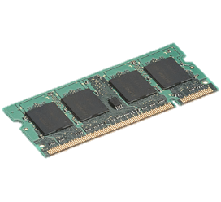

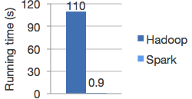
Comparison with Hadoop
HDFS read
iter. 1
iter. 2
. . .
Input
Not tied to 2 stage Map Reduce paradigm
Extract a working set
Cache it
Query it repeatedly
Logistic regression in Hadoop and Spark

Slide 8
Project Goals
Extend the MapReduce model to better support two common classes of analytics apps:
Iterative algorithms (machine learning, graphs)
Interactive data mining
Enhance programmability:
Integrate into Scala programming language
Allow interactive use from Scala interpreter
Notes:
Point out that Scala is a modern PL etc
Mention DryadLINQ (but we go beyond it with RDDs)
Point out that interactive use and iterative use go hand in hand because both require small tasks and dataset reuse

Slide 9
Programming Model
Resilient distributed datasets (RDDs)
Immutable, partitioned collections of objects
Created through parallel transformations (map, filter, groupBy, join, …) on data in stable storage
Can be cached for efficient reuse
Actions on RDDs
Count, reduce, collect, save, …
Notes:
You write a single program → similar to DryadLINQ
Distributed data sets with parallel operations on them are pretty standard; the new thing is that they can be reused across ops
Variables in the driver program can be used in parallel ops; accumulators useful for sending information back, cached vars are an optimization
Mention cached vars useful for some workloads that won’t be shown here
Mention it’s all designed to be easy to distribute in a fault-tolerant fashion

Slide 10
RDD’s
Resilient Distributed Datasets (RDD) are the primary abstraction in Spark – It is an immutable distributed collection of data, which is partitioned across machines in a cluster
There are currently two types:
parallelized collections : Take an existing Scala collection and run functions on it in parallel
External datasets : Spark can create distributed datasets from any storage source supported by Hadoop, including local file system, HDFS, Cassandra, HBase, Amazon S3, etc.

Slide 11
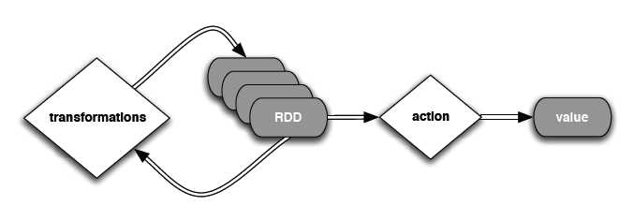
RDD’s(continued…)
Two types of operations on RDDs:
transformations and actions
A transformation is a lazy (not computed immediately) operation on an RDD that yields another RDD
An action is an operation that triggers a computation, returns a value back to the Master, or writes to a stable storage system

Slide 12
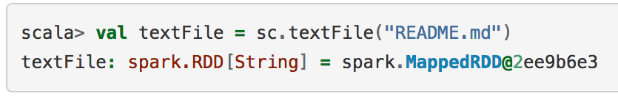
Operations
Programming Interface: Programmer can perform 3 types of operations:
Transformations
Create a new dataset from and existing one.
Lazy in nature. They are executed only when some action is performed.
Actions
Returns to the driver program a value or exports data to a storage system after performing a computation.
Persistence
For caching datasets in-memory for future operations.
Option to store on disk or RAM or mixed (Storage Level).
Notes:
Transformations: Like map – takes an RDD as an input, passes & process each element to a function, and return a new transformed RDD as an output.
By default, each transformed RDD is recomputed each time you run an action on it. Unless you specify the RDD to be cached in memory. Spark will try to keep the elements around the cluster for faster access.
RDD can be persisted on discs as well.
Caching is the Key tool for iterative algorithms.
Using persist, one can specify the Storage Level for persisting an RDD. Cache is just a short hand for default storage level. Which is MEMORY_ONLY.
MEMORY_ONLY
Store RDD as deserialized Java objects in the JVM. If the RDD does not fit in memory, some partitions will not be cached and will be recomputed on the fly each time they're needed. This is the default level.
MEMORY_AND_DISK
Store RDD as deserialized Java objects in the JVM. If the RDD does not fit in memory, store the partitions that don't fit on disk, and read them from there when they're needed.
MEMORY_ONLY_SER
Store RDD as serialized Java objects (one byte array per partition). This is generally more space-efficient than deserialized objects, especially when using a fast serializer, but more CPU-intensive to read.
MEMORY_AND_DISK_SER
Similar to MEMORY_ONLY_SER, but spill partitions that don't fit in memory to disk instead of recomputing them on the fly each time they're needed.
DISK_ONLY
Store the RDD partitions only on disk.
MEMORY_ONLY_2, MEMORY_AND_DISK_2 etc
Same as the levels above, but replicate each partition on two cluster nodes.
Which Storage level is best:
Few things to consider:
Try to keep in-memory as much as possible
Try not to spill to disc unless your computed datasets are memory expensive
Use replication only if you want fault tolerance

Slide 13
Transformations
Transformation & Purpose | Example & Result
filter(func) Purpose: new RDD by selecting those data elements on which func returns true | scala> val rdd = sc.parallelize(List(“ABC”,”BCD”,”DEF”)) scala> val filtered = rdd.filter(_.contains(“C”)) scala> filtered.collect() Result: Array[String] = Array(ABC, BCD)
map(func) Purpose: return new RDD by applying func on each data element | scala> val rdd=sc.parallelize(List(1,2,3,4,5)) scala> val times2 = rdd.map(_*2) scala> times2.collect() Result: Array[Int] = Array(2, 4, 6, 8, 10)
flatMap(func) Purpose: Similar to map but func returns a Seq instead of a value. For example, mapping a sentence into a Seq of words | scala> val rdd=sc.parallelize(List(“Spark is awesome”,”It is fun”)) scala> val fm=rdd.flatMap(str=>str.split(“ “)) scala> fm.collect() Result: Array[String] = Array(Spark, is, awesome, It, is, fun)

Slide 14
Actions
Actions & Purpose | Example & Result
count() Purpose: Get the number of data elements in the RDD | scala> val rdd = sc.parallelize(List(‘A’,’B’,’C’)) scala> rdd.count() Result: Long = 3
collect() Purpose: get all the data elements in an RDD as an Array | scala> val rdd = sc.parallelize(List(‘A’,’B’,’C’)) scala> rdd.collect() Result: Array[Char] = Array(A, B, C)
reduce(func) Purpose: Aggregate the data elements in an RDD using this function which takes two arguments and returns one | scala> val rdd = sc.parallelize(List(1,2,3,4)) scala> rdd.reduce(_+_) Result: Int = 10
take (n) Purpose: fetch first n data elements in an RDD. Computed by driver program. | Scala> val rdd = sc.parallelize(List(1,2,3,4)) scala> rdd.take(2) Result: Array[Int] = Array(1, 2)

Slide 15
How Spark Works
How Spark Works:
RDD: Parallel collection with partitions
User application create RDDs, transform them, and run actions.
This results in a DAG (Directed Acyclic Graph) of operators.
DAG is compiled into stages
Each stage is executed as a series of Task (one Task for each Partition).

Slide 16
Spark Stack

Slide 17
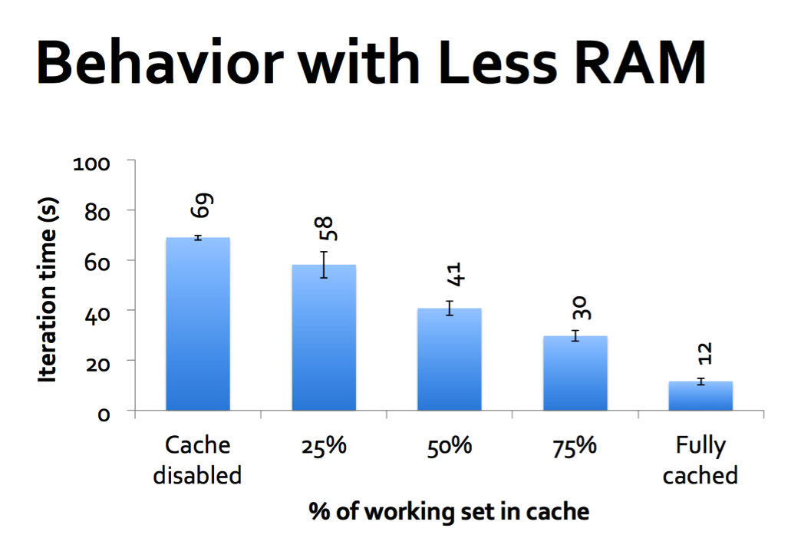
Persistence

Slide 18
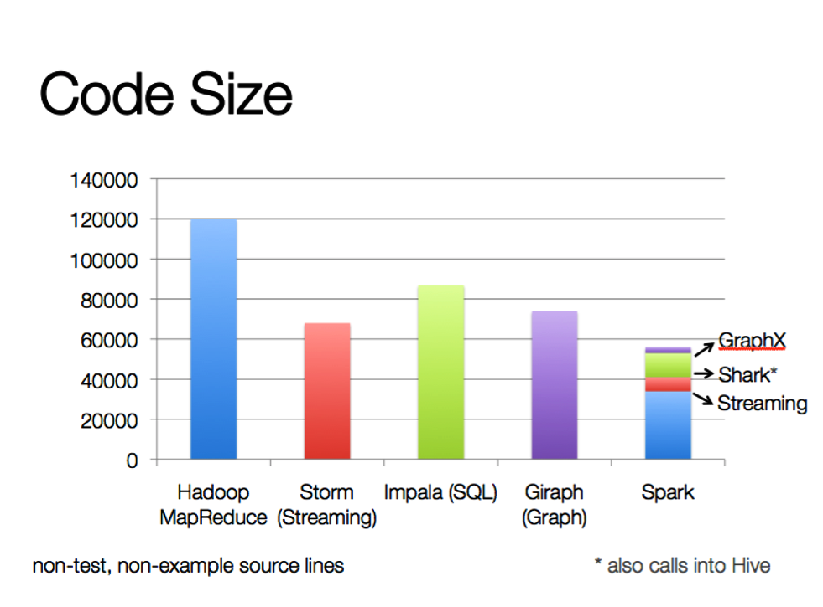
Comparisons
Programming at a higher level of abstraction : faster, easier development

Slide 19
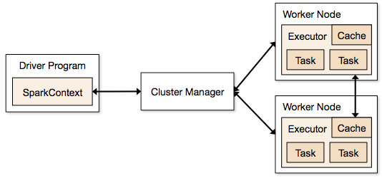
Execution Flow
http://spark.apache.org/docs/latest/cluster-overview.html

Slide 20
Discretized Stream Processing
live data stream
Spark
Streaming
Chop up the live stream into batches of X seconds
Spark treats each batch of data as RDDs and processes them using RDD operations
Finally, the processed results of the RDD operations are returned in batches
batches of X seconds
Spark
processed results
Run a streaming computation as a series of very small, deterministic batch jobs

Slide 21
What is MLLIB?
MLlib is a Spark subproject providing machine learning primitives:
•
initial contribution from AMPLab, UC Berkeley
•
shipped with Spark since version 0.8
•
33 contributors

Slide 22


Types of Machine Learning
Machine Learning
Interest rate
prediction
Regression
Supervised
Classification
Spam/No-spam
Unsupervised
Recommender Systems
Clustering
Social Network analysis
Netflix recommendation
Collaborative Filtering

Slide 23
K-Means(scala)
// Load and parse the data.
val data = sc.textFile("kmeans_data.txt")
val parsedData = data.map(_.split(‘ ,’))))))
// Cluster the data into two classes using KMeans.
val clusters = KMeans.train(parsedData, 2, numIterations = 20)
// Compute the sum of squared errors.
val cost = clusters.computeCost(parsedData) println("Sum of squared errors = " + cost)

Slide 24
K-Means Performance
127 s / iteration
first iteration 174 s
further iterations 6 s
Notes:
This is for a 29 GB dataset on 20 EC2 m1.xlarge machines (4 cores each)

Slide 25
Conclusion
Spark offers a rich API to make data analytics fast: both fast to write and fast to run
Efficient for iterative algorithms.
Achieves 10x speedups in real applications
Growing community with 25+ companies contributing
Supports real-time processing and machine learning algorithms.

Slide 26



