Slide 1
Personal Health Digital Twin
Simulate lifestyle changes before you commit to them
CRP Digital Twin Challenge 2026 (Happiest Health)
Ayush Kakulte | IIIT Jabalpur

Slide 2
Problem
Chronic lifestyle conditions (hypertension, prediabetes, obesity) build up silently over months
People get generic advice and cannot see how their own habits change their own numbers
Check-ups are snapshots; there is no way to test 'what if I sleep more and walk daily?'
Our question: how can people see in advance how their own habits will change their own health markers?
CRP Digital Twin Challenge 2026 | Ayush Kakulte, IIIT Jabalpur

Slide 3
Healthcare Use Case: Preventive Care
Individual: enter profile and habits, see projected BP, glucose, heart rate, weight and risk
Compare 'current habits' vs a 'what-if plan' side by side over 30-365 days
Coach / clinician: use the twin to motivate and personalise lifestyle plans
Focus: prevention and early behaviour change, not diagnosis
CRP Digital Twin Challenge 2026 | Ayush Kakulte, IIIT Jabalpur

Slide 4
Our Solution
A virtual copy of the user's key health markers that evolves day by day
Inputs: steps, sleep, calories, sodium, stress
Outputs: weight, systolic BP, fasting glucose, resting HR and a 0-100 risk score
Transparent, explainable model: every coefficient is readable and editable
Delivered as a Streamlit dashboard and a CLI demo, with unit tests
CRP Digital Twin Challenge 2026 | Ayush Kakulte, IIIT Jabalpur

Slide 5
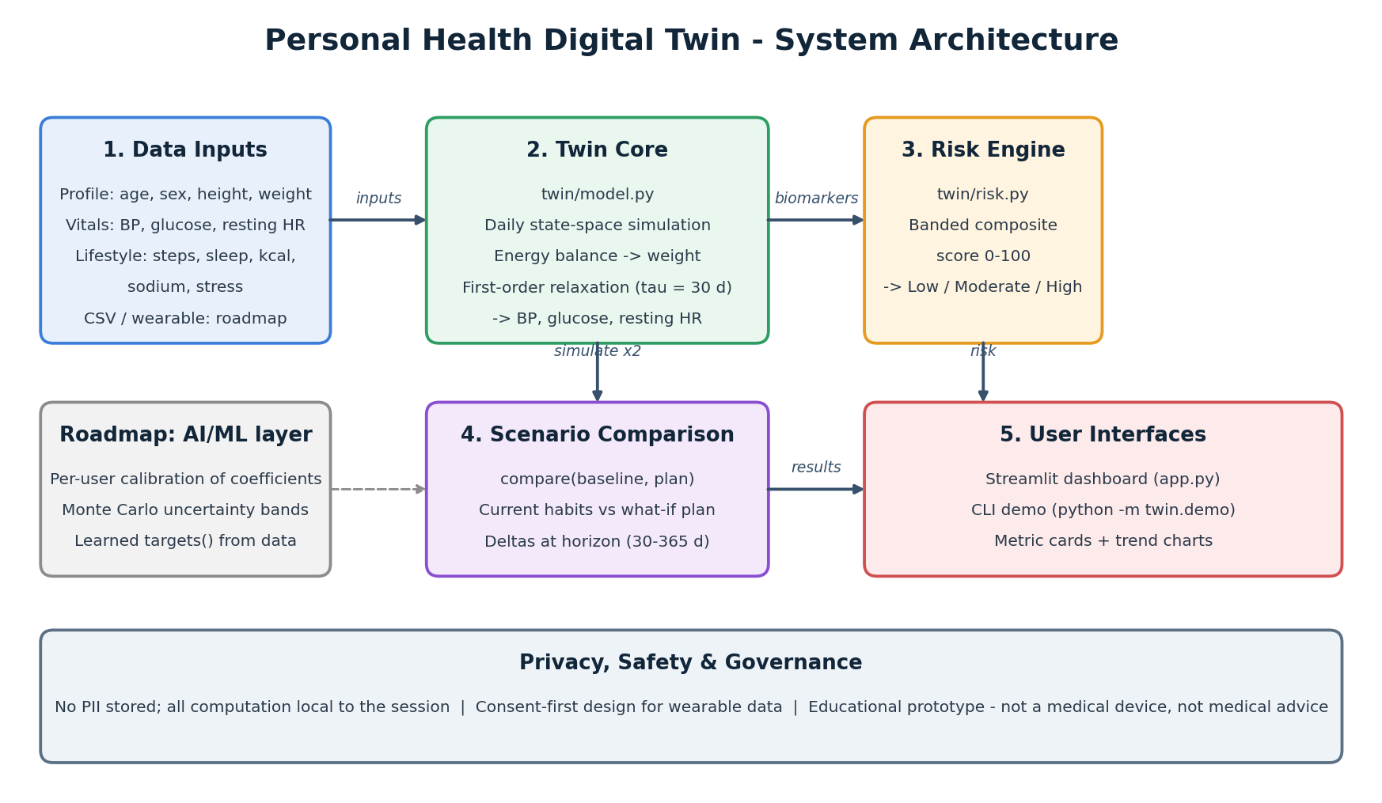
Architecture
CRP Digital Twin Challenge 2026 | Ayush Kakulte, IIIT Jabalpur

Slide 6
Model and AI/ML Framework
Mechanistic state-space model: weight from energy balance (Mifflin-St Jeor BMR + activity, 7700 kcal/kg)
BP, glucose and heart rate relax toward lifestyle-dependent targets (30-day time constant)
Composite risk score from banded biomarkers (BP, glucose, BMI, HR, age)
Stack: Python, NumPy, pandas, Streamlit, pytest
Honest status: coefficients are illustrative, not yet clinically validated; ML calibration is on the roadmap
CRP Digital Twin Challenge 2026 | Ayush Kakulte, IIIT Jabalpur

Slide 7
Outcome: Day-90 Simulation
Healthier plan vs current habits
9,000 steps, 7.5 h sleep, 2,200 kcal, 2.3 g sodium, low stress
Weight -5.2 kg
Systolic BP -9.5 mmHg
Glucose -9.0 mg/dL
Risk score -13.4 points
CRP Digital Twin Challenge 2026 | Ayush Kakulte, IIIT Jabalpur

Slide 8
Roadmap, Privacy and Impact
Calibrate to real wearable and lab data per user; add uncertainty bands (Monte Carlo)
Learn target functions from public datasets; clinician and coaching views
Privacy by design: no PII stored, computation local, consent-first data connection
Educational prototype; not a medical device and not medical advice
Impact: earlier, more motivated prevention at low cost
CRP Digital Twin Challenge 2026 | Ayush Kakulte, IIIT Jabalpur

