Slide 1
Programming in Java
Course:BCA201B
SYBCA SEM-IV
by
Prof. Punam Chaudhari

Slide 2
Introduction
POP Vs. OOP Programming
Why Java?
Java Applications;
stand-alone Java programs
Java applets, which run within browsers e.g. Netscape

Slide 3
Procedural vs. Object-Oriented Programming
The unit in procedural programming is function, and unit in object-oriented programming is class
Procedural programming concentrates on creating functions, while object-oriented programming starts from isolating the classes, and then look for the methods inside them.
Procedural programming separates the data of the program from the operations that manipulate the data, while object-oriented programming focus on both of them

Slide 4
Why Java?
It’s the current “Booming” language
It’s almost entirely object-oriented
It has a vast library of predefined objects and operations
It’s more platform independent
this makes it great for Web programming
It’s more secure
It isn’t C++

Slide 5
Java isn't C!
In C, almost everything is in functions
In Java, almost everything is in classes
There is often only one class per file
There must be only one public class per file
The file name must be the same as the name of that public class, but with a .java extension

Slide 6
Introduction
Java is a high-level programming language originally developed by Sun Microsystems and released in 1995. Java runs on a variety of platforms, such as Windows, Mac OS, and the various versions of UNIX.

Slide 7
Features of Java
It is easy to learn and simple to use
Object-Oriented Programming
It is open-source and free
Platform independent
Multithreading
Automatic garbage collecting system.
Exception handling
Distributed language

Slide 8
What is a class?
Early languages had only arrays
all elements had to be of the same type
Then languages introduced structures (called records, or structs)
allowed different data types to be grouped
Then Abstract Data Types (ADTs) became popular
Ex. Class

Slide 9
Applets, Servlets and Applications
An applet is designed to be embedded in a Web page, and run by a browser
Applets run with numerous restrictions; for example, they can’t read files and then use the network
A servlet is designed to be run by a web server
An application is a conventional program

Slide 10
Java Virtual Machine
The .class files generated by the compiler are not executable binaries
so Java combines compilation and interpretation
Instead, they contain “byte-codes” to be executed by the Java Virtual Machine
This approach provides platform independence, and greater security

Slide 11
Characteristics of Java
^{Java is simple}
^{Java is object-oriented}
^{Java is distributed}
^{Java is interpreted}
^{Java is robust}
^{Java is secure}
^{Java is architecture-neutral}
^{Java is portable}
^{Java’s performance}
^{Java is multithreaded}
^{Java is dynamic}

Slide 12
Cont…
Familiar, Simple & small
Java does not use Preprocessor header files, goto statement and many others
no pointers
automatic garbage collection
rich pre-defined class library http://download.oracle.com/javase/6/docs/api/index.html

Slide 13
Cont…
Object-Oriented
focus on the data (objects) and methods manipulating the data
Almost every thing in Java is Object.
all functions are associated with objects
almost all datatypes are objects (files, strings, etc.)
potentially better code organization and reuse

Slide 14
Cont…
Platform-Independent and Portable
Java is portable.
1) Java Complier generates bytecode that can be
implemented on any machine.
2) the sizes of the primitive data types are always the same
application runs on all platforms

Slide 15
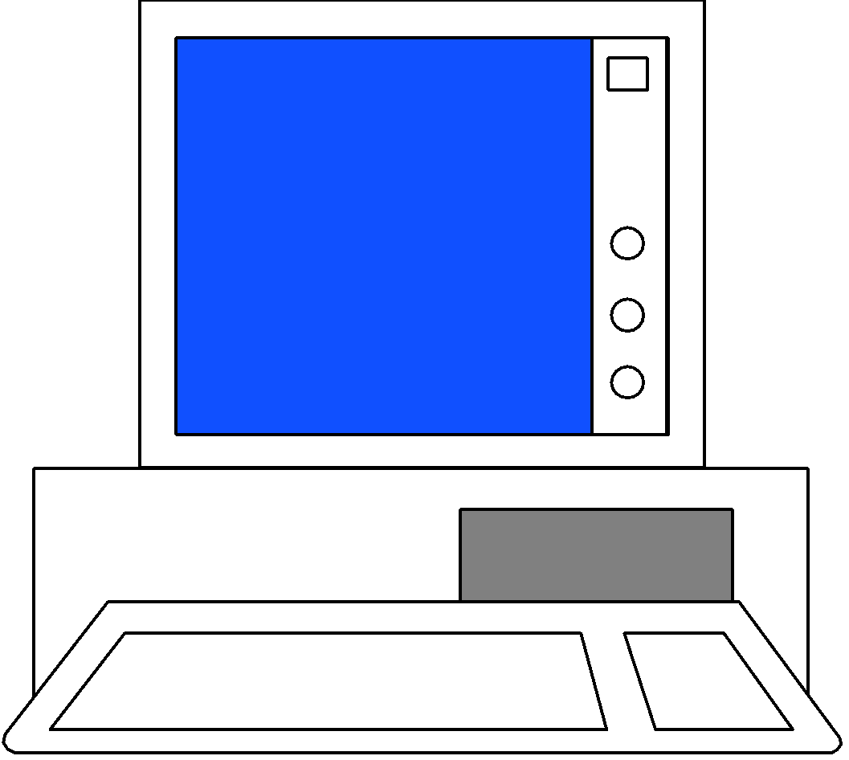
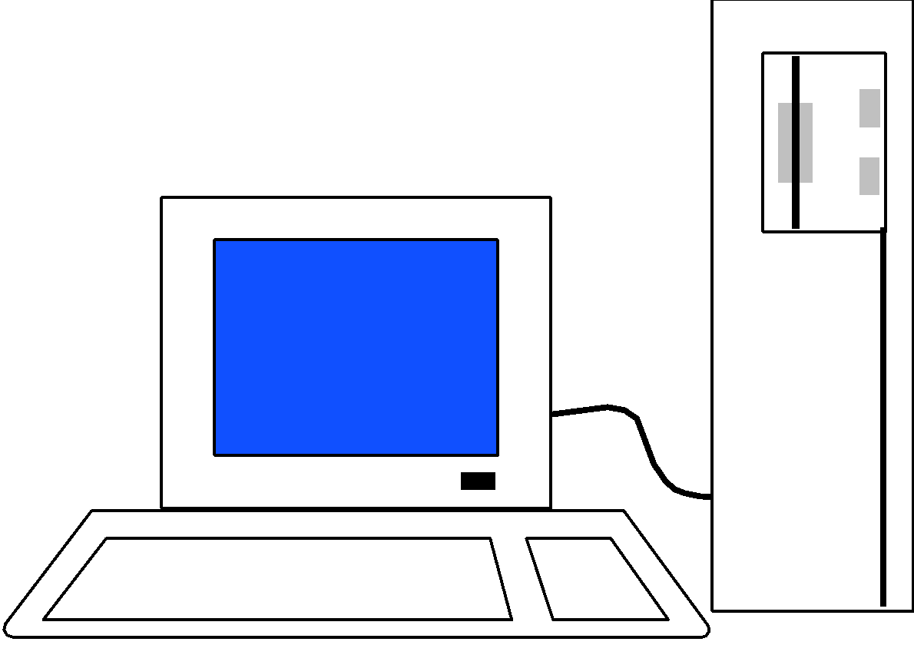
Cont…
JAVA COMPILER
(translator)
JAVA BYTE CODE
(same for all platforms)
JAVA INTERPRETER
(one for each different system)
Windows
Macintosh
Solaris
Windows NT

Slide 16
Cont…
Compiled and Interpreted
java compiler generate byte-codes, not native machine code
the compiled byte-codes are platform-independent
java bytecodes are translated on the fly to machine readable instructions in runtime (Java Virtual Machine)

Slide 17
Cont…
Programmer
Hardware and
Operating System
Source Code
Byte Code
Text Editor
Compiler
Interpreter
.java file
.class file
Notepad, vi
javac
java
appletviewer
netscape

Slide 18
Cont…
Robust and Secure
usage in networked environments requires more security
Provides many safeguard to ensure reliable code.
Strict compile time & run time type checking.
access restrictions are forced (private, public)

Slide 19
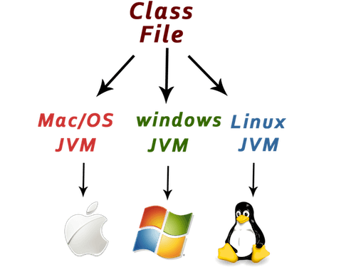

Slide 20
Structure of Java Program
Documentation Section
Package Declaration
Import Statements
Interface Section
Class Definition
Class Variables and Variables
Main Method Class
Methods and Behaviors

Slide 21
First Simple Program
Create a java file as HelloWorld.java
public class HelloWorld {
public static void main(String args[]) {
System.out.println("Hello World");
}
}

Slide 22
Continued….
To compile this program type the command shown below on your command prompt and press enter.
javac <Java_file_name>.java
Ex. javac HelloWorld.java
Once you hit enter, the HelloWorld .class file will be generated.
You will find both HelloWorld.java and HelloWorld.class among
the files in your working directory.
To run the program the following command is used:
java <Java file_name>
Ex. java HelloWorld

Slide 23
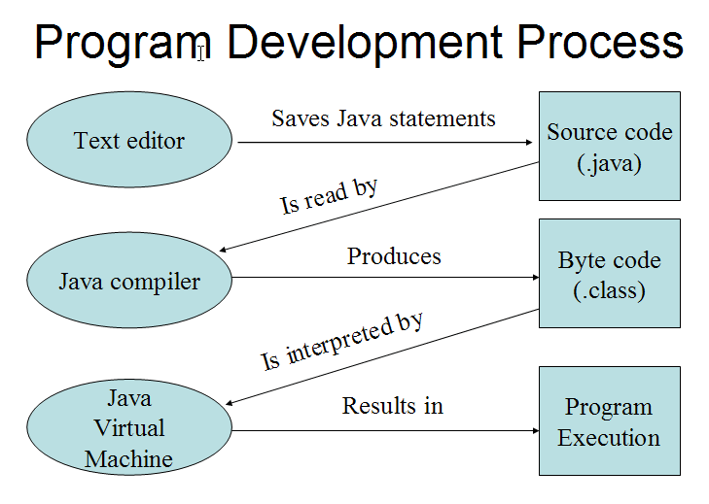

Slide 24
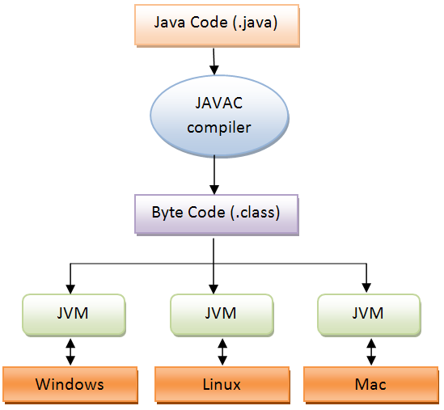

Slide 25
Real Time JAVA Applications
Java Standard Edition –
It is known as JSE or J2SE.
It is a very basic version and is the first flavor of Java Language.
This version of Java includes the basic application structure, Fundamental structure (Operator, Data type, OOP concept), Exception Handling and File handling. It is also known as core Java.
It is used to develop Desktop applications.

Slide 26
Continued…..
Java Enterprise Edition –
It is known as J2EE or JEE.
J2EE is build up from JSE with additional features for business purpose. It has extra libraries which can be used to develop JEE applications.
It is used to develop Web applications

Slide 27
Java Micro Edition
It is known as J2ME or JME.
It is used for developing device programs and mobile applications. Android is the best example for use of Java ME.
Continued…..

Slide 28
Continued…..
Java program development environment :
JDK (Java Development Kit) : JDK is a software development environment used to develop and execute(run) the Java program.
JDK is a kit(or package) which includes two things:
Development Tools(to provide an environment to develop your java programs)
Java Runtime Environment (JRE) (to execute your java program).

Slide 29
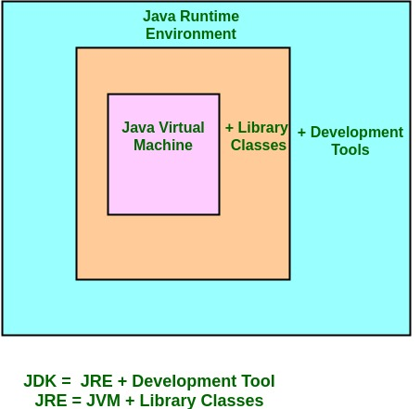
Java Development Kit (JDK)

Slide 30
Java Runtime Environment (JRE)
The Java Runtime Environment provides the minimum requirements for executing a Java application on your machine.
it consists of the Java Virtual Machine (JVM), core classes, and supporting files.

Slide 31
Java Virtual machine(JVM)
JVM is a very important part of both JDK and JRE because it is inbuilt in both. Whatever Java program you run using JRE or JDK goes into JVM and JVM is responsible for executing the java program line by line hence it is also known as interpreter.

Slide 32
Java Development Tools
appletviewer : This tool is used to run and debug Java applets without a web browser.
javac : It is a Java compiler, which converts source code into Java bytecode.
jar : It is a Java Archive File. It combines the several files (class libraries) into a single jar file. It is also used to create and manage java archive (jar) files.
java : The loader for Java applications. This tool is an interpreter and can interpret the class files generated by the javac compiler.

Slide 33
Java Development Tools
javah : the C header, used to write native methods.
javap : the class file disassembler, It converts the .class file(byte code) into source code(.java format)(human readable code).
jdb : the java debugger, it is used to debug the java program.
javadoc : It is used for generating java code documentation in HTML format from java source code.

Slide 34
Java Variables

Slide 35
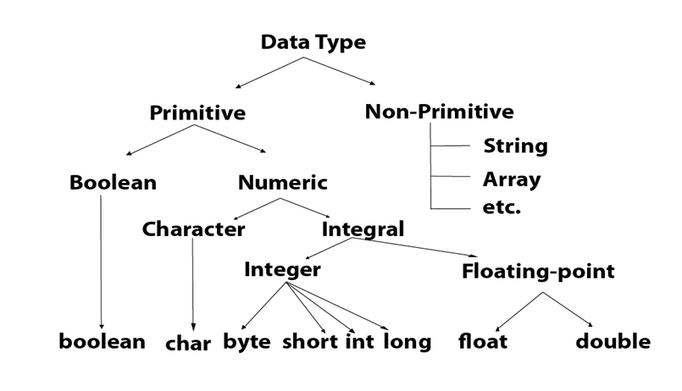
Data Types in java

Slide 36
Data Types in java
Primitive data types :
The primitive data types include byte, short, int, char, float, long, Boolean, double
Non-primitive data types :
The non-primitive data types include Classes(String), Interfaces and Arrays

Slide 37
Data Types Primitive Types
Type | Default | Size | Range
boolean | false | 1 bit | false, true
byte | 0 | 8 bits | -2^{8 –} (2⁸-1)
char | \u0000 | 16 bits | -2^{16 –} (2¹⁶-1)
short | 0 | 16 bits | -2^{16 –} (2¹⁶-1)
int | 0 | 32 bits | -2^{32 –} (2³²-1)
long | 0 | 64 bits | -2^{64 –} (2⁶⁴-1)
float | 0.0 | 32 bits | -/+(1.4e-45 – 3.4e+38)
double | 0.0 | 64 bits | -/+(4.94e-324 – 1.79e+308)
Notes:
Talk about what are primitive/inbuilt types and their default values and why they cannot fit into the Object Oriented model per se.
Talk about language provided – String, Date.
Also talk about User Data Type – Class/Enum.

Slide 38
Data Types
Wrapper classes around all primitive data types
e.g. :
Integer class is a wrapper of int .
String
Object to store a sequence of characters
Advanced Data Types
Arrays: to store set of values/objects of similar type
Collections: to store set of objects of different types
Notes:
Corresponding to all the primitive type there is a wrapper class defined
Why wrapper Classes?
It is not possible to simply re-declare a primitive variable to be an object.
2. These classes provide useful methods for manipulating primitive data values and objects
E.g. Integer count = new Integer(25);
The Integer class provides methods to extract this value as a byte, short, or int value.
the Integer class also provided an opportunity for the Java language to define a number of additional static methods
Strings: Explain that Strings are constant; their values cannot be changed after they are created.
StringBuffer supports mutable strings and String concatenation is implemented through the StringBuffer class and its append method.

Slide 39
Continued…..
Why do we need Wrapper class for every primitive data type?
This enables the primitive data types to be used in Object Oriented manner
If primitive data types do not support Object Oriented approach then why does Java as a OOP language support them?
It is faster and easier to process primitive data types at the machine level.
These can be used with out impacting the implementation of basic OOP concepts and platform independence of Java.

Slide 41
Thank You

