Slide 1
Software Systems Development and Integration
CSCI 2020U
Version Control
Mariana Shimabukuro
Acknowledgement: Parts of this course materials are based on material prepared by Randy Fortier.

Slide 2
Today we will…
Talk about GitHub Classroom
Learn about version control
  Definition
  Examples using Git

Slide 3
GitHub Classroom
Accepting and submitting assignments

Slide 4
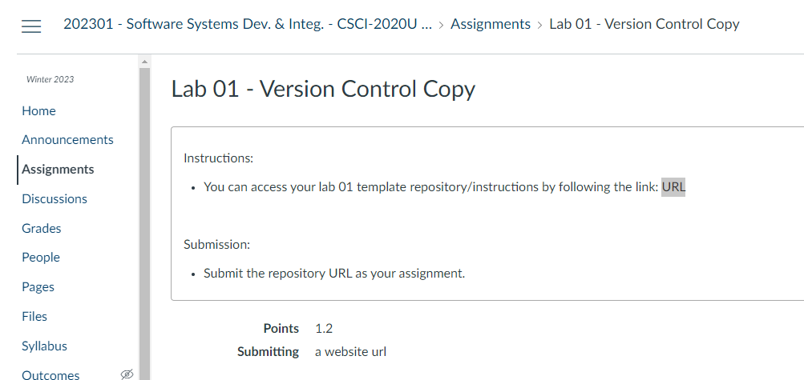
Canvas/Assignments

Slide 5
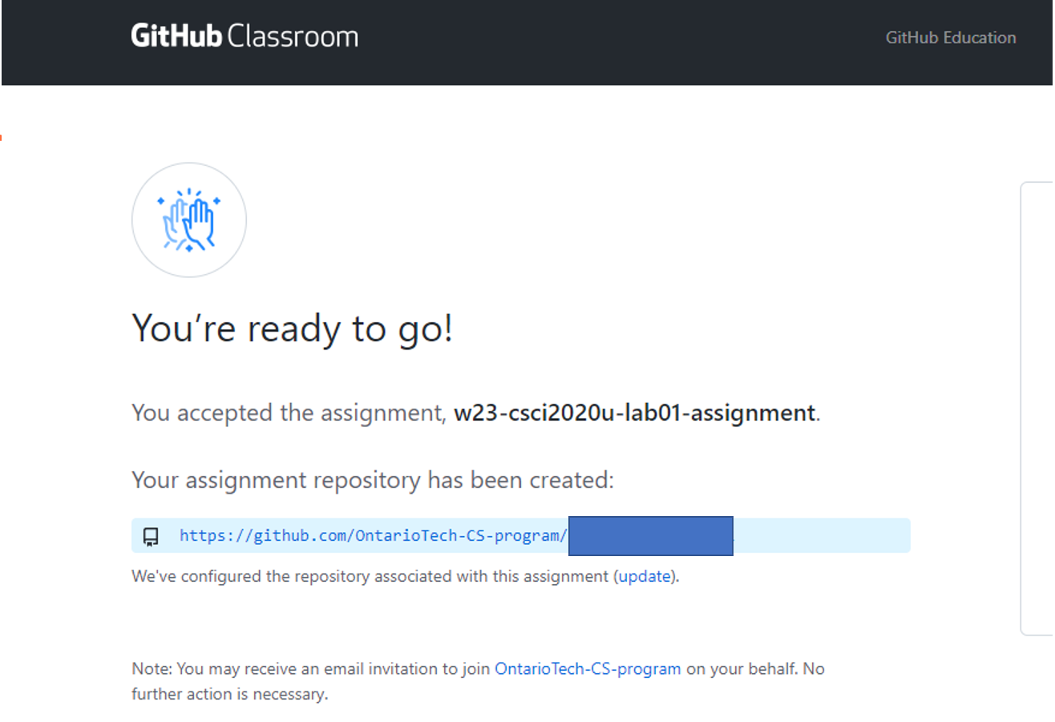
GitHub Classroom

Slide 6
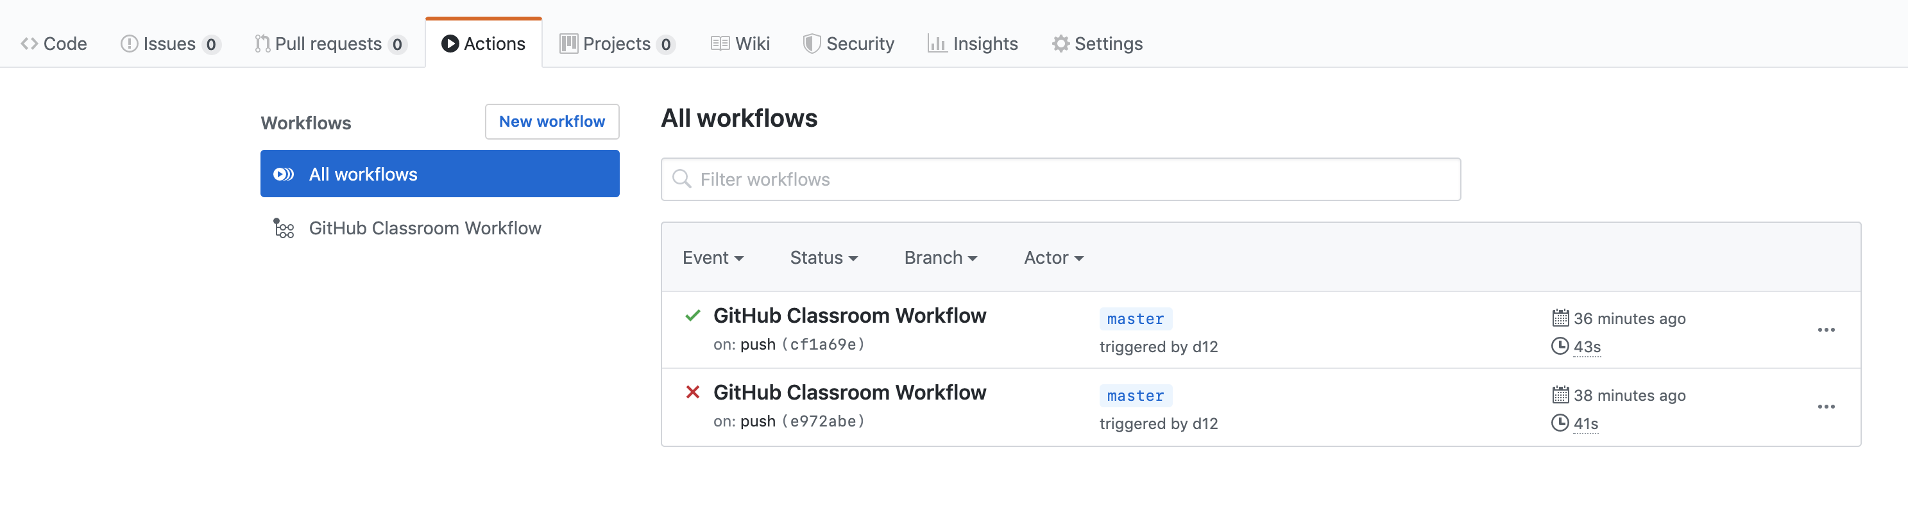
Viewing autograding results
Source: https://docs.github.com/en/education/manage-coursework-with-github-classroom/learn-with-github-classroom/view-autograding-results

Slide 7
Version control
What does it mean?

Slide 8
What is a version control software?
Software that records changes to files
Version control lets you:
  Revert to previous versions
  See the changes log
    Along with messages, who submitted, etc.
  Share your code with the rest of your team
    Including merging your work
  Backup/publish your work to a public repository
    e.g. GitHub, BitBucket

Slide 9
Types of version control
Centralized (obsolete)
  SVN
Distributed
  Git

Slide 10
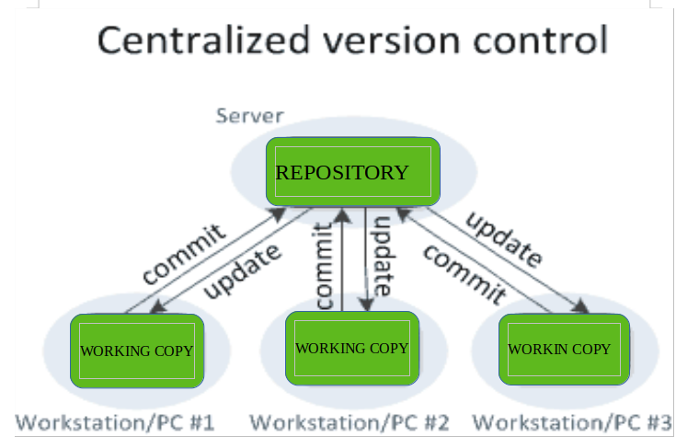
Types of version control: centralized
One server repository
All commits from all users are done into the same server repository
It can cause more conflict if more than one person work on the same file/module
  Changes need to be well coordinated within the team, e.g., locking files.
Source: https://www.geeksforgeeks.org/version-control-systems/

Slide 11
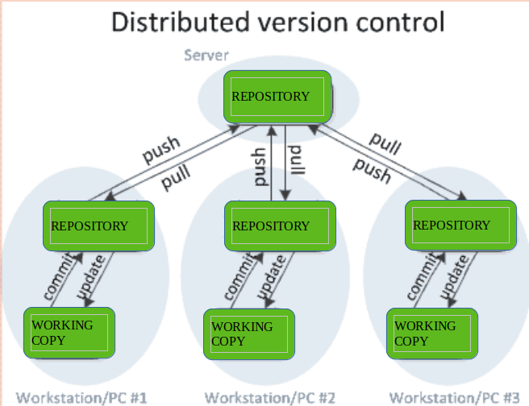
Types of version control: distributed
One server repository
One client repository to each user
User commit/update to their own repository
After testing, the client updates the server repository (push)
It allows more flexibility for collaboration in a team
Source: https://www.geeksforgeeks.org/version-control-systems/

Slide 12
Examples
Basic Git commands

Slide 13
GitHub Student
Sign up for the student developer pack (if you haven’t)
  https://education.github.com/pack
You don’t need to create a new account, just link your ontariotechu.net email
Allows you to use private repositories and other premium features

Slide 14
Getting started with a new project locally
Create you own local folder
  The folder you want to start the project at
  Going into the desired location (cd – change directory)
  Create a new folder
  Go inside the project folder
  cd /home/someworkfolder/
  mkdir myproj1
  cd myproj1

Slide 15
Creating a local repository
Setting the new folder as a Git repository
  Telling git to manage this folder
  Creating a new file
  Tell git to add everything (.) to be version controlled
    Alternatively, you can say the fie name, for ex. “newfile.txt”
  Commit the changes to the local repository
    Parameter –m : indicates the message describing the commit
  git init
  touch newfile.txt
  git add .
  git commit –m “initial commit”
Note: git manages FILES not folders, if a folder or its subfolders have no files inside, the folder won’t be “saved” into the git repository.
  For your initial commit to work you need to have a file in the folder

Slide 16
Making changes
As you work, you can create other files
  Creating another file
  Tell git to manage “otherfile.txt”
  Commit the changes to the local repository
  touch otherfile.txt
  git add otherfile.txt
  git commit –m “adding other file”

Slide 17
How to observe changes to the project
git status
  Shows the status of your project compared to the repository
  Ex. newfile.txt was modified
git diff --cached
  Shows the differences between versions in the files itself
  This is used to handle conflicts, where conflicts are when both version have different code at the same position.
  You will find those conflicts, then decide which version to keep, or if you will keep both by merging them together.
diff git diff --cached
--git a/library.cpp b/library.cpp
new file mode 100644
index 0000000..55d5de0
--- /dev/null +++ b/library.cpp
@@ -0,0 +1,3 @@
+void calculate(int a, int b) {
+ return a + b;
+}

Slide 18
Other tutorials
Adding locally hosted code to GitHub
https://docs.github.com/en/github/importing-your-projects-to-github/adding-an-existing-project-to-github-using-the-command-line

Slide 19
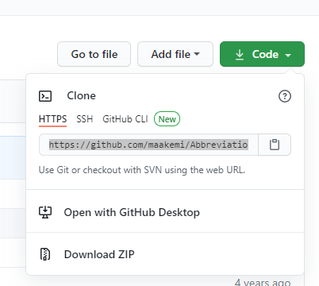
Getting started with remote repository
Create your repository via the Github website
  On your computer, clone the remote project your have just created using its URL
git clone https://github.com/user1/myproj2.git myproj2

Slide 20
Push to Remote Repository
If you make changes in your local repository
You can push changes back to the remote repository
  git commit -m "Added hashing"
  git push -u origin main

Slide 21
Downloading changes
If you are about to start work, it is best to update your code before you begin
Download any changes in the remote repository:
git pull

Slide 22
Other tutorials
https://docs.github.com/en/github/importing-your-projects-to-github/importing-a-git-repository-using-the-command-line

Slide 23
Customize your GitHub repo
.gitignore files: https://docs.github.com/en/get-started/getting-started-with-git/ignoring-files
readme.md files: https://docs.github.com/en/repositories/managing-your-repositorys-settings-and-features/customizing-your-repository/about-readmes
  README files use markdown language – also used in Jupyter notebooks
  Contain information about your project including how to run it
  How to write a good README file: https://www.freecodecamp.org/news/how-to-write-a-good-readme-file/
Example .gitignore file for a Java project
*.class
# Package Files #
*.jar
*.war
*.ear
touch .gitignore
touch README.md

Slide 24
Examples
Not basic Git commands

Slide 25
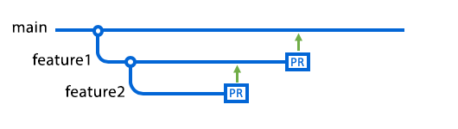
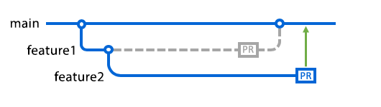
Branches
A branch is a separate changelog
  Any changes made to a branch do not affect other
  branches
  Useful for experimental features
About branches: https://docs.github.com/en/pull-requests/collaborating-with-pull-requests/proposing-changes-to-your-work-with-pull-requests/about-branches
  Sometimes branches are kept separate
    e.g. Mobile-optimized kernel
  Sometimes branches are merged
    e.g. When an experimental feature becomes stable
  In general, you are making big changes you use branching
  Please read more at: https://guides.github.com/introduction/flow/

Slide 26
Working with a branch
Create a new branch “webInterfaceVersion”
  git branch webInterfaceVersion
  git branch
Switch to your new branch
  git checkout webInterfaceVersion

Slide 27
Update branch and merge
You can make changes on your branch, then switch into the master branch to merge the other branch into master
  The master branch is the original main branch
  git checkout main
Merge branches
  git merge webInterfaceVersion
  At this steps, you might find conflicts, you can use git diff to find them

Slide 28
Other useful commands
git log
  View commit history
gitk
  View the commit history in a graphical window
You will be practicing this commands on your lab assignment

Slide 29
All tutorial links mentioned
https://docs.github.com/en/github/creating-cloning-and-archiving-repositories/creating-a-new-repository
https://docs.github.com/en/github/importing-your-projects-to-github/adding-an-existing-project-to-github-using-the-command-line
https://docs.github.com/en/github/importing-your-projects-to-github/importing-a-git-repository-using-the-command-line
https://education.github.com/pack
https://docs.github.com/en/get-started/getting-started-with-git/ignoring-files
https://docs.github.com/en/repositories/managing-your-repositorys-settings-and-features/customizing-your-repository/about-readmes
How to write a good README file: https://www.freecodecamp.org/news/how-to-write-a-good-readme-file/
https://docs.github.com/en/pull-requests/collaborating-with-pull-requests/proposing-changes-to-your-work-with-pull-requests/about-branches
https://guides.github.com/introduction/flow/
https://guides.github.com/

