Slide 1
Blinkit Sales Data Analysis
Business Intelligence Project
using Python, SQL , Power BI,Excel
created by
Ayush Kashyap
23FE10ITE00371
Manipal University Jaipur
under the guidance of
Dr.Pratishtha Mathur

Slide 2

Introduction
Blinkit is an Indian quick-commerce platform.
It delivers groceries and daily essentials in minutes.
This project analyzes sales data to understand business performance.

Slide 3

Business Problem
Retail businesses need answers to important questions:
• Which outlets generate the highest sales?
• Which products perform best?
• Which outlet type needs improvement?
Goal: Convert raw data into business decisions.

Slide 4

Dataset & Tools
Dataset: BlinkIT Grocery Sales Dataset
Python → Data cleaning and Exploratory Data Analysis (EDA).
SQL → Query data and calculate KPIs.
Power BI → Build an interactive dashboard and reports.

Slide 5
Project Workflow
1. Data Collection – Import CSV dataset.
2. Data Cleaning – Remove errors, duplicates and standardize values.
3. EDA – Explore patterns, trends and distributions.
4. SQL Analysis – Calculate KPIs and business metrics.
5. Dashboard – Create interactive visualizations.
6. Insights – Recommend business actions.

Slide 6

Important KPIs
Total Sales → Overall revenue generated.
Average Sales → Average revenue per product.
Average Rating → Customer satisfaction score.
Number of Items → Total products sold.
Filters → Analyze data by outlet, size or product.

Slide 7

Key Business Insights
• Tier 3 outlets generated the highest sales.
• Low Fat products contributed more revenue.
• Medium-sized outlets performed consistently.
• Supermarket Type 1 achieved the highest sales.
• Dashboard allows dynamic analysis using slicers.

Slide 8
Conclusion & Future Scope
Conclusion:
Interactive dashboard simplifies sales analysis.
Supports better business decisions.
Future Scope:
• Sales Forecasting
• Customer Segmentation
• Inventory Optimization
• Demand Prediction using Machine Learning

Slide 9
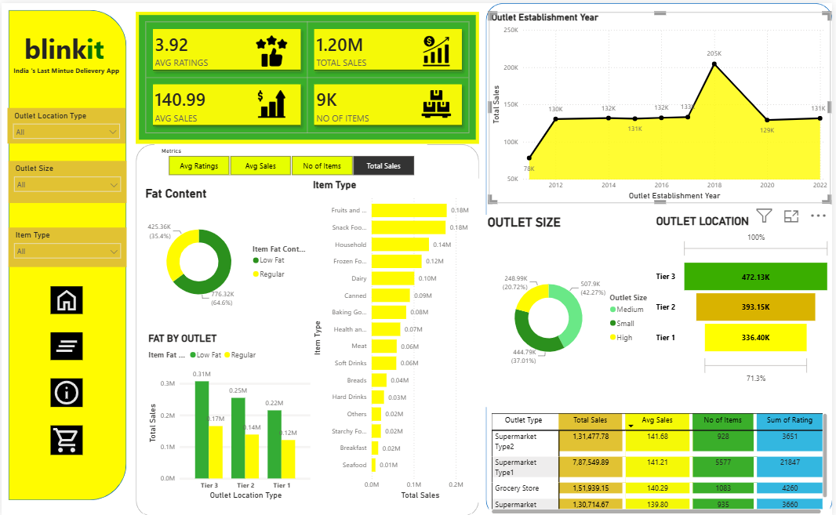

Slide 10
Thank You
Questions & Discussion

