Slide 1
Teach & Repeat Rover Navigation
Project update | Recorded-data simulation
Tapisar Singh
Ayush Kaulgud
Irenov Joel
October 7, 2026

Slide 2
How we built the recorded-data test
Recorded Freiburg University mapped data gave us the route and laser map.
Python parses scans and plans paths. PyBullet drives a Husky rover at 120 Hz.
Recorded route
15 offset starts
Four planners
Bullet runs
All four methods share the same 15 starts, map, controller, and safety checks.
Recorded inputs; simulated repeat runs. FYI - ICP remains a separate test.

Slide 3
What was recorded and simulated
Recorded outdoors
Our repeat trials
Freiburg Campus, July 2004: Pioneer 2AT with a SICK laser.
Four planners × 15 common starts = 60 Bullet runs.
The raw log contains 15,683 laser scans and odometry poses.
Offsets −1.2 to +1.2 m; headings −30°, 0°, +30°.
Scans 300–549 give a 29.59 m route; laser returns build the map.
Completion, rejection, contacts, clearance, goal error, and time.
Sensor observations are from there, isplaced starts and repeat drives are simulated and logged odometry is a route reference, so not independent ground truth.

Slide 4
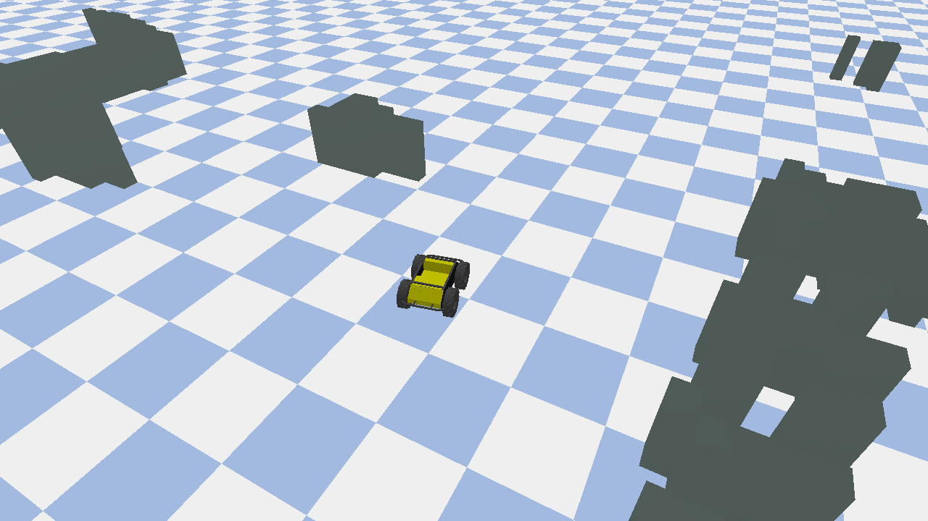
Recorded map, simulated run
RECORDED INPUT
29.59 m logged route
751 laser obstacle cells
SIMULATED REPEAT
Four planners × 15 starts
PyBullet Husky surrogate
Shared map and controller
ICP tested separately
The obstacle mesh comes from the Pioneer 2AT's recorded laser scans.

Slide 5
From recording to repeat run
Read route
›
Build map
›
Set start
›
Plan path
›
Drive + score
Four candidate paths
Direct waypoints
Local A* reconnection
Classical DMP
Obstacle-aware DMP

Slide 6
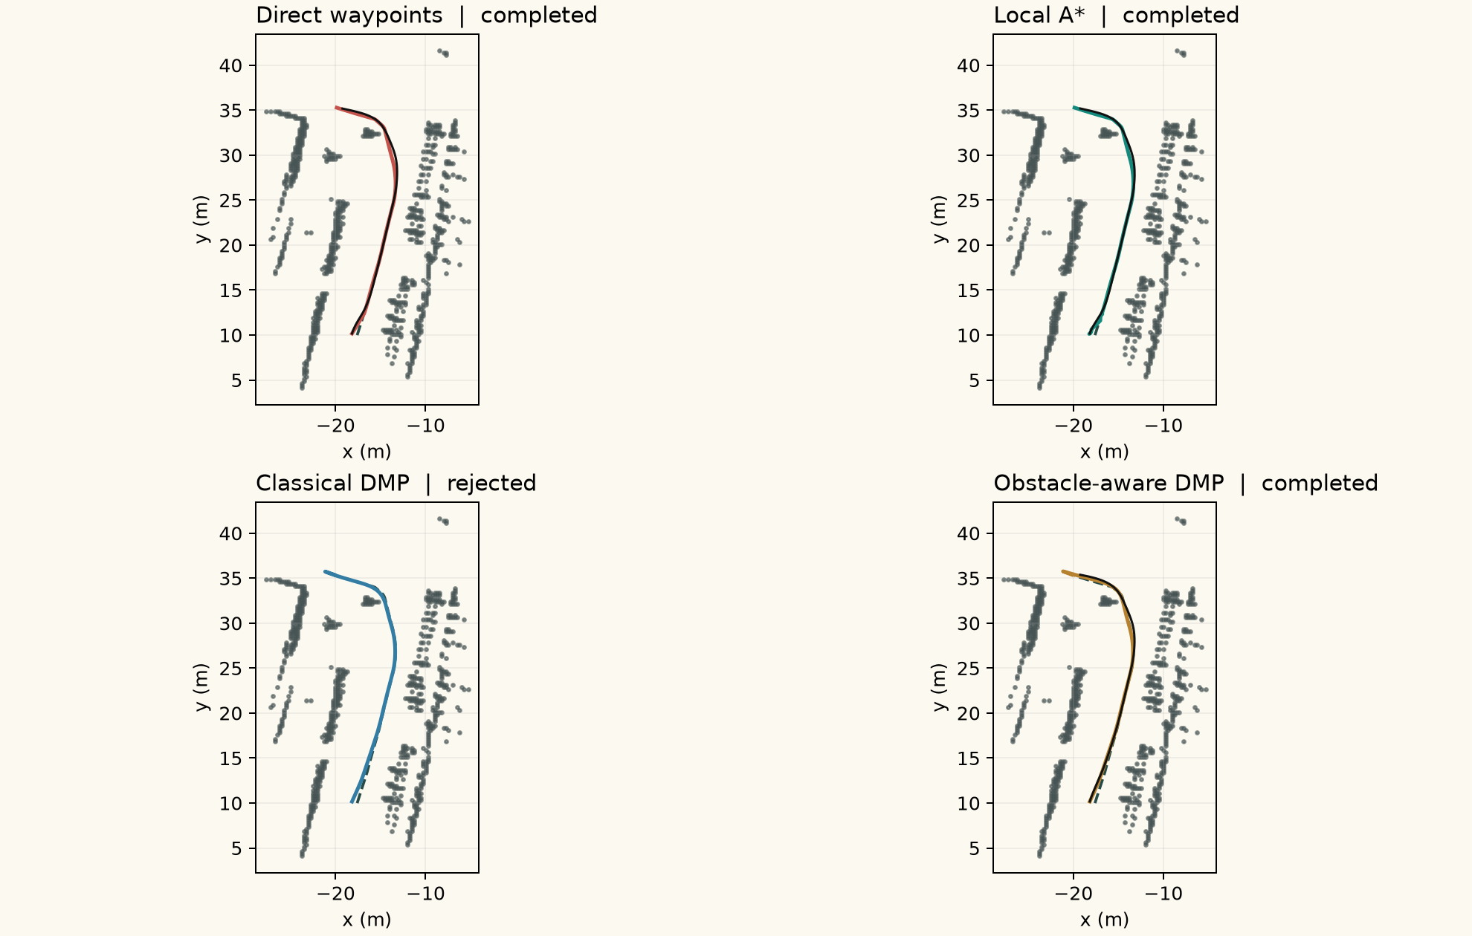
One offset start, four outcomes
Start: +0.6 m lateral, 0° heading. Gray points are recorded laser returns; black traces are Bullet runs.

Slide 7
Completion across 15 starts per method
Direct waypoints
100%
Local A*
100%
Classical DMP
0%
Obstacle-aware DMP
100%
Three methods completed all 15 starts; classical DMP failed path clearance.
0 obstacle contacts in 60 trials. Rejected paths were not driven.

Slide 8
Other measurements from the same runs
Method
Rejected
Stopped
Min. clear.*
Goal err.
Plan time
Direct waypoints
0%
0%
0.287 m
0.646 m
0.12 ms
Local A*
0%
0%
0.287 m
0.646 m
1.59 ms
Classical DMP
100%
0%
N/A
N/A
7.73 ms
Obstacle-aware DMP
0%
0%
0.287 m
0.647 m
10.15 ms
No Bullet obstacle contacts. Goal error is the median among completed runs.
*Grid distance minus a 0.42 m body proxy; timing is planning only, on this PC.

Slide 9
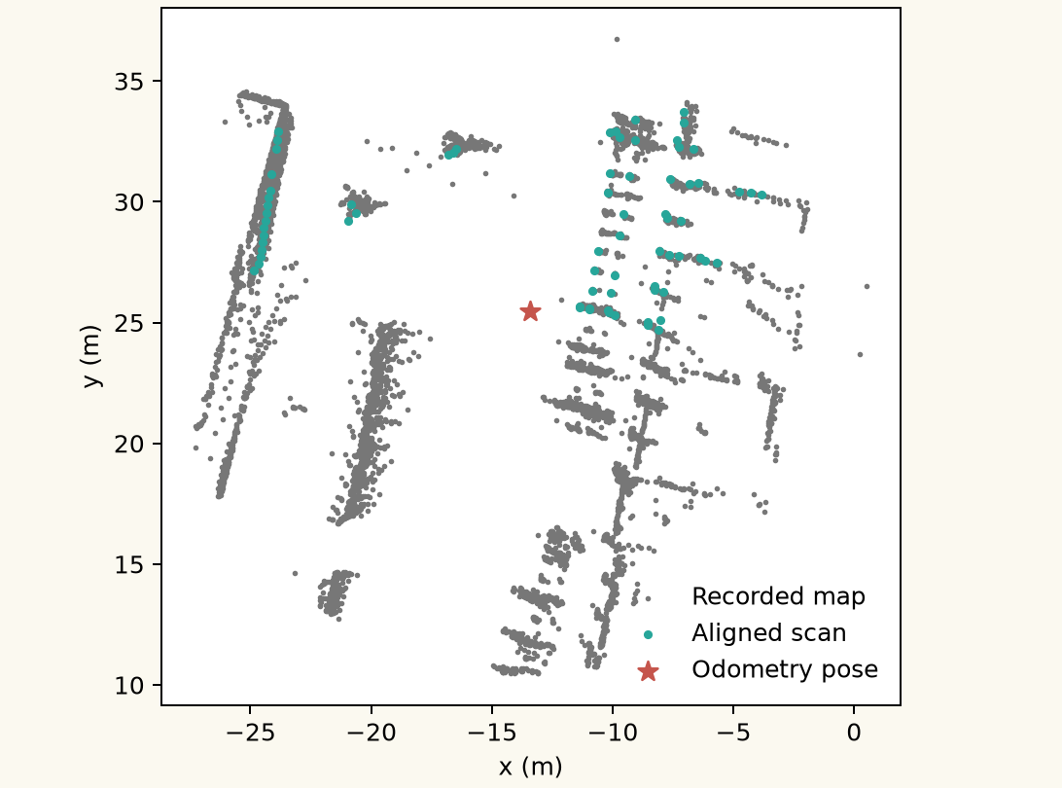
ICP on a recorded laser scan
Held-out Freiburg scan #430
Initial pose offset 0.640 m
After ICP 0.044 m
Map residual 0.047 m
Compared with logged odometry, not ground truth. Navigation still uses exact Bullet pose.

Slide 10
What the results tell us
1
Direct, A*, and coupled DMP completed every start in this recorded segment.
2
Classical DMP failed the 0.15 m path margin; all 15 paths were rejected.
3
No Bullet obstacle contacts occurred with the safety screen enabled.
Next: test other routes and starts; use ICP during navigation; tune the rover model.

Slide 11
Method notes and sources
Trial design
15 starts = 5 lateral offsets × 3 headings. Route: 29.59 m. Laser map: 0.25 m. Path screen: 0.42 m body radius + 0.15 m margin. PyBullet Husky surrogate at 120 Hz.
Reproduce
python src/recorded_demo.py
GitHub: github.com/ayushkaulgud/teach-repeat-rover-navigation
Background references
Data: Stachniss & Grisetti, Freiburg Campus 2004 raw log (CC0 via MIT). Software: PyBullet. Code, CSV, plots, and slides: GitHub teach-repeat-rover-navigation.

