Slide 1
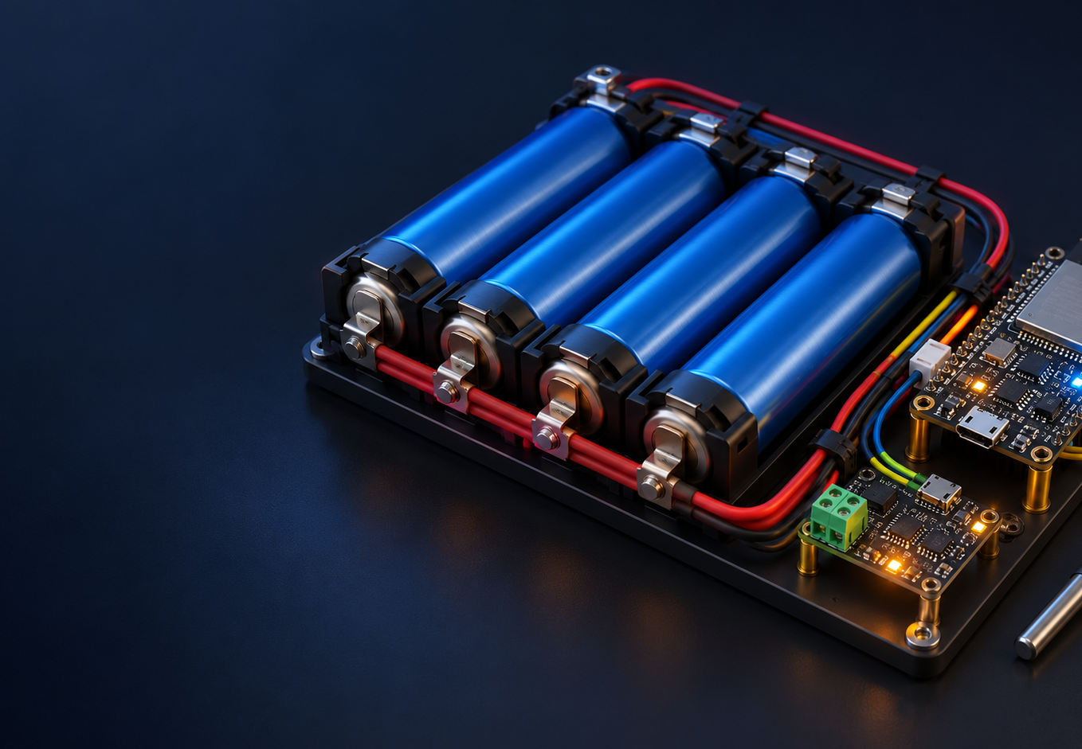
INTRODUCTION
01 / 04
SMART BMS
MONITORING SYSTEM
An Integrated Hardware–Software Platform for Intelligent Battery Monitoring
TARANG
Battery operation is shaped by voltage, current and temperature. A shared view helps teams follow those conditions and spot configured abnormal readings.
Connecting battery measurements with actionable software insights for more visible and manageable battery operation.
CONCEPT ILLUSTRATION / NOT A BUILT PROTOTYPE
SOFTWARE FOUNDATION / IMPLEMENTED
PHYSICAL INTEGRATION / PENDING
MEASURE
PROCESS
VIEW
Current dashboard values come from the backend development simulator. Physical sensor measurements are not connected.
V / I / 4 temperatures
FastAPI + SQLite
Vanilla JS dashboard
Notes:
Timing: 45 seconds.
Battery performance changes with load and temperature, so teams need to see voltage, current and temperature together. Tarang's Smart BMS Monitoring System connects battery measurements to a software view that can show trends and configured abnormal readings.
The software foundation is implemented. The frontend currently receives simulated telemetry from the backend. No physical sensor or embedded controller is connected yet. The image is conceptual artwork, not a photograph of our prototype.
Our value proposition is to connect battery measurements with actionable software insights for more visible and manageable battery operation.
Judge cue: If asked whether this is live hardware, say no. The displayed values come from the development mock. Physical integration and measurement validation are next.
Sources: README.md; frontend2/index.html; frontend2/app.js; backend/README.md; hardware/README.md.

Slide 2
TECHNICAL EXPLANATION
02 / 04
SYSTEM ARCHITECTURE & TECHNICAL METHODOLOGY
Implemented software path with physical measurement shown as pending
HARDWARE / PENDING
COMMUNICATION / DEVICE LINK PENDING
SOFTWARE / IMPLEMENTED
Battery pack
Measurement
ESP32
HTTP JSON
FastAPI
SQLite + services
Dashboard
Prototype concept
not integrated
Voltage, current
4 temperature channels
Sensors TBD
Controller and firmware
pending
POST /api/telemetry
API route ready
Pydantic validates
telemetry payload
History, risk rules
and alert records
5 vanilla JS views
REST polling every 5 s
WHAT THE SOFTWARE DOES TODAY
VALIDATED TELEMETRY
RISK, HISTORY AND ALERTS
MODEL AND INTERFACE
Schema accepts voltage, current, SOC and four temperatures. Power is derived if omitted. SOH is optional.
SQLite stores readings and alerts. Risk logic uses the hottest cell and recent trend against a configured threshold.
CALCE-trained XGBoost estimates average temperature 10 minutes ahead. Advisory only, not validated on this pack.
IMPLEMENTATION STATUS
Safety boundary
SOFTWARE FOUNDATION / IMPLEMENTED
The 55°C threshold is an inherited demo default, not a validated cell limit. Fan output is a display indicator. No automatic shutdown, cell balancing or certified protection is implemented. The physical BMS remains authoritative.
PHYSICAL SENSOR FEED / PENDING
Notes:
Timing: 105 seconds.
The software architecture starts with a telemetry schema, not a hardware assumption. The API requires a device identifier, timestamp, voltage, current, SOC and four cell temperatures. Power is calculated when the sender omits it. SOH remains optional because no validated estimator is present.
The intended physical path is a battery pack, measurement channels and ESP32 firmware. The repository does not identify selected sensor part numbers, and this path has not been integrated. The backend provides an HTTP POST endpoint at /api/telemetry. The development mock currently supplies samples.
FastAPI passes incoming payloads through Pydantic validation. SQLAlchemy stores telemetry and alert rows in SQLite by default. The status endpoint combines the latest record with history, four-channel averages and maximums, risk, prediction, alerts, connection freshness and a demo fan indicator. The frontend polls that status endpoint every five seconds.
Risk classification uses the hottest current sensor and recent hottest-sensor trend against a configured threshold. The included default of 55 degrees Celsius came from the earlier UI and is not a validated safe limit. The fan percentage is calculated for display only. There is no relay command, shutdown, or cell-balancing control.
The XGBoost artifact predicts the four-sensor average about ten minutes ahead from CALCE single-cell cycling traces. The held-out CALCE test report records MAE 0.952 degrees Celsius across 8,437 samples. This does not establish performance on a four-cell pack, and the estimate is advisory.
Judge cues: Accuracy is unknown until calibrated against reference instruments. The REST endpoint is ready, while the ESP32 sender is pending. Hardware protection remains authoritative.
Sources: docs/ARCHITECTURE.md; docs/API.md; backend/app/schemas/telemetry.py; backend/app/api/telemetry.py; backend/app/services/risk_service.py; backend/app/services/mock_telemetry_service.py; ml/models/metrics.json.

Slide 3

REAL-LIFE APPLICATION
03 / 04
REAL-WORLD APPLICATION & SCALABILITY
Potential contexts after hardware integration and measurement validation
APPLICATION AREAS
EV AND ELECTRIC MOBILITY
Review pack conditions during testing and maintenance.
STATIONARY STORAGE
Follow trends in storage and backup-power systems.
INDUSTRIAL BATTERY BANKS
Support bench checks and maintenance workflows.
CURRENT SOFTWARE CAPABILITIES
One view for voltage, current, reported SOC and four temperature channels. Stored history and configured risk alerts support review. Device IDs support per-device API queries. More sensor channels require schema changes.
POTENTIAL USE CONTEXTS / CONCEPT ART
Deployment needs sensor compatibility checks, calibration, reliable networking, threshold configuration and a safety review.
MONITOR
ANALYSE
INFORM
Validated measurements
History and configured rules
Dashboard and stored alerts
Use cases are proposed. No field deployment is demonstrated.
Notes:
Timing: 90 seconds.
Battery monitoring can be useful in electric mobility test settings, stationary storage and backup-power systems, and industrial battery-bank maintenance. These are potential applications for this architecture, not deployments completed by Tarang.
The current software presents telemetry in one dashboard, stores history and records configured risk alerts. Operators could use those records to review an abnormal reading and trace whether it followed a load or temperature change. The system does not establish that an incident was prevented or that safety improved.
The API includes a device identifier and per-device query paths, which gives a starting point for monitoring more than one unit. The current telemetry contract has four fixed temperature channels. Adding modules, sensor types or additional channels would require schema and interface changes. Database migration and operational load testing would also be needed before expanding beyond the prototype.
Before use outside a lab, the team needs to choose sensors compatible with the pack, calibrate them, verify wiring and controller behavior, test network loss and stale readings, and set thresholds from cell specifications. The 55 degree demo threshold must not be treated as a deployment limit.
Judge cue: EV, storage or grid use is a target context after integration, calibration and safety review. There is no field test or customer deployment in the repository.
Sources: docs/ARCHITECTURE.md; docs/API.md; hardware/README.md; frontend2/app.js; backend/app/schemas/telemetry.py.

Slide 4
CONCLUSION
04 / 04
FROM SOFTWARE FOUNDATION TO A VALIDATED BMS
A practical validation sequence for the next engineering milestone
01
02
03
04
05
Integrate physical sensors and ESP32
Compare readings with reference instruments
Verify telemetry delivery and latency
Test fault logic with controlled inputs
Review reliability and safety before deployment
NEXT MILESTONE
NEXT MILESTONE
NEXT MILESTONE
NEXT MILESTONE
NEXT MILESTONE
PROPOSED VALIDATION METRICS / NO RESULTS RECORDED
Voltage measurement error
Current measurement error
Temperature measurement error
End-to-end telemetry latency
Successful data-delivery rate
Fault-detection correctness
“Our vision is to connect reliable battery measurements with a clear, scalable and thoroughly validated monitoring experience.”
TARANG
Software demo complete / physical integration and validation remain
Notes:
Timing: 60 seconds.
The next milestone is physical integration, followed by calibration against appropriate reference instruments. The team should record voltage, current and temperature error rather than assume sensor accuracy from a part datasheet. It should also measure how long a sample takes to reach the API and dashboard, and how often delivery succeeds under normal and degraded network conditions.
Fault tests should use controlled inputs around thresholds agreed from actual cell and pack specifications. The current threshold in the demo configuration is not a verified trip point. The team should test stale or missing samples, out-of-range values, and alert clearing behavior before connecting any real actuator.
The six validation measures on the slide are proposed. No values have been collected yet. Reliability and safety review must precede any field deployment, with the physical BMS retaining protection authority.
Our vision is to connect reliable battery measurements with a clear, scalable and thoroughly validated monitoring experience. We are Tarang.
Judge cue: Do not give accuracy, latency, delivery-rate or detection numbers until controlled tests document the method and reference equipment.
Sources: hardware/README.md; docs/ARCHITECTURE.md; docs/API.md; backend/app/core/config.py; backend/app/services/risk_service.py.

