Slide 1



Trithon Triplets
THEME: Technology Intervention in Climate Change Challenges and Sustainability.
Team Name : Phoenix
Problem Statement Title : Building a Collaborative Farmer-centric digital hub
Team Leader Name : Safia Aktar
Institute Name : C. V. Raman Global University
Track (1/2/3) : 1

Slide 2
The Overview :
Design an intuitive, secure space fostering community and collaborative solutions, addressing the unique challenges farmers face and help them in adopting sustainable farming practices, resource optimization and sharing of eco-friendly methods.

Slide 3
The Problem :
Farmers grapple with unpredictable weather patterns and extreme events. They often face isolation and lack of relevant information which lead to bad agricultural practices, loss of crops and unsustainability.

Slide 4
The Solution:
The proposed digital hub offers a solution by uniting farmers to share climate-resilient practices, cultivating a community committed to sustainable farming.

Slide 5
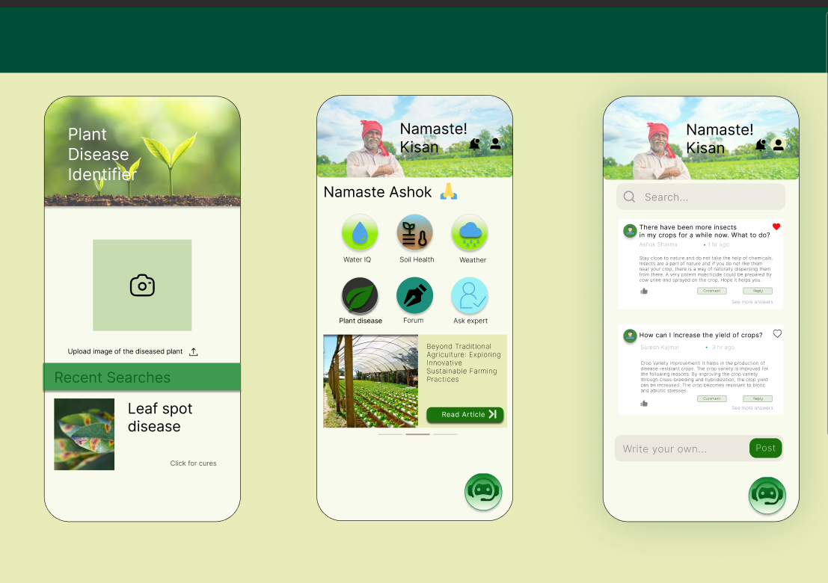
The UX design link
Of our app

Slide 6
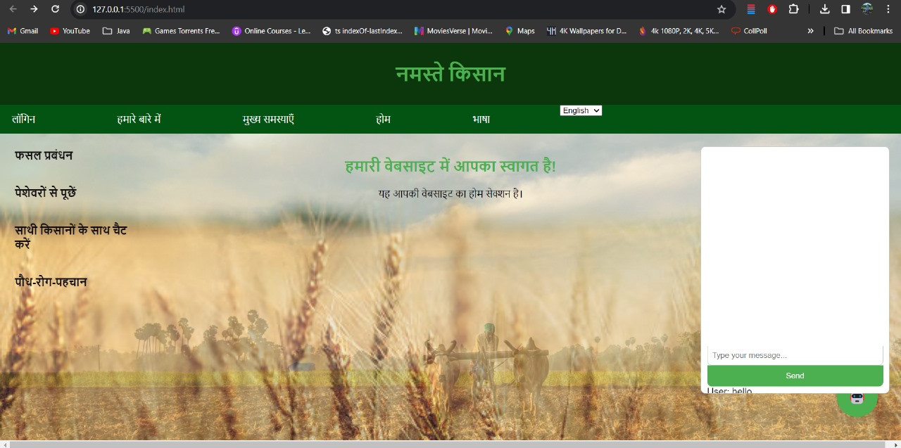
Home page of our Website:

Slide 7
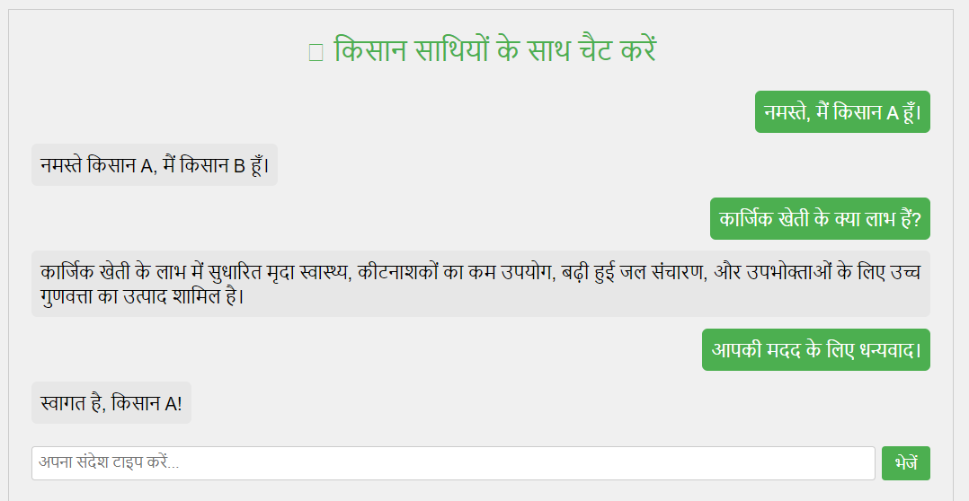
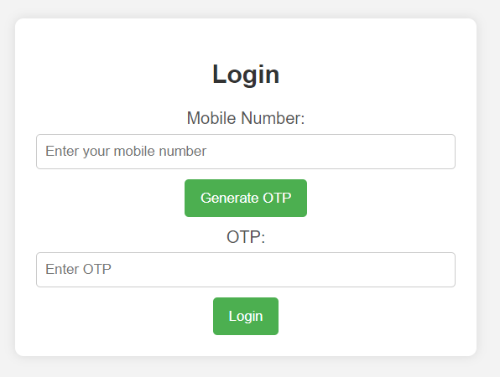
Login page and Discussion forum:

Slide 8
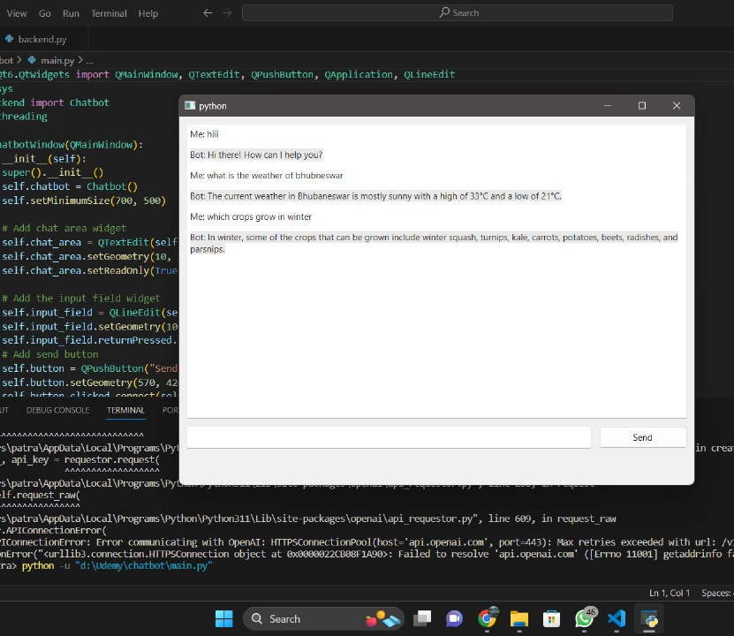
Chatbot
Working:

Slide 9
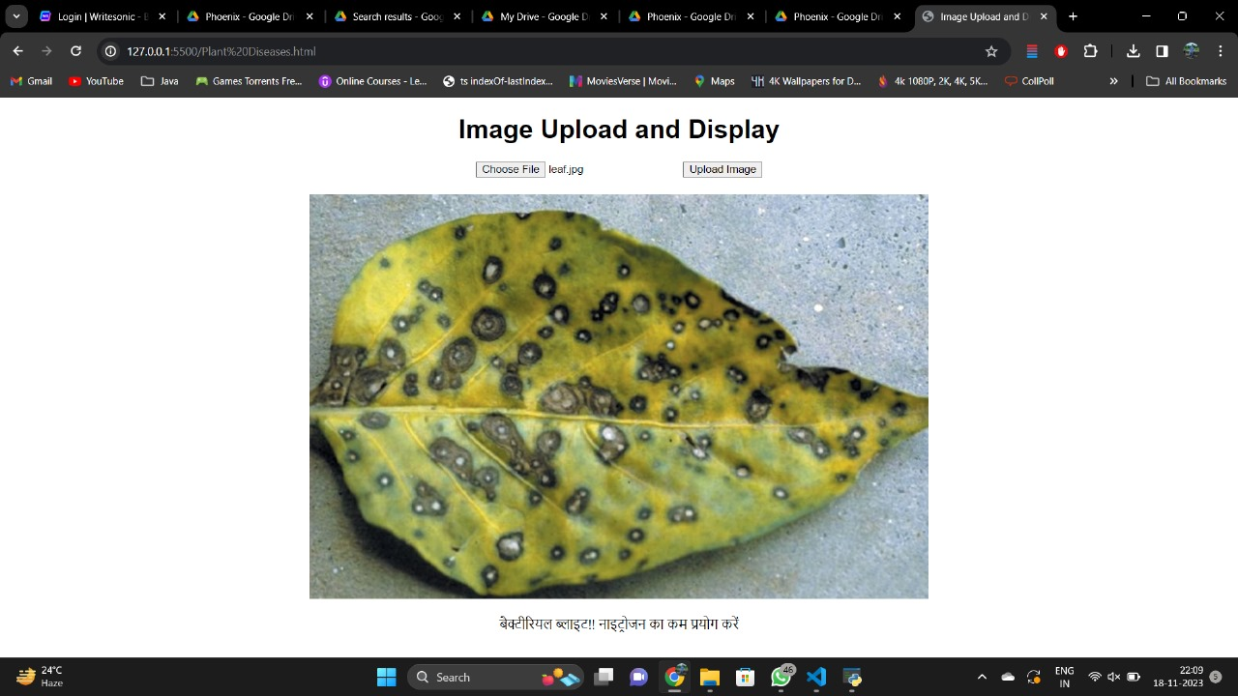
Plant disease identification prototype

Slide 10
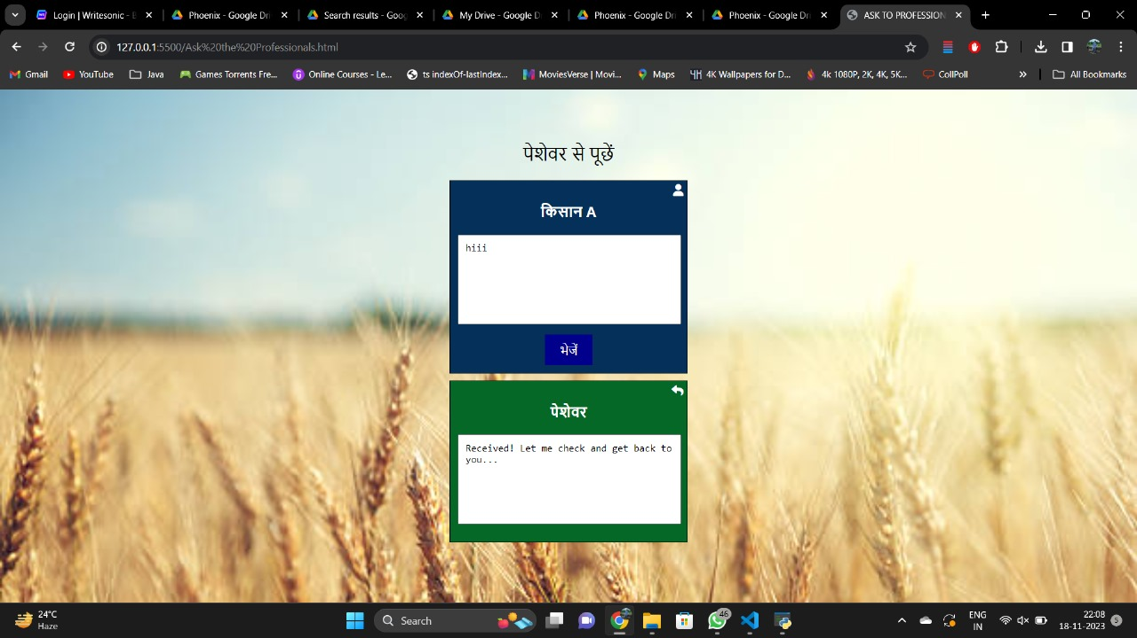
Ask the professional:

Slide 11
The Innovation :
Two way communication
Real time solutions through AI
Digital Collaboration

Slide 12
Value Proposition Canvas :
Jobs: Share experiences, find solutions, stay updated on market trends.
Pains: Limited access to real-time info, isolation, difficulty finding solutions.
Gains: Improved yield, timely solutions, informed decision-making, community support.
Products & Services: Forums, knowledge hub, marketplace insights, community features.
Pain Relievers: Real-time info, community support, dedicated problem-solving.
Gain Creators: Enhanced productivity, informed decisions, emotional well-being.
Fit: The platform addresses farmer's pain points, offering real-time information, collaborative problem-solving, and emotional support—a compelling value proposition aligning with farmers' needs for enhanced agricultural practices and community engagement.

Slide 13
Market and Oppurtunity :
Conduct thorough market research to understand the needs and challenges of farmers in different regions.
Identify gaps in existing solutions and opportunities for innovation.
Consider language localization and cultural sensitivity in platform design.
Forge strategic partnerships with agricultural organizations, government agencies, and agribusinesses to expand the platform's reach.
Stay abreast of emerging agricultural technologies and integrate relevant tools or features into the platform.

Slide 14
Technology/Innovation :
Web development technology
Cloud computing
Real time communication using websocket
Android app development
AI and ML
Encryption , security, authentication

Slide 15
Business Model :
Offer basic platform access for free and charge for advanced features, analytics, or additional support services.
Implement different subscription levels catering to various user needs, such as individual farmers, cooperatives, or agricultural organizations.
Develop and charge for specialized training courses on modern farming techniques, sustainable practices, or technology adoption.
Seek sponsorships for farmer-centric events organized through the platform, creating revenue streams and fostering community engagement.

Slide 16
Team Details :
Team Leader: Safia Aktar
Team Members: Anshu Kumari
Radhika Rani Panda
Ayush kumar Tiwary

