Slide 1

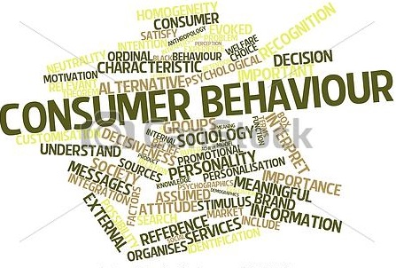

Slide 2

MOBILE CONSUMER ANALYSIS
K. Rohit Reddy
V. Deekshith Raya
Nidhi Bharti
Vikram Agarwal
Nitesh kerketta
Konathala Sai Ashok
Ayush Kumar

Slide 3
PROJECT BACKGROUND
The project correlates the topics learnt in Consumer Behaviour course ,like the EKB Model, Segmentation , Marketing and Positioning of products into real world scenarios through consumer surveys and market place analysis.
The project focuses specifically on analysis of consumers and the role of currently employed marketing strategies in the mobile sector.

Slide 4
PROJECT OBJECTIVE
Surveying mobile users.
Analysing the shopping, purchase and consuming trends in the mobile sector.
Drawing conclusions so as to help budding marketers.

Slide 5
PROJECT STAGES OVERVIEW
Customer survey
Collecting data from customers through
Questionnaires
Unstructured interviews.
Marketplace analysis
Analysing customers behaviour in marketplace situation.
Sales executives influence.
Other factors like ambience, impulse buying etc.
Analysis and conclusions
Analysing data acquired from surveys and marketplace.
Conclude Patterns of relevant and retrieval sets.
Concluding significance of various other factors influencing the customers.
Drawing parallels between the research and the success or Failure of a mobile.

Slide 6
CURRENT PROGRESS
Questionnaire
Survey
Data Analysis

Slide 7
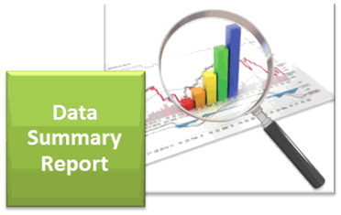
DATA SUMMARY
(355 Responses)

Slide 8
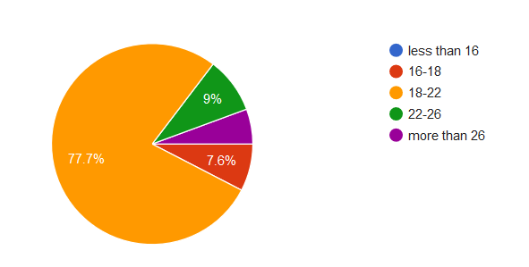
Age Group

Slide 9
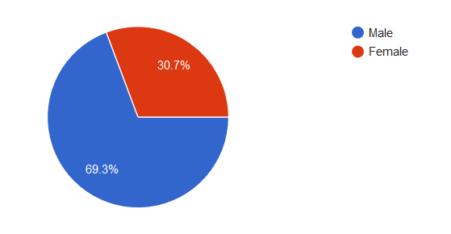
Gender

Slide 10
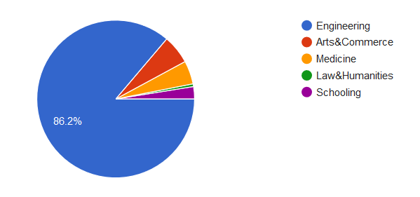
Educational Background

Slide 11
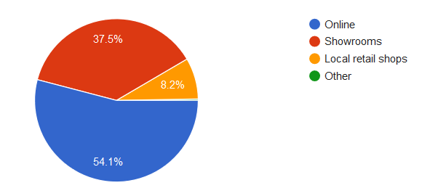
Preferred mode of buying a phone

Slide 12
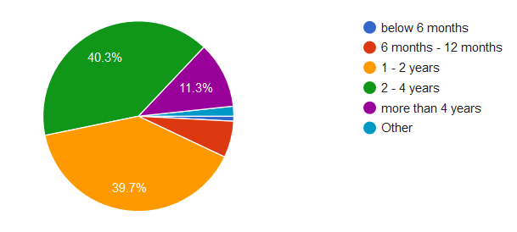
How often do you change your mobile phone

Slide 13
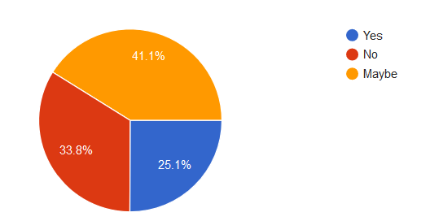
Do you prefer to stick to your brand ?

Slide 14
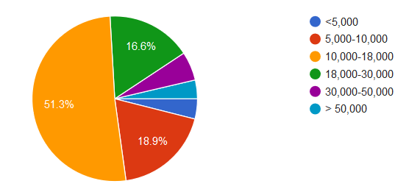
Price range (Mobile phone)

Slide 15
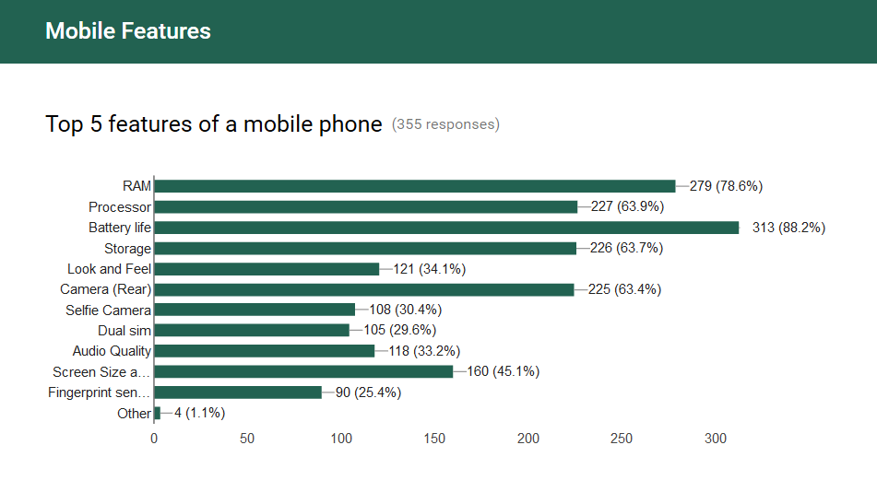

Slide 16
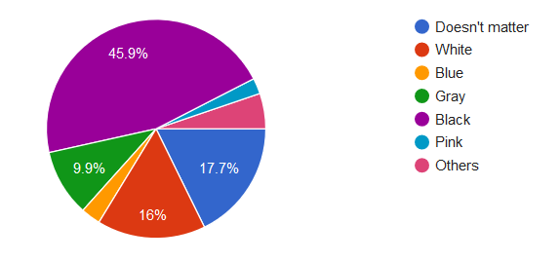
Preferred mobile colour

Slide 17
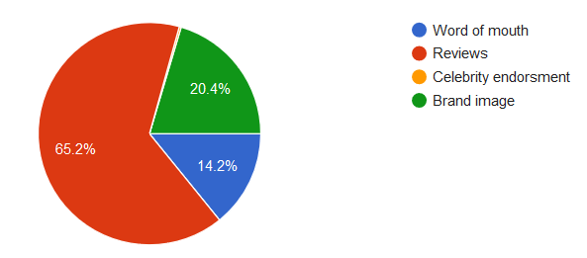
What do you trust while buying a mobile phone?

Slide 18
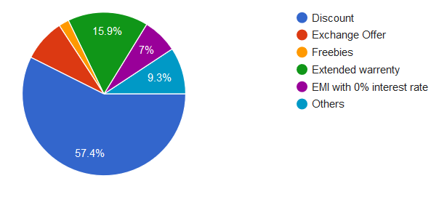
Offer preferred while buying mobile phone?

Slide 19
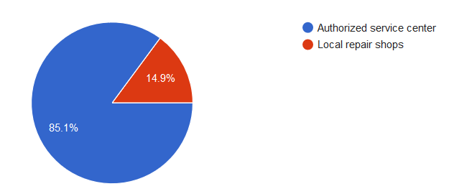
Where do you repair your mobile ?

Slide 20
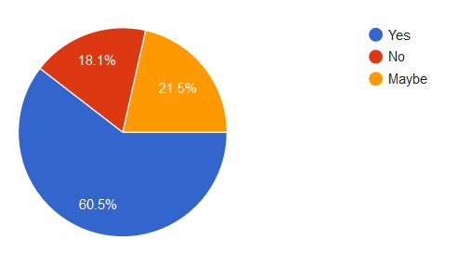
Would you recommend your mobile to others?

Slide 21
FURTHER OBJECTIVES
Observation of customers and sales executive at marketplace.
conducting above observations at multiple showrooms, local outlets In Guwahati.
Using Google Analytics ,and other Data analysis tools to draw conclusions.
Collecting information of few brands that succeeded or failed in appealing to attract customers.

Slide 22


