Slide 1

GlobalTech Financial Data Analytics & Audit
Capstone project
Name: Ayush Kumar
Internship by: iStudio
Course / Batch: Data Analytics Internship (2025-26)

Slide 2
Executive Summary
Split-layout card view with 3 primary metrics highlighted in large bold text on the left, and key takeaways on the right.
Key Metrics Cards:
$148.27M USD: Total Audited Revenue
14,183: Verified Active Accounts
< 2.0 Seconds: Full Pipeline Execution Time
Key Takeaways:
Resolved multi-source data fragmentation across relational SQL, raw server logs, and static exchange rate files.
Eliminated system error logs and deduplicated user status histories using windowing logic.
Provided real-time executive visibility via an interactive Power BI audit dashboard.

Slide 3
Target Audience:
4-quadrant grid detailing impact across different corporate teams.
Executive Leadership & CFO: Delivers an audited, single source of truth for total global USD revenue and quarterly financial performance.
Financial Auditors & Compliance: Verifies cross-border transaction integrity, exchange rate consistency, and account deduplication accuracy.
Data Engineering & Analytics: Establishes a scalable, reproducible ETL pipeline architecture for future automated reporting.
Account Management & Sales Strategy: Provides customer-level contribution metrics to drive enterprise retention and growth.

Slide 4
Problem Statement
3 horizontal risk callout boxes.
Unstructured & Fragmented Logs: Over 100,000 server log entries contained unstructured JSON payloads mixed with system error logs that skewed raw calculations.
Account Status Duplication: Users transition through Pending, Active, and Suspended states over time; without deduplication, suspended accounts risked polluting active figures.
Temporal Exchange Rate Gaps: Currency exchange rate tables omitted weekends and holidays, leaving cross-border transactions unrecorded if not handled programmatically.

Slide 5
Data Quality & Cleaning Metrics Slide
Raw Log Ingestion: 100,000 raw server log entries processed.
Error Log Filtration: ~5,098 system error/failed transaction logs identified and removed.
Valid Parsed Transactions: 94,902 clean financial transaction records.
Active Deduplicated Transactions: 53,899 reconciled transactions belonging strictly to verified active accounts.

Slide 6
Risk, Governance & Audit Compliance
In financial fin-tech environments, compliance and data security are critical.
Auditability & Traceability: Every line item in the final Power BI dashboard maps back directly to a parsed raw log line and timestamp.
Deduplication Safeguards: Used SQL window functions to ensure suspended or pending users do not artificially inflate company valuation or active user KPIs.
Exchange Rate Integrity: Eliminated missing weekend data points by standardizing rates via Friday forward-fill logic, preventing artificial weekend revenue dips

Slide 7
Technology Stack
Pipeline Phase | Technology / Library
Database Querying | SQLite3
Data Engineering | Python 3.x (Pandas, Regex)
Static Analytics | Matplotlib & Seaborn
BI Reporting | Power BI Desktop

Slide 8
End-to-End ETL Pipeline Methodology
A 4-step horizontal process flowchart with arrows connecting each phase.
Phase 1: SQL Extraction →Execute window functions to isolate current Active users (14,183 verified accounts).
Phase 2: Vectorized Regex Parsing →Apply regex patterns to discard system errors and extract 94,902 valid transaction logs (eur_val).
Phase 3: Temporal Forward-Fill → Reindex 2023 calendar dates and roll Friday exchange rates forward across weekend transactions.
Phase 4: USD Revenue Normalization → Multiply Euro values by daily exchange rates to yield 53,899 reconciled active user transactions.

Slide 9
Power BI Executive Dashboard Overview
Full-slide screenshot of the Power BI Dashboard with callout arrows pointing to key visual elements.
Visual Highlights:
Top Header & Date Slicer: Enables interactive filtering across Q1–Q4 or individual date ranges.
KPI Summary Cards: Displays Total Revenue ($148.27M), Total Volume (54K transactions), and Average Ticket Size ($2.75K).
Monthly Revenue Trajectory: Demonstrates consistent monthly revenue velocity without major seasonal drops.
Top 5 Customer Bar Chart: Highlights leading accounts (User_U-06582 at ~$40.05K) showing balanced revenue distribution.

Slide 10
Customer Contribution & Growth Insights
Side-by-side comparison cards highlighting revenue stability and customer concentration risk.
Revenue Trajectory Analysis:
Monthly revenue velocity remained steady across Q1–Q4, averaging ~$12.35M USD per month.
Confirms strong product-market fit and recurring operational stability without reliance on seasonal spikes.
Customer Concentration Analysis:
The top 5 enterprise accounts contribute ~$196K USD combined.
Top spender User_U-06582 generated $40,050.99 USD, followed closely by User_U-23313 at $39,555.81 USD.
Demonstrates healthy account diversification with low single-customer concentration risk.

Slide 11
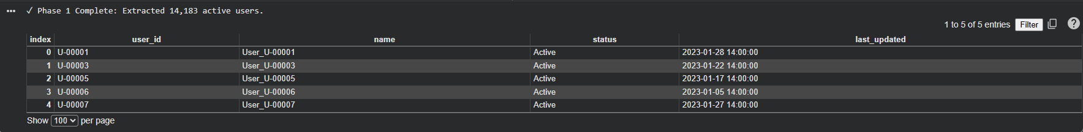
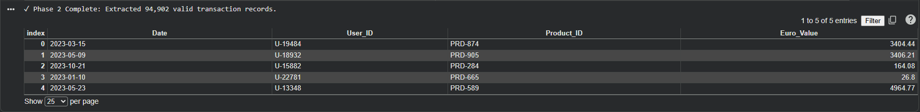
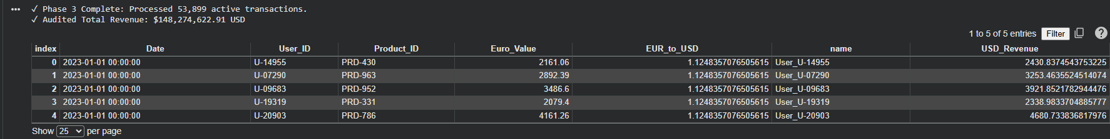
Results

Slide 12
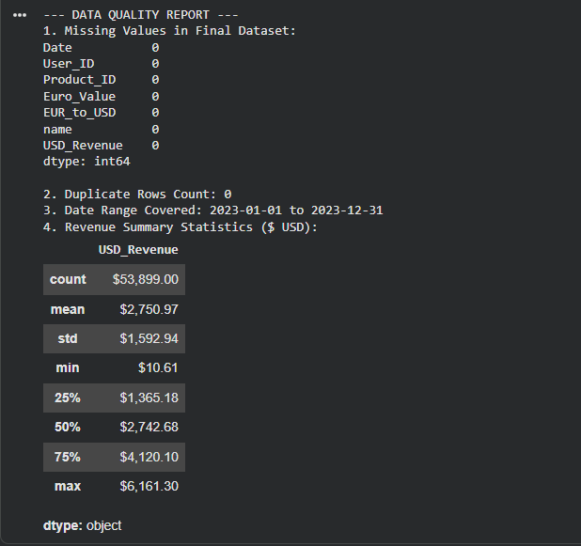
Results

Slide 13
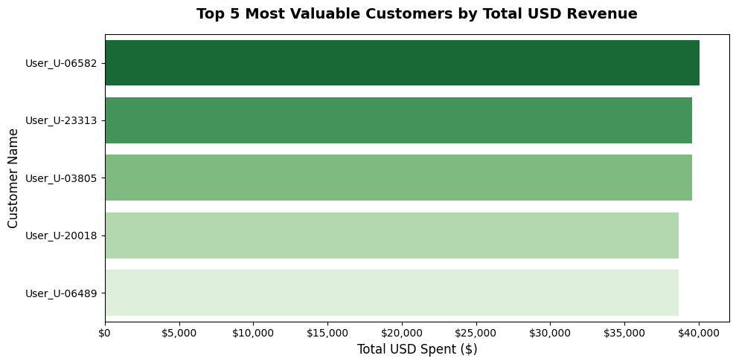
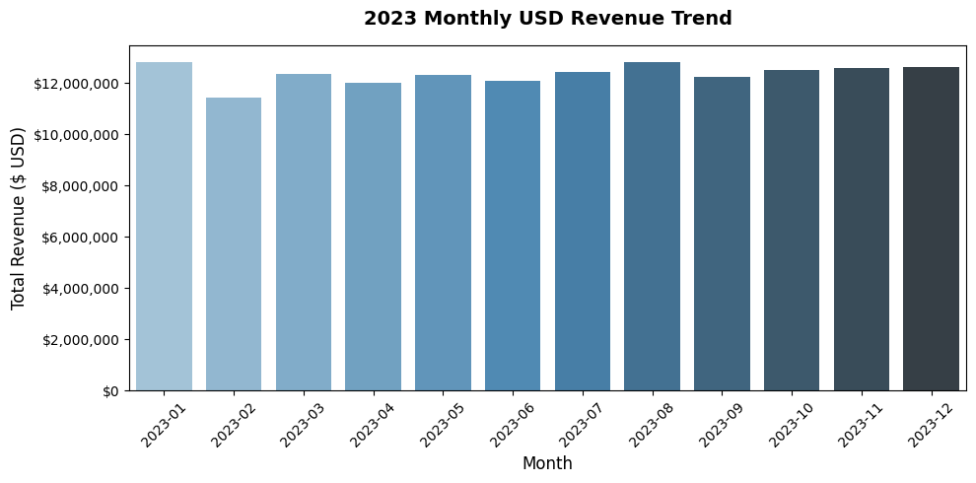
Results:

Slide 14
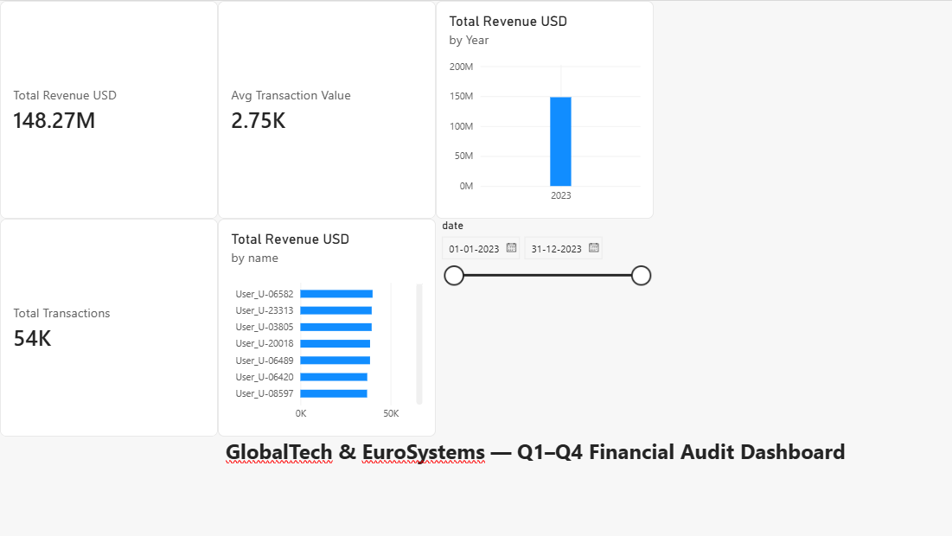
Results

Slide 15
Business Impact & Operational ROI
Explain the business value of building this automated pipeline rather than relying on manual spreadsheets.
Time Efficiency: Reduces financial reconciliation processing time from days of manual Excel work to under 2 seconds.
Error Reduction: Completely removes human error in manual currency conversions and log filtering.
Scalability: The pipeline can easily handle millions of rows as GlobalTech scales internationally without requiring additional headcount.

Slide 16
Future Scope & Technical Enhancement Roadmap
4-step vertical roadmap timeline.
1. Pipeline Orchestration & Scheduling: Transition manual execution to automated AWS Lambda or Apache Airflow DAGs for nightly ETL updates.
2. Live Exchange Rate API Feeds: Connect directly to the European Central Bank API for real-time currency conversion rates.
3. Real-Time Log Ingestion: Implement Apache Kafka message streaming to filter error logs at ingestion time.
4. Predictive Financial Analytics: Integrate machine learning time-series models (Prophet/ARIMA) in Python to forecast quarterly revenue performance.

Slide 17
Strategic Recommendations
3 action-oriented callout blocks.
1. Enterprise Customer Retention: Focus key account management efforts on high-value enterprise accounts driving recurring volume.
2. Productionizing the Dashboard: Deploy GlobalTech Financial_Audit_Dashboard.pbix to Power BI Service for scheduled cloud refreshes.
3. Automated Log Filtering: Require engineering teams to separate error logs into dedicated log files at source.

Slide 18
Conclusion
Automated Data Reconciliation: Successfully engineered an end-to-end Python ETL pipeline that ingests, cleans, deduplicates, and merges multi-source enterprise data in under 2 seconds.
Audited Single Source of Truth: Reconciled 53,899 active transactions across 2023, establishing an audited total global revenue of $148,274,622.91 USD.
Data Quality & Risk Mitigation: Removed system error logs via vectorized Regex string matching, deduplicated account status histories through SQL window functions, and eliminated unrecorded weekend transactions via temporal forward-filling.
Executive Visibility: Delivered an executive Power BI audit dashboard (GlobalTech Financial Data Analytics & Audit.pbix) offering dynamic slicing across quarterly performance and top enterprise customer contributions

Slide 19
Project links
GitHub Link:
https://github.com/ayushkumar1311/GlobalTech-Financial-Data-Analytics-Audit.git
Google Collob:
https://colab.research.google.com/drive/128pGzLybn_OGt-UiZCpFZ136gcSmyK7r?usp=sharing

