Slide 1
Cyber Security Internship
Codec Technologies Pvt. Ltd. | 25 May 2026 – 25 Jul 2026
Ayush Kumar
Roll No: CS-23411156 | B.Tech CSE (Cybersecurity), 2023-27
School of Computer Science and Engineering, IILM University, Greater Noida

Slide 2
Internship Overview
Organization
Role
Codec Technologies Pvt. Ltd., Powai, Mumbai (ISO 9001:2015, Google for Education Partner)
Cyber Security Intern
Duration
Approval
2 months: 25/05/2026 to 25/07/2026
AICTE & ICAC approved program
Cyber Security Internship | Codec Technologies | Ayush Kumar

Slide 3
Problem Statement & Objectives
Why this internship?
Objectives
Most breaches come from known weaknesses: misconfigurations, unpatched software and insecure web apps. Students need hands-on, authorised practice to find and report them.
Learn security and networking fundamentals
Use industry tools in an isolated lab
Perform scanning and vulnerability assessment
Understand OWASP Top 10 web risks
Write clear reports with fixes
Follow ethical and legal rules
Cyber Security Internship | Codec Technologies | Ayush Kumar

Slide 4
Technologies and Tools
Kali Linux
Nmap
Wireshark
Attacker OS
Port scanning
Traffic analysis
Burp Suite / ZAP
OpenVAS / Nessus
Metasploit
Web testing
Vuln. scanning
Lab exploitation
Cyber Security Internship | Codec Technologies | Ayush Kumar

Slide 5
Methodology
1
2
3
4
5
Reconnaissance
Scanning & Enumeration
Vulnerability Analysis
Controlled Exploitation
Reporting & Remediation
All work done in an isolated virtual lab on authorised, intentionally vulnerable targets.
Cyber Security Internship | Codec Technologies | Ayush Kumar

Slide 6
Internship Plan
Weeks 1-2
Cyber security basics, networking, Linux, lab setup
Weeks 3-4
Nmap scanning, enumeration, Wireshark analysis
Weeks 5-6
Vulnerability scans, Burp Suite and ZAP web testing
Weeks 7-8
Lab exploitation, documentation, final report
Cyber Security Internship | Codec Technologies | Ayush Kumar

Slide 7
Outcomes and Skills Gained
Hands-on use of scanning, analysis and testing tools
Understanding of common vulnerabilities and attack techniques
Structured, evidence-based security reporting
Awareness of legal and ethical boundaries
Industry exposure and a Letter of Recommendation
Cyber Security Internship | Codec Technologies | Ayush Kumar

Slide 8
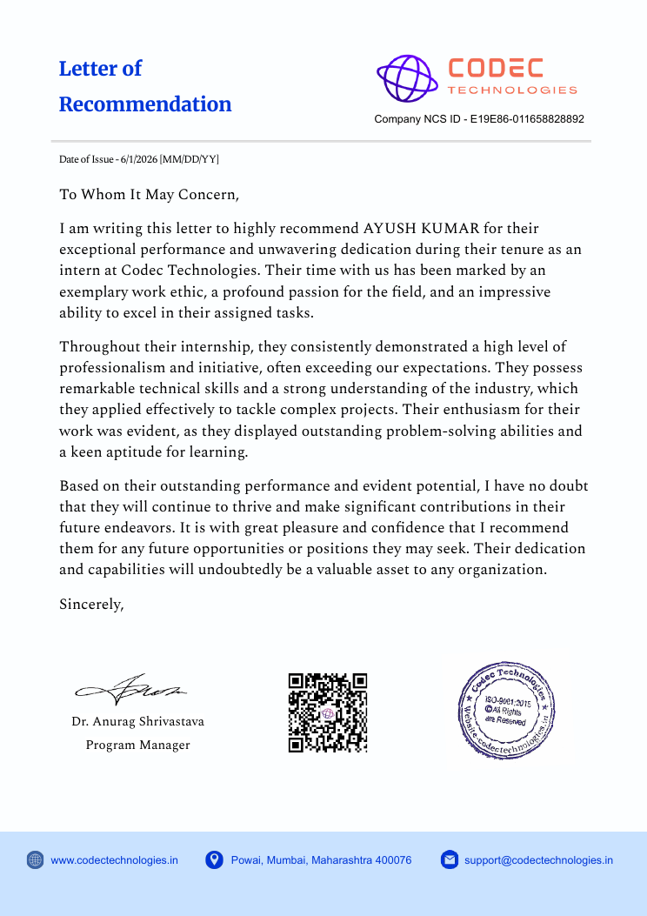
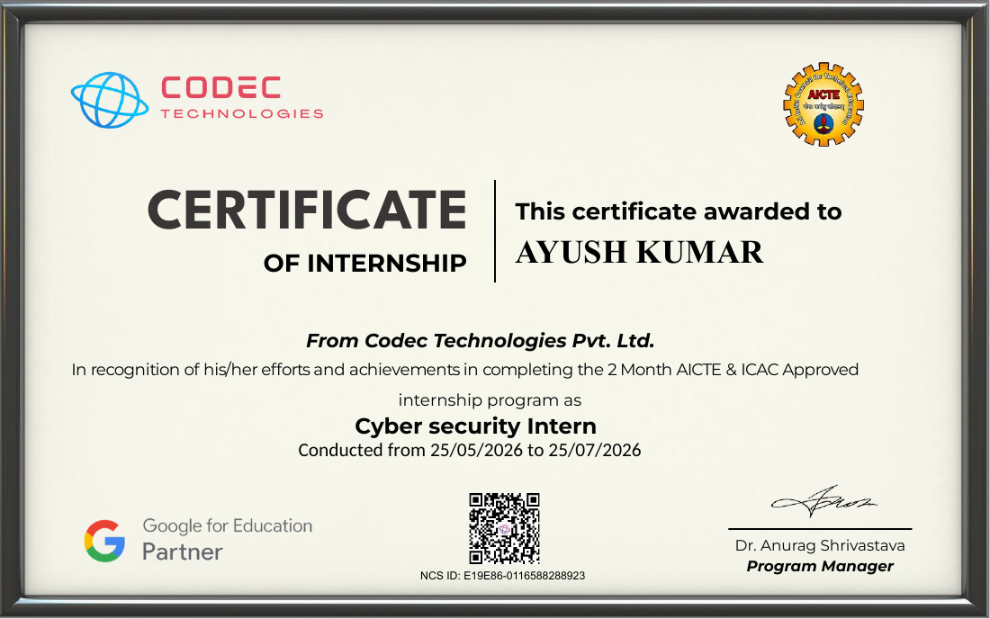
Certificate and Recommendation
Cyber Security Internship | Codec Technologies | Ayush Kumar

