Slide 1
American Express Campus Analyze This 2018
Final Submission

Slide 2
Team Details
Team Name : Hackdata
Name | Campus | Roll No. | Mobile No. | Email Id
Ayush Kumar | IIT Guwahati | 150106014 | 8723920572 | ayushkum10@gmail.com

Slide 3
Estimation Technique Used
Please provide the estimation/modeling technique(s)/approach used to arrive at the solution/equation
Used knn imputation to get missing values in the dataset.
Firstly found the correlation between the variables and then the variables which were correlated they were put in the knn multiple imputation algorithm to get the missing values of those variables.
Variables which had more than 30% missing values were removed from the training model.
For training various models were used like trees, Random Forest, XGBoost, SVM and Neural Network.
Out of all these models Random Forest turned out to be the best model as was expected from the training dataset as it was very large.

Slide 4
Strategy to decide final list
By training and tuning Random Forest model on training dataset and then by testing on Leaderboard dataset I first got the probabilities of applicant to default for each application key.
Then I sorted the probabilities in ascending order as in question we had to give the solution of the applicant from lower risk to higher risk of default.
After sorting according to probabilities I turned all those probabilities less than 0.4 to 0 and more than and equal to 0.4 to 1. Thus I got the final list of applicant key vs indicator for default

Slide 5
Details of each Variable used in the logic/model/strategy
Please provide details of each variable used in the final logic
Mvar1 and mvar2 turned out to be most important variable in the modeling as shown by the plot of variable importance by Random Forest.
Mvar8, mvar6, mvar7, mvar10 also turned out be important. Also they were highly correlated with mvar1.
Mvar28, mvar34 and mvar43 were correlated with mvar2. Thus these were used to get missing values of mvar2.
Mvar42, mvar29, mvar25, mvar32 also turned out be important.
All remaining variables mvar12,33,36,44,13,3,14,38,28,36,43,37,19,20,4,34 and 39 turned to be moderately important.
See the graph for full details.

Slide 6
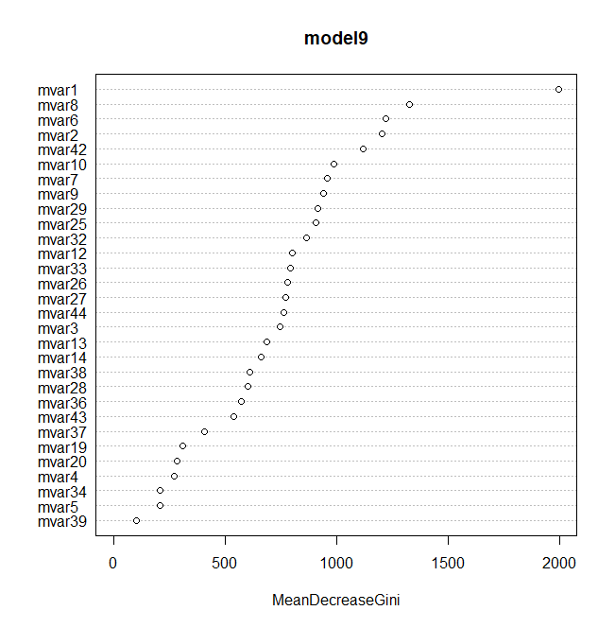
Plot of Variable Importance
This plot can easily summarize above slide

Slide 7
Reasons for Technique(s) Used
KNN imputation is the best technique for finding missing values because in this algorithm a point value is approximated by the values of the points that are closest to it. Thus there in this problem there are many variables which are correlated and are close to eachother.
Random Forest algorithm is one of the best model when you have large dataset and many variables. It can deal with outliers and randomness in the data and do not need normalization. Random forests are a way of averaging multiple deep decision trees, trained on different parts of the same training set, with the goal of overcoming over-fitting problem of individual decision tree. Thus in this problem there is a high chance of overfitting and random forest will work best on it by tuning it. Tuning is very simple in random forest and can easily tell on which parameter value it will show best result.

Slide 8
Final Submission File

Slide 9
THANK YOU

