Slide 1
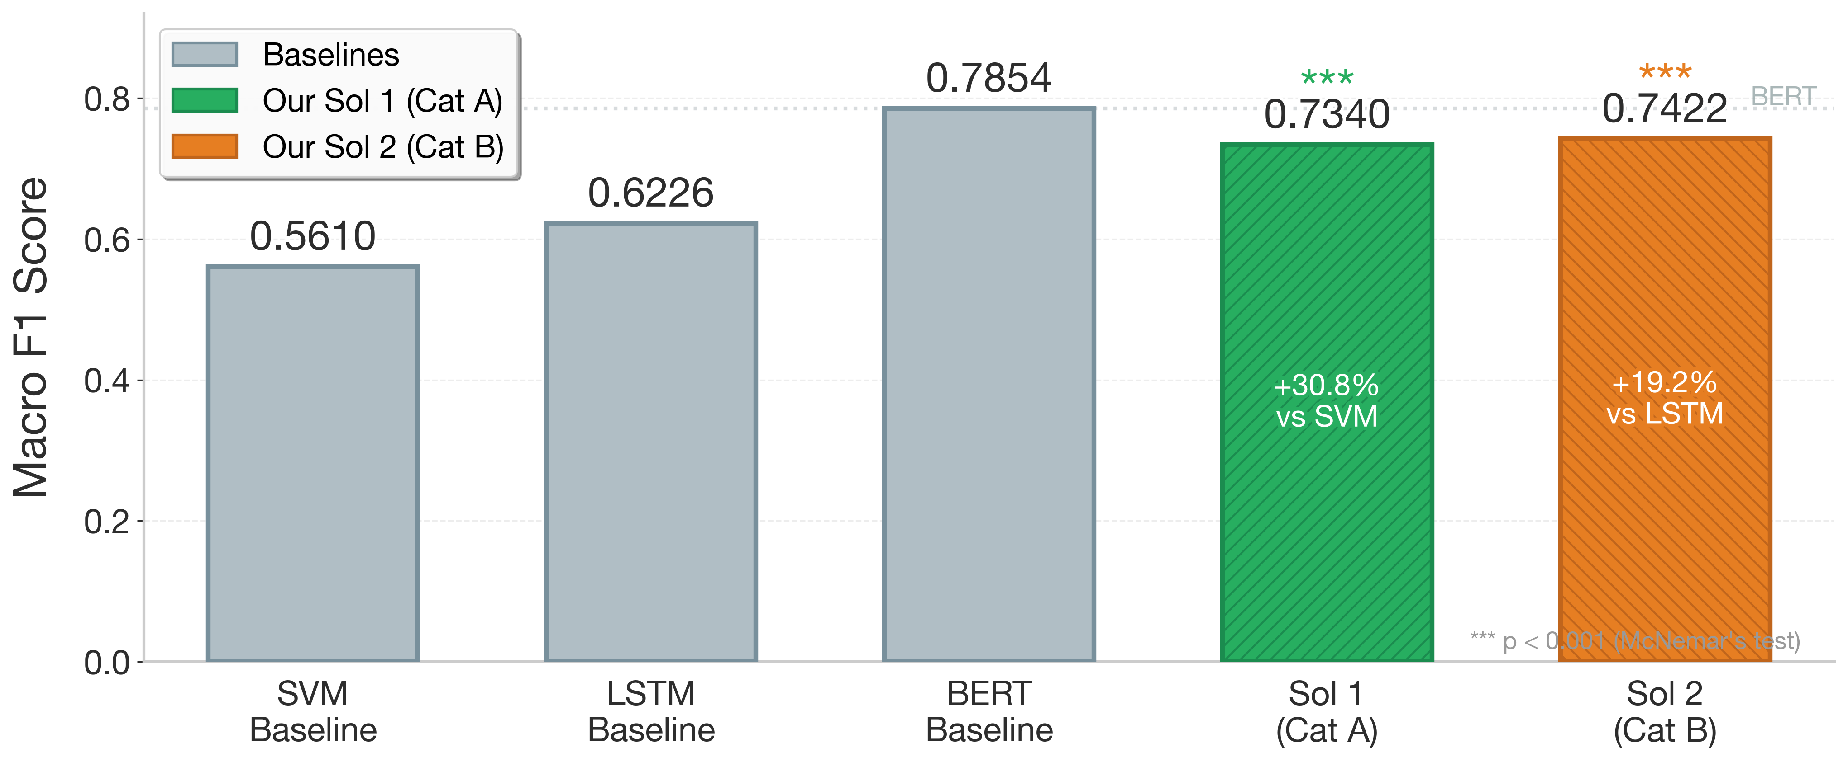
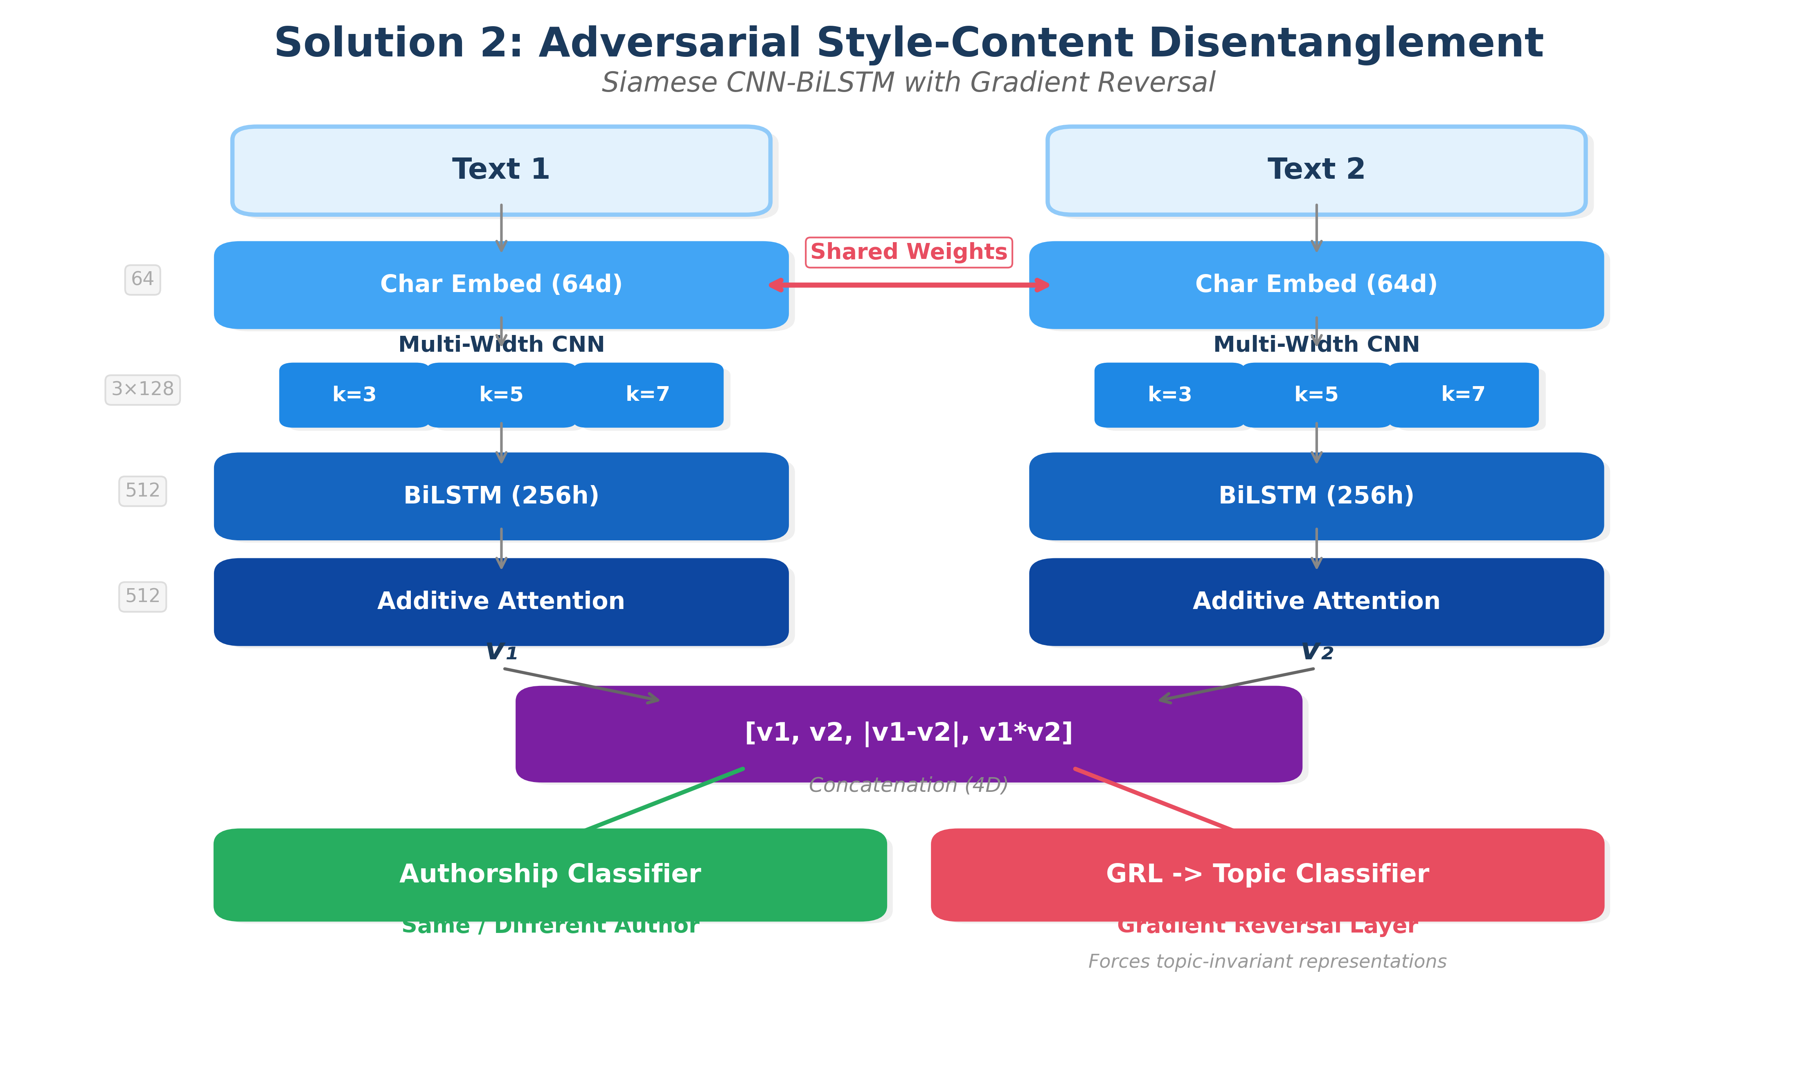
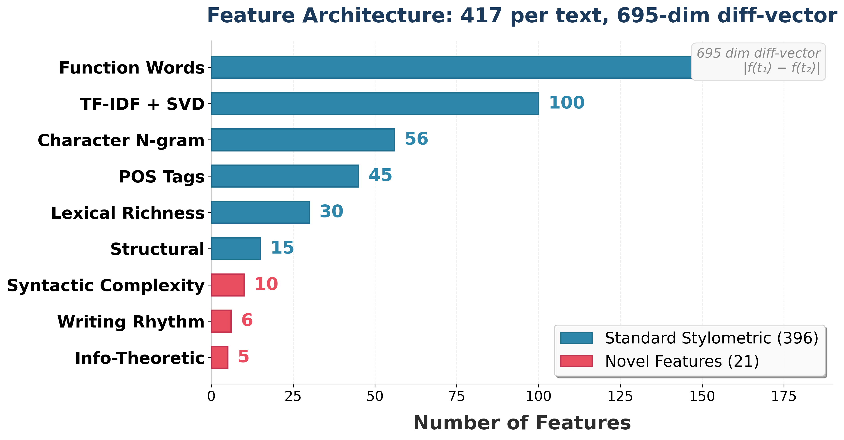
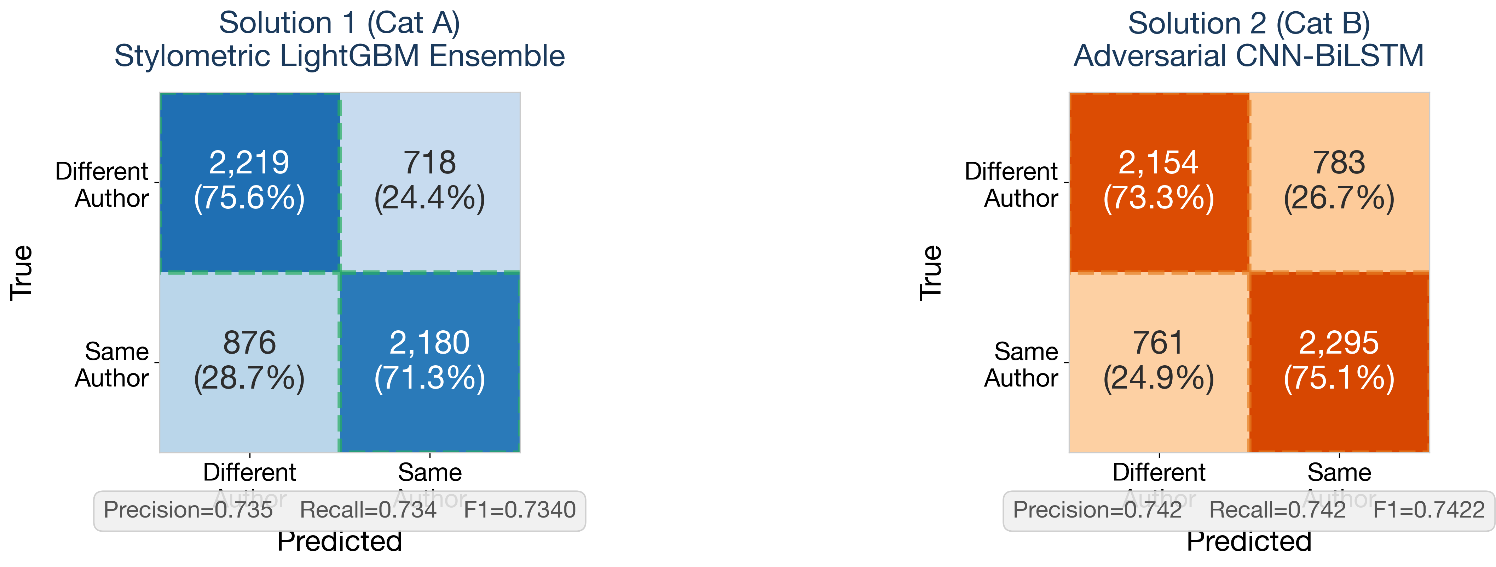
Authorship Verification: Combining Stylometric Feature Engineering with Adversarial Neural Style-Content Disentanglement
COMP34812 Natural Language Understanding | Group 34 | University of Manchester | 2025–26
Sol 1 (Cat A): F1 = 0.7340 (+30.8% vs SVM)
Sol 2 (Cat B): F1 = 0.7422 (+19.2% vs LSTM) Both p < 0.001 ***
①
Introduction
④
Solution 1: Stylometric Ensemble (Cat A)
⑤
Solution 2: Adversarial CNN-BiLSTM (Cat B)
⑥
Results (Development Set)
Task Definition
Given two texts, determine whether they were written by the same author. Binary classification requiring models to capture authorial style while remaining robust to topical variation.
Key Challenge
Style-content confound: models may exploit topic similarity as a proxy for shared authorship, producing spurious correlations that fail to generalize.
Our Approach
• Solution 1 (Cat A) — Stylometric feature ensemble with LightGBM classifier
• Solution 2 (Cat B) — Adversarial CNN-BiLSTM with gradient reversal for debiasing
417 features per text → 695-dim diff-vector:
Standard Stylometric (396):
• Function words (150) — Closed-class style markers
• TF-IDF + SVD (100) — Latent semantic dims
• Char n-grams (56) — 2–4 char profiles
• POS distributions (45) — Syntactic signatures
• Lexical richness (30) — TTR, Yule's K, hapax
• Structural (15) — Sentence/paragraph patterns
Novel Features (21):
• Syntactic complexity (10) — Parse depth, clause density
• Writing rhythm (6) — Syllable var, punct cadence
• Info-theoretic (5) — Entropy, compression ratio
Classifier: LightGBM (1000 trees, depth=7)
Siamese Encoder (813K params):
• Char embedding (64d) — Sub-word stylistic patterns
• Multi-width CNN (k=3,5,7) — Multi-scale local features
• BiLSTM (256 hidden) — Sequential style dependencies
• Additive Attention — Salient feature weighting
Adversarial Debiasing:
• Gradient Reversal Layer — Ganin & Lempitsky (2015)
• Topic pseudo-labels — TF-IDF + KMeans (k=10)
• Forces topic-invariant style representations
Data Aug: char perturbation (insert/delete/swap)
Model F1 vs Baseline
──────────────────────────────────────────────────
SVM Baseline 0.5610 —
LSTM Baseline 0.6226 —
BERT Baseline 0.7854 —
──────────────────────────────────────────────────
★ Sol 1 (Cat A) 0.7340 +30.8% vs SVM ***
MCC=0.469 Acc=0.734
★ Sol 2 (Cat B) 0.7422 +19.2% vs LSTM ***
MCC=0.485 Acc=0.742
*** p < 0.001, McNemar’s test. Both statistically significant.
②
Dataset Summary
Performance Comparison
Training: 27,643 text pairs
Development: 5,993 text pairs
Labels: Same Author (51%) / Different Author (49%)
Domains: Cross-domain (emails, blog posts, reviews)
Representation
• Text pair (t₁, t₂) → diff-vector |f(t₁) − f(t₂)| capturing stylistic distance
• Content-agnostic by design
Closed mode — only provided training data permitted.
Neural Architecture Diagram
Feature Group Breakdown
③
Evaluation Methodology
Confusion Matrices
Metrics
• Macro F1 (primary), MCC, Per-class P/R
Statistical Testing
• McNemar's test for paired significance
• All improvements significant at p < 0.001
Additional Evaluation
• Feature ablation study (Sol 1)
• Inter-model agreement (Cohen’s κ)
• Cross-domain error breakdown
Error Analysis & Key Findings
Limitations & Key References
Inter-model agreement: ~70% (Cohen’s κ = 0.40) — complementary patterns
Complementary Failure Modes:
• Sol 1: Struggles with short texts (<200 tokens) — insufficient features
• Sol 2: Struggles with formal/structured texts — less char-level variation
• Topic Confound: Elevated FP on same-topic pairs; GRL partially mitigates
Ablation: Removing novel features drops Sol 1 F1 by 1.8%
Limitations:
• Closed-mode — may not generalize to other domains/languages
• English-only; cultural biases in writing norms
• Neither surpasses BERT baseline (0.7854) — transformer headroom
Ethics:
• Risk: surveillance, deanonymization, forensic false positives
References:
[1] Stamatatos+ (2023) Diff-Vectors for AV [2] Ganin & Lempitsky (2015) GRL
[3] Abbasi & Chen (2008) Writeprints [4] Boenninghoff+ (2019) AdHominem
COMP34812 Natural Language Understanding │ University of Manchester │ Group 34 │ 2025–26 │ Closed Mode │ github.com/ayush-kumar-prog

