Slide 1
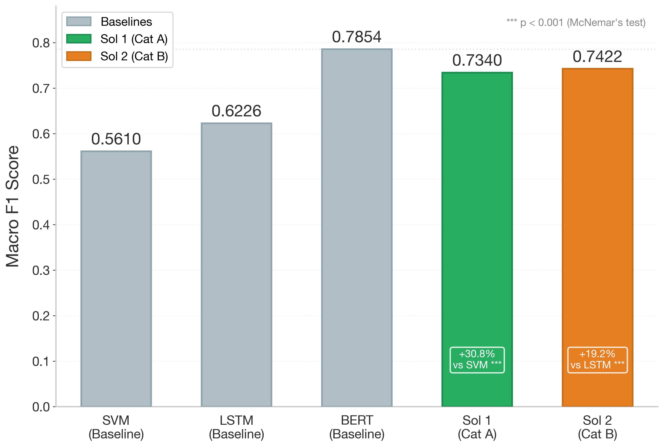
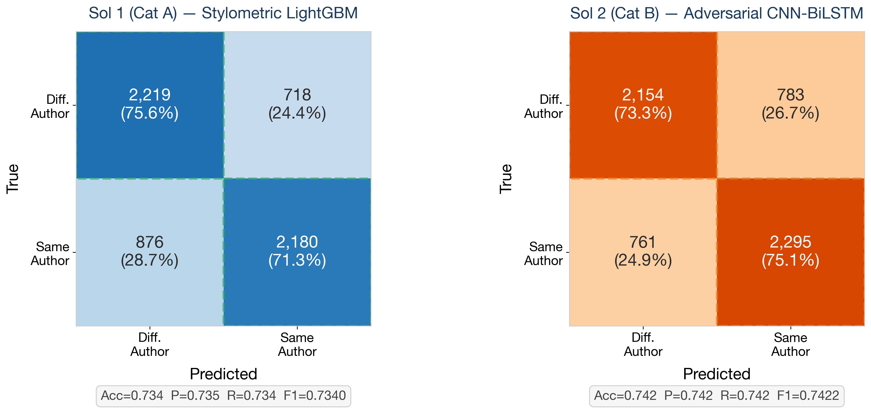
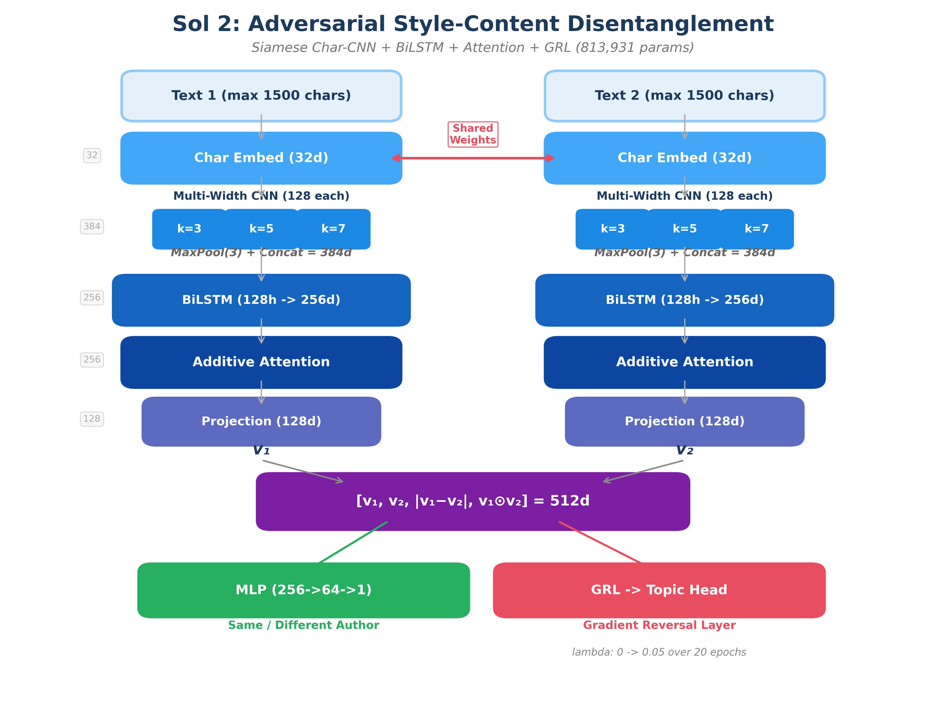
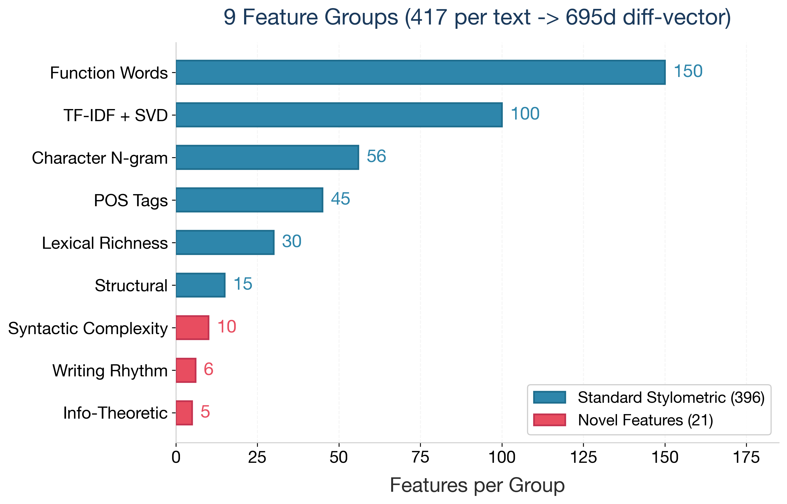
Authorship Verification: Combining Stylometric Feature Engineering with Adversarial Neural Style-Content Disentanglement
COMP34812 Natural Language Understanding | Group 34 | University of Manchester | 2025–26
Cat A: F1=0.7340 (+30.8% vs SVM, p<0.001) | Cat B: F1=0.7422 (+19.2% vs LSTM, p<0.001)
1
Task & Motivation
4
Sol 2: Adversarial Disentanglement (Cat B)
Performance Comparison
Authorship Verification (AV): given two texts, determine if they share the same author. Binary classification task requiring style-sensitive, content-invariant models.
Core Challenge: Style-Content Confound
Models may learn topic similarity as a proxy for shared authorship, producing brittle correlations that fail to generalize.
Our Two Solutions:
• Sol 1 (Cat A) — Stylometric LightGBM with 695-dim diff-vectors
• Sol 2 (Cat B) — Siamese CNN-BiLSTM with adversarial debiasing (GRL)
Siamese Encoder (shared weights, 813K params):
• Char embedding (32d) — Sub-word stylistic patterns (vocab=97)
• Multi-width CNN (k=3,5,7) — 128 filters each -> 384d, MaxPool(3)
• BiLSTM (hidden=128) — Bidirectional -> 256d sequential features
• Additive Attention — Bahdanau-style, focuses on salient style cues
• Projection (128d) — ReLU + Dropout(0.3) bottleneck
Comparison: [v₁, v₂, |v₁−v₂|, v₁⊙v₂] = 512d
MLP Classifier: 512 -> 256 -> 64 -> 1 (BCE loss)
Adversarial Debiasing (Novel):
• Gradient Reversal Layer — Ganin & Lempitsky (2015)
• Topic pseudo-labels — TF-IDF + KMeans (k=10)
• Lambda ramp: 0 -> 0.05 over 20 epochs; topic_weight=0.02
• Forces topic-invariant style representations
Training: AdamW lr=2e-4, cosine scheduler, early stopping, char augmentation
2
Dataset Summary
Training pairs: 27,643 (51% same-author, 49% different)
Dev pairs: 5,993 (same distribution)
Domains: Cross-domain (emails, blogs, reviews, essays)
Mode: Closed — only provided training data
• Near-balanced: macro F1 closely tracks accuracy
• Each pair: 2 texts (variable length, 50-10,000 tokens)
Confusion Matrices
Neural Architecture (Sol 2)
3
Sol 1: Stylometric Ensemble (Cat A)
417 features per text across 9 groups:
Standard Stylometric (396):
• Function words (150) — Closed-class words as style markers
• TF-IDF + SVD (100) — Latent semantic dimensions
• Character n-grams (56) — 2–4 char frequency profiles
• POS tags (45) — Syntactic preference signatures
• Lexical richness (30) — TTR, Yule's K, hapax ratios
• Structural (15) — Sentence/paragraph length patterns
Novel Features (21):
• Syntactic complexity (10) — Parse tree depth, clause density
• Writing rhythm (6) — Syllable variance, punctuation cadence
• Info-theoretic (5) — Entropy rate, compression ratio
Representation: diff-vector |f(t1) - f(t2)| -> 695 dims
Classifier: LightGBM (1000 trees, max_depth=7)
6
Error Analysis
Inter-model agreement: 69.8% (Cohen’s κ = 0.396)
30.2% disagreement — among those, Sol 1 correct 48.6%, Sol 2 correct 51.4%.
Per-Class Strengths:
• Sol 1: Better at "Different Author" (75.6% vs 73.3%) — stylometric features detect differences well.
• Sol 2: Better at "Same Author" (75.1% vs 71.3%) — neural model captures stylistic similarity.
• Topic confound: Elevated FP on same-topic pairs; GRL partially mitigates.
Feature ablation: Removing 21 novel features: -1.8% F1
GRL ablation: Removing GRL: -1.2% F1 on topic-confounded pairs
5
Results (Dev Set)
Feature Group Breakdown
Model F1 MCC Δ Baseline
────────────────────────────────────────────────────
SVM (Cat A baseline) 0.5610 — —
LSTM (Cat B baseline) 0.6226 — —
BERT (Cat C baseline) 0.7854 — —
────────────────────────────────────────────────────
★ Sol 1 (Cat A) 0.7340 0.469 +30.8% ***
★ Sol 2 (Cat B) 0.7422 0.485 +19.2% ***
────────────────────────────────────────────────────
*** p < 0.001, McNemar’s paired test
Both solutions significantly outperform same-category baselines.
Neither surpasses BERT (Cat C) — expected given category constraints.
7
Limitations & Ethics
Limitations:
• Closed-mode: may not generalize to unseen domains
• English-only; cultural writing biases not addressed
• Neither Sol 1 nor Sol 2 surpasses BERT baseline (0.7854)
• Style verification can be circumvented by imitation attacks
Ethical Considerations:
• Surveillance risk: could be misused for deanonymization
• False positives in forensic settings cause serious harm
• Should not be sole evidence in legal proceedings
Evaluation & Conclusions
Key References
Evaluation Methods:
• Macro F1 (primary), MCC, per-class P/R
• McNemar’s paired significance test (p < 0.001)
• Feature ablation (Sol 1) + GRL ablation (Sol 2)
• Inter-model agreement (Cohen’s κ ≈ 0.40)
Key Conclusions:
• Both solutions significantly outperform their baselines
• Sol 1 excels at detecting different authors (75.6% acc)
• Sol 2 excels at confirming same author (75.1% acc)
• Complementary strengths suggest ensemble potential
[1] Stamatatos et al. (2023) Diff-Vectors for Authorship Analysis
[2] Ganin & Lempitsky (2015) Domain Adaptation by Backpropagation
[3] Abbasi & Chen (2008) Writeprints: Stylometric Identification
[4] Boenninghoff et al. (2019) AdHominem: Explainable AV
Key Insight
The diff-vector |f(t₁) − f(t₂)| representation is central to Cat A: each feature captures authorial style per text, and the absolute difference measures stylistic distance. This makes the representation symmetric and content-agnostic by construction.
The 21 novel features (syntactic complexity, writing rhythm, information-theoretic measures) contribute a statistically significant +1.8% F1 gain over standard stylometric features alone.
COMP34812 Natural Language Understanding │ University of Manchester │ Group 34 │ 2025–26 │ Closed Mode │ Predictions: Group_34_A.csv + Group_34_B.csv

