Slide 1
PROJECT DOCUMENTATION
Sales Analytics and Business
Decision Support System
A menu-driven Python system that turns historical sales data into
business decisions, using pandas analytics and scikit-learn Machine Learning.
Python • Pandas • NumPy • Matplotlib • Scikit-learn

Slide 2
THE PROBLEM
Why This Project Exists
A company records every sale: region, category, customer, amount sold, profit made. On its own, raw data is not useful — a manager cannot scan 3,000+ rows and know what to do next.
1
Descriptive Analysis
Summarizes what already happened — best region, worst product, monthly trend — using pandas.
This program does the two things a real business tool must do:
2
Predictive Analysis
Uses Machine Learning (scikit-learn) to learn from history and estimate what happens next with new, unseen data.
Sales Analytics and Business Decision Support System
02

Slide 3
PURPOSE
Business Questions This System Answers
Which region performs best — and worst?
Which customers contribute the most revenue?
Which category generates maximum sales?
Which region should receive more stock?
Which product sells the most?
Which region is likely to grow next?
Which months have the strongest / weakest sales?
Which category needs marketing investment?
Sales Analytics and Business Decision Support System
03

Slide 4
TOOLS USED
Technology Stack
pd
np
plt
sk
pandas
NumPy
Matplotlib
Scikit-learn
Reads CSV data into DataFrames; groupby(), sum(), mean() work like an Excel PivotTable.
Powers pandas internally; used directly for np.where() to build conditional columns.
Draws and saves Bar, Line, Pie, Histogram, and Scatter charts as image files.
Ready-made ML algorithms: Linear Regression, KMeans, Random Forest — no maths from scratch.
Sales Analytics and Business Decision Support System
04

Slide 5
HOW IT'S BUILT
Design Philosophy: Simple by Choice
1
No classes, no OOP
Plain functions + global variables so every line is traceable without needing object-oriented concepts first.
2
No lambdas, no advanced syntax
Every operation is written as its own clear, commented step — built for a first-year B.Tech evaluation.
3
Fully menu-driven
One while loop, one if/elif chain, 15 numbered options — predictable and easy to demo.
Sales Analytics and Business Decision Support System
05

Slide 6
MENU OPTION 1
Loading and Validating Data
Reads the CSV into a pandas DataFrame, then splits Order_Date into Month and Year columns for later trend analysis.
sales_data = pd.read_csv(file_path) sales_data["Order_Date"] = pd.to_datetime( sales_data["Order_Date"]) sales_data["Month"] = sales_data["Order_Date"].dt.month sales_data["Year"] = sales_data["Order_Date"].dt.year
No os module: pd.read_csv() is simply tried inside a try/except — a missing file raises FileNotFoundError, caught with a helpful message.
Column validation: every loaded file is checked against a required-columns list, so ANY correctly-shaped CSV (not just the sample) can be used.
Sales Analytics and Business Decision Support System
06

Slide 7
MENU OPTIONS 2 – 3
Dataset Information & Business Summary
Dataset Information
Overall Business Summary
.shape, .columns
row/column counts and names
.head()
preview the first rows
.isnull().sum()
count missing values per column
.describe() min, max, mean, quartiles
Total Sales & Profit
Average Sales & Profit / Order
Total Orders, Customers, Products
Average Discount Given
Uses .sum(), .mean(), .nunique() — the “big picture” numbers a manager wants first.
Sales Analytics and Business Decision Support System
07

Slide 8
MENU OPTIONS 4 – 6
The Core Technique Behind Every Analysis
1
2
3
4
groupby()
sum()
sort_values()
idxmax() / idxmin()
→
→
→
Collects rows sharing a value (e.g. Region) into one group — exactly like an Excel PivotTable.
Calculates a total for each group separately (e.g. Sales per Region).
Arranges totals biggest-to-smallest; head(10) / tail(10) show best and weakest.
Returns the actual name (label) of the best/worst group, not just the number.
Applied to Product Analysis (4), Category Analysis (5), and Region Analysis (6) — answering which region/category/product is strongest and weakest.
Sales Analytics and Business Decision Support System
08

Slide 9
MENU OPTIONS 4 – 9
Detailed Drill-Down Features
Menu Option | Extra Detail Added
4. Product Analysis | Region × Category breakdown, plus lookup of one Product+Category+Region
5. Category Analysis | Category × Region breakdown — which region sells the most/least of each category
6. Region Analysis | Each region's top-selling Category and top-selling Product
7. Customer Analysis | Table of each region's most popular category and top-spending customer
8. Monthly Sales Trend | Month NAMES, each month's top category/product, each region's most-liked category
9. Profit Analysis | Leads with highest/lowest profit Region and Category
Sales Analytics and Business Decision Support System
09

Slide 10
MENU OPTIONS 7 – 8
Customer Insight & Seasonal Trend
Customer Analysis
Monthly Sales Trend
Finds the best and worst customers by total Sales, and calculates what percentage of total revenue the top customer contributes — flagging who is worth protecting with a loyalty program.
Groups sales by calendar Month and Year to reveal seasonality — which months are strongest so management can plan stock and staffing ahead of time.
+ New: a table showing each region's most popular category and top-spending customer, side by side.
+ New: shows month NAMES (not numbers), each month's top category/product, and each region's most-liked category.
Sales Analytics and Business Decision Support System
10

Slide 11
MENU OPTION 9
Profit Analysis: Beyond Just Sales
A product can have high Sales but a low profit margin, or low Sales but a high margin. Analyzing profit separately gives management the fuller picture before deciding what to promote or discontinue.
Now Leads With
Highest / lowest profit Region and Category, shown first — before overall margin figures.
Profit Margin = ( Total Profit ÷ Total Sales ) × 100
Also Shows
Top and bottom 5 most/least profitable products.
Sales Analytics and Business Decision Support System
11

Slide 12
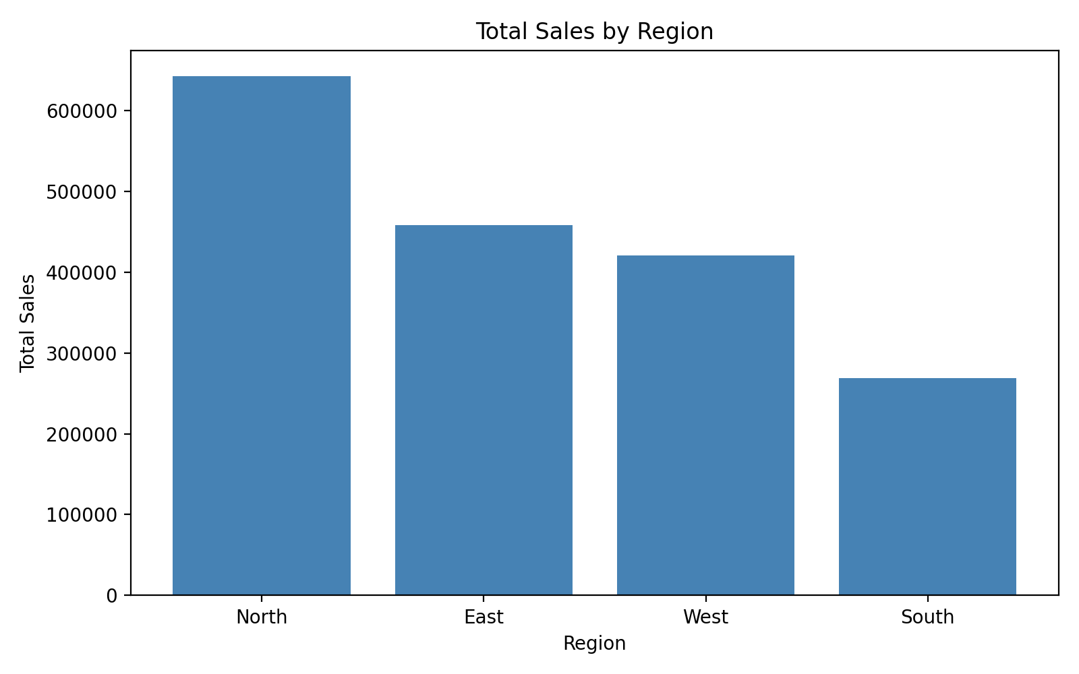
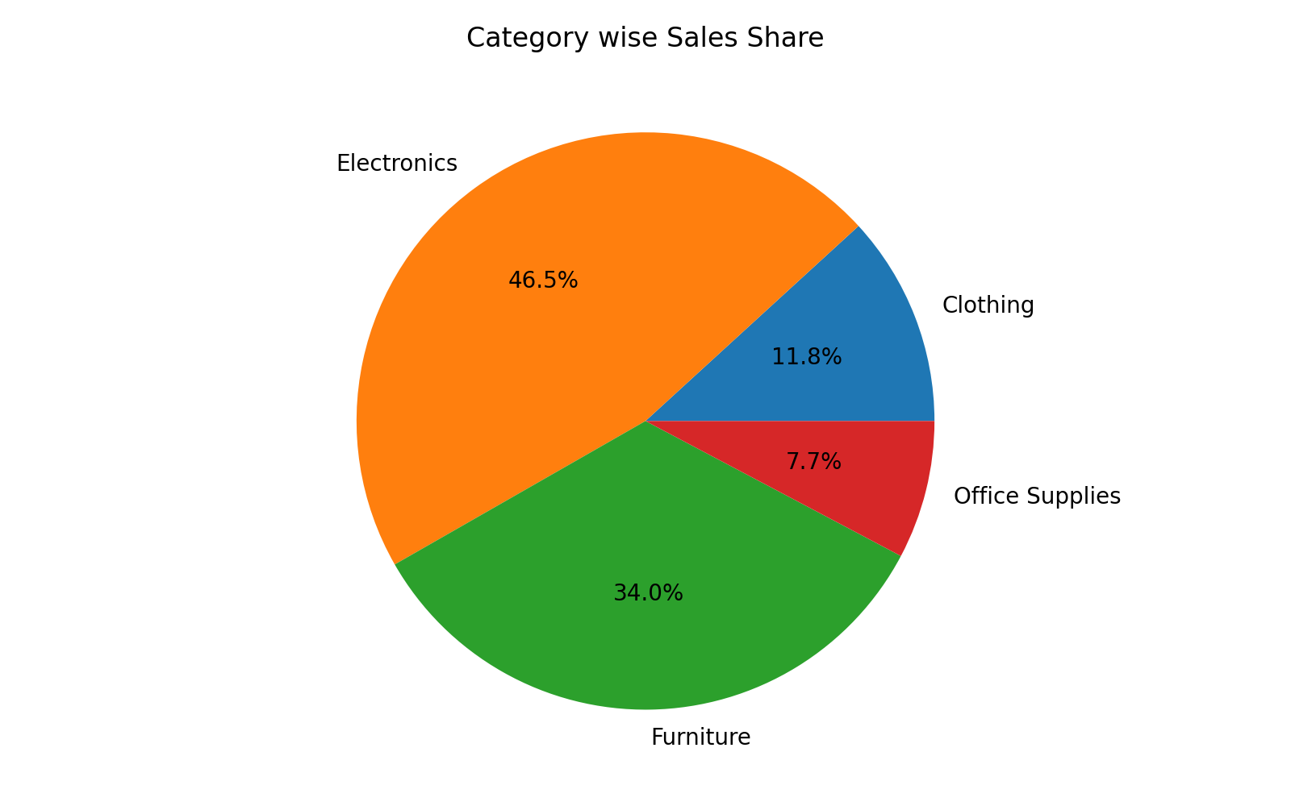
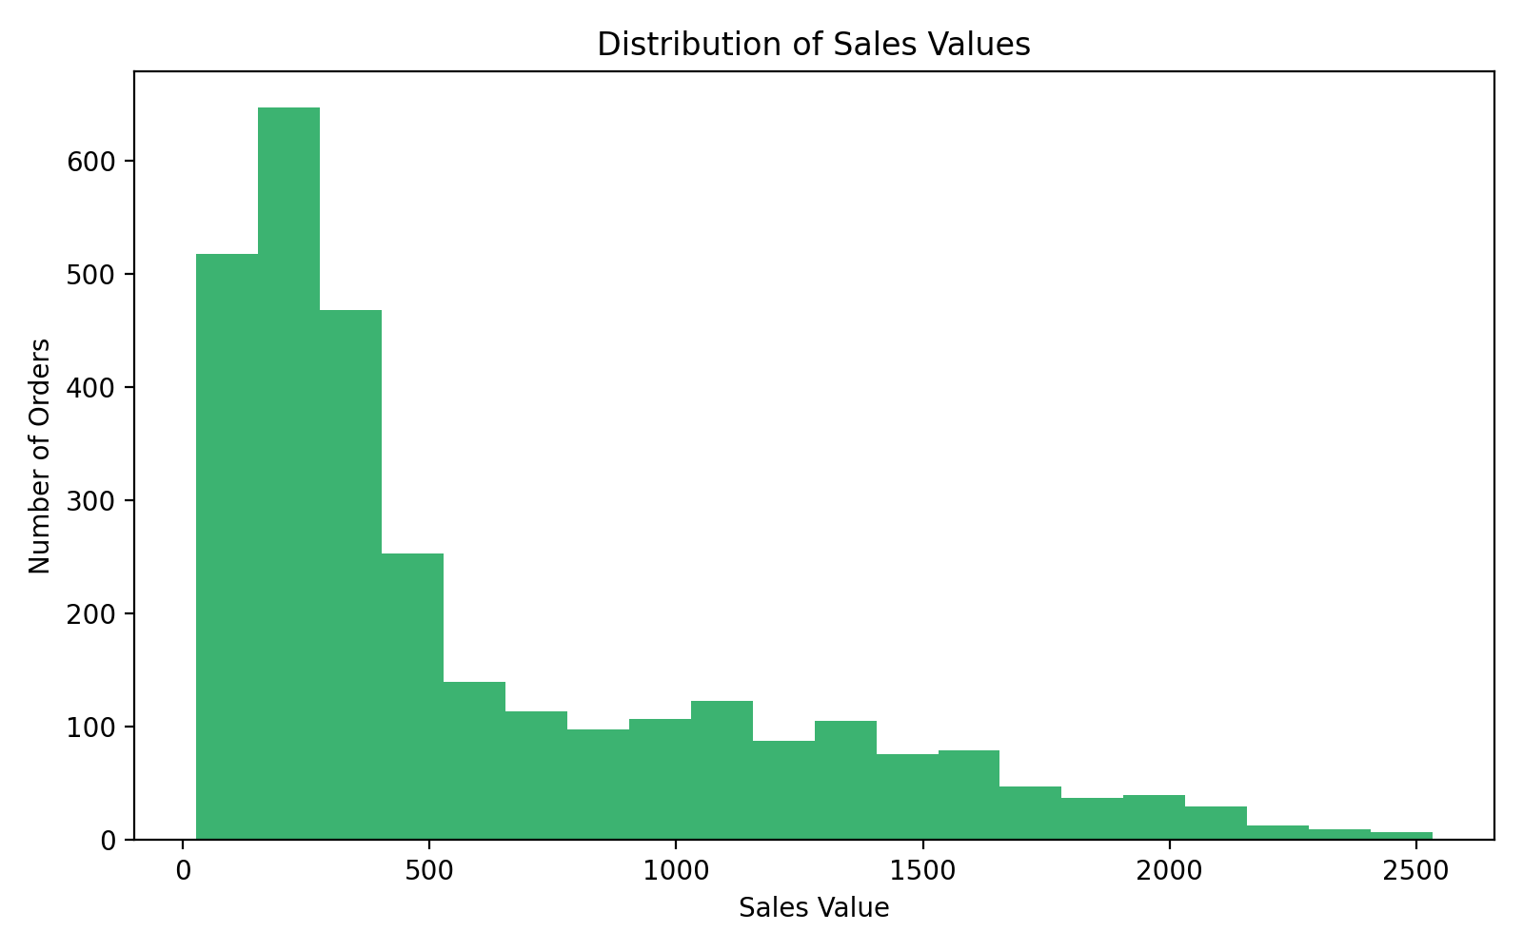
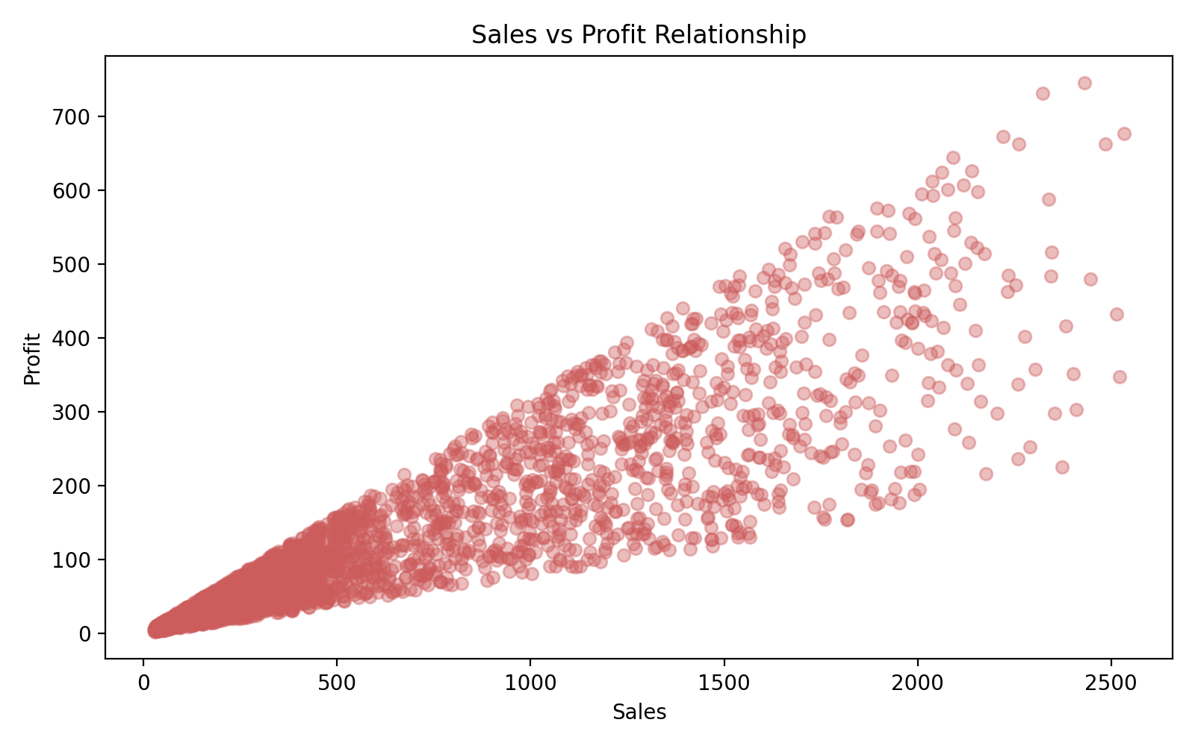
MENU OPTION 10
Visual Graph Reports
Chart | Answers
Bar Chart | Compare totals across regions
Line Chart | Show trend across months
Pie Chart | Show each category's share of the whole
Histogram | Distribution of order values
Scatter Plot | Relationship between Sales and Profit
SAMPLE OUTPUT — ACTUAL CHARTS FROM THE CODE
Bar Chart — Total Sales by Region
Pie Chart — Category Sales Share
Histogram — Order Value Spread
Scatter — Sales vs Profit
Every chart is saved as a file with plt.savefig() and closed with plt.close() so charts never overlap.
Sales Analytics and Business Decision Support System
12

Slide 13
MENU OPTION 11
Machine Learning: Four Models, Trained on History
1
2
3
4
Linear Regression
Linear Regression
KMeans Clustering
Random Forest
Predicts Sales
Predicts Profit
Unsupervised
Classification
Learns the relationship between Quantity, Discount, Region and Category vs. actual Sales.
Same approach, trained separately to estimate Profit for new orders.
Groups regions into High / Medium / Low performance by similarity in Sales & Profit — no labels given.
100 small trees vote on whether an order is High-Value or Low-Value — majority wins.
Sales Analytics and Business Decision Support System
13

Slide 14
MENU OPTION 11 — DEEP DIVE
How the Random Forest Model Works
100
Trees
RandomForestClassifier( n_estimators = 100, max_depth = 4, random_state = 42 )
Each tree trains on a random, slightly different slice of the historical data.
✓
Majority Vote
Every tree guesses High/Low; the forest's final answer is whichever guess wins the vote.
A median Sales cutoff first labels every historical order High-Value (1) or Low-Value (0). The forest then learns to predict that label for new orders.
4
Max Depth
Each tree is kept shallow — simple, fast, and resistant to overfitting.
Why not one single tree? One tree can be thrown off by a few noisy rows — 100 trees voting together smooth that noise out.
Sales Analytics and Business Decision Support System
14

Slide 15
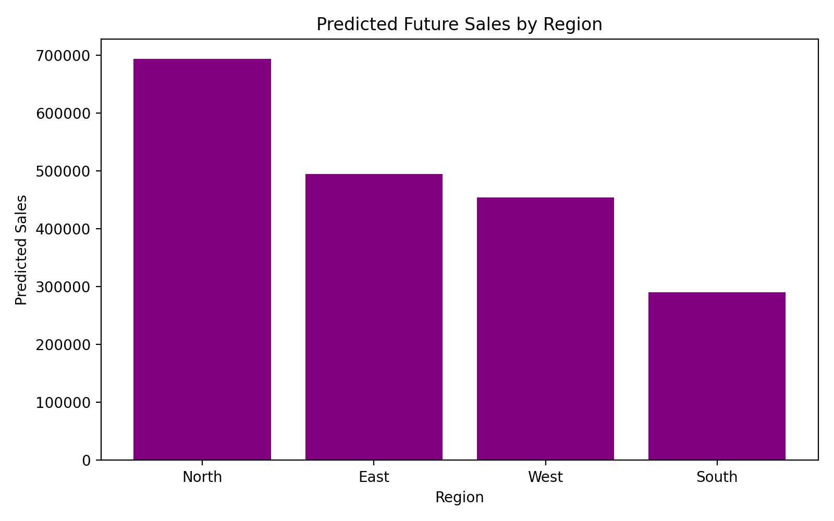
MENU OPTION 12
Predicting Future Sales From a New CSV
1
2
3
4
Read & Encode
Predict
Drill to Product
Save & Visualize
Load the new CSV (no Sales/Profit yet); reuse the same Region/Category number-mappings from training.
→
Apply the trained models to estimate Sales, Profit, and High/Low performance for every new row.
→
Find the top / weakest Product inside the best/weak Region and Category — concrete, not just a region name.
→
Write predicted_future_sales.csv, save a bar graph, and store the result for Business Suggestions.
Output includes: Expected High-Performing Region + its leading product, and Expected Weak Region/Category + their weakest product.
Actual code output: predicted_sales_by_region.png
Sales Analytics and Business Decision Support System
15

Slide 16
MENU OPTION 13
Business Suggestions: The Decision Engine
Choose the dataset the suggestions are based on:
Not Just Facts — Reasoning
Historical Dataset (Option 1)
Instead of only stating “Region North has the highest sales,” the engine drills one level deeper to explain WHY — which category and product actually drove it, and which category/region the top customer prefers.
Predicted / Future Dataset (Option 12)
“Region South is weakest, dragged down by the Furniture category and product X — increase marketing there.”
Both — clearly labeled side by side
This is the layer that turns numbers into decisions.
Sales Analytics and Business Decision Support System
16

Slide 17
MENU OPTIONS 14 – 15 & OVERALL FLOW
Wrapping Up: Report, Menu Loop & Algorithm
1
Show the menu, read the user's choice
2
Route the choice through an if/elif chain to the matching function
3
Every insight generated is appended to report_lines
4
Option 14 writes report_lines to business_report.txt
5
The while loop repeats until Option 15 (Exit) is chosen
open() · .write() · .close() — plain built-in Python file functions, no external library needed for the text report.
Sales Analytics and Business Decision Support System
17

Slide 18
PROGRAM STRUCTURE
System Flow at a Glance
Start Program
↓
Show Main Menu (1–15)
↓
Read User Choice
↓
Run Matching Function
Data & Analysis
(Options 1–9)
Graphs & ML
(Options 10–11)
Predict & Suggest
(Options 12–13)
Report & Exit
(Options 14–15)
Loop repeats until Option 15 (Exit) sets program_running = False.
Sales Analytics and Business Decision Support System
18

Slide 19
REFERENCE
Key Function Glossary
Function | What It Does
groupby() | Groups rows sharing a column value, like a PivotTable
idxmax() / idxmin() | Finds the label (name) of the best / worst group
sort_values() / head() / tail() | Ranks results; shows top / bottom performers
.map() / .fillna() | Encodes text to numbers for ML; fills missing values safely
np.where() | Creates a value based on a condition (e.g. High/Low label)
.fit() / .predict() | Trains a model on history, then estimates outcomes for new data
Sales Analytics and Business Decision Support System
19

Slide 20
FROM NUMBERS TO DECISIONS
Descriptive Analytics + Machine Learning
+ a Business Decision Engine
Stock / inventory allocation by region
Marketing budget allocation by region & category
Product strategy — expand or discontinue
Team Members
Customer retention for top revenue contributors
1. Nikhil Malviya
2. Shreyash Pandey
3. Ayush Kumar Gupta
4. Ashutosh Singh Senger
Sales Analytics and Business Decision Support System — Python Project

