Slide 1

Managing
Cash Flow
Notes:
This "Deco" border was drawn on the Slide master using PowerPoint's Rectangle and Line tools. A smaller version was placed on the Notes Master by selecting all of the elements (using Select All from the Edit menu), deselecting the unwanted elements such as the Title (holding down the Shift key and clicking on the unwanted elements), and then using Paste as Picture from the Edit menu to place the border on the Notes Master. After pasting as a picture, we used the resize handles (with Shift to maintain the proportions) to reduce it to the size you see.
Be sure to delete this word processing box before using this template for your own presentation.

Slide 2

Cash Management
Common cause of business failure: Cash crisis!
A business can be earning a profit and be forced to close because it runs out of cash!
NFIB study:
  67 percent of small business owners have at least occasional problems managing cash flow.
  19 percent report cash flow as a continuing problem.

Slide 3

Cash Management
Cash management – forecasting, collecting, disbursing, investing, and planning for the cash a company needs to operate smoothly.
Young, growing companies are “cash sponges.”
Know your company’s cash flow cycle.

Slide 4

The Cash Flow Cycle
Deliver
Goods
Order
Goods
Receive
Goods
Pay
Invoice
Sell
Goods*
Send
Invoice
Customer
Pays**
Day
1
15
40
218
221
230
280
14
25
178
3
9
50
Cash Flow Cycle = 240 days
* Based on Average Inventory Turnover:
365 days = 178 days
2.05 times/year
** Based on Average Collection Period:
365 days = 50 days
7.31 times/year

Slide 5

Five Cash Management Roles of an Entrepreneur
Cash Finder
Cash Planner
Cash Distributor
Cash Collector
Cash Conserver

Slide 6

Cash Flow
Increase in Cash
Decrease in Cash
Cash
Leakage
Accounts Receivable
Accounts Payable
Cash Sales
Production/Cash Purchases
Inventory
Leakage

Slide 7

The Cash Budget
A “cash map,” showing the amount and the timing of a firm's cash receipts and cash disbursements over time.
Predicts the amount of cash a company will need to operate smoothly.
A helpful tool for visualizing the firm's cash receipts and cash disbursements and the resulting cash balance.

Slide 8

Preparing a Cash Budget
Determine a Minimum Cash Balance
Forecast Sales
Forecast Cash Receipts
Forecast Cash Disbursements
Estimate End-of-Month Cash Balance

Slide 9

Determine a Minimum Cash Balance
Remember Goldilocks, the Three Bears, and the porridge:
Not too much...
not too little...
but a cash balance that's just right ... for you!

Slide 10
Forecast Sales
The heart of the cash budget.
Sales are ultimately transformed into cash receipts and cash disbursements.
Cash forecast is only as accurate as the sales forecast from which it is derived.
“Lumpy” sales patterns are common.
  15 percent to 18 percent of wine and spirits shops’ annual sales occur between December 15 and 31.
  40 percent of toy sales take place in last 6 weeks of the year.

Slide 11
Forecast Sales
Prepare three sales forecasts:
  Most Likely
  Pessimistic
  Optimistic

Slide 12
Sales Forecast for a Start-Up
Example:
Number of cars in trading zone 84,000
x Percent of imports x 24%
= Number of imported cars in trading zone 20,160
Number of imports in trading zone 20,160
x Average expenditure on repairs x $485
= Total import repair sales potential $9,777,600
Total import repair sales potential $9,777,600
x Estimated market share x 9.9%
= Sales estimate $967,982

Slide 13
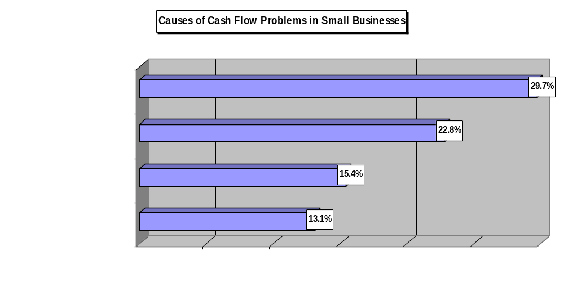

Slide 14

Forecast Cash Receipts
Record all cash receipts when actually received (i.e., the cash method of accounting).
Determine the collection pattern for credit sales; then add cash sales.
Monitor closely slow and nonpayers.

Slide 15
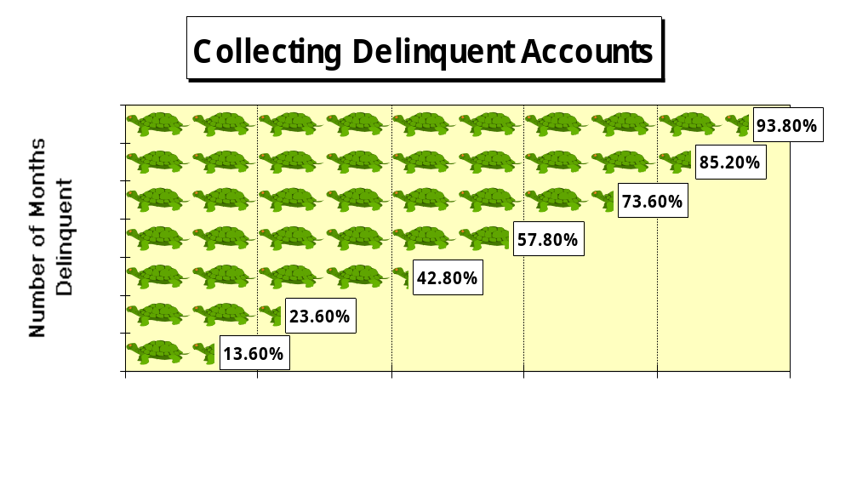

Slide 16
Forecast Cash Disbursements
Record disbursements when you expect to make them.
Start with those disbursements that are fixed amounts due on certain dates.
Review the business checkbook to ensure accurate estimates.
Add a cushion to the estimate to account for “Murphy’s Law.”
Don’t know where to begin? Try making a daily list of the items that generate cash and those that consume it.

Slide 17

Estimate End-of-Month Balance
Take Beginning Cash Balance...
Add Cash Receipts...
Subtract Cash Disbursements
Result is Cash Surplus or Cash Shortage (Repay or Borrow?)

Slide 18

Benefits of Cash Management
Increase amount and speed of cash flowing into the company
Reduce the amount and speed of cash flowing out
Make the most efficient use of available cash
Take advantage of money-saving opportunities such as cash discounts
Finance seasonal business needs

Slide 19
Benefits of Cash Management
Develop a sound borrowing and repayment program
Impress lenders and investors
Reduce borrowing costs by borrowing only when necessary
Provide funds for expansion
Plan for investing surplus cash

Slide 20

The “Big Three” of
Cash Management
Accounts Receivable
Accounts Payable
Inventory

Slide 21
Accounts Receivable
About 90 percent of industrial and wholesale sales are on credit, and 40 percent of retail sales are on account.
Survey of small companies across a variety of industries found that 77 percent extend credit to their customers.
Remember: “A sale is not a sale until you collect the money.”
The goal with accounts receivable is to collect your company’s cash as fast as you can.

Slide 22
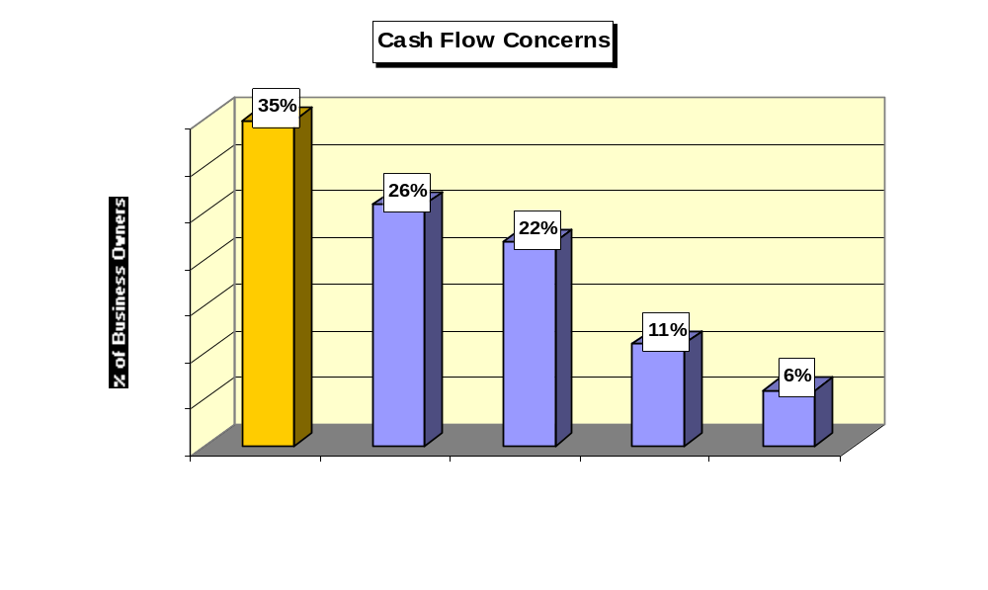

Slide 23

Beating the Cash Crisis
Accounts Receivable
Establish a firm credit-granting policy.
Screen credit customers carefully.
When an account becomes overdue, take action immediately.
Add finance charges to overdue accounts (check the law first!).
Develop a system of collecting accounts.
Send invoices promptly.

Slide 24

Accelerating Accounts Receivable
Ask customers to fax or e-mail orders
Send invoices when goods are shipped
Highlight the due date on invoices
Restrict customers’ credit until past-due bills are paid
Deposit checks and credit card receipts daily

Slide 25
Accelerating Accounts Receivable
Identify the top 20 percent of your customers and monitor them closely
Ask customers for up-front payments
Watch for signs that a customer may be about to declare bankruptcy
Consider using a lockbox service
Track the results of your company’s collection efforts

Slide 26

Beating the Cash Crisis
Accounts Payable
Stretch out payment times as long as possible without damaging your credit rating.
Verify all invoices before paying them.
Take advantage of cash discounts.

Slide 27
The Cost of Forgoing a Cash Discount
$1,000 invoice 2/10, net 30
$20
Amount
$980
$1,000
Day
0
10
30
20 days
I
P x T
$20
$980 x 20/360
R =
=
= 36.7%

Slide 28

Beating the Cash Crisis
Accounts Payable
Negotiate the best possible terms with your suppliers.
Be honest with creditors; avoid the “the check is in the mail” syndrome.
Schedule controllable cash disbursements to come due at different times.
Use credit cards wisely.

Slide 29
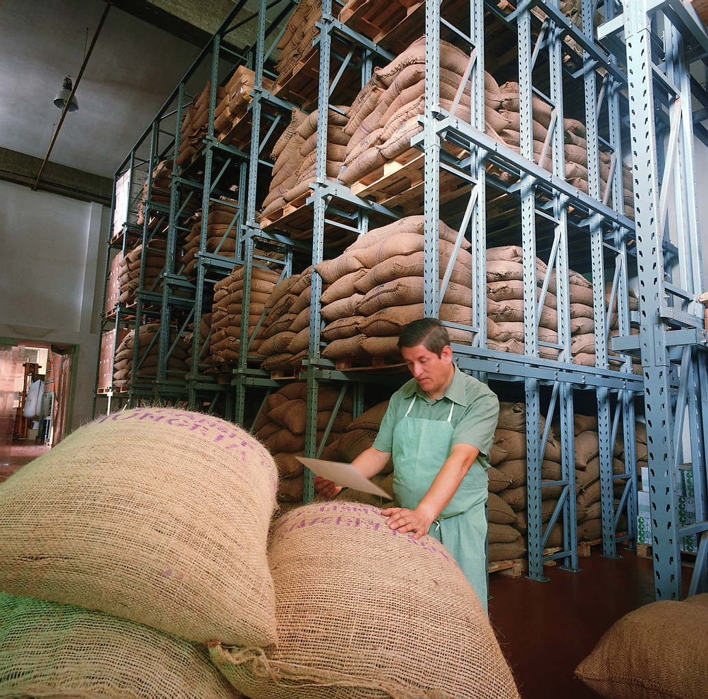
Beating the Cash Crisis
Inventory
Monitor it closely; it can drain a company’s cash.
Avoid inventory “overbuying.” It ties up valuable cash at a zero rate of return.
Arrange for inventory deliveries at the latest possible date.
Negotiate quantity discounts with suppliers when possible.

Slide 30
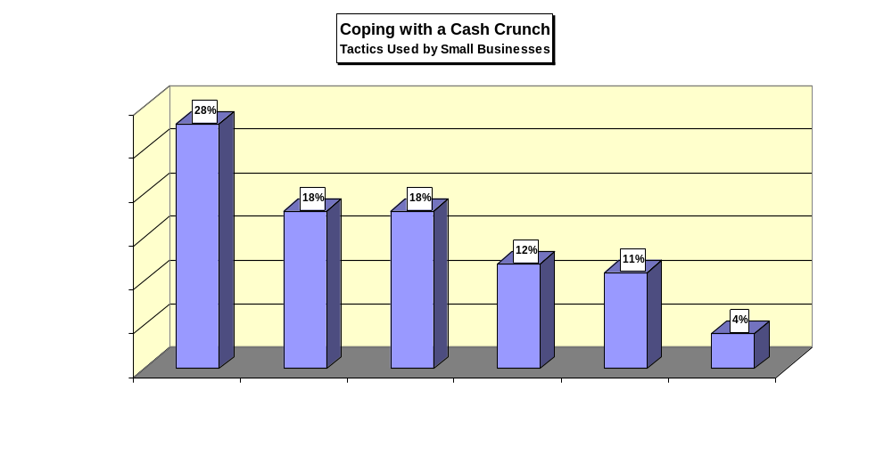

Slide 31
Avoiding the Cash Crunch
Consider bartering, exchanging goods and services for other goods and services, to conserve cash.
Trim overhead costs. For example:
  Ask for discounts and “freebies”
  Periodically evaluate expenses
  Lease rather than buy
  Avoid nonessential cash outlays
  Negotiate fixed loan payments to coincide with your company’s cash flow

Slide 32
Avoiding the Cash Crunch
(Continued)
Trim overhead costs. For example:
  Buy used equipment
  Hire part-time employees and freelancers
  Outsource nonessential activities
  Control employee advances and loans
  Establish an internal security and control system
  Devise a method for fighting check fraud
  Change shipping terms
  Start selling gift cards
  Switch to zero-based budgeting

Slide 33
Avoiding the Cash Crunch
(Continued)
Be on the lookout for employee theft
Keep your business plan current
Invest surplus cash

