Slide 1
The Foundations of Entrepreneurship
Notes:
This "Deco" border was drawn on the Slide master using PowerPoint's Rectangle and Line tools. A smaller version was placed on the Notes Master by selecting all of the elements (using Select All from the Edit menu), deselecting the unwanted elements such as the Title (holding down the Shift key and clicking on the unwanted elements), and then using Paste as Picture from the Edit menu to place the border on the Notes Master. After pasting as a picture, we used the resize handles (with Shift to maintain the proportions) to reduce it to the size you see.
Be sure to delete this word processing box before using this template for your own presentation.

Slide 2
The World of the Entrepreneur
Entrepreneurial spirit is the most significant economic development in recent history.
Entrepreneurs innovative products and services, pushed back technological frontiers, created new jobs, opened foreign markets, and, in the process, provided themselves with the opportunity to do what they enjoy most.
Chapter 1: Entrepreneurship

Slide 3
The World of the Entrepreneur
Entrepreneurs are business builders who embark on one of the most exhilarating, and one of the most frightening adventures ever know – launching a business.
It can be both thrilling and dangerous, like living a life without a safety net.
Still, true entrepreneurs see owing a business as the real measure of success.
Chapter 1: Entrepreneurship
Notes:
Rather than pursue corporate careers after graduation, many college students are choosing to launch companies of their own.

Slide 4
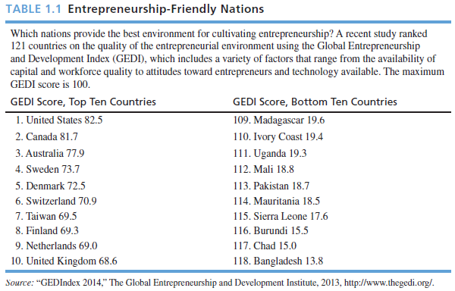
Chapter 2: Creativity

Slide 5
What Is an Entrepreneur?
An individual who creates a new business in the face of risk and uncertainty for the purpose of achieving profit and growth by identifying opportunities and assembling the necessary resources to capitalize on them.
Chapter 1: Entrepreneurship

Slide 6
Entrepreneurs act as a force for creative destruction by sweeping away establishes technologies, products, and ways of doing things and replace them with others with greater value.
Entrepreneurs are important change agents in the global economy, uprooting staid industries with fresh new business models that spot market opportunities and deliver the products and services customers want.
Chapter 2: Creativity

Slide 7
Characteristics of Entrepreneurs
Desire for responsibility
Preference for moderate risk – risk eliminators
Confidence in their ability to succeed
Desire for immediate feedback
High level of energy
Future orientation – serial entrepreneurs
Skilled at organizing
Value achievement over money
Chapter 1: Entrepreneurship

Slide 8
High degree of commitment
Tolerance for ambiguity
Flexibility
Resourceful – bootstrapping
Willingness to work hard
Tenacity
Chapter 2: Creativity

Slide 9
Serial entrepreneurs repeatedly start businesses and grow them to a sustainable size before striking out again.
The majority of serial entrepreneurs are leapfroggers, people who start a company, manage its growth until they get bored, and then sell it to start another.
A few are jugglers (or parallel entrepreneurs), people who start and manage several companies at once.
Chapter 2: Creativity

Slide 10
One characteristic of entrepreneurs that stands out is Diversity!
Entrepreneurs tend to be nonconformists, a characteristics that seems to be central to their views of the world and to their success.
Anyone, regardless of age, race, gender, color, national origin, or any other characteristic – can become an entrepreneur (although not everyone should).
Chapter 1: Entrepreneurship

Slide 11
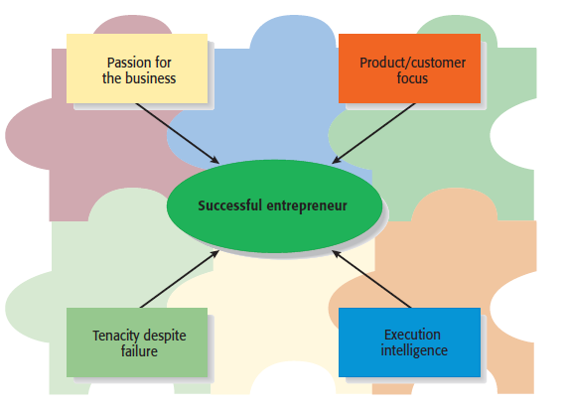
Chapter 2: Creativity

Slide 12

The Benefits of Entrepreneurship
The opportunity to:
Create your own destiny
Make a difference
Reach your full potential
Reap impressive profits
Contribute to society and to be recognized for your efforts
Do what you enjoy and to have fun at it
Chapter 1: Entrepreneurship

Slide 13
The Drawbacks of Entrepreneurship
Uncertainty of income
Risk of losing your entire investment
Long hours and hard work
Lower quality of life until the business gets established
High levels of stress
Complete responsibility
Discouragement
Chapter 1: Entrepreneurship

Slide 14




Feeding the
Entrepreneurial Fire
Entrepreneurs as heroes
Entrepreneurial education
Demographic and economic factors
Shift to a service economy
Technological advancements
Independent lifestyles
The Internet, cloud computing, mobile marketing
International opportunities
Chapter 1: Entrepreneurship

Slide 15
The Cultural Diversity of Entrepreneurship
Young entrepreneurs
Women entrepreneurs
Minority-owned enterprises
Immigrant entrepreneurs
Part-time entrepreneurs
Home-based businesses
Family businesses
Copreneurs
Corporate castoffs
Corporate dropouts
Chapter 1: Entrepreneurship

Slide 16
The Power of “Small” Businesses
Small business is one that employs fewer than 100 people.
Contributions of small businesses to the economy are anything but small.
Almost 90 percent of businesses with paid employees are small, employing fewer than 20 workers, but small companies account for 43 percent of total private payroll in the United States.
Chapter 1: Entrepreneurship

Slide 17
Small businesses…
create more jobs than big businesses.
are leaders in offering training and advancement opportunities to workers.
also are incubators of new ideas, products, and services.
create 16 times more patents per employee than large companies.
Chapter 1: Entrepreneurship

Slide 18
have played a vital role in innovation, and they continue to do so today.
Many important inventions trace their roots to an entrepreneur, including
  zipper, laser, air conditioning, escalator, light bulb, personal computer, automatic transmission, FM radio, and many more!
Chapter 2: Creativity

Slide 19
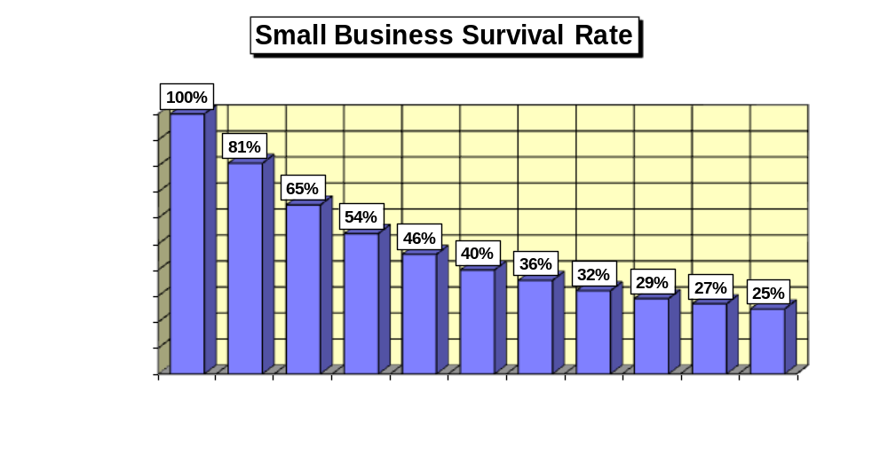
Source: NFIB Business Policy Guide, 2003, p. 16.

Slide 20
Ten Deadly Mistakes of Entrepreneurship
Management mistakes
Lack of experience
Poor financial control
Weak marketing efforts
Failure to develop a strategic plan
Chapter 1: Entrepreneurship

Slide 21
Ten Deadly Mistakes of Entrepreneurship
Uncontrolled growth
Poor location
Improper inventory control
Incorrect pricing
Inability to make the “entrepreneurial transition”
Chapter 1: Entrepreneurship

Slide 22
Putting Failure into Perspective
Entrepreneurs are not paralyzed by the prospect of failure.
Failure – a natural part of the creative process.
Successful entrepreneurs learn to fail intelligently.
Chapter 1: Entrepreneurship

Slide 23

Avoiding the Pitfalls of
Small Business Failure
Know your business in depth
Develop a solid business plan
Manage financial resources
Understand financial statements
Learn to manage people effectively
Keep in tune with yourself
Chapter 1: Entrepreneurship

