Slide 1

Inside the Entrepreneurial Mind: From Ideas to Reality
Chapter 2: Creativity
Notes:
This "Deco" border was drawn on the Slide master using PowerPoint's Rectangle and Line tools. A smaller version was placed on the Notes Master by selecting all of the elements (using Select All from the Edit menu), deselecting the unwanted elements such as the Title (holding down the Shift key and clicking on the unwanted elements), and then using Paste as Picture from the Edit menu to place the border on the Notes Master. After pasting as a picture, we used the resize handles (with Shift to maintain the proportions) to reduce it to the size you see.
Be sure to delete this word processing box before using this template for your own presentation.

Slide 2

Creativity and Innovation
Creativity – the ability to develop new ideas and to discover new ways of looking at problems and opportunities; thinking new things.
Innovation – the ability to apply creative solutions to problems or opportunities to enhance or to enrich people’s lives; doing new things.
Chapter 2: Creativity

Slide 3
Entrepreneurship
Entrepreneurship – the result of a disciplined, systematic process of applying creativity and innovation to the needs and opportunities in the marketplace.
Entrepreneurs connect their creative ideas with the purposeful action and structure of a business.
Chapter 2: Creativity

Slide 4
Failure: Just Part of the Creative Process!
For every 3,000 new product ideas:
  Four make it to the development stage.
  Two are actually launched.
  One becomes a success in the market.
On average, new products account for 40 percent of companies’ sales!!
Creativity is an important source for building a competitive advantage.
Chapter 2: Creativity

Slide 5
Can We Learn to Be Creative?
Yes!
By overcoming paradigms and by suspending
conventional thinking long enough to consider new
and different alternatives!
Chapter 2: Creativity

Slide 6

How Creative Are You?
Hundred Chun Hundred Chun Hundred Chun Hundred Chun Hundred | O R H E S W S | Umph Umph Umph Of the Spirit | Grace.
 | Stand I |  | S Media
2 1111 STO CK | THEBLUEFACE | Intensity | S H E E T
Objection Ruled | W E B | Roll Roll Roy Roy | Tomb of 210,N
SPR ING
Scholar

Slide 7
How Creative Are You?
Fortune 500 | Scattered Showers | Triumph of the Spirit | Grace Period
Rhodes Scholar | I Understand | Spring Break | Media Bias
Two for One Stock Split | Blue in the Face | High Intensity | Spreadsheet
Objection Overruled | Web Links | Rolls Royce | Tomb of Tutankhamen

Slide 8

Right-Brained, Creative Thinkers
Always ask, “Is there a better way?”
Challenge custom, routine, and tradition.
Are reflective.
Are prolific thinkers.
Play mental games.
Chapter 2: Creativity

Slide 9
Right-Brained, Creative Thinkers
Realize that there may be more than one “right” answer.
See mistakes as pit stops on the way to success.
See problems as springboards for new ideas.
Relate seemingly unrelated ideas to a problem.
Have “helicopter skills.”
Chapter 2: Creativity

Slide 10

Chapter 2: Creativity

Slide 11

Left-Brained or Right-Brained?
Entrepreneurship requires both left-and right-brained thinking.
  Right-brained thinking draws on divergent reasoning, the ability to create a multitude of original, diverse ideas.
  Left-brained thinking counts on convergent reasoning, the ability to evaluate multiple ideas and to choose the the best solution to a problem.
Chapter 2: Creativity

Slide 12
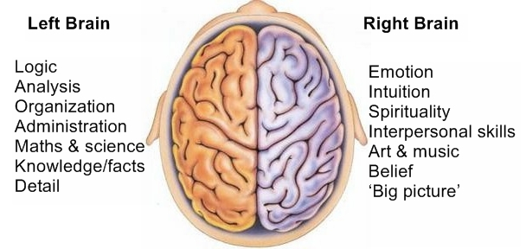
Chapter 2: Creativity

Slide 13

Barriers to Creativity
Searching for the one “right” answer
Focusing on “being logical”
Blindly following the rules
Constantly being practical
Viewing play as frivolous
Chapter 2: Creativity

Slide 14
Barriers to Creativity
Becoming overly specialized
Avoiding ambiguity
Fearing looking foolish
Fearing mistakes and failure
Believing that “I’m not creative”
Chapter 2: Creativity

Slide 15

Questions to Spur the Imagination
Is there a new way to do it?
Can you borrow or adapt it?
Can you give it a new twist?
Do you merely need more of the same?
Less of the same?
Chapter 2: Creativity

Slide 16
Questions to Spur the Imagination
Is there a substitute?
Can you rearrange the parts?
What if you do just the opposite?
Can you combine ideas?
Can you put it to other uses?
Chapter 2: Creativity

Slide 17
Questions to Spur the Imagination
What else could you make from this?
Are there other markets for it?
Can you reverse it?
Can you rearrange it?
What idea seems impossible, but if executed would revolutionize your business?
Chapter 2: Creativity

Slide 18

Tips for Enhancing Organizational Creativity
Include creativity as a core company value
Embrace diversity
Expect creativity
Expect and tolerate failure
Encourage creativity
Chapter 2: Creativity

Slide 19
Tips for Enhancing Organizational Creativity
Create a change of scenery periodically
View problems as challenges
Provide creativity training
Provide support
Develop a procedure for capturing ideas
Chapter 2: Creativity

Slide 20
Tips for Enhancing Organizational Creativity
Talk with customers
Look for uses for your company’s products or services in other markets
Reward creativity
Model creative behavior
Chapter 2: Creativity

Slide 21

Tips for Enhancing Individual Creativity
Allow yourself to be creative
Give your mind fresh input every day
Observe the products and services of other companies, especially those in completely different markets
Recognize the creative power of mistakes
Chapter 2: Creativity

Slide 22
Tips for Enhancing Individual Creativity
Keep a journal handy to record your thoughts and ideas
Listen to other people
Listen to customers
Talk to a child
Keep a toy box in your office
Read books on stimulating creativity or take a class on creativity
Take some time off
Chapter 2: Creativity

Slide 23
The Creative Process
Preparation
Investigation
Transformation
Incubation
Illumination
Verification
Implementation
Chapter 2: Creativity

Slide 24
The Creative Process
Preparation
Investigation
Transformation
Incubation
Illumination
Verification
Implementation
Chapter 2: Creativity

Slide 25
Preparation
Get your mind ready for creative thinking.
  Adopt the attitude of a lifelong student.
  Read …a lot…and not just in your field of expertise.
  Clip articles of interest to you and file them.
  Take time to discuss your ideas with other people.
Chapter 2: Creativity

Slide 26
Preparation
Get your mind ready for creative thinking.
  Join professional or trade associations and attend their meetings.
  Study other countries and their cultures and travel.
  Develop your listening skills.
  Eliminate creative distractions.
Chapter 2: Creativity

Slide 27
The Creative Process
Preparation
Investigation
Transformation
Incubation
Illumination
Verification
Implementation
Chapter 2: Creativity

Slide 28
Investigation
Develop a solid understanding of problem, situation, or decision at hand.
  Study the problem and understand its basic components
  Careful observations of the world and then investigate the way things work (or fail to work)
Chapter 2: Creativity

Slide 29
The Creative Process
Preparation
Investigation
Transformation
Incubation
Illumination
Verification
Implementation
Chapter 2: Creativity

Slide 30
Transformation
Involves viewing both the similarities and the differences among the information collected.
Two types of thinking required:
  Convergent – the ability to see the similarities and the connections among various and often diverse data and events.
  Divergent – the ability to see the differences among various data and events.
Chapter 2: Creativity

Slide 31
Transformation
How can you transform information into purposeful ideas?
  Grasp the “big picture” by looking for patterns that emerge.
  Rearrange the elements of the situation.
  Use synectics, taking two seeming nonsensical ideas and combining them.
  Remember that several approaches can be successful. If one fails, jump to another.
Chapter 2: Creativity

Slide 32
The Creative Process
Preparation
Investigation
Transformation
Incubation
Illumination
Verification
Implementation
Chapter 2: Creativity

Slide 33
Incubation
Allow your subconscious to reflect on the information collected.
  Walk away from the situation.
  Take the time to daydream.
  Relax – and play – regularly.
  Dream about the problem or opportunity.
  Work on it in a different environment.
Chapter 2: Creativity

Slide 34
The Creative Process
Preparation
Investigation
Transformation
Incubation
Illumination
Verification
Implementation
Chapter 2: Creativity

Slide 35
Illumination
Occurs tat some point during the incubation stage when a spontaneous breakthrough causes “the light bulb to go on”
All of the previous stages come together to produce the “Eureka factor” – the creation of the innovative idea.
Usually occur when an individual is away from the problem
Chapter 2: Creativity

Slide 36
The Creative Process
Preparation
Investigation
Transformation
Incubation
Illumination
Verification
Implementation
Chapter 2: Creativity

Slide 37
Verification
Validate the idea as accurate and useful.
  Is it really a better solution?
  Will it work?
  Is there a need for it?
  If so, what is the best application of this idea in the marketplace?
  Does this product or service fit into our core competencies?
  How much will it cost to produce or to provide?
  Can we sell it at a reasonable price?
Chapter 2: Creativity

Slide 38
The Creative Process
Preparation
Investigation
Transformation
Incubation
Illumination
Verification
Implementation
Chapter 2: Creativity

Slide 39
Implementation
Transformation of idea into reality is what sets entrepreneurs apart
  “Ready, aim, fire”
Chapter 2: Creativity

Slide 40
Techniques for Improving the Creative Process
Brainstorming
  Goal is to create a large quantity of novel and imaginative ideas.
  Key aspect of creative thinking and innovation
  Requires an open and non-judgemental environment
Chapter 2: Creativity

Slide 41
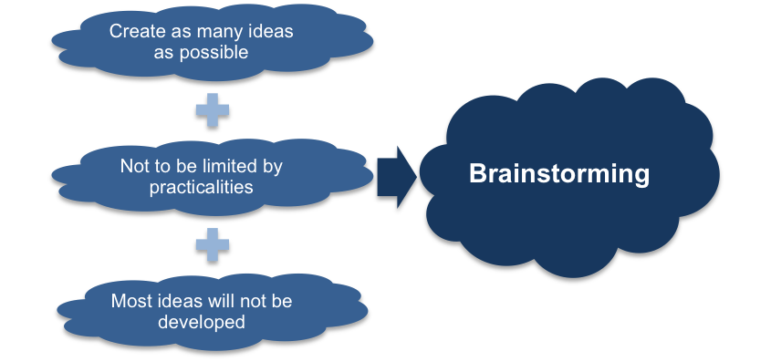
Chapter 2: Creativity

Slide 42

Brainstorming Guidelines
Keep the group small – “Two pizza rule.”
Make the group as diverse as possible.
Company rank is irrelevant.
Have a well-defined problem, but don’t reveal it ahead of time.
Limit the session to 40 to 60 minutes.
Take a field trip.
Appoint a recorder.
Chapter 2: Creativity

Slide 43
Brainstorming Guidelines
Use a seating pattern that encourages interaction.
Throw logic out the window.
Encourage all ideas from the team.
Shoot for quantity of ideas over quality of ideas.
Forbid criticism.
Encourage idea “hitch-hiking.”
Dare to imagine the unreasonable.
Chapter 2: Creativity

Slide 44

Techniques for Improving the Creative Process
Brainstorming
  Goal is to create a large quantity of novel and imaginative ideas.
Mind-mapping
  A graphical technique that encourages thinking on both sides of the brain, visually displays relationships among ideas, and improves the ability to see a problem from many sides.
Chapter 2: Creativity

Slide 45
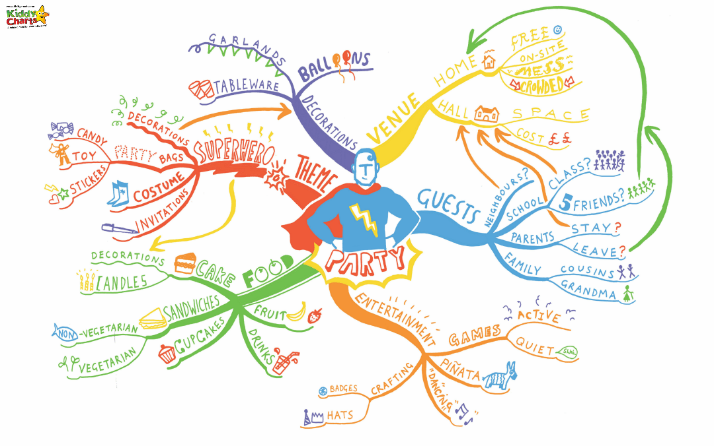
Figure: Planning a Kids Party with a Mindmap
Chapter 2: Creativity

Slide 46
Techniques for Improving the Creative Process
TRIZ, a Russian acronym for
Theoria Resheneyva Isobretatelskehuh Zadach
(Theory of Inventive Problem Solving)
  A systematic approach designed to solve any technical problem, whatever its source.
  Relies on 40 principles and left-brained thinking to solve problems.
Chapter 2: Creativity
Notes:
Idea generation and problem solving technique in which new concepts are created by looking at things in novel ways. Whereas the logical ('vertical') thinking carries a chosen idea forward, the sideways ('lateral') thinking provokes fresh ideas or changes the frame of reference. And, while vertical thinking tries to overcome problems by meeting them head-on, lateral thinking tries to bypass them through a radically different approach.
Read more: http://www.businessdictionary.com/definition/lateral-thinking.html

Slide 47
Rapid prototyping
  Transforming an idea into an actual model that will point out flaws and lead to design improvements.
Chapter 2: Creativity

Slide 48

Protecting Your Ideas
Patent – a grant from the Patent and Trademark Office to the inventor of a product, giving the exclusive right to make, use, or sell the invention for 20 years from the date of filing the patent application.
Chapter 2: Creativity

Slide 49
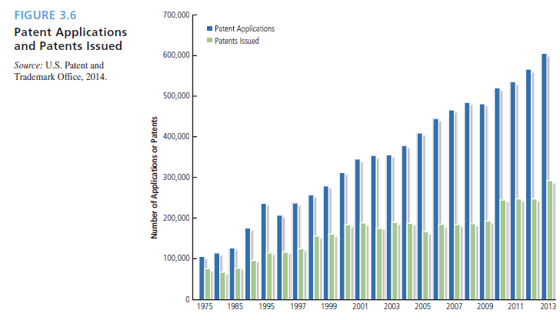

Slide 50
The Steps to a Patent
Prosecute the patent application
Submit the patent application
Study search results
Search existing patents
Document the device
Establish the invention’s novelty
Chapter 2: Creativity

Slide 51
Protecting Your Ideas
Trademark – any distinctive word, symbol, design, name, logo, slogan, or trade dress a company uses to identify the origin of a product or to distinguish it from other goods on the market.
Servicemark – the same as a trademark except that it identifies the source of a service rather than a product.
Chapter 2: Creativity

Slide 52
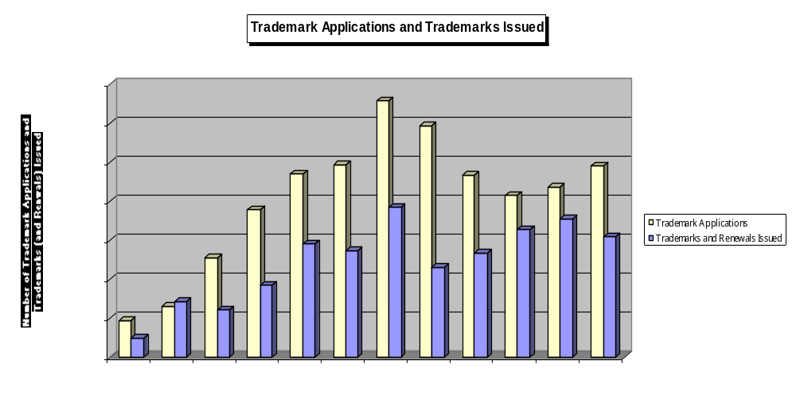

Slide 53
Protecting Your Ideas
Copyright – an exclusive right that protects the creators of original works of authorship such as literary, dramatic, musical, and artistic works.
Copyrighted material is denoted by the symbol ©.
Chapter 2: Creativity

Slide 54
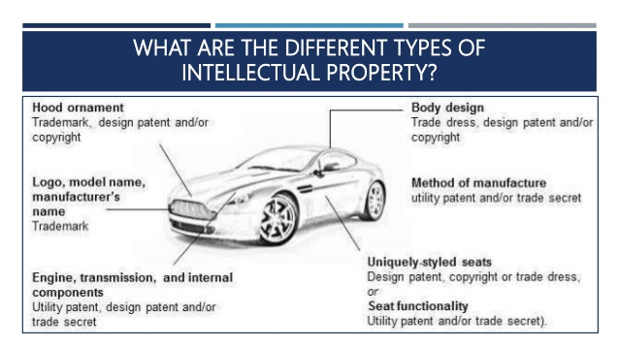
Chapter 2: Creativity

Slide 55
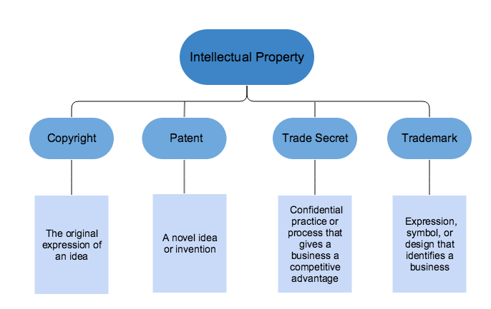
Chapter 2: Creativity

Slide 56
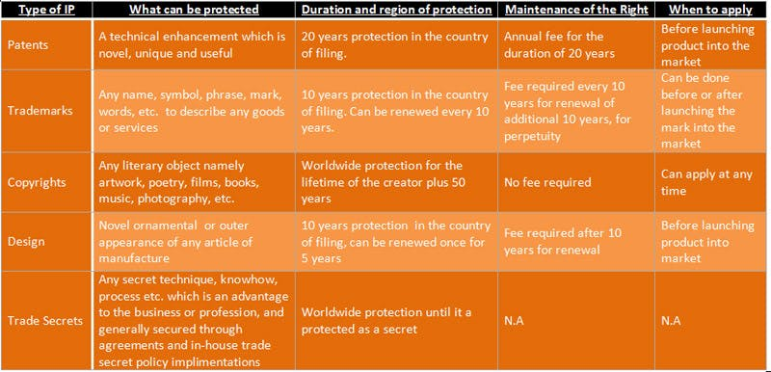
Chapter 2: Creativity

Slide 57
Chapter 2: Creativity

Slide 58
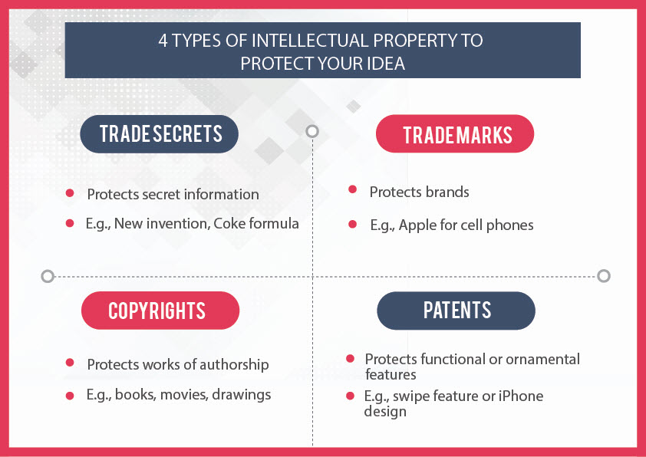
Chapter 2: Creativity

Slide 59
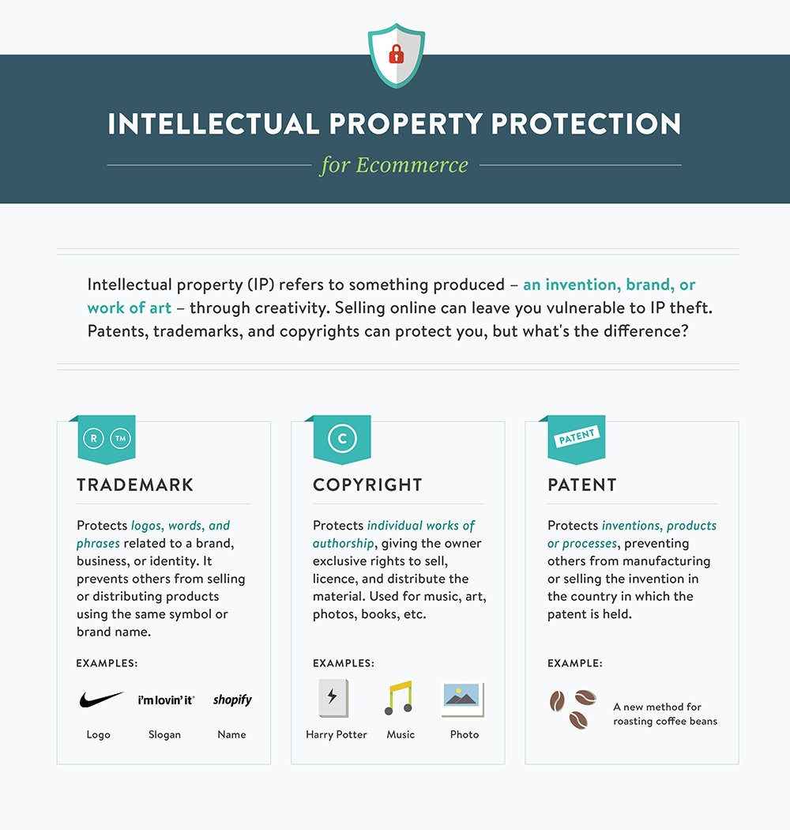
Chapter 2: Creativity

Slide 60
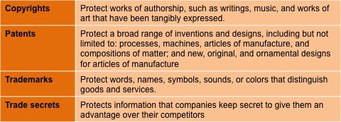
Protecting Your Ideas
Chapter 2: Creativity

Slide 61
Protecting Your Ideas
Type of Protection | What It Covers | Time Required | Cost
Copyright | Works of original authorship | About 2 weeks | About $30
Trademark | Logos, names, phrases | 6 – 12 months | $900 - $1,500
Design patent | Look of an original product | Up to 2 years | $5,000 - $20,000
Utility patent | How an original product works | 2 – 5 years | $5,000 - $20,000
Business method patent | A business process | 2 – 5 years | $5,000 - $20,000
Source: Anne Field, “How to Knock Out Knock Offs,” Business Week, March 14, 2005.

Slide 62
Patents
  A right protecting an invention
  The deal – a patent affords a territorial privilege or monopoly for a limited period – in exchange for letting the world use your invention after monopoly expires
  Maximum duration of 20 years in most countries
Chapter 2: Creativity
Notes:
A patent is a monopoly right to prevent others from using an invention. As I said earlier, it is negative right, which means that it prevents others from exploiting the invention.
In exchange for the rights given by the patent, the patent must teach the world how to use the invention so as to encourage technological progress.
In order to obtain a patent, you need to file a patent application to define the invention. The patent application must describe in detail one way of putting the invention into effect and also provides a legal definition of what is protected by the patent, in the claims.
Patent protection typically lasts for 20 years from date of filing
Here are some pictures of some inventions which may have been patentable. These pictures show that sometimes, it might be possible to gain protection for an invention with a patent, but it is not always desirable to do so.

Slide 63
Trademark
  Anything which can be represented graphically e.g. words (including personal names), colours, slogan, logo, packaging, product shape, holograms, smells, sounds…
  E.g. Coca Cola, Lego, Kodak etc have
Chapter 2: Creativity
Notes:
Territorial - a registration in one country or region does not automatically give owner rights in another
Once registered protection can be renewed indefinitely!
Used to distinguish the product and/or service of one company from those of another- creates brand identity.
Hard to protect descriptive or generic words – to be successful need to show have become distinctive through use – shown by sales, marketing surveys etc.
Renewal is every 10 years.

Slide 64




Chapter 2: Creativity

Slide 65
Design
Protect the visual appearance of a product
E.g. lines, contours, colours, shape, texture or materials of product or its ornamentation
Can cover whole or part of a product
Protects against competitor selling a product that is visually the same
Chapter 2: Creativity

Slide 66
Copyright
Copyright resides in “original artistic, dramatic, literary, and musical works…irrespective of quality”
Often described as “the expression of an idea” – e.g. pictures/photographs, films, books, articles, guides, instructions, music, lyrics, software source code, graphical user interface etc.
Chapter 2: Creativity

Slide 67
Trade Secret
  Keeping information secret (e.g. process, recipe etc.) E.g. Coca-Cola, KFC
  Hard to protect
  Only really useful if you can’t patent the idea and you are completely sure you can prevent disclosure
Chapter 2: Creativity

Slide 68


Chapter 2: Creativity

