Slide 1

Designing a Competitive Business Model and Building a Solid Strategic Plan
Chapter 3: Strategic Plan
Notes:
This "Deco" border was drawn on the Slide master using PowerPoint's Rectangle and Line tools. A smaller version was placed on the Notes Master by selecting all of the elements (using Select All from the Edit menu), deselecting the unwanted elements such as the Title (holding down the Shift key and clicking on the unwanted elements), and then using Paste as Picture from the Edit menu to place the border on the Notes Master. After pasting as a picture, we used the resize handles (with Shift to maintain the proportions) to reduce it to the size you see.
Be sure to delete this word processing box before using this template for your own presentation.

Slide 2

A Major Shift . . .
. . . From financial capital to intellectual capital.
  Human
  Structural
  Customer
Chapter 3: Strategic Plan

Slide 3

Strategic Management
Is crucial to building a successful business.
Involves developing a game plan to guide a company as it strives to accomplish its mission, goals , and objectives, and to keep it on its desired course.
Chapter 3: Strategic Plan

Slide 4

Strategic Management and Competitive Advantage
Developing a strategic plan is crucial to creating a sustainable competitive advantage, the aggregation of factors that sets a company apart from its competitors and gives it a unique position in the market that is superior to its competition.
Example: Blockbuster Video
Chapter 3: Strategic Plan

Slide 5
Key: Core Competencies
Unique set of capabilities a company develops in key areas, such as superior quality, customer service, innovation, team-building, flexibility, responsiveness, and others that allow it to vault past competitors.
  They are what a company does best.
  Best to rely on a natural advantage (often linked to a company’s “smallness”).
Examples: Netflix and Tom’s of Maine
Chapter 3: Strategic Plan

Slide 6
Building a Sustainable Competitive Advantage
Capabilities
Core competencies
Sustainable competitive advantage
Superior value for customers
Lessons learned
Skills
Chapter 3: Strategic Plan

Slide 7

Strategic Management Process
Step 1. Develop a vision and translate it into a mission statement.
Step 2. Assess strengths and weaknesses.
Step 3. Scan environment for opportunities and threats.
Step 4. Identify key success factors.
Chapter 3: Strategic Plan

Slide 8
Strategic Management Process
(continued)
Step 5. Analyze competition.
Step 6. Create goals and objectives.
Step 7. Formulate strategies.
Step 8. Translate plans into actions.
Step 9. Establish accurate controls.
Chapter 3: Strategic Plan

Slide 9

Step 1: Develop a Vision and
Create a Mission Statement
Vision – the result of an entrepreneur’s dream of something that does not exist yet and the ability to paint a compelling picture of that dream for everyone to see.
A clearly defined vision:
  Provides direction
  Determines decisions
  Motivates people
Chapter 3: Strategic Plan

Slide 10

Step 1: Develop a Vision and
Create a Mission Statement
Addresses question: “What business are we in?”
The mission is a written expression of how the company will reflect an entrepreneur’s values, beliefs, and vision – more than just “making money.”
Serves as a “strategic compass.”
Examples: Chick-fil-A and Starbucks.
Chapter 3: Strategic Plan

Slide 11
Step 1: Develop a Vision and
Create a Mission Statement
Survey of employees: 89 percent of employees say their companies have a mission statement
but…
Only 23 percent of workers believe their company’s mission statement has become a way of doing business!
Chapter 3: Strategic Plan

Slide 12

Step 2: Assess Company Strengths and Weaknesses
Strengths
  Positive internal factors a company can draw on to accomplish its mission, goals, and objectives.
Weaknesses
  Negative internal factors that inhibit a company’s ability to accomplish its mission, goals, and objectives.
Chapter 3: Strategic Plan

Slide 13

Step 3: Scan for Opportunities and Threats
Opportunities
  Positive external factors the company can exploit to accomplish its mission, goals, and objectives.
Threats
  Negative external factors that inhibit the firm's ability to accomplish its mission, goals, and objectives.
Chapter 3: Strategic Plan

Slide 14

The Power of External Market Forces
Technological
Competitive
Economic
Political and Regulatory
Social and Demographic

Slide 15

Step 4: Identify Key Success Factors
Key success factors: controllable variables that determine the relative success of market participants.
The keys to unlocking the secrets of competing successfully in a particular market segment.
Example: John H. Daniel Company
Chapter 3: Strategic Plan

Slide 16
Identifying Key Success Factors
List the skills, characteristics, and core competencies that your business must possess if it is to be successful in its market segment.
Key Success Factor | How Your Company Rates
1. | Low 1 2 3 4 5 6 7 8 9 10 High
2. | Low 1 2 3 4 5 6 7 8 9 10 High
3. | Low 1 2 3 4 5 6 7 8 9 10 High
4. | Low 1 2 3 4 5 6 7 8 9 10 High
5. | Low 1 2 3 4 5 6 7 8 9 10 High
Conclusions:

Slide 17

Step 5: Analyze Competitors
NFIB study: Small business owners believe they operate in a highly competitive environment and the level of competition is increasing.
Yet, 97 percent of all U.S. businesses do not systematically track the progress of their key competitors.
Chapter 3: Strategic Plan

Slide 18
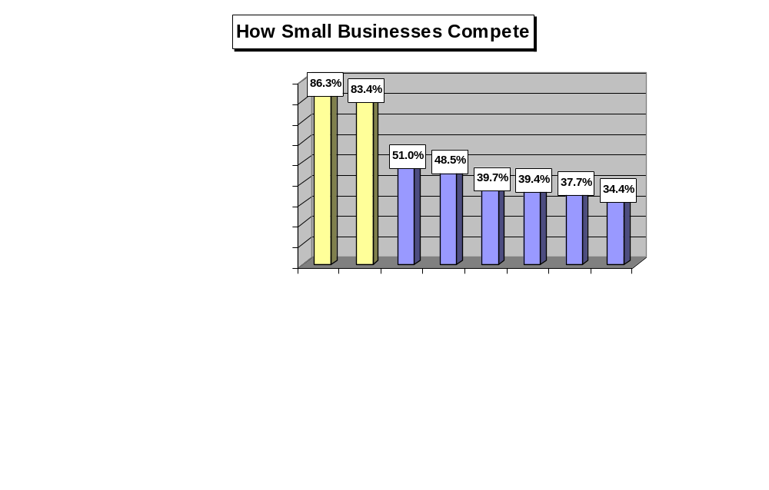

Slide 19
Step 5: Analyze Competitors
Analyzing key competitors allows an entrepreneur to:
  Avoid surprises from existing competitors’ new strategies and tactics.
  Identify potential new competitors and the threats they pose.
  Improve reaction time to competitors’ actions.
  Anticipate rivals’ next strategic moves.
Chapter 3: Strategic Plan

Slide 20
Step 5: Analyze Competitors
Techniques do not require unethical behavior:
  Monitor industry and trade publications.
  Talk to customers and suppliers.
  Regularly debrief employees, especially sales representatives and purchasing agents.
  Attend trade shows and conferences and study competitors’ sales literature.
  Watch for employment ads from competitors to get an idea about their plans for the future.
  Conduct patent searches for patents competitors have filed.
  Get EPA reports that provide information about the factories of competing manufacturers.
Chapter 3: Strategic Plan

Slide 21
Step 5: Analyze Competitors
Techniques do not require unethical behavior:
  Learn about the kinds of equipment and raw materials competitors are importing from the Journal of Commerce Port Import Export Reporting Service.
  Buy competitors’ products and “benchmark” them.
  Get competitors’ credit reports.
  Check out the reports publicly held competitors must file with the SEC.
  Investigate UCC reports.
  Check out the resources in your local library.
  Use the World Wide Web to learn more about competitors.
  Visit competing businesses to observe their operations.
Chapter 3: Strategic Plan

Slide 22
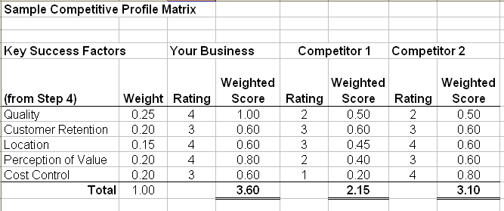

Slide 23
Knowledge Management
The practice of gathering, organizing, and disseminating the collective wisdom and experience of a company’s employees for the purpose of strengthening its competitive position.
Knowledge management involves:
  Taking inventory of the special knowledge the people in the company possess.
  Organizing that knowledge and disseminating it to those who need it.
Chapter 3: Strategic Plan

Slide 24


Is Setting Goals and Objectives
Really Important?
“Would you tell me, please, which way I ought to go from here?” said Alice.
“That depends a good deal on where you want to get to,” said the Cheshire cat.
“I don’t much care care where.…” said Alice.
‘Then it doesn’t matter which way you go,” said the cat.
- Lewis Carroll’s
Alice in Wonderland
Chapter 3: Strategic Plan

Slide 25

Step 6: Create Company Goals and Objectives
Goals - broad, long-range attributes to be accomplished.
Objectives - more detailed, specific targets of performance that are S.M.A.R.T.
  Specific
  Measurable
  Attainable
  Realistic (yet challenging)
  Timely
Chapter 3: Strategic Plan

Slide 26

Step 7: Formulate Strategies
Strategy - a road map of the actions an entrepreneur draws up to achieve a company’s mission, goals, and objectives. It is the company’s game plan for gaining a competitive advantage.
Three basic strategies:
Cost leadership
Differentiation
Strategy?
Focus
Chapter 3: Strategic Plan

Slide 27
Three Strategic Options
Competitive Advantage
Uniqueness Perceived
by the Customer
Low Cost
Position
Industry
Differentiation
Low Cost
Target
Market
Differentiation
Focus
Cost
Focus
Niche

Slide 28
Cost Leadership
Goal: to be the low-cost producer in the industry (or market segment).
Low-cost leaders have an advantage in reaching buyers who buy on the basis of price, and they have the power to set the industry’s price floor.
Works well when:
  Buyers are sensitive to price changes.
  Competing firms sell the same commodity products.
  A company can benefit from economies of scale.
Example: JetBlue Airlines
Chapter 3: Strategic Plan

Slide 29
Differentiation
Company seeks to build customer loyalty by positioning its goods or services in a unique or different fashion.
Idea is to be special at something customers value.
Key: Build basis for differentiation on a distinctive competence, something that the small company is uniquely good at doing in comparison to its competitors.
Examples: Urban Outfitters and the Ice Hotel
Chapter 3: Strategic Plan

Slide 30
Focus
Company selects one or more customer segments in a market; identifies customers’ special needs, wants, or interests; and then targets them with a product or service designed specifically for them.
Strategy builds on differences among market segments.
Rather than try to serve the total market, the company focuses on serving a niche (or several niches) within that market.
Examples: Cereality and Flutter Fetti Fun Factory
Chapter 3: Strategic Plan

Slide 31

Step 8: Translate Strategies into Action Plans
Survey of senior executives: Companies achieved only 63 percent of the results in their strategic plans.
Create projects by defining:
  Purpose
  Scope
  Contribution
  Resource requirements
  Timing
Chapter 3: Strategic Plan

Slide 32


Step 9: Establish Accurate Controls
Plan establishes the standards against which actual performance is measured.
Entrepreneur must:
  identify and track key performance indicators.
  take corrective action.
Chapter 3: Strategic Plan

Slide 33

Balanced Scorecards
A set of measurements unique to a company that includes both financial and operational measures
Gives managers a quick, yet comprehensive, picture of a company’s overall performance.
Chapter 3: Strategic Plan

Slide 34
Balanced Scorecards
Four Perspectives:
  Customer: How do customers see us?
  Internal Business: At what must we excel?
  Innovation and Learning: Can we continue to improve and create value?
  Financial: How do we look to shareholders?
Chapter 3: Strategic Plan

Slide 35
The Balanced Scorecard Links Performance Measures
Financial Perspective
How do we look
to shareholders?
Goals
Measures
How do customers
see us?
At what must we
excel?
Customer Perspective
Internal Business Perspective
Goals
Measures
Goals
Measures
Innovation and Learning Perspective
Goals
Measures
Can we continue to
improve and create
value?

