Slide 1



Forms of Business Ownership
Notes:
This "Deco" border was drawn on the Slide master using PowerPoint's Rectangle and Line tools. A smaller version was placed on the Notes Master by selecting all of the elements (using Select All from the Edit menu), deselecting the unwanted elements such as the Title (holding down the Shift key and clicking on the unwanted elements), and then using Paste as Picture from the Edit menu to place the border on the Notes Master. After pasting as a picture, we used the resize handles (with Shift to maintain the proportions) to reduce it to the size you see.
Be sure to delete this word processing box before using this template for your own presentation.

Slide 2
Choosing a Form of Ownership
There is no one “best” form of ownership.
The best form of ownership depends on an entrepreneur’s particular situation.
Key: Understanding the characteristics of each form of ownership and how well they match an entrepreneur’s business and personal circumstances.

Slide 3

Factors Affecting the Choice
Tax considerations
Liability exposure
Start-up and future capital requirements
Control
Managerial ability
Business goals
Management succession plans
Cost of formation

Slide 4
Major Forms of Ownership
Sole Proprietorship
Partnership
Corporation
S Corporation
Limited Liability Company
Joint Venture

Slide 5
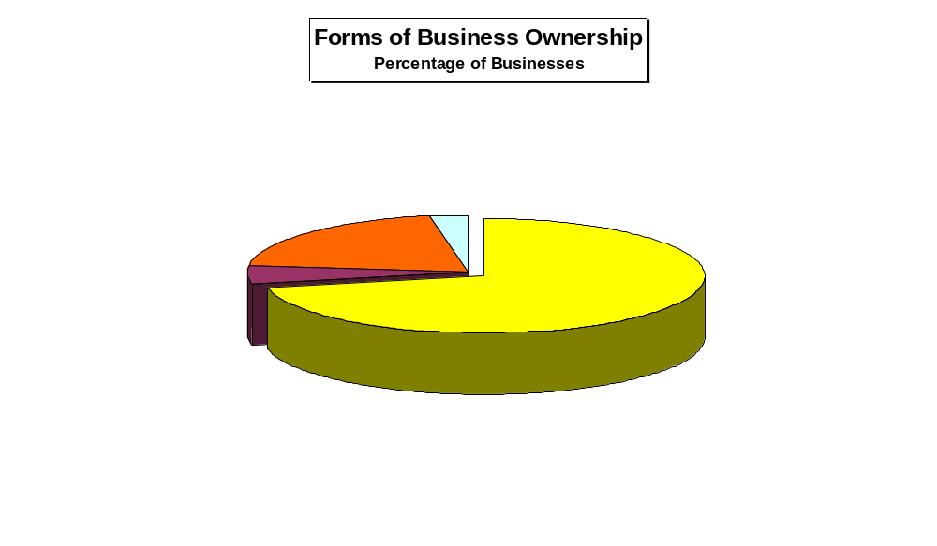
Source: BizStats.com/businesses.htm

Slide 6
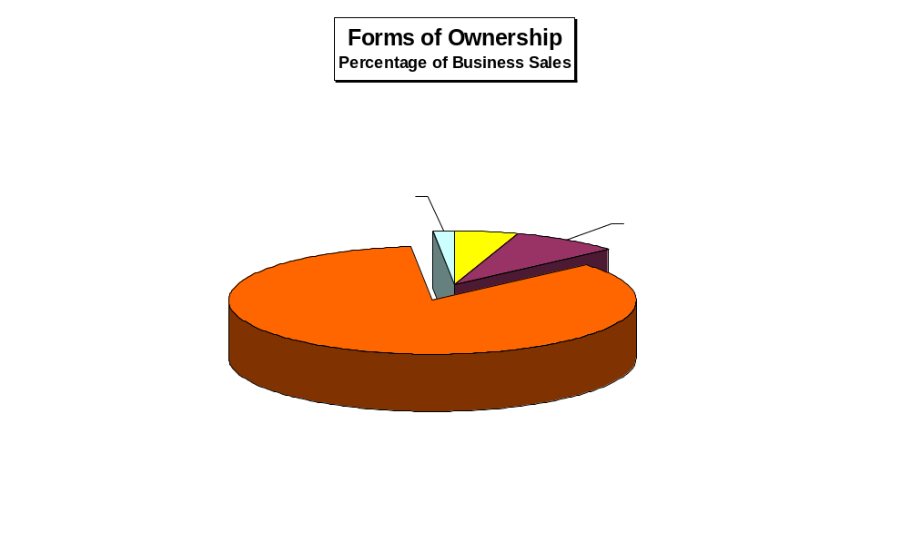
Source: BizStats.com/businesses.htm

Slide 7
Advantages of the Sole Proprietorship
Simple to create
Least costly form to begin
Profit incentive
Total decision-making authority
No special legal restrictions
Easy to discontinue

Slide 8
Disadvantages of the Sole Proprietorship
Unlimited personal liability
Limited skills and capabilities
Feelings of isolation
Limited access to capital
Lack of continuity

Slide 9
Liability Features of the Basic Forms of Ownership
Sole Proprietorship
Claims of Sole Proprietor’s Creditors
Sole Proprietor’s Personal Assets

Slide 10

Partnership
An association of two or more people who co-own a business for the purpose of making a profit.
Always wise to create a partnership agreement.
Best partnerships are built on trust and respect.

Slide 11

Advantages of the Partnership
Easy to establish
Complementary skills of partners
Division of profits
Larger pool of capital
Ability to attract limited partners

Slide 12
Types of Partners
General partners
  Take an active role in managing a business.
  Have unlimited liability for the partnership’s debts.
  Every partnership must have at least one general partner.
Limited partners
  Cannot participate in the day-to-day management of a company.
  Have limited liability for the partnership’s debts.

Slide 13
Advantages of the Partnership
Easy to establish
Complementary skills of partners
Division of profits
Larger pool of capital
Ability to attract limited partners
Little government regulation
Flexibility
Taxation

Slide 14
Disadvantages of the Partnership
Unlimited liability of at least one partner
Capital accumulation
Difficulty in disposing of partnership interest
Lack of continuity
Potential for personality and authority conflicts
Partners bound by law of agency

Slide 15
Liability Features of the Basic Forms of Ownership
Partnership
Claims of Partnership’s Creditors
General
Partner’s
Personal
Assets
General
Partner’s
Personal
Assets
Partnership’s Assets

Slide 16

Limited Partnership
A partnership composed of at least one general partner and one or more limited partners.
General partner in this partnership is treated exactly as in a general partnership.
Limited partner has limited liability and is treated as an investor in the business.

Slide 17
Corporation
A separate legal entity from its owners.
Types of corporations:
  Domestic – a corporation doing business in the state in which it is incorporated.
  Foreign – a corporation doing business in a state other than the state in which it is incorporated.
  Alien – a corporation formed in another country but doing business in the United States.

Slide 18
Corporation
Types of corporations:
Publicly held – a corporation that has a large number of shareholders and whose stock usually is traded on one of the large stock exchanges.
Closely held – a corporation in which shares are controlled by a relatively small number of people, often family members, relatives, or friends.

Slide 19

Advantages of the Corporation
Limited liability of stockholders
Ability to attract capital
Ability to continue indefinitely
Transferable ownership

Slide 20
Liability Features of the Basic Forms of Ownership
Corporation
Claims of Corporation’s Creditors
Barrier
Barrier
Corporation’s Assets
Shareholder’s
Personal Assets
Shareholder’s
Personal Assets

Slide 21
Disadvantages of the Corporation
Cost and time of incorporating
Double taxation
Potential for diminished managerial incentives
Legal requirements and regulatory “red tape”
Potential loss of control by founder(s)

Slide 22
S Corporation
No different from any other corporation from a legal perspective.
For tax purposes, however, an S corporation is taxed like a partnership, passing all of its profits (or losses) through to individual shareholders.
To elect “S” status, all shareholders must consent, and the corporation must file with the IRS within the first 75 days of its tax year.

Slide 23
Liability Features of the Basic Forms of Ownership
S-Corporation
Claims of S-Corporation’s Creditors
Barrier
Barrier
S-Corporation’s Assets
Shareholder’s
Personal Assets
Shareholder’s
Personal Assets

Slide 24

Limited Liability Company (LLC)
Resembles an S corporation but is not subject to the same restrictions.
Two documents required:
  Articles of organization
  Operating agreement

Slide 25
Limited Liability Company (LLC)
An LLC cannot have more than two of these four corporate characteristics:
  Limited liability
  Continuity of life
  Free transferability of interest
  Centralized management

Slide 26
Liability Features of the Basic Forms of Ownership
Limited Liability Company (LLC)
Claims of LLC’s Creditors
Barrier
Barrier
LLC’s Assets
Member’s
Personal Assets
Member’s
Personal Assets

