Slide 1





Franchising and the Entrepreneur
Notes:
Chapter 6: Franchising
This "Deco" border was drawn on the Slide master using PowerPoint's Rectangle and Line tools. A smaller version was placed on the Notes Master by selecting all of the elements (using Select All from the Edit menu), deselecting the unwanted elements such as the Title (holding down the Shift key and clicking on the unwanted elements), and then using Paste as Picture from the Edit menu to place the border on the Notes Master. After pasting as a picture, we used the resize handles (with Shift to maintain the proportions) to reduce it to the size you see.
Be sure to delete this word processing box before using this template for your own presentation.

Slide 2

The Franchising Boom !!!
Annual sales of more than $1 trillion of almost every product or service imaginable.
Franchise sales account for 44 percent of total retail sales.
More than 3,000 franchisers operating some 350,000 outlets in the United States.
Boom!
Notes:
Chapter 6: Franchising

Slide 3
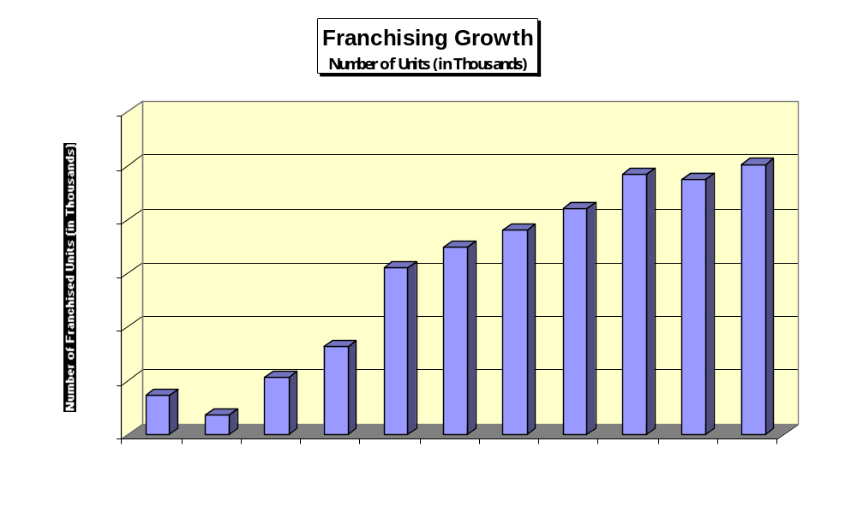

Slide 4
The Franchising Boom !!!
Franchises employ one in every 16 workers in the U.S. in more than 100 major industries.
Economic impact of franchising on the U.S. economy: $1.5 trillion.
A new franchise opens somewhere in the world every six-and-a-half minutes.
Boom!
Notes:
Chapter 6: Franchising

Slide 5
Franchising
A system in which semi-independent business owners (franchisees) pay fees and royalties to a parent company (franchiser) in return for the right to become identified with its trademark, to sell its products or services, and often to use its business format and system.
Notes:
Chapter 6: Franchising

Slide 6


The Franchising Relationship
Element
The Franchiser
The Franchisee
Site selection
Design
Employees
Products and services
Prices
Purchasing
Advertising
Quality control
Support
Oversees and approves; may choose site
Provides prototype design
Makes general recommendations and
training suggestions
Determines product or service line
Can only recommend prices
Establishes quality standards; provides
list of approved suppliers; may require
franchisees to purchase from the franchisor
Develops and coordinates national ad
campaign; may require minimum level of
spending on local advertising
Sets quality standards and enforces them
with inspections; trains franchisees
Provides support through an established
business system
Chooses site with franchiser’s approval
Pays for and implements design
Hires, manages, and fires
employees
Modifies only with franchiser’s approval
Sets final prices
Must meet quality standards; must purchase
only from approved suppliers; must purchase
from supplier if required.
Pays for national ad campaign; complies with
local advertising requirements; gets franchisor
approval on local ads
Maintains quality standards; trains employees
to implement quality systems
Operates business on a day-to-day basis with
franchiser’s support
Source: Adapted from Economic Impact of Franchised Businesses: A Study for the International Franchise Association, National Economic Consulting Practice of
PriceWaterhouseCoopers, (IFA Educational Foundation, New York: 2004), pp. 3,5.

Slide 7
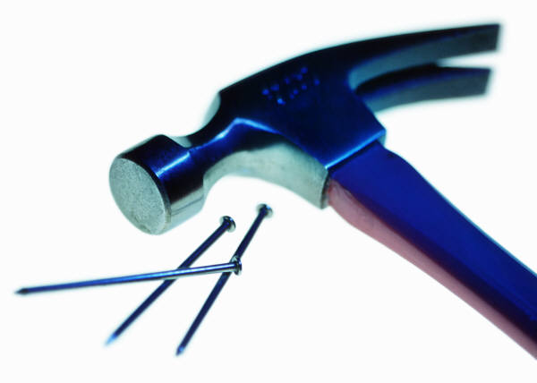
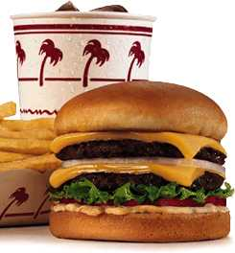
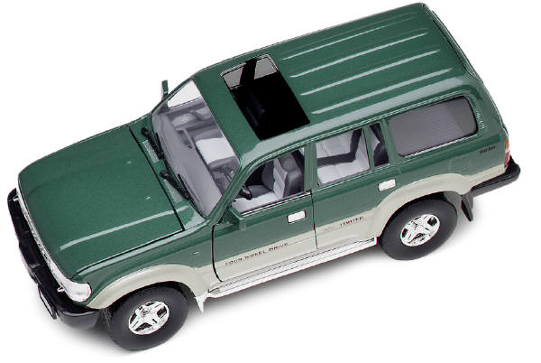
Types of Franchising
Tradename
Product distribution
Pure (Business format)

Slide 8
Franchising Basics
Franchisee gets the right to use all of the elements of a fully integrated business operation.
Essence of what franchisees purchase from the franchisers: Experience.
Key Question: What can a franchise do for me that I cannot do for myself?
Notes:
Chapter 6: Franchising

Slide 9

Benefits of Franchising
Management training and support
  Start-up
  Ongoing
Brand name appeal
  “Cloning”
Standardized quality of goods and services
Notes:
Chapter 6: Franchising

Slide 10
Benefits of Franchising
National advertising program
  Franchisees contribute 1 percent to 5 percent of sales
Financial assistance
  Only one-third of franchisers offer financial assistance to franchisees.
  SBA – Franchise Registry
Notes:
Chapter 6: Franchising

Slide 11
Benefits of Franchising
Proven products and business formats
Centralized buying power
Site selection and territorial protection
  Important issue: Territorial encroachment
Greater chance for success
Notes:
Chapter 6: Franchising

Slide 12
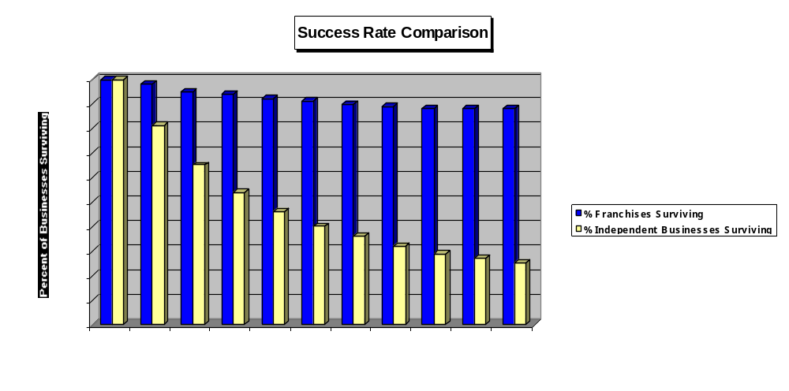

Slide 13

Drawbacks of Franchising
Franchise fees and ongoing royalties
  Average initial franchise investment (excluding real estate) = $318,975
  Royalties range from 1 percent to 11 percent of franchisees’ sales
Strict adherence to standardized operations
Restrictions on purchasing
  Approved suppliers only
Notes:
Chapter 6: Franchising

Slide 14
Drawbacks of Franchising
Limited product line
Contract terms and renewal
  Average term = 10.3 years
Unsatisfactory training programs
Market saturation
Less freedom
  “Happy prisoners”
Notes:
Chapter 6: Franchising

Slide 15
Ten Myths of Franchising
1. Franchising is the safest way to go into business because franchises never fail.
2. I’ll be able to open my franchise for less money than the franchiser estimates.
3. The bigger the franchise organization, the more successful I’ll be.
4. I’ll use 80 percent of the franchiser’s business system, but I’ll improve upon it by substituting my experience and know-how.
Notes:
Chapter 6: Franchising

Slide 16
Ten Myths of Franchising
(Continued)
5. All franchises are the same.
6. I don’t have to be a hands-on manager. I can be an absentee owner and still be very successful.
7. Anyone can be a satisfied, successful franchise owner.
Notes:
Chapter 6: Franchising

Slide 17
Ten Myths of Franchising
(Continued)
8. Franchising is the cheapest way to get into business for yourself.
9. The franchiser will solve my business problems for me; after all, that’s why I pay an ongoing royalty fee.
10. Once I open my franchise, I’ll be able to run things the way I want to.
Notes:
Chapter 6: Franchising

Slide 18

Franchising and the Law
Uniform Franchise Offering Circular (UFOC)
  Requires franchisers to disclose to potential franchisees information on 23 important topics
  Idea is to give franchisees the information they need to protect themselves from dishonest franchisers and to make good investment decisions
Notes:
Chapter 6: Franchising

Slide 19

Detecting Dishonest Franchisers
Claims that the contract is “standard; no need to read it.”
Failure to provide a copy of the required disclosure documents.
Marginally successful prototype or no prototype.
Poorly prepared operations manual.
Promises of future earnings with no documentation.
High franchisee turnover or termination rate.
Unusual amount of litigation by franchisees.
Notes:
Chapter 6: Franchising

Slide 20
Detecting Dishonest Franchisers
(Continued)
Attempts to discourage your attorney from evaluating the contract before signing it.
No written documentation.
A high pressure sale.
Claims to be exempt from federal disclosure laws.
“Get rich quick” schemes, promising huge profits with minimal effort.
Reluctance to provide a list of existing franchisees.
Evasive, vague answers to your questions.
Notes:
Chapter 6: Franchising

Slide 21
The Right Way to Buy a Franchise
Evaluate yourself - What do you like and dislike?
Research your market.
Consider your franchise options.
Get a copy of the franchiser’s Uniform Franchise Offering Circular (UFOC) and read it.
Talk to existing franchisees.
Ask the franchiser some tough questions.
Make your choice.
Notes:
Chapter 6: Franchising

Slide 22
Factors That Make a Franchise Appealing
Unique concept or marketing approach
Profitability
Registered trademark
Business system that works
Solid training program
Affordability
Positive relationship with franchisees
Notes:
Chapter 6: Franchising

Slide 23

Trends Shaping Franchising
Changing face of franchisees
  Better educated with more business acumen
Multiple-unit franchising
  11 percent of franchisees operate multiple outlets (and growing)
International opportunities
  More than 500 U.S. franchisers now have international locations
Smaller, nontraditional locations
  Intercept marketing
Notes:
Chapter 6: Franchising

Slide 24
Trends Shaping Franchising
Conversion franchising
  72 percent of North American franchisers use as a growth strategy
Master franchising
Piggybacking (or combination or multi-branded franchising)
Serving dual-career couples and baby boomers
Notes:
Chapter 6: Franchising

