Slide 1

Buying an Existing Business
For Sale
Notes:
This "Deco" border was drawn on the Slide master using PowerPoint's Rectangle and Line tools. A smaller version was placed on the Notes Master by selecting all of the elements (using Select All from the Edit menu), deselecting the unwanted elements such as the Title (holding down the Shift key and clicking on the unwanted elements), and then using Paste as Picture from the Edit menu to place the border on the Notes Master. After pasting as a picture, we used the resize handles (with Shift to maintain the proportions) to reduce it to the size you see.
Be sure to delete this word processing box before using this template for your own presentation.

Slide 2
Key Questions to Consider Before Buying a Business
Is the right type of business for sale in the market in which you want to operate?
What experience do you have in this particular business and the industry in which it operates? How critical is experience in the business to your ultimate success?
What is the company’s potential for success?
What changes will you have to make – and how extensive will they have to be – to realize the business’s full potential?

Slide 3
Key Questions to Consider Before Buying a Business
What price and payment method are reasonable for you and acceptable to the seller?
Will the company generate sufficient cash to pay for itself and leave you with a suitable rate of return on your investment?
Should you be starting a business and building it from the ground up rather than buying an existing one?

Slide 4

Advantages of Buying a Business
It may continue to be successful
It may already have the best location
Employees and suppliers are established
Equipment is already installed
Inventory is in place and trade credit is established

Slide 5
Advantages of Buying a Business
(Continued)
You can “hit the ground running”
You can use the previous owner’s experience
Easier financing
It’s a bargain

Slide 6

Disadvantages of Buying a Business
“It’s a loser”
Previous owner may have created ill will
“Inherited” employees may be unsuitable
Location may have become unsatisfactory
Equipment may be obsolete or inefficient

Slide 7
Disadvantages of Buying a Business
(Continued)
Change and innovation can be difficult to implement
Inventory may be stale
Accounts receivable may be worth less than face value

Slide 8
Valuing Accounts Receivable
Age of Accounts (days)
Amount
Probability of Collection
Value
0-30
31-60
61-90
91-120
121-150
151+
Total
$40,000
$25,000
$14,000
$10,000
$7,000
$5,000
$101,000
.95
.88
.70
.40
.25
.10
$38,000
$22,000
$9,800
$4,000
$1,750
$500
$76,050

Slide 9
Disadvantages of Buying a Business
(Continued)
Changes can be difficult to implement
Inventory may be stale
Accounts receivable may be worth less than face value
It may be overpriced

Slide 10


Acquiring a Business
More than 50 percent of all business acquisitions fail to meet buyers’ expectations.
The right way:
Analyze your skills, abilities, and interest.
Prepare a list of potential candidates.
  Remember the “hidden market.”
Kwik-Mart

Slide 11
Acquiring a Business
Investigate and evaluate candidate businesses and select the best one.
Explore financing options.
  Potential source: the seller.
Ensure a smooth transition.
  Communicate with employees.
  Be honest.
  Listen.
  Consider asking the seller to serve as a consultant through the transition.
Kwik-Mart

Slide 12
Five Critical Areas for Analyzing an Existing Business
Why does the owner want to sell.... the real reason?
What is the physical condition of the business?
What is the potential for the company's products or services?
  Customer characteristics and composition
  Competitor analysis
What legal aspects must I consider?
Is the business financially sound?

Slide 13
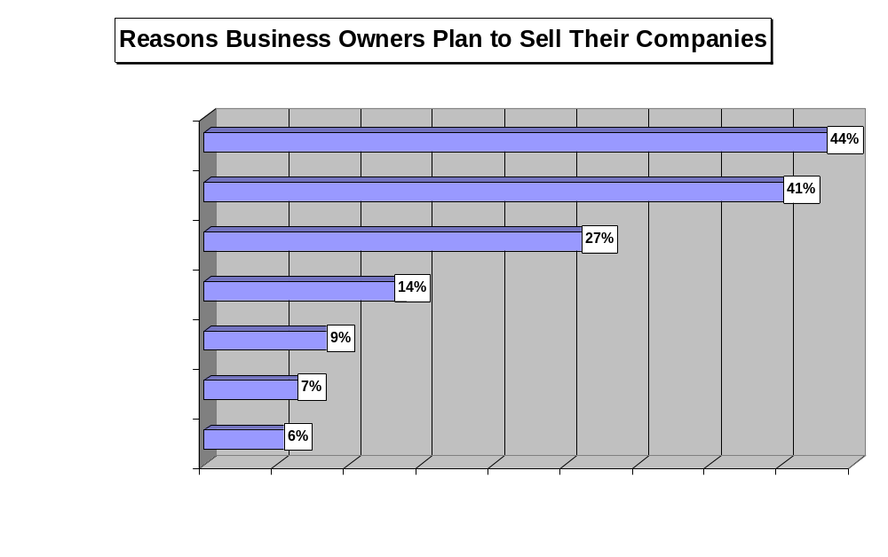

Slide 14

The Legal Aspects of Buying a Business
Lien - creditors’ claims against an asset.
Bulk transfer - protects business buyer from the claims unpaid creditors might have against a company’s assets.

Slide 15
Bulk Transfer
Seller must give the buyer a sworn list of creditors.
Buyer and seller must prepare a list of the property included in the sale.
Buyer must keep the list of creditors and property for six months.
Buyer must give written notice of the sale to each creditor at least ten days before he takes possession of the goods or pays for them (whichever is first).

Slide 16
The Legal Aspects of Buying a Business
Lien - creditors’ claims against an asset.
Bulk transfer - protects business buyer from the claims unpaid creditors might have against a company’s assets.
Contract assignment - buyer’s ability to assume rights under seller’s existing contracts.

Slide 17
The Legal Aspects of Buying a Business
Restrictive covenant (covenant not to compete) - contract in which a business seller agrees not to compete with the buyer within a specific time and geographic area.
Ongoing legal liabilities - physical premises, product liability, and labor relations.

Slide 18
The Acquisition Process
1. Identify
and approach
candidate
2. Sign
nondisclosure
statement
3. Sign
letter of
intent
4. Buyer’s
due diligence
investigation
5. Draft the
purchase
agreement
6. Close
the final
deal
7. Begin the
transition
Negotiations
1. Approach the candidate. If a
business is advertised for sale, the
proper approach is through the
channel defined in the ad.
Sometimes, buyers will contact
business brokers to help them
locate potential target companies.
If you have targeted a company in
the “hidden market,” an
introduction from a banker,
accountant, or lawyer often is the
best approach. During this phase,
the seller checks out the buyer’s
qualifications, and the buyer begins
to judge the quality of the company.
2. Sign a nondisclosure document. If
the buyer and the seller are satisfied
with the results of their preliminary
research, they are ready to begin
serious negotiations. Throughout the
negotiation process, the seller expects
the buyer to maintain strict
confidentiality of all of the records,
documents, and information he
receives during the investigation and
negotiation process. The nondisclosure
document is a legally binding contract that
ensures the secrecy of the parties’
negotiations.
3. Sign a letter of intent. Before a buyer
makes a legal offer to buy the company,
he typically will ask the seller to sign a
letter of intent. The letter of intent is a
nonbinding document that says that the
buyer and the seller have reached a
sufficient “meeting of the minds” to
justify the time and expense of negotiating
a final agreement. The letter should state
clearly that it is nonbinding, giving either
party the right to walk away from the deal.
It should also contain a clause calling for
“good faith negotiations” between the
parties. A typical letter of intent addresses
terms such as price, payment terms,
categories of assets to be sold, and a deadline
for closing the final deal.
4. Buyer’s due diligence. While
negotiations are continuing, the buyer
is busy studying the business and
evaluating its strengths and weaknesses.
In short, the buyer must “do his homework”
to make sure that the business is a good
value.
5. Draft the purchase agreement. The
purchase agreement spells out the parties’
final deal! It sets forth all of of the details of
the agreement and is the final product of the
negotiation process.
6. Close the final deal. Once the parties have
drafted the purchase agreement, all that
remains to making the deal “official” is the
closing. Both buyer and seller sign the
necessary documents to make the sale final.
The buyer delivers the required money, and
the seller turns the company over to the
buyer.
7. Begin the transition. For the buyer, the real
challenge now begins: Making the transition
to a successful business owner!
Sources: Adapted from Buying and Selling: A Company Handbook, Price Waterhouse,( New York: 1993) pp.38-42;Charles F. Claeys, “The Intent to Buy,” Small Business Reports, May 1994, pp.44-47.

Slide 19

Determining the Value of a Business
Balance Sheet Technique
  Variation: Adjusted Balance Sheet Technique
Earnings Approach
  Variation 1: Excess Earnings Approach
  Variation 2: Capitalized Earnings Approach
  Variation 3: Discounted Future Earnings Approach
Market Approach

Slide 20
Balance Sheet Techniques
“Book Value”of Net Worth = Total Assets - Total Liabilities
= $266,091 - $114,325
= $151,766
Variation: Adjusted Balance Sheet Technique:
Adjusted Net Worth = $274,638 - $114,325
= $160,313

Slide 21

Earnings Approaches
Variation 1: Excess Earnings Method
Step 1: Compute adjusted tangible net worth:
Adjusted Net Worth = $274,638 - $114,325 = $160,313
Step 2: Calculate opportunity costs of investing:
Investment $160,313 x 25% = $40,078
Salary $25,000
Total $65,078
Step 3: Project earnings for next year:
$74,000

Slide 22
Excess Earnings Method
(Continued)
Step 4: Compute extra earning power (EEP):
EEP = Projected Net Earnings - Total Opportunity Costs
= $74,000 - 65,078 = $8,922
Step 5: Estimate the value of the intangibles (“goodwill”):
Intangibles = Extra Earning Power x “Years of Profit” Figure*
= 8,922 x 3 = $26,766
* Years of Profit Figure ranges from 1 to 7; for a normal risk business, it is 3 or 4.

Slide 23
Excess Earnings Method
(Continued)
Step 6: Determine the value of the business:
Value = Tangible Net Worth + Value of Intangibles
= $160,313 + 26,766 = $187,079
Estimated Value of the Business = $187,079

Slide 24
Earnings Approaches
Variation 2: Capitalized Earnings Method:
Value = Net Earnings (After Deducting Owner's Salary)
Rate of Return*
* Rate of return reflects what could be earned on a similar-risk investment.
Value = $74,000 - $25,000 = $196,000
25%

Slide 25

Earnings Approaches
Variation 3: Discounted Future Earnings Method:
Step 1: Project earnings five years into the future:
3 Forecasts:
Pessimistic
Most Likely
Optimistic
$
$
Compute a weighted average of the earnings:
Pessimistic + (4 x Most Likely) + Optimistic
6

Slide 26
Discounted Future Earnings Method
Step 1: Project earnings five years into the future:
Year Pess ML Opt Weighted Average
1
2
3
4
5
$65,000
$74,000
$82,000
$88,000
$88,000
$74,000
$90,000
$100,000
$109,000
$115,000
$92,000
$101,000
$112,000
$120,000
$122,000
$75,500
$89,167
$99,000
$107,333
$111,667

Slide 27


Discounted Future Earnings Method
Step 2: Discount weighted average of future earnings at the appropriate present value rate:
1
Present Value Factor =
(1 +k) ^{t}
where...
k = Rate of return on a similar risk investment.
t = Time period (Year - 1, 2, 3...n).

Slide 28
Discounted Future Earnings Method
Step 2: Discount weighted average of future earnings at the appropriate present value rate:
Year Weighted Average x PV Factor = Present Value
1
2
3
4
5
$75,500
$89,167
$99,000
$107,333
$111,667
.8000
.6400
.5120
.4096
.3277
$60,400
$57,067
$50,688
$43,964
$36,593
Total $248,712

Slide 29
Discounted Future Earnings Method
Step 3: Estimate the earnings stream beyond five years:
Weighted Average Earnings in Year 5 x 1
Rate of Return
= $111,667 x 1
25%
Step 4: Discount this estimate using the present value factor for year 6:
$446,668 x .2622 = $117,116

Slide 30
Discounted Future Earnings Method
Step 5: Compute the value of the business:
Value =
Discounted earnings in years 1 through 5
Discounted earnings in years 6 through ?
+
= $248,712 + $117,116 = $365,828
Estimated Value of Business = $365,828

Slide 31
Market Approach
Step 1: Compute the average Price-Earnings (P-E) Ratio for as many similar businesses as possible:
Company P-E Ratio
1 3.3
2 3.8 Average P-E Ratio = 3.975
3 4.7
4 4.1
Step 2: Multiply the average P-E Ratio by next year's forecasted earnings:
Estimated Value = 3.975 x $74,000 = $294,150

Slide 32
Understanding the Seller’s Side
Study: 64 percent of owners of closely held companies within three years.
Exit Strategies:
Straight business sale
Business sale with an agreement from the founder to stay on
Form a family limited partnership
Sell a controlling interest
Restructure the company

Slide 33
Restructuring a Business for Sale
Company A
Restructuring
Owner’s New Position
$15 Million
Market Value
Equity $1.5
Million
50% Ownership
$1.5 Million
Investor’s Equity
$1.5 Million
Cash Out
$13.5 Million
Bank Loan
$12 Million

Slide 34
Understanding the Seller’s Side
Exit Strategies:
Straight business sale
Business sale with an agreement from the founder to stay on
Form a family limited partnership
Sell a controlling interest
Restructure the company
Sell to an international buyer
Use a two-step sale
Establish an ESOP

Slide 35
A Typical Employee Stock Ownership Plan (ESOP)
Corporation
Shareholders
Financial
Institution
Tax-Deductible Contributions
Loan
Payments
Funds to Purchase Stock
Borrowed
Funds
Shares of
Company
Stock
ESOP Trust
Stock as
collateral
Source: Corey Rosen, “Sharing Ownership with Employees,” Small Business Reports, December 1990, p.63.

Slide 36

The Five Ps of Negotiating.
Preparation - Examine the needs
of both parties and all of the
relevant external factors affecting
the negotiation before you sit
down to talk.
Poise - Remain calm during the
negotiation. Never raise your voice
or lose your temper, even if the situation gets difficult or emotional.
It’s better to walk away and calm
down than to blow up and blow the deal.
Patience - Don’t be in such
a hurry to close the deal that
you end up giving up much of what
you hoped to get. Impatience is
a major weakness in
a negotiation.
Persuasiveness - Know what
your most important positions are,
articulate them, and offer support
for your position.
Persistence - Don’t give in at the
first sign of resistance to your
position, especially if it is an issue
that ranks high in your list of priorities.

