Slide 1

Building a Powerful Marketing Plan
Notes:
This "Deco" border was drawn on the Slide master using PowerPoint's Rectangle and Line tools. A smaller version was placed on the Notes Master by selecting all of the elements (using Select All from the Edit menu), deselecting the unwanted elements such as the Title (holding down the Shift key and clicking on the unwanted elements), and then using Paste as Picture from the Edit menu to place the border on the Notes Master. After pasting as a picture, we used the resize handles (with Shift to maintain the proportions) to reduce it to the size you see.
Be sure to delete this word processing box before using this template for your own presentation.

Slide 2
Building a Guerrilla Marketing Plan
Marketing
  The process of creating and delivering desired goods and services to customers.
  Involves all of the activities associated with winning and retaining loyal customers.
D&B Study
  Just 1 in 5 small companies creates a strategic marketing plan.
  Most common sales method: Walk-in traffic.

Slide 3
Building a Guerrilla Marketing Plan
Guerrilla marketing strategies
  Unconventional, low-cost creative marketing techniques that allow a small company to wring more bang from its marketing bucks than do larger rivals.
  Do not have to spend large amounts of money to be effective.
  Example: Borsheim’s

Slide 4
A Guerrilla Marketing Plan
Pinpoints the specific target markets the company will serve.
Determines customer needs and wants through market research.
Analyzes a firm’s competitive advantages and builds a marketing strategy around them.
Creates a marketing mix that meets customer needs and wants.

Slide 5

Pinpointing the Target Market
One objective of market research: Pinpoint the company's target market, the specific group of customers at whom the company aims its products or services.
Marketing strategy must be built on clear definition of a company’s target customers.
Mass marketing techniques no longer work.

Slide 6
Pinpointing the Target Market
Target customer must permeate the entire business – merchandise sold, background music, layout, décor, and other features.
Without a clear image of its target market, a small company tries to reach almost everyone and ends up appealing to almost no one!

Slide 7
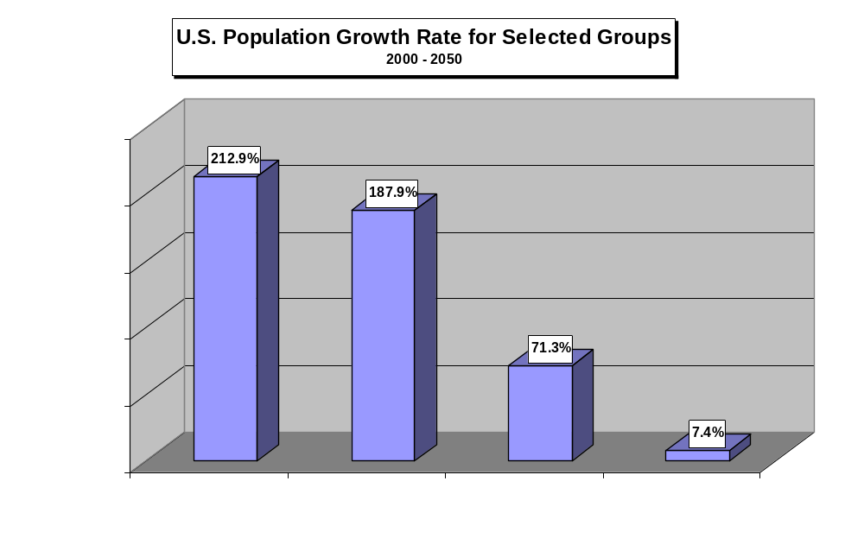

Slide 8
Market Research
Market research is the vehicle for gathering the information that serves as the foundation for the marketing plan.
Never assume that a market exists for your company’s product or service; prove it!
Market research does not have to be time consuming, complex, or expensive to be useful.
  Web-based market research – online surveys
  Trend-tracking

Slide 9

Be a Trend-Tracker
Read many diverse current publications
Watch top 10 TV shows
See the top 10 movies
Talk to at least 150 customers a year
Talk with the 10 smartest people you know
Listen to your children and their friends

Slide 10

Market Research
How to Conduct Market Research:
Define the objective.
Collect the data.
  Individualized (one-to-one) marketing

Slide 11
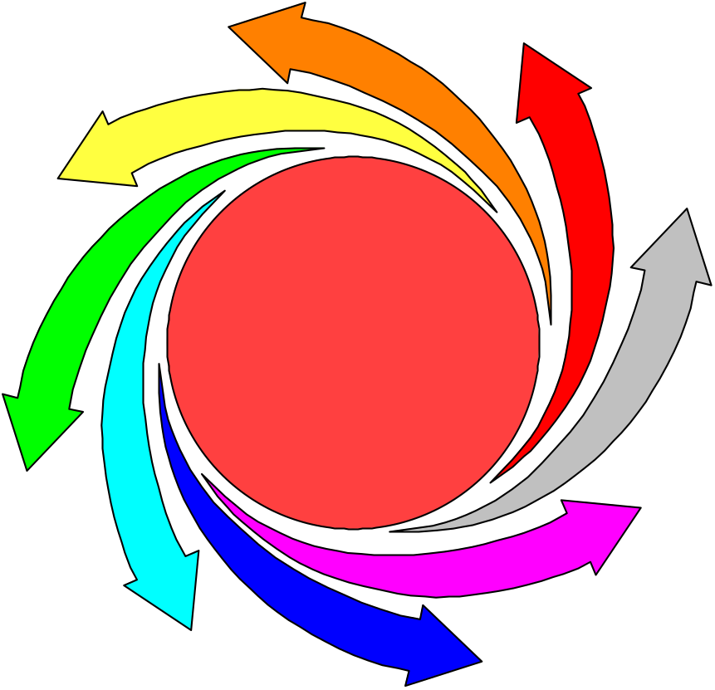
How to Become an Effective One-to-One Marketer
Identify your best customers,
never passing up the
opportunity to get their names.
Enhance your products and
services by giving customers
information about them and how
to use them.
See customer complaints
for what they are - a
chance to improve
your service and
quality. Encourage
complaints and then
fix them!
Collect information on these
customers, linking their
identities to their transactions.
Successful
One-to-One
Marketing
Calculate the long-term value
of customers so you know
which ones are most desirable
(and most profitable).
Make sure your company’s
product and service quality
will astonish your customers.
Know what your customers’
buying cycle is and time your
marketing efforts to coincide
with it - “just-in-time marketing.”
Source: Adapted from Susan Greco, “The Road to One-
to-One Marketing,” Inc., October 1995, pp. 56-66.

Slide 12
Market Research
How to Conduct Market Research:
Define the problem.
Collect the data.
  Individualized (one-to-one) marketing
  Data mining – See Harrah’s Entertainment
Analyze and interpret the data.
Draw conclusions and act.

Slide 13

Relationship Marketing
(Customer Relationship Management)
Involves developing and maintaining long-term relationships with customers so that they will keep coming back to make repeat purchases.

Slide 14
Relationship Marketing
(Customer Relationship Management)
Steps:
  Collect meaningful customer information and compile it in a database.
  Mine the database to identify “best” customers.
  Use the information to develop lasting relationships with “best” customers.
  Attract more customers who fit the “best” customer profile.
  Stay in contact with customers between sales.

Slide 15
The Relationship Marketing Process
Analyze
If you have done everything else correctly, this step is relatively easy. Superb customer service is the best way to retain your most valuable customers.
Sell,
Service,
and Satisfy
Conduct detailed customer intelligence to pinpoint most valuable customers and to learn all you can about them, including their lifetime value (LTV) to the company.
Build
Relationships
Connect
and
Collect
Learn
Based on what you have learned, contact customers with an offer designed for them. Make customers feel special and valued.
Make contact with most valuable customers and begin building a customer database using data mining and data warehousing techniques.
Learn from your customers by encouraging feedback from them; develop a thorough customer profile and constantly refine it.

Slide 16
Steps in CRM
Collect meaningful information on existing customers and compile it in a database.
Mine the database to identify the company’s best and most profitable customers and their buying habits.
Use the information to establish lasting relationships with these customers.
Attract more customers who fit the profile of the company’s best customers.

Slide 17
Four Levels of Customer Sensitivity
Level 4: Customer Partnership. The company has embraced a customer service attitude
as an all-encompassing part of its culture. Customers are part of all major decisions.
Employees throughout the company routinely use data mining reports to identify the
best customers and to serve them better. The focus is on building lasting relationships
with the company’s best customers.
Level 3: Customer Alignment. Managers and employees understand the customer’s
central role in the business. They spend considerable time talking about and with
customers, and they seek feedback through surveys, focus groups, customer visits, and
other techniques.
Level 2: Customer Sensitivity. A wall stands between the company and its customers.
Employees know a little about their customers but don’t share this information with
others in the company. The company does not solicit feedback from customers.
Level 1: Customer Awareness. Prevailing attitude: “There’s a customer out there.”
Managers and employees know little about their customers and view them only in the
most general terms. No one really understands the benefit of close customer
relationships.

Slide 18

Guerrilla Marketing Strategies
Find a niche and fill it.
Don’t just sell; entertain.
  “Entertailing”
Strive to be unique.
Connect with customers on an emotional level.
  Build trust
  Define a unique selling proposition (USP)

Slide 19
Unique Selling Proposition
A key customer benefit of a product that sets it apart from its competition.
Answers key customer question: “What’s in it for me?”
Consider intangible or psychological benefits as well as tangible ones.
Communicate your USP to your customers often.

Slide 20
Guerrilla Marketing Strategies
Create an identity for your business through branding.

Slide 21
Building a Brand
High
“Antes”
Features that are important to customers but all competitors provide them
Every company in the market must “ante up” on these features.
“Drivers”
Features that are both important to customers and are highly differentiated from those of competitors
These are the attributes on which a company must focus to build its brand.
Relevance
“Neutrals”
Features that are irrelevant to customers
These features are useless when it comes to branding.
“Fool’s Gold”
Features that are unique to your company but do not drive customers’ loyalty to your product and services
Don’t make the mistake of trying to build a brand on these features!
Low
Low
Differentiation
High
Source: Adapted from “What Really Matters in Building a Brand,” The McKinsey Quarterly, May 2004, www.mckinseyquarterly.com/newsletters/chartfocus/2004_05.htm

Slide 22
Guerrilla Marketing Strategies
Create an identity for your business through branding.
Start a blog.
Focus on the customer.

Slide 23
Focus on the Customer
67 percent of customers who stop patronizing a business do so because an indifferent employee treated them poorly.
96 percent of dissatisfied customers never complain about rude or discourteous service, but...
  91 percent will not buy from that business again.
  100 percent will tell their “horror stories” to at least nine other people.
  13 percent of those unhappy customers will tell their stories to at least 20 other people.

Slide 24
Focus on the Customer
Treating customers indifferently or poorly costs the average company from 15% percent to 30 percent of gross sales!
Replacing lost customers is expensive; it costs seven to nine times as much to attract a new customer as it does to sell to an existing one!
About 70 percent of a company’s sales come from existing customers.
Because 20 percent of a typical company’s customers account for about 80 percent of its sales, no business can afford to alienate its best and most profitable customers and survive!

Slide 25
Principles of Customer Experience Management (CEM)
In every customer interaction
Intimate understanding of each customer’s needs, wants, preferences, and peculiarities
Personal, customized messages in marketing, sales, service, and advertising
Consistent, courteous, and professional treatment by everyone in the company
Responsive, rapid handling of requests, questions, problems, and complaints
Helpful information and advice delivered proactively, where appropriate
Involvement of caring, well-trained people rather than strict reliance on technology for service delivery
Long-term view of the company/customer relationship rather than a focus on “making a sale”
Emphasis on sustaining an ongoing relationship built on trust and respect
Frequent and visible demonstrations of commitment to nurturing the company/customer relationship
Satisfied, loyal, repeat (and profitable) customers
Source: Adapted from “Wake-Up Call: To Fix CRM, Fix the Customer Experience Now!, BearingPoint White Paper (www.bearingpoint.com, Fall 2005, p. 5.

Slide 26

Focus on the Customer
Companies that are successful at retaining their customers constantly ask themselves (and their customers) four questions:
1. What are we doing right?
2. How can we do that even better?
3. What have we done wrong?
4. What can we do in the future?

Slide 27
Guerrilla Marketing Strategies
Create an identity for your business through branding.
Start a blog.
Focus on the customer.
Be devoted to quality.

Slide 28
Devotion to Quality
Study: 60 percent of customers who change suppliers do so because of problems with a company’s products or services.
World-class companies treat quality as a strategic objective, an integral part of the company culture.
The philosophy of Total Quality Management (TQM):
  Quality in the product or service itself.
  Quality in every aspect of the business and its relationship with the customer.
  Continuous improvement in quality.

Slide 29

How Do Americans Define Quality in a Product?
Reliability (average time between breakdowns)
Durability (how long an item lasts)
Ease of use
Known or trusted brand name
Low price
Quality

Slide 30
How Do Americans Define Quality in a Service?
Tangibles (equipment, facilities, people)
Reliability (doing what you say you will do)
Responsiveness (promptness in helping customers)
Assurance and empathy (conveying a caring attitude)
Quality

Slide 31
Guerrilla Marketing Strategies
Create an identity for your business through branding.
Start a blog.
Focus on the customer.
Be devoted to quality.
Pay attention to convenience.

Slide 32
Attention to Convenience
Is your business conveniently located near customers?
Are your business hours suitable to your customers?
Would customers appreciate pickup and delivery services?
Do you make it easy for customers to buy on credit or with credit cards?

Slide 33
Attention to Convenience
Are your employees trained to handle business transactions quickly, efficiently, and politely?
Does your company offer “extras” that would make customers’ lives easier?
Can you bundle existing products to make it easier for customers to use them?
Can you adapt existing products to make them more convenient for customers?
Does your company handle telephone calls quickly and efficiently?

Slide 34
Guerrilla Marketing Strategies
Concentrate on innovation.

Slide 35

Concentration on Innovation
Innovation
  The key to future success.
  One of the greatest strengths of entrepreneurs. It shows up in the new products, techniques, and unusual approaches they introduce.
Entrepreneurs often create new products and services by focusing their efforts on one area and by using their size and flexibility to their advantage.

Slide 36
Guerrilla Marketing Strategies
Concentrate on innovation.
Be dedicated to service and customer satisfaction.
  Survey: 46 percent of customers had walked out of a store within the past year because of poor service.

Slide 37

Dedication to Service
Goal: to achieve customer astonishment!
Listen to customers.
Define “superior service.”
Set standards and measure performance.
Examine your company’s service cycle.
Hire the right employees.
Train employees to deliver superior service.

Slide 38
Dedication to Service
(continued)
Goal: to achieve customer astonishment!
Empower employees to offer superior service.
Treat employees with respect and show them how valuable they are.
Use technology to provide improved service.
Reward superior service.
Get top managers’ support.
View customer service as an investment, not an expense.

Slide 39
Guerrilla Marketing Strategies
Concentrate on innovation.
Be dedicated to service and customer satisfaction.
Emphasize speed.

Slide 40

Emphasis on Speed
Use principles of time compression management (TCM):
  Speed new products to market
  Shorten customer response time in manufacturing and delivery
  Reduce the administrative time required to fill an order.
Study: Most businesses waste 85 to 99 percent of the time required to produce products or services!

Slide 41
Emphasis on Speed
Re-engineer the process rather than try to do the same thing - only faster.
Create cross-functional teams of workers and empower them to attack and solve problems.
Set aggressive goals for production and stick to the schedule.

Slide 42
Emphasis on Speed
Rethink the supply chain.
Instill speed in the company culture.
Use technology to find shortcuts wherever possible.
Put the Internet to work for you.

Slide 43

Marketing on the
World Wide Web
An essential business tool - Even the smallest companies can market their products and services around the globe.
The Web can be the “Great Equalizer” in a small company’s marketing program.

Slide 44
Marketing on the
World Wide Web
About 70 percent of small companies have a Website, double the number in 2002.
Web marketing strategy must emphasize small company’s strengths and core competencies.

Slide 45




The Marketing Mix
Product
Place
Price
Promotion

Slide 46
Stages in the Product Life Cycle
Introductory stage
High
Costs

Slide 47
Stages in the Product Life Cycle
Introductory stage
Growth and acceptance stage
High
Costs
High
Costs
High
Costs
Sales
Climb

Slide 48
Stages in the Product Life Cycle
Introductory stage
Growth and acceptance stage
Maturity and competition stage
High
Costs
High
Costs
Sales
Climb
Sales
Climb
Profits
Peak
Profits
Peak

Slide 49
Stages in the Product Life Cycle
Introductory stage
Growth and acceptance stage
Maturity and competition stage
Market saturation stage
High
Costs
High
Costs
Sales
Climb
Sales
Climb
Profits
Peak
Sales
Peak
Profits
Peak
Sales
Peak

Slide 50
Stages in the Product Life Cycle
Introductory stage
Growth and acceptance stage
Maturity and competition stage
Market saturation stage
Product decline stage
High
Costs
Sales &
Profits
Fall
High
Costs
High
Costs
Sales
Climb
Sales
Climb
Profits
Peak
Profits
Peak
Sales
Peak
Profits
Peak
Sales
Peak
Sales
Peak

Slide 51
Channels of Distribution
Consumer Goods
Manufacturer
Consumer
Manufacturer
Retailer
Consumer
Manufacturer
Wholesaler
Retailer
Consumer
Manufacturer
Wholesaler
Wholesaler
Retailer
Consumer

Slide 52
Channels of Distribution
Industrial Goods
Manufacturer
Industrial User
Manufacturer
Wholesaler
Industrial User

