Slide 1

Sources of Financing:
Debt and Equity
Notes:
This "Deco" border was drawn on the Slide master using PowerPoint's Rectangle and Line tools. A smaller version was placed on the Notes Master by selecting all of the elements (using Select All from the Edit menu), deselecting the unwanted elements such as the Title (holding down the Shift key and clicking on the unwanted elements), and then using Paste as Picture from the Edit menu to place the border on the Notes Master. After pasting as a picture, we used the resize handles (with Shift to maintain the proportions) to reduce it to the size you see.
Be sure to delete this word processing box before using this template for your own presentation.

Slide 2

Raising Capital
Raising capital to launch or expand a business is a challenge.
Many entrepreneurs are caught in the “credit crunch.”
Financing needs in the $100,000 to $3 million may be the toughest to fill.

Slide 3
The “Secrets” to Successful Financing
1. Choosing the right sources of capital is a decision that will influence a company for a lifetime.
2. The money is out there; the key is knowing where to look.
3. Raising money takes time and effort.
4. Creativity counts. Entrepreneurs have to be as creative in their searches for capital as they are in developing their business ideas.

Slide 4
The “Secrets” to Successful Financing
5. The World Wide Web puts at entrepreneur’s fingertips vast resources of information that can lead to financing.
6. Be thoroughly prepared before approaching lenders and investors.
7. Entrepreneurs should not underestimate the importance of making sure that the “chemistry” among themselves, their companies, and their funding sources is a good one.

Slide 5

Layered Financing
Entrepreneurs must cast a wide net to capture the financing they need to launch their businesses.
Layering – piecing together capital from multiple sources.

Slide 6
Three Types of Capital
Capital is any form of wealth employed to produce more wealth for a firm.
Fixed - used to purchase the permanent or fixed assets of the business (e.g., buildings, land, equipment, and others).
Working - used to support the small company's normal short-term operations (e.g., buy inventory, pay bills, wages, or salaries, and others).
Growth - used to help the small business expand or change its primary direction.

Slide 7
Equity Capital
Represents the personal investment of the owner(s) in the business.
Is called risk capital because investors assume the risk of losing their money if the business fails.
Does not have to be repaid with interest like a loan does.
Means that an entrepreneur must give up some ownership in the company to outside investors.

Slide 8

Debt Capital
Must be repaid with interest.
Is carried as a liability on the company’s balance sheet.
Can be just as difficult to secure as equity financing, even though sources of debt financing are more numerous.
Can be expensive, especially for small companies, because of the risk/return tradeoff.

Slide 9

Sources of Equity Financing
Personal savings
Friends and family members
Angels
Partners
Corporations
Venture capital companies
Public stock sale
Simplified registrations and exemptions

Slide 10

Personal Savings
The first place an entrepreneur should look for money.
The most common source of equity capital for starting a business.
Outside investors and lenders expect entrepreneurs to put some of their own capital into the business before investing theirs.

Slide 11

Friends and Family Members
After emptying their own pockets, entrepreneurs should turn to those most likely to invest in the business: friends and family members.
Careful!!! Inherent dangers lurk in family/friendly business deals, especially those that flop.

Slide 12
Friends and Family Members
Guidelines for family and friendship financing:
  Consider the impact of the investment on everyone involved.
  Keep the arrangement “strictly business.”
  Settle the details up front.
  Never accept more than investors can afford to lose.
  Create a written contract.
  Treat the money as “bridge financing.”
  Develop a payment schedule that suits both parties.
  Have an exit plan.

Slide 13

Angels
Private investors who invest in emerging entrepreneurial companies.
Fastest growing segment of the small business capital market.
An excellent source of “patient money” for investors needing relatively small amounts of capital ranging from $100,000 (sometimes less) to as much as $5 million.

Slide 14

Angels
An estimated 230,000 angels across the U.S. invest $23 billion a year in 50,000 small companies.
Their investments exceed those of venture capital firms, providing more capital to 17 times as many small companies.

Slide 15

Angels
The typical angel:
  Invests in companies at the seed or startup stages.
  Accepts 10 percent of the proposals presented to him.
  Makes an average of two investments every three years.
  Has invested an average of $80,000 in 3.5 businesses.
  90 percent are satisfied with their investments.
Key: finding them!
  Network!
  Look nearby, a 50- to 100-mile radius.
  Informal angel “clusters” and networks

Slide 16
Corporate Venture Capital
20 percent of all venture capital investments come from corporations.
About 300 large corporations across the globe invest in start-up companies.
Capital infusions are just one benefit; corporate partners may share marketing and technical expertise.

Slide 17
Venture Capital Companies
More than 1,300 venture capital firms operate across the U.S.
Most venture capitalists seek investments in the $3,000,000 to $10,00,000 range in companies with high-growth and high-profit potential.
Business plans are subjected to an extremely rigorous review - less than 1 percent accepted.

Slide 18
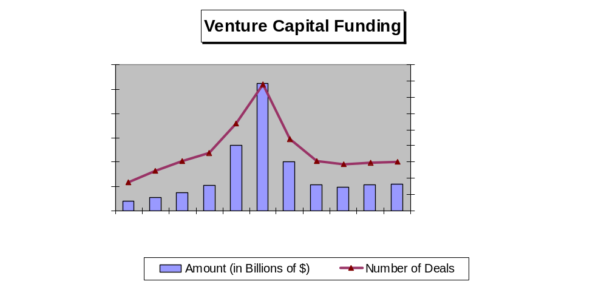
Source: “MoneyTree Report,” PriceWaterhouseCoopers, http://www.pwcmoneytree.com/moneytree/nav.jsp?page=historical

Slide 19
Venture Capital Companies
Most venture capitalists take an active role in managing the companies in which they invest.
Many venture capitalists focus their investments in specific industries with which they are familiar.
Venture capitalists typically purchase between 20 percent and 40 percent of a company but in some cases will buy 70 percent or more.

Slide 20
Venture Capital Companies
Most often, venture capitalists invest in a company across several stages.
On average, 98 percent of venture capital goes to:
  Early stage investments (companies in the early stages of development).
  Expansion stage investments (companies in the rapid growth phase).
Only 2 percent of venture capital goes to businesses in the startup or seed phase.

Slide 21

What Do Venture Capital
Companies Look For?
Competent management
Competitive edge
Growth industry
Viable exit strategy
Intangibles factors

Slide 22
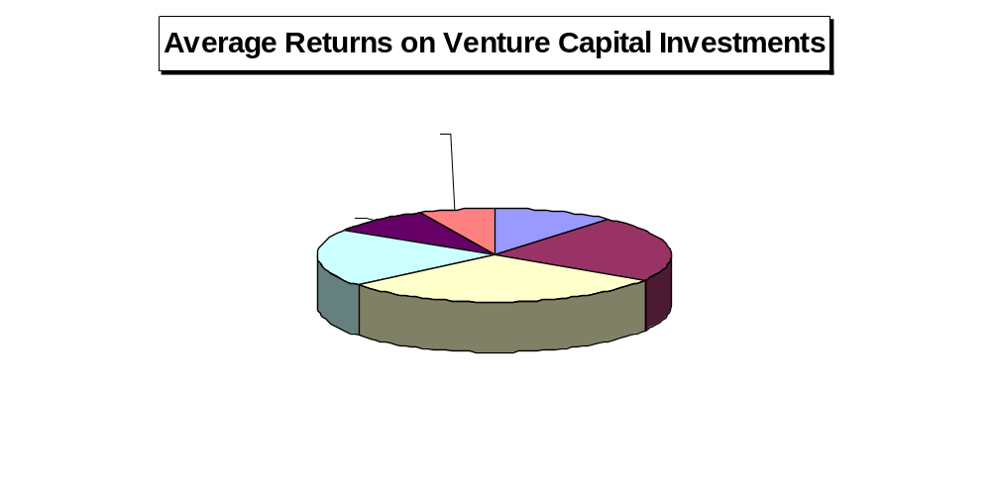
Source: Paul Keaton, "The Reality of Venture Capital," Small Business Forum, Arkansas Small Business Development Center,
http://asbdc.ualr.edu/bizfacts/501.asp?print=Y, p. 8.

Slide 23

Going Public
Initial public offering (IPO) - when a company raises capital by selling shares of its stock to the public for the first time.
Typical year: about 410 companies make IPOs.
Few companies with sales below $20 million in annual sales make IPOs.

Slide 24
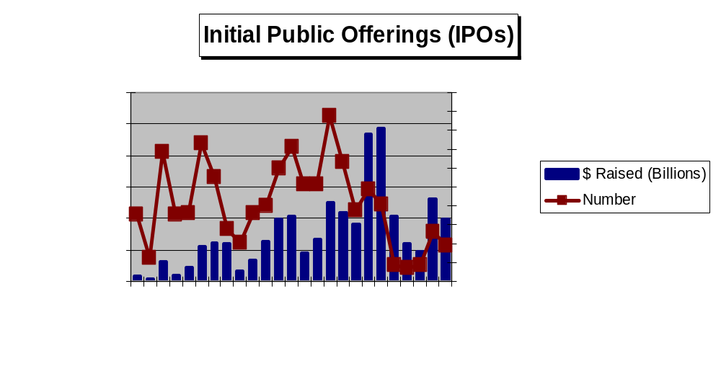

Slide 25
Successful IPO Candidates
Consistently high growth rates
Strong record of earnings
3 to 5 years of audited financial statements that meet or exceed SEC standards
Solid position in a rapidly growing industry
Sound management team with experience and a strong board of directors

Slide 26

Advantages of “Going Public”
Ability to raise large amounts of capital
Improved corporate image
Improved access to future financing
Attracting and retaining key employees
Using stock for acquisitions
Listing on a stock exchange

Slide 27

Disadvantages of “Going Public”
Dilution of founder’s ownership
Loss of control
Loss of privacy
Reporting to the SEC
Filing expenses
Accountability to shareholders
Pressure for short-term performance
Timing

Slide 28

The Registration Process
Choose the underwriter
Negotiate a letter of intent
Prepare the registration statement
File with the SEC
Wait to “go effective” and road show
Meet state requirements

Slide 29
Timetable for an IPO
Time | Action
Week 1 | Conduct organizational meeting with IPO team, including underwriter, attorneys, accountants, and others. Begin drafting registration statement.
Week 5 | Distribute first draft of registration statement to IPO team and make revisions.
Week 6 | Distribute second draft of registration statement and make revisions.
Week 7 | Distribute third draft of registration statement and make revisions.
Week 8 | File registration statement with the SEC. Begin preparing presentations for road show to attract other investment bankers to the syndicate. Comply with Blue Sky laws in states where offering will be sold.
Week 12 | Receive comment letter on registration statement from SEC. Amend registration statement to satisfy SEC comments.
Week 13 | File amended registration statement with SEC. Prepare and distribute preliminary offering prospectus (called a “red herring”) to members of underwriting syndicate. Begin road show meetings.
Week 15 | Receive approval for offering from SEC (unless further amendments are required). Issuing company and lead underwriter agree on final offering price. Prepare, file, and distribute final offering prospectus.
Week 16 | Company and underwriter sign the final agreement. Underwriter issues stock, collects the proceeds from the sale, and delivers proceeds (less commission) to company.

Slide 30
Simplified Registrations and Exemptions
Goal: To give small companies easy access to capital markets with simplified registration requirements.
Regulation S-B
Regulation D: Rule 504 - Small Company Offering Registration (SCOR)
Regulation D: Rule 505 and 506

Slide 31

Simplified Registrations and Exemptions
Section 4 (6) Private Placements
Rule 147 (Intrastate offerings)
Regulation A
Direct Stock Offering on the World Wide Web (WWW)

Slide 32

Sources of Debt Capital
Commercial banks

Slide 33

Commercial Banks
...the heart of the financial market for small businesses!
Short-term loans
  Commercial loans
  Lines of credit
  Floor planning
Intermediate and long-term loans
  Installment loans and contracts

Slide 34
Six Most Common Reasons Bankers Reject Small Business Loans
“Our bank doesn’t make small business loans.”
Cure: Before applying for a loan, research banks to find out which ones seek the type of loan you need.
“I don’t know enough about you or your business.”
Cure: Develop a detailed business plan to present to the banker.

Slide 35
Six Most Common Reasons Bankers Reject Small Business Loans
(continued)
3. “You haven’t told me why you need the money.”
Cure: Your business plan should explain how much money you need and how you plan to use it.
4. “Your numbers don’t support your loan request.”
Cure: Include a cash flow forecast in your business plan.

Slide 36
Six Most Common Reasons Bankers Reject Small Business Loans
(continued)
5. “You don’t have enough collateral.”
Cure: Be prepared to pledge your company’s assets – and perhaps your personal assets – as collateral for the loan.
6. “Your business does not support the loan on its own.”
Cure: Be prepared to provide a personal guarantee on the loan.

Slide 37

Sources of Debt Capital
Commercial banks
Asset-based lenders

Slide 38
Asset-Based Borrowing
Businesses can borrow money by pledging as collateral otherwise idle assets – accounts receivable, inventory, and others
Advance rate – the percentage of an asset’s value that a lender will lend.

Slide 39


Asset-Based Borrowing
Discounting accounts receivable
Accounts
Receivable
Inventory financing

Slide 40

Sources of Debt Capital
Commercial banks
Asset-based lenders
Vendor financing (trade credit)
Equipment suppliers
Commercial finance companies
Saving and loan associations
$$

Slide 41

Sources of Debt Capital
(Continued)
Stock brokerage houses
Insurance companies
Credit unions
Bonds
Private placements
Small Business Investment Companies (SBICs)
Small Business Lending Companies (SBLCs)

Slide 42
Sources of Debt Capital
(Continued)
Federally Sponsored Programs:
Economic Development Administration (EDA)
Department of Housing and Urban Development (HUD)
U.S. Department of Agriculture’s Rural Business-Cooperative Service
Small Business Innovation Research (SBIR)
Small Business Technology Transfer programs
Small Business Administration (SBA)

Slide 43
Small Business Administration Loan Programs
Low Doc Loan Program
SBAExpress Program
7(A) Loan Guaranty Program – the most popular SBA loan program

Slide 44
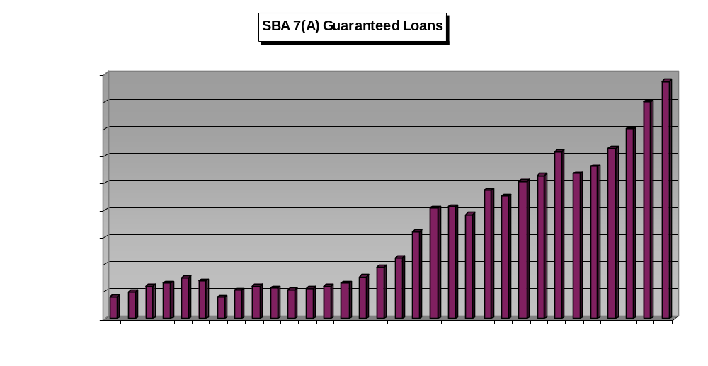

Slide 45
Small Business Administration Loan Programs
Low Doc Loan Program
SBAExpress Program
7(A) Loan Guaranty Program – the most popular SBA loan program
CAPLine Program
International Trade Programs
  Export Working Capital Program
  International Trade Program

Slide 46
SBA Loan Programs
Section 504 Certified Development Company Program
Microloan Program
Prequalification Loan Program
Disaster Loans

Slide 47
State and Local Loan Programs
Capital Access Programs (CAPs) – designed to encourage lenders to make loans to businesses that do not qualify for traditional financing.
Revolving Loan Fund (RLFs) – combine private and public funds to make small business loans.

Slide 48

Internal Methods of Financing
Factoring - selling accounts receivable outright
Leasing - assets rather than buying them
Credit cards

