Slide 1

Choosing the Right Location and Layout
Notes:
This "Deco" border was drawn on the Slide master using PowerPoint's Rectangle and Line tools. A smaller version was placed on the Notes Master by selecting all of the elements (using Select All from the Edit menu), deselecting the unwanted elements such as the Title (holding down the Shift key and clicking on the unwanted elements), and then using Paste as Picture from the Edit menu to place the border on the Notes Master. After pasting as a picture, we used the resize handles (with Shift to maintain the proportions) to reduce it to the size you see.
Be sure to delete this word processing box before using this template for your own presentation.

Slide 2
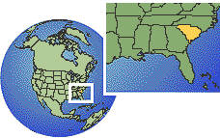

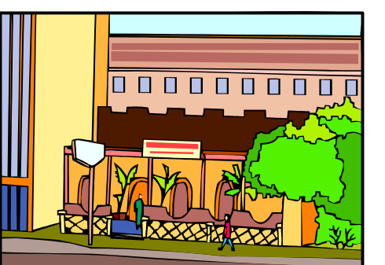
Choosing a Location
The right region of the country
The right state in the region
The right city in the state
The right site in the city

Slide 3
Choosing the Region:
Sources of Information
Census data
World Wide Web
  http://www.census.gov/
  http://factfinder.census.gov
STAT-USA http://www.statusa.gov

Slide 4
Choosing the Region:
Sources of Information
Demographics USA
Lifestyle Market Analyst
Survey of Buying Power
Editor and Publisher Market Guide
Rand McNally's Commercial Atlas and Marketing Guide
Zip Code Atlas and Market Planner

Slide 5
Choosing the Region:
Sources of Information
The American Marketplace: Demographics and Spending Patterns
Commercial Atlas and Marketing Guide
Zip Code Atlas
Geographic Information Systems (GIS)
  U.S. Census Department’s TIGER

Slide 6
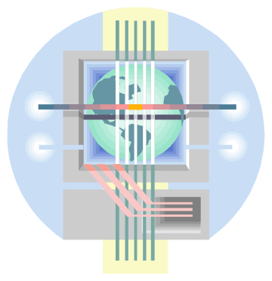
Geographic Information Systems
(GIS)
Computerized programs combining map-drawing with database management capability.
Search through virtually any database and then plot the results on a map.
Visual display reveals otherwise hidden trends.

Slide 7
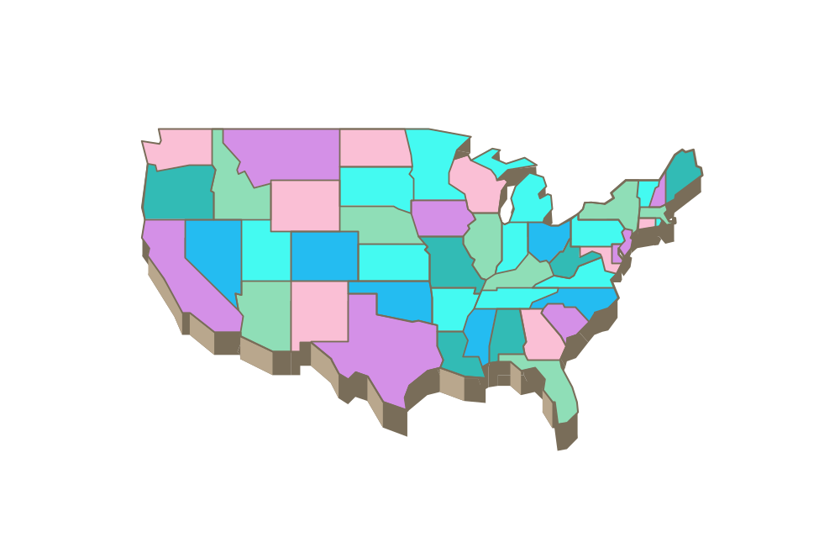
Choosing the State
Proximity to markets
Proximity to needed raw materials
Wage rates
Labor supply needs
Business climate
Tax rates
Internet access

Slide 8
State Evaluation Matrix
 |  |  | State Weighted Score (Weight x Score)
Location Criterion | Weight | Score (Low = 1, High = 5) | State 1 | State 2 | State 3
Quality of labor force
Wage rates
Union activity
Property/building costs
Utility costs
Transportation costs
Tax burden
Educational/training assistance
Start-up incentives
Raw material availability
Quality of life
Other:
Other
 |  | Total Score

Slide 9

Choosing the City
Population trends
Competition
Clustering
Compatibility with community
Local laws and regulations

Slide 10
Choosing the City
(Continued)
Transportation networks
Police and fire protection
Cost of utilities and public services
Quality of life

Slide 11

Retail and Service Location Considerations
Trade area – the region from which a business can expect to draw customers.
  Retail compatibility
  Degree of competition
  Index of retail saturation (IRS)

Slide 12
Index of Retail Saturation
C x RE
RF
where
C = Number of customers in the trading area
RE = Retail expenditures = the average expenditure per person for the product in the trading area
RF = Retail facilities = the total square feet of selling space allocated to the product in the trading area
IRS =

Slide 13
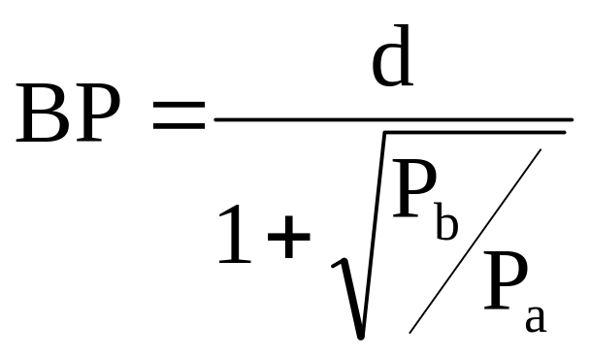
Reilly’s Law of Retail Gravitation
where:
BP = Distance in miles from location A to the break point
d = Distance in miles between locations A and B
P_{a} = Population surrounding location A
P_{b} = Population surrounding location B

Slide 14
Retail and Service Location Considerations
Trade area size
  Retail compatibility
  Degree of competition
  Index of retail saturation (IRS)
  Transportation network
  Physical, racial, or emotional barriers
  Political barriers

Slide 15
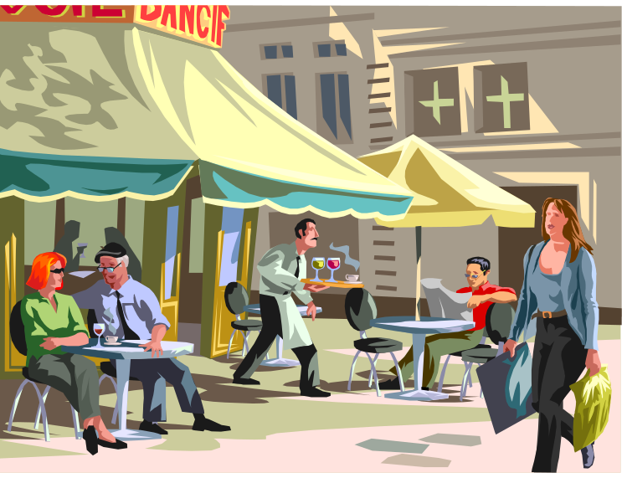
Retail and Service Location Considerations
(Continued)
Trade area size
  Customer traffic
  Adequate parking
  Reputation
  Room for expansion
  Visibility

Slide 16
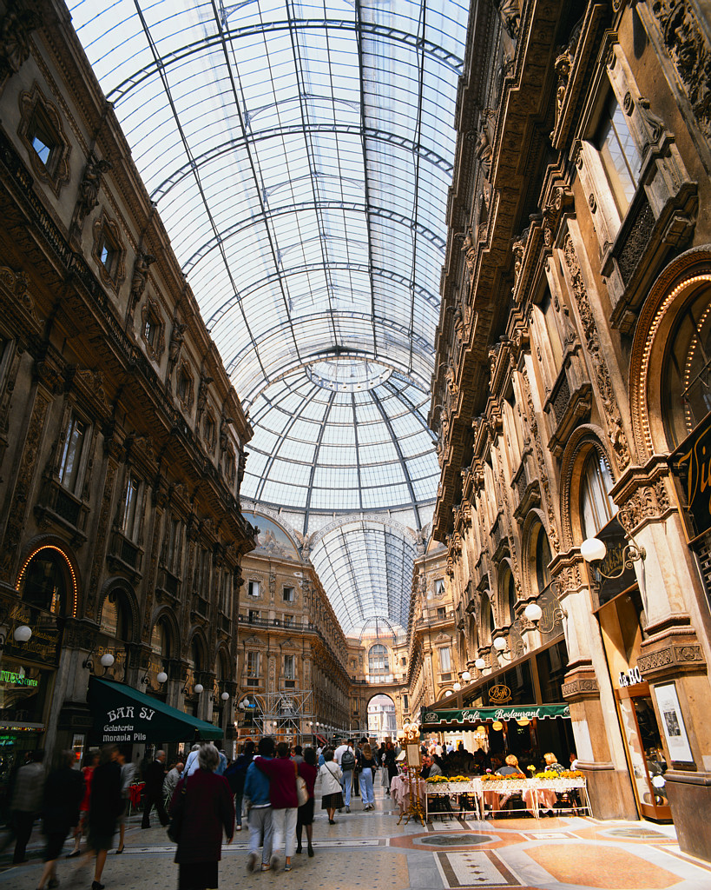
Retail and Service Location Options
Central Business Districts (CBDs)
Neighborhood locations
Shopping centers and malls
  Neighborhood shopping centers
  Community shopping centers
  Regional shopping centers
  Power centers

Slide 17
Shopping Centers and Malls
Neighborhood shopping centers
  3 to 12 Stores; anchor is supermarket or drugstore; serves up to 40,000 people
Community shopping centers
  12 to 50 stores; anchor is department or variety store; serves 40,000 to 150,000 people
Power centers
  Combine drawing power of a mall with convenience of neighborhood shopping center; anchor stores typically occupy 80 percent of space.

Slide 18
Shopping Centers and Malls
Theme or festival centers
  Employ a unifying theme, often involving entertainment, to attract tourists
Outlet centers
  Feature manufacturers’ and retailers’ outlet stores selling name-brand goods at discount prices; usually follows “open air” design
Lifestyle centers
  Located near affluent residential neighborhoods; designed to look more like a central business district than a shopping center or mall

Slide 19
Shopping Centers and Malls
Regional shopping malls
  50 to 100 stores; anchor is one or more major department stores; draws customers from a large trading area, often 5 to 15 miles or more in all directions
Super-regional shopping malls
  Similar to a regional mall but bigger; trading area is 25 miles or more in all directions.
  Examples
    Mall of America (Bloomington, MN), largest mall in the U.S.
    West Edmonton Mall (West Edmonton, Canada), largest mall in the world

Slide 20
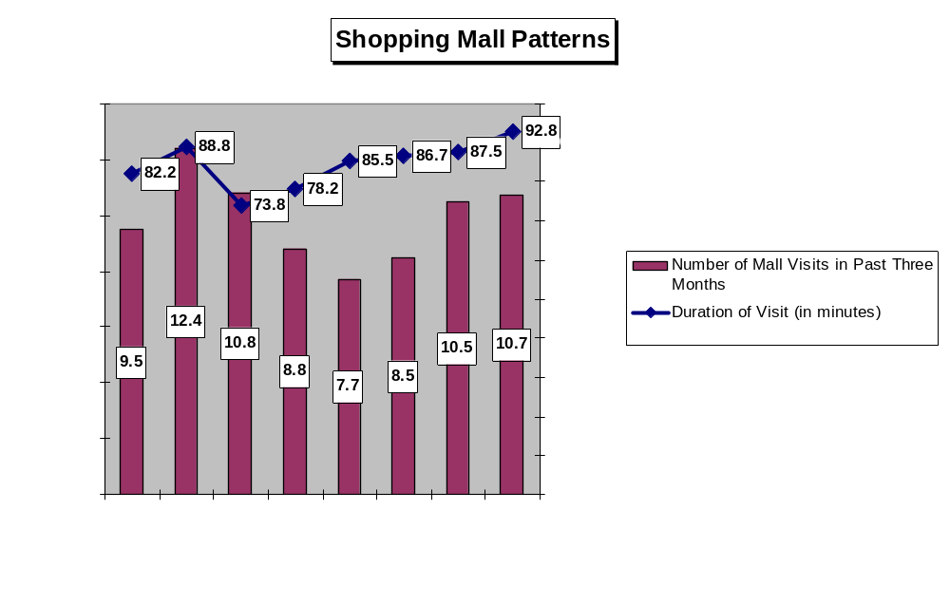

Slide 21
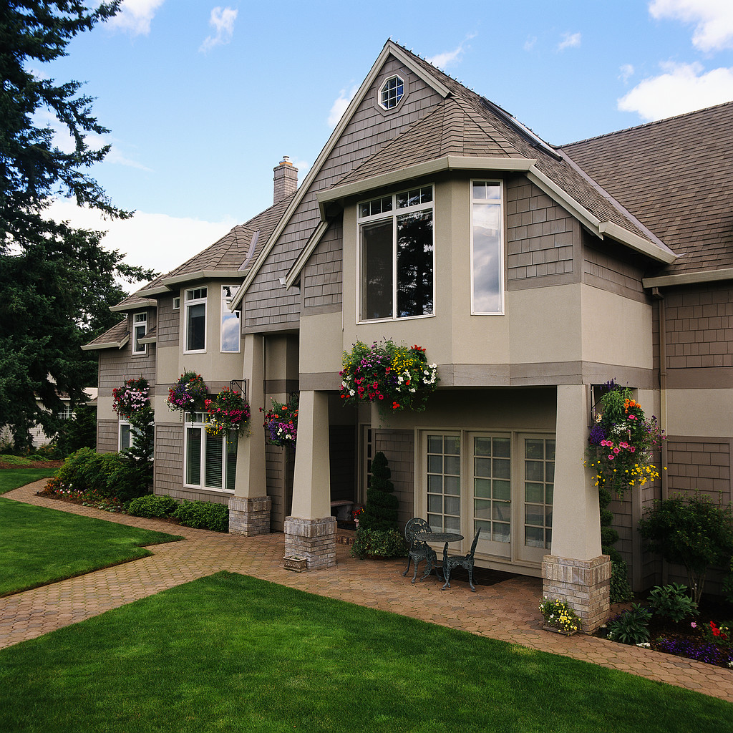
Retail and Service Location Options
(continued)
Near competitors
Outlying areas
Home-based businesses

Slide 22

Manufacturing Locations
Foreign trade zones

Slide 23

How a Foreign Trade Zone (FTZ) Works
Small
Company
No Duty Paid
U.S.
Sales
Without FTZ
Duty
Paid
Duty Paid
Store
Exports
Imported Parts
and Materials
Assemble
Duty Paid
U.S.
Sales
Package
No
Duty
Paid
With FTZ
Manufacture
No Duty Paid
Process
Exports
Mix

Slide 24
Manufacturing Locations
Foreign trade zones
Empowerment zones
Business incubators

Slide 25
Business Incubators
Organizations that combine low-cost, flexible rental space with a multitude of support services for their small business residents.
More than 1,000 in operation across the U.S., and a new one opening, on average, every week.
They work!! Firms that “graduate” from incubators have a success rate of 87 percent.
Average incubator houses 20 businesses employing 55 people.

Slide 26

Layout
Layout – the logical arrangement of the physical facilities of a business that contributes to efficient operations, increased productivity, and higher sales.
Study: Look and feel of employees’ work spaces is third most important consideration (after salary and benefits) when deciding whether or not to accept or to quit a job.

Slide 27
Layout:
External Factors
Size must be adequate to accommodate business needs.
Appearance must create the proper image or “personality” for the business in the customer’s eyes.
Entrances must invite customers to come in.

Slide 28
Layout:
External Factors
(Continued)
Create effective window displays and change them often; they can be powerful sales tools.
Must comply with Americans with Disabilities Act (ADA).
Pay attention to the business sign, the most direct method of reaching potential customers.

Slide 29
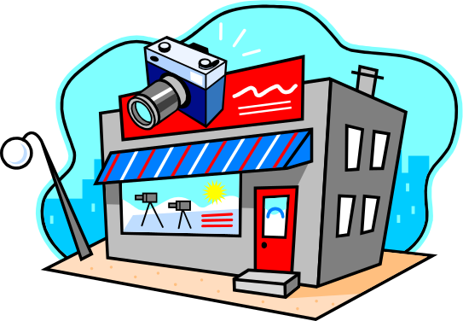
A Business Sign
Tells potential customers who you are and what you’re selling.
Must comply with local sign ordinances.
Should be visible, simple, and clear.
Should be changed periodically to avoid becoming part of the background.
Should be legible both day and night.
Must be maintained properly.

Slide 30
Building Interiors
Ergonomics is an integral part of any design.
Proper layout and design pays off in higher productivity, efficiency, or sales.
Proper lighting is measured by what is ideal for the job being done.
  Use of natural light can increase retail sales.
Careful selection of colors can create the desired impressions among customers and employees.
Appealing to all of the customer’s senses can boost sales.

Slide 31
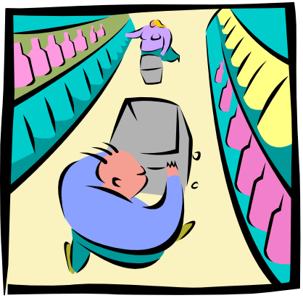
Three Retail Layout Patterns
Grid
  Rectangular with parallel aisles; formal; controls traffic flow; uses selling space efficiently.
  Supermarkets and self-service discount stores.

Slide 32

Three Retail Layout Patterns
Free-Form
  Free-flowing; informal; creates “friendly” environment; flexible.
  Small specialty shops.

Slide 33

Three Retail Layout Patterns
Boutique
  Divides store into a series of individual shopping areas, each with its own theme; unique shopping environment.
  Small department stores.

Slide 34
Layout Guidelines
Know your customers buying habits and plan your layout accordingly.
Display merchandise as attractively as your budget will allow.
Display complementary items together.
Recognize the value of floor space; never waste valuable selling space with nonselling functions.

Slide 35
Factors to Consider in Manufacturing Layouts
Type of product
Type of production process
Ergonomic considerations
Economic considerations
Space availability within the facility

Slide 36

Manufacturing Layouts
Product layout
Process layout
Fixed position layout
Functional layout

