Slide 1

Global Aspects of
Entrepreneurship
Notes:
This "Deco" border was drawn on the Slide master using PowerPoint's Rectangle and Line tools. A smaller version was placed on the Notes Master by selecting all of the elements (using Select All from the Edit menu), deselecting the unwanted elements such as the Title (holding down the Shift key and clicking on the unwanted elements), and then using Paste as Picture from the Edit menu to place the border on the Notes Master. After pasting as a picture, we used the resize handles (with Shift to maintain the proportions) to reduce it to the size you see.
Be sure to delete this word processing box before using this template for your own presentation.

Slide 2

Why “Go Global”?
Offset sales declines in the domestic market
Increase sales and profits
Extend products’ life cycles
Lower manufacturing costs
Lower product cost
Improve competitive position
Raise quality levels
Become more customer-oriented

Slide 3

Nine Strategies for Going Global
Creating a Web site
Establishing
international
locations
Relying on trade intermediaries
Importing and
outsourcing
Creating joint ventures
Exporting
Foreign licensing
Countertrading and bartering
International franchising

Slide 4
Strategies for “Going Global”
Create a presence on the Web

Slide 5
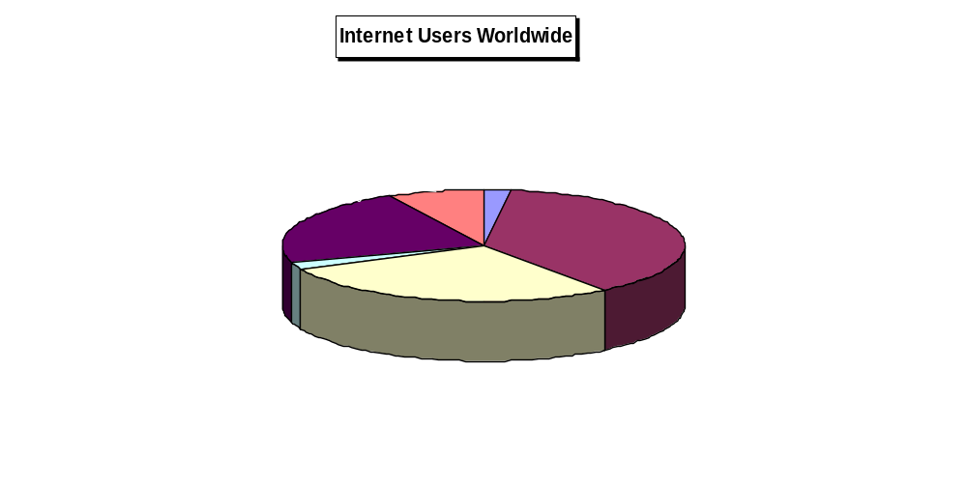
Source: Adapted from E-Commerce and Development Report 2003, United Nations Conference on Trade and Development (New York and Geneva: 2003), pp.2-4.

Slide 6

The Web’s Global Reach
Available 24 hours a day to anyone anywhere in the world.
1.02 billion Web users worldwide
  227 million in U.S.
  795 million in other countries
49 percent of eBay users live outside the U.S.

Slide 7
Strategies for “Going Global”
Create a presence on the Web
Rely on trade intermediaries

Slide 8

Trade Intermediaries
Domestic agencies that serve as distributors in foreign countries for companies of all sizes.
Several types:
  Export Management Companies (EMCs)
  Export Trading Companies (ETCs)
  Manufacturer’s Export Agents (MEAs)
  Export merchants
  Resident buying offices
  Foreign distributors

Slide 9
Strategies for “Going Global”
Create a presence on the Web
Rely on trade intermediaries
Form joint ventures

Slide 10

Joint Ventures
Domestic joint venture – two or more U.S. companies form an alliance for the purpose of exporting their goods and services abroad.
Foreign joint venture – a domestic firm forms an alliance with a company in the target nation.
  Most important ingredient: choosing the right partner
  Use the joint venture as a learning process

Slide 11
Strategies for “Going Global”
Create a presence on the Web
Rely on trade intermediaries
Form joint ventures
Engage in foreign licensing
Consider international franchising

Slide 12
International Franchising
To expand internationally, franchisers should:
  Identify the country or countries that are best suited to the franchiser’s business concept.
  Generate leads for potential franchisees.
  Select quality candidates.
  Structure the franchise deal.
    Direct franchising
    Area development
    Master franchising

Slide 13
Strategies for “Going Global”
Create a presence on the Web
Rely on trade intermediaries
Form joint ventures
Engage in foreign licensing
Consider international franchising
Use countertrading and bartering
Export

Slide 14

Exporting
Small companies account for 97 percent of all companies involved in exporting, but they generate just 29 percent of the dollar value of the nation’s exports.
Only 12 percent of all of exporting small companies actively market their products and services regularly in foreign markets.

Slide 15
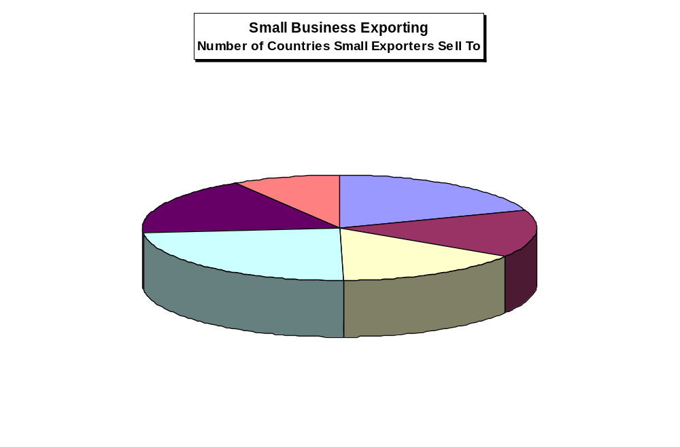
Source: NFIB National Small Business Poll: Interntational Trade, National Federation of Independent Businesses, Volume 4, Issue I, 2004, p. 3.

Slide 16

Steps to Successful Exporting
1. Recognize that even the tiniest companies and least experienced entrepreneurs have the potential to export.
2. Analyze your product or service.
3. Analyze your commitment to developing export markets.
4. Research potential markets and pick your target.

Slide 17

Steps to Successful Exporting
(Continued)
5. Develop a distribution strategy.
6. Find your customer.
  U.S. Department of Commerce
  International Trade Administration
7. Find financing for export sales.
8. Ship your goods.
9. Collect your money.

Slide 18






How a Letter of Credit Works.
Seller
Buyer
Foreign buyer agrees to buy products;
seller agrees to ship goods if buyer
arranges a letter of credit.
Seller ships goods to buyer according to letter of credit’s terms and submits shipping documents to bank issuing
letter of credit.
Seller’s Bank
Buyer's Bank
$
$
$
Letter
of Credit
$
Buyer requests that his bank grant a
letter of credit, which assures exporter
payment if she presents documents
proving goods were actually shipped.
Bank makes out letter of credit to seller
and sends it to seller’s bank (called the
confirming bank).
Buyer’s bank makes payment to seller’s (confirming) bank. Confirming bank then pays seller amount specified in letter of credit.

Slide 19
Strategies for “Going Global”
Establish a presence on the Web
Rely on trade intermediaries
Form joint ventures
Engage in foreign licensing
Consider international franchising
Use countertrading and bartering
Export
Establish international locations
Use importing and outsourcing

Slide 20

Steps to Successful Importing or Outsourcing
Make sure that importing or outsourcing is right for your business.
Establish a target cost for your product.
Do your research before you leave home.
Be sensitive to cultural differences.
Do your groundwork.

Slide 21
Steps to Successful Importing or Outsourcing
Protect your company’s intellectual property.
Select a manufacturer.
Provide an exact model of the product you want manufactured.
Stay in constant contact with the manufacturer and try to build a long-term relationship.

Slide 22

Barriers to International Trade
Domestic Barriers:
Attitude: “My company is too small to export.”
Lack of information about how to get started.
Lack of export financing.

Slide 23
Barriers to International Trade
International Barriers:
Tariffs - Taxes a government imposes on goods and services imported into that country.
Quotas - Limits on the amount of a product imported into a country.
Embargoes - Total bans on imports of certain products.

Slide 24
Barriers to International Trade
International Barriers:
Dumping - Selling large quantities of a product in a foreign country below cost to gain market share.
Political barriers - rules, regulations, and risks.
Cultural barriers - Differing languages, philosophies, traditions, and accepted business practices.

Slide 25

International Trade Agreements
Major Agreements:
World Trade Organization (WTO)
North American Free Trade Agreement (NAFTA)
Central America Free Trade Agreement (CAFTA)

Slide 26

Guidelines for Success in
International Markets
Make yourself at home in all three of the world’s key markets - North America, Europe, and Asia.
Appeal to the similarities in the various regions in which you operate but recognize the differences in local cultures.
Develop new products for the world market.
Familiarize yourself with foreign customs and languages.
“Glocalize” - make global decisions about products, markets, and management, but allow local employees to make tactical decisions about packaging, advertising, and service.

Slide 27
Guidelines for Success in
International Markets
Recruit and retain multicultural workers who can give your company meaningful insight into the intricacies of global markets.
Train employees to think globally, send them on international trips, and equip them with state-of-the-art communication technology.
Hire local managers to staff foreign offices and branches.
Do whatever seems best wherever it seems best, even if people at home lose jobs or responsibilities.
Consider using partners and joint ventures to break into foreign markets you cannot penetrate on your own.

