Slide 1
A Rule-based Recursive Lemmatization Algorithm with POS tagging for Plagiarism Detection in Nepali texts
Ayush Kumar Shah
Ph.D. Student
Department of Computing and Information Sciences, RIT
Manuscript Presentation 2020 Date: 3 Nov 2020

Slide 2
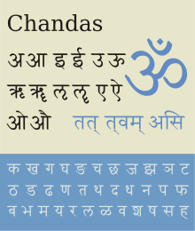
Introduction
Preprocessing – integral component of Plagiarism detection
Devanagari scripts
47 primary characters: 14 vowels and 33 consonants
>120 languages: e.g. Nepali, Sanskrit, Benagli, Hindi, etc.
Notes:
No plagiarism detection system developed in Nepali language.
Structure: S O V (English – S V O)

Slide 3
Introduction
Challenges of preprocessing in Nepali texts
Different syntactic structure
Complex grammatical rules
Notes:
No plagiarism detection system developed in Nepali language.
Structure: S O V (English – S V O)

Slide 4
Introduction
Grammatical constraints
Gender agreement
Number agreement
Person agreement
Honorifics
Example:
Root word: eat - खा
“You eat food.”
1. तँ खाना खान्छस्। 2. तिमी खाना खान्छौ। 3. तपाई खाना खानुहुन्छ।
4. तँ खाना खान्छेस्। 5. तिमी खाना खान्छ्यौ। 6. तपाई खाना खानुहुन्छ।
“He eats food.”
1. ऊ खाना खान्छ। 2. उनी खाना खान्छन्। 3. उहाँ खाना खानुहुन्छ।
“She eats food.”
1. ऊ खाना खान्छे। 2. उनी खाना खान्छिन्। 3. उहाँ खाना खानुहुन्छ।
Notes:
No plagiarism detection system developed in Nepali language.
Structure: S O V (English – S V O)

Slide 5
Previous Works
Previous works
Combination of lookup algorithm, suffix stripping algorithm, and prefix removal algorithm [3]
n-gram models to design a common stemmer [4]
Romanization utilizing English corpus [5]
Limitations
No consideration of grammatical rules specific to Nepali language
Parts of Speech (POS) not considered
[3] D. MONIKA, T. ABHISHEK, and M. UPENDRA, “An effective stemmer in Devanagari script,” Hamirpur, India, Apr. 2013, pp. 22–25. [Online]. Available: https://www.seekdl.org/conferences/paper/details/1309.html
[4] S. R. Dangui and N. Naik, “A Lightweight Stemmer for Devanagari Script,” in Proceedings of the 8th Annual ACM India Conference, ser. Compute ’15. New York, NY, USA: Association for Computing Machinery, Oct. 2015, pp. 55–62. [Online]. Available: http://doi.org/10.1145/2835043.2835061
[5] B. P. Pande, P. Tamta, H. S. Dhami, and S. Campus, “A Devanagari Script based Stemmer,” p. 12.
Notes:
Monika et.al. [3] have presented the development of Hindi stemmer based on Devanagari script for stripping both prefixes and suffixes to obtain the root word using the combination of lookup algorithm, suffix stripping algorithm, and prefix removal algorithm.
[4] used a supervised approach using n-gram models to design a common stemmer for languages in Devanagari scripts. They tested four approaches based on frequency, statistics, length, and iterations to split the words into suffix and stem. This method does not consider prefix, and the results are worse in the Nepali language, since the complex grammar and structure specific to the Nepali language are not considered.
[5] used a unique approach of romanization (one to one mapping of each vowel and consonant of Devanagari script into an English roman code to exploit the English coded corpus.

Slide 6
Paper Contributions
Contributions
140 custom suffix and prefix rules
Rule-based recursive lemmatization algorithm
NEP-PLAG2019v1 dataset¹
Nepali Plagiarism Detection System
Significance
Better performance for Nepali texts
Lemmatization – initial step of various NLP tasks
¹https://github.com/ayushkumarshah/Nepali_Plagiarism_Detection/tree/master/datasets/NEP-PLAG2019v1
Notes:
introduces a set of 140 custom suffix and prefix rules to extract the root word, that deals with the grammatical complexities and syntactic structure specific to the Nepali language,
presents a rule-based recursive lemmatization algorithm, which considers the effect of parts of speech (POS) to pre-process Nepali texts using these rules,
presents a NEP-PLAG2019v1 dataset
implements a Nepali Plagiarism Detection System, which uses tf-idf feature vector obtained from the preprocessed texts as inputs to compute the Cosine similarity to detect plagiarism.
For the NEP-PLAG2019v1 dataset (10,000 pairs), the proposed method was able to obtain an F1-score of 96.05%.
The ability to extract root words with higher accuracy from Nepali texts, with the complex grammar and structure handled by the introduced rules, gives rise to opportunities to perform various NLP tasks in the Nepali language.

Slide 7
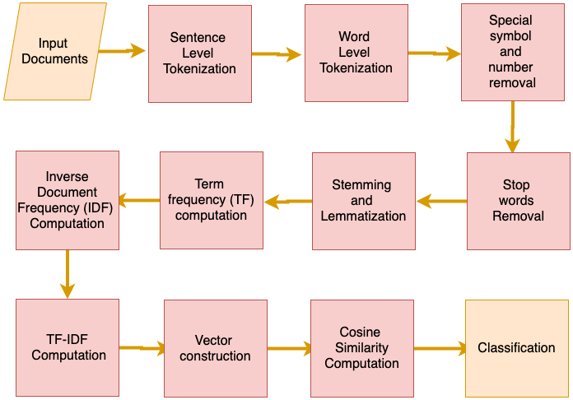
Methodology

Slide 8
Methodology: Preprocessing
'परिश्रम नगरी हुन्छ? परिश्रम सफलताको एक-मात्र बाटो हो। अक्सर जो परिश्रम गर्छ, उही सफल हुन्छ। अब त परिश्रम गर्छौ नि? नगरी कहाँ हुन्छ त महानगरपालिकाहरूमा!'
'परिश्रम नगरी हुन्छ?’,
'परिश्रम सफलताको एक-मात्र बाटो हो।', 'अक्सर जो परिश्रम गर्छ, उही सफल हुन्छ।', 'अब त परिश्रम गर्छौ नि?’,
'नगरी कहाँ हुन्छ त महानगरपालिकाहरूमा!'
Sentence tokenization
Lemmatization
Word tokenization
'परिश्रम’,
'नगर्’,
'परिश्रम’,
'सफल’,
'एक’,
'परिश्रम’,
'उही’,
'सफल’,
'परिश्रम’,
'गर्’,
'नगर्’
'नगर’
'परिश्रम’,
'नगरी’,
'परिश्रम’,
'सफलताको’,
'एकमात्र’,
'परिश्रम’,
'उही’,
'सफल’,
'परिश्रम’,
'गर्छौ’,
'नगरी’,
'महानगरपालिकाहरूमा'
'परिश्रम’,
'नगरी’,
'हुन्छ?’,
'परिश्रम’,
'सफलताको’,
'एक-मात्र’,
'बाटो’,
'हो।’,
'अक्सर’,
'जो’,
'परिश्रम’,
'गर्छ’,
'उही’,
'सफल’,
'हुन्छ।’,
'अब’,
'त’,
'परिश्रम', 'गर्छौ’,
'नि?’,
'नगरी’,
'कहाँ’,
'हुन्छ’,
'त', 'महानगरपालिकाहरूमा!'
Special symbols, numbers and stop words removal

Slide 9
Methodology: Lemmatization
Prerequisites
POS Tagger [6]
Wordbreaking Rules (Suffix and Prefix)
Affixes list (Suffix and Prefix)
Dictionary containing root words
[6] B. K. Bal, “Structure of Nepali Grammar,” Working Papers, p. 65.

Slide 10
Methodology: Lemmatization
Examples
Prefix set:
न|1
उप|2
महा|3
अ|4
सु|5
Suffix set:
यो|17
दा|18
द| 19
द| 19
पालका|20
Prefix rules:
3 PFX 1 महा महा
महा .
4 PFX 1 अ NEG
अ .
5 PFX 1 सुPTV
सु.
Suffix rules:
13 SFX 3 छु CHU N
◌ँछ .
न्छु.
14 SFX 2 छे प N
◌ँछ .
छे .
15 SFX 2 छौ CHAU N
◌ँछौ .
छौ .

Slide 11
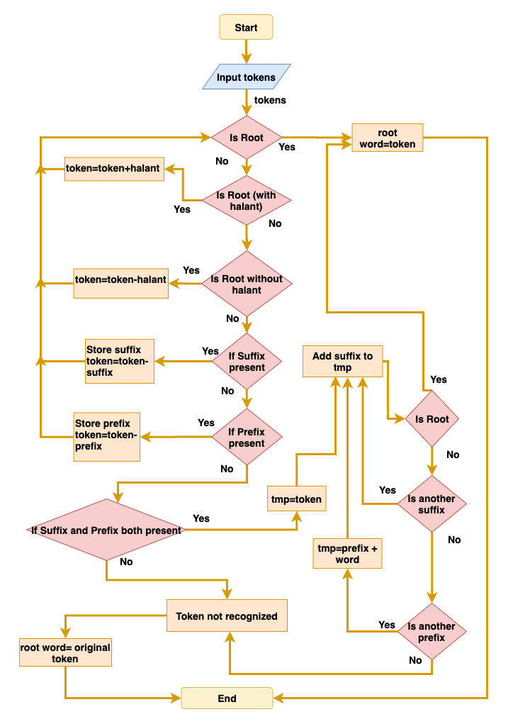
Methodology
Lemmatization Algorithm

Slide 12
Methodology: Lemmatization
Example:
Root Found:
Yes
No
Is Prefix present?
Is Suffix present?
Is Root?
Is Suffix present?
महानगरपालिका
पालिका
महानगरपालिकाहरू
महा
नगर
हरू
मा
महानगरपालिकाहरूमा
महानगर
Stripping suffix rule: 57
Suffix_del: मा
मा .
Stripping suffix rule:1
Suffix_del: हरू
हरू .
Stripping suffix rule:20
Suffix_del:पालिका
पालिका .
Stripping prefix rule:3
Prefix_del:महा
महा .
Notes:
'एकमात्र',

Slide 13
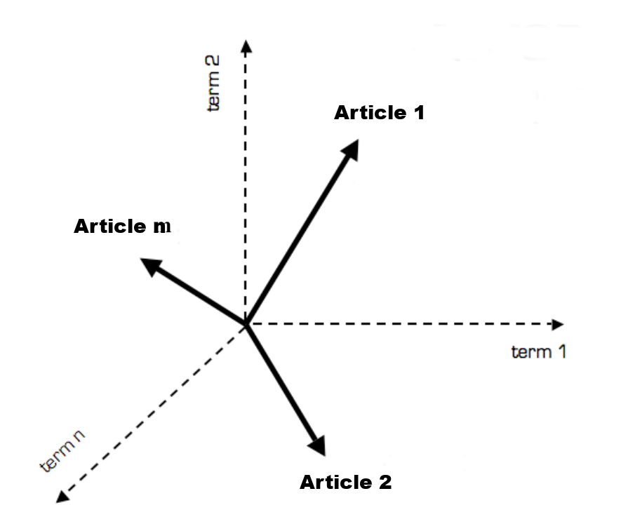
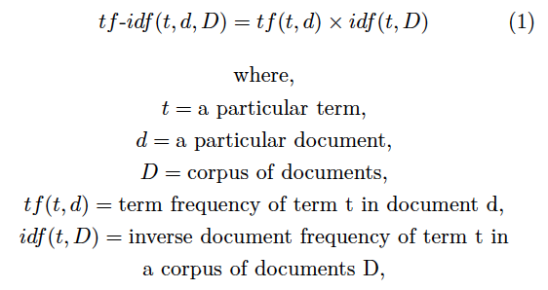
Methodology: Feature Vector
Term frequency – inverse document frequency (Tf-idf) vector
Vector space of artciles
Notes:
n – size of vocabulary in entire collection of documents

Slide 14
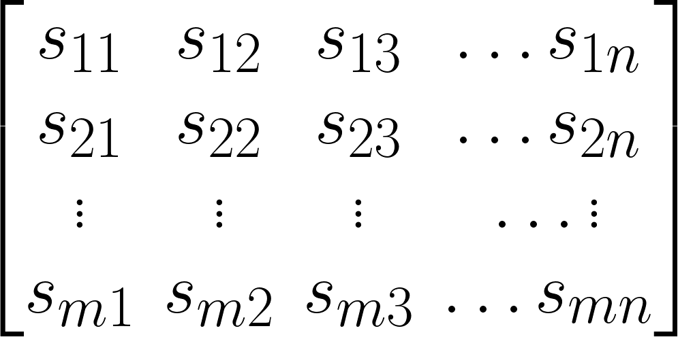
Methodology: Feature Vector
Term frequency – inverse document frequency (Tf-idf) vector
[{ t₁: tf-idf (t₁, d₁, D),
t₂ : tf-idf (t₂, d₁, D),
.
.
t_{n1} : tf-idf (t_{n1}, d₁, D)}
{ t₁: tf-idf (t₁, d₂, D),
t₂ : tf-idf (t₂, d₂, D),
.
.
t_{n2} : tf-idf (t_{n2}, d₂, D)}
{ t₁: tf-idf (t₁, d_{m}, D),
t₂ : tf-idf (t₂, d_{m}, D),
.
.
t_{nm} : tf-idf (t_{n3}, d_{m}, D)}]
,
, …
Token 1
Token 2
Token 3
Token n
Article 1
Article 2
Article m
Notes:
n – size of vocabulary in entire collection of documents

Slide 15
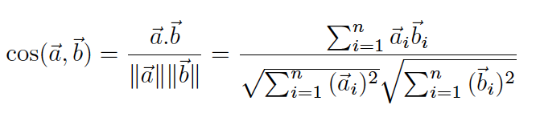

Methodology: Classification
Cosine similarity
For each pair of articles:
If , then class = plagiarised
Else, class = non-plagiarised
$$\cos\left(\vec{a}, \vec{b}\right)≥0.25$$

Slide 16
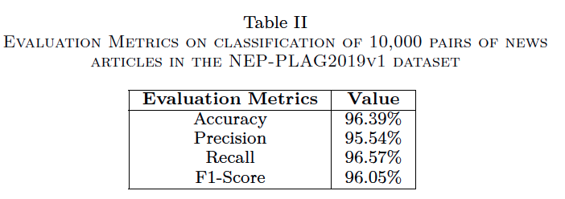
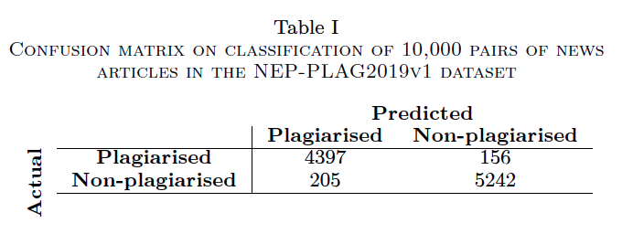
Results
NEP-PLAG2019v1Dataset
Total – 10,000 pairs of Nepali news articles
Plagiarised - 4,553 pairs
Non-plagiarized – 5,447 pairs

Slide 17
Discussion
Why better for Nepali texts?
Both prefix and suffix rules applied recursively
Handles uniqe cases of changes in Nepali texts
Includes POS tag dependency on stemming
Higher chances of returning a valid root word
Notes:
defining both prefix and suffix rules, which are applied recursively until the root word is obtained.
The approach can handle any unique cases of changes in the vowel or consonant, specific to Nepali texts as well.
Likewise, including the POS tags in the rule adds the ability to apply different rules to the words with consideration to the POS of the word in the sentence.
Improvements have been made to ensure that the root word is almost always valid by using a dictionary to perform lemmatization.
Valid root word -> better features for plagiarism

Slide 18
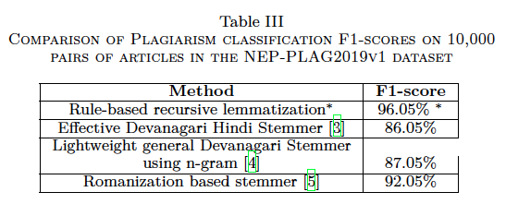
Discussion
Comparison
[3] D. MONIKA, T. ABHISHEK, and M. UPENDRA, “An effective stemmer in Devanagari script,” Hamirpur, India, Apr. 2013, pp. 22–25. [Online]. Available: https://www.seekdl.org/conferences/paper/details/1309.html
[4] S. R. Dangui and N. Naik, “A Lightweight Stemmer for Devanagari Script,” in Proceedings of the 8th Annual ACM India Conference, ser. Compute ’15. New York, NY, USA: Association for Computing Machinery, Oct. 2015, pp. 55–62. [Online]. Available: http://doi.org/10.1145/2835043.2835061
[5] B. P. Pande, P. Tamta, H. S. Dhami, and S. Campus, “A Devanagari Script based Stemmer,” p. 12.

Slide 19
Conclusion
Significance
Custom recursive rules for preprocessing Nepali texts
Accounted for complex syntactic and grammatical structures
Higher F1-score in plagiarism detection of Nepali texts
Preprocessing useful in other NLP tasks

Slide 20
Limitations and Future Work
Limitations
Non-robust and language dependent
Semantic and contextual information not used
Future plans
Replace Tf-idf by embedding models: word2vec or BERT
Notes:
algorithm’s non-robust nature since the grammatical and syntactic rules required in this algorithm need to be defined manually, which is dependent on the language completely.
Similarity based on only frequency. Likewise, the semantic and contextual information in the texts is not considered, which may reduce the performance in a large dataset.
In the future, we plan to overcome the current limitation by incorporating semantic and contextual information during the computation of the similarity measures by using deep learning approaches to capture the context of the words instead of relying on the frequency entirely.

Slide 21
Questions?
Ayush Kumar Shah ayush.shah@mail.rit.edu

