Slide 1
Vision Transformer (ViT)
Aaryan Gupta 19D070001
Adit Akarsh 19D070003
Ayush Munjal 19D070014
Vipin Singh 19D070069

Slide 2
Transformers
Self-attention based architecture
Extensively used in NLP
Eschews recurrence and instead relies entirely on an attention mechanisms to draw global dependencies between input and output

Slide 3
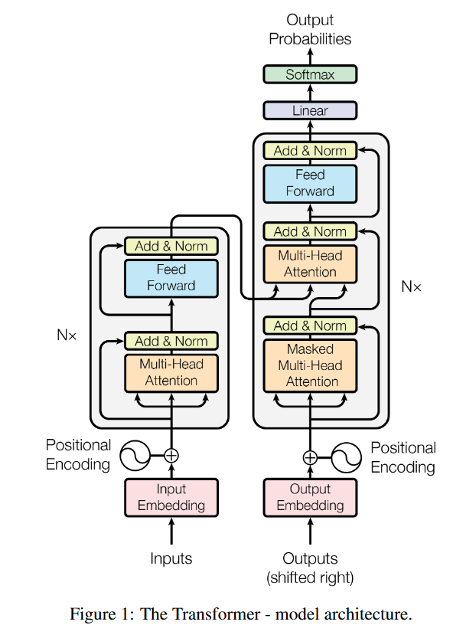
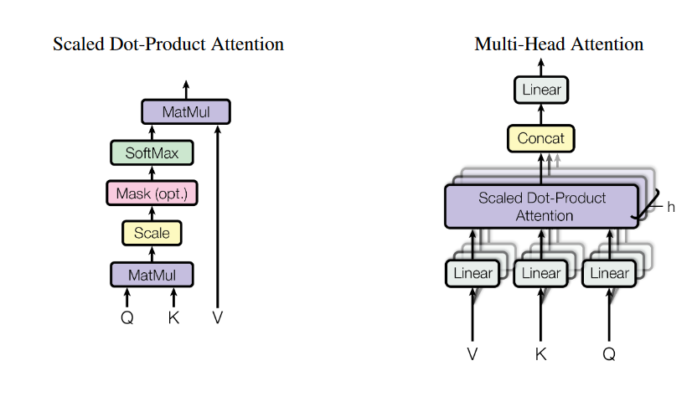
Transformer architecture

Slide 4
Transformer architecture
Encoder maps an input sequence of symbol representations (x1,...,xn) to a sequence of continuous representations z = (z1,...,zn).
Given z, the decoder then generates an output sequence (y1,...,ym) of symbols one element at a time

Slide 5
Attention
An attention function can be described as mapping a query and a set of key-value pairs to an output, where the query, keys, values, and output are all vectors.
The output is computed as a weighted sum of the values, where the weight assigned to each value is computed by a compatibility function of the query with the corresponding key.

Slide 6
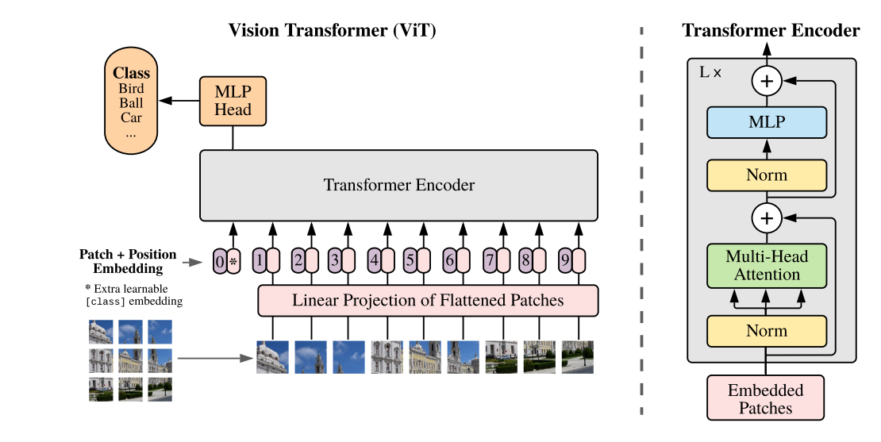
Vision Transformer

Slide 7
Inspired by the Transformer scaling successes in NLP, we experiment with applying a standard Transformer directly to images, with the fewest possible modifications.
To do so, we split an image into patches and provide the sequence of linear embeddings of these patches as an input to a Transformer. Image patches are treated the same way as tokens (words) in an NLP application. We train the model on image classification in supervised fashion.
z₀ = [x_{class}; x¹_{p}E; x²_{p}E; · · · ;x^{N}_{p}E] + E_{pos}
z’_{l} = MSA(LN(z_{l-1})) + z_{l-1}
z_{l} = MLP(LN(z’_{l})) + z’_{l}
y = LN(z⁰_{L})
Typically, we pre-train ViT on large datasets, and fine-tune to smaller tasks.

Slide 8
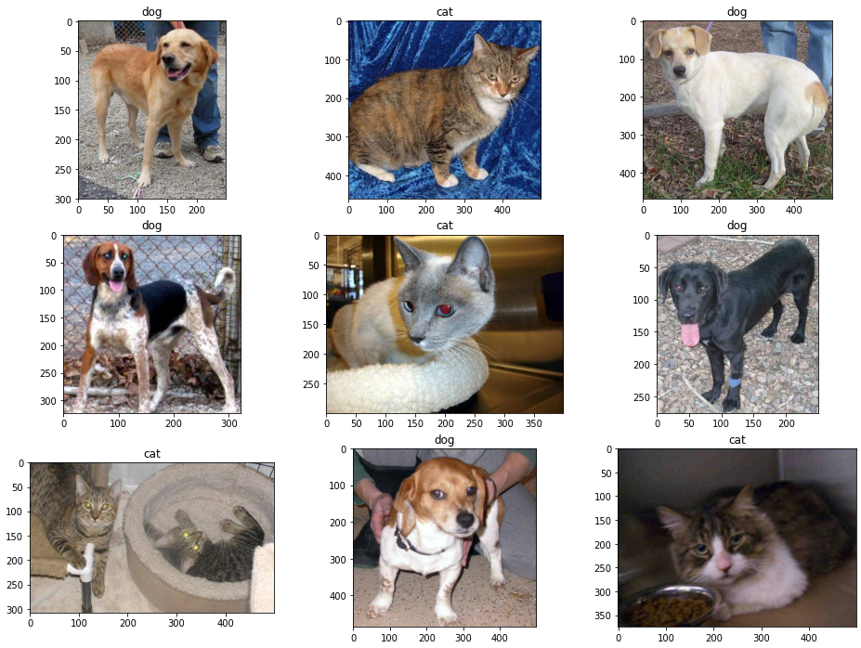
Random plots generated from test dataset

Slide 9
Training and Testing the model
We ran our model for 30 epochs with the following hyperparameters:
Batch size = 64
Learning rate = 9*10⁻⁵
Gamma = 0.7
Seed = 42
from this we got test accuracy of 70.53%.

Slide 10
EXPERIMENTS
Here, the representation learning capabilities of ResNet, Vision Transformer (ViT) and hybrid have been evaluated. Models are pre-trained on various datasets of different sizes. Also an experiment is performed using self-supervision to show that ViT proves to be promising in the future.
3 datasets have been used: ImageNet (small), ImageNet-21k, JFT-300M (large).
Model Variants:
ViT (Base, Large & Huge) : Notation involves the model size & the input patch size. Ex:ViT-L/16 indicated large model with 16x16 input patch size.
For baseline CNNs, ResNet has been used but the Batch Normalization layers is replaced with Group Normalization & standardized convolutions which improve transfer. Modified model is denoted as ResNet (BiT).
For hybrids, the intermediate feature maps are fed into ViT with patch size of one “pixel”.

Slide 11
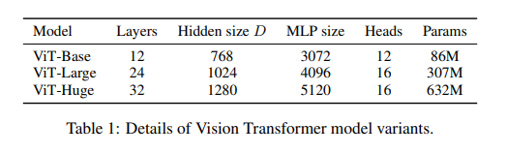
Training & Fine-tuning
All models are trained using Adam with β1 = 0.9, β2 = 0.999, a batch size of 4096 and apply a high weight decay of 0.1, which was found to be useful for transfer of all models.
For fine-tuning we use SGD with momentum, batch size 512, for all models.
Metrics
Results are reported on downstream datasets either through few-shot or fine-tuning accuracy. Though we mainly focus on fine-tuning performance, we sometimes use linear few-shot accuracies for fast on-the-fly evaluation where fine-tuning would be too costly.

Slide 12
Comparison to State of the Art
Our largest models - ViT-H/14 and ViT-L/16 are compared to state of the art CNNs from the literature:
Currently, Noisy Student, which is a large EfficientNet trained using learning, is the state of the art on ImageNet.
Big Transfer (BiT-L), which performs supervised transfer learning on large ResNets, is the state of the art on the other datasets.
Comparison of our models with CNNs show the following results:
The smaller ViT-L/16 model pre-trained on JFT-300M outperforms BiT-L on all tasks, while requiring substantially less computational resources to train.
The larger model, ViT-H/14, further improves the performance, especially on the more challenging datasets – ImageNet, CIFAR-100, and the VTAB suite.

Slide 13
Pre-Training Data Requirements
The Vision Transformer performs well when pre-trained on large JFT-dataset. To determine how crucial is the dataset size, two series of experiments are performed.
Pre-train ViT models on datasets of increasing size: ImageNet, ImageNet-21k, JFT-300M. ViT-Large models underperform ViT-Base models on small ImageNet dataset, show similar performance with ImageNet-21k, and only with the JFT-dataset do we see the full benefit of the larger models.
Models are trained on random subsets of 9M, 30M, and 90M as well as the full JFT300M dataset. No additional regularization is done for the smaller subsets (same hyper parameters for all settings). This way, we assess the intrinsic model properties, and not the effect of regularization. Results show that Vision Transformers overfit more than ResNets with comparable computational cost on smaller datasets.

Slide 14
Scaling Studies
A controlled scaling study for different models is performed by evaluating transfer performance from JFT-300M dataset. In the above setting, data size does not bottleneck the model performance.
Following model sets were used for the experiment:
7 ResNets, R50x1, R50x2 R101x1, R152x1, R152x2, pre-trained for seven epochs, and R152x2 and R200x3 pre-trained for 14 epochs
6 Vision Transformers, ViT-B/32, B/16, L/32, L/16, pre-trained for seven epochs, and L/16 and H/14 pre-trained for 14 epochs
five hybrids, R50+ViT-B/32, B/16, L/32, L/16 pre-trained for seven epochs, and R50+ViT-L/16 pre-trained for 14 epochs.

Slide 15
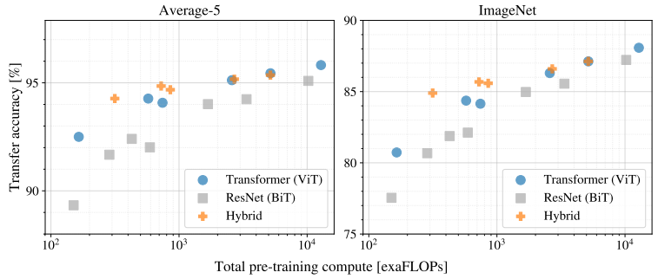
Performance v/s Computation Cost

Slide 16
Following patterns were observed:
ViT dominated ResNets on the performance-computation trade-offs. ViT used about 4x times less computation power than ResNets to attain the same performance.
Hybrids slightly outperformed ViT at small computation budgets, but the difference vanishes for large models.
The ViT models did not saturate at the tried ranges of data, motivating future scaling of data.

Slide 17
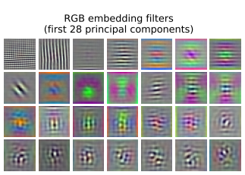
Inspecting Vision Transformer
First layer: Projects the flattened patches into a lower-dimensional space. The figure given below shows the top principal component of the learned embedding filters, and the components resemble plausible basis functions for a low-dimensional representation of the fine structure within each patch.

Slide 18
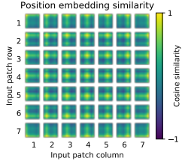
After the above mentioned projection, a learned position embedding is added to the patch representation. The figure given below shows that the model learns to encode distance within the image in the similarity of position embeddings.

Slide 19
Conclusion
Direct application of transformers to image recognition is explored in this experiment. Models based on self-attention in computer images generally involve the introduction of image-specific induction biases in the architecture; however, in this experiment, images are interpreted as a sequence of patches and are processed through a transformer encoder similar to NLP. By coupling this simple strategy with pre-training on large datasets, improved accuracy is observed. Thus, Vision Transformers matches or exceeds state-of-the-art on many image classification datasets while being relatively cheap to pre-train.
Though the results are encouraging, applying ViT to image segmentation and detection is a challenging task. In the experiment, with the increase in scaling, the ViT did not show saturation in performance, and hence further scaling is possible.

Slide 20
Thank You

