Slide 1
Federated Learning for Pest Classification
EE 451 - Supervised Research Exposition
Ayush Munjal, 19D070014
Guided By Prof. Rajbabu Velmurugan
Department of Electrical Engineering
Indian Institute of Technology Bombay, Mumbai

Slide 2
Contents
Introduction
Literature Survey:
Federated Learning - Challenges, Methods and Future Directions
Decentralized Federated Learning - A Segmented Gossip Approach
Multiple diseases and pest detection based on federated learning and faster r-cnn
Comparison of federated learning algorithms

Slide 3
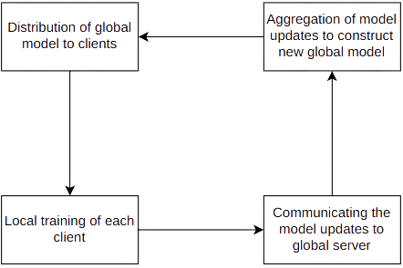
Federated Learning
Shared machine learning
Client data is not shared with anyone
Helps in model generalization
Helps in learning complex models
Common applications
Industry 4.0
Autonomous driving
Smart home
Virtual reality

Slide 4
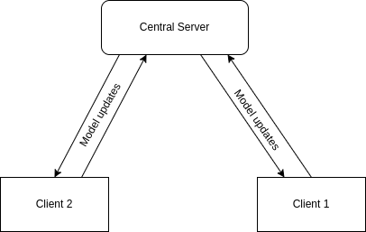
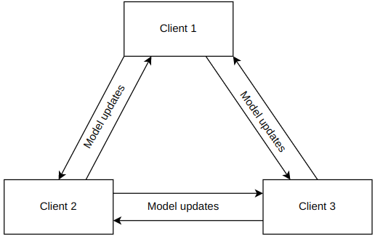
Different types of Federated Learning
Centralized Federated Learning
Decentralized Federated Learning

Slide 5
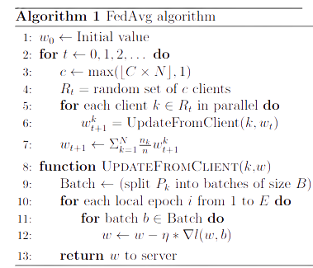
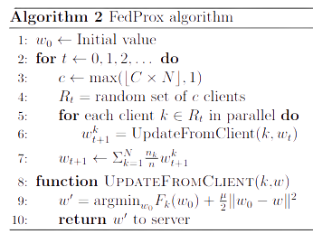
Centralized Federated Learning algorithms

Slide 6

Federated Learning - Challenges, methods and future directions
This paper discuss about major challenges faced in federated learning setup and methods to overcome them
Federated learning is defined mathematically as
where m is total number of clients, p_{k} is relative impact of each client on global model and F_{k}(w) is local objective function of each client
References: T. Zhang, L. Gao, C. He, M. Zhang, B. Krishnamachari, and S. Avestimehr, “Federated Learning for Internet of Things: Applications, Challenges, and Opportunities,” CoRR, vol. abs/2111.07494, 2021,

Slide 7
Major challenges faced in federated learning
Expensive communication:
Due to large number of devices in the federated network
Can be reduced by reducing total number of rounds and size of messages transmitted at each round
Systems heterogeneity:
Devices differ in a lot of ways storage capacity, computational limits, communication capabilities
Only a fraction of total devices work at any moment
Statistical heterogeneity: Data between devices is generally non-i.i.d
Privacy concern
References: T. Zhang, L. Gao, C. He, M. Zhang, B. Krishnamachari, and S. Avestimehr, “Federated Learning for Internet of Things: Applications, Challenges, and Opportunities,” CoRR, vol. abs/2111.07494, 2021,

Slide 8
Solutions used for these challenges
For expensive communication:
Local updating
Compression schemes
Decentralized training
For systems heterogeneity:
Asynchronous communication
Active sampling
Fault tolerance
For statistical heterogeneity:
Modelling heterogeneous data using meta learning and multitask learning
FedProx
For privacy preservation: Cryptographic algorithms
References: T. Zhang, L. Gao, C. He, M. Zhang, B. Krishnamachari, and S. Avestimehr, “Federated Learning for Internet of Things: Applications, Challenges, and Opportunities,” CoRR, vol. abs/2111.07494, 2021,

Slide 9
Multiple diseases and pest detection based on federated learning and faster r-cnn
Pest detection using federated learning and faster r-cnn
Federated learning helps in overcoming
Data constraints
Communication costs
FedAvg algorithm improved to give better results
References: F. Deng, W. Mao, Z. Zeng, H. Zeng and B. Wei, "Multiple Diseases and Pests Detection Based on Federated Learning and Improved Faster R-CNN,"

Slide 10
Problem
Multiple orchard farms
Different orchards based on different geographical locations
Data of each orchard is unbalanced and insufficient
References: F. Deng, W. Mao, Z. Zeng, H. Zeng and B. Wei, "Multiple Diseases and Pests Detection Based on Federated Learning and Improved Faster R-CNN,"

Slide 11
Approach used: Federated learning
Centralized federated learning used
FedAvg gives better results when data characteristics are similar
FedAvg does not give good convergence for unbalanced data
Improved FedAvg algorithm by adding a restriction term to client’s loss function
Allows each client model to differ from the global model
References: F. Deng, W. Mao, Z. Zeng, H. Zeng and B. Wei, "Multiple Diseases and Pests Detection Based on Federated Learning and Improved Faster R-CNN,"

Slide 12
Approach used: CNN architecture
Faster R-CNN model uses VGG CNN but this doesn’t provide good accuracy due to gradient explosion and gradient dispersion
VGG CNN replaced by ResNet-101 architecture
First 92 layers of RestNet-101 are for feature extraction
Remaining 9 layers for target detection
L2-normalization used due to large size difference in feature maps
References: F. Deng, W. Mao, Z. Zeng, H. Zeng and B. Wei, "Multiple Diseases and Pests Detection Based on Federated Learning and Improved Faster R-CNN,"

Slide 13
Approach used: Online Hard Example Mining
An effective method to improve the detection accuracy of CNNs
Re-enters difficult cases to the network to improve the performance
Loss values calculated and then sorted from large to small
First K maximum loss values are selected as difficult cases and added to network for further training
References: F. Deng, W. Mao, Z. Zeng, H. Zeng and B. Wei, "Multiple Diseases and Pests Detection Based on Federated Learning and Improved Faster R-CNN,"

Slide 14
Results obtained in the paper
Model can accurately identify diseases in full fruit diseases while not misclassifying the good fruits nearby
Each orchard was able to recognize all diseases while some diseases were missing from each orchard dataset:
Generalization achieved due to federated learning
References: F. Deng, W. Mao, Z. Zeng, H. Zeng and B. Wei, "Multiple Diseases and Pests Detection Based on Federated Learning and Improved Faster R-CNN,"

Slide 15
Experiment
This experiment aims to compare the performance of two major federated learning algorithms FedAvg and FedProx
First the variation of accuracy of these algorithms are tested against various parameters involved in the algorithms
Then the accuracy is compared of these algorithms for same parameter settings

Slide 16
Dataset used
The dataset used to evaluate performance of FedAvg and FedProx algorithms is MNIST dataset
MNIST is a dataset of handwritten digits from 0 to 9
It is widely used in computer vision and deep learning
It is a dataset of 60,000 small square 28*28 pixel grayscale images

Slide 17
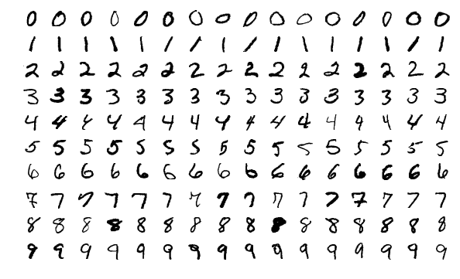
Some of the images from MNIST dataset are shown below
Source: MnistExamples.png (594×361) (wikimedia.org)

Slide 18
Statistical Heterogeneity
As we can see from the previous image, different labels in MNIST dataset corresponds to different handwriting style
This is quite obvious given that different label belongs to handwriting of different person
Thus the MNIST data follows statistical heterogeneity property
Therefore the data on which we will be evaluating our results follows non-i.i.d distribution
This will lead to more generalization in comparison of the algorithms

Slide 19
Experiment setup
The accuracy of these algorithms is tested for various metrics like:
Number of clients
Client learning rate
Global server learning rate
Number of epochs of clients
Total number of rounds
Proximal strength

Slide 20
First variation of accuracy of FedAvg algorithm is studied with variation in number of epochs and total number of rounds in the algorithm
Total number of rounds is the total iterations carried at global server for update
Number of epochs is the number of iterations carried out at every device for one global round
Results are as shown below for same number of clients = 4, learning rate of server = 1, learning rate of clients = 0.02
Number of epochs | Total rounds | Categorical accuracy
5 | 10 | 30.0%
5 | 20 | 56.7%
10 | 10 | 54.2%
10 | 20 | 81.6%

Slide 21
First variation of accuracy of FedAvg algorithm is studied with variation in learning rate of client and global server
Learning algorithm used at both clients and global server is Stochastic Gradient Descent (SGD)
Results are shown below for same number of clients = 4, same number of epochs =10 and total rounds = 20
Server Optimizer | Client Optimizer | Categorical accuracy
1 | 0.02 | 81.6%
1.5 | 0.02 | 89.0%
1 | 0.05 | 51.8%

Slide 22
First variation of accuracy of FedProx algorithm is studied with variation in number of epochs and total number of rounds in the algorithm and proximal strength
Proximal strength is the lambda term in FedProx algorithm
Results are as shown below for same number of clients = 4, learning rate of server = 1, learning rate of clients = 0.02
Number of epochs | Total rounds | Proximal strength | Categorical accuracy
5 | 10 | 1 | 33.7%
5 | 20 | 0.5 | 38.0%
10 | 10 | 1.5 | 42.0%
10 | 10 | 2.0 | 46.3%
10 | 20 | 2.0 | 93.3%

Slide 23
Now accuracy of FedAvg and FedProx for different number of clients keeping all other parameters equal
Number of clients | FedAvg accuracy | FedProx accuracy
4 | 81.6% | 93.3%
8 | 78.1% | 91.9%
16 | 75.5% | 89.3%

Slide 24
Observations
Accuracy of both algorithms increase if total number of rounds and number of epochs are increased keeping other parameters same
As proximal strength increase accuracy of FedProx algorithm increases significantly
As number of clients increase accuracy of both algorithms drop
For same parameters FedProx gives better accuracy than FedAvg

Slide 25

Gboard
Uses centralized federated learning
Encrypted communication
Ensures privacy
Provides smarter models, low latency and less power consumption
FedAvg type algorithm
Compression of model updates
References: https://ai.googleblog.com/2017/04/federated-learning-collaborative.html

Slide 26
References
A. Imteaj, U. Thakker, S. Wang, J. Li and M. H. Amini, "A Survey on Federated Learning for Resource-Constrained IoT Devices," in IEEE Internet of Things Journal, vol. 9, no. 1, pp. 1-24, 1 Jan.1, 2022, doi: 10.1109/JIOT.2021.3095077.
T. Li, A. K. Sahu, A. Talwalkar and V. Smith, "Federated Learning: Challenges, Methods, and Future Directions," in IEEE Signal Processing Magazine, vol. 37, no. 3, pp. 50-60, May 2020, doi: 10.1109/MSP.2020.2975749.
H. B. McMahan, E. Moore, D. Ramage, S. Hampson, and B. A. y Arcas, “Communication-Efficient Learning of Deep Networks from Decentralized Data,” 2016.
F. Deng, W. Mao, Z. Zeng, H. Zeng and B. Wei, "Multiple Diseases and Pests Detection Based on Federated Learning and Improved Faster R-CNN," in IEEE Transactions on Instrumentation and Measurement, vol. 71, pp. 1-11, 2022, Art no. 3523811, doi: 10.1109/TIM.2022.3201937.

Slide 27
Hu, Chenghao & Jiang, Jingyan & Wang, Zhi. (2019). Decentralized Federated Learning: A Segmented Gossip Approach.
T. Gafni, N. Shlezinger, K. Cohen, Y. C. Eldar, and H. V. Poor, “Federated Learning: A signal processing perspective,” IEEE Signal Processing Magazine, vol. 39, no. 3, pp. 14–41, May 2022, doi: 10.1109/msp.2021.3125282.
T. Zhang, L. Gao, C. He, M. Zhang, B. Krishnamachari, and S. Avestimehr, “Federated Learning for Internet of Things: Applications, Challenges, and Opportunities,” CoRR, vol. abs/2111.07494, 2021, [Online]. Available: https://arxiv.org/abs/2111.07494
https://ai.googleblog.com/2017/04/federated-learning-collaborative.html

Slide 28
Thank You!

