Slide 1


The JEE Advanced mock test website serves as an essential resource for students preparing for the JEE Advanced examination. It offers a user-friendly interface that allows candidates to simulate real exam conditions through mock tests. The website is designed to enhance the learning experience by providing various resources to help students understand their strengths and weaknesses.

Slide 2

OUR TEAM: -
Jenil Prajapati – U24CS107
Vineet Gupta – U24CS117
Ayushman Singh – U24CS103

Slide 3
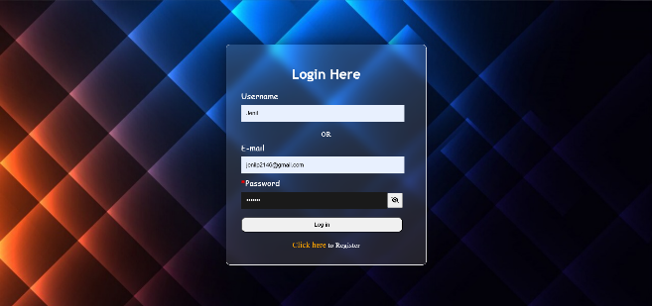
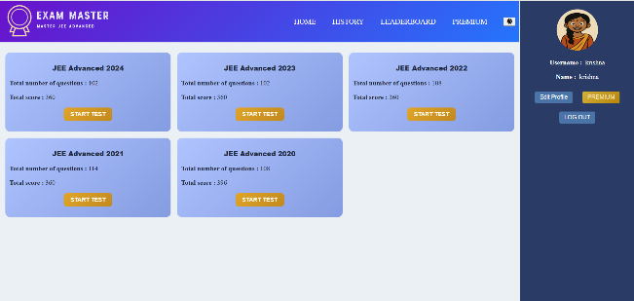
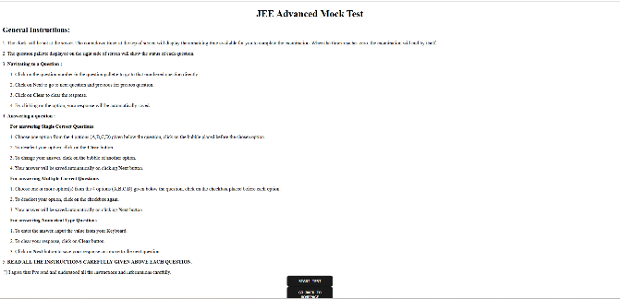
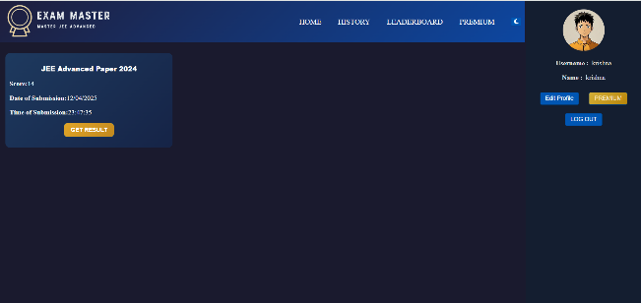
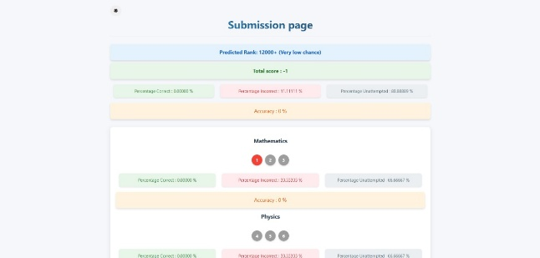
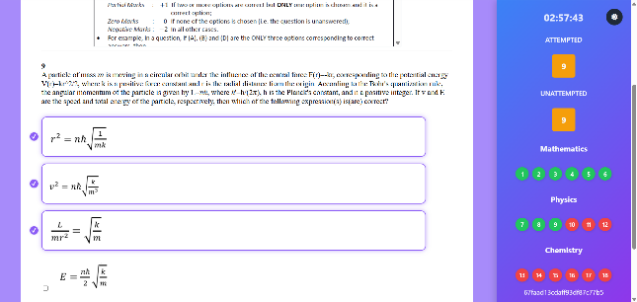
Redirected
to Home
Page
User
redirected
To Instruction
after starting
test
Login Page
Home Page
Flow Diagram
Of Website
After reading instructions user redirected to question page
User can access
their history after
test

Slide 4

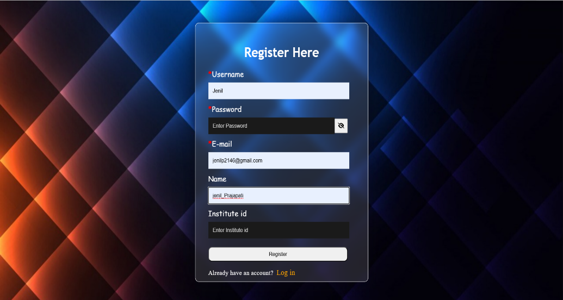
1. Login/Register Page
Login Page
Register Page
User can login through username/e-mail and password. Password validation
is done through Vanilla JS (Frontend). Uniqueness of username is also handled through
Backend.
Highlight - Each institute will have their own unique institute id which will be shared to users
of that institute.

Slide 5

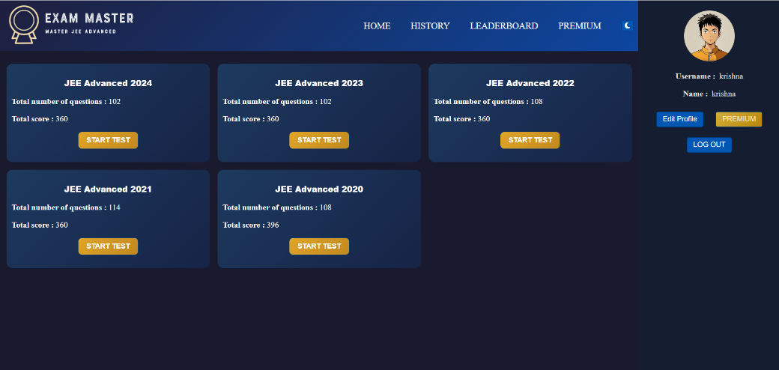
2. Home Page
Light Mode
Dark Mode
1. Home Page contains four sections in nav bar namely History, Leaderboard, Resources and Premium.
2. User can also switch modes.
3. User can also edit profile avatar and their name.
4. User can start test by clicking on ‘Start Test’ option provided in Test Card.

Slide 6
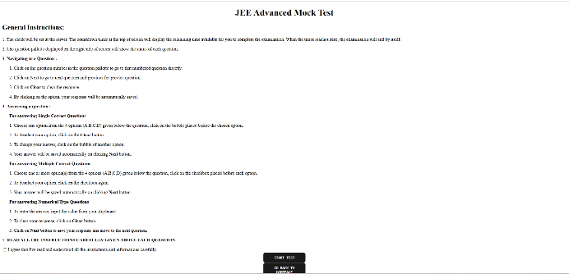
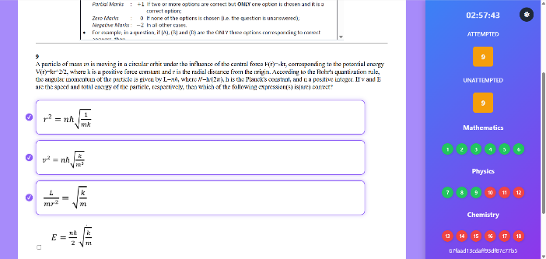
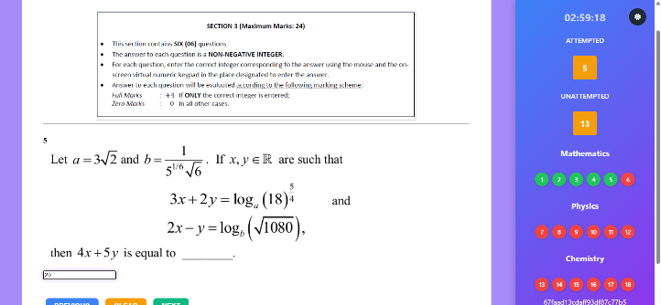
3. Question Page
Instruction Page
Multiple Correct Type
Numerical Value Type
1. Instruction page is displayed before starting test in which user read and agree to all the instructions.
2. After clicking on checkbox, user is redirected to question page. It contains instructions above each questions.
3. This contains questions of three types namely Single Correct Questions (SCQs), Multiple Correct Questions
(MCQs) and Numerical questions.
4. User can select NEXT, CLEAR and PREVIOUS options.
5. User can navigate directly to any question using question number given in side palette.

Slide 7
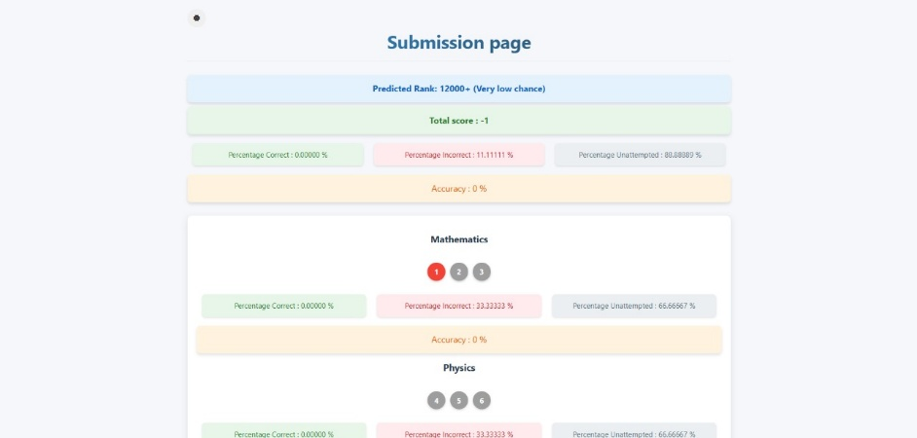
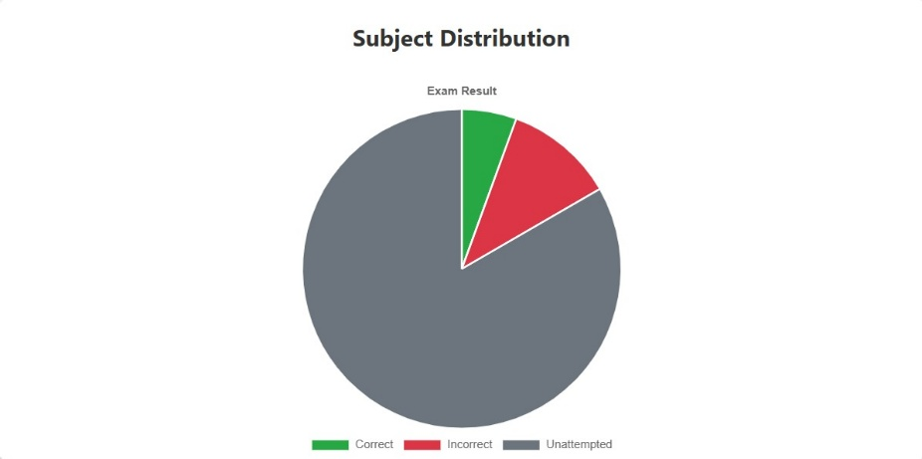
4. Submission Page
Submission Page
Attempt status Graph
1. Contains Total score, %age Correct, %age Incorrect, and Accuracy.
2. SPECIAL FEATURE :- Gives Predicted Rank on the basis of previous year records.
3. Subject-wise analysis
4. Attempt Status Graph

Slide 8
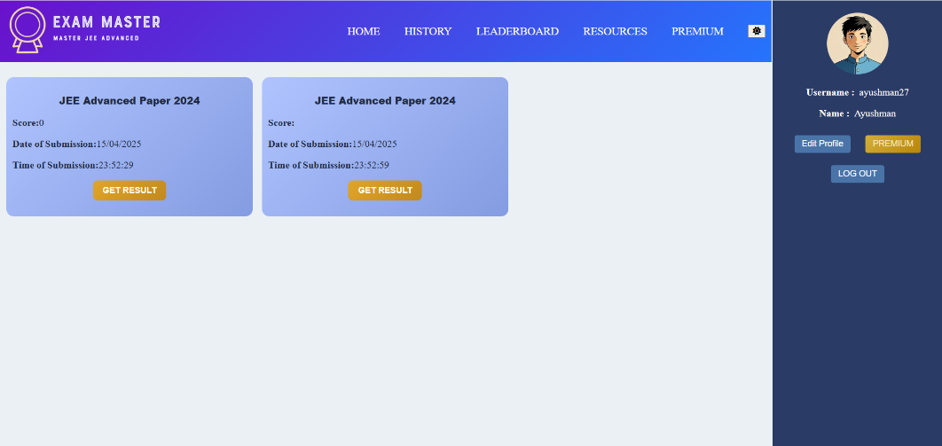
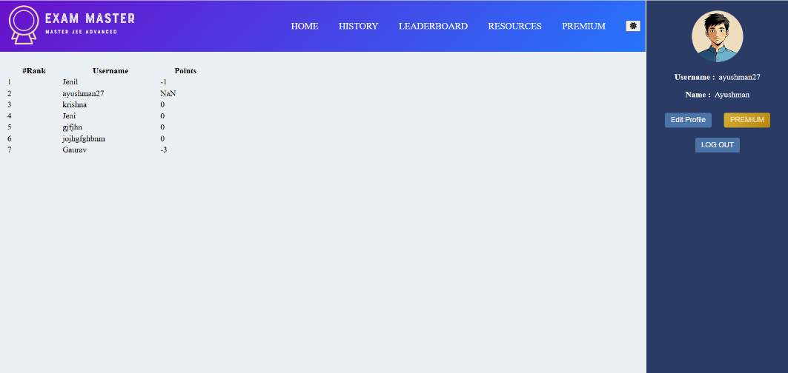
5. History and Leaderboard
History
Leaderboard
1. History page contains user records.
2. Leaderboard provides you ranking based on all the tests given.

Slide 9
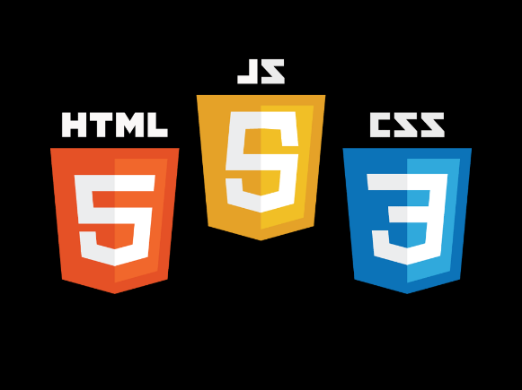






TECH STACK
Front-end
Back-end
Database

Slide 10
Express JS
In this website, Express serves as the backbone for routing, middleware integration, and handling HTTP requests and responses, thus facilitating a fast and organized structure for the application.
Node JS
NodeJS is a runtime environment for executing JavaScript outside the browser. It enables server-side development, supports asynchronous, event-driven programming.
EJS
EJS is a simple templating language that lets you generate HTML markup with plain JavaScript. It is designed to simplify the process of rendering dynamic content in web applications.
Axios
In this website, Axios is utilized to fetch data from various resources, ensuring that users receive up-to-date information seamlessly and enhancing the overall user experience.
Mongoose
Mongoose is an ODM (Object Data Modeling) library for MongoDB and Node.js, enabling schema-based modeling. Mongoose is used to interact with the database, allowing for efficient query management and data storage.
MongoDB
MongoDB is a powerful, open-source NoSQL database that offers a document-oriented data model, providing a flexible alternative to traditional relational databases.

Slide 11
Thank You !

