Slide 1
ML Project Presentation
Project Category: Email Spam Prediction
Roll No.: 1901049
Name: Ayushman Singh Chauhan
Institute Name: Indian Institute of Information Technology Guwahati

Slide 2

Outline
Introduction
Objectives
LITERATURE Survey / REVIEW
Data understanding / Description
NAÏVE BAYS CLASSIFIER
Results
Conclusion
Novelty

Slide 3
Introduction / Problem definition
Spam e-mails can be not only annoying but also dangerous to consumers.
❖ Unwanted e-mails irritating internet connection
Critical e-mail message are missed and / or delayed.
Millions of compromised computers
Billions of dollars lost worldwide
Identity theft
Spam can crash mail servers and fill up hard drives

Slide 4
The objective of identification of Spam e-mails are :
To give knowledge to the user about the fake e-mails and relevant e-mails
To classify that mail spam or not.
Objective
Spam e-mails can be defined as :
Anonymity
Mass Mailings
Unsolicited:
Spam e-mail are message randomly sent to multiple addressees by all sorts of groups, but mostly lazy advertisers and criminals who wish to lead you to phishing sites.

Slide 5
LITERATURE Survey / REVIEW
I consulted from articles below that are all after year 2019
Paper-1: [Email classification via intention-based segmentation] (https://sci-hub.mksa.top/10.23919/eecsi50503.2020.9251306)
Paper-2: [Feature Extraction aligned Email Classification based on Imperative Sentence Selection through Deep Learning] (https://iecscience.org/uploads/jpapers/202108/rvRUTTmGYo1MiJ86KpRHOop8SqW8HWawp2xvrkn0.pdf)
Paper-3: [Email Classification Research Trends: Review and Open Issues] (https://ieeexplore.ieee.org/stamp/stamp.jsp?tp=&arnumber=7921698)
Paper-4: [Classification Of Power Relations Based On Email Exchange](https://sci-hub.mksa.top/10.1109/gucon48875.2020.9231072)

Slide 6
Initial Dataset: Enron-Email-Dataset
Enron Email Dataset downloaded from : https://www.cs.cmu.edu/~enron/. And it is the May 7, 2015 Version of dataset.This email set is a gzipped tar file of emails stored in directories.
This generates the following directory structure:
maildir
- $userName subdirectories for each user
- $folderName subdirectories per user
-mail messages in folder or additional subfolders This directory structure contains over 500,000 small mail files without attachments. These files all have the following layout:
Message-ID: 31335512.1075861110528.JavaMail.evans@thyme
Date: Wed, 2 Jan 2002 09:26:29 -0800 (PST)
From: sender@test.com
To: rec1@test.com,rec2@test.com Cc: Bcc: Subject: Kelly Webb ... Message Body Some headers like To, Cc and Bcc or Subject can also be multiline values.
Data understanding / Description

Slide 7
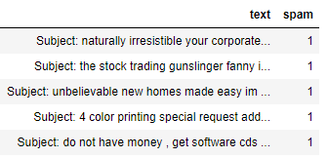
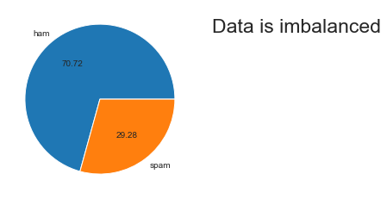
The new dataset contains two columns. The descriptive feature consists of text. The target feature consists of two classes ham and spam, the column name is spam. The classes are labeled for each document in the data set and represent our target feature with a binary string-type alphabet of {ham; spam}. Classes are further mapped to integer 0 (ham) and 1 (spam).
Spam email percentage in the dataset = 29.88268156424581 %
Ham email percentage in the dataset = 70.11731843575419 %

Slide 8
Best Resust by : NAÏVE BAYS CLASSIFIER
NAÏVE BAYS CLASSIFIER Simple probabilistic classifier that calculates a set of probabilities by counting the frequency and combination of values in a given dataset.
Represent as a vector of feature values.
It is very useful to classify the e-mails properly
The precision and recall of this method is known to be very effective

Slide 9
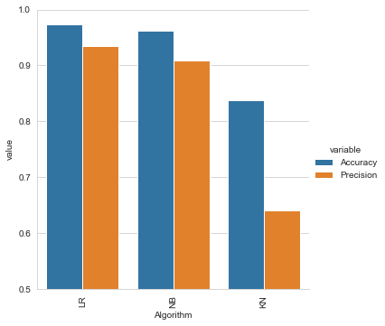
Results (in brief) and analysis of results
Results (in brief) is :
and analysis of results is in my excel file [Ayushman_1901049_Project_Result_Analysis.xlsx]..

Slide 10
• We are able to classify the emails as spam or non-spam. With high number of emails lots if people using the system it will be difficult to handle all possible mails as our project deals with only limited amount of corpus.
CONCLUSION

Slide 11
Novelty
● My project is Heroku Deployed
● Launch my Project (https://email-spam-cassifier.herokuapp.com/)

Slide 12
Thank You

