Slide 1
MLLP EXPERIENTIAL LEARNING GROUP ASSIGNMENT
Image Caption
Generator
Image-to-text description generation using BLIP
PROJECT TEAM
Shourya Basu
Manit Kumar Sahu
2330400-Basu
2430605-Manit
Ayushman Mahapatra
Shrutik Sinha
2330020-Ayushman
2330404-Shrutik
Topic 16 | Submission deadline: 12 November 2026
Notes:
Introduce the four group members and the selected MLLP topic.
Project title: Image Caption Generator, using the Salesforce BLIP base image-captioning checkpoint.

Slide 2
01 PROBLEM AND OBJECTIVE
Images need a useful text description
PROBLEM
OBJECTIVE
A photo can be difficult to search, review, or understand without a short text equivalent.
Upload one image and generate one concise English caption with a pretrained vision-language model.
PROJECT SCOPE
Local inference
No model fine-tuning
Caption shown for human review
EXPECTED OUTCOME
A working prototype that returns a short description of the main visible subject or scene.
PROBLEM AND OBJECTIVE
02 / 09
Notes:
Image captions can support accessibility, cataloguing, and search. Hugging Face's image-captioning guide describes captioning as generating a caption for a given image and notes accessibility as a use case.
The prototype focuses on one image and one English caption. It uses an existing model without fine-tuning.
Source: https://huggingface.co/docs/transformers/main/tasks/image_captioning

Slide 3
02 METHODOLOGY
One upload flows through six processing steps
The app validates the file, prepares image pixels, then decodes generated tokens into a caption.
01
02
03
04
05
06
Upload
Validate
Prepare
Encode
Generate
Return
JPG, PNG,
or WebP
Type, size,
and dimensions
EXIF orientation
and RGB
BLIP image
processor + vision
Text decoder
with beam search
Show caption
and TXT download
Uploaded image stays in memory and is not written to disk.
PROCESSING PIPELINE
03 / 09
Notes:
Walk through the six steps from upload to downloaded caption.
The app applies EXIF orientation correction and RGB conversion before passing the image to the BLIP processor.
Transformers handles preprocessing and text generation. The app keeps the upload in memory and does not write it to disk.

Slide 4
03 MODELS AND TOOLS
BLIP provides the pretrained captioning model
CHECKPOINT
Salesforce/blip-image-captioning-base
BLIP combines image understanding with language generation. This project uses the released checkpoint for inference only.
Transformers
PyTorch
Streamlit
Pillow
Load processor and model from Hugging Face
Run inference on CPU or CUDA
Provide the upload and results interface
Decode, orient, and convert image files
First run downloads about 1 GB of model weights. Later runs reuse the local cache.
MODEL AND TOOLS
04 / 09
Notes:
The Salesforce model card describes the checkpoint as BLIP base architecture with an image-captioning checkpoint pretrained on COCO.
The project does not train or fine-tune the model. The app loads it through Transformers and runs on the available PyTorch device.
Sources: https://huggingface.co/Salesforce/blip-image-captioning-base ; https://arxiv.org/abs/2201.12086

Slide 5
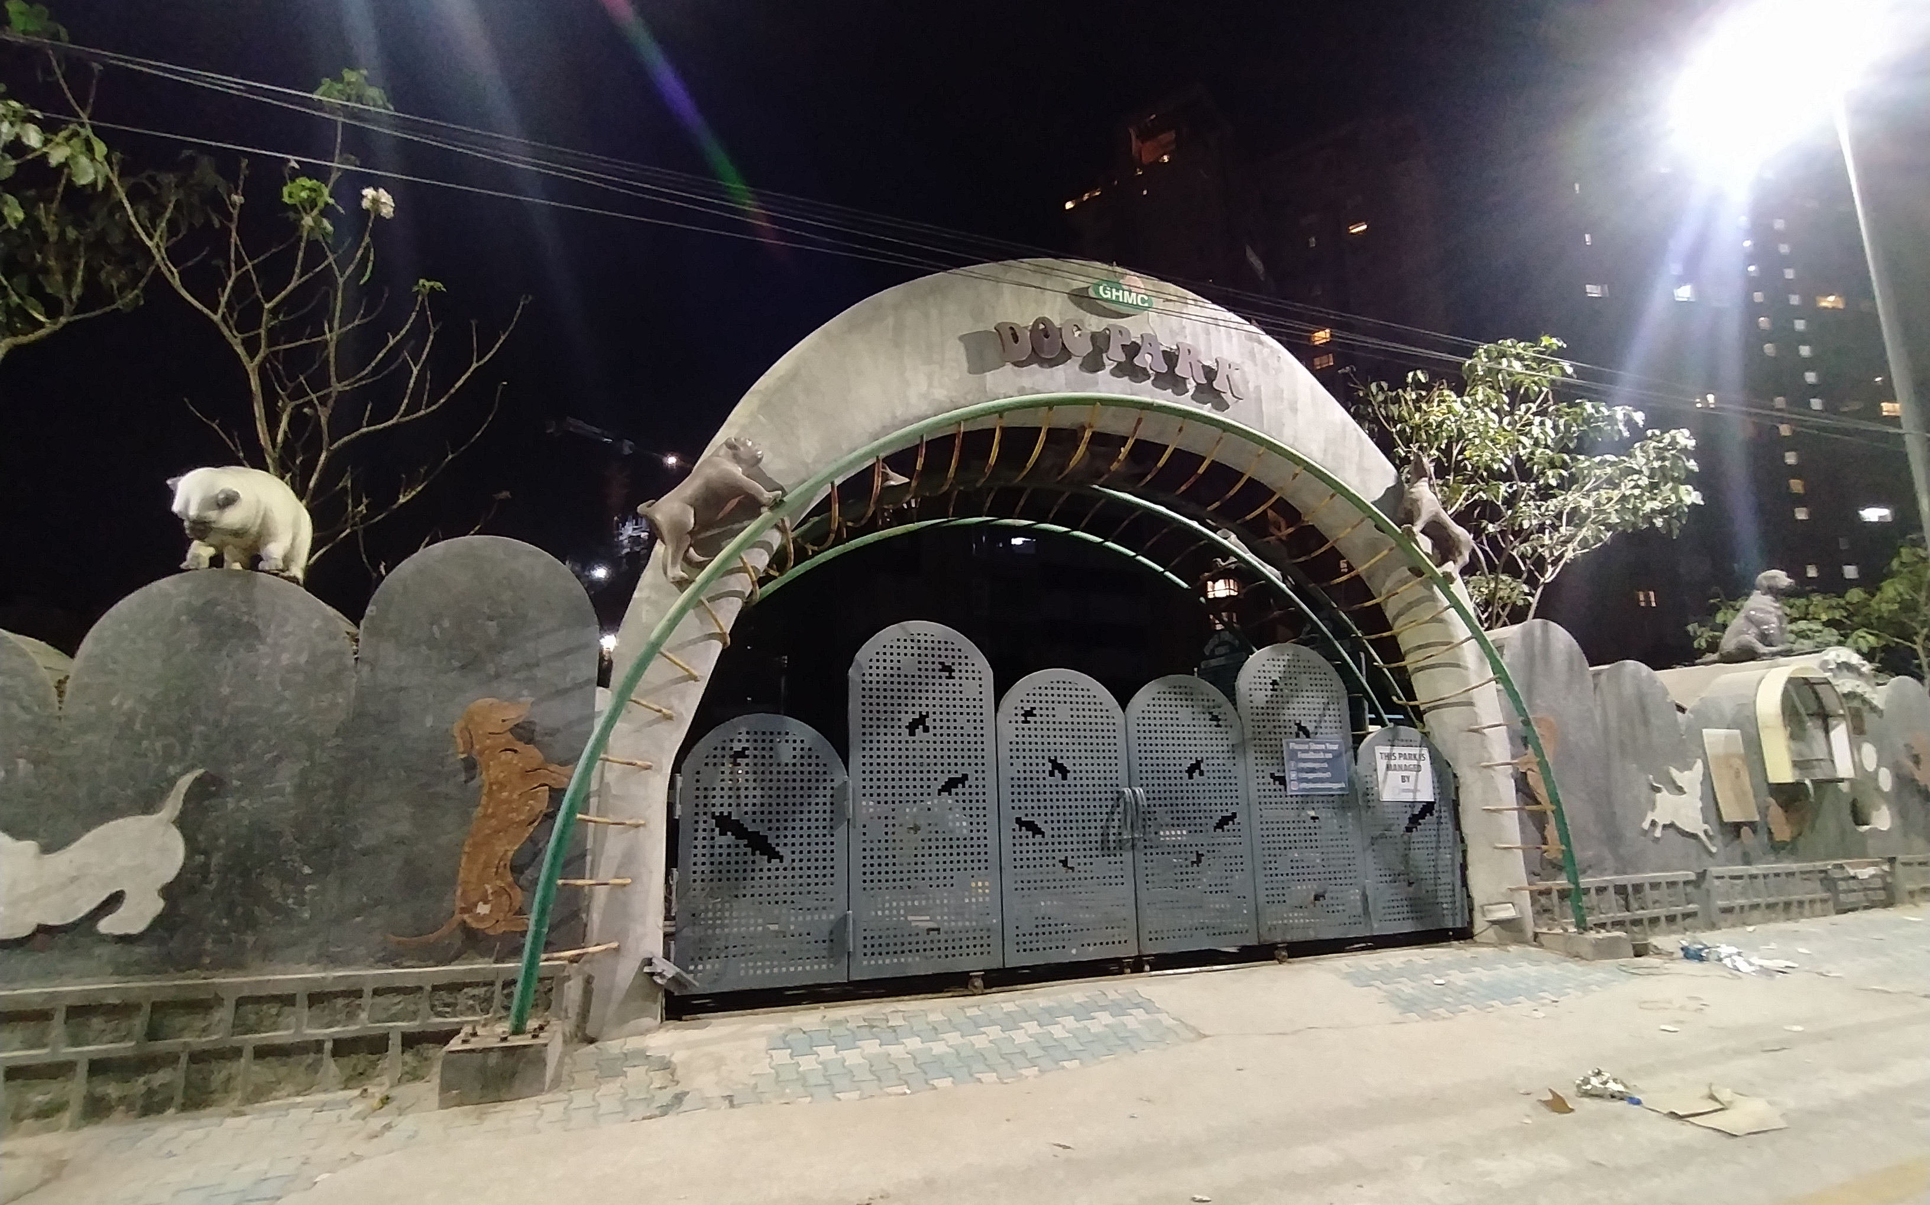
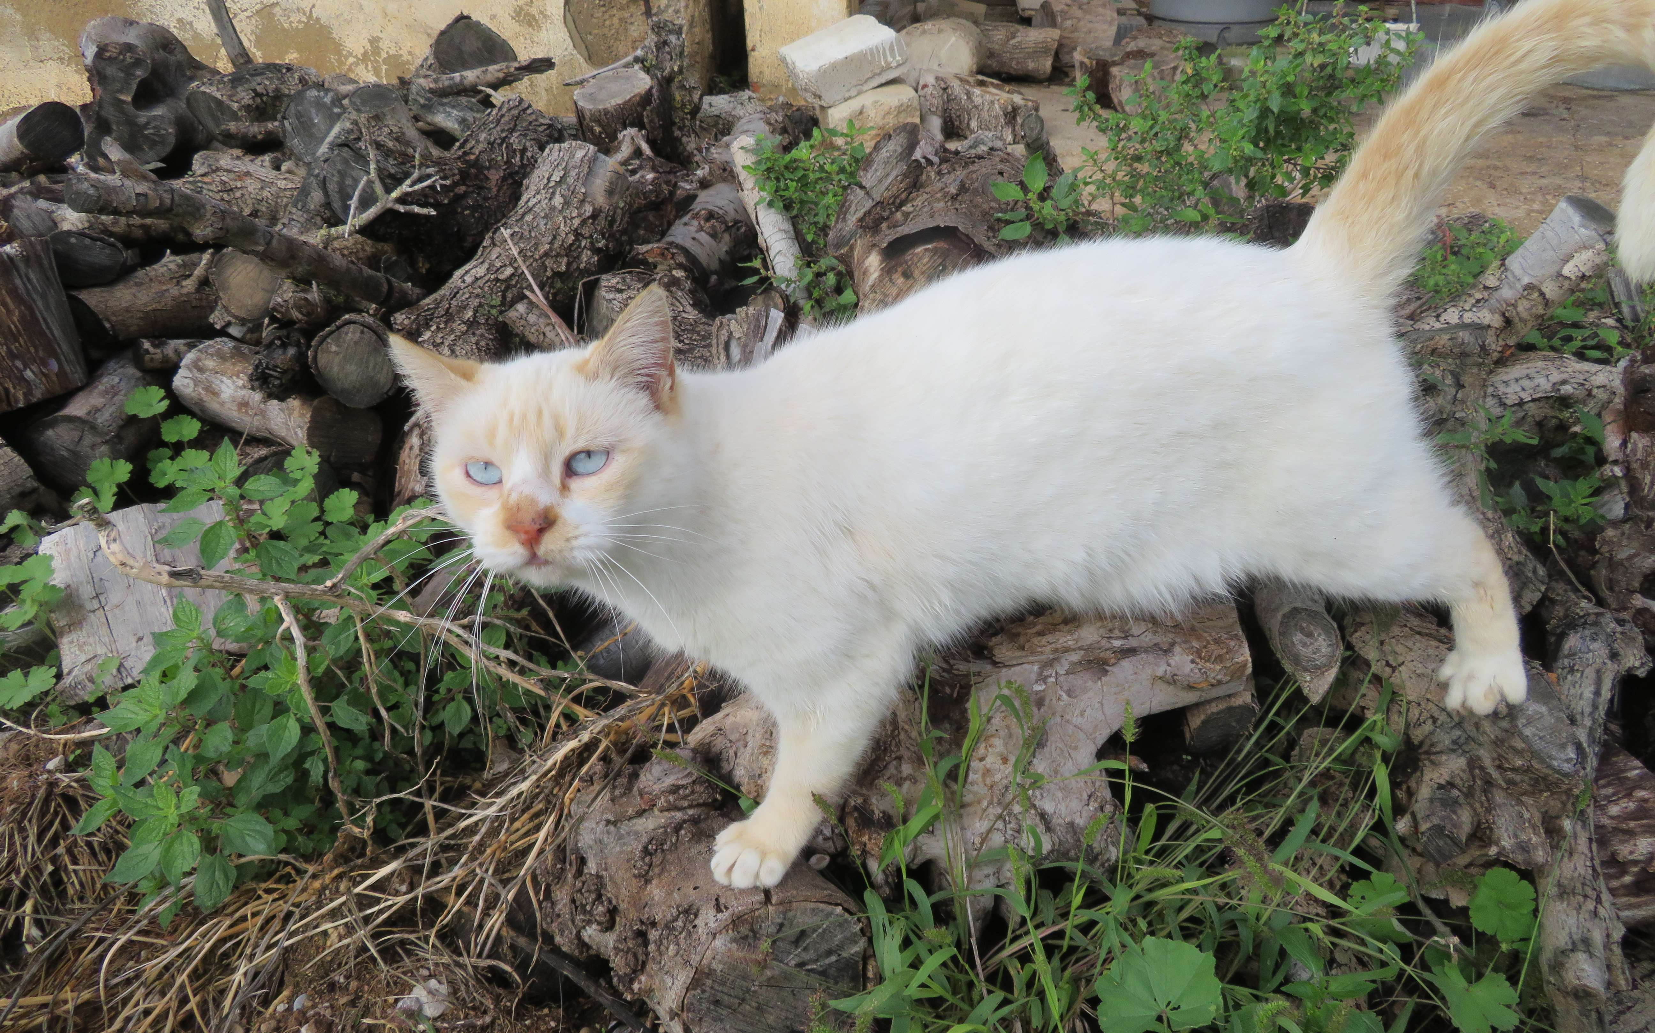
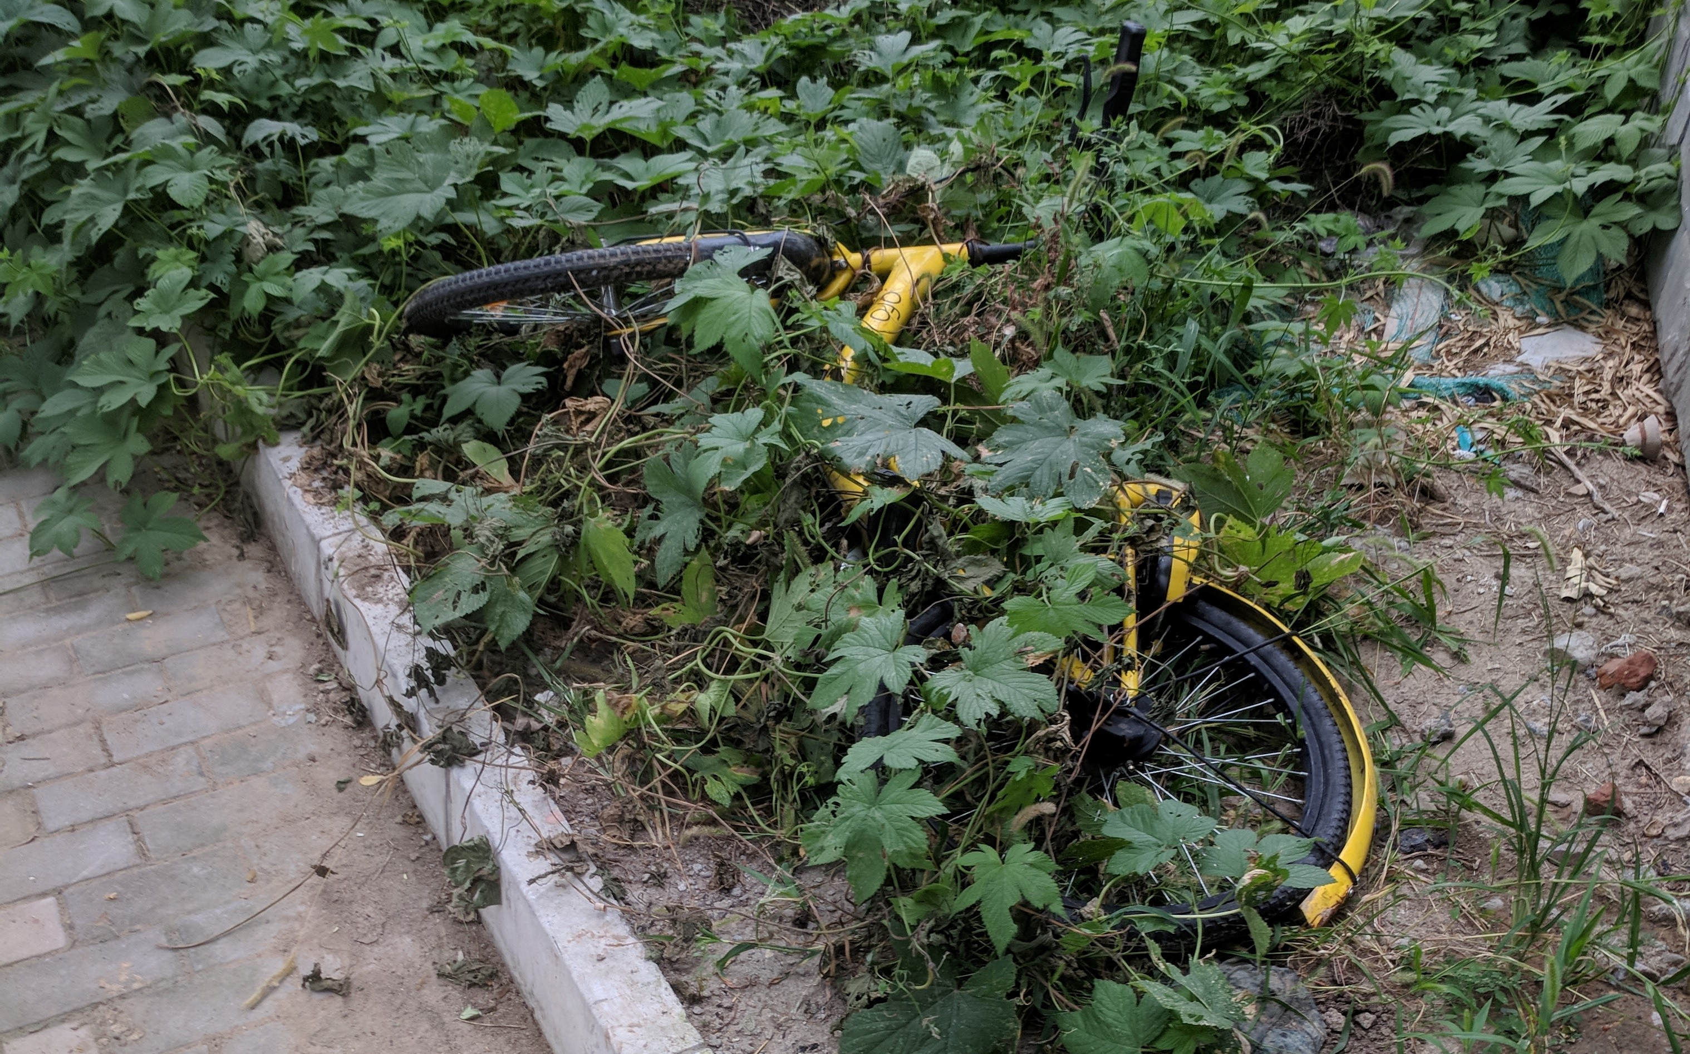
04 SAMPLE OUTPUTS
Three images show useful captions and one clear error
DOG PARK
CAT PORTRAIT
BICYCLE IN GRASS
GENERATED CAPTION
GENERATED CAPTION
GENERATED CAPTION
a gate with a cat sitting on top of it
a small white cat standing in a pile of wood
a bike is laying in the middle of a garden
2.222 seconds on CPU
2.367 seconds on CPU
2.472 seconds on CPU
CC0 image credit: Nskjnv
CC0 image credit: Juan Emilio Prades Bel
CC0 image credit: Wikimedia Commons contributor
OBSERVED OUTPUTS
05 / 09
Notes:
These are verbatim captions produced by the local run using num_beams=3 and max_new_tokens=32.
The dog-park image has animal sculptures. BLIP describes an animal as a cat and does not identify the location as a dog park.
The cat output identifies the main subject. The bicycle output identifies a bike in greenery but misses that it is partly hidden.
Each image is released under CC0. Credits and exact source pages: https://commons.wikimedia.org/wiki/File:Dog_park.jpg ; https://commons.wikimedia.org/wiki/File:Gato_dom%C3%A9stico_(Felis_silvestris_catus).jpg ; https://commons.wikimedia.org/wiki/File:A_shared_bicycle_in_the_grass.jpg

Slide 6
05 EVALUATION
The outputs capture main subjects but miss scene detail
DOG PARK
Identifies an entrance-like structure
Calls a sculpture a cat and misses the dog-park setting
CAT PORTRAIT
Names the white cat
Scene detail is broad but plausible
BICYCLE IN GRASS
Names a bicycle and greenery
Does not mention that the bicycle is partly hidden
EVALUATION METHOD
Manual qualitative review of three CC0 images. No benchmark score is claimed.
Generation took 2.222 to 2.472 seconds per image on this CPU run, excluding model loading.
QUALITATIVE REVIEW
06 / 09
Notes:
Explain that the evaluation uses three selected images and a human review of the main subject and scene.
Do not present this small review as an accuracy rate. The outputs are not compared against a large human-reference dataset, so no BLEU or CIDEr score is claimed.
Inference times were measured after the model loaded on the local CPU environment. Source data: output/sample_results.json.

Slide 7
06 IMPLEMENTATION
The prototype is ready for a local demonstration
1
Create a virtual environment
2
Install requirements
Python 3.11 is used for the recorded run.
Install the pinned Streamlit and Transformers versions.
3
Start the app
4
Upload and caption
Run: streamlit run app.py
Select a sample image and choose Generate caption.
The first run downloads about 1 GB. This local app uses CPU when CUDA is unavailable and keeps uploads in memory.
APP DEMONSTRATION
07 / 09
Notes:
Show the local app. Run it with streamlit run app.py, upload an image, select Generate caption, and download the text output.
Streamlit's file uploader keeps uploaded data in a BytesIO buffer in Python memory. The app also uses Streamlit resource caching for the model.
Sources: https://docs.streamlit.io/develop/api-reference/widgets/st.file_uploader ; https://docs.streamlit.io/develop/api-reference/caching-and-state/st.cache_resource

Slide 8
07 LIMITATIONS AND NEXT STEPS
Human review remains part of the caption workflow
CURRENT LIMITS
POSSIBLE EXTENSIONS
Captions are English and usually short.
Small or obscured objects may be missed.
Similar objects can be confused.
A generated detail can be unsupported.
Evaluate a larger image set with reference captions.
Report standard captioning metrics.
Explore multilingual output.
Collect user feedback and review examples.
Review every caption before using it for accessibility or decisions that need high accuracy.
LIMITATIONS AND FUTURE SCOPE
08 / 09
Notes:
BLIP can produce useful captions but may omit details or add unsupported ones. The sample dog-park result demonstrates an object-level error.
The model card recommends evaluating the model for downstream use and considering accuracy, safety, and fairness concerns.
Source: https://huggingface.co/Salesforce/blip-image-captioning-base

Slide 9
08 GROUP AND SUBMISSION HANDOFF
The team details are ready for the final recording
Shourya Basu
2330400-Basu
Contribution: to be added by the member
Manit Kumar Sahu
2430605-Manit
Contribution: to be added by the member
Ayushman Mahapatra
2330020-Ayushman
Contribution: to be added by the member
Shrutik Sinha
2330404-Shrutik
Contribution: to be added by the member
GITHUB REPOSITORY
URL to be added after the group publishes the repository
PRESENTATION VIDEO
Record the 4 to 5 minute team walkthrough and add it to the repository
References: BLIP paper (2022) | Salesforce BLIP model card | Hugging Face Transformers | Streamlit docs
Sample image credits and licenses are listed in the repository README.
GROUP AND REFERENCES
09 / 09
Notes:
The names and roll numbers came from the group. Each member should fill in the contribution they actually completed before presenting.
The repository URL must be added after publication. The assignment also requires the group to record a presentation and demonstration video and make it accessible from the repository.
References: https://arxiv.org/abs/2201.12086 ; https://huggingface.co/Salesforce/blip-image-captioning-base ; https://huggingface.co/docs/transformers/main/tasks/image_captioning ; https://docs.streamlit.io/develop/api-reference/widgets/st.file_uploader

