Slide 1
Attendance System using Face Recognition

Slide 2
Problems with Traditional Attendance Management Systems
Traditional attendance management systems are tedious, repetitive and time consuming.
The supervisor needs to carry a physical attendance sheet.
Extra efforts are required both from the attendance taker and the attendees.
Identification of proxies is very difficult.
If a large number of attendees are present, it is not possible for a single supervisor to conduct attendance using a physical attendance sheet.

Slide 3
Solution to the problem
AUTOMATED ATTENDANCE SYSTEM
How can it be achieved?
USING FACE RECOGNITION METHOD

Slide 4
What is Face Recognition?
Face Recognition is a computer application capable of identifying or verifying a person from a digital image or a video frame.
Face Recognition is considered as a good biometric as it is a person’s primary identification characteristic.
Facial Recognition can perform mass identification whereas other biometrics cannot.

Slide 5
Why attendance system using Face Recognition is better?
It is an automated application.
The supervisor and attendees have to perform zero work as the attendance will be updated automatically.
Proxies cannot be made as physical presence in the class is important.
It is not at all time consuming.
Multiple attendance can be marked at a single time.

Slide 6
Basic Concept behind Face Recognition for Attendance System
Image of a classroom of students is captured using a camera.
The image is pre-processed, faces are detected, features are extracted and face recognition algorithms are used.
When the faces are matched with the faces in the database, the attendance is marked as present.

Slide 7
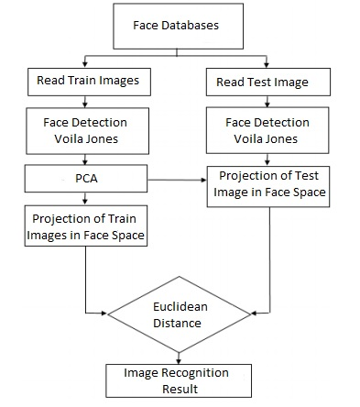
Proposed Algorithm

Slide 8
Why our proposed method is better than existing methods?
We will use PCA with Voila Jones algorithm method to make the results more accurate.
After calculating the Euclidean distance between all training image eigen-faces and test image (captured image) eigenface, we have set a threshold distance that will determine the most perfect match for the test image more efficiently.

Slide 9
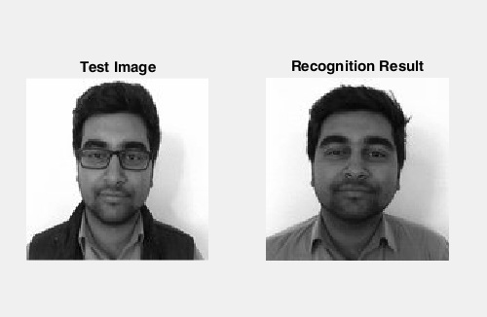
Test Results
TEST CASE 1
Input Image: Face with spectacles
Training Database: Images of different people including that face without spectacles.
Expected Output: Match the input image (with spectacles) with the corresponding database image (without spectacles)
Output: As expected. The person was recognized correctly. No problem was faced because of the spectacles.
Result: Pass

Slide 10
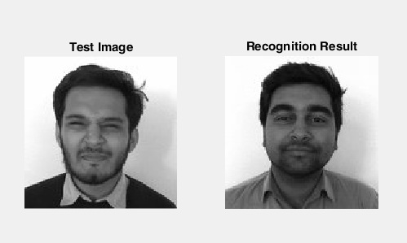
TEST CASE 2
Input Image: Face with eyes closed
Training Database: Images of different people including that face with eyes open.
Expected Output: Match the input image (with eyes closed) with the corresponding database image (with eyes open)
Output: Not as expected. The person was not recognized correctly.
Result: Fail

Slide 11

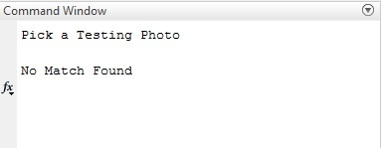
TEST CASE 3
Input Image: No face image
Training Database: Images of different people
Expected Output: Shouldn’t match with any image
Output: As expected. No match found
Result: Pass
Input Image
Output

Slide 12
THANK YOU

