Slide 1
Data Mining
Data Preprocessing
(Discretization and Concept Hierarchy Generation)
Dr. Kaberi Das
Associate Professor
Department of Computer Science and Engineering
ITER, Siksha ‘O’ Anusandhan University.

Slide 2
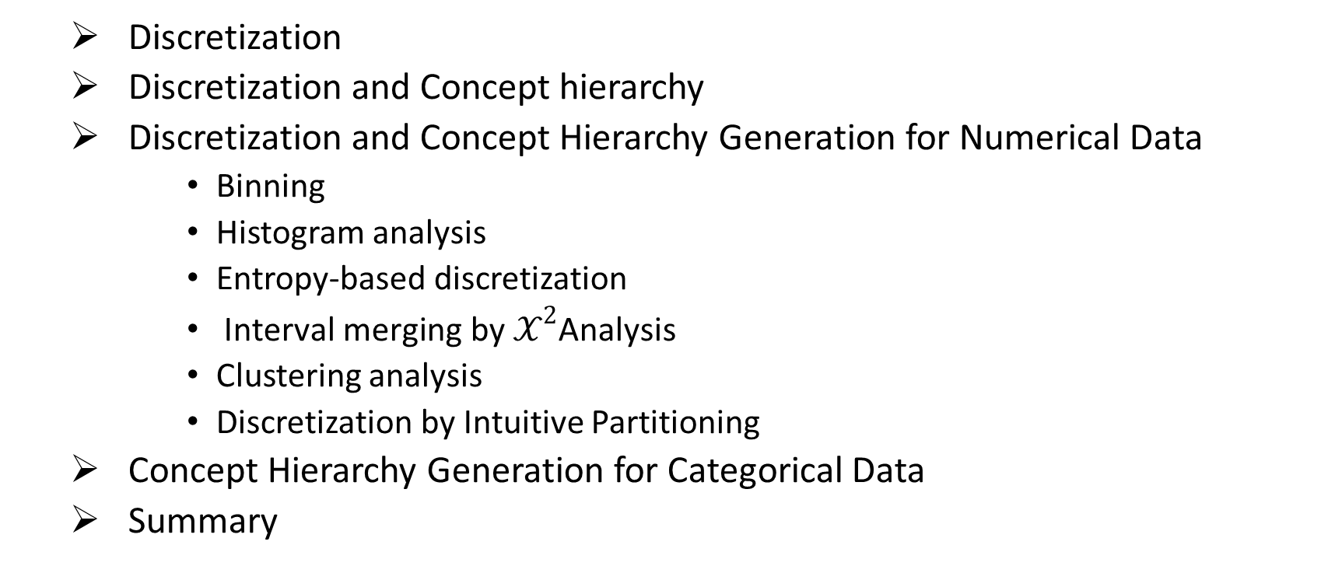
Content
Discretization
Discretization and Concept hierarchy
Discretization and Concept Hierarchy Generation for Numerical Data
Binning
Histogram analysis
Entropy-based discretization
${\text{Interval} \text{merging} \text{by} 𝒳}^{2}$Analysis
Clustering analysis
Discretization by Intuitive Partitioning
Concept Hierarchy Generation for Categorical Data
Summary

Slide 3
Discretization
Three types of attributes:
Nominal — values from an unordered set
Ordinal — values from an ordered set
Continuous — real numbers
Discretization:
Divide the range of a continuous attribute into intervals.
Some classification algorithms only accept categorical attributes.
Reduce data size by discretization.
Prepare for further analysis.

Slide 4
Discretization and Concept hierachy
Discretization
Reduce the number of values for a given continuous attribute by dividing the range of the attribute into intervals. Interval labels can then be used to replace actual data values.
Concept hierarchies
Reduce the data by collecting and replacing low level concepts (such as numeric values for the attribute age) by higher level concepts (such as young, middle-aged, or senior).

Slide 5

Discretization and Concept Hierarchy Generation for Numerical Data
Binning
Histogram analysis
Entropy-based discretization
${\text{Interval} \text{merging} \text{by} 𝒳}^{2}$Analysis
Clustering analysis
Discretization by Intuitive Partitioning

Slide 6
Binning
Binning is a top-down splitting technique based on a specified number of bins.
These methods are also used as discretization methods for numerosity reduction and concept hierarchy generation.
Binning does not use class information and is therefore an unsupervised discretization technique.
It is sensitive to the user-specified number of bins, as well as the presence of outliers.

Slide 7
Histogram Analysis
Histogram analysis is an unsupervised discretization technique because it does not use class information.
Histograms partition the values for an attribute, A, into disjoint ranges called buckets.
We use partitioning rules to define histograms.
The histogram analysis algorithm can be applied recursively to each partition in order to automatically generate a multilevel concept hierarchy, with the procedure terminating once a pre-specified number of concept levels has been reached.
A minimum interval size can also be used per level to control the recursive procedure.

Slide 8
Entropy-Based Discretization
Entropy-based discretization is a supervised, top-down splitting technique.
To discretize a numerical attribute, A, the method selects the value of A that has the minimum entropy as a split-point, and recursively partitions the resulting intervals to arrive at a hierarchical discretization.
Such discretization forms a concept hierarchy for A.
Let D consist of data tuples defined by a set of attributes and a class-label attribute.
The class-label attribute provides the class information per tuple.

Slide 9
Entropy-Based Discretization [Cont..]
Method for entropy-based discretization
Each value of A can be considered as a potential interval boundary or split-point to partition the range of A.
Split-point for A can partition the tuples in D into two subsets satisfying the conditions A ≤ split point and A > split point, hence creating a binary discretization.
The expected information requirement for classifying a tuple in D based on partitioning by A.

Slide 10


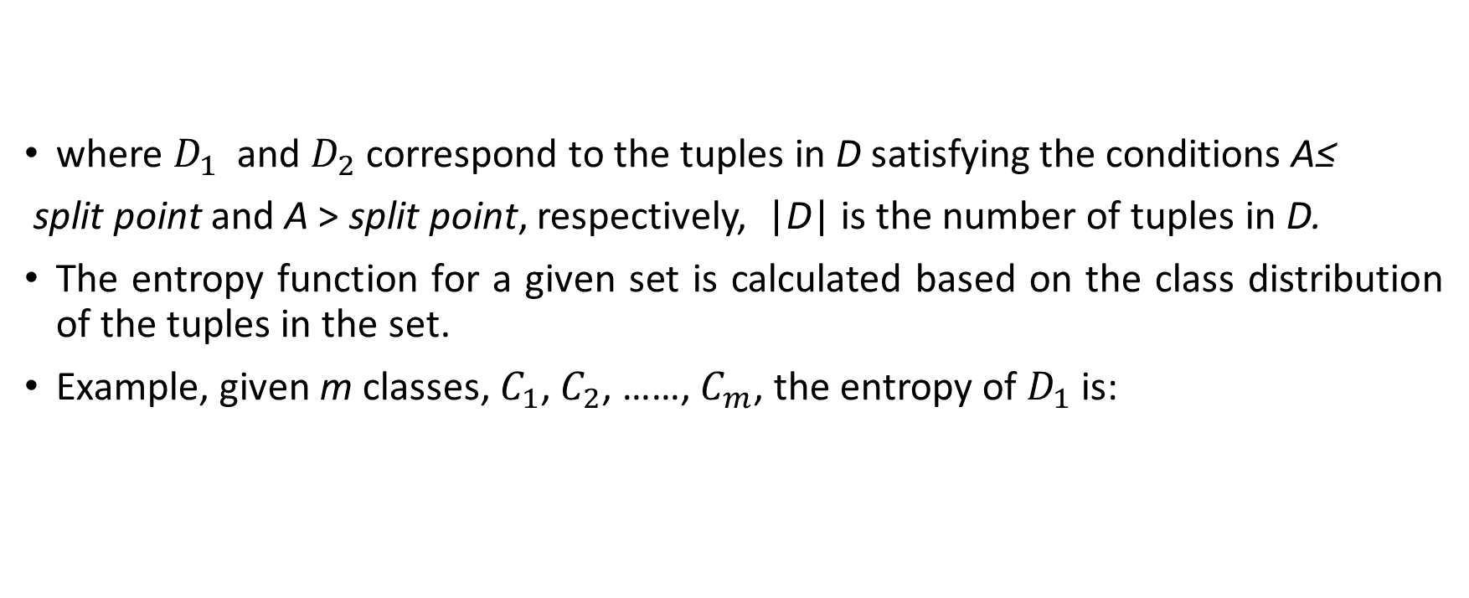
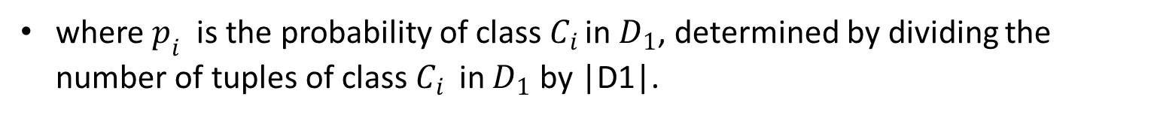
Entropy-Based Discretization [Cont..]
where $D_{1}$ and $D_{2}$ correspond to the tuples in D satisfying the conditions A≤
split point and A >split point, respectively, |D|is the number of tuples in D.
The entropy function for a given set is calculated based on the class distribution of the tuples in the set.
Example, given m classes, $C_{1}$, $C_{2}$, ……, $C_{m}$, the entropy of $D_{1}$ is:
where $p_{i}$ is the probability of class $C_{i }$in $D_{1}$, determined by dividing the number of tuples of class $C_{i }$ in $D_{1}$ by |D1|.

Slide 11
Entropy-Based Discretization [Cont..]
The minimum amount of expected information required to perfectly classify the tuples after partitioning by A ≤ split point and A>split point.
“Here our task is discretization, not classification!”,
We use the split-point to partition the range of A into two intervals, corresponding to A ≤ split point and A > split point.
The process of determining a split-point is recursively applied to each partition obtained.

Slide 12
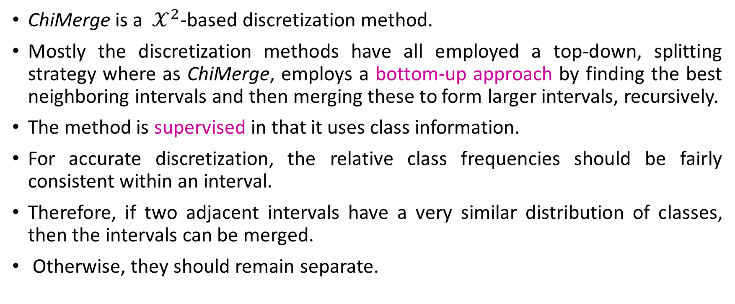

${\text{Interval} \text{merging} \text{by} 𝒳}^{2}$Analysis
ChiMergeis a ${ 𝒳}^{2}$-based discretization method.
Mostly the discretization methods have all employed a top-down, splitting strategy where as ChiMerge, employs a bottom-up approach by finding the best neighboring intervals and then merging these to form larger intervals, recursively.
The method is supervised in that it uses class information.
For accurate discretization, the relative class frequencies should be fairly consistent within an interval.
Therefore, if two adjacent intervals have a very similar distribution of classes, then the intervals can be merged.
Otherwise, they should remain separate.

Slide 13
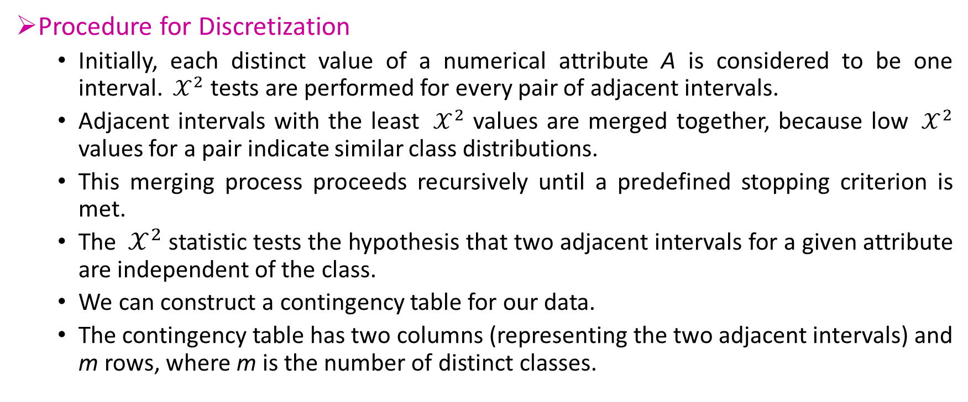

${\text{Interval} \text{merging} \text{by} 𝒳}^{2}$Analysis [Cont..]
Procedure for Discretization
Initially, each distinct value of a numerical attribute A is considered to be one interval. ${ 𝒳}^{2}$ tests are performed for every pair of adjacent intervals.
Adjacent intervals with the least ${ 𝒳}^{2}$ values are merged together, because low ${ 𝒳}^{2}$ values for a pair indicate similar class distributions.
This merging process proceeds recursively until a predefined stopping criterion is met.
The ${ 𝒳}^{2}$ statistic tests the hypothesis that two adjacent intervals for a given attribute are independent of the class.
We can construct a contingency table for our data.
The contingency table has two columns (representing the two adjacent intervals) and m rows, where m is the number of distinct classes.

Slide 14
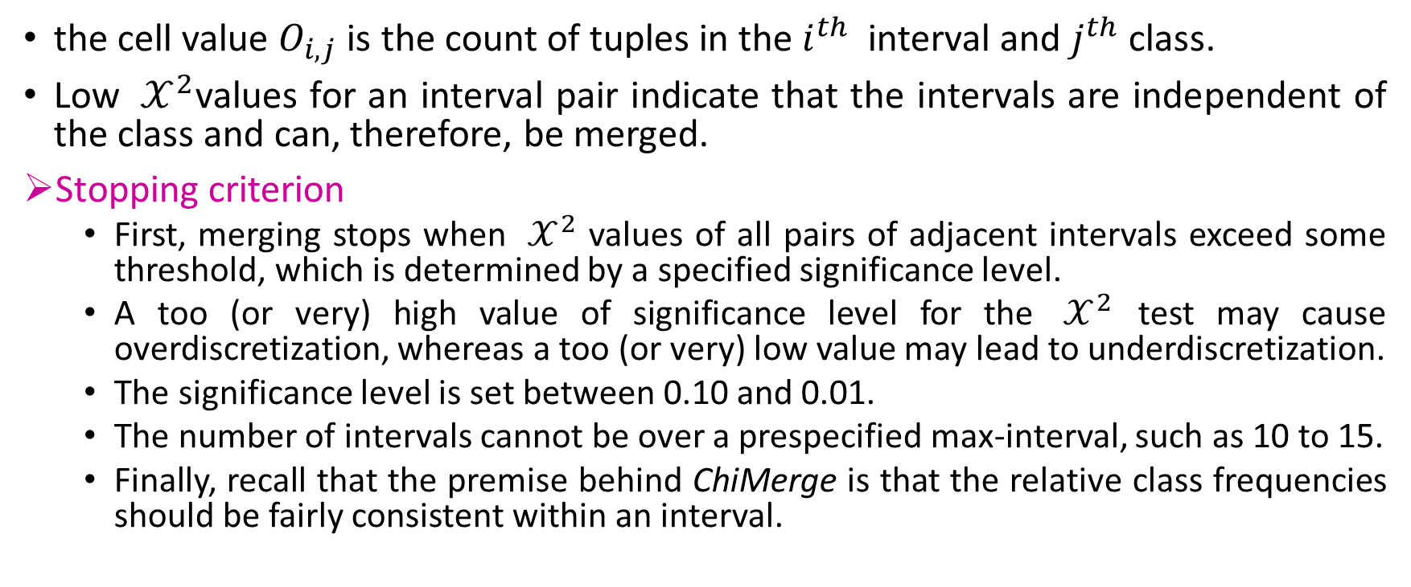
${\text{Interval} \text{merging} \text{by} 𝒳}^{2}$Analysis [Cont..]
the cell value $O_{i,j}$is the count of tuples in the $i^{th}$interval and $j^{th}$class.
Low ${ 𝒳}^{2}$values for an interval pair indicate that the intervals are independent of the class and can, therefore, be merged.
Stopping criterion
First, merging stops when ${ 𝒳}^{2}$ values of all pairs of adjacent intervals exceed some threshold, which is determined by a specified significance level.
A too (or very) high value of significance level for the ${ 𝒳}^{2}$ test may cause overdiscretization, whereas a too (or very) low value may lead to underdiscretization.
The significance level is set between 0.10 and 0.01.
The number of intervals cannot be over a prespecified max-interval, such as 10 to 15.
Finally, recall that the premise behind ChiMerge is that the relative class frequencies should be fairly consistent within an interval.

Slide 15
Cluster Analysis
A clustering algorithm can be applied to discretize a numerical attribute, A, by partitioning the values of A into clusters or groups.
Clustering can be used to generate a concept hierarchy for A by following either a top-down splitting strategy or a bottom-up merging strategy, where each cluster forms a node of the concept hierarchy.
In the former, each initial cluster or partition may be further decomposed into several sub-clusters, forming a lower level of the hierarchy.
In the latter, clusters are formed by repeatedly grouping neighboring clusters in order to form higher-level concepts.

Slide 16
Discretization by Intuitive Partitioning
3-4-5 rule can be used to segment numeric data into relatively uniform, “natural” intervals.
If an interval covers 3, 6, 7 or 9 distinct values at the most significant digit, partition the range into 3 equi-width intervals.
If it covers 2, 4, or 8 distinct values at the most significant digit, partition the range into 4 intervals.
If it covers 1, 5, or 10 distinct values at the most significant digit, partition the range into 5 intervals

Slide 17
Discretization by Intuitive Partitioning : Example
Numeric concept hierarchy generation by intuitive partitioning.
Suppose that profits at different branches of AllElectronics for the year 2004 cover a wide range, from - $ 351,976.00 to $4,700,896.50.
A user desires the automatic generation of a concept hierarchy for profit.
Suppose that the data within the 5th percentile and 95th percentile are between
-$159,876 and $1,838,761.

Slide 18
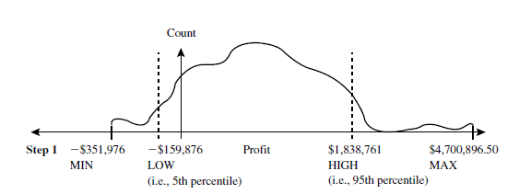
Discretization by Intuitive Partitioning : Example [Cont..]
By applying the 3-4-5 rule the result obtained:-
Step-1
Based on the above information,
The minimum value MIN = -$351,976.00
The maximum values MAX =$4,700,896.50
The low (5th percentile) value LOW = -$159,876
The high (95th percentile) values HIGH= $1,838,761.

Slide 19
Discretization by Intuitive Partitioning : Example [Cont..]
Step-2
Given LOW and HIGH, the most significant digit (msd) is at the million dollar digit position (i.e., msd = 1,000,000).
Rounding LOW down to the million dollar digit, we get LOW’= -$1,000,000.
Rounding HIGH up to the million dollar digit, we get HIGH’ = +$2,000,000.

Slide 20

Discretization by Intuitive Partitioning : Example [Cont..]
Step-3
Since this interval ranges over three distinct values at the most significant digit, that is, (2,000,000-(-1,000,000))/1,000,000 = 3, the segment is partitioned into three equal-width subsegments according to the 3-4-5 rule: (-$1,000,000….$0], ($0….$1,000,000], and ($1,000,000……$2,000,000]

Slide 21
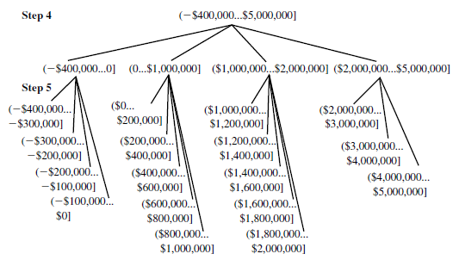
Discretization by Intuitive Partitioning : Example [Cont..]
Step-4
Figure 1. Automatic generation of a concept hierarchy for profit based on the 3-4-5 rule.
Source: Jiawei Han and Micheline Kamber, Data Mining Concepts and Techniques, Third Edition, Elsevier.

Slide 22
Concept Hierarchy Generation for Categorical Data
Categorical data are discrete data. Categorical attributes have a finite (but possibly large) number of distinct values, with no ordering among the values.
Methods for the generation of concept hierarchies for categorical data.
Specification of a partial ordering of attributes explicitly at the schema level by users or experts.
Specification of a portion of a hierarchy by explicit data grouping.
Specification of a set of attributes, but not of their partial ordering.
Specification of only a partial set of attributes.

Slide 23
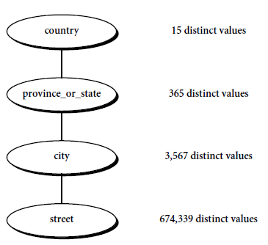
Specification of a set of attributes
Concept hierarchy can be automatically generated based on the number of distinct values per attribute in the given attribute set.
The attribute with the most distinct values is placed at the lowest level of the hierarchy.
Figure 2. Automatic generation of a schema concept hierarchy based on the number of distinct attribute values.
Source: Jiawei Han and Micheline Kamber, Data Mining Concepts and Techniques, Third Edition, Elsevier.

Slide 24

Summary
Data discretization and automatic generation of concept hierarchies for numerical data can involve techniques such as binning, histogram analysis, entropy-based discretization, ${ 𝒳}^{2}$analysis, cluster analysis, and discretization by intuitive partitioning.
For categorical data, concept hierarchies may be generated based on the number of distinct values of the attributes defining the hierarchy.

Slide 25
Thank You

