Slide 1
Data Mining
Data Preprocessing
(Problem Solving Session)
Dr. Kaberi Das

Slide 2

Content
Problem Related to Binning Methods for Data Smoothing
Problem Related to Pearson’s Product Moment Coefficient
Problem Related to $𝒳^{2}$ (Chi-square) Analysis
Summary

Slide 3
Problem Related to Binning Methods for Data Smoothing
Q. Suppose a group of 15 sales price records has been given as follows: 15,35,10,204,92,5,215,11,55,13,50,72,48,62,25
Partition them into three bins by each of the following methods:
equal-frequency partitioning
Smooth by bin mean, bin median and bin boundaries
equal-width partitioning.

Slide 4
Solution Procedure
Input:
Sorted data for sales price :[5, 10, 11, 13,15, 25, 35,48, 50, 55,62, 72, 92, 204, 215]
Given: Number of Bin=3
Partition into (equi-depth/equal-frequency) bins:
- Bin 1: 5, 10, 11, 12, 13
- Bin 2: 25, 35, 48, 50, 55
- Bin 3: 62, 72, 92, 204, 215
Smoothing by bin means:
- Bin 1: 11, 11, 11, 11,11
- Bin 2: 43, 43, 43, 43, 43
- Bin 3: 129, 129, 129, 129, 129

Slide 5
Solution Procedure [Cont..]
Sorted data for price: 5, 10, 11, 13,15, 25, 35,48, 50, 55, 62, 72, 92, 204, 215
Smoothing by bin medians:
- Bin 1: 11, 11, 11, 11,11
- Bin 2: 48, 48, 48, 48, 48
- Bin 3: 92, 92, 92, 92, 92
Smoothing by bin boundaries:
- Bin 1: 5, 5, 15, 15, 15
- Bin 2: 25, 25, 55, 55, 55
- Bin 3: 62, 62, 62, 215,215

Slide 6
Solution Procedure [Cont..]
Sorted data for price (in dollars): 5, 10, 11, 13,15, 25, 35,48, 50, 55,62, 72, 92, 204, 215
Partition into (equi-width) bins:
Lowest value A=5
Highest value B=215
Width of Interval W=215-5/3=70
- Bin 1: Range(5 to 75) : 5, 10, 11, 13, 15, 25, 35, 48, 50, 55, 62, 72
- Bin 2: Range(76 to 146) : 92
- Bin 3: Range(147 to 215) :204, 215

Slide 7
Problem Related to Pearson’s Product Moment Coefficient
Find the Co-relation between the attributes height and weight for data given for 10 observations.
Sl. No | Height | Weight
1 | 60 | 102
2 | 62 | 120
3 | 63 | 130
4 | 65 | 150
5 | 65 | 120
6 | 68 | 145
7 | 69 | 175
8 | 70 | 170
9 | 72 | 185
10 | 74 | 210

Slide 8
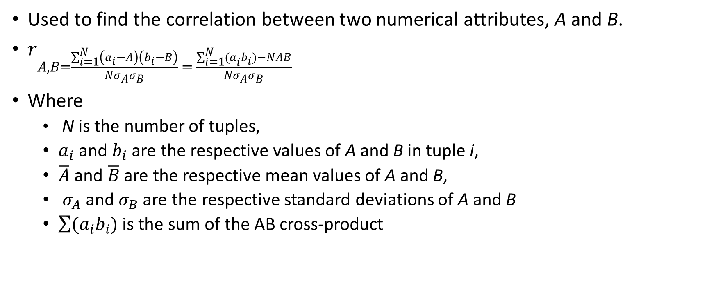
Pearson’s Product Moment Coefficient
Used to find the correlation between two numerical attributes, A and B.
$r_{A,B=\frac{\sum_{i=1}^{N}{\left(a_{i}−\overline{A}\right)\left(b_{i}−\overline{B}\right)}}{Nσ_{A}σ_{B}} = \frac{\sum_{i=1}^{N}{{(a}_{i}b_{i})−N\overline{A}\overline{B}}}{Nσ_{A}σ_{B}}}$
Where
N is the number of tuples,
$a_{i}$and $b_{i}$are the respective values of A and B in tuple i,
$\overline{A}$ and $\overline{B}$ are the respective mean values of A and B,
$σ_{A}$and $σ_{B}$are the respective standard deviations of A and B
$\sum{(a_{i}b_{i})}$ is the sum of the AB cross-product

Slide 9
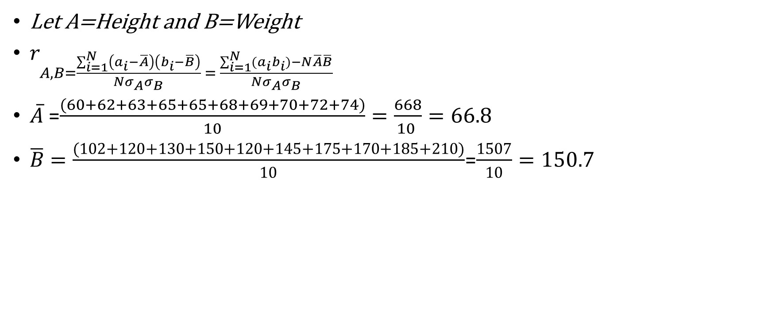
Solution Procedure
Let A=Height and B=Weight
$r_{A,B=\frac{\sum_{i=1}^{N}{\left(a_{i}−\overline{A}\right)\left(b_{i}−\overline{B}\right)}}{Nσ_{A}σ_{B}} = \frac{\sum_{i=1}^{N}{{(a}_{i}b_{i})−N\overline{A}\overline{B}}}{Nσ_{A}σ_{B}}}$
$\overline{A}$ =$\frac{(60+62+63+65+65+68+69+70+72+74)}{10}=\frac{668}{10 }=66.8$
$\overline{B}=\frac{(102+120+130+150+120+145+175+170+185+210)}{10}$=$\frac{1507}{10}=150.7$
Sl. No | Height | Weight
1 | 60 | 102
2 | 62 | 120
3 | 63 | 130
4 | 65 | 150
5 | 65 | 120
6 | 68 | 145
7 | 69 | 175
8 | 70 | 170
9 | 72 | 185
10 | 74 | 210

Slide 10
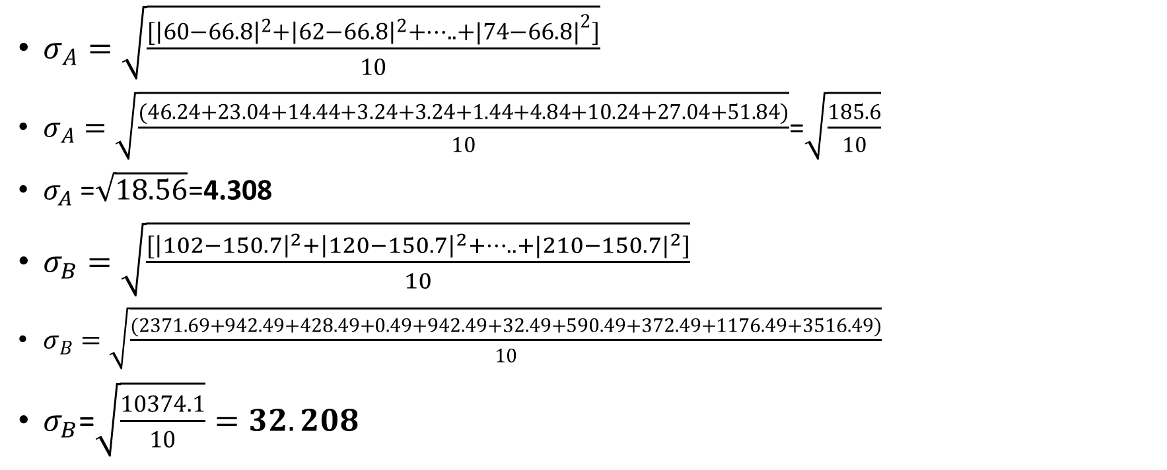
Solution Procedure [Cont..]
$σ_{A}=\sqrt{\frac{[{\left|60−66.8\right|}^{2}+{\left|62−66.8\right|}^{2}+…..+|{74−66.8|}^{2}]}{10}}$
$σ_{A}=\sqrt{\frac{(46.24+23.04+14.44+3.24+3.24+1.44+4.84+10.24+27.04+51.84)}{10}}$=$\sqrt{\frac{185.6}{10}}$
$σ_{A}$ =$\sqrt{18.56}$=4.308
$σ_{B}=\sqrt{\frac{[{\left|102−150.7\right|}^{2}+{\left|120−150.7\right|}^{2}+…..+|{210−150.7|}^{2}]}{10}}$
$σ_{B}=\sqrt{\frac{(2371.69+942.49+428.49+0.49+942.49+32.49+590.49+372.49+1176.49+3516.49)}{10}}$
$σ_{B}$=$\sqrt{\frac{10374.1}{10}}=32.208$
Sl. No | Height | Weight
1 | 60 | 102
2 | 62 | 120
3 | 63 | 130
4 | 65 | 150
5 | 65 | 120
6 | 68 | 145
7 | 69 | 175
8 | 70 | 170
9 | 72 | 185
10 | 74 | 210

Slide 11

Solution Procedure [Cont..]
Let A=Height and B=Weight
$r_{A,B=\frac{\sum_{i=1}^{N}{\left(a_{i}−\overline{A}\right)\left(b_{i}−\overline{B}\right)}}{Nσ_{A}σ_{B}} = \frac{\sum_{i=1}^{N}{{(a}_{i}b_{i})−N\overline{A}\overline{B}}}{Nσ_{A}σ_{B}}}$
$\overline{A}$ =$66.8$
$\overline{B}=150.7$
$σ_{A}$= 4.308
$σ_{B}=32.208$
Sl. No | Height | Weight
1 | 60 | 102
2 | 62 | 120
3 | 63 | 130
4 | 65 | 150
5 | 65 | 120
6 | 68 | 145
7 | 69 | 175
8 | 70 | 170
9 | 72 | 185
10 | 74 | 210

Slide 12
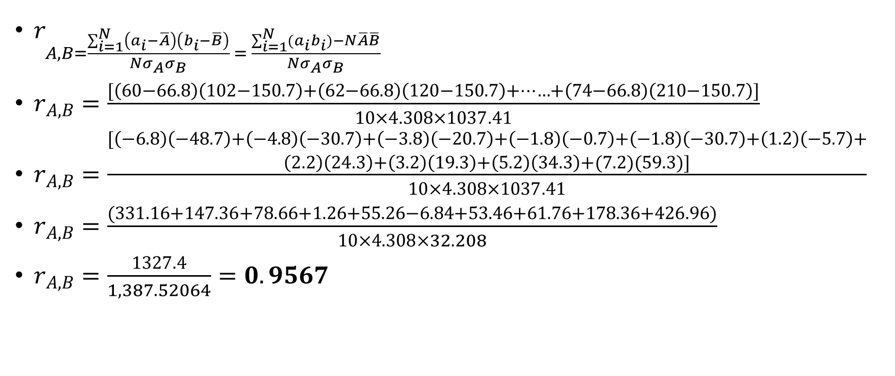
Solution Procedure [Cont..]
$r_{A,B}=\frac{\begin{aligned}[\left(−6.8\right)\left(−48.7\right)+\left(−4.8\right)\left(−30.7\right)+\left(−3.8\right)\left(−20.7\right)+\left(−1.8\right)\left(−0.7\right)+\left(−1.8\right)\left(−30.7\right)+\left(1.2\right)\left(−5.7\right)+ \\ \left(2.2\right)\left(24.3\right)+\left(3.2\right)\left(19.3\right)+\left(5.2\right)\left(34.3\right)+(7.2)(59.3)]\end{aligned}}{10×4.308×1037.41}$
$r_{A,B}=\frac{(331.16+147.36+78.66+1.26+55.26−6.84+53.46+61.76+178.36+426.96)}{10×4.308×32.208}$
$r_{A,B}=\frac{1327.4}{1,387.52064}=0.9567$
Sl. No | Height | Weight
1 | 60 | 102
2 | 62 | 120
3 | 63 | 130
4 | 65 | 150
5 | 65 | 120
6 | 68 | 145
7 | 69 | 175
8 | 70 | 170
9 | 72 | 185
10 | 74 | 210

Slide 13
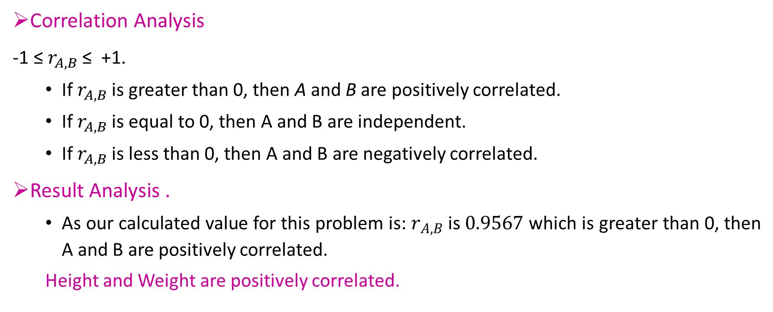
Solution Procedure [Cont..]
Correlation Analysis
-1 ≤ $r_{A,B}$ ≤ +1.
If $r_{A,B}$is greater than 0, then A and B are positively correlated.
If $r_{A,B}$ is equal to 0, then A and B are independent.
If $r_{A,B}$ is less than 0, then A and B are negatively correlated.
Result Analysis .
As our calculated value for this problem is: $r_{A,B}$ is $0.9567$ which is greater than 0, then A and B are positively correlated.
Height and Weight are positively correlated.

Slide 14

Problem Related to $𝒳^{2}$ (Chi-square) Analysis
The following contingency tables shows a transaction or in the shopping-cart of a sales analysis. Where coffee refers to the transactions that people likes coffee, !Coffee refers to the transactions that people do not like coffee, tea refers to the transactions containing liking of people for tea, and !tea refers to the transactions that people do not like tea.
Based on the given data, is the liking of coffee independent of the liking of tea? If not, what kind of correlation relationship exists between the two?
 | coffee | !coffee | ∑_{row}
tea | 150 | 50 | 200
!tea | 650 | 150 | 800
∑_{col} | 800 | 200 | 1000

Slide 15
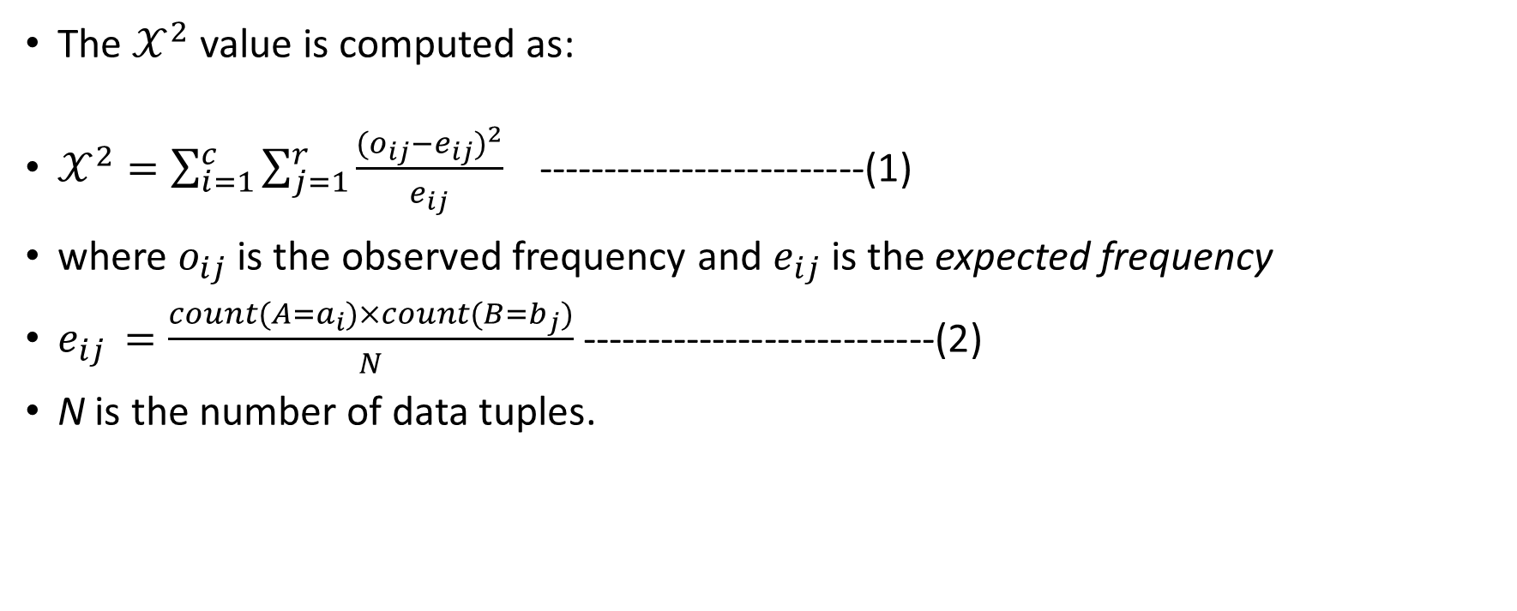
Solution Procedure
The $𝒳^{2}$ value is computed as:
$𝒳^{2}=\sum_{i=1}^{c}{\sum_{j=1}^{r}{\frac{{(o_{ij}−e_{ij})}^{2}}{e_{ij}}}}$ -------------------------(1)
where $o_{ij}$is the observed frequency and $e_{ij}$ is the expected frequency
$e_{ij }=\frac{count(A=a_{i})×count(B=b_{j})}{N}$ ---------------------------(2)
N is the number of data tuples.

Slide 16

Solution Procedure [Cont..]
count(A=$a_{i}$) is the number of tuples having value $a_{i}$for A, and count(B = $b_{j}$) is the number of tuples having value $b_{j}$for B.
The sum in Equation (1) is computed over all of the r$×$c cells.
The $𝒳^{2}$ statistic tests the hypothesis that A and B are independent.
The test is based on a significance level, with (r-1) $×$(c-1) degrees of freedom.

Slide 17
Solution Procedure [Cont..]
liking of coffee independent of the liking of tea?
The observed frequency (or count) of each possible joint event is summarized in the contingency table, where the numbers in parentheses are the expected frequencies. A 2× 2 contingency table for the data of Example
 | coffee | !coffee | ∑_{row}
tea | 150(160) | 50(40) | 200
!tea | 650(640) | 150(160) | 800
∑_{col} | 800 | 200 | 1000

Slide 18
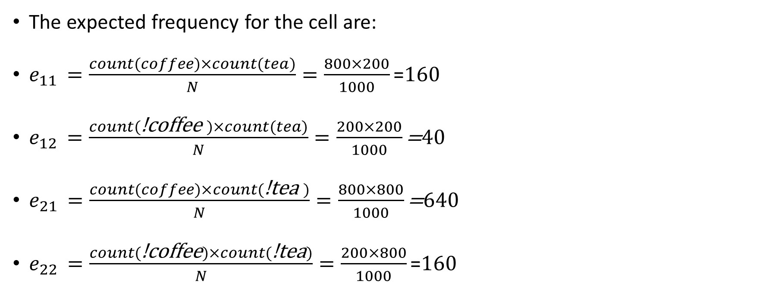
Solution Procedure [Cont..]
The expected frequency for the cell are:
$e_{11 }=\frac{count(coffee)×count(tea)}{N}=\frac{800×200}{1000}\text{=}160$
$e_{12 }=\frac{count(\text{!}\text{coffee} )×count(tea)}{N}=\frac{200×200}{1000}\text{=}40$
$e_{21 }=\frac{count(coffee)×count(\text{!}\text{tea} )}{N}=\frac{800×800}{1000}\text{=}640$
$e_{22 }=\frac{count(\text{!}\text{coffee})×count(\text{!}\text{tea})}{N}=\frac{200×800}{1000}\text{=}160$
A 2× 2 contingency table for the data of Example
 | coffee | !coffee | ∑_{row}
tea | 150(160) | 50(40) | 200
!tea | 650(640) | 150(160) | 800
∑_{col} | 800 | 200 | 1000

Slide 19

Solution Procedure [Cont..]
$𝒳^{2}=\sum_{i=1}^{c}{\sum_{j=1}^{r}{\frac{{(o_{ij}−e_{ij})}^{2}}{e_{ij}}}}$
$𝒳^{2}=\frac{{(150−160)}^{2}}{160}+\frac{{(50−40)}^{2}}{40}+\frac{{(650−640)}^{2}}{640}+\frac{{(150−160)}^{2}}{160}$
$𝒳^{2}$ =$\frac{{(−10)}^{2}}{160}+\frac{{(10)}^{2}}{40}+\frac{{(10)}^{2}}{640}+\frac{{(−10)}^{2}}{160}$
$𝒳^{2}$=$\frac{100}{160}$+$\frac{100}{40}$+$\frac{100}{640}$+$\frac{100}{160}=0.625+2.5+0.156+0.625$
$𝒳^{2}$=3.906
=
 | coffee | !coffee | ∑_{row}
tea | 150(160) | 50(40) | 200
!tea | 650(640) | 150(160) | 800
∑_{col} | 800 | 200 | 1000

Slide 20

Result Analysis
For this 2 $×$ 2 table, the degrees of freedom are (2-1)(2-1) = 1.
For 1 degree of freedom, the $𝒳^{2}$ value needed to reject the hypothesis at the 0.001 significance level is 10.828.
Since our computed value 3.906 is less than 10.828, we can accept the hypothesis that height and weight are independent.

Slide 21
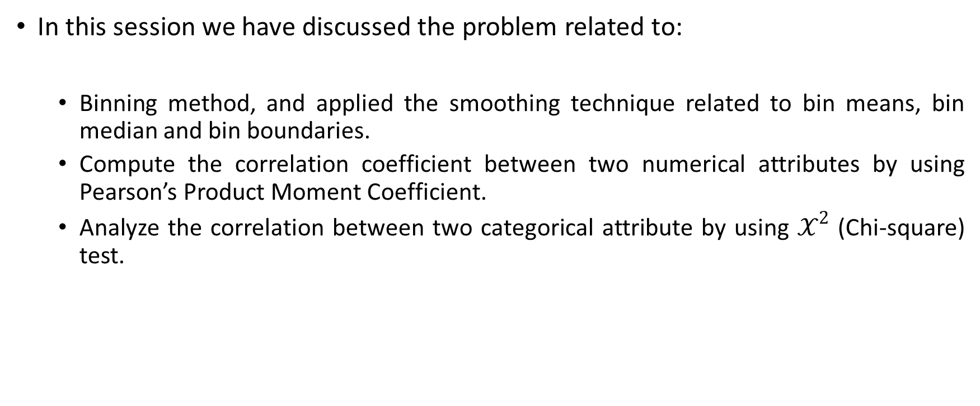
Summary
In this session we have discussed the problem related to:
Binning method, and applied the smoothing technique related to bin means, bin median and bin boundaries.
Compute the correlation coefficient between two numerical attributes by using Pearson’s Product Moment Coefficient.
Analyze the correlation between two categorical attribute by using $𝒳^{2}$ (Chi-square) test.

Slide 22
Thank You

