Slide 1
Data Mining
Lecture-14
Data Warehouse and OLAP Technology for Data Mining
(Multi-Dimensional Data Model)
Dr. Kaberi Das
Associate Professor
Department of Computer Science and Engineering
ITER, Siksha ‘O’ Anusandhan University.

Slide 2
Content
A Multi-Dimensional Data Model
From Tables and Spreadsheets to Data Cubes
Conceptual Modeling of Data Warehouses
Star Schema
Snowflake Schema
Fact Constellation
A Data Mining Query Language, DMQL: Language Primitives
Measures: Three Categories
A Concept Hierarchy: Dimension (location)
Summary

Slide 3
A Multi-Dimensional Data Model
A data warehouse is based on a multidimensional data model which views data in the form of a data cube.
What is a data cube?
A data cube allows data to be modeled and viewed in multiple dimensions.
It is defined by dimensions and facts.
Dimensions are the perspectives or entities with respect to which an organization wants to keep records.

Slide 4
From Tables and Spreadsheets to Data Cubes
A data cube, such as sales, allows data to be modeled and viewed in multiple dimensions.
Dimension tables, such as item (item_name, brand, type), or time(day, week, month, quarter, year).
Fact table contains measures (such as dollars_sold) and keys to each of the related dimension tables.

Slide 5
From Tables and Spreadsheets to Data Cubes [Cont..]
In data warehousing literature, an n-D base cube is called a base cuboid. The top most 0-D cuboid, which holds the highest-level of summarization, is called the apex cuboid. The lattice of cuboids forms a data cube.

Slide 6
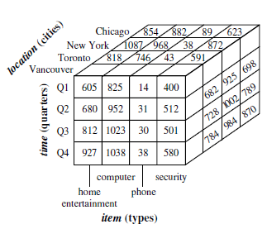
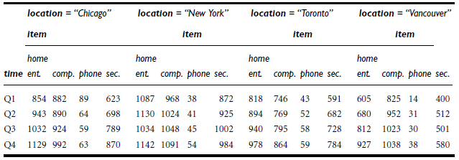
From Tables and Spreadsheets to Data Cubes [Cont..]
A 3-D view of sales data for AllElectronics, according to the dimensions time, item, and location
Figure 1. A 3-D data cube representation of the data according to the dimensions time, item, and location

Slide 7
From Tables and Spreadsheets to Data Cubes [Cont..]
Suppose that we would now like to view our sales data with an additional fourth dimension, such as supplier.
We can think of a 4-D cube as being a series of 3-D cubes.
If we continue in this way, we may display any n-D data as a series of (n-1)-D “cubes.”
The data cube is a metaphor for multidimensional data storage.

Slide 8
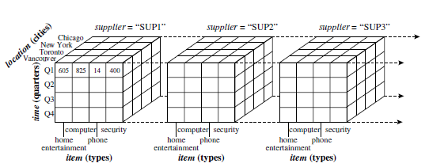
From Tables and Spreadsheets to Data Cubes [Cont..]
Figure 2. A 4-D data cube representation of sales data, according to the dimensions time, item, location, and supplier.

Slide 9
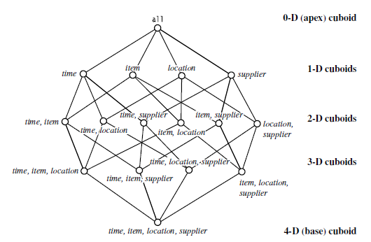
From Tables and Spreadsheets to Data Cubes [Cont..]
Figure 3. Lattice of cuboids, making up a 4-D data cube for the dimensions time, item, location, and supplier. Each cuboid represents a different degree of summarization.

Slide 10
Conceptual Modeling of Data Warehouses
Modeling data warehouses: dimensions & measures
Star schema: A fact table in the middle connected to a set of dimension tables
Snowflake schema: A refinement of star schema where some dimensional hierarchy is normalized into a set of smaller dimension tables, forming a shape similar to snowflake
Fact constellations: Multiple fact tables share dimension tables, viewed as a collection of stars, therefore called galaxy schema or fact constellation

Slide 11
Star Schema
Data warehouse contains
a large central table (fact table) containing the bulk of the data, with no redundancy, and
a set of smaller attendant tables (dimension tables), one for each dimension.
The schema graph resembles a starburst, with the dimension tables displayed in a radial pattern around the central fact table.

Slide 12
Example of Star Schema
time
item
time_key
day
day_of_the_week
month
quarter
year
item_key
item_name
brand
type
supplier_type
Sales Fact Table
time_key
item_key
branch_key
branch
location
location_key
branch_key
branch_name
branch_type
location_key
street
city
province_or_street
country
units_sold
dollars_sold
avg_sales
Measures
Figure 4. Star schema of a data warehouse for sales.

Slide 13
Snowflake Schema
The snowflake schema is a variant of the star schema model, where some dimension tables are normalized, thereby further splitting the data into additional tables.
The resulting schema graph forms a shape similar to a snowflake.
The major difference between the snowflake and star schema models is that the dimension tables of the snowflake model may be kept in normalized form to reduce redundancies.

Slide 14
Example of Snowflake Schema
time
item
Tim e_key
day
day_of_the_week
month
quarter
year
item_key
item_name
brand
type
supplier_key
supplier
Sales Fact Table
supplier_key
supplier_type
time_key
item_key
branch_key
branch
location
location_key
location_key
street
city_key
branch_key
branch_name
branch_type
units_sold
city
dollars_sold
city_key
city
province_or_street
country
avg_sales
Measures
Figure 5. Snowflake schema of a data warehouse for sales.

Slide 15
Fact Constellation
Sophisticated applications may require multiple fact tables to share dimension tables.
This kind of schema can be viewed as a collection of stars, and hence is called a galaxy schema or a fact constellation.

Slide 16
Example of Fact Constellation
time
time_key
day
day_of_the_week
month
quarter
year
item
Shipping Fact Table
item_key
item_name
brand
type
supplier_type
Sales Fact Table
time_key
time_key
item_key
shipper_key
item_key
branch_key
from_location
branch
location_key
location
to_location
branch_key
branch_name
branch_type
units_sold
location_key
street
city
province_or_street
country
dollars_cost
dollars_sold
units_shipped
avg_sales
shipper
Measures
shipper_key
shipper_name
location_key
shipper_type
Figure 6. Fact constellation schema of a data warehouse for sales and shipping.

Slide 17
A Data Mining Query Language, DMQL: Language Primitives
Cube Definition (Fact Table)
define cube <cube_name> [<dimension_list>]: <measure_list>
Dimension Definition ( Dimension Table )
define dimension <dimension_name> as (<attribute_or_subdimension_list>)
Special Case (Shared Dimension Tables)
First time as “cube definition”
define dimension <dimension_name> as <dimension_name_first_time> in cube <cube_name_first_time>

Slide 18
Defining a Star Schema in DMQL
define cube sales_star [time, item, branch, location]:
dollars_sold = sum(sales_in_dollars), avg_sales = avg(sales_in_dollars), units_sold = count(*)
define dimension time as (time_key, day, day_of_week, month, quarter, year)
define dimension item as (item_key, item_name, brand, type, supplier_type)
define dimension branch as (branch_key, branch_name, branch_type)
define dimension location as (location_key, street, city, province_or_state, country)

Slide 19
Defining a Snowflake Schema in DMQL
define cube sales_snowflake [time, item, branch, location]:
dollars_sold = sum(sales_in_dollars), avg_sales = avg(sales_in_dollars), units_sold = count(*)
define dimension time as (time_key, day, day_of_week, month, quarter, year)
define dimension item as (item_key, item_name, brand, type, supplier(supplier_key, supplier_type))
define dimension branch as (branch_key, branch_name, branch_type)
define dimension location as (location_key, street, city(city_key, province_or_state, country))

Slide 20
Defining a Fact Constellation in DMQL
define cube sales [time, item, branch, location]:
dollars_sold = sum(sales_in_dollars), avg_sales = avg(sales_in_dollars), units_sold = count(*)
define dimension time as (time_key, day, day_of_week, month, quarter, year)
define dimension item as (item_key, item_name, brand, type, supplier_type)
define dimension branch as (branch_key, branch_name, branch_type)
define dimension location as (location_key, street, city, province_or_state, country)
define cube shipping [time, item, shipper, from_location, to_location]:
dollar_cost = sum(cost_in_dollars), unit_shipped = count(*)
define dimension time as time in cube sales
define dimension item as item in cube sales
define dimension shipper as (shipper_key, shipper_name, location as location in cube sales, shipper_type)
define dimension from_location as location in cube sales
define dimension to_location as location in cube sales

Slide 21
Measures: Three Categories
Distributive: if the result derived by applying the function to n aggregate values is the same as that derived by applying the function on all the data without partitioning.
E.g., count(), sum(), min(), max().
Algebraic: if it can be computed by an algebraic function with M arguments (where M is a bounded integer), each of which is obtained by applying a distributive aggregate function.
E.g., avg(), min_N(), standard_deviation().
Holistic: if there is no constant bound on the storage size needed to describe a subaggregate.
E.g., median(), mode(), rank().

Slide 22
A Concept Hierarchy: Dimension (location)
all
all
region
Europe
...
North_America
country
Germany
...
Spain
Canada
...
Mexico
city
Frankfurt
...
Vancouver
...
Toronto
office
L. Chan
...
M. Wind
Figure 7.A concept hierarchy for the dimension location

Slide 23
Summary
A multidimensional data model is typically used for the design of corporate data warehouses and departmental data marts.
Such a model can adopt a star schema, snowflake schema, or fact constellation schema.
The core of the multidimensional model is the data cube, which consists of a large set of facts (or measures) and a number of dimensions.
Dimensions are the entities or perspectives with respect to which an organization wants to keep records and are hierarchical in nature.
A data cube consists of a lattice of cuboids, each corresponding to a different degree of summarization of the given multidimensional data.
Concept hierarchies organize the values of attributes or dimensions into gradual levels of abstraction.
They are useful in mining at multiple levels of abstraction.

Slide 24
Thank You

