Slide 1
Data Mining
Lecture-15
Data Warehouse and OLAP Technology for Data Mining
(OLAP Operations & Data Warehouse Architecture)
Dr. Kaberi Das
Associate Professor
Department of Computer Science and Engineering
ITER, Siksha ‘O’ Anusandhan University.

Slide 2
Content
A Multi-Dimensional Data Model
OLAP Operations
Data warehouse architecture
Design and Construction a Data Warehouse.
A Three-tier Data Warehouse Architecture.
Three Data Warehouse Models
Data Warehouse Development: A Recommended Approach
Back-end Tools and Utilities for Data Warehouses
The Metadata Repository
Types of OLAP Servers
Summary

Slide 3
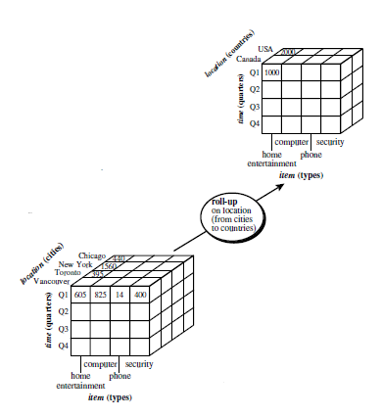
OLAP Operations
Roll up (drill-up): summarize data
performs aggregation on a data cube,
by climbing up hierarchy or by dimension reduction
Figure 1 shows the result of a roll-up operation performed on the central cube by climbing up the concept hierarchy for location.
Figure 1. Examples of Roll up operations on multidimensional data.
Source: Jiawei Han and Micheline Kamber, Data Mining Concepts and Techniques, Third Edition, Elsevier.

Slide 4
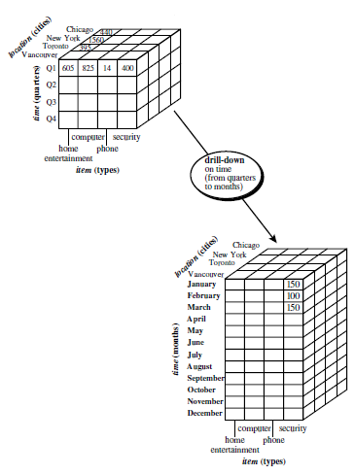
OLAP Operations [Cont..]
Drill down (roll down): reverse of roll-up
from higher level summary to lower level summary or detailed data, or introducing new dimensions
Figure 2 shows the result of a drill-down operation performed on the central cube by stepping down a concept hierarchy for time defined as “day < month < quarter < year.”
Figure 2. Examples of Drill down operations on multidimensional data
Source: Jiawei Han and Micheline Kamber, Data Mining Concepts and Techniques, Third Edition, Elsevier.

Slide 5
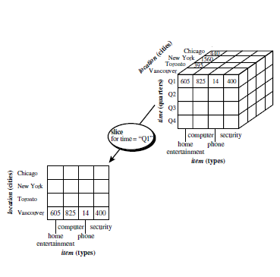
OLAP Operations [Cont..]
Slice:
The slice operation performs a selection on one dimension of the given cube, resulting in a subcube.
Figure 3 shows a slice operation where the sales data are selected from the central cube for the dimension time using the criterion time = “Q1”.
Figure 3. Examples of Slice operations on multidimensional data
Source: Jiawei Han and Micheline Kamber, Data Mining Concepts and Techniques, Third Edition, Elsevier.

Slide 6
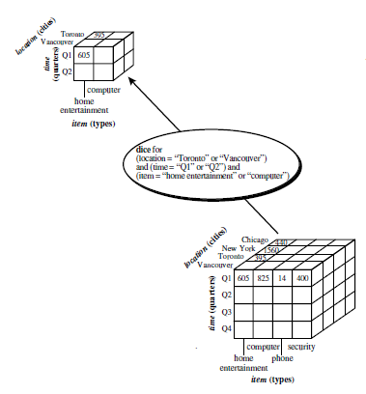
OLAP Operations [Cont..]
Dice:
The dice operation defines a subcube by performing a selection on two or more dimensions.
Figure 4 shows a dice operation on the central cube based on the following selection criteria that involve three dimensions: (location = “Toronto” or “Vancouver”) and (time = “Q1” or “Q2”) and (item =“home entertainment” or “computer”).
Figure 4. Examples of Dice operations on multidimensional data
Source: Jiawei Han and Micheline Kamber, Data Mining Concepts and Techniques, Third Edition, Elsevier.

Slide 7
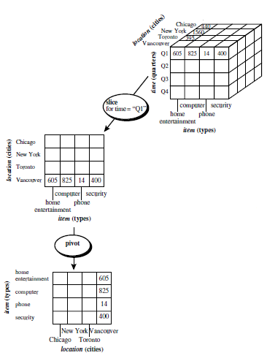
OLAP Operations [Cont..]
Pivot (rotate):
Pivot (also called rotate) is a visualization operation that rotates the data axes in view in order to provide an alternative presentation of the data.
Figure 5 shows a pivot operation where the item and location axes in a 2-D slice are rotated.
Figure 5. Examples of Pivot operations on multidimensional data
Source: Jiawei Han and Micheline Kamber, Data Mining Concepts and Techniques, Third Edition, Elsevier.

Slide 8
OLAP Operations [Cont..]
Other operations
drill across: involving (across) more than one fact table
drill through: through the bottom level of the cube to its back-end relational tables (using SQL)

Slide 9
Data warehouse architecture
Design and construction a data warehouse.
A three-tier data warehouse architecture.
Three Data Warehouse Models
Data Warehouse Development: A Recommended Approach
Back-end tools and utilities for data warehouses
The metadata repository
Types of OLAP Servers

Slide 10
Design and Construction of DataWarehouses
Four different views regarding the design of a data warehouse must be considered
The top-down view
Allows the selection of the relevant information necessary for the data warehouse.
This information matches the current and future business needs.
The data source view
Exposes the information being captured, stored, and managed by operational systems.
This information may be documented at various levels of detail and accuracy, from individual data source tables to integrated data source tables.

Slide 11
Design and Construction of Data Warehouses [Cont..]
The data warehouse view
Includes fact tables and dimension tables.
It represents the information that is stored inside the data warehouse, including precalculated totals and counts, as well as information regarding the source, date, and time of origin, added to provide historical context.
The business query view
It is the perspective of data in the data warehouse from the viewpoint of the end user.

Slide 12
The Process of Data Warehouse Design
A data warehouse can be built using a top-down approach, a bottom-up approach, or a combination of both.
The top-down approach
Starts with the overall design and planning.
It is useful in cases where the technology is mature and well known, and where the business problems that must be solved are clear and well understood.

Slide 13
The Process of Data Warehouse Design [Cont..]
The bottom-up approach
Starts with experiments and prototypes.
This is useful in the early stage of business modeling and technology development.
It allows an organization to move forward at considerably less expense and to evaluate the benefits of the technology before making significant commitments.

Slide 14
The Process of Data Warehouse Design [Cont..]
In the combined approach
An organization can exploit the planned and strategic nature of the top-down approach while retaining the rapid implementation and opportunistic application of the bottom-up approach.
From the software engineering point of view
The design and construction of a data warehouse may consist of the following steps
planning,
requirements study
Problem analysis
warehouse design
data integration and testing
deployment of the data warehouse

Slide 15
The Process of Data Warehouse Design [Cont..]
Large software systems can be developed using two methodologies: the waterfall method or the spiral method.
The waterfall method
Performs a structured and systematic analysis at each step before proceeding to the next, which is like a waterfall, falling from one step to the next.
The spiral method
Involves the rapid generation of increasingly functional systems, with short intervals between successive releases.

Slide 16
The Process of Data Warehouse Design [Cont..]
In general, the warehouse design process consists of the following steps:
Choose a business process to model
Example: orders, invoices, shipments, inventory, account administration, sales, or the general ledger
If the business process is organizational and involves multiple complex object collections, a data warehouse model should be followed.
However, if the process is departmental and focuses on the analysis of one kind of business process, a data mart model should be chosen.

Slide 17
The Process of Data Warehouse Design [Cont..]
Choose the grain of the business process.
The grain is the fundamental, atomic level of data to be represented in the fact table for this process, for example, individual transactions, individual daily snapshots, and so on.
Choose the dimensions that will apply to each fact table record.
Typical dimensions are time, item, customer, supplier, warehouse, transaction type, and status.
Choose the measures that will populate each fact table record.
Typical measures are numeric additive quantities like dollars sold and units sold.

Slide 18
A Three-Tier Data Warehouse Architecture
Monitor
&
Integrator
OLAP Server
other
sources
Metadata
Analysis
Query
Reports
Data mining
Operational
DBs
Extract
Transform
Load
Refresh
Data
Warehouse
Serve
Data Marts
Data Sources
Data Storage
OLAP Engine
Front-End Tools
Figure 6. A three-tier data warehousing architecture.

Slide 19
A Three-Tier Data Warehouse Architecture [Cont..]
The bottom tier
It is a warehouse database server that is almost always a relational database system.
Back-end tools and utilities are used to feed data into the bottom tier from operational databases or other external sources.
These tools and utilities perform data extraction, cleaning, and transformation as well as load and refresh functions to update the data warehouse.
The data are extracted using application program interfaces known as gateways.

Slide 20
A Three-Tier Data Warehouse Architecture [Cont..]
The middle tier
It is an OLAP server that is typically implemented using either (1) a relational OLAP (ROLAP) model that is, an extended relational DBMS that maps operations on multidimensional data to standard relational operations.
A multidimensional OLAP (MOLAP) model, that is, a special-purpose server that directly implements multidimensional data and operations.
The top tier
It is a front-end client layer, which contains query and reporting tools, analysis tools, and/or data mining tools (e.g., trend analysis, prediction, and so on).

Slide 21
Three Data Warehouse Models
Enterprise warehouse
collects all of the information about subjects spanning the entire organization
Data Mart
A subset of corporate-wide data that is of value to a specific groups of users.
Its scope is confined to specific, selected groups, such as marketing data mart.
Independent vs. dependent (directly from warehouse) data mart
Virtual warehouse
A set of views over operational databases
Only some of the possible summary views may be materialized

Slide 22
Three Data Warehouse Models [Cont..]
What are the pros and cons of the top-down and bottom-up approaches to data warehouse development?
The top-down development of an enterprise warehouse serves as a systematic solution and minimizes integration problems.
It is expensive, takes a long time to develop, and lacks flexibility due to the difficulty in achieving consistency and consensus for a common data model for the entire organization.
The bottom-up approach to the design, development, and deployment of independent data marts provides flexibility, low cost, and rapid return of investment.
It, however, can lead to problems when integrating various disparate data marts into a consistent enterprise data warehouse.

Slide 23
Data Warehouse Development: A Recommended Approach
Multi-Tier Data Warehouse
Distributed Data Marts
Enterprise Data Warehouse
Data Mart
Data Mart
Model refinement
Model refinement
Define a high-level corporate data model
Figure 7. A recommended approach for data warehouse development

Slide 24
Data Warehouse Back-End Tools and Utilities
Data extraction
which typically gathers data from multiple, heterogeneous, and external sources
Data cleaning
which detects errors in the data and rectifies them when possible
Data transformation
which converts data from legacy or host format to warehouse format
Load
which sorts, summarizes, consolidates, computes views, checks integrity, and builds indices and partitions
Refresh
which propagates the updates from the data sources to the warehouse

Slide 25
Metadata Repository
Metadata are data about data.
A metadata repository should contain the following:
A description of the structure of the data warehouse
Operational metadata
The algorithms used for summarization
The mapping from the operational environment to the data warehouse
Data related to system performance
Business metadata

Slide 26
Types of OLAP Servers
Relational OLAP (ROLAP) servers:
These are the intermediate servers that stand in between a relational back-end server and client front-end tools.
They use a relational or extended-relational DBMS to store and manage warehouse data, and OLAP middleware to support missing pieces.
ROLAP servers include optimization for each DBMS back end, implementation of aggregation navigation logic, and additional tools and services.
ROLAP technology tends to have greater scalability than MOLAP technology.

Slide 27
Types of OLAP Servers [Cont..]
Multidimensional OLAP (MOLAP) servers:
These servers support multidimensional views of data through array-based multidimensional storage engines.
They map multidimensional views directly to data cube array structures.
The advantage of using a data cube is that it allows fast indexing to pre-computed summarized data.

Slide 28
Types of OLAP Servers [Cont..]
Hybrid OLAP (HOLAP) servers:
The hybrid OLAP approach combines ROLAP and MOLAP technology, benefiting from the greater scalability of ROLAP and the faster computation of MOLAP.
Specialized SQL servers:
To meet the growing demand of OLAP processing in relational databases, some database system vendors implement specialized SQL servers that provide advanced query language and query processing support for SQL queries over star and snowflake schemas in a read-only environment.

Slide 29
Summary
Typical OLAP operations include rollup, drill-(down, across, through), slice-and-dice, pivot (rotate), as well as statistical operations such as ranking and computing moving averages and growth rates.
Data warehouses often adopt a three-tier architecture. (The bottom tier is a warehouse database server, which is typically a relational database system, the middle tier is an OLAP server, and the top tier is a client, containing query and reporting tools).
A data warehouse contains back-end tools and utilities for populating and refreshing the warehouse.
Data warehouse metadata are data defining the warehouse objects.
OLAP servers may use relational OLAP (ROLAP), or multidimensional OLAP (MOLAP), or hybrid OLAP (HOLAP).

Slide 30
Thank You

