Slide 1
Data Mining
Data Preprocessing
(Data Integration)
Dr. Saumendra Pattnaik
Associate Professor
Department of Computer Science and Engineering
ITER, Siksha ‘O’ Anusandhan University.

Slide 2
Content
Data Integration
Handling Redundant Data in Data Integration
Issues to be considered for data integration
Correlation Analysis
Pearson’s product-moment coefficient
Ch-square statistics
Summary

Slide 3
Data Integration
Data integration:
combines data from multiple sources into a coherent store
Schema integration
integrate metadata from different sources
Entity identification problem: identify real world entities from multiple data sources, e.g., A.cust-id ≡ B.cust-#
Detecting and resolving data value conflicts
for the same real world entity, attribute values from different sources are different
possible reasons: different representations, different scales, e.g., metric vs. British units

Slide 4
Handling Redundant Data in Data Integration
Redundant data occur often when integration of multiple databases
The same attribute may have different names in different databases
One attribute may be a “derived” attribute in another table, e.g., annual revenue
Redundant data may be able to be detected by correlational analysis
Careful integration of the data from multiple sources may help reduce/avoid redundancies and inconsistencies and improve mining speed and quality

Slide 5
Issues to be considered for data integration
Schema Integration
Integrate metadata from different sources
Entity identification problem: identify real world entities from multiple data sources, e.g., A.cust-id ≡ B.cust-#
Redundancy
An attribute may be redundant if it can be “derived” from another attribute or set of attributes.
Inconsistencies in attribute or dimension naming can also cause redundancies in the resulting data set.
Someredundancies can be detected by correlation analysis

Slide 6
Issues to be considered for data integration [Cont..]
Detection and resolution of data value conflicts.
For the same real world entity, attribute values from different sources are different.
Possible reasons: different representations, different scales, e.g., metric vs. British units
For a hotel chain, the price of rooms in different cities may involve not only different currencies but also different services (such as free breakfast) and taxes.

Slide 7

Correlation Analysis
Given two attributes, such analysis can measure how strongly one attribute implies the other, based on the available data.
Methodology for Correlation Analysis
Pearson’s product moment coefficient (for numerical attributes)
$𝒳^{2}$ (Chi-square) test (for categorical data)

Slide 8
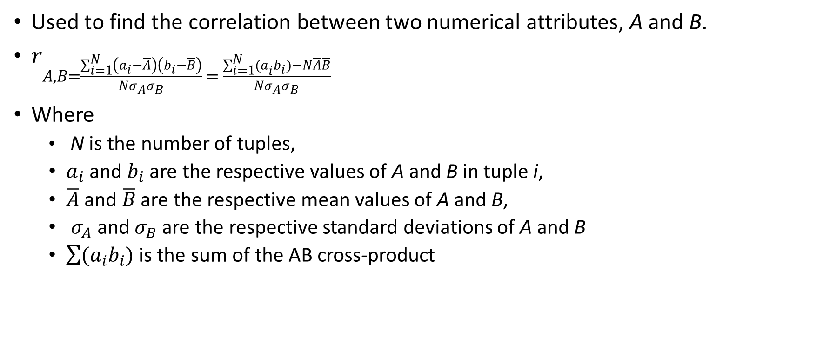
Pearson’s product moment coefficient
Used to find the correlation between two numerical attributes, A and B.
$r_{A,B=\frac{\sum_{i=1}^{N}{\left(a_{i}−\overline{A}\right)\left(b_{i}−\overline{B}\right)}}{Nσ_{A}σ_{B}} = \frac{\sum_{i=1}^{N}{{(a}_{i}b_{i})−N\overline{A}\overline{B}}}{Nσ_{A}σ_{B}}}$
Where
N is the number of tuples,
$a_{i}$and $b_{i}$are the respective values of A and B in tuple i,
$\overline{A}$ and $\overline{B}$ are the respective mean values of A and B,
$σ_{A}$and $σ_{B}$are the respective standard deviations of A and B
$\sum{(a_{i}b_{i})}$ is the sum of the AB cross-product

Slide 9
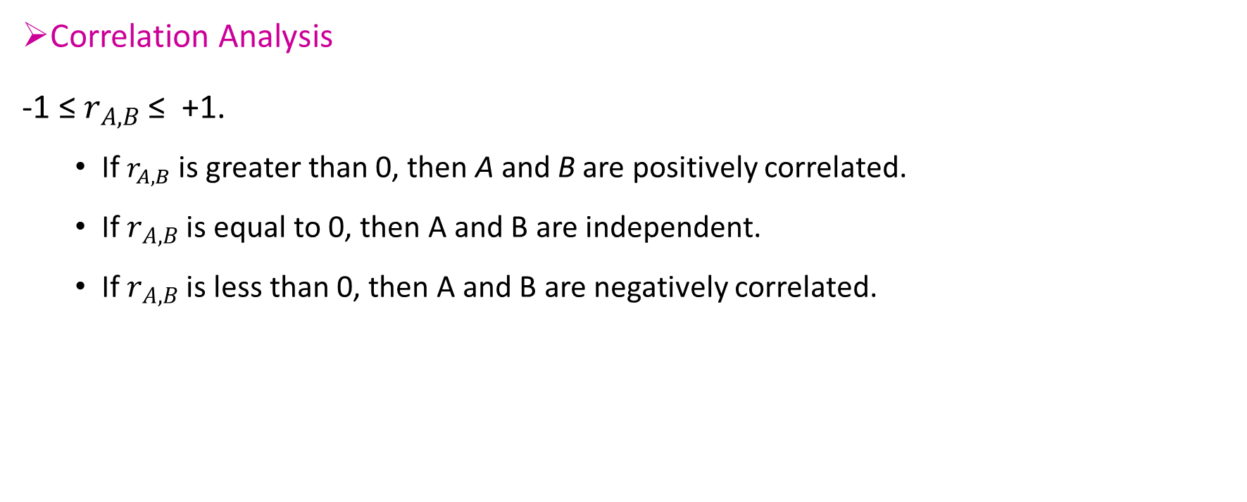
Pearson’s product moment coefficient [Cont..]
Correlation Analysis
-1 ≤ $r_{A,B}$ ≤ +1.
If $r_{A,B}$is greater than 0, then A and B are positively correlated.
If $r_{A,B}$ is equal to 0, then A and B are independent.
If $r_{A,B}$ is less than 0, then A and B are negatively correlated.

Slide 10
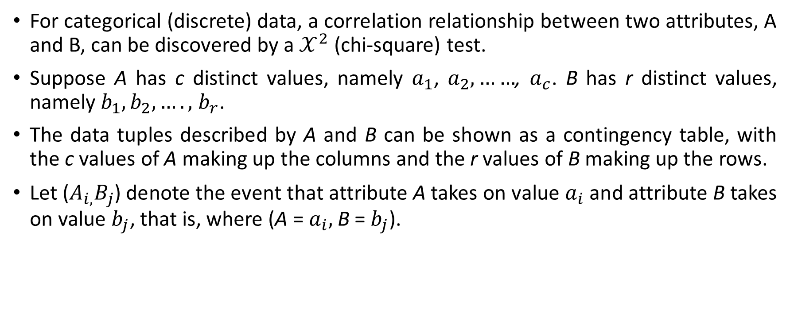

$𝒳^{2}$ (Chi-square) test
For categorical (discrete) data, a correlation relationship between two attributes, A and B, can be discovered by a $𝒳^{2}$ (chi-square) test.
Suppose A has c distinct values, namely $a_{1}$,$a_{2},……$,$a_{c}$. B has r distinct values, namely $b_{1},b_{2},….,$$b_{r}$.
The data tuples described by A and B can be shown as a contingency table, with the c values of A making up the columns and the r values of B making up the rows.
Let ($A_{i,}B_{j}$) denote the event that attribute A takes on value $a_{i}$and attribute B takes on value $b_{j}$, that is, where (A = $a_{i},$B= $b_{j}$).

Slide 11
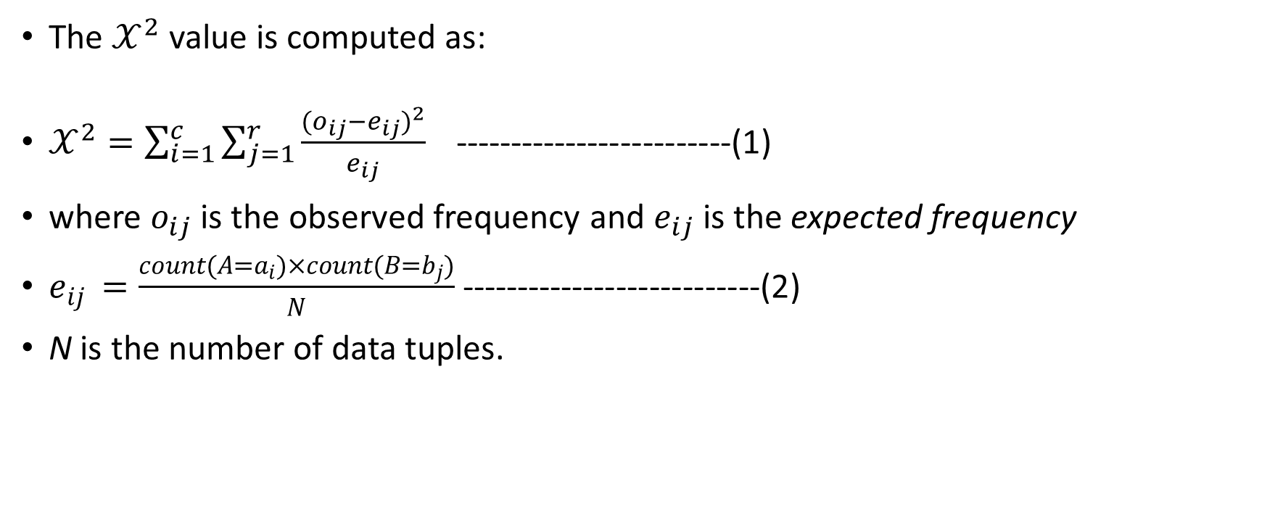

$𝒳^{2}$ (Chi-square) test [Cont..]
The $𝒳^{2}$ value is computed as:
$𝒳^{2}=\sum_{i=1}^{c}{\sum_{j=1}^{r}{\frac{{(o_{ij}−e_{ij})}^{2}}{e_{ij}}}}$ -------------------------(1)
where $o_{ij}$is the observed frequency and $e_{ij}$ is the expected frequency
$e_{ij }=\frac{count(A=a_{i})×count(B=b_{j})}{N}$ ---------------------------(2)
N is the number of data tuples.

Slide 12

$𝒳^{2}$ (Chi-square) test [Cont..]
count(A=$a_{i}$) is the number of tuples having value $a_{i}$for A, and count(B = $b_{j}$) is the number of tuples having value $b_{j}$for B.
The sum in Equation (1) is computed over all of the r$×$c cells.
The $𝒳^{2}$ statistic tests the hypothesis that A and B are independent.
The test is based on a significance level, with (r-1) $×$(c-1) degrees of freedom.

Slide 13
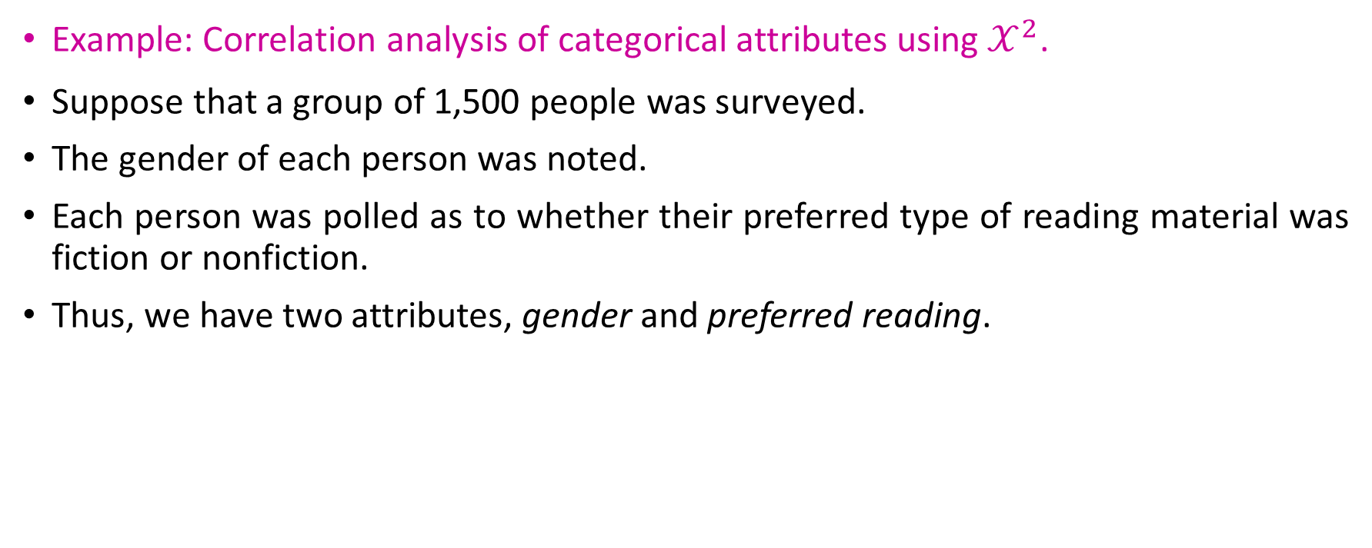
$𝒳^{2}$ (Chi-square) test [Cont..]
Example: Correlation analysis of categorical attributes using $𝒳^{2}$.
Suppose that a group of 1,500 people was surveyed.
The gender of each person was noted.
Each person was polled as to whether their preferred type of reading material was fiction or nonfiction.
Thus, we have two attributes, gender and preferred reading.

Slide 14
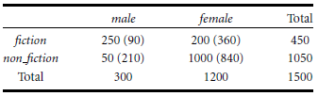
$𝒳^{2}$ (Chi-square) test [Cont..]
Are gender and preferred Reading correlated?
The observed frequency (or count) of each possible joint event is summarized in the contingency table, where the numbers in parentheses are the expected frequencies.
A 2× 2 contingency table for the data of Example

Slide 15
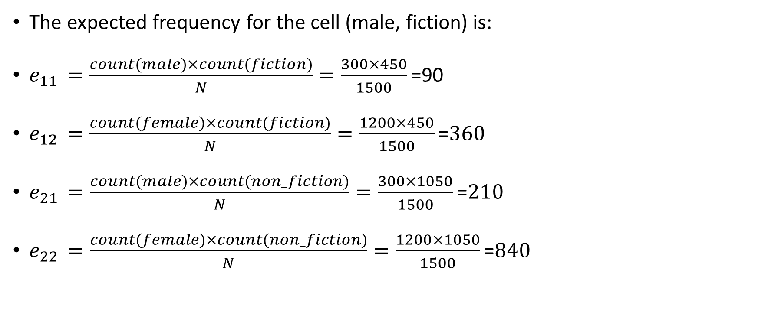
$𝒳^{2}$ (Chi-square) test [Cont..]
The expected frequency for the cell (male, fiction) is:
$e_{11 }=\frac{count(male)×count(fiction)}{N}=\frac{300×450}{1500}\text{=90}$
$e_{12 }=\frac{count(female)×count(fiction)}{N}=\frac{1200×450}{1500}\text{=}360$
$e_{21 }=\frac{count(male)×count(non_fiction)}{N}=\frac{300×1050}{1500}\text{=}210$
$e_{22 }=\frac{count(female)×count(non_fiction)}{N}=\frac{1200×1050}{1500}\text{=}840$
A 2× 2 contingency table for the data of Example

Slide 16

$𝒳^{2}$ (Chi-square) test [Cont..]
$𝒳^{2}=\sum_{i=1}^{c}{\sum_{j=1}^{r}{\frac{{(o_{ij}−e_{ij})}^{2}}{e_{ij}}}}$
$𝒳^{2}=\frac{{(250−90)}^{2}}{90}+\frac{{(50−210)}^{2}}{210}+\frac{{(200−360)}^{2}}{360}+\frac{{(1000−840)}^{2}}{840}$
= 288.44+121.90+71.11+30.48= 507.93

Slide 17
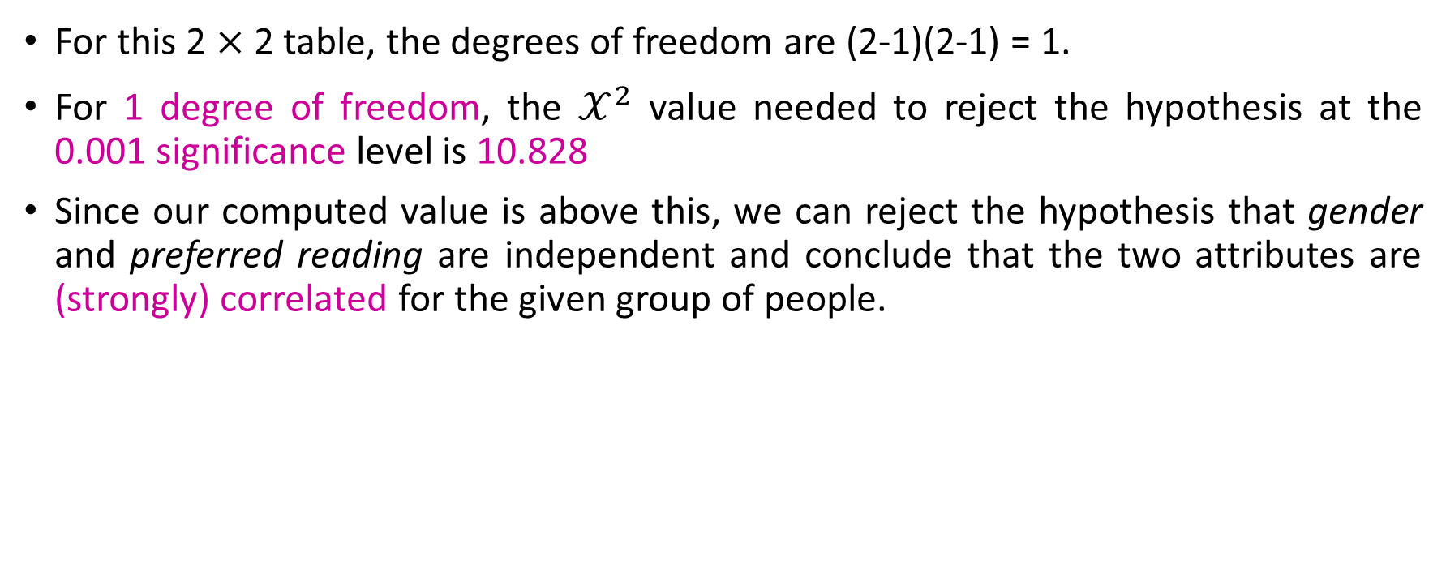
Result Analysis
For this 2 $×$ 2 table, the degrees of freedom are (2-1)(2-1) = 1.
For 1 degree of freedom, the $𝒳^{2}$ value needed to reject the hypothesis at the 0.001 significance level is 10.828
Since our computed value is above this, we can reject the hypothesis that gender and preferred reading are independent and conclude that the two attributes are (strongly) correlated for the given group of people.

Slide 18
Summary
Data integration combines data from multiple sources to form a coherent data store.
Metadata, correlation analysis, data conflict detection, and the resolution of semantic heterogeneity contribute toward smooth data integration.

Slide 19
Thank You

