Slide 1
Data Mining
Data Preprocessing
(Data Transformation)
Dr. Kaberi Das
Associate Professor
Department of Computer Science and Engineering
ITER, Siksha ‘O’ Anusandhan University.

Slide 2
Content
Data Transformation
Normalization
min-max normalization
z-score normalization
normalization by decimal scaling
Attribute Construction
Summary

Slide 3
Data Transformation
In data transformation, the data are transformed or consolidated into forms appropriate for mining.
Smoothing
Remove noise from data
Aggregation
summarization, data cube construction
Generalization
low-level or “primitive” (raw) data are replaced by higher-level concepts through the use of concept hierarchies.

Slide 4
Data Transformation [Cont..]
Normalization
scaled to fall within a small, specified range
min-max normalization
z-score normalization
normalization by decimal scaling
Attribute construction
where new attributes are constructed and added from the given set of attributes.

Slide 5
Normalization
An attribute is normalized by scaling its values so that they fall within a small specified range, such as 0.0 to 1.0.
Normalization is particularly useful for classification algorithms neural networks, nearest-neighbor classification and clustering.
By normalizing the input values for each attribute measured in the training tuples used in back propagation algorithm, will help to speed up the learning phase.
There are many methods for data normalization.

Slide 6
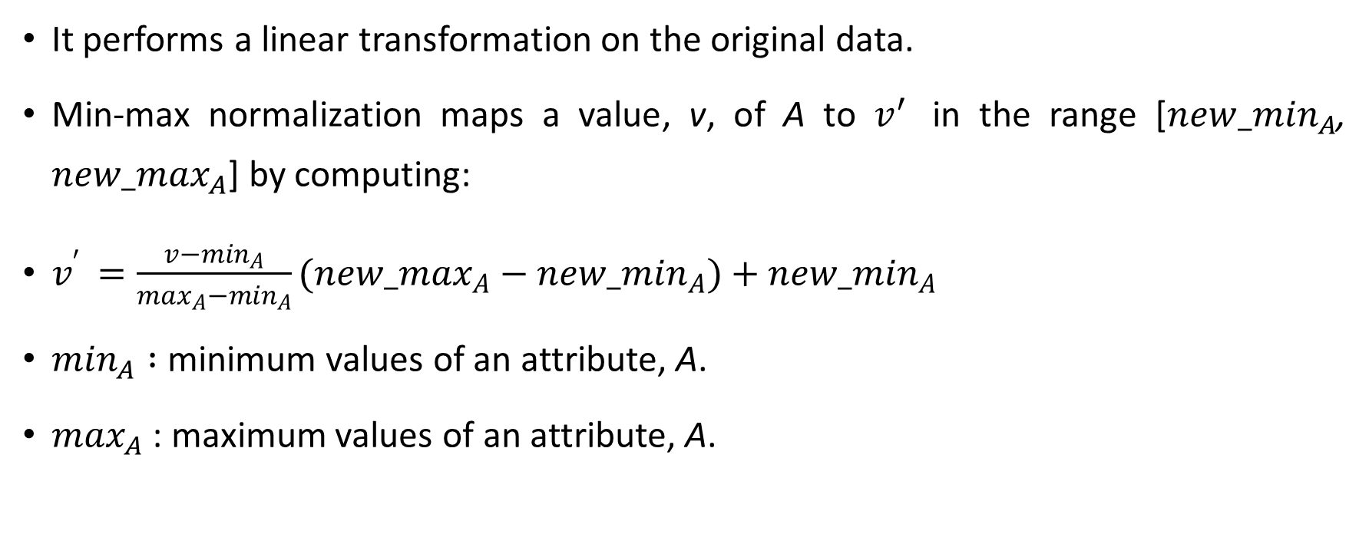
Min-max normalization
It performs a linear transformation on the original data.
Min-max normalization maps a value, v, of A to $v^{′ }$ in the range [$new_\min_{A}$, $new_\max_{A}$] by computing:
$v^{′ }=\frac{v−\min_{A}}{\max_{A}−\min_{A}}(new_\max_{A}−new_\min_{A})+new_\min_{A}$
$\min_{A} :$minimum values of an attribute, A.
$\max_{A}$ : maximum values of an attribute, A.

Slide 7
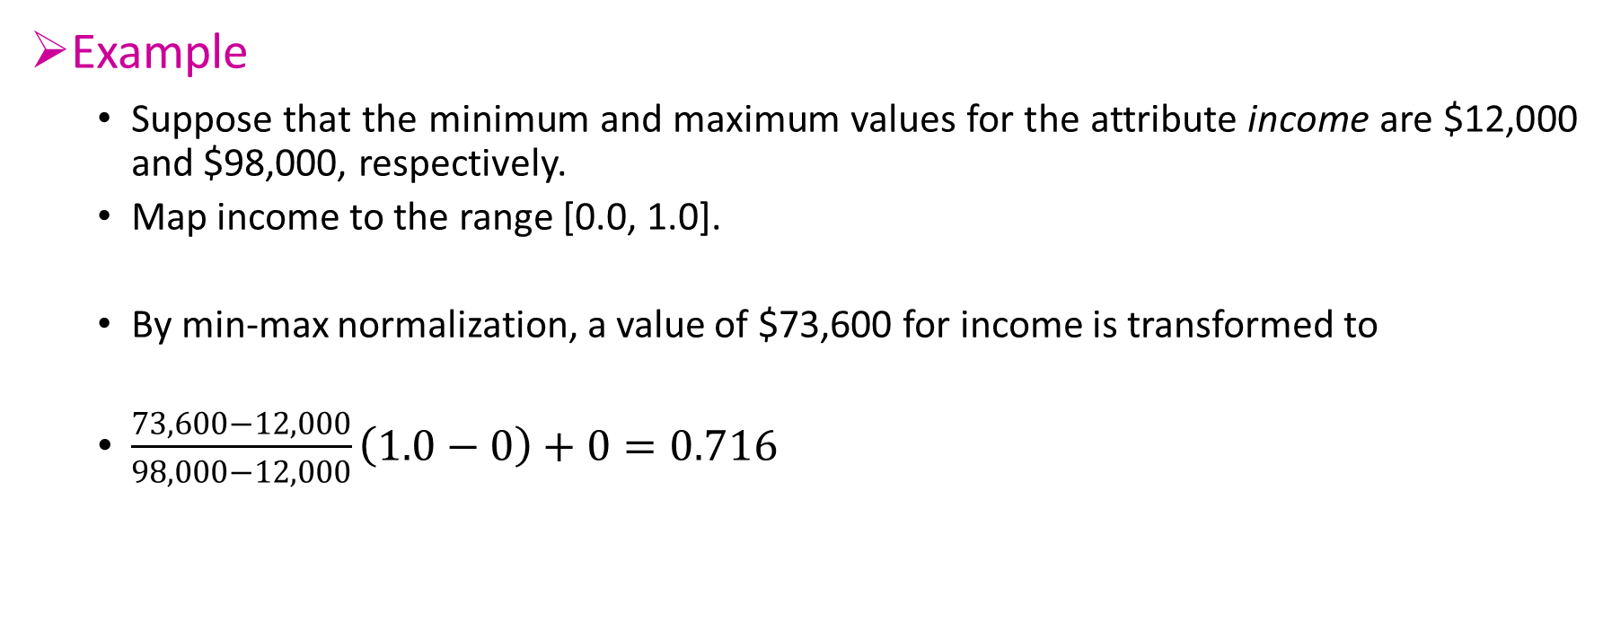
Min-max normalization [Cont..]
Example
Suppose that the minimum and maximum values for the attribute income are $12,000 and $98,000, respectively.
Map income to the range [0.0, 1.0].
By min-max normalization, a value of $73,600 for income is transformed to
$\frac{73,600−12,000}{98,000−12,000}\left(1.0−0\right)+0=0.716$

Slide 8
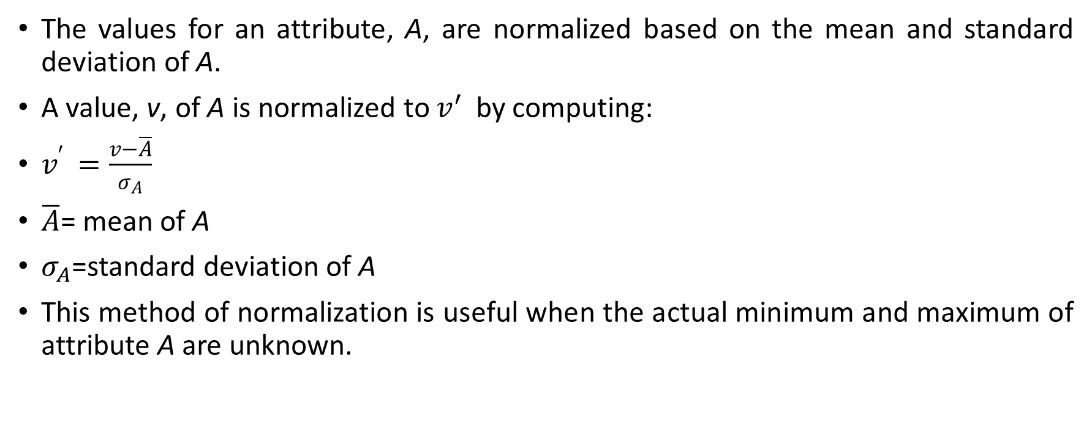
Z-score normalization
The values for an attribute, A, are normalized based on the mean and standard deviation of A.
A value, v, of A is normalized to $v^{′ }$ by computing:
$v^{′ }=\frac{v−\overline{A}}{σ_{A}}$
$\overline{A}$= mean of A
$σ_{A}$=standard deviation of A
This method of normalization is useful when the actual minimum and maximum of attribute A are unknown.

Slide 9
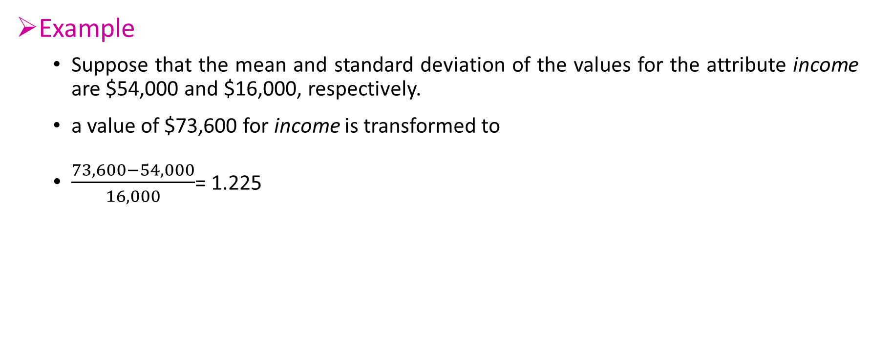
Z-score normalization [Cont..]
Example
Suppose that the mean and standard deviation of the values for the attribute income are $54,000 and $16,000, respectively.
a value of $73,600 for income is transformed to
$\frac{73,600−54,000}{16,000}$= 1.225

Slide 10
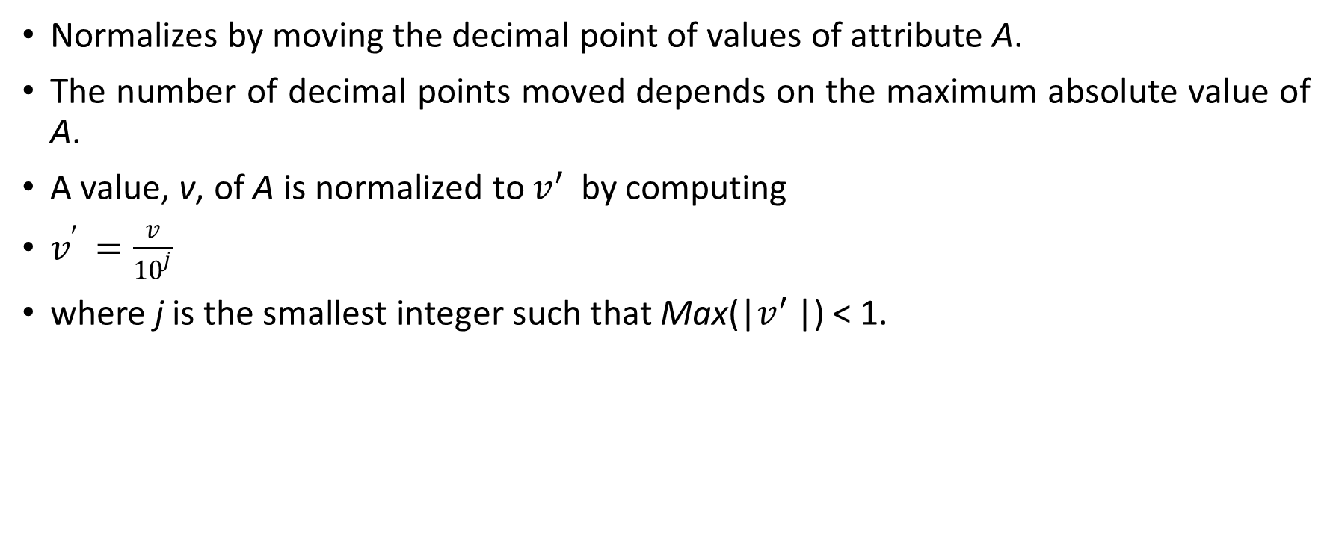
Normalization by decimal scaling
Normalizes by moving the decimal point of values of attribute A.
The number of decimal points moved depends on the maximum absolute value of A.
A value, v, of A is normalized to $v^{′ }$ by computing
$v^{′ }=\frac{v}{{10}^{j}}$
where j is the smallest integer such that Max(|$v^{′ }$|) < 1.

Slide 11
Normalization by decimal scaling [Cont..]
Example
Suppose that the recorded values of A range from -986 to 917.
The maximum absolute value of A is 986.
To normalize by decimal scaling, we therefore divide each value by 1,000 (i.e., j = 3) so that -986 normalizes to -0.986 and 917 normalizes to 0.917.

Slide 12
Attribute Construction
New attributes are constructed from the given attributes and added in order to help improve the accuracy and understanding of structure in high-dimensional data.
Example, we can add the attribute area based on the attributes height and width.
Attribute construction can discover missing information about the relationships between data attributes that can be useful for knowledge discovery.

Slide 13
Summary
Data transformation routines convert the data into appropriate forms for mining.
For example, attribute data may be normalized so as to fall between a small range, such as 0.0 to 1.0.

Slide 14
Thank You

